Slide 1
HOT TOPICS
Responding to the complicated issues of our day from a life-giving biblical basis

Slide 2
DIVERSITY IN THE CHRUCH: WHAT SHOULD AND SHOULDN’T WE DO?

Slide 3
WHY IS THIS A HOT TOPIC?
Notes:
Diversity = a range of different things

Slide 4
Notes:
As a society we are eager to ensure diversity in all areas of society
Modelling industry
Cricket
adverts

Slide 5
Notes:
Business
Role models
In cooking

Slide 6
Notes:
In policing
In Apple
In bank of England
17 honours went to people who had rendered “serves to diversity” in various fields
Diversity seems to be an important issue within our society
The word diversity obviously has a deeper meaning in our context than just a range of different things
Video by Ohio Uni helps us get an understanding of the current meaning within our world

Slide 7
Notes:
Our differences…
Define us
Allow us to make unique contributions
Make life interesting
Seeking to
Embracing differences
Demonstrating respect
Creating a welcoming environment
Working together
Watch the video via the link on the page…
But sometimes things can become a little restrictive and complicate as you can see with these students.
Are we being too sensitive? You can see even in this setting diversity and seeking to avoid offense can be a Hot Topic

Slide 8
CULTURAL CONTEXT

Slide 9
EQUALITIES ACT 2010
Age
Disability
Gender Assignment
Race
Religion/Belief & culture
Sex
Sexual orientation
Marriage & civil partnership
Pregnancy
Notes:
This Act makes it illegal to discriminate against anyone because of
The purpose is to make sure all in society can benefit and contribute.

Slide 10
COMING OFF THE RAILS
Self-identifying
Notes:
Here are some of the areas the ‘diversity agenda’ comes off the rail of what is a commendable starting line. I will look back at these from a scriptural filter.

Slide 11
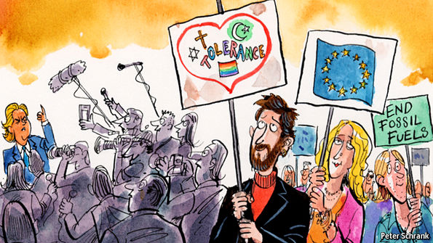
COMING OFF THE RAILS
Tribalism
Notes:
Identity politics
a tendency for people of a particular religion, race, social background, etc., to form exclusive political alliances, moving away from traditional broad-based party politics.

Slide 12
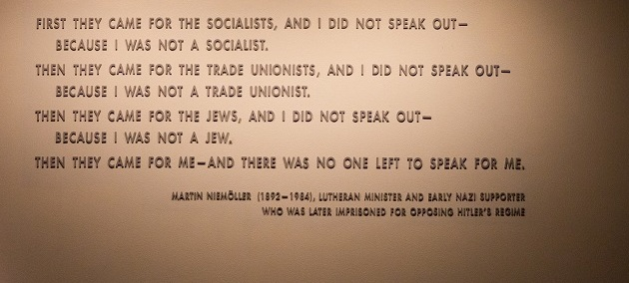

Slide 13
COMING OFF THE RAILS
Race to the bottom
Notes:
Who has it worse

Slide 14
COMING OFF THE RAILS
Fight for my rights
Notes:
Defending my rights will inevitably infringe on someone else’s right. E.g. I have the right to be loved but you have the right not to love me. I have a right not to be offended by what you say, but you have the right to say what you think.

Slide 15
COMING OFF THE RAILS
Hard to legislate
Tokenism
Notes:
“the practice of making only a perfunctory or symbolic effort to do a particular thing, especially by recruiting a small number of people from underrepresented groups in order to give the appearance of sexual or racial equality within a workforce.”

Slide 16
COMING OFF THE RAILS
Hard to legislate
Back fire
Notes:
Back fire – affirmative action
Ben Shapiro (American conservative political commentator) – Affirmative Action (trying to readdress the balance but ends up harming)

Slide 17
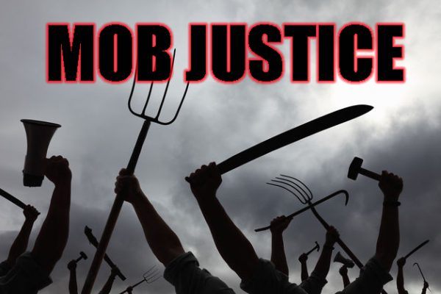
COMING OFF THE RAILS
Bullying campaigns
Notes:
Bullying campaigns (bandwagons)
Hounding out – no space for redemption
Fear of expression – don’t get the benefit of a genuine conversation which could lead to revelation
Someone points at someone and shouts an accusation and the mob join in and drown out the response.
Oxfam
Sir Tim Hunt – apology not enough, co-workers who said he is not sexist. One joke…
Me Too
Stop Funding Hate
McCathyism
Just as we established in the first Hot Topic (Media) – be careful which campaigns you add your weight to (God has made you heavy). God has given you weight. Let’s be thinking people.

Slide 18
COMING OFF THE RAILS
Self-identifying
Tribalism
Race to the bottom
Fight for my rights
Hard to legislate
Bullying campaigns
Notes:
Bullying campaigns (bandwagons)
Hounding out – no space for redemption
Fear of expression – don’t get the benefit of a genuine conversation which could lead to revelation
Oxfam
Sir Tim Hunt
Me Too
Stop Funding Hate
McCathyism
Someone points at someone and shouts an accusation and the mob join in and drown out speech.
Just as we established in the first Hot Topic (Media) – be careful which campaigns you add your weight to. God has given you weight. Let’s be thinking people.

Slide 19
COMING OFF THE RAILS | GETTING BACK ON TRACK
Self-identifying | God defines our identity
Tribalism | Unity
Race to the bottom | More than Conquerors
Fight for my rights | Love Justice
Hard to legislate | Law written on heart
Bullying campaigns | Building bridges
Notes:
Bullying campaigns (bandwagons)
Hounding out – no space for redemption
Fear of expression – don’t get the benefit of a genuine conversation which could lead to revelation
Oxfam
Sir Tim Hunt
Me Too
Stop Funding Hate
McCathyism
Someone points at someone and shouts an accusation and the mob join in and drown out speech.
Just as we established in the first Hot Topic (Media) – be careful which campaigns you add your weight to. God has given you weight. Let’s be thinking people.

