Slide 1
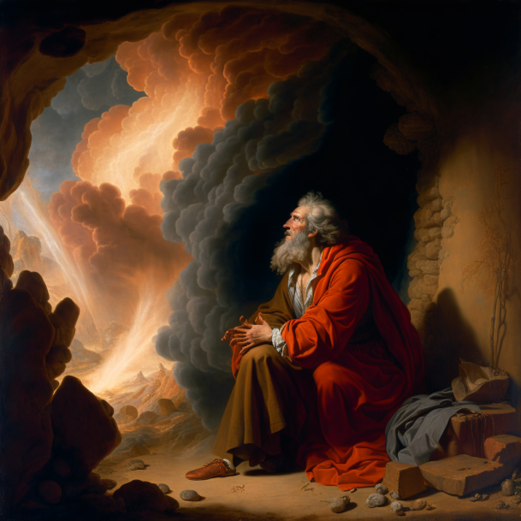
1 Kings 19

Slide 2
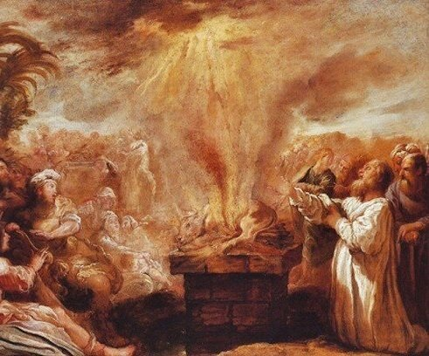
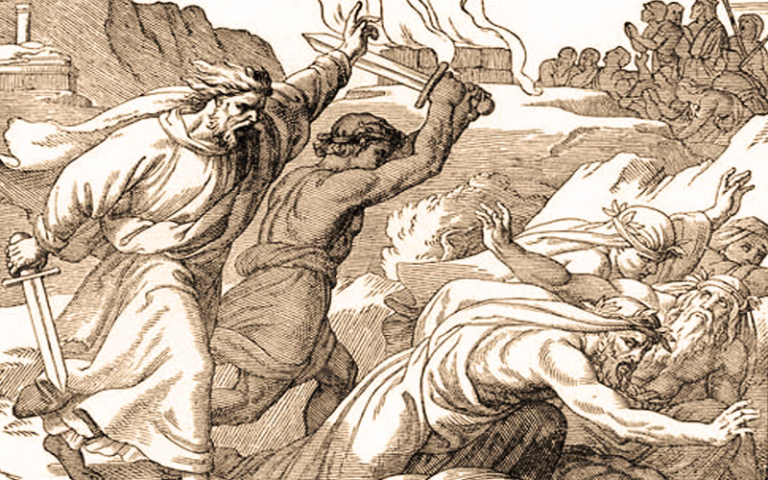
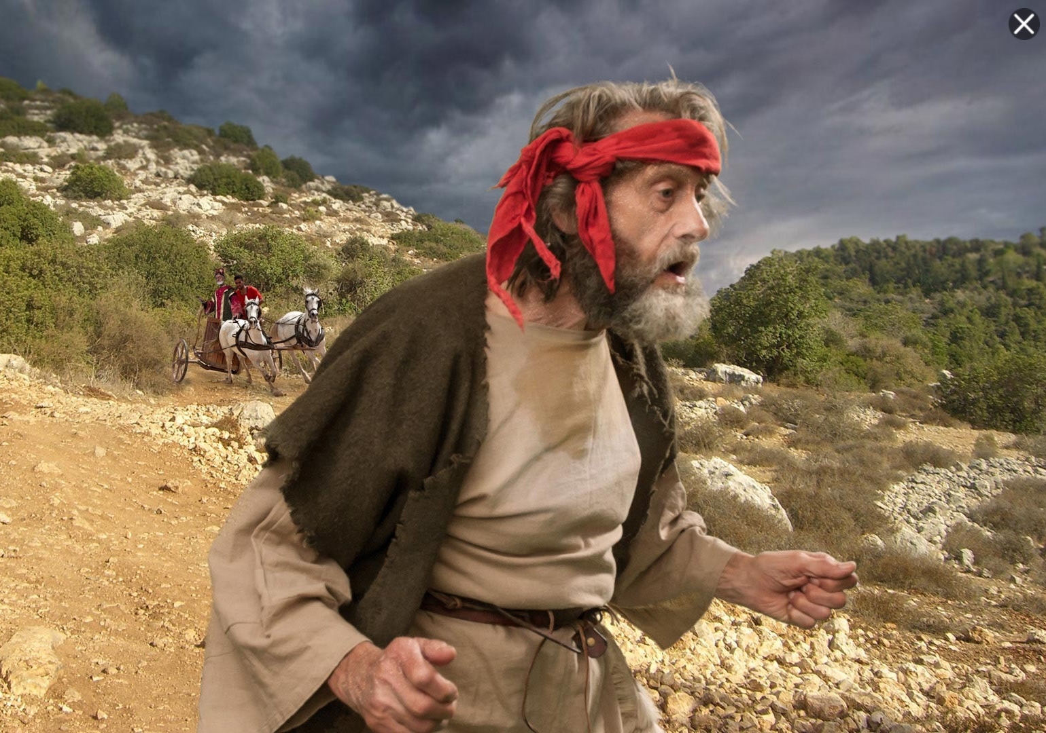
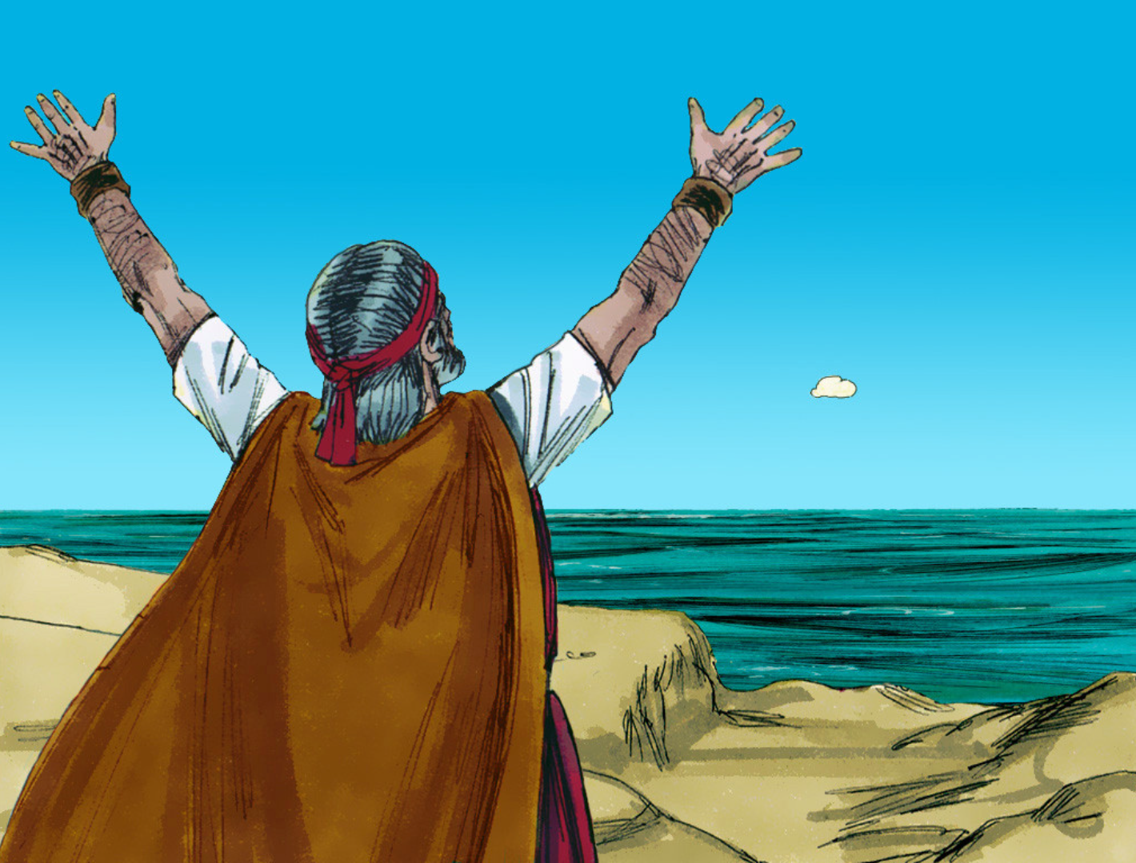
Notes:
Recap...

Slide 3
Elijah...
bold
audacious
brave
cheeky
fiery
“huspah”
Notes:
What do we know about Elijah?
How would you describe Elijah’s character?

Slide 4
1 Ahab told Jezebel all that Elijah had done, and how he had killed all the prophets with the sword. 2 Then Jezebel sent a messenger to Elijah, saying, “So may the gods do to me and more also, if I do not make your life as the life of one of them by this time tomorrow.”
3 Then he was afraid, and he arose and ran for his life and came to Beersheba, which belongs to Judah, and left his servant there.

Slide 5
“Then he was afraid, and he arose and ran for his life and came to Beersheba, which belongs to Judah...”
- 1 Kings 19.3

Slide 6
Notes:
How did this happen? Just done amazing miracles...

Slide 7
1. Fear and “fiery darts”...
Notes:
We see Elijah at the start of the chapter in a state of vulnerability.
Strange, because just had incredible success... Great success in God doesn’t make us immune from attack.

Slide 8
“...take up the shield of faith, with which you can extinguish all the flaming darts of the evil one...”
- Ephesians 6.1
Notes:
The reality of the battle. Fiery darts.
We’re in the old testament story, but Elijah facing same battle every follower of God has faced ever.
Jamie talked about being “troublers”. Reality is, as we step out into the darkness as salt and light, we’re not in neutral territory. The enemy is not happy when we step out. Sometimes face attack not because we’re doing something wrong but doing something right.
Enemy is called the “accuser of the brethren”. Also, as “like a roaring lion, seeking someone to devour...” In this story he uses the words of Jezebel to discourage. Same strategy.
Have you ever been going about your day? Suddenly out of nowhere a thought comes... Fear, accusation, a chain of events that suddenly unfolds – “this will happen, this will happen...” Suddenly feels like your world is crumbling.
A few times in my life when I’ve felt the effect of a fiery dart... Each time I can trace departing in my thinking from trusting in Him, and trusting in my own ideas for what He should do.
E.g. on holiday... Again – time of tranquility – felt attack... But realised I traced it back to something I was looking to God for that He wasn’t fulfilling...
The thing about a fiery dart is there is the initial impact, but then if it’s not dealt with it can take hold, and spread...

Slide 9
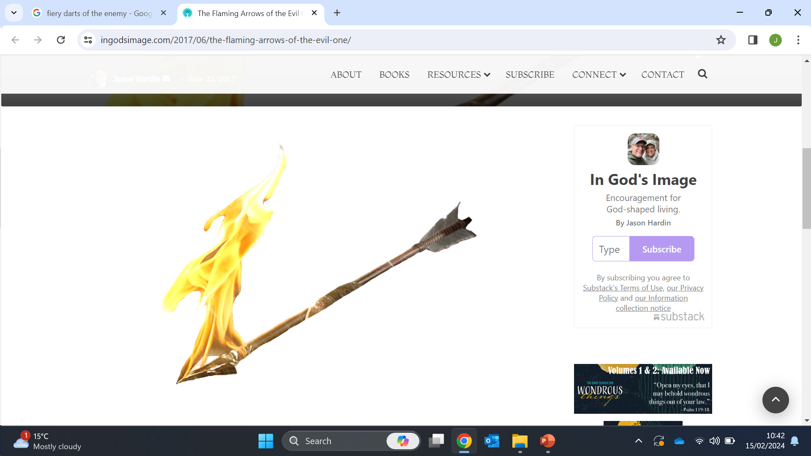
“Did God really say...?”
“God can’t really be trusted...”
“There is no way back from this...”
“You’re getting what you deserve...”
Notes:
Elijah has just seen incredible things... But he’s come under attack. He’s hit by a fiery dart.
We see effects of that. But the good news is we are equipped to deal with them.

Slide 10

Taking up the shield of faith...
a. Recognise when we are clinging to our strength and strategy instead of Him
Notes:
To take up the shield of faith, sometimes we have to put something down that we’re already holding...
In my experience, I can be saying that I’m trusting God. But secretly there’s a sneaky strategy that I have behind the scenes that I’m hoping God will fulfil.
Hugh challenged us last week... Spelling faith TRUST. Faith is a “developing trust in the Lord...” Love that. Relational. Sometimes we have to lay down our strategies in order to pick up God’s shield.

Slide 11
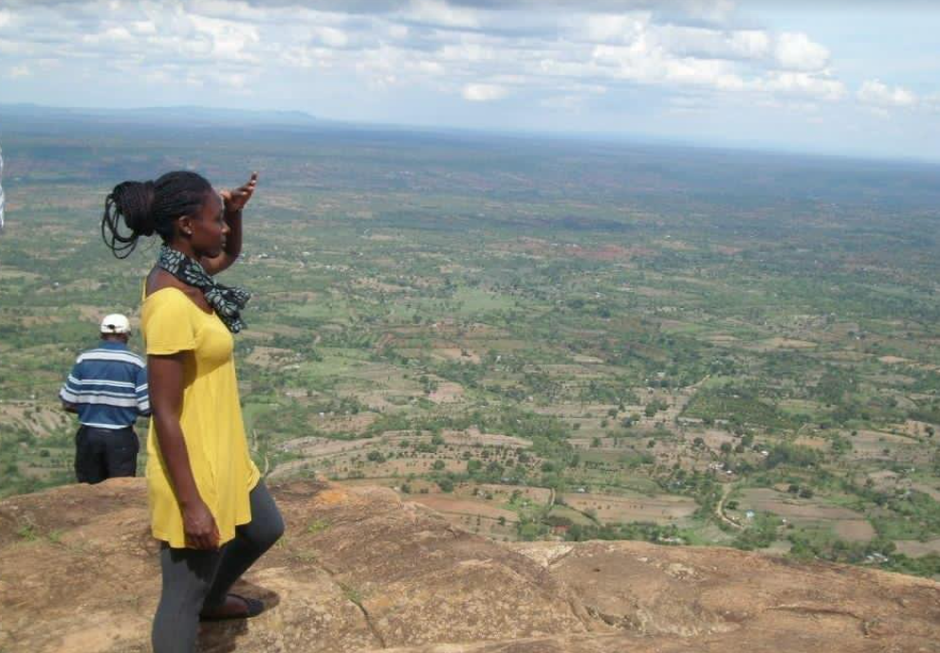
Notes:
Jane: Kenya trip...
Jamie: ending relationship...
Fiquiret: take a stand for righteoustness, provision meant to flow in...
We don’t realise that our hope is really conditional on God fulfilling a certain set of criteria... Sometimes until that fiery dart hits... Has God abandoned me?
If our hope is shifted from Him, we become vulnerable to the enemy’s attempts to discourage.

Slide 12
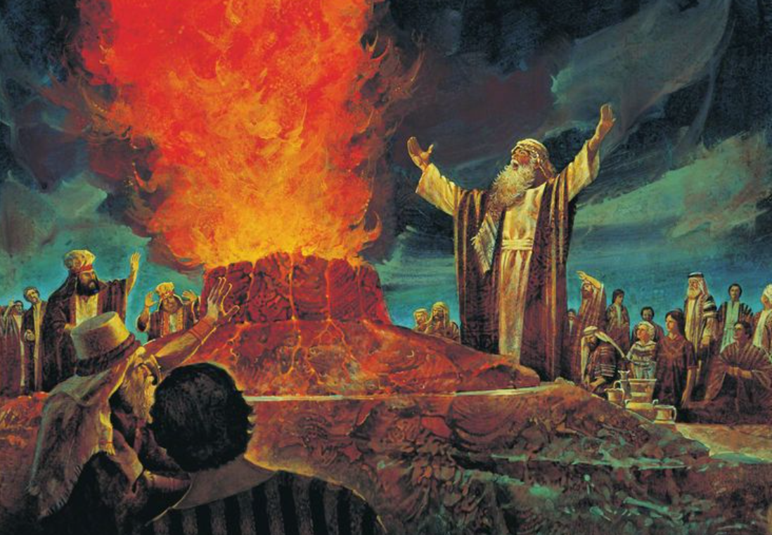
“...O Lord, answer me, that this people may know that you ... are God, and that you have turned their hearts back.”
- 1 Kings 18.37

Slide 13
“The heart of man plans his way, but the Lord establishes his steps.”
- Proverbs 16.9

Slide 14
Taking up the shield of faith...
b. We choose to agree with what He says, not what the accuser says.
Notes:
Toby story, “the panther...”
Husk story. Hebrews 12?
Jane, unsure about Zimbabwe. Family opinions...
Heidi. Tea towel?
Quite often when we think of faith we often imagine having to summon it up from somewhere. I’m facing this challenge, let me summon up faith. But quite often it’s not a case of groping around for new expression of faith but standing in what’s already there.
What has he already said about me? What has he already spoken? However small, however seemingly insignificant, start there, agree with what He’s saying, and see what God does.
An authority comes when we agree with what God has spoken. Hugh. Zecharaiah 4. “Speak to the mountain to move...” Let me declare what God has said. Lies have no power when we agree with God’s word.

Slide 15
“Then Jezebel sent a messenger ... Then he was afraid...”
- 1 Kings 19.2-3
Notes:
Elijah agrees with Jezebel, spirit of fear. What we’re seeing play out.
Doesn’t have to be like that. God has equipped us.

Slide 16
1. Is there a “strategy” I’m trusting in instead of God?
2. Where can I declare God’s truth over the enemy’s accusations?
Notes:
Declaring: might be over someone else instead of me...

Slide 17
4 But he himself went a day's journey into the wilderness and came and sat down under a broom tree. And he asked that he might die, saying, “It is enough; now, O Lord, take away my life, for I am no better than my fathers.”
5 And he lay down and slept under a broom tree. And behold, an angel touched him and said to him, “Arise and eat.” 6 And he looked, and behold, there was at his head a cake baked on hot stones and a jar of water. And he ate and drank and lay down again.

Slide 18
7 And the angel of the Lord came again a second time and touched him and said, “Arise and eat, for the journey is too great for you.”
8 And he arose and ate and drank, and went in the strength of that food forty days and forty nights to Horeb, the mount of God. 9 There he came to a cave and lodged in it.

Slide 19
2. We don’t decide when we’re done

Slide 20
“...he went a day’s journey into the wilderness and came and sat down under a broom tree. And he asked that he might die, saying, ‘It is enough; now, O Lord, take away my life, for I am no better than my fathers.”
- 1 Kings 19.4

Slide 21
“‘It is enough...’”
Notes:
We see Elijah here in his darkest moment. Laying his emotions bare before God.
Interesting... Elijah asking to die.
Wasn’t he just afraid of dying? Isn’t that why he ran away, for his life? Doesn’t make sense.
To me, suggests something has happened between verse 3 and 4.

Slide 22
fear shame
Notes:
Suggests he’s moved from fear to shame.
Running for his life. Dawns on him that he’s run away from his God-given purpose.
To turn nation back to God. To be a “troubler”...
“I am no better than my fathers...” “It is enough...”

Slide 23
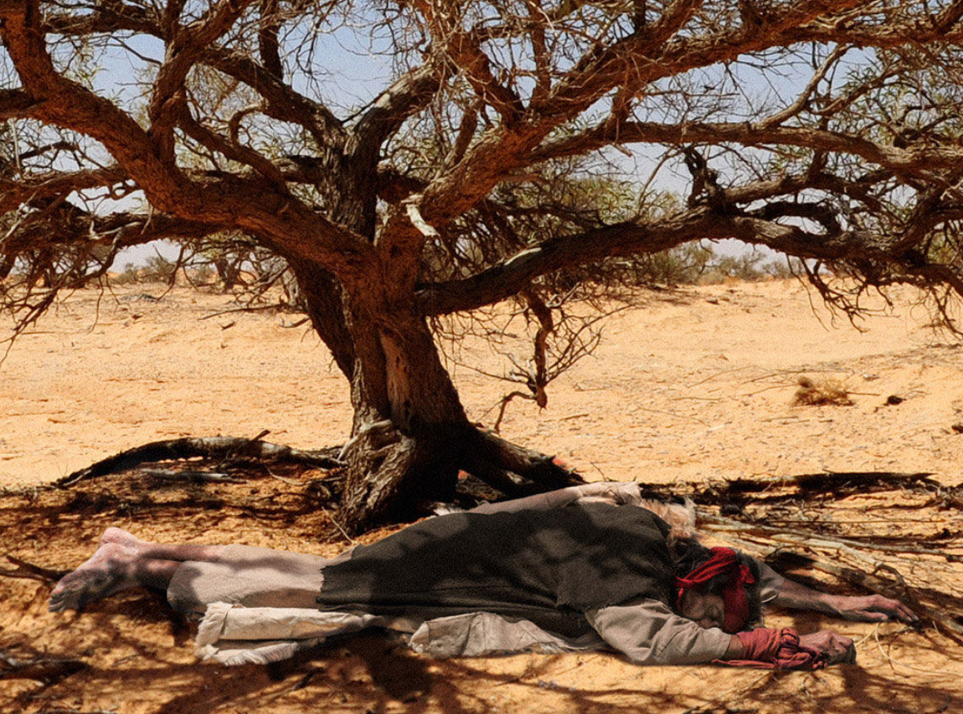
“‘It is enough...’”
Notes:
When I read this chapter this was the part that really struck me.
Elijah sees no way forward. He sees no hope. He’s at the end of himself. He feels he’s thrown away his calling, his purpose on earth...
He pours out his deepest, darkest thoughts before God.
And what is God’s response?

Slide 24
“‘Arise and eat, for the journey is too great for you...’”
1 Kings 19.7
Notes:
I love this.
Praise God that we don’t get to decide when we’re done. That fear and shame and stupid decisions don’t get to seal our fate.
God alone knows when He’s finished with us, and I love the tenderness of God in this moment, this simple response He gives to Elijah, through the angel.
“Arise and eat...” “Come on, there’s a journey for you to walk, you’re gonna need some strength...”
He’s saying to Elijah, “I’m not done with you yet. I have more for you.”
And, as it happens, this dark episode is actually a turning point in the life of Elijah.
The best is yet to come for Him. God has more for Him.

Slide 25
Notes:
Elijah sees a full stop. God turns it into a comma.
God is in the business of turning our full-stops into commas. Of breathing hope into hopeless situations. Of lifting our head when we can’t see a way forward and saying, “Come on, there’s a journey for us to walk, take some strength...”

Slide 26
“‘It is enough...’”
Notes:
I wonder if there are people here today who are struggling to see a way forward. Maybe like Elijah you’re thinking “It is enough”.
Maybe you’ve told yourself that your best days are behind you. “I’ve done my bit, I’m not able to do what I used to, it’s time for others to take the reins.” “It is enough...”
Maybe there’s a physical restriction. A sickness, a disability, something holding you back and you’re considering whether it’s worth the effort.
Maybe your life circumstances have changed. You’ve lost a job... You’re in a new season of life and you aren’t sure what serving God looks like. “I knew how to serve God before...”
Maybe you’ve encountered changed relationships. There were people you were close to that now seem distant. Friends who you thought would always be a constant in your life, and now that’s in question...
Maybe you used to be on fire for God, come to a place of flatness, feel tired, lethargic. Maybe this is what life is? Just paying the bills, getting by, saving up for holidays, ticking along... “It is enough”.
Maybe you tried to step out before and were disappointed. Maybe, like Elijah, things didn’t work in quite the way you expected. Maybe you prayed and prayed and felt like God didn’t answer. “It is enough...”
Maybe you feel disqualified by sin. How can God ever use me? “It is enough”.
Praise God that he comes to use in these moments in a spirit of gentleness and gives us food for the journey.
“I’ve come to the end of myself...” Finally, now enter into my grace. There’s something coming.

Slide 27
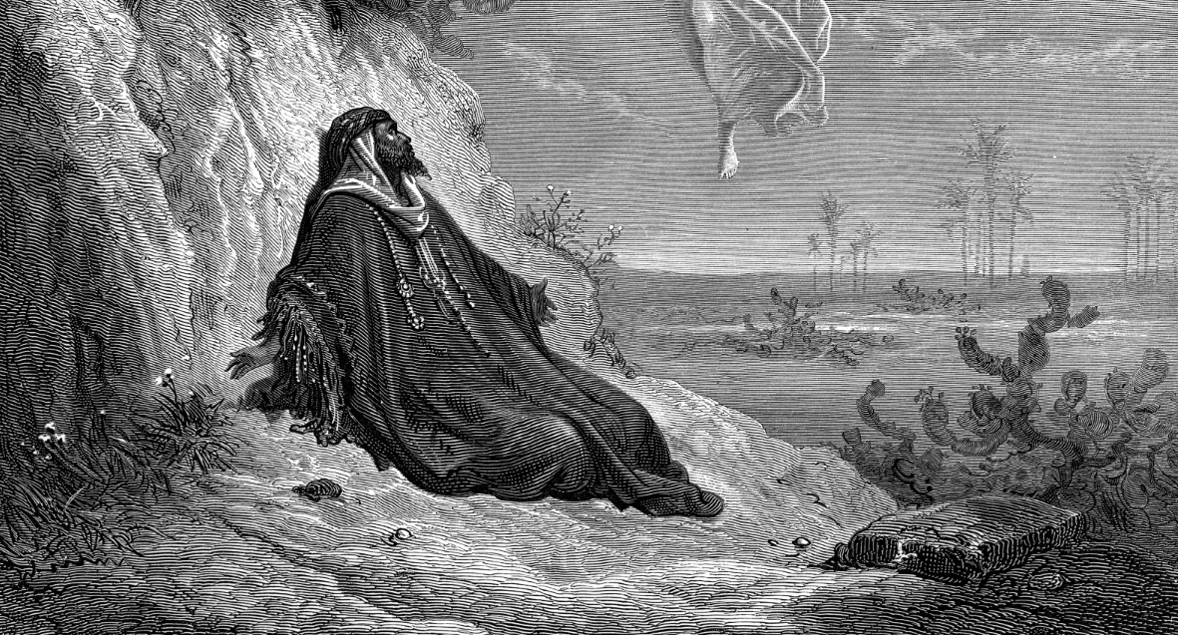
Notes:
Elijah thinks he’s done. He thinks he’s disqualified. He thinks he’s run his race.
And God says, No.
“The journey is too great for you.”
“I’ve got work for you to do. I’ve got a whole new chapter for you to live. And the best is yet to come.”
If God is still moving me, keep going...

Slide 28
3. Have I declared “it is enough” over any area of my life?
4. Will I step into the journey beyond the “comma”?

Slide 29
And behold, the word of the Lord came to him, and he said to him, “What are you doing here, Elijah?”
10 He said, “I have been very jealous for the Lord, the God of hosts. For the people of Israel have forsaken your covenant, thrown down your altars, and killed your prophets with the sword, and I, even I only, am left, and they seek my life, to take it away.” 11 And he said, “Go out and stand on the mount before the Lord.”

Slide 30
And behold, the Lord passed by, and a great and strong wind tore the mountains and broke in pieces the rocks before the Lord, but the Lord was not in the wind. And after the wind an earthquake, but the Lord was not in the earthquake. 12 And after the earthquake a fire, but the Lord was not in the fire. And after the fire the sound of a low whisper.
13 And when Elijah heard it, he wrapped his face in his cloak and went out and stood at the entrance of the cave.
And behold, there came a voice to him and said, “What are you doing here, Elijah?”

Slide 31
3. The voice of gentle silence
Notes:
Break in dramatic...
You done with argument? Come to me, lowly, gentle. Person of Jesus. Same voice that calms storm.
“A thin silence...”; “A voice of gentle silence...”

Slide 32
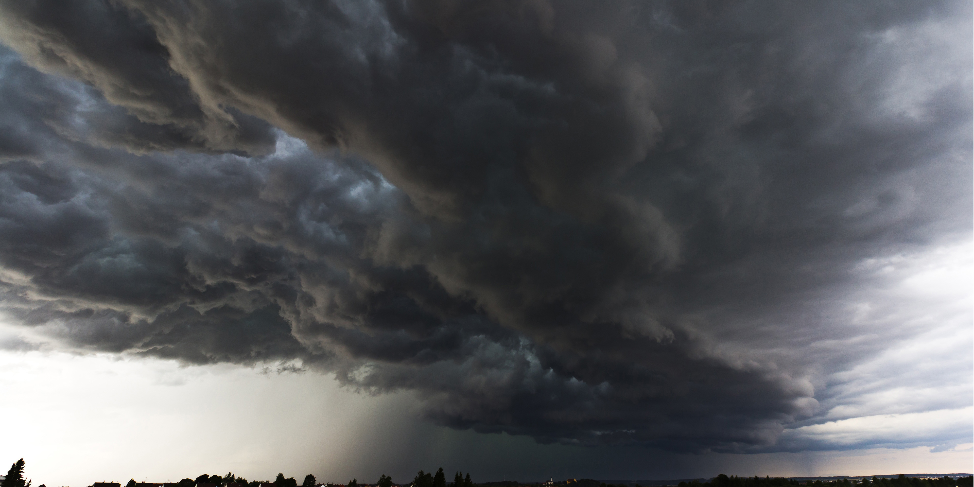
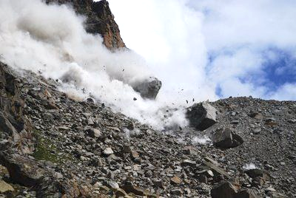
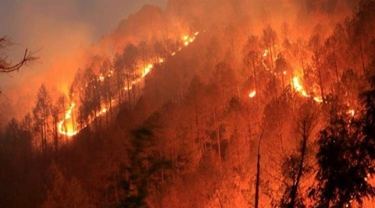
Notes:
Elijah on familiar territory. Fiery personality, track record. Surely God is in this??
No.
What is significance of these manifestations? We don’t know. As I’ve considered, two things...

Slide 33
Wind, earthquake, fire...
1. Valid expressions of God’s presence but not for this time...
Notes:
Previous ways God has revealed himself.
Remember earth split as confirmation? Jereboam. Elijah probably aware. Fire of Mt. Carmel. Holy Spirit.
“See, I am doing a new thing...”
Owen...
Can tune into that thin silence in between the dramatic. Are we looking for old expressions in our life when God is saying, “I am doing a new thing...”?
Jewish authorities expecting a Messianic warrior to come and set Israel free. Instead they got a man without any showy, outward glory... Missed it. We don’t want to miss what God is doing.

Slide 34
Wind, earthquake, fire...
2. Distractions from the quiet strength of His voice.
Notes:
Sometimes the enemy uses drama to try to distract us from the reality of God’s gentle presence with us.
Jesus, calm in storm.
Me, losing work. In the midst of anxiety.
May be in the midst of difficult and quite scary circumstances. May seem like everything is crumbling around you... But there is a “gentle silence” for you to access.
Can be a challenge! Like Elijah, God challenges our assumptions, our status quo. There is a response we need sometimes.

Slide 35
“A low whisper...”
“A gentle silence...”
“A still small voice...”
“The sound of a gentle whisper...”

Slide 36
“He made the storm be still, and the waves of the sea were hushed...”
Psalm 107.29

Slide 37
5. Lord, help me tune-in to your gentle silence in the midst of my circumstances...
6. Do I need to respond to a “gentle whisper” in my life?

Slide 38
13 And when Elijah heard it, he wrapped his face in his cloak and went out and stood at the entrance of the cave.
And behold, there came a voice to him and said, “What are you doing here, Elijah?”
14 He said, “I have been very jealous for the Lord, the God of hosts. For the people of Israel have forsaken your covenant, thrown down your altars, and killed your prophets with the sword, and I, even I only, am left, and they seek my life, to take it away.”

Slide 39
15 And the Lord said to him, “Go, return on your way to the wilderness of Damascus. And when you arrive, you shall anoint Hazael to be king over Syria. 16 And Jehu the son of Nimshi you shall anoint to be king over Israel, and Elisha the son of Shaphat of Abel-meholah you shall anoint to be prophet in your place. 17 And the one who escapes from the sword of Hazael shall Jehu put to death, and the one who escapes from the sword of Jehu shall Elisha put to death.

Slide 40
18 Yet I will leave seven thousand in Israel, all the knees that have not bowed to Baal, and every mouth that has not kissed him.”
19 So he departed from there and found Elisha the son of Shaphat, who was plowing with twelve yoke of oxen in front of him, and he was with the twelfth. Elijah passed by him and cast his cloak upon him.

Slide 41
4. “Go make a disciple...”
Notes:
God has been dealing with Elijah.
Challenging his assumptions. Gently and lovingly correcting him.
Showing him that he’s a God not just of the big and bold and brash... The wind, the earthquake, the fire. But a God of the gentle whisper. Who’s present in the quiet, the unseen.
And then we come to this final passage.

Slide 42
Notes:
Remember, start of chapter, we’d just had an incredible demonstration of the power of God. Mount Carmel. Dramatic contest.
But what happens? Is it turning point for the nation? No.
When Israel is in the grip of Jezebel. Evil queen. When 90 percent of Israelites are running after other Gods, it’s not the miracle that turns things around... God doesn’t change the world with fireworks.

Slide 43
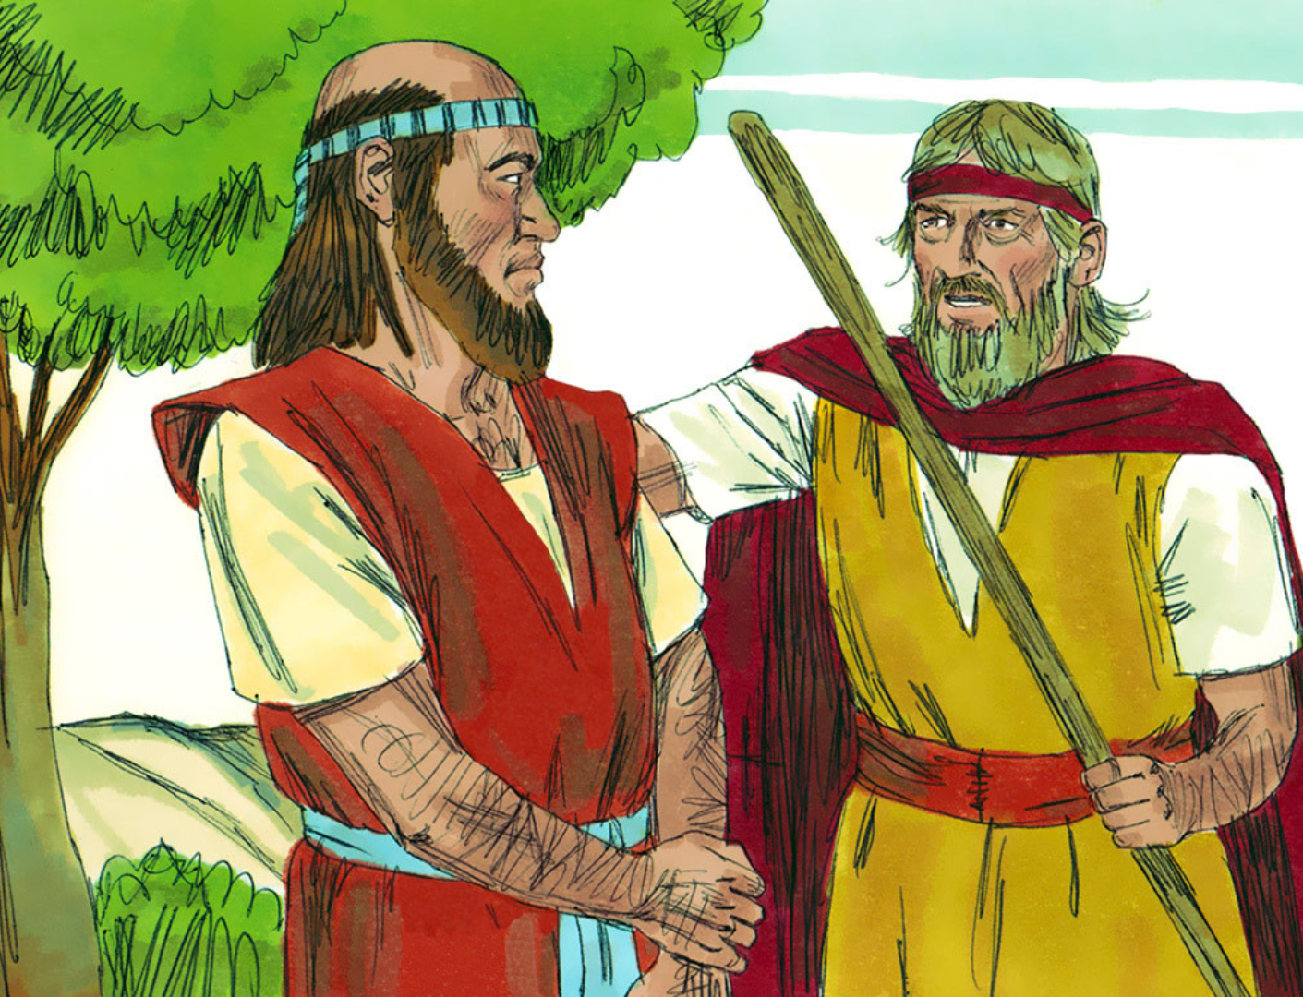
Notes:
When God wants to intervene to restore a nation, he uses people.
He uses Discipleship.
“Go back to Damascus. Anoint Hazael to be king... Anoint Jehu to be king over Israel... Anoint Elisha to pick up from where you left off...”
And, by the way, I have 7000 others who have not bowed the knee.
It’s easy to read these episodes, and make them about Elijah. And I get it, he’s a great character... The exploits, the miracles. And then he gets discouraged, but God comes to him and restores his calling, and sends him out...
But I think one of the main points about this passage is ... It’s not about Elijah, it’s bigger than Elijah. It’s like God is saying...
“Elijah. You are not the only one. This is bigger than you. I have a plan for this nation that will extend long after you are gone. But you still have a part to play. I am calling you to relationship, to community. The next chapter of your life is not about being a lone ranger, it’s about walking with others and passing on your mantle. I have 7,000 others who have not bowed the knee...”
We live in a very individualised society. It’s all about the individual, about “me”. Fulfilling my dreams. Being authentic to my true self. And in a spiritualised sense, fulfilling my calling. Can creep into the church, too.
Sometimes can feel a bit like Elijah. “I’m the only one...” Jamie asked the question a couple of weeks ago, “Am I a troubler?” Am I willing to pay the price to carry God’s message of justice to the places I’m planted. But we can sometimes be tricked into thinking we’re alone in this.
In my workplace, “I’m the only one following God.” In my school, “I’m the only one...” How can I carry this message on my own. But God wants to remind us, “No, there are others...” The power of community. Look around. Together we have the mind of Christ. We draw strength, then we go out and we represent Him in all the spheres where God has us. As teachers, in healthcare, in our homes...
Elijah and Elisha generally recognised as one of the first if not the first Biblical example of discipleship relationship. Of Hebrew rabbi/student relationship. Archetype followed. And this is His chosen method of bringing change.

Slide 44
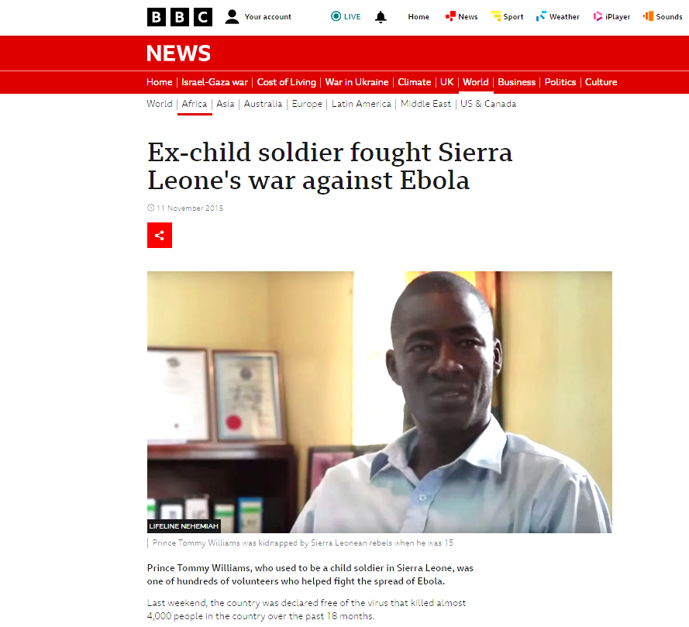
Notes:
In 2015 BBC News published an article entitled, “Ex-child soldier fought Sierra Leone’s war against Ebola”.
Many of you will remember the Ebola pandemic that hit the country in 2014. The article describes how Prince Tommy Williams helped lead the response to the disease through offering relief for affected families, setting up a clinic and taking in orphaned children to the Nehemiah home.
But Prince Tommy had his own story. In 1991, age 15, he was captured by rebels in the Sierra Leone civil war and forced to fight and kill.
I just want to read a passage from that article:
I had a normal family life before the war started in 1991.
But at 15 I was kidnapped by the rebels and taken to the jungle where I was trained on how to use a gun and initiated into the group.
I thought it was the end of my life. It was like living in a different world, not like living on earth.
The rebels also threatened to cut off my legs or arms if I tried to flee, and I saw this happen to other people.
Sometimes we were forced to kill, which we did under the influence of drugs.
Luckily I did manage to escape from the jungle without being killed and I went to the capital, Freetown, but was unable to find my relatives.
I lived alone, but teamed up with some guys doing things like pick-pocketing and I was caught.
Fortunately [while in jail] I met a preacher called Richard Cole, who was the founder of a project called Lifeline Nehemiah which aimed to give hope, and a home, to people like me who felt they had lost hope.
He encouraged me saying: "You used to cause atrocities, but you can be used to contribute to rebuild the nation.“
Richard taught me that it was God who was taking me through all these troubling times...
He passed away in 2006 but we had that vision and continue with it.

Slide 45
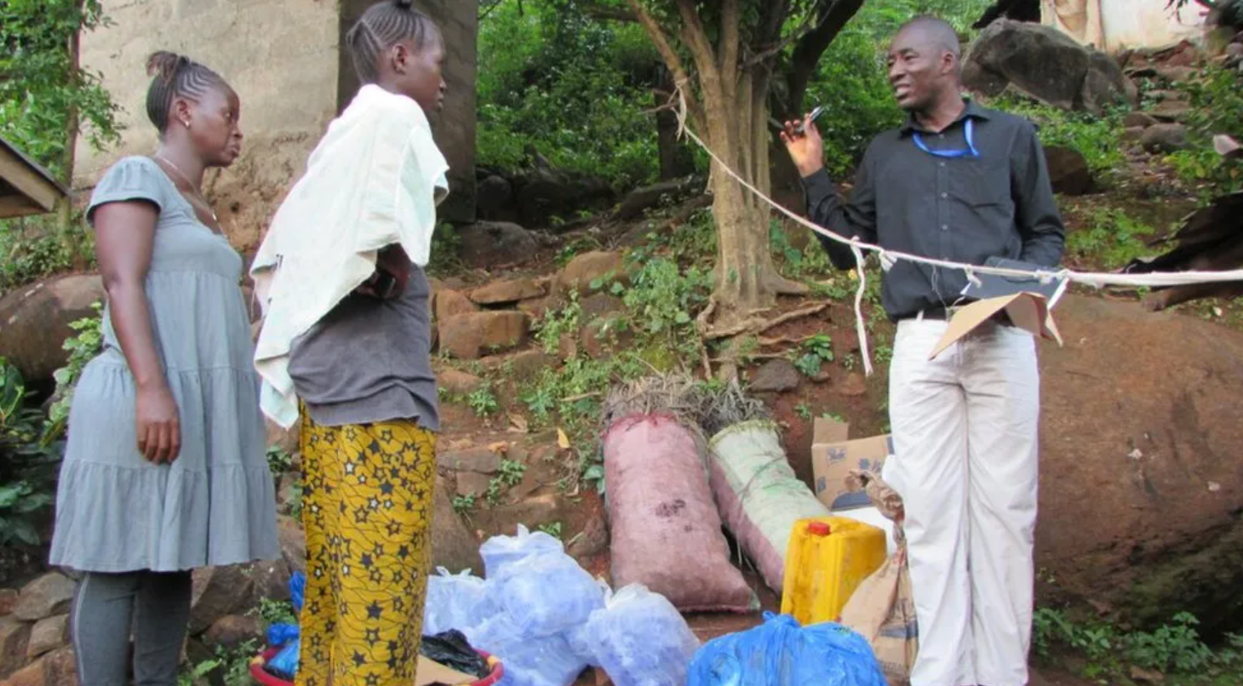
Notes:
Prince was positioned to lead during the Ebola crisis because someone else had had vision for him when most people would have written him off.
Because Richard Cole had responded to the leading of God to take Prince into the Nehemiah home. Demonstrate the love of God in a very real, practical way.
This is the stuff that changes nations. The quiet, the unseen...
As a church we’re grappling with the question of how do we encourage a new generation of leaders.
As Hugh spoke about last week, how to we build a worthy capstone upon the foundation that has been laid in this community?
The Kingdom pattern for the transformation of lives, for the advancement of God’s glory in a community, location, nation...
It’s passed on, communicated, not through displays of power... Mt. Carmel.
Not through sermons.
But through overlapping lives, through examples set, through iron sharpening iron.
Didn’t feel able to be youth leader. Sally word.

Slide 46
“Be imitators of me, as I am of Christ.”
- 1 Cor. 11.1
Notes:
It’s about imitating.
Can only happen in close proximity. We can’t be imitators through listening to podcasts, or through sermons. We can’t be imitators by turning up at 10.30 on a Sunday morning, singing some songs, listening to a talk, collecting our children, having tea and coffee and going home again.
We become imitators through spending time. Walking with, watching how they act.

Slide 47
7. How can I move from a “lone ranger” mindset to pressing into community?
8. What does embracing discipleship look like for me?
Notes:
Community.
Called not to be lone rangers. Together we have the mind of Christ. I am not alone. In my school, workplace, etc.
Said at the beginning that the enemy’s strategy hasn’t changed across thousands of years of human history...
But you know what? God’s strategy hasn’t changed.
There is a figure behind the stories we’ve looked at this morning, it’s the person of Jesus.
The angel of the Lord.
Elijah. In a spirit of gentleness, bringing restoration. Coming to a place of death, bringing resurrection life.

Slide 48
“He will not quarrel or cry aloud,
nor will anyone hear his voice in the streets;
a bruised reed he will not break,
and a smouldering wick he will not quench,
until he brings justice to victory;
and in his name the Gentiles will hope.”
- Matthew 12:19–21
Notes:
Matthew in his gospel describes Jesus as the fulfilment of an old testament prophecy.
He quotes Isaiah 42.

Slide 49
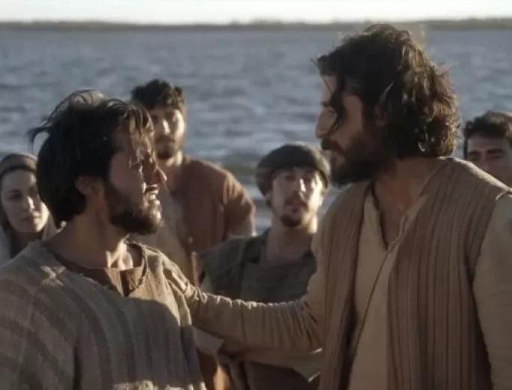
Notes:
Peter... Like Elijah.
He agreed with fear. Denied Jesus, and ran away.
Just like Elijah, shame followed hot on the heels of fear. Wept bitterly.
And yet, Jesus didn’t leave Peter in fear and shame.
After Jesus rose from the dead, he came and found him fishing. And in that same spirit of gentleness, he restored him, asking him three times, “do you love me?”
He came in a way that Peter needed.
And you know what? After that he commissioned him. “Feed my lambs”. He sent Peter into the world to go and make disciples. To go and turn the world upside down not through great displays of power but through love.

Slide 50
Declaring truth over fear
Experiencing Jesus’ restoration
Accessing His voice of gentle silence in my circumstances
Embracing His commission to build community

