Slide 1

1 Samuel 1

Slide 2
1 There was a certain man ... whose name was Elkanah ... an Ephrathite. 2 He had two wives. The name of the one was Hannah, and the name of the other, Peninnah. And Peninnah had children, but Hannah had no children.
3 Now this man used to go up year by year from his city to worship and to sacrifice to the Lord of hosts at Shiloh, where the two sons of Eli, Hophni and Phinehas, were priests of the Lord.

Slide 3
4 On the day when Elkanah sacrificed, he would give portions to Peninnah his wife and to all her sons and daughters. 5 But to Hannah he gave a double portion, because he loved her, though the Lord had closed her womb. 6 And her rival used to provoke her grievously to irritate her, because the Lord had closed her womb. 7 So it went on year by year. As often as she went up to the house of the Lord, she used to provoke her. Therefore Hannah wept and would not eat. 8 And Elkanah, her husband, said to her, “Hannah, why do you weep? And why do you not eat? And why is your heart sad? Am I not more to you than ten sons?”

Slide 4
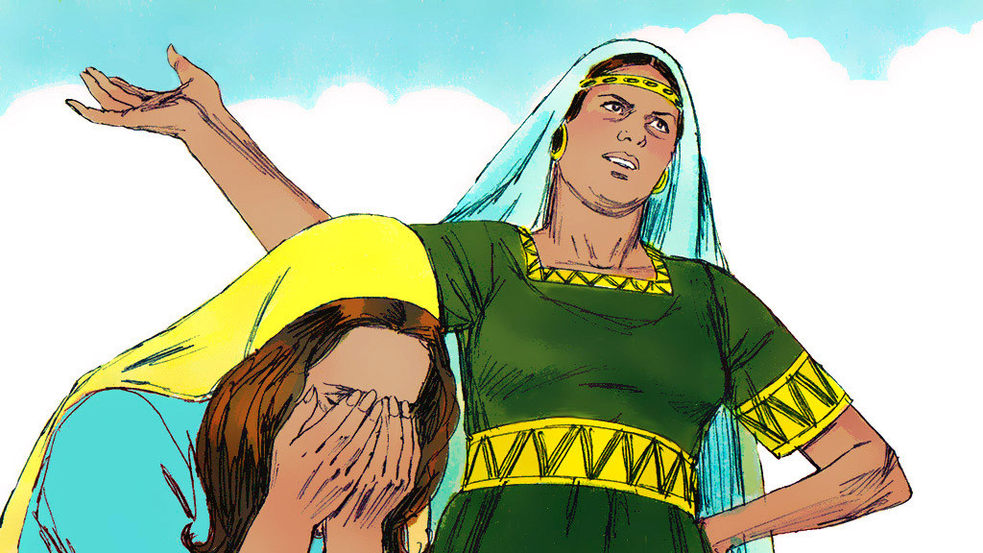

Slide 5
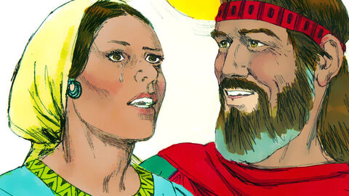

Slide 6
9 After they had eaten and drunk in Shiloh, Hannah rose. Now Eli the priest was sitting on the seat beside the doorpost of the temple of the Lord. 10 She was deeply distressed and prayed to the Lord and wept bitterly. 11 And she vowed a vow and said, “O Lord of hosts, if you will indeed look on the affliction of your servant and remember me and not forget your servant, but will give to your servant a son, then I will give him to the Lord all the days of his life, and no razor shall touch his head.”

Slide 7
12 As she continued praying before the Lord, Eli observed her mouth. 13 Hannah was speaking in her heart; only her lips moved, and her voice was not heard. Therefore Eli took her to be a drunken woman. 14 And Eli said to her, “How long will you go on being drunk? Put your wine away from you.” 15 But Hannah answered, “No, my lord, I am a woman troubled in spirit. I have drunk neither wine nor strong drink, but I have been pouring out my soul before the Lord.

Slide 8
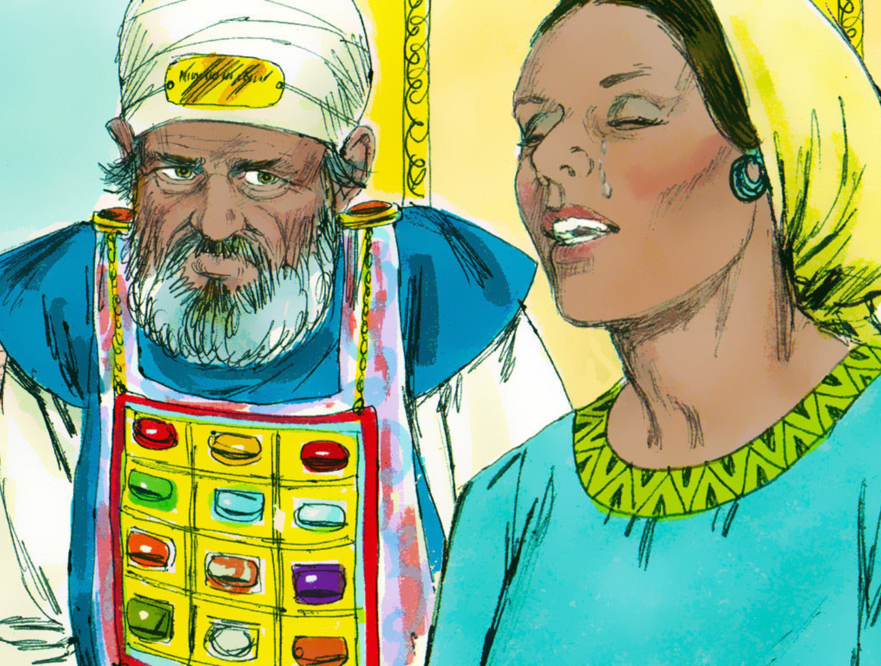

Slide 9
16 Do not regard your servant as a worthless woman, for all along I have been speaking out of my great anxiety and vexation.” 17 Then Eli answered, “Go in peace, and the God of Israel grant your petition that you have made to him.” 18 And she said, “Let your servant find favour in your eyes.” Then the woman went her way and ate, and her face was no longer sad ...
20 And in due time Hannah conceived and bore a son, and she called his name Samuel, for she said, “I have asked for him from the Lord.”

Slide 10
“deeply distressed”
“troubled in spirit”
“great anxiety and vexation...”

Slide 11
How does Hannah respond?
Admits her feelings
Pours out her soul
Opens her hands

Slide 12
1. Admits her feelings

Slide 13
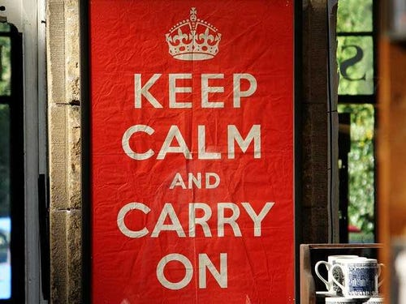

Slide 14

“To feel is to be human. To minimize or deny what we feel is a distortion of what it means to be image bearers of God.”
- Pete Scazzero

Slide 15
“Then he said to them, ‘My soul is very sorrowful...’”
- Matthew 26.38
“Now is my soul troubled ...”
- John 12.27

Slide 16
2. Pours out her soul

Slide 17
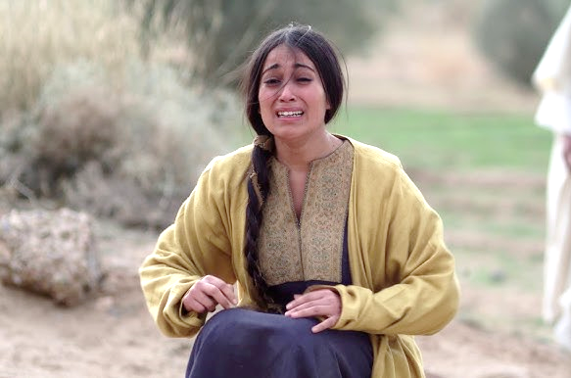
“I have drunk neither wine nor strong drink, but I have been pouring out my soul before the Lord...”
- Hannah

Slide 18
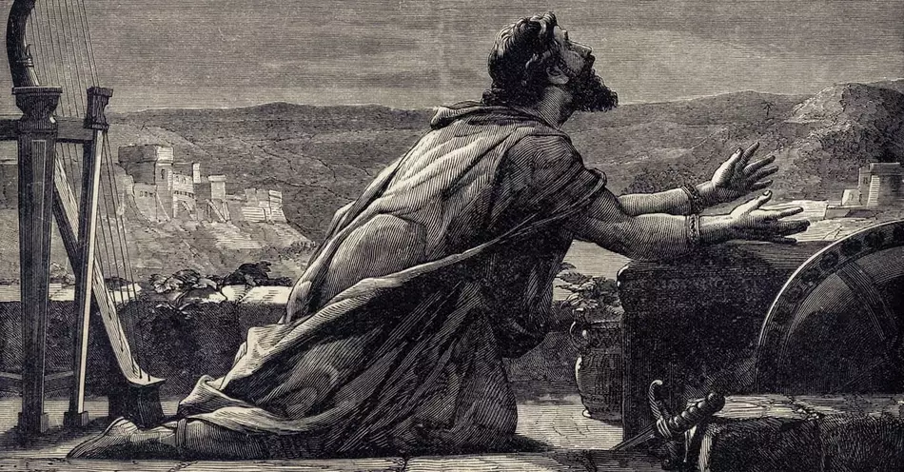
Why are you cast down, O my soul, and why are you in turmoil within me?
- Psalm 42.11
David

Slide 19
Trust in him at all times, O people; pour out your heart before him; God is a refuge for us...
- Psalm 62.8

Slide 20
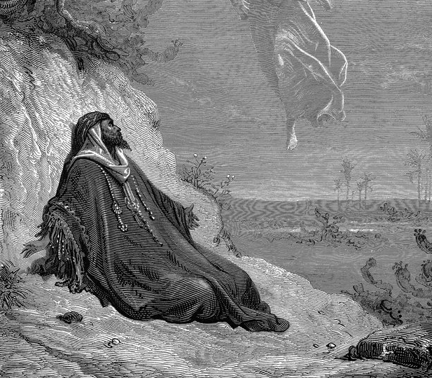
“It is enough now, O Lord...”
- 1 Kings 19
Elijah

Slide 21
“Do not be anxious about anything...”
- Philippians 4.6

Slide 22
“Do not let your hearts be troubled...”
- John 14.1

Slide 23
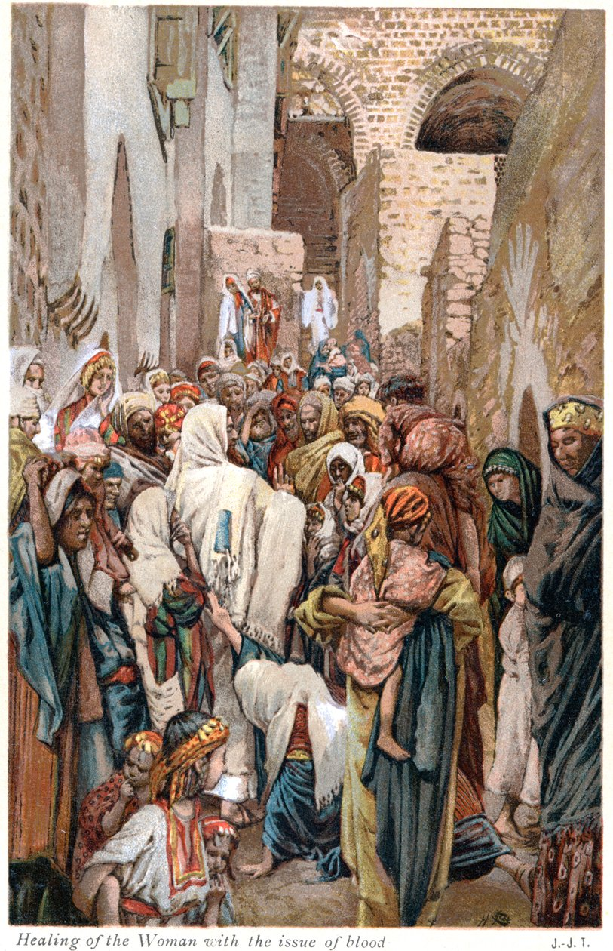
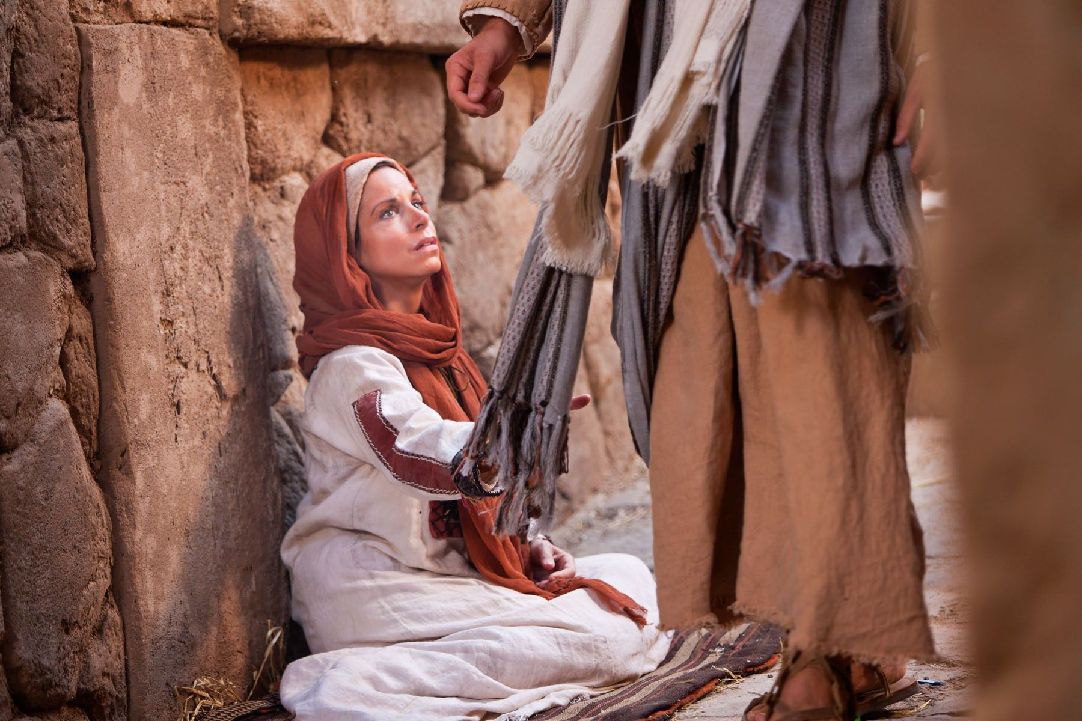

Slide 24
...casting all your anxieties on him, because he cares for you...
- 1 Peter 5.7

Slide 25
Do not be anxious about anything, but in everything by prayer and supplication with thanksgiving let your requests be made known to God.
- Philippians 4.6-7

Slide 26
3. Opens her hands

Slide 27
“If you will ... give to your servant a son, then I will give him to the Lord...”
- Hannah

Slide 28
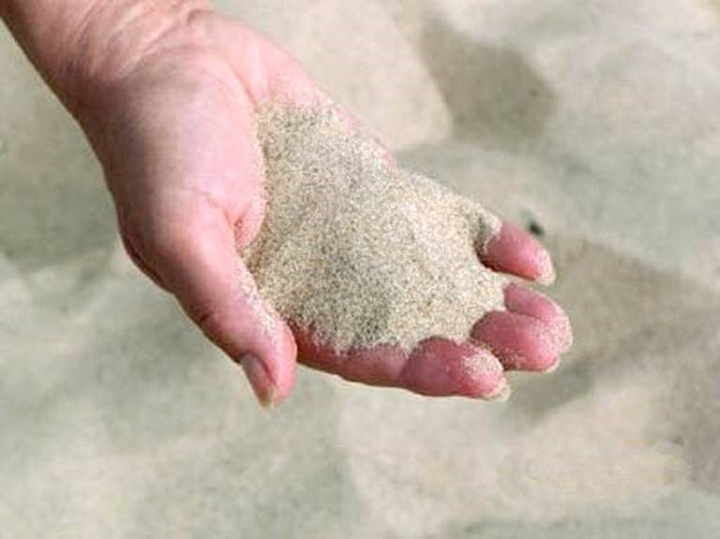

Slide 29
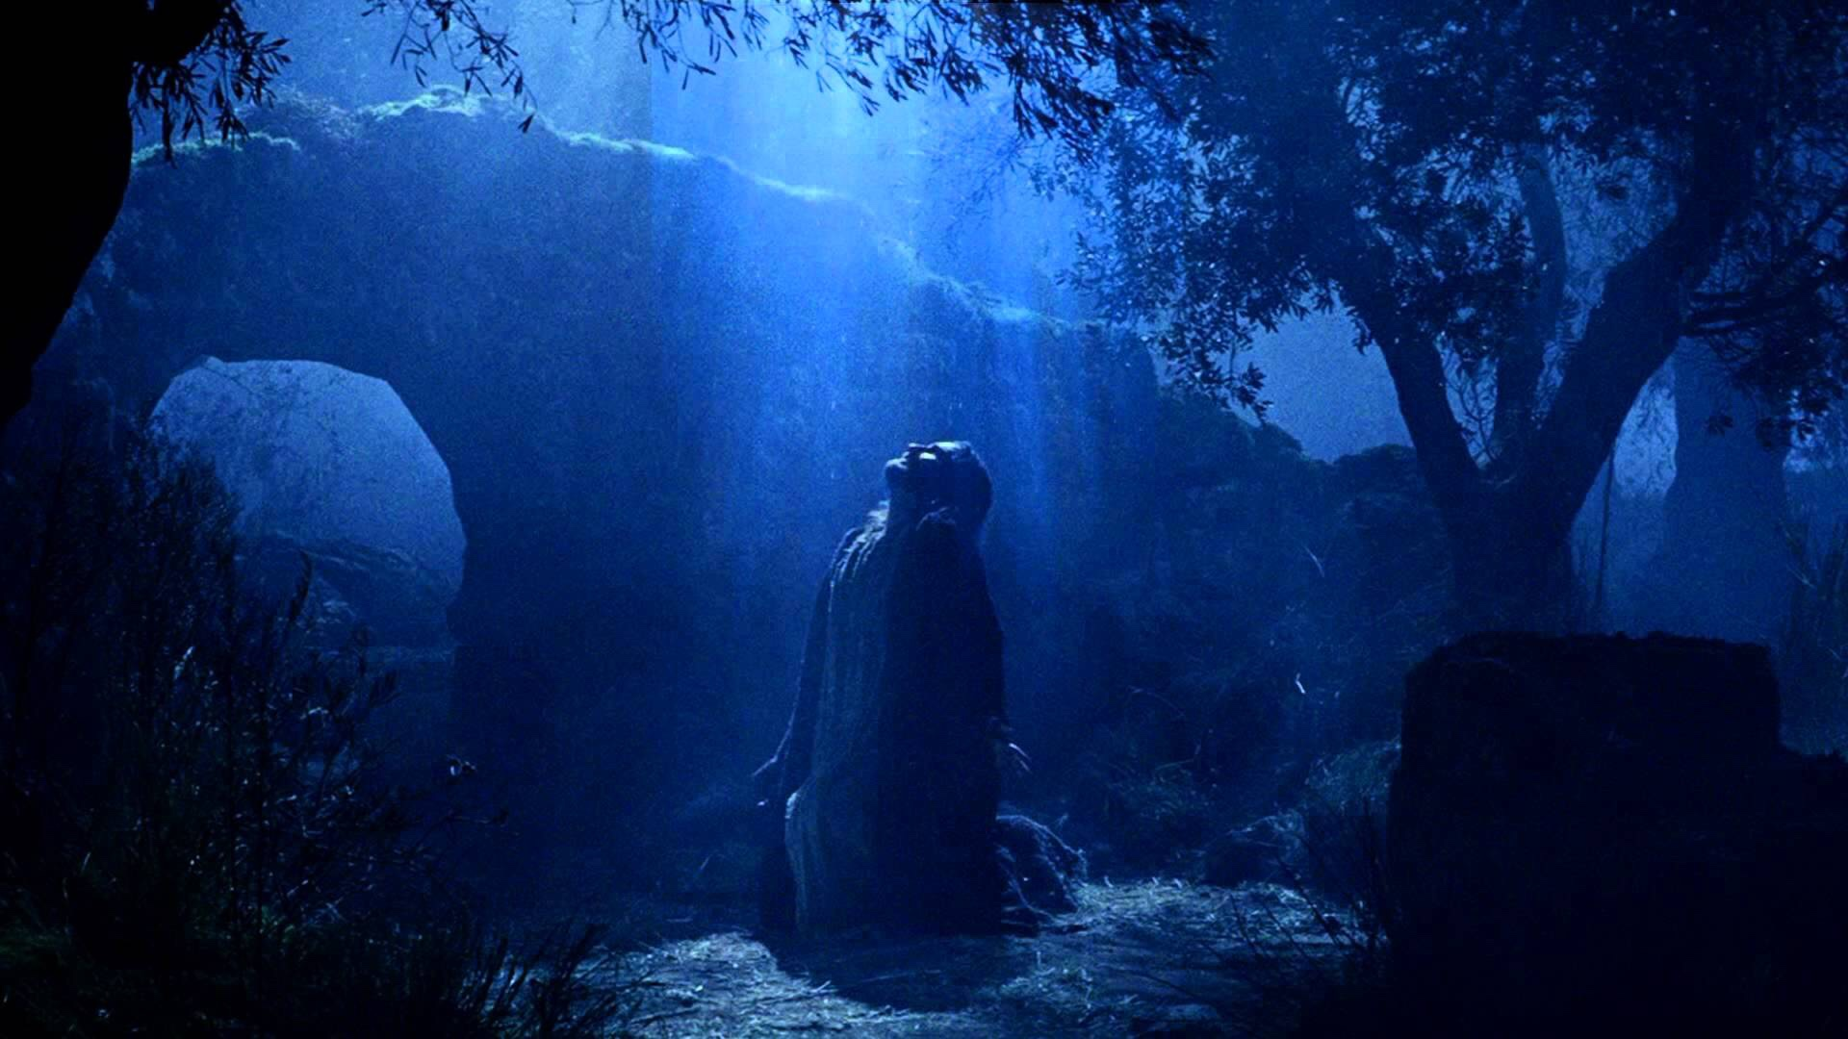

Slide 30
...then the woman went her way and ate, and her face was no longer sad.
- 1 Samuel 1.18

Slide 31
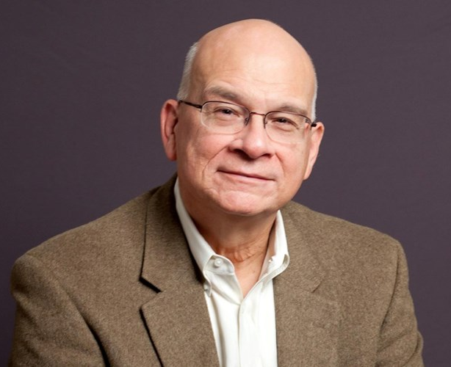
“Joy is not the absence of pain but the presence of God...”
- Tim Keller

Slide 32
...those who look to him are radiant, and their faces shall never be ashamed.
- Psalm 34

Slide 33
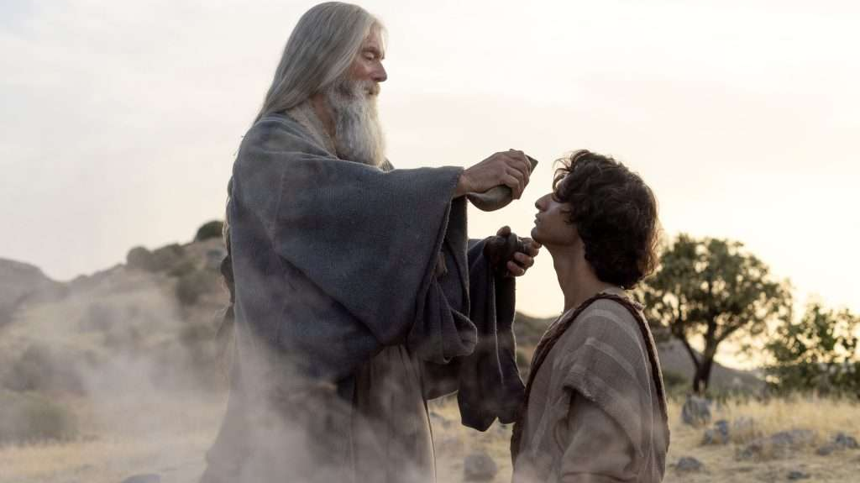

Slide 34
Honesty with where we are
Coming before God
Power to “open our hands”

