Slide 1


Slide 2

Acts 3
God’s in the business of releasing people

Slide 3
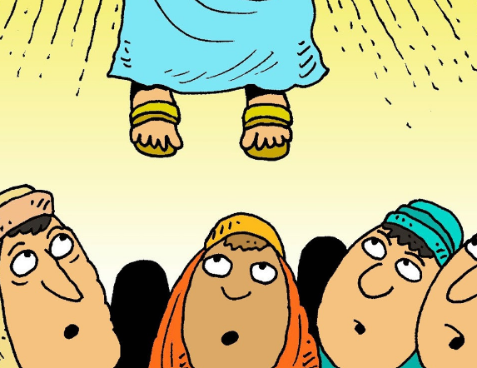
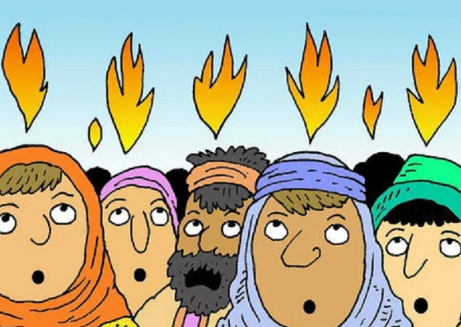
Recap
Acts 1
Acts 2
Jesus taken up to heaven
Apostles restored to 12 (Mattias replaces Judas)
Holy Spirit comes at Pentecost
Peter addresses crowd – 3000 added
Formation of early church

Slide 4
Acts 3 overview
Shifting towards daily life for the early church
Acts 3 in two parts:
  V1-10 – lame man is healed: first recorded miracle performed by disciples since Pentecost
  V11-26 – Peter addresses the crowd
God is in the business of releasing people
  Are there areas where I am feeling trapped or crippled?
  What am I asking God for today? Do I expect a miracle?
  It’s time to change the way we view repentance: it is a gift that releases us from power of sin and leads to times of refreshing in God’s presence

Slide 5
Acts 3:1-10
One day Peter and John were going up to the temple at the time of prayer—at three in the afternoon. 2 Now a man who was lame from birth was being carried to the temple gate called Beautiful, where he was put every day to beg from those going into the temple courts. 3 When he saw Peter and John about to enter, he asked them for money. 4 Peter looked straight at him, as did John. Then Peter said, “Look at us!” 5 So the man gave them his attention, expecting to get something from them.
6 Then Peter said, “Silver or gold I do not have, but what I do have I give you. In the name of Jesus Christ of Nazareth, walk.” 7 Taking him by the right hand, he helped him up, and instantly the man’s feet and ankles became strong. 8 He jumped to his feet and began to walk. Then he went with them into the temple courts, walking and jumping, and praising God. 9 When all the people saw him walking and praising God, 10 they recognized him as the same man who used to sit begging at the temple gate called Beautiful, and they were filled with wonder and amazement at what had happened to him

Slide 6

Reflection questions (1)
Are we alert to the prompting of the Holy Spirit for today?
What might stop us from hearing Him: what “noise” stands in our way?
Do we make time to hear from Him?
Are we Martha (running around trying to get things done) or Mary (sitting at his feet)?

Slide 7
Acts 3:1-10
One day Peter and John were going up to the temple at the time of prayer—at three in the afternoon. 2 Now a man who was lame from birth was being carried to the temple gate called Beautiful, where he was put every day to beg from those going into the temple courts. 3 When he saw Peter and John about to enter, he asked them for money. 4 Peter looked straight at him, as did John. Then Peter said, “Look at us!” 5 So the man gave them his attention, expecting to get something from them.
6 Then Peter said, “Silver or gold I do not have, but what I do have I give you. In the name of Jesus Christ of Nazareth, walk.” 7 Taking him by the right hand, he helped him up, and instantly the man’s feet and ankles became strong. 8 He jumped to his feet and began to walk. Then he went with them into the temple courts, walking and jumping, and praising God. 9 When all the people saw him walking and praising God, 10 they recognized him as the same man who used to sit begging at the temple gate called Beautiful, and they were filled with wonder and amazement at what had happened to him

Slide 8
What do we think he was expecting to receive?
Who was this man? A beggar, lame from birth, had been dealt a bad hand through no fault of his own
He was a victim
In that moment he was looking for provision, just to meet his immediate needs in the context of his situation
Was he seeking a way out?
Did he expect to be released?
God wanted to release this man that day

Slide 9
Reflection questions (2)
Have I been a victim of circumstances that have crippled me in some way?
What am I expecting to receive from God today?
Am I open to receiving a miracle to flip my situation totally around? To be the head and not the tail

Slide 10
Acts 3:1-10
One day Peter and John were going up to the temple at the time of prayer—at three in the afternoon. 2 Now a man who was lame from birth was being carried to the temple gate called Beautiful, where he was put every day to beg from those going into the temple courts. 3 When he saw Peter and John about to enter, he asked them for money. 4 Peter looked straight at him, as did John. Then Peter said, “Look at us!” 5 So the man gave them his attention, expecting to get something from them.
6 Then Peter said, “Silver or gold I do not have, but what I do have I give you. In the name of Jesus Christ of Nazareth, walk.” 7 Taking him by the right hand, he helped him up, and instantly the man’s feet and ankles became strong. 8 He jumped to his feet and began to walk. Then he went with them into the temple courts, walking and jumping, and praising God. 9 When all the people saw him walking and praising God, 10 they recognized him as the same man who used to sit begging at the temple gate called Beautiful, and they were filled with wonder and amazement at what had happened to him

Slide 11
Acts 3:11-16
11 While the man held on to Peter and John, all the people were astonished and came running to them in the place called Solomon’s Colonnade. 12 When Peter saw this, he said to them: “Fellow Israelites, why does this surprise you? Why do you stare at us as if by our own power or godliness we had made this man walk? 13 The God of Abraham, Isaac and Jacob, the God of our fathers, has glorified his servant Jesus. You handed him over to be killed, and you disowned him before Pilate, though he had decided to let him go. 14 You disowned the Holy and Righteous One and asked that a murderer be released to you. 15 You killed the author of life, but God raised him from the dead. We are witnesses of this. 16 By faith in the name of Jesus, this man whom you see and know was made strong. It is Jesus’ name and the faith that comes through him that has completely healed him, as you can all see.

Slide 12
Peter hits them hard…
Accusations levelled at the crowd
You handed him over to be killed
You disowned him before Pilate, though he had decided to let him go
You disowned the Holy and Righteous One and asked that a murderer be released to you.
You killed the author of life, but God raised him from the dead

Slide 13
…But he’s also speaking to us
Accusations levelled at the crowd
OC Supertones – Louder than the mob:
You handed him over to be killed
You disowned him before Pilate, though he had decided to let him go
You disowned the Holy and Righteous One and asked that a murderer be released to you.
You killed the author of life, but God raised him from the dead
“My sin yelled crucify louder than the mob that day”

Slide 14
Acts 3:17-26
17 “Now, fellow Israelites, I know that you acted in ignorance, as did your leaders. 18 But this is how God fulfilled what he had foretold through all the prophets, saying that his Messiah would suffer. 19 Repent, then, and turn to God, so that your sins may be wiped out, that times of refreshing may come from the Lord, 20 and that he may send the Messiah, who has been appointed for you—even Jesus. 21 Heaven must receive him until the time comes for God to restore everything, as he promised long ago through his holy prophets. 22 For Moses said, ‘The Lord your God will raise up for you a prophet like me from among your own people; you must listen to everything he tells you. 23 Anyone who does not listen to him will be completely cut off from their people.’ 24 “Indeed, beginning with Samuel, all the prophets who have spoken have foretold these days. 25 And you are heirs of the prophets and of the covenant God made with your fathers. He said to Abraham, ‘Through your offspring all peoples on earth will be blessed.’ 26 When God raised up his servant, he sent him first to you to bless you by turning each of you from your wicked ways.”

Slide 15
Reflection questions (3)
Are there situations you face where you feel trapped / restricted / locked up?
Have I asked God to show me if there are areas that I need to offer repentance?
What might stop me from wanting to embrace repentance as a gift?

Slide 16
Response
I want to be open to God interrupting my day, hearing and responding to him
I’ve been a victim of circumstances that have crippled me in some way and I want to be open to see God do a miracle
I feel trapped and I want to embrace the opportunity for repentance as a route out of my situation to be refreshed by the Holy Spirit

Slide 17
All reflection questions
Are we alert to the prompting of the Holy Spirit for today?
What might stop us from hearing Him: what “noise” stands in our way?
Do we make time to hear from Him?
Are we Martha (running around trying to get things done) or Mary (sitting at his feet)?
Have I been a victim of circumstances that have crippled me in some way?
What am I expecting to receive from God today?
Am I open to receiving a miracle to flip my situation totally around? To be the head and not the tail
Are there situations you face where you feel trapped / restricted / locked up?
Have I asked God to show me if there are areas that I need to offer repentance?
What might stop me from wanting to embrace repentance as a gift?

