Slide 1
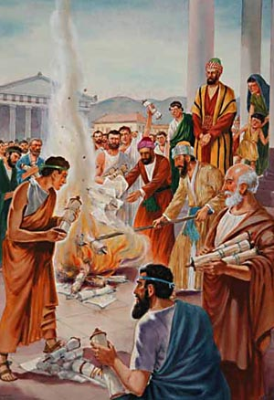
Acts 19
A first-hand faith
Three distinct groups of people
12 disciples of John
7 sons of Sceva
Former sorcerers

Slide 2
12 disciples of John [Acts 19: 1-7]
“While Apollos was at Corinth, Paul took the road through the interior and arrived at Ephesus. There he found some disciples and asked them, “Did you receive the Holy Spirit when you believed?”
They answered, “No, we have not even heard that there is a Holy Spirit.”
So Paul asked, “Then what baptism did you receive?”
“John’s baptism,” they replied.
Paul said, “John’s baptism was a baptism of repentance. He told the people to believe in the one coming after him, that is, in Jesus.” On hearing this, they were baptised in the name of the Lord Jesus. When Paul placed his hands on them, the Holy Spirit came on them, and they spoke in tongues and prophesied. There were about twelve men in all.”

Slide 3


12 disciples of John [Acts 19: 1-7]
The disciples are baptised in the Holy Spirit and immediately receive gifts of the spirit [prophecy and tongues]

Slide 4
1 Corinthians 12
7 Now to each one the manifestation of the Spirit is given for the common good. 8 To one there is given through the Spirit a message of wisdom, to another a message of knowledge by means of the same Spirit, 9 to another faith by the same Spirit, to another gifts of healing by that one Spirit, 10 to another miraculous powers, to another prophecy, to another distinguishing between spirits, to another speaking in different kinds of tongues, and to still another the interpretation of tongues. 11 All these are the work of one and the same Spirit, and he distributes them to each one, just as he determines.
The gifts of the spirit are manifestations of the spirit - it's not that we should be desiring the accolades of these gifts but more the Spirit himself manifest in our lives

Slide 5
12 disciples of John [Acts 19: 1-7]
The disciples are baptised in the Holy Spirit and immediately receive gifts of the spirit [prophecy and tongues]
To desire the gifts of the spirit is to desire more of the Spirit himself
The gifts of the spirit are for the common good not self promotion

Slide 6
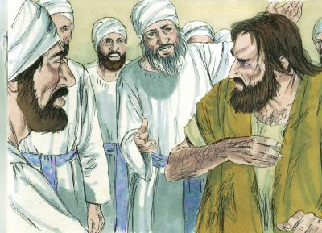
b) 7 sons of Sceva [Acts 19: 13-17]
Some Jews who went around driving out evil spirits tried to invoke the name of the Lord Jesus over those who were demon-possessed. They would say, “In the name of the Jesus whom Paul preaches, I command you to come out.” Seven sons of Sceva, a Jewish chief priest, were doing this. One day the evil spirit answered them, “Jesus I know, and Paul I know about, but who are you?” Then the man who had the evil spirit jumped on them and overpowered them all. He gave them such a beating that they ran out of the house naked and bleeding.
When this became known to the Jews and Greeks
living in Ephesus, they were all seized with fear,
and the name of the Lord Jesus was held in
high honor.

Slide 7
b) 7 sons of Sceva [Acts 19: 13-17]
The sons of Sceva had only a secondhand belief in Jesus.
The sons of Sceva thought Jesus’ name was something they could take up and put down as they chose.
In contrast, Paul came to have a true belief in Christ as the Son of God, the atonement, the resurrection and the Holy Spirit. This was not added to his Judaism but replaced it. Christ became Paul's Lord. Paul surrendered fully to Christ.
We need to follow Paul's example, not the sons of Sceva.

Slide 8
Jeremiah 2
“This is what the Lord says: “‘I remember the devotion of your youth, how as a bride you loved me and followed me through the wilderness, through a land not sown…This is what the Lord says: “What fault did your ancestors find in me, that they strayed so far from me?”
When we stray from him we don’t just break his law we break his heart.
The seven sons didn’t understand this as they thought the name of Jesus was something they could use for their own gain.

Slide 9
Revelation 2: 1-7
“Yet I hold this against you: You have forsaken the love you had at first. Repent and do the things you did at first….Whoever has ears, let them hear what the Spirit says to the churches. To the one who is victorious, I will give the right to eat from the tree of life, which is in the paradise of God.”
What are these first acts? - “They devoted themselves to the apostles’ teaching and to fellowship, to the breaking of bread and to prayer. Everyone was filled with awe at the many wonders and signs performed by the apostles. All the believers were together and had everything in common.” ‭‭Acts‬ ‭2‬:‭42‬-‭44‬

Slide 10
c) Many former sorcerers - [Acts 19: 18-20]
Many of those who believed now came and openly confessed what they had done. A number who had practiced sorcery brought their scrolls together and burned them publicly. When they calculated the value of the scrolls, the total came to fifty thousand drachmas. In this way the word of the Lord spread widely and grew in power.
A drachma was a silver coin worth about a day’s wages

Slide 11
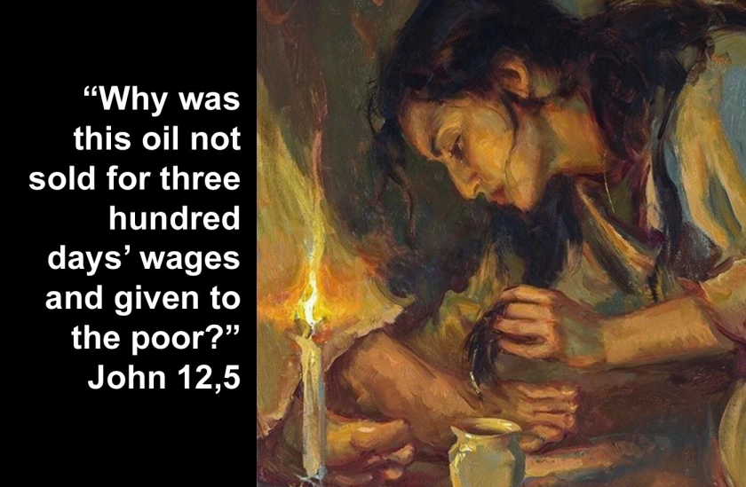

Slide 12
Hebrews 12:1-2
Therefore, since we are surrounded by such a great cloud of witnesses, let us throw off everything that hinders and the sin that so easily entangles. And let us run with perseverance the race marked out for us, fixing our eyes on Jesus, the pioneer and perfecter of faith.

Slide 13
A first-hand faith
Ask God to help you [re]discover the gifts of the spirit
Ask God for a fresh revelation of His heart for you
Ask God to search your heart for anything you need to confess and walk away from today

