Slide 1
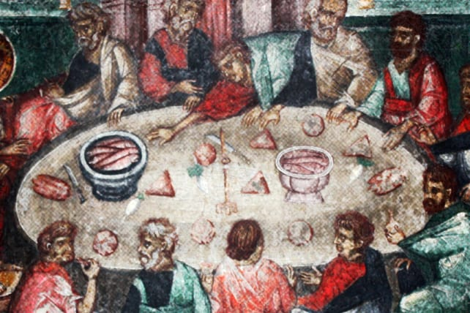
Acts 6

Slide 2
1 In those days when the number of disciples was increasing, the Hellenistic Jews among them complained against the Hebraic Jews because their widows were being overlooked in the daily distribution of food.

Slide 3
“Hellenistic Jews”
From wider mediterranean
Spoke Greek
“Hebraic Jews”
Local to Palestine
Spoke Aramaic or Hebrew

Slide 4
2 So the Twelve gathered all the disciples together and said, “It would not be right for us to neglect the ministry of the word of God in order to wait on tables. 3 Brothers and sisters, choose seven men from among you who are known to be full of the Spirit and wisdom. We will turn this responsibility over to them 4 and will give our attention to prayer and the ministry of the word.”

Slide 5
5 This proposal pleased the whole group. They chose Stephen, a man full of faith and of the Holy Spirit; also Philip, Procorus, Nicanor, Timon, Parmenas, and Nicolas from Antioch, a convert to Judaism. 6 They presented these men to the apostles, who prayed and laid their hands on them.
7 So the word of God spread. The number of disciples in Jerusalem increased rapidly, and a large number of priests became obedient to the faith.

Slide 6
8 Now Stephen, a man full of God’s grace and power, performed great wonders and signs among the people. 9 Opposition arose, however, from members of the Synagogue of the Freedmen (as it was called)—Jews of Cyrene and Alexandria as well as the provinces of Cilicia and Asia—who began to argue with Stephen. 10 But they could not stand up against the wisdom the Spirit gave him as he spoke.

Slide 7
11 Then they secretly persuaded some men to say, “We have heard Stephen speak blasphemous words against Moses and against God.” 12 So they stirred up the people and the elders and the teachers of the law. They seized Stephen and brought him before the Sanhedrin. 13 They produced false witnesses, who testified, “This fellow never stops speaking against this holy place and against the law.

Slide 8
14 For we have heard him say that this Jesus of Nazareth will destroy this place and change the customs Moses handed down to us.”
15 All who were sitting in the Sanhedrin looked intently at Stephen, and they saw that his face was like the face of an angel.

Slide 9
Serving in the Kingdom...
An invitation to participate in a vision
A work of the Holy Spirit
Expression of self-giving love

Slide 10
1. An invitation to participate in a vision...

Slide 11
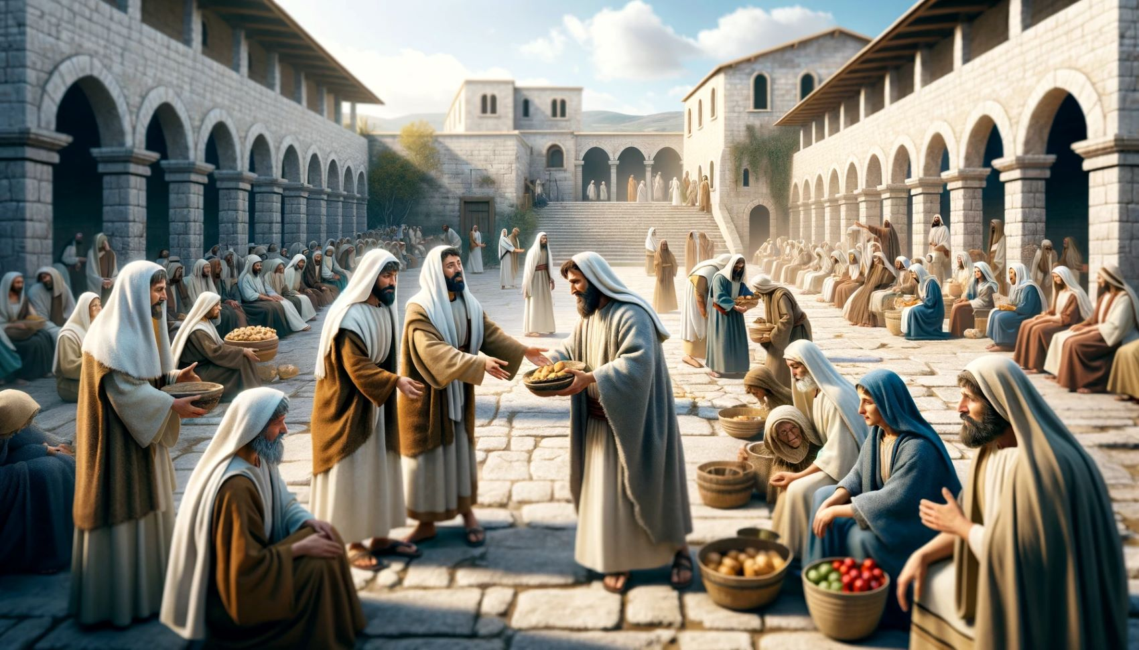

Slide 12
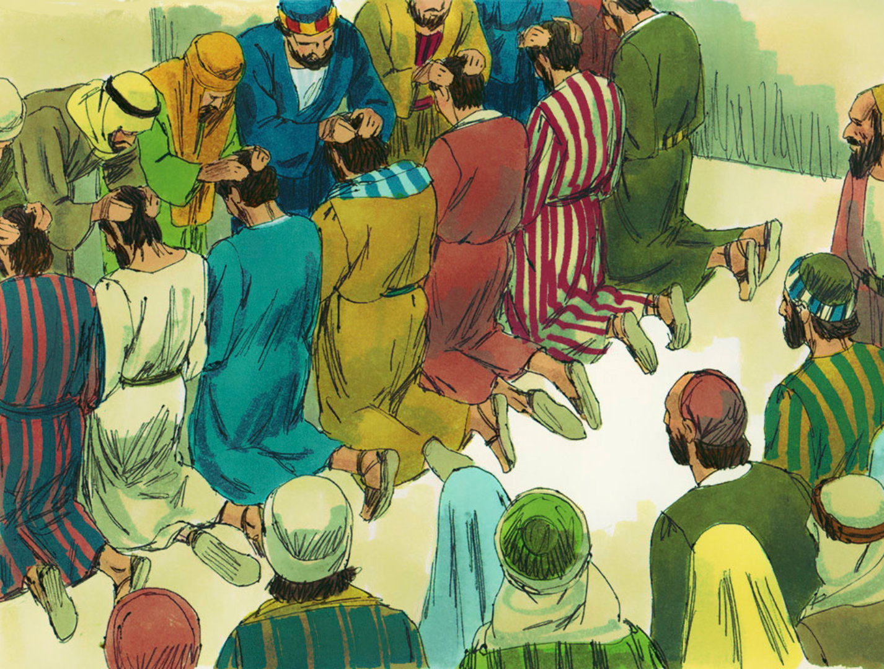

Slide 13
When we encounter a challenge, we get to choose either participation or passivity...

Slide 14
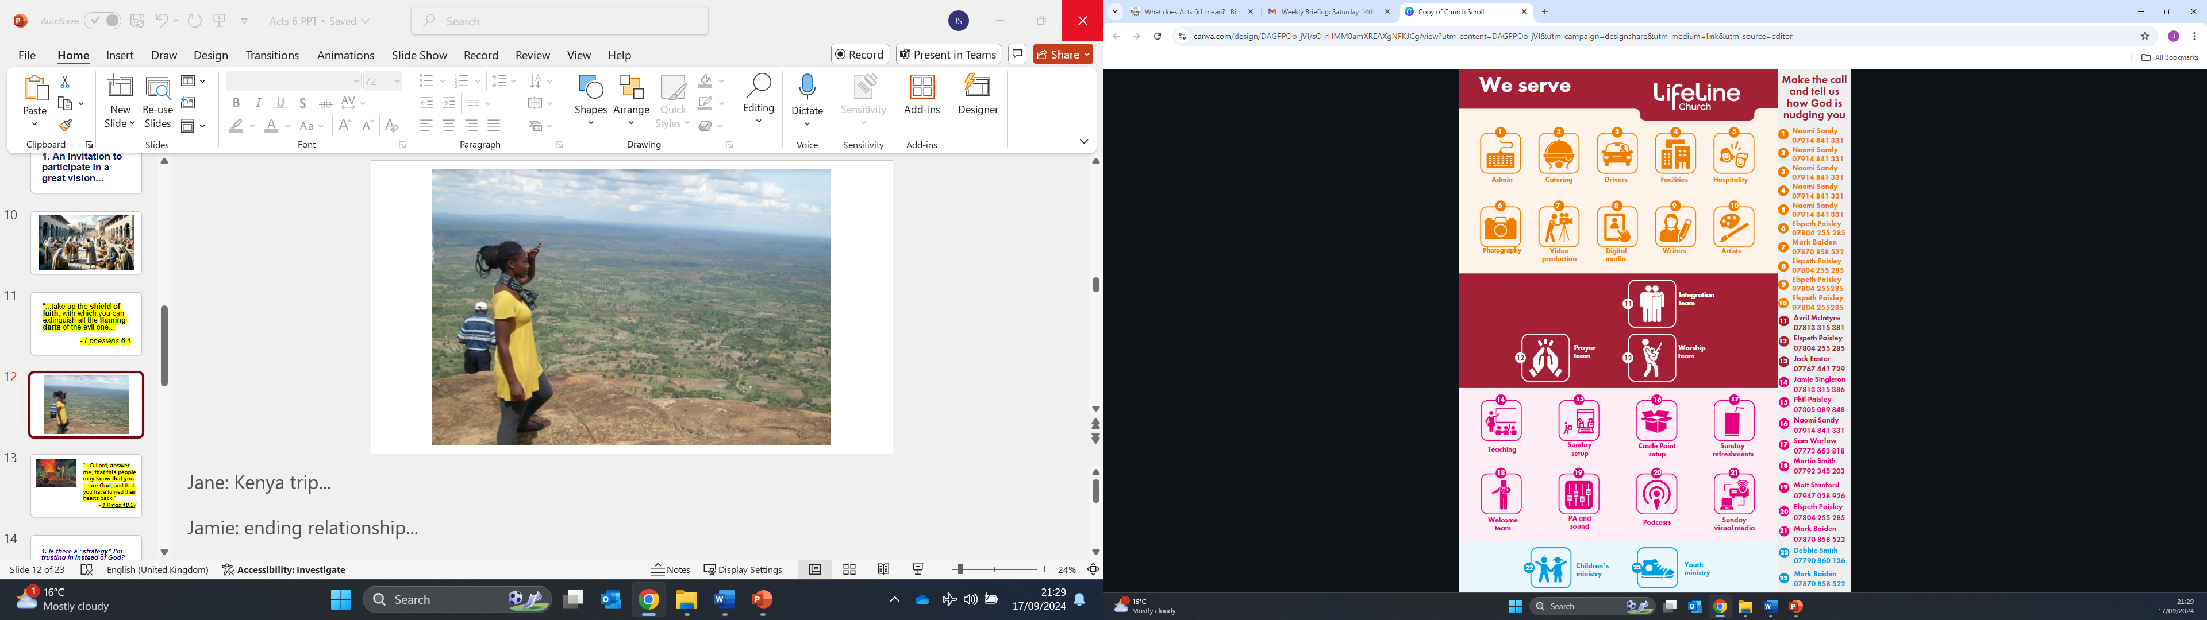

Slide 15
2. A work of the Holy Spirit

Slide 16
“...choose seven men from among you who are known to be full of the Spirit...”
- Acts 6.3

Slide 17
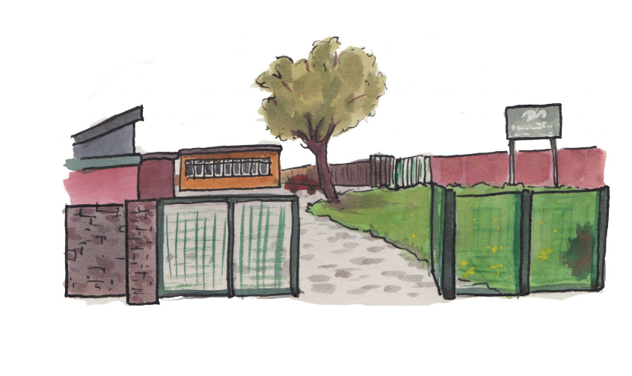

Slide 18
“...so the word of God spread. The number of disciples in Jerusalem increased rapidly, and a large number of priests became obedient to the faith...”
- Acts 6.7

Slide 19
3. Expression of self-giving love

Slide 20
“Greater love has no one than this: to lay down one’s life for one’s friends.”
- John 15.13

Slide 21
“Stéphanos”
...means 'wreath, crown' and by extension 'reward, honour, renown, fame’...
- Wikipedia

Slide 22
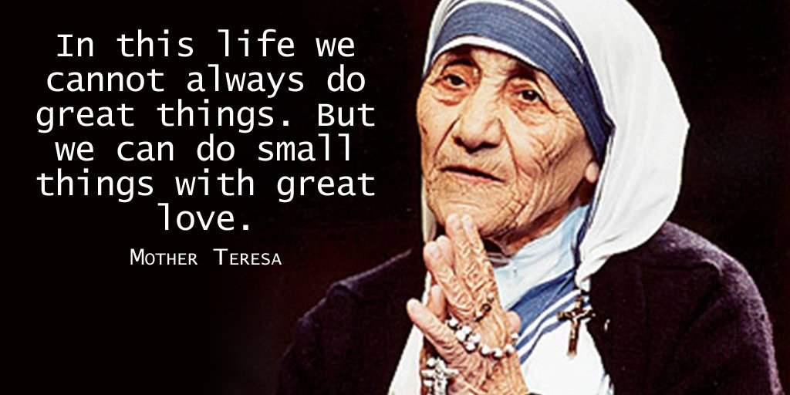

Slide 23
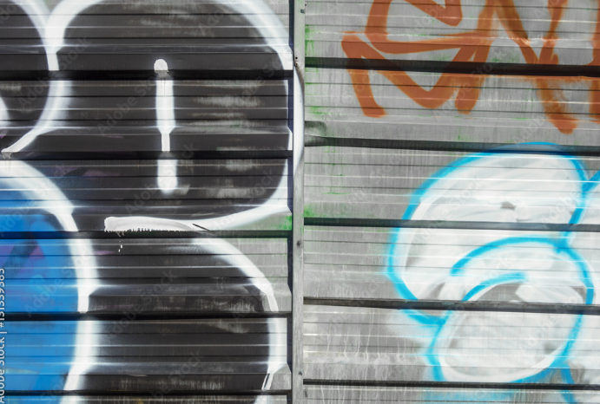

Slide 24
“the Son of Man did not come to be served, but to serve, and to give his life as a ransom for many...”
- Matthew 20.28

Slide 25
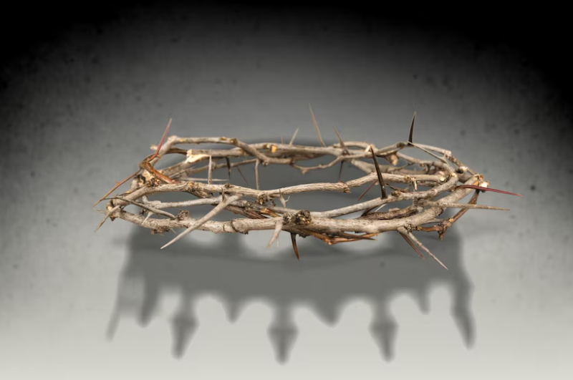

Slide 26
“So if you have any encouragement from being united with Christ, if any comfort from his love, if any common sharing in the Spirit, if any tenderness and compassion, then make my joy complete by being of the same mind, having the same love, being one in spirit and of one mind. Do nothing from selfish ambition or vain conceit, but in humility count others more significant than yourselves. Let each of you look not only to his own interests, but also to the interests of others.
- Philippians 2.1-4

Slide 27
Have this mind among yourselves, which is yours in Christ Jesus, who, though he was in the form of God, did not count equality with God a thing to be grasped, but emptied himself, by taking the form of a servant, being born in the likeness of men. And being found in human form, he humbled himself by becoming obedient to the point of death, even death on a cross.”
- Philippians 2.5-8

Slide 28
...which is yours in Christ Jesus...”

Slide 29
Moving from passivity to participation. A fresh vision.
Released into serving, not by my strength but by the Holy Spirit
Empowered to love out of the love He has shown me.

