Slide 1


Slide 2
Stephen
‘Full of faith and of the Holy Spirit’
‘Full of God’s grace and power’
‘…performed great signs and wonders amongst the people.’
…they could not stand up against the wisdom the Spirit gave him as he spoke.’

Slide 3
Chapter 7
Stephen, full of the Holy Spirit.

Slide 4
Not only do you not need the temple to meet God
Not only have you not been obeying the law
Whenever God has sent a saviour, that saviour is rejected and persecuted.

Slide 5
Acts 7:51-60
⁵¹ “You stiff-necked people! Your hearts and ears are still uncircumcised. You are just like your ancestors: You always resist the Holy Spirit! ⁵² Was there ever a prophet your ancestors did not persecute? They even killed those who predicted the coming of the Righteous One. And now you have betrayed and murdered him— ⁵³ you who have received the law that was given through angels but have not obeyed it.”
⁵⁴ When the members of the Sanhedrin heard this, they were furious and gnashed their teeth at him.

Slide 6
⁵⁵ But Stephen, full of the Holy Spirit, looked up to heaven and saw the glory of God, and Jesus standing at the right hand of God. ⁵⁶ “Look,” he said, “I see heaven open and the Son of Man standing at the right hand of God.”
⁵⁷ At this they covered their ears and, yelling at the top of their voices, they all rushed at him, ⁵⁸ dragged him out of the city and began to stone him. Meanwhile, the witnesses laid their coats at the feet of a young man named Saul.
⁵⁹ While they were stoning him, Stephen prayed, “Lord Jesus, receive my spirit.” ⁶⁰ Then he fell on his knees and cried out, “Lord, do not hold this sin against them.” When he had said this, he fell asleep.

Slide 7
Boldness

Slide 8
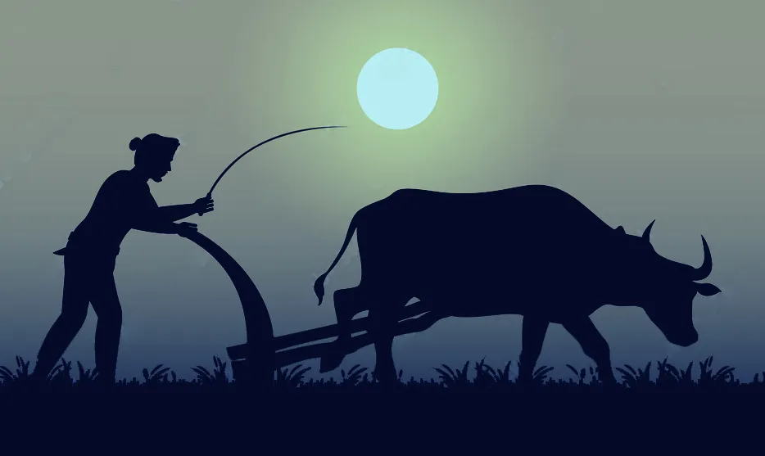

Slide 9
Love

Slide 10
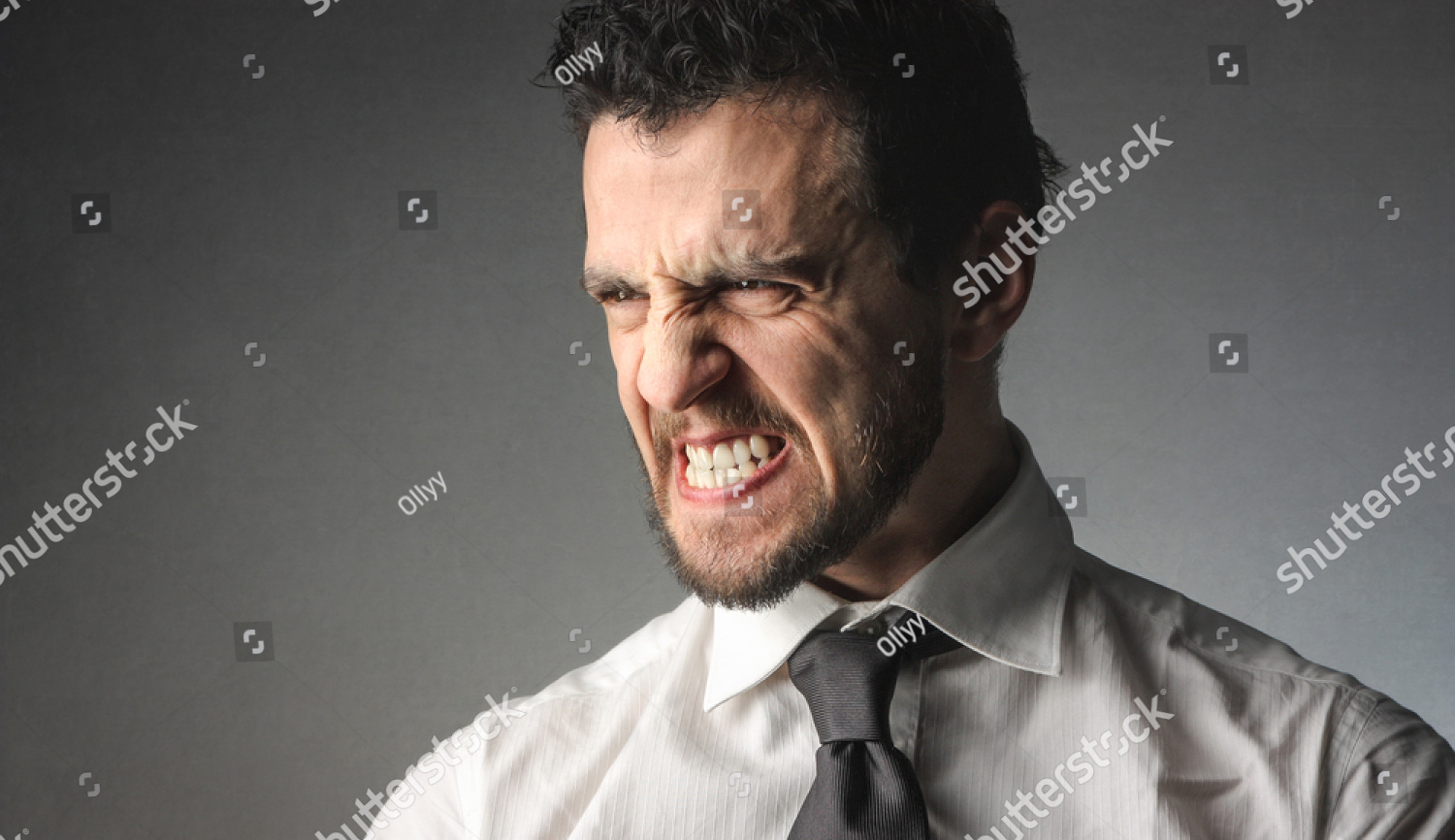

Slide 11
Peace

Slide 12
Are you, like Stephen, full of the Holy Spirit, and if not, do you want to be?
Has your heart been hardened? Do you want God to free you from that?
What might it look for you to deny yourself in order to follow him? Ask God to show you.

