Slide 1
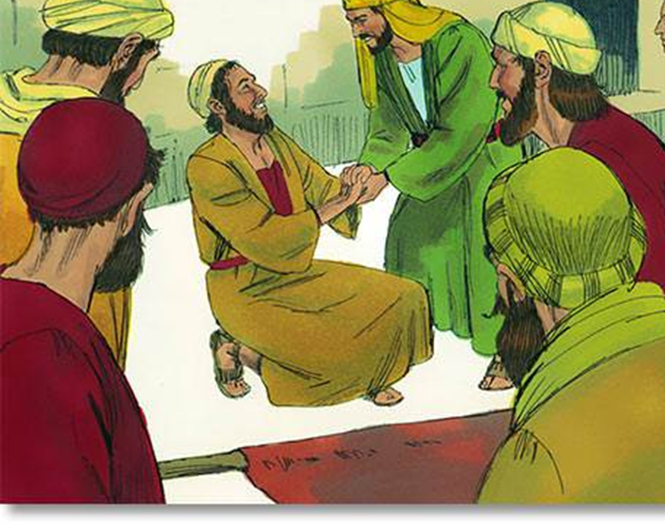
Philip – Acts 8
16 April 2023

Slide 2
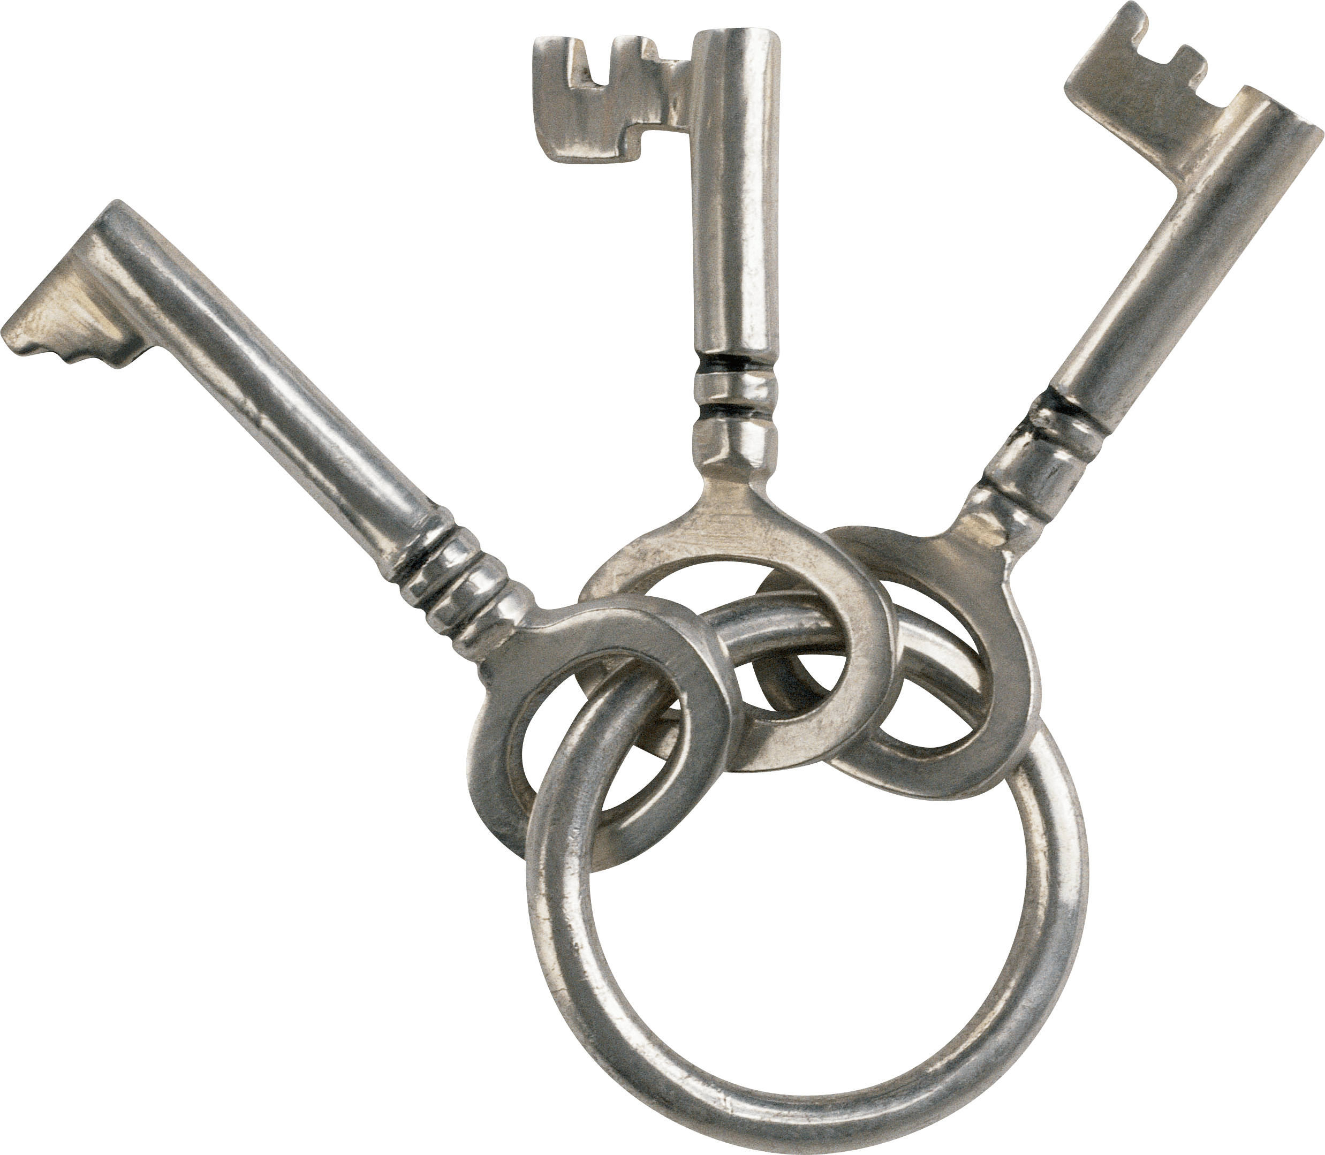
Recap
Ministry in the Holy Spirit
Households together with Christ at the centre
Sharper, clearer ability to share the Gospel
It all starts with Him
This Photo by Unknown Author is licensed under CC BY-NC

Slide 3
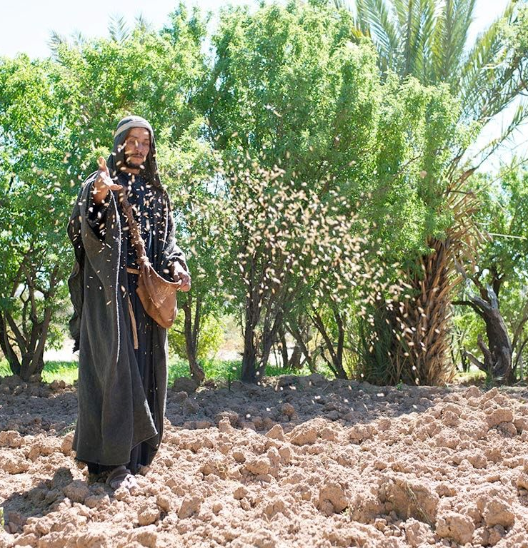
The Church persecuted and scattered
Acts 8
On that day a great persecution broke out against the church in Jerusalem, and all except the apostles were scattered throughout Judea and Samaria.
² Godly men buried Stephen and mourned deeply for him.
³ But Saul began to destroy the church. Going from house to house, he dragged off both men and women and put them in prison.

Slide 4
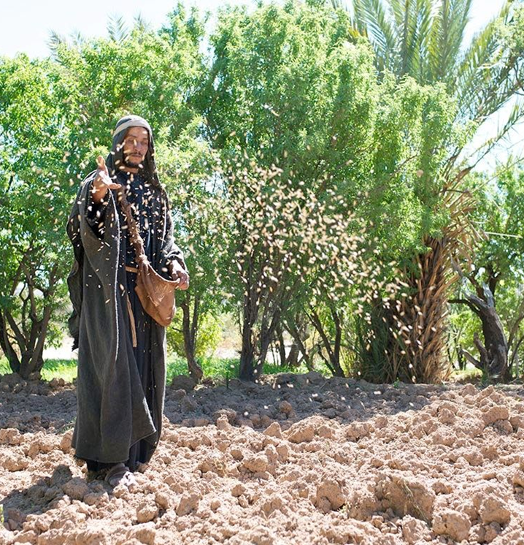

Scattered
Sown like seed, not scattered to disappear.
Notes:
Up until now in the book of Acts all the ministry has taken place in Jerusalem. No one had moved out to Judea and Samaria. But Jesus had said in Acts 1:8 that the coming of the Holy Spirit was to empower missions in Jerusalem and beyond. "You shall receive power when the Holy Spirit has come upon you; and you shall be my witnesses in Jerusalem and in all Judea and Samaria and to the end of the earth.“
To confirm this missionary purpose of the persecution, look at Acts 11:19.
"Now those who were scattered because of the persecution that arose over Stephen traveled as far as Phoenicia and Cyprus and Antioch, speaking the word to none except Jews." But in Antioch some spoke to Greeks also. In other words, the persecution not only sent the church to Judea and Samaria (Acts 8:1) but also beyond to the Gentiles (Acts 11:19).
God makes persecution serve the unstoppable mission of the church—your mission, your ministry.
If your faithfulness brings trouble to the church (like Stephen's did), you will be honoured and not blamed—at least by the godly.
Your worst critics can become your precious comrades by the power of Christ's converting grace.
And the very Word—the gospel—that brings persecution sometimes, brings joy always and forever.

Slide 5
Scattered
Meaning: sown like seed, not scattered to disappear.
Remember Jesus said, “You shall be my witnesses in Jerusalem and in all Judea and Samaria and to the end of the earth”
God can even make persecution serve His purpose.
Stephen is not blamed, but honoured. In a world where God works all things together for our benefit, what is the point of blame and unforgiveness?
And we know that in all things God works for the good of those who love him, who have been called according to his purpose. Rom 8:28
The persecution of the church in Jerusalem continues and gains strength
Notes:
Up until now in the book of Acts all the ministry has taken place in Jerusalem. No one had moved out to Judea and Samaria. But Jesus had said in Acts 1:8 that the coming of the Holy Spirit was to empower missions in Jerusalem and beyond. "You shall receive power when the Holy Spirit has come upon you; and you shall be my witnesses in Jerusalem and in all Judea and Samaria and to the end of the earth.“
To confirm this missionary purpose of the persecution, look at Acts 11:19.
"Now those who were scattered because of the persecution that arose over Stephen traveled as far as Phoenicia and Cyprus and Antioch, speaking the word to none except Jews." But in Antioch some spoke to Greeks also. In other words, the persecution not only sent the church to Judea and Samaria (Acts 8:1) but also beyond to the Gentiles (Acts 11:19).
God makes persecution serve the unstoppable mission of the church—your mission, your ministry.
If your faithfulness brings trouble to the church (like Stephen's did), you will be honoured and not blamed—at least by the godly.
Your worst critics can become your precious comrades by the power of Christ's converting grace.
And the very Word—the gospel—that brings persecution sometimes, brings joy always and forever.

Slide 6
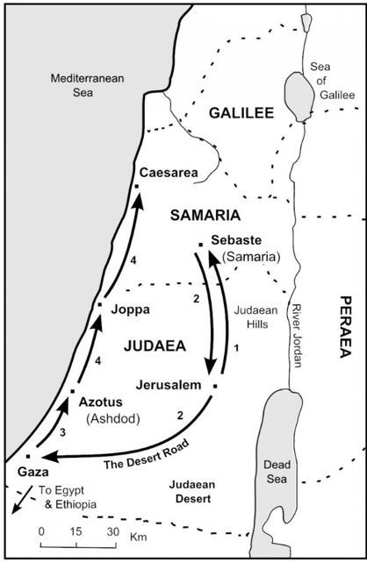
Philip in Samaria
⁴ Those who had been scattered preached the word wherever they went.
⁵ Philip went down to a city in Samaria and proclaimed the Messiah there. ⁶ When the crowds heard Philip and saw the signs he performed, they all paid close attention to what he said.
⁷ For with shrieks, impure spirits came out of many, and many who were paralyzed or lame were healed.
⁸ So there was great joy in that city.
Notes:
What we do give credibility to what we say

Slide 7

Attention
What we do gives credibility to what we say and gains the attention of others
Gaining attention doesn’t always lead to the right kind of followers, as we shall see in due course!
Notes:
Up until now in the book of Acts all the ministry has taken place in Jerusalem. No one had moved out to Judea and Samaria. But Jesus had said in Acts 1:8 that the coming of the Holy Spirit was to empower missions in Jerusalem and beyond. "You shall receive power when the Holy Spirit has come upon you; and you shall be my witnesses in Jerusalem and in all Judea and Samaria and to the end of the earth.“
To confirm this missionary purpose of the persecution, look at Acts 11:19.
"Now those who were scattered because of the persecution that arose over Stephen traveled as far as Phoenicia and Cyprus and Antioch, speaking the word to none except Jews." But in Antioch some spoke to Greeks also. In other words, the persecution not only sent the church to Judea and Samaria (Acts 8:1) but also beyond to the Gentiles (Acts 11:19).
God makes persecution serve the unstoppable mission of the church—your mission, your ministry.
If your faithfulness brings trouble to the church (like Stephen's did), you will be honoured and not blamed—at least by the godly.
Your worst critics can become your precious comrades by the power of Christ's converting grace.
And the very Word—the gospel—that brings persecution sometimes, brings joy always and forever.

Slide 8
Attention
Philip, like Stephen, is one of the 7 chosen to wait on tables
Like Stephen he doesn’t restrict his serving to his given role
Samaria wasn’t the obvious place for a Jewish missionary to start, but persecution drove many there.
What we do gives credibility to what we say and gains the attention of others
Gaining attention doesn’t always lead to the right kind of followers, as we shall see in due course!

Slide 9
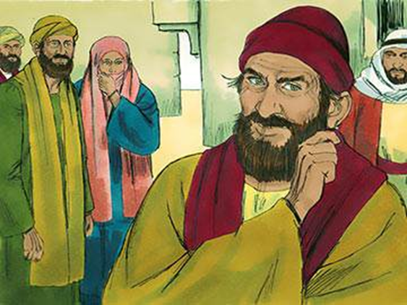
Simon
Acts 8 ⁹ Now for some time a man named Simon had practiced sorcery in the city and amazed all the people of Samaria. He boasted that he was someone great, ¹⁰ and all the people, both high and low, gave him their attention and exclaimed, “This man is rightly called the Great Power of God.”
¹¹ They followed him because he had amazed them for a long time with his sorcery. ¹² But when they believed Philip as he proclaimed the good news of the kingdom of God and the name of Jesus Christ, they were baptized, both men and women. ¹³ Simon himself believed and was baptized. And he followed Philip everywhere, astonished by the great signs and miracles he saw.
Notes:
God is the source

Slide 10
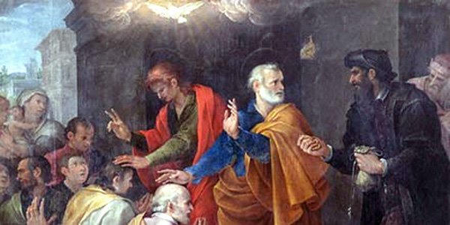
Peter and John
Acts 8 ¹⁴ When the apostles in Jerusalem heard that Samaria had accepted the word of God, they sent Peter and John to Samaria.
¹⁵ When they arrived, they prayed for the new believers there that they might receive the Holy Spirit, ¹⁶ because the Holy Spirit had not yet come on any of them; they had simply been baptized in the name of the Lord Jesus.
¹⁷ Then Peter and John placed their hands on them, and they received the Holy Spirit.
Notes:
Going out of order here, so make the story clearer

Slide 11

Laying on hands
Philip brought the good news, but Peter and John brought the Holy Spirit
Notes:
Weirdly – Philip brought the good news, but his followers had

Slide 12
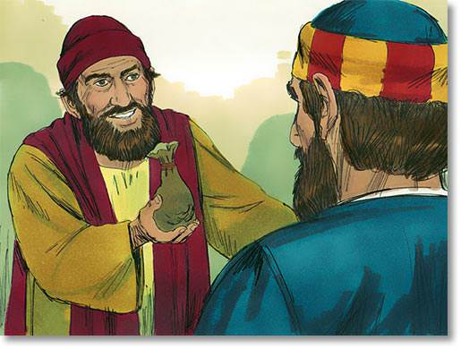
¹⁷ Then Peter and John placed their hands on them, and they received the Holy Spirit.
¹⁸ When Simon saw that the Spirit was given at the laying on of the apostles’ hands, he offered them money ¹⁹ and said, “Give me also this ability so that everyone on whom I lay my hands may receive the Holy Spirit.”
²⁰ Peter answered: “May your money perish with you, because you thought you could buy the gift of God with money! ²¹ You have no part or share in this ministry, because your heart is not right before God. ²² Repent of this wickedness and pray to the Lord in the hope that he may forgive you for having such a thought in your heart. ²³ For I see that you are full of bitterness and captive to sin.”
²⁴ Then Simon answered, “Pray to the Lord for me so that nothing you have said may happen to me.”
Notes:
²⁵ After they had further proclaimed the word of the Lord and testified about Jesus, Peter and John returned to Jerusalem, preaching the gospel in many Samaritan villages.

Slide 13
What does Simon get wrong?
And what does Peter do right?
Simon
What has attracted him in the first place?
Why does he want to be able to give the Holy Spirit?
God cannot be commanded!
He asks Peter to pray on his behalf, rather than repenting for himself
Peter
Not distracted by outward signs of commitment
Not taken in by the money
Challenge is clear and to the point, not polite and gentle!
Points the way back through repentance
It’s not how much of Him do I have, but how much of me does He have?
Notes:
Simon is initially “converted”, but he wants what he can get out of God
His heart is revealed in the interaction with Peter and John, after the Holy Spirit is given to those around him
Not all spirituality is God - manifesting
Counterfeits exist – the source is key
We cannot give to get
James 4:³ When you ask, you do not receive, because you ask with wrong motives, that you may spend what you get on your pleasures.

Slide 14
Philip’s journey continues…
²⁶ Now an angel of the Lord said to Philip, ‘Go south to the road – the desert road – that goes down from Jerusalem to Gaza.’ ²⁷ So he started out, and on his way he met an Ethiopian^{[a]} eunuch, an important official in charge of all the treasury of the Kandake (which means ‘queen of the Ethiopians’). This man had gone to Jerusalem to worship, ²⁸ and on his way home was sitting in his chariot reading the Book of Isaiah the prophet. ²⁹ The Spirit told Philip, ‘Go to that chariot and stay near it.’
³⁰ Then Philip ran up to the chariot and heard the man reading Isaiah the prophet. ‘Do you understand what you are reading?’ Philip asked.
³¹ ‘How can I,’ he said, ‘unless someone explains it to me?’
Notes:
²⁶ Now an angel of the Lord said to Philip, ‘Go south to the road – the desert road – that goes down from Jerusalem to Gaza.’ ²⁷ So he started out, and on his way he met an Ethiopian^{[a]} eunuch, an important official in charge of all the treasury of the Kandake (which means ‘queen of the Ethiopians’). This man had gone to Jerusalem to worship, ²⁸ and on his way home was sitting in his chariot reading the Book of Isaiah the prophet. ²⁹ The Spirit told Philip, ‘Go to that chariot and stay near it.’
³⁰ Then Philip ran up to the chariot and heard the man reading Isaiah the prophet. ‘Do you understand what you are reading?’ Philip asked.
³¹ ‘How can I,’ he said, ‘unless someone explains it to me?’ So he invited Philip to come up and sit with him.
³² This is the passage of Scripture the eunuch was reading:
‘He was led like a sheep to the slaughter,
and as a lamb before its shearer is silent,
so he did not open his mouth.
³³ In his humiliation he was deprived of justice.
Who can speak of his descendants?
For his life was taken from the earth.’^{[b]}
³⁴ The eunuch asked Philip, ‘Tell me, please, who is the prophet talking about, himself or someone else?’ ³⁵ Then Philip began with that very passage of Scripture and told him the good news about Jesus.
³⁶ As they travelled along the road, they came to some water and the eunuch said, ‘Look, here is water. What can stand in the way of my being baptised?’ ^{[c]} ³⁸ And he gave orders to stop the chariot. Then both Philip and the eunuch went down into the water and Philip baptised him. ³⁹ When they came up out of the water, the Spirit of the Lord suddenly took Philip away, and the eunuch did not see him again, but went on his way rejoicing. ⁴⁰ Philip, however, appeared at Azotus and travelled about, preaching the gospel in all the towns until he reached Caesarea.

Slide 15
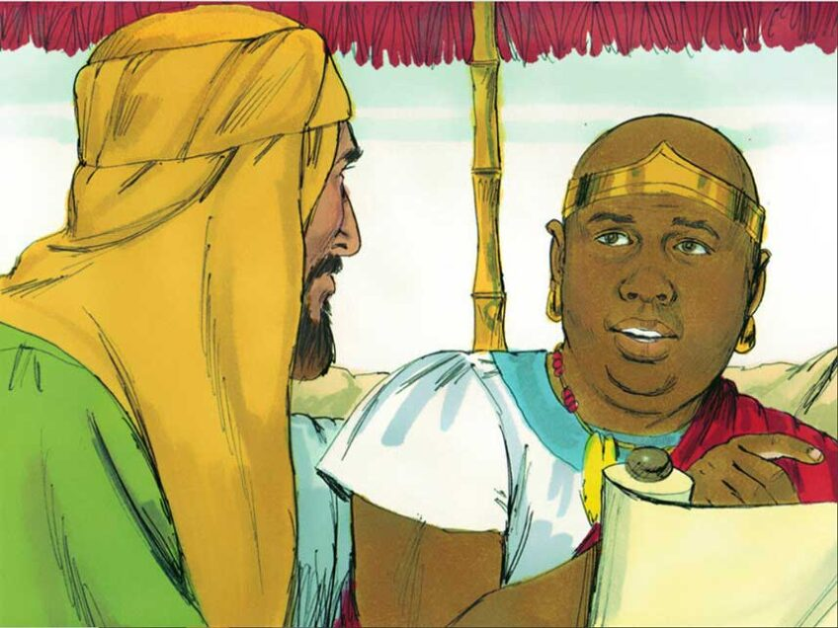
From Isaiah to Jesus
³² This is the passage of Scripture the eunuch was reading:
‘He was led like a sheep to the slaughter, and as a lamb before its shearer is silent, so he did not open his mouth.
³³ In his humiliation he was deprived of justice.
Who can speak of his descendants?
For his life was taken from the earth.’
³⁴ The eunuch asked Philip, ‘Tell me, please, who is the prophet talking about, himself or someone else?’
³⁵ Then Philip began with that very passage of Scripture and told him the good news about Jesus.
Notes:
Who was the eunuch?
A eunuch is a man who has been castrated for the purpose of trusted servitude in a royal household (see Esther 1:10; 4:4; and Daniel 1:9). A king would often castrate his servants to ensure they would not be tempted to engage in sexual activity with others in the palace (specifically, the royal harem) or to prevent their plotting an overthrow (eunuchs were incapable of setting up a dynasty of their own). Eunuchs have been employed in many civilizations, including the Ancient Middle East, Ancient Greece and Rome, China, Korea, and Thailand. Jesus mentions them in Matthew 19:12.

Slide 16
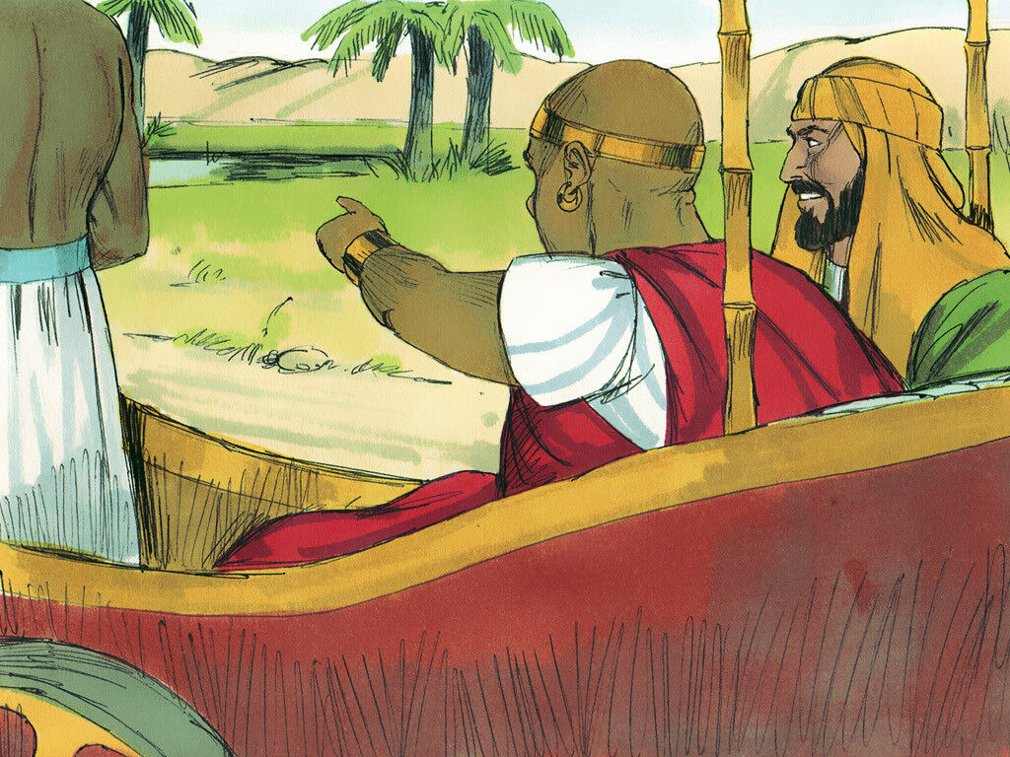
From Jesus to baptism
³⁶ As they travelled along the road, they came to some water and the eunuch said, ‘Look, here is water. What can stand in the way of my being baptised?’
³⁸ And he gave orders to stop the chariot. Then both Philip and the eunuch went down into the water and Philip baptised him.
³⁹ When they came up out of the water, the Spirit of the Lord suddenly took Philip away, and the eunuch did not see him again, but went on his way rejoicing.
⁴⁰ Philip, however, appeared at Azotus and travelled about, preaching the gospel in all the towns until he reached Caesarea.

Slide 17
Lessons from Philip’s interaction with the Ethiopian…
Rely on the Holy Spirit
Recognise that God is already at work – we are not filling a void but lighting a fire
Remember the word – moves us from the world of I think / you think to what God says about things
The good news provokes a response – look out for the one and don’t be too busy to help
Notes:
(1) Relying on the on the Holy Spirit
Clear that Philip relied on and was directed by the Spirit (v.26, 29, 39). He was open to going where God told him to go in the power that God gave him, and we need to do the same. We can easily drift into doing evangelism in our own strength through our plans, programme and strategies without leaving much room for God.
Gal 3: 3 warns “Are you so foolish? After beginning with the Spirit, are you now trying to attain your goal by human effort?”
How do we rely on the Spirit in sharing our faith?
Praying deliberately and daily for opportunities
Going around prayerfully. Being mindful of God and his purposes throughout the day, whatever we’re doing.
Recognising that the gospel is for everyone, whatever their background or circumstances
Being on the look out - noticing people around us. (Not being plugged into headphones or distracted with mobiles).
Recognising that stirring in the heart or a voice or thought telling us to speak to someone.
Recognising that God has given us a unique network of friends, colleagues, family and encounters with strangers. We’re all missionaries!
We can’t make people Christians by clever arguments or persuasive words. We just need to be prayerful and obedient and leave the results to God.
(2) Recognising that God is already at work
God has been at work in the Ethiopian’s life long before Philip got there - he was returning from worshipping in Jerusalem and he was sitting there reading the Scriptures!
It’s not about us. God graciously allows us to be part of his plans, but he doesn’t need us, which is tremendously liberating! We get to be part of something joyful and amazing that God is doing, but the pressure isn’t on us to transform people’s lives because only God can do that.
We just need to be faithful and obedient by responding to the Spirit and taking the initiative with people.
We can join in with people and travel with them as they explore spiritual truth. My friend Duncan describes it as ‘spiritual hitchiking’.
Philip comes alongside the Ethiopian, asks a good question to understand where he’s at spiritually, finds out what’s on his heart and responds to his deepest spiritual need.
(3) The Power of God’s word
Philip recognises the power of God’s word and uses it to explain about Jesus.
He’s able to adapt his methods of evangelism - whether he’s talking to crowds of ordinary Samaritans or with this individual VIP - but he never changes the gospel message. He always brings the same good news of Jesus.
We need to recognise that God’s word is true and powerful.
One way to engage people with God’s word is to do evangelistic Bible studies - essentially just a Bible study with non-Christians focussing on Christ and his work. These are powerful because:
The Bible has authority - they’re not just taking your word for it, but going to the source.
We can be ‘learners’ together. Asking each other questions of the text.
Sometimes focussing on something in front of you is less intense than sitting opposite each other looking into each other’s eyes!
We can be prepared by knowing our Bible well - by having some passages that have a particularly clear gospel focus that we’re very familiar with, so that we have an idea of how to explain them to others and what questions to ask.
(4) The challenge to respond
It’s clear that Philip’s mission is not just an intellectual exercise to help people learn facts about God and his word. There’s a response needed, and the eunuch wants to be baptised.
The eunuch goes on his way rejoicing. He has understood and responded to the good news of Jesus and it has transformed his life.
How do we challenge people to respond to the gospel?
We need to make it clear that nothing they can do can earn their salvation - it is a gracious gift of God through the death and resurrection of Jesus.
Encourage them to pray to turn from their own way of doing things and commit to following Jesus, accepting his love and forgiveness.
Explain to them the cost of discipleship - that it means dying to your old life and following Jesus with every ounce of your being.
Encourage them to read and study the Bible to get to know their loving saviour more deeply.
Encourage them to meet with someone to explore all the implications of following Jesus - new hope, changed priorities, care for the poor, desire to share faith etc.
Introduce them to a church where they can serve and learn in a community of Christians.
Encourage them to be baptised - a public declaration of the inward renewal that Christ has brought.
In this instance, Philip wasn’t able to disciple the man, but he could trust that the Holy Spirit would continue transforming the man’s life. He went on his way rejoicing because Christ was with him, even though he was heading home to Africa and away from Jerusalem.
Encountering Jesus brings a changed life. We can challenge people to grow in their faith, live by the Spirit and share their new faith with others.

Slide 18

What’s my response?
When the enemy scatters, God sows. Is there something in your life where God wants to shift your perspective?
God is wanting to fill you with the Holy Spirit – have you been filled?
Do you want to have a greater gift in evangelism?

