Slide 1
The Acts … Community
How we are to be
Daniel Singleton
12th May 2024- Lifeline Church
Notes:
This talk sits within a set (2 of 3 parts)
Gods mission from Eden to Pentecost (a relationship with mankind)
The Acts community – how we should be
Church without walls – the churches place in the mission of God, as our life together affects the world around (Diss Shared Life affecting community)

Slide 2
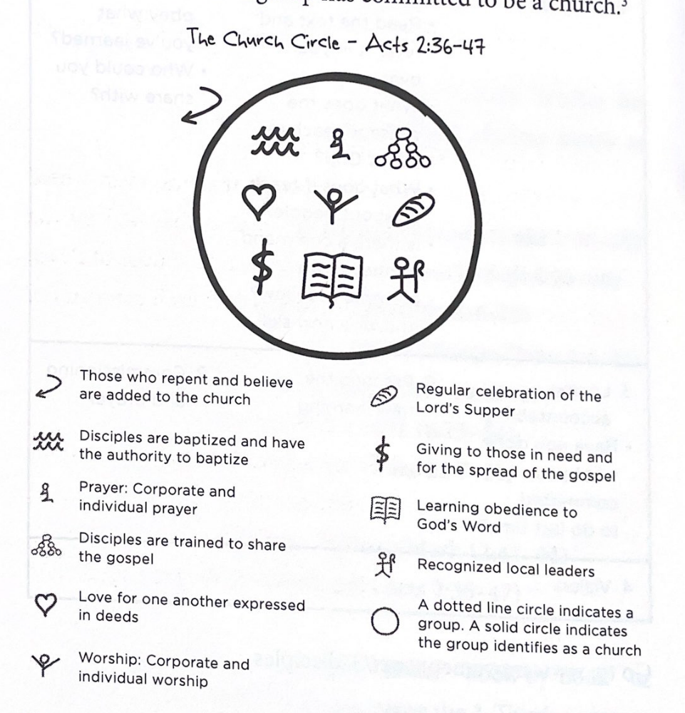











Fellow Travellers –
I’m / We’re not there yet
-------------------------------------
It all starts with Pentecost(Acts2 42-47)
–
the coming of the Holy Spirit …then (Acts2 42-47)
Teaching, Fellowship, breaking bread, Prayer
‘all together’ ‘in common’ ‘together in temple’ ‘ together in homes’
Notes:
BUT before we start – Phil 3 v 12 --- I have not got there, we have not got there but we are on a journey “Not already obtained all this … but press one to the goal!” Phil 3 v12. Will talk about today relationship – but I want the transforming experience of the HS in my life and yours ‘compelling of the spirit’
READ Pentecost Acts 2 v 1-4 … we should dwell on this – wow – Tower of Babel (Gen 11) reversed Acts v 5- 13 – Pentecost marks/ symbolises a supernatural bringing together of people (over the language/ cultural barrier) In Jesus in last pronouncement –says wait for HS (Acts 1 v7-8)
Every time we speak of the church – we must give proper recognition to the fact all of this happened after the day of Pentecost! It’s the in filling which powers the acts of the apostles and the church. The ring and the robe! (WATCH TIME)
READ v42-47
Together, eating, teaching, fellowshipping, worshipping and prayer Together, together, together!

Slide 3
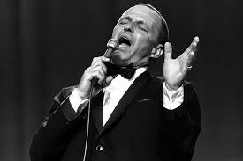
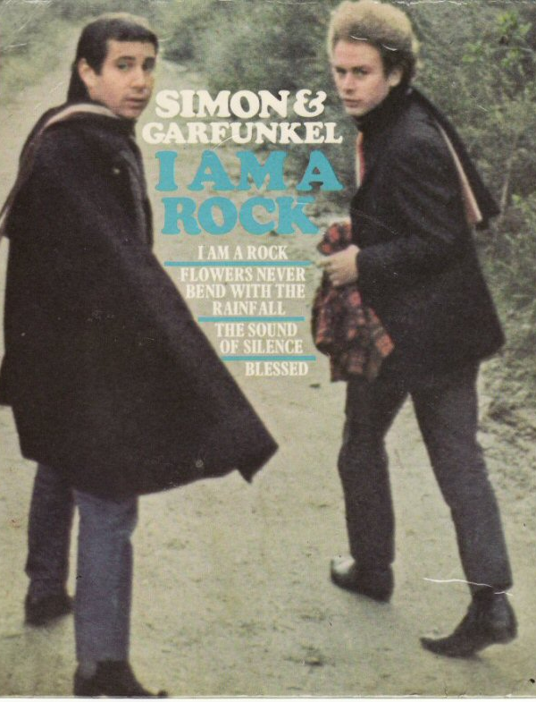
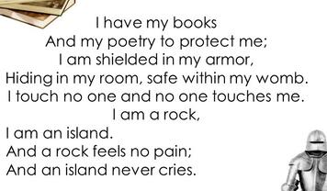

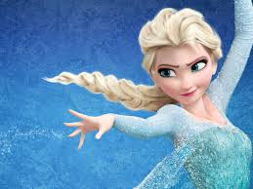
Our Context
I am a rock I am an Island
Let it go
Notes:
I’ll worldy context, the messages to us are very different to what we see in the Acts church
Simon & Garfunkel I am a rock 1966 (60’s) Frank Sinatra My way 1969 (70’s) 1.44 to 2.25 Frozen movie -Let it go 2013 (2000’s) 45sec to 1.27
Summary I’ll do it, no-ones gonna get in my way, I made my own way, I want to barrier myself from others
my possessions will keep me secure - (in book the kindness of strangers its consistently the poorest and those of faith, and often both, who are more open and hospitable)

Slide 4

‘The Spirit of the Age’
Victimhood chic is in style on both the right and the left today, among both the rich and the poor. In fact, this may be the first time in human history that every single demographic group has felt victimized simultaneously. And they’re riding the highs of the moral indignation that comes with it.
Mark Manson
Orphan mentality, Authority of self, no moral absolutes, Individualism, poverty& greed, grasping, victim tyranny
Works against – family, community, preferring others
‘You do you..’
‘if it feels right –just do it’
‘its my truth’
But it can seep into the church as well – it can even be cloaked in spirituality.
Some Christians say “I just need to do my spiritual practices, do sabbath, pray and fast, have my spiritual director, but I don’t do Church or community”
John Mark Comer
Notes:
These songs – great as they are - speak of the attitudes all around us
Orphan mentality ( not enough time to examine in full) - but it means I act as if ….. no-one cares if you live or die, fend for yourself, No one to give account to (or look after) Act as if everyone else is an orphan (out for themselves)
The authority of self (not one else but me to answer to – an idolatry), not morality beyond my feelings (nothing that can be judged)
Poverty/ greed/ grasping

Slide 5
Contrast with …
The Early church in action
Acts 2 all- together etc – ‘Fellowship of the Believers’ house to house, praying eating etc
Acts 4 v31 – another filling and place shaking
Acts 4 v 32-35 – sharing belongings
Acts 9 v 17 ‘Brother’ – former persecutor
Acts 12 v12 released Peter knows the house
Acts 16 v 15 Lydia (new convert) hospitality
Acts 18 v 3 Paul stayed with Priscilla & Aquila
Acts 20 v 36 weeping for Paul at final farewell
Pauls letters – Phil 1v1-6 greeting, 4v2 involved, 1Cor16v15 House of, v19 church in their home, Col4v7-15greetings, 2Tim4v19
Jesus commands us
“A new command I give you: Love one another. As I have loved you, so you must love one another. By this everyone will know that you are my disciples, if you love one another.”
“Now that I, your Lord and Teacher, have washed your feet, you also should wash one another’s feet. I have set you an example that you should do as I have done for you.”
(John 13)
Notes:
Jesus called those he wanted that they woud be with him – shard life is at the core of the way of Jesus
He gives these commands READ
We see in early church clear descriptions of their involvement – intentional community – Love for one another (shown practically) is an outworking of the H.S
See Acts examples Paul letter ( the bits we skip over) show devotion to relationship and shared life READ phil 1 1-6 (maybe READ Col 4 7-15)
Involvement – food sharing and visiting homes is very important (English Cup of tea/ wifi code for teenagers, staying with Liswe in township ‘considered it visiting down’)

Slide 6

The radical nature of Church
Tom Wright
‘ In the ancient Near East the idea of a single community across the traditional boundaries of culture, gender, and ethnic and social grouping was unheard of.’
‘ it mattered that the followers of Jesus should find a way of living together as a single family despite the inevitable tensions’
‘…to live as an extended family without the ties of kinship or ancestral symbols,.. Geographic focus of Jerusalem and the Temple, (or) a central authority like that of Caesar’
There is neither Jew nor Gentile, neither slave nor free, nor is there male and female, for you are all one in Christ Jesus (Gal 3)
Notes:
NT Wright – points out that this new community was not an obvious natural thing
Woodlawn Movie – racial integration of schools in 1970’s USA (explain the plot) revival breaks out
The Coach says “how comes the only place the Black and white can come together is on my football team”

Slide 7
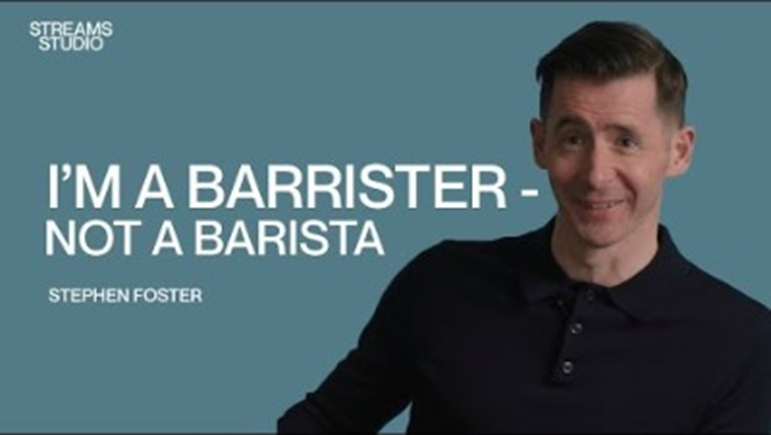
A Revelation – knowledge & Power to change
Revelation
Leads us to action – Shared Life
Open homes, shared meals, resources pooled, prayer, care, weeping and rejoicing
Love – serving and commitment
https://www.youtube.com/watch?v=pECvf2lxHOI
Notes:
Film https://www.youtube.com/watch?v=pECvf2lxHOI
Supernatural revelation of love for the brethren – he cannot explain why it happened (he was serving, not excited by it, but something changed) – that inexplicable is what I want for me for you for our community.
Revelation leads us to action – activity sharing life (shared life is intentional you have to shape for it) Open homes, shared meals, resources pooled, prayer, care, weeping and rejoicing
Love is primarily shown through serving and commitment

Slide 8
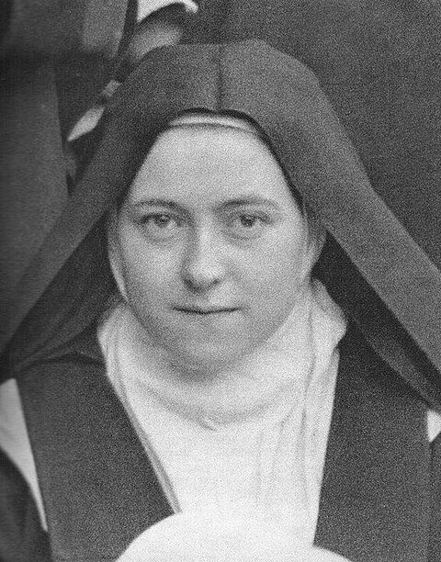
St Therese – another level
“Therese deliberately sought the company of the sisters who, on account of their imperfections, were shunned by others, or those who pleased her least. One of these was very difficult to live with on account of her crotchety character and disagreeable manner. Therese forced herself to treat her “as she would the person that she loved most.” At times when she was tempted to give a sharp answer, she treated the Sister’s rudeness with a friendly smile.
Notes:
“If ye love not each other in daily communion how can ye love God whom ye have not seen?”
(-From the hymn “More Love,” based on 1 John 4:20)

Slide 9
We mean God putting into us a bit of Himself… He lends us a little of His reasoning powers and that is how we think; He puts a little of His love into us and that is how we love one another.
C.S Lewis
With Gods help – Our response
Notes:
READING of ‘With Gods Help’
So how do we respond?
Repent, ask for his Holy spirit in us – so that we might Think as he does, Love one another as he does
Repentance is practical its about steering our life direction His way
Open my life, open my home, my time, my resources
Having a family mindset not an orphan mindset – involved not isolated (not justifying the idolatry of self)
Lets take an opportunity now to come and repent and ask for an infilling of the Holy spirit (we need another Pentecost) come and let stand together in prayer.

Slide 10








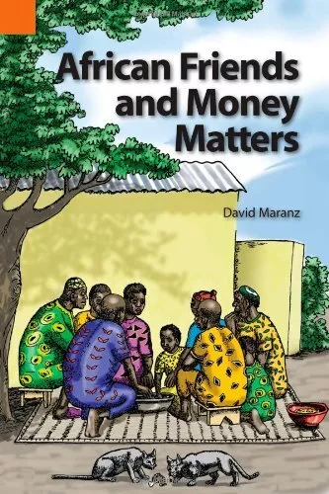


Resources

