Slide 1
Acts – Kingdom Continued
Reign and Rule
Lifeline Church – 26/5/24
Daniel Singleton

Slide 2
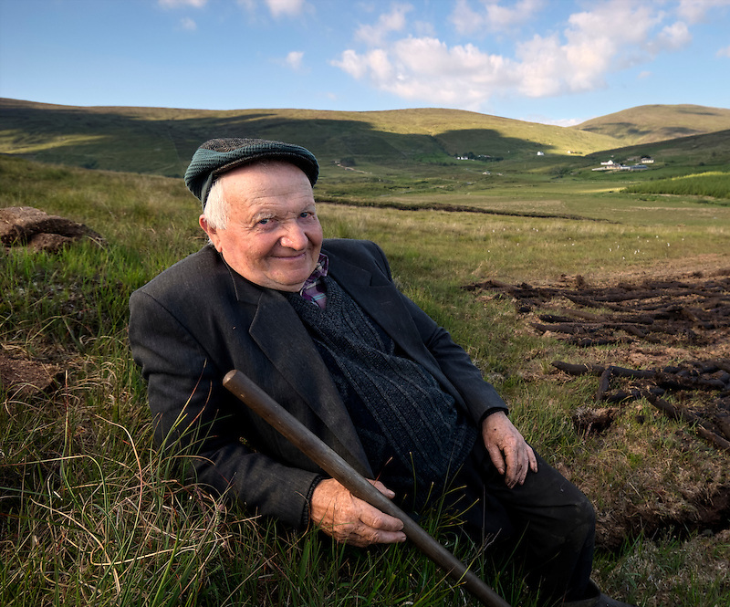
“Can’t get there from here!”

Slide 3
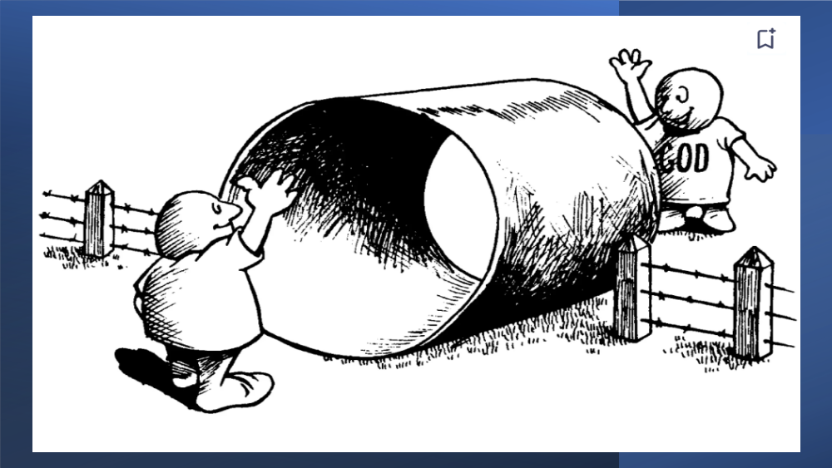

Slide 4
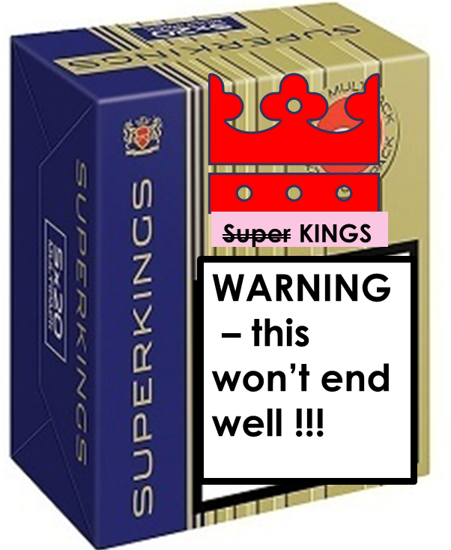
God plan purpose – the coming Kingdom
Eden
Exodus
Example Nation
Acts – birth of the Church an exemplar …
“In the world but not of the world”
Notes:
TUBE sketch
– God doesn’t get caught out by mankinds sin, He doesn’t wait for our attempt to get to him he comes to us. The story throughout scripture is God come to us
Eden – God relates walks in the call the day
Exodus – he calls a people and rescue them – he send leaders, prophets, judges, (allows for kings with a warning)
Example Nation {{{{{{{{Is 49v6
Acts the birth of church … meant to be an example (last message) our community our love ‘by this they will know you….’
To be in not of – was never revoked – it is in line with the whole pattern and plan of God (no holy huddle – exclusive)

Slide 5
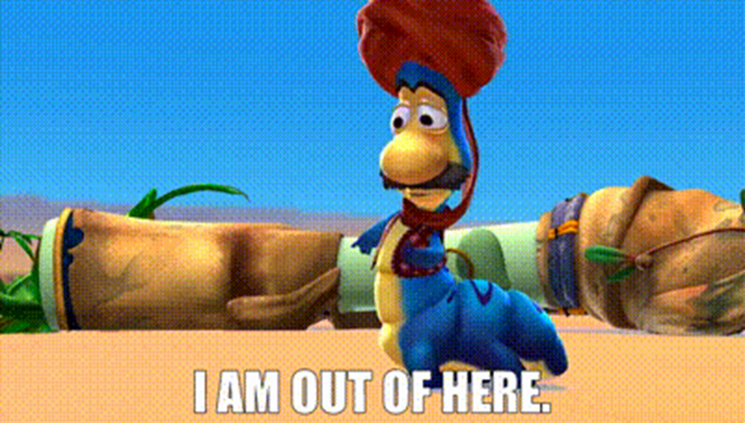
The wrong response
Go Thunder in their ears! (Moffat)
No thanks ….
Storm, fish, 3 days …
Restart
Shock … They repent …..
Jonah left under a shade (God mercifully provided)
Gods mercy to Jonah and Ninevah
Notes:
https://getyarn.io/yarn-clip/eb34f5dd-4dad-47af-8e29-2b542589f81c
The Story of Jonah – (GO THROUGH at SPEED) – Jonah focus is to get out he is motivated by fear/ distaste ….not for these unbelievers
God shows mercy again and again – He has not written them off
Keith Green – ‘Jesus commands us to go’ ‘We’re his hands and feet’

Slide 6
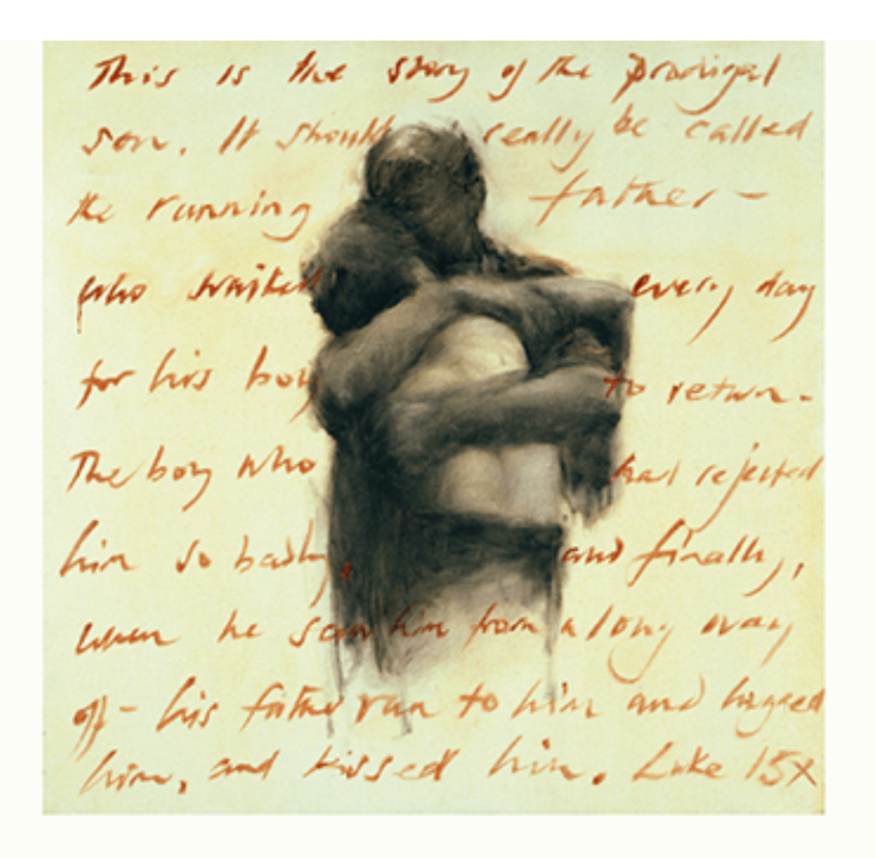
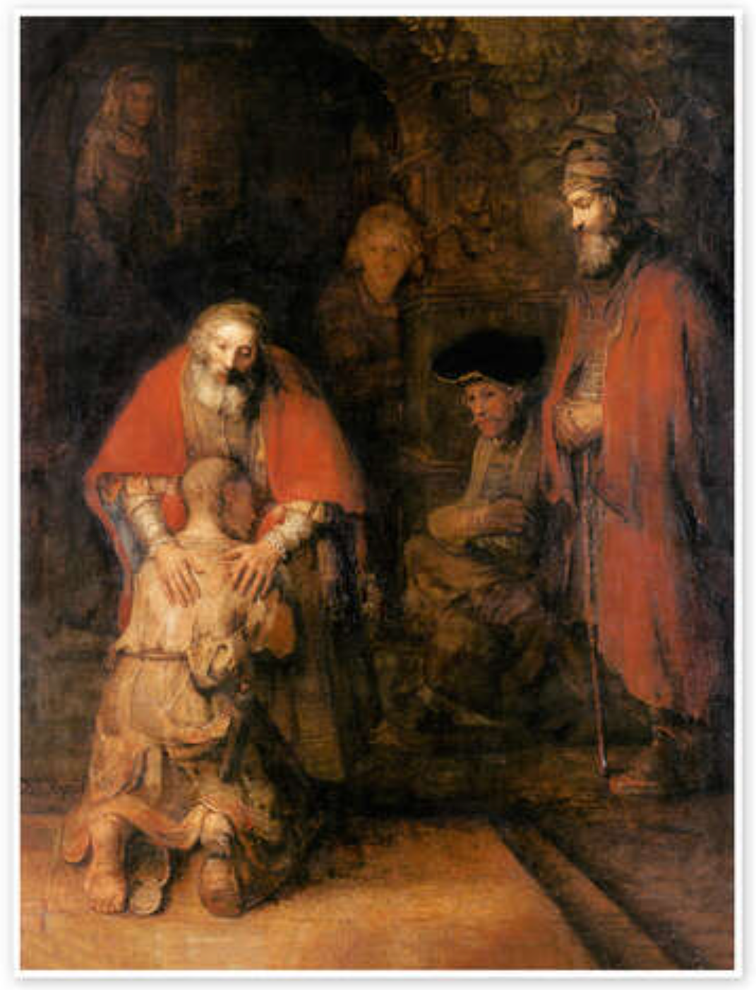
The story of the Running Father
We need the covering of the blood (ROBE)
But also the power to live Gods way (the way) (RING)
Charlie Mackesy
Notes:
Story of the Lost son – Luke 15 (Keith Green song) https://open.spotify.com/track/0AYz0jLIRVLm6KdsBjcWDu?si=9fdd8e94139f4549
2 sons youngest decides want££ (wish you were dead) wild living/ sinful/ soiled (pigs) let me be servant of father RETURN and beg
God heart (he is there waiting … the son knows where he will be dad hasn’t moved away, started somewhere else.)
Father waiting & watching when he is far off he runs (not done) Son prep speech Fathers celebration
CLICK1 RING (Power of HS) and ROBE (blood covering)
Credit card of my parents We need the covering of the blood (ROBE) --- But also the power to live Gods way (the way) (RING) --- Israel keep falling sacrifice wasn’t enough they needed HS power.
CLICK 2 beware the elder son CLICK3… not merciful … resentful not fathers heart
The picture here – want to leave us with is the Running father – Father God involved not distant – holed up in heaven

Slide 7
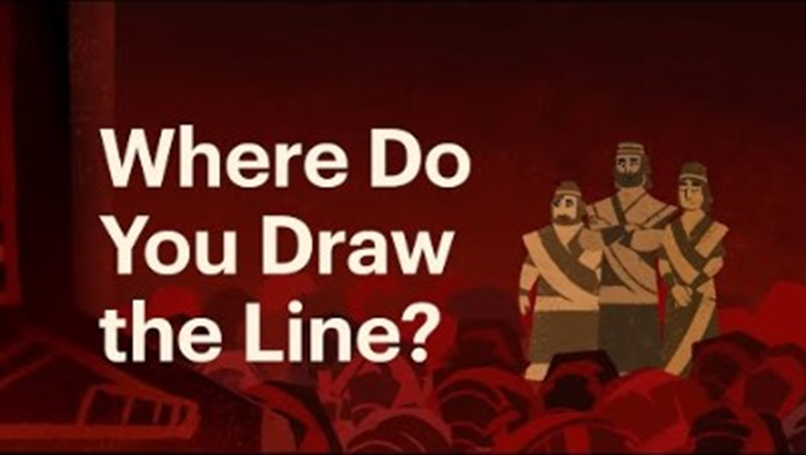
Exiles
“ not …Bishops getting together and trying to write plays and novels in their spare time”
C.S Lewis
https://youtu.be/XzWpa0gcPyo?si=Wq5scekHXvgXc08m
Notes:
So how should we view ourselves - what is our part in all this (more of that next time)
Would seem important to consider our ‘faith in the public square’ as we approach a General Election July 2024
CS Lewis – the church should take the lead – reading
Exiles is a useful idea - PLAY VIDEO – particularly the instructions Jeremiah - to seek the welfare of the city - Isaiah 58:12 restoration of streets and dwellings
https://youtu.be/XzWpa0gcPyo?si=Wq5scekHXvgXc08m

Slide 8




A Kingdom Community…..
not an escape pod
“Do we pack our bags the moment we’re forgiven?”
Jesus – Rule and Reign
The Kingdom of God is like... Restoration (Matt 10, 13);
Healing, finding, Turn-around, Returning
‘sermon on the mount people’ NT Wright
Holy Nation Royal Priesthood (1Peter2v 9)
The Kingdom of God is expanded as individuals' hand over control of their individual kingdoms to His rule.
Notes:
We have set out to be a Kingdom Community (whatever that means we are still exploring) … not cosy group of people waiting on heaven
Jack Little – used this phrase - to prayer Jesus – Rule and Reign ---- reminded to infinity war --- as the doom is breached, the evitable reign is glimpsed – when we are involved in these things we join God as agents of the kingdom – Ambassadors – Embassy Sermon on the mount people – royal priesthood Kingdom – rule reign starts – here – with me
But we have made moves to work collectively – kingdom activities (corporate) LCP etc --- use our togetherness – plantings as well as ambassadors

Slide 9
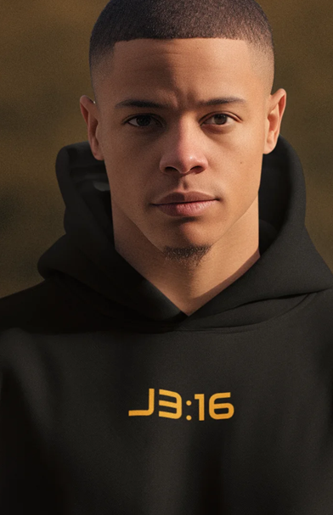
My part, now
He looked and was moved with compassion
‘sheep without shepherd’
Compassion not contempt – melt my heart – do you see?
Turn and be covered
Received the power to change
Notes:
Next time look at our corporate community part … but my part in this restoration kingdom --- renew heart for the world – for God so loved the world
Compassion not contempt – melt my heart – do you see? ( Peter said look … have to look and see to change) --- not about escaping
Turn and be covered Like lost son – be covered
Received the power to change

Slide 10
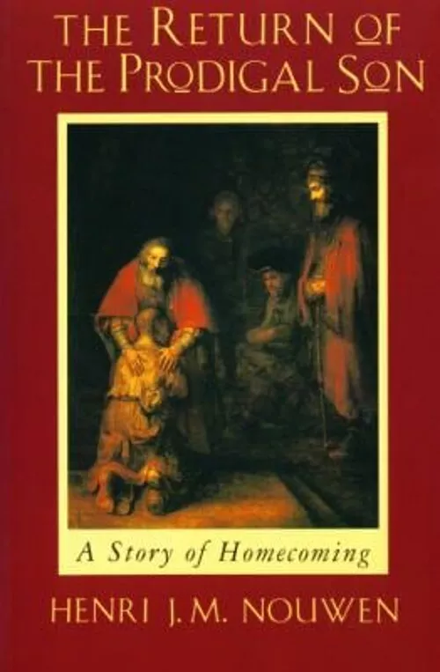


Resources
Jesus and Modern Politics with Tom 'NT' Wright, Preston Sprinkle and Billy Hallowell
Unbelievable?
The Prodigal Son Suite – Keith Green
https://open.spotify.com/track/0AYz0jLIRVLm6KdsBjcWDu?si=9fdd8e94139f4549
Notes:
https://lifehopeandtruth.com/prophecy/kingdom-of-god/parables-of-jesus/the-kingdom-of-heaven-is-like/

