Slide 1

Acts Series
Episode 1: Introducing Acts
9th June 2024

Slide 2
Why are we studying Acts?

Slide 3
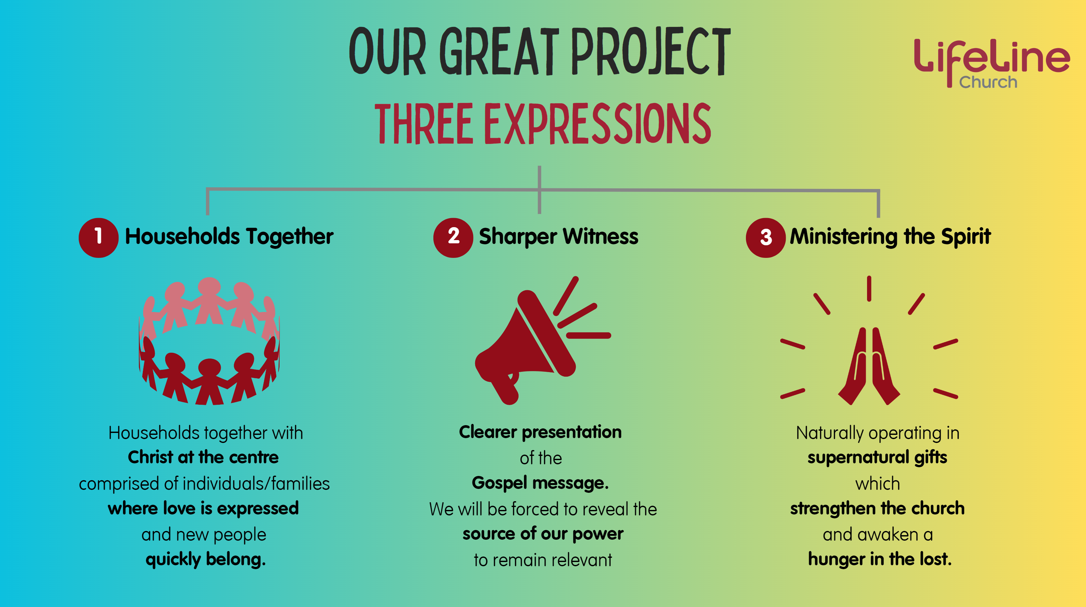
Notes:
When we considered God’s word over us, we see Acts speaks to each
Households together – unity of diverse group of people, experiencing the love/power of God and expressing it through love to one another
Ministering the spirit – first pouring out of the holy spirit at Pentecost and then many miracles
Sharper witness – combined with the demonstration of power of spirit was a gospel presentation which held no punches (Jack Little – power evangelism)

Slide 4



4. Maintaining the Movement
Notes:
Maintaining the Movement – building values through training and equipping which not only lasts the test of time but expands across the world over future generations
Expect God to speak to us about these themes in our setting today from 2,000 years ago

Slide 5
How does the narrative take us from
1 Kings to Acts?

Slide 6
Kings
Destruction of Israel
Abductions
Destruction of Judah
    Elijah
    Elisha
    Amos
    Hosea
    Daniel & Co
    Ezekiel
    Isaiah
    Micah
    Zephaniah
    Habakkuk
    Jeremiah
Notes:
19 kings of Israel, 20 Judah
Prophets were key feature – God’s warn of destruction if they refused to obey and blessing if they were to obey

Slide 7
Exile
Return
Silence
The Gospels
    Zerubbabel
    Ezra
    Nehemiah
    Joel
    Haggai
    Zechariah
    Malachi
    Jesus’s
    Birth
    Ministry
    Death
    Resurrection
    Commissioning
    Ascension

Slide 8
Acts

Slide 9
The book of Acts

Slide 10
Name of book:
Author:
Who was it written for & why:
Timespan:
When written:
Acts (of the Apostles) – more accurate to say ‘Acts of the Spirit’ – Spirit is the one consistent character throughout the whole narrative.
Luke
Author of Luke & Acts, (investigative journalist), Greek, gentile, doctor, co-worker – served in church plants, journey with and imprisoned with Paul
Theophilus (wealthy benefactor, publishing deal)
would know with certainty about the person and work of Jesus Christ (Luke 1:4)
Acts like the sequel to Luke
Also to general audience of Jews – many of speeches recorded were aim at calling Jews to join the Jesus movement
Roughly about 30 years
Estimated Between 70-90CE
Notes:
(OT covers about 2000 years)
(NT covers about 90 years)

Slide 11

Luke 24 The Prequel to Acts
⁴⁶ He told them, “This is what is written: The Messiah will suffer and rise from the dead on the third day, ⁴⁷ and repentance for the forgiveness of sins will be preached in his name to all nations, beginning at Jerusalem. ⁴⁸ You are witnesses of these things. ⁴⁹ I am going to send you what my Father has promised; but stay in the city until you have been clothed with power from on high.”
⁵⁰ When he had led them out to the vicinity of Bethany, he lifted up his hands and blessed them. ⁵¹ While he was blessing them, he left them and was taken up into heaven. ⁵² Then they worshiped him and returned to Jerusalem with great joy. ⁵³ And they stayed continually at the temple, praising God.
Notes:
Witnesses to whom?
What does He mean clothed with power from on high?
How long do we need to stay in the city?
Then Jesus ascended…
Now what?!
What are the disciples meant to do now? Do they go back to the lives they lead before the ‘Jesus tornado’ had blown through their lives over the last 3 years?
Jesus had taught and called them to a completely different way to be human – are we meant to be able to live accordingly without Him now?
Had Jesus completed that part of His mission?
What about those who killed Jesus…Aren’t they still out for us? What about the Romans, they still oppress us!

Slide 12
Key Characters in Acts

Slide 13

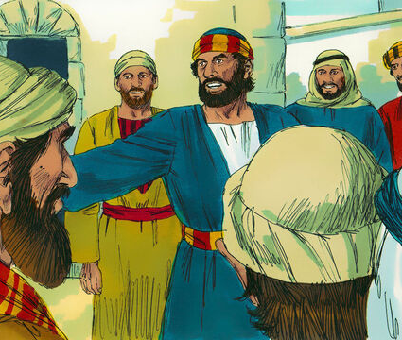
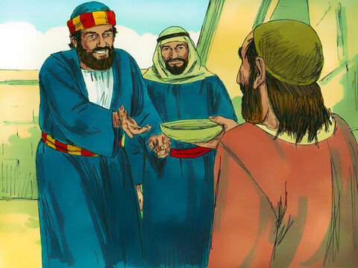
Name: Peter
Position: Disciple of Jesus, Apostle, friend of Jesus
Featured a lot in gospels

Slide 14

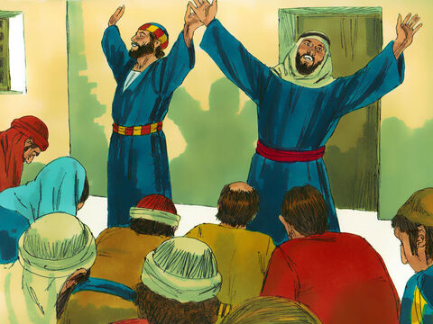
Name: John
Disciple of Jesus, Apostle, closest friend of Jesus
Brother of James, son of Zebedee
Worked closely with Peter

Slide 15

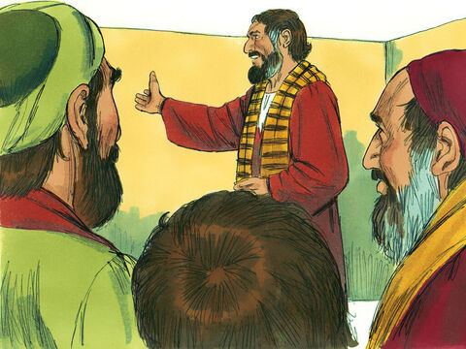
Name: James
(Half) Brother of Jesus
Initially sceptical of Jesus as Messiah.
Became head of church in Jerusalem

Slide 16

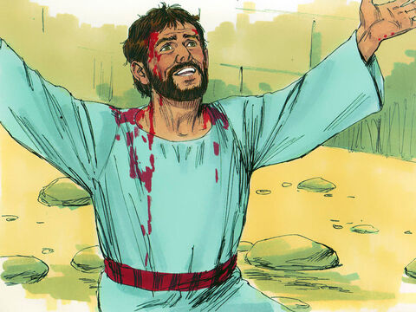
Name: Stephen
Spirit-filled administrator
Becomes first martyr when stoned to death.

Slide 17

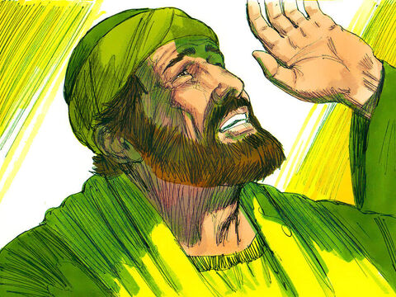
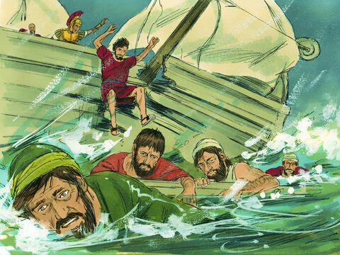
Name: Paul(a.k.a Saul)
Pharasee persecuting Christians.
After dramatic conversion become evangelist to gentiles and church planter. His letters account for most of NT.
Responsible for establishing Christianity

Slide 18
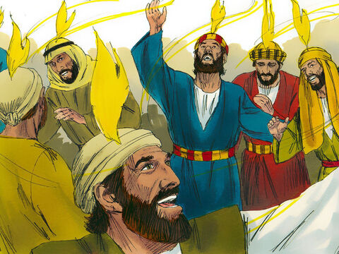
Name: The Holy Spirit
One person of the trinity.
Was present and involved in creation
Before Jesus often came upon and empowered particular people at particular times for particular reasons.
At the beginning of Acts we see the Holy Spirit, the very presence of God coming to reside in faulty humanity, enabling people to reflect what God is like.

Slide 19
In Acts, God is still executing His ‘Grand Plan’

Slide 20
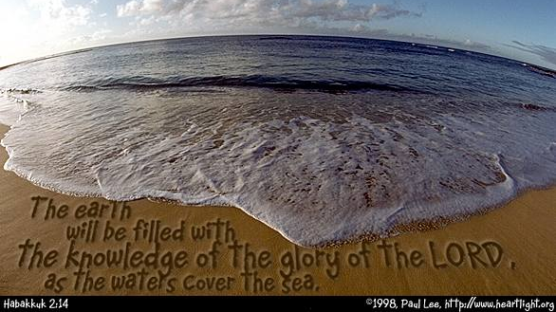
Notes:
Glory = attributes on display

Slide 21
God’s ‘Grand Plan’
Made humans in His image and have them fill the earth (earth will be mirror reflecting and displaying His attributes)
Humans rejected God, wanted to promote self (sin), lost ability to reflect God
God choose one man (Abraham) & family (children of Israel), invited into covenant, to model to world how God and humans can work together.
God faithful but humans repeatedly betray
God sends son, Jesus to show how we can relate to God and to die and rise from the dead to break curse of sin
Now to those willing to embrace, He comes to live in us as Holy Spirit, empowering us to become like Him
Thus, putting His attributes on display, filling whole earth with His glory
Notes:
In Acts, God is still gathering a community of people to relate to and commissioning them to show the rest of world what He is like. But now power of sin is broken and, as we’ll see, His Holy Spirit is sent to live within us and empower us to become like (the image of) God.
God is still up to the same thing today. This was never about just you and Jesus. Never about your life improvements. This is an invitation to join with God to make Him known to all the world. And now you are empowered by the Spirit.
Because we are free to do what we want, we are restricted to only responding to what is the bible verses of the day – let us take time now to invite the spirit to come and empower us. To lead us to repent from making our relationship with God about merely personal comfort and improvements.

Slide 22
Response
I commit to be part of His Grand Plan
I need to be (re)filled with His Holy Spirit

