Slide 1
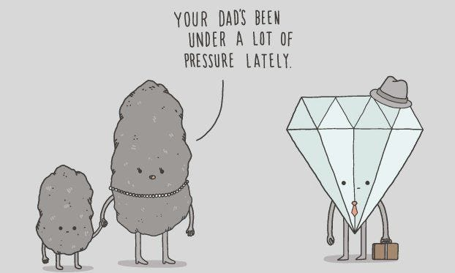
Acts Series
Episode 11: Chpt 8
13th Oct 2024
Notes:
God can bring precious things out of tough/messy situations
Acts 8 can be divided into 3 sections
Response to Stephens murder
Revival whilst Philip is in Samaria (including story of Simon the sorcerer who tries to buy the Holy Spirit)
Philip and the Ethiopian Eunuch
I’m not going to talk about Philip’s time in Samaria

Slide 2
Acts 8:1-4
And Saul approved of their killing him.
On that day a great persecution broke out against the church in Jerusalem, and all except the apostles were scattered throughout Judea and Samaria. Godly men buried Stephen and mourned deeply for him. But Saul began to destroy the church. Going from house to house, he dragged off both men and women and put them in prison.
Those who had been scattered preached the word wherever they went.

Slide 3
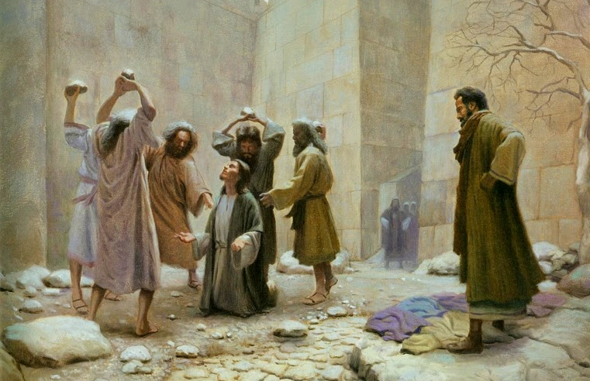
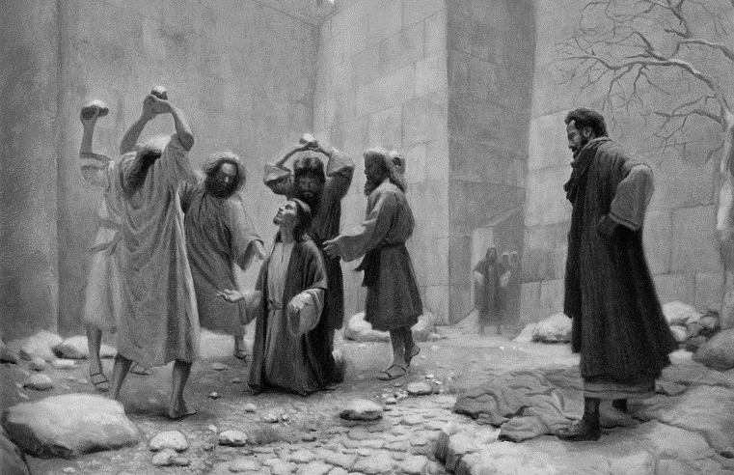
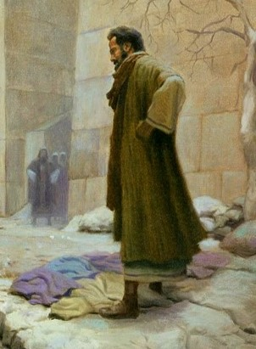
A nemesis to reckon with
At this they covered their ears and, yelling at the top of their voices, they all rushed at him, dragged him out of the city and began to stone him. Meanwhile, the witnesses laid their coats at the feet of a young man named Saul.
Acts 7:57-58
Notes:
Nemesis = enemy
Setting up Saul for significant role – massive twist to come
Saul personified the persecution
The church went house to house (gladness and sincerity of heart - Acts 2:46) , now Saul is going house to house
the season has changed, now under threat of death (Sanhedrin had chosen not to kill before).
dragged off both men and women and put them in prison
(shows significance of women in the movement)
How would the church respond?

Slide 4
Question
What might persecution look like in your world?

Slide 5
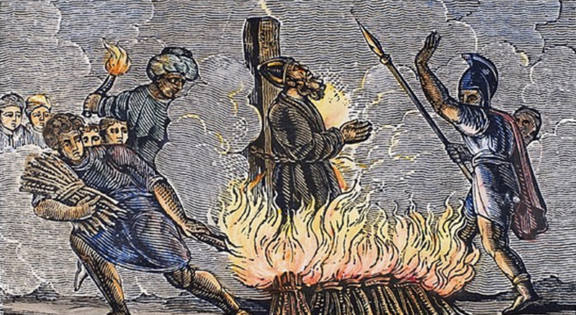
Notes:
Persecution – some suggest church does better under attack. Would you prefer to be comfortable and ineffective or persecuted and irresistible?
We are not under threat of death – we can be glad of this but also beware of blending in [what is it today?]
There is a good chance of persecution if we don’t toe the line
“The blood of Christians is seed” is a loose translation of a statement by Tertullian, a second-century church father
Polycarp killed around AD155
"Eighty and six years I have served Him, and He has done me no wrong.“
"I bless you, Father, for judging me worthy of this hour, so that in the company of the martyrs I may share the cup of Christ.“
Polycarp was burned at the stake and pierced with a spear for refusing to burn incense to the Roman emperor

Slide 6
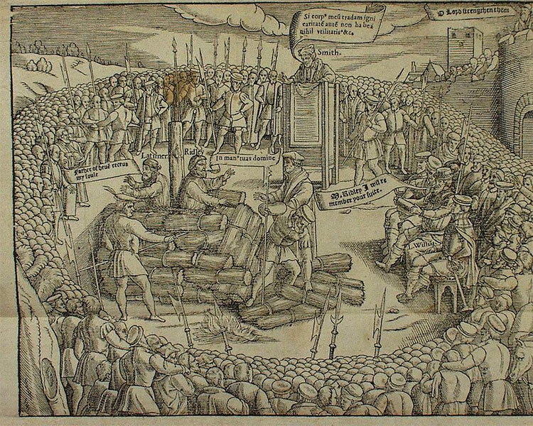
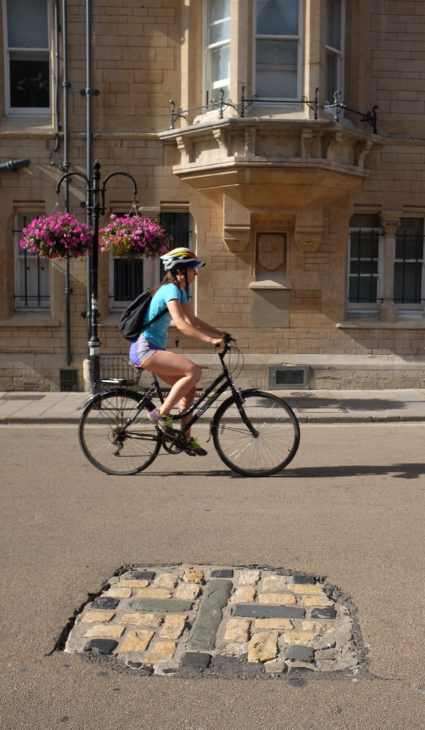
Notes:
Latimer and Ridley Burned at the Stake
‘Be of good comfort, Master Ridley, and play the man; we shall this day light such a candle by God’s grace in England as shall never be put out’
Are you willing to take a risk?
Perhaps you have never risen your head above the parapet to warrant persecution – blended in, kept quiet, compromised
I want to be sold out to God whatever season we are in – I don’t find looking martyrs inspiring (more intimidating/crushing) – but to look at WHO they were looking at. Once I’ve seen Him, it is the appropriate response. Have you seen Him?

Slide 7
Question
What do you need to
(a) ‘provoke’ persecution
(b) withstand persecution?

Slide 8
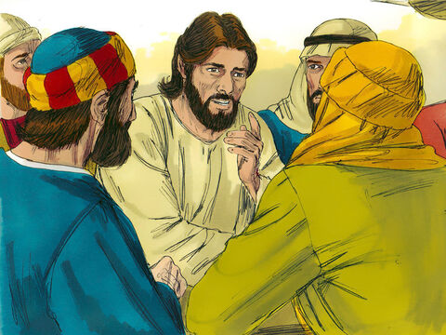
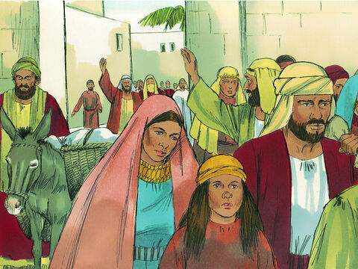
scattered throughout Judea and Samaria
you will be my witnesses in Jerusalem, and in all Judea and Samaria, and to the ends of the earth.”
Notes:
not the way they imagined when Jesus told they would be witness to Judea & Samaria
- scattered throughout Judea and Samaria
Gospel now on the road – Those who had been scattered preached the word wherever they went.

Slide 9
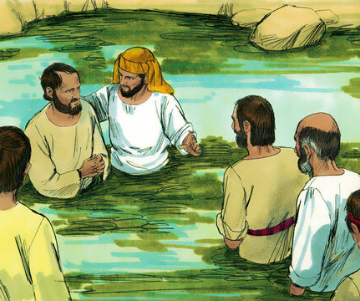
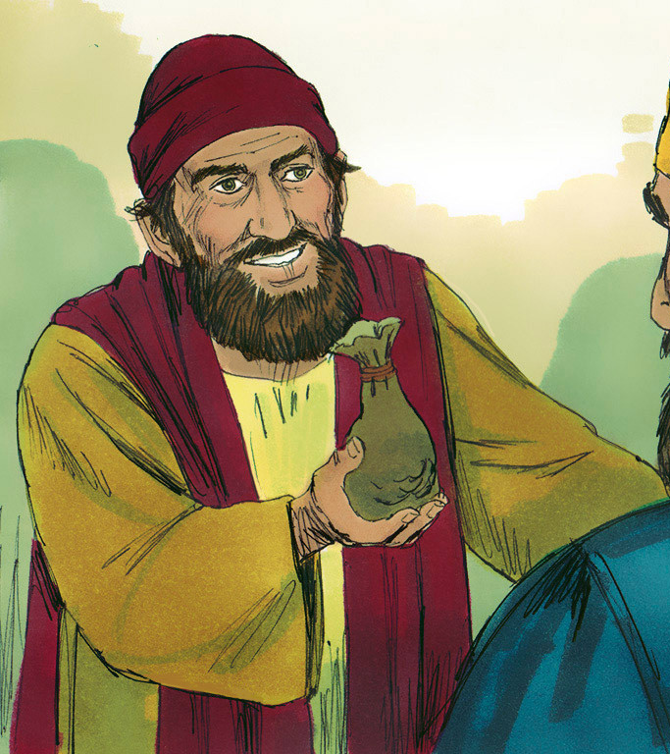
Revival in Samaria
Notes:
Philip goes to Samaria where a revival kicks off
Apostles send Peter & John to come join him
Simon the Sorcerer gets converted but then tried to buy the Holy Spirit – he is strongly rebuked

Slide 10
Acts 8:26-40
²⁶ Now an angel of the Lord said to Philip, “Go south to the road—the desert road—that goes down from Jerusalem to Gaza.” ²⁷ So he started out, and on his way he met an Ethiopian eunuch, an important official in charge of all the treasury of the Kandake (which means “queen of the Ethiopians”). This man had gone to Jerusalem to worship, ²⁸ and on his way home was sitting in his chariot reading the Book of Isaiah the prophet. ²⁹ The Spirit told Philip, “Go to that chariot and stay near it.”
³⁰ Then Philip ran up to the chariot and heard the man reading Isaiah the prophet. “Do you understand what you are reading?” Philip asked.
³¹ “How can I,” he said, “unless someone explains it to me?” So he invited Philip to come up and sit with him.
³² This is the passage of Scripture the eunuch was reading:
“He was led like a sheep to the slaughter, and as a lamb before its shearer is silent, so he did not open his mouth.

Slide 11
³³ In his humiliation he was deprived of justice.
Who can speak of his descendants?
For his life was taken from the earth.”
³⁴ The eunuch asked Philip, “Tell me, please, who is the prophet talking about, himself or someone else?” ³⁵ Then Philip began with that very passage of Scripture and told him the good news about Jesus.
³⁶ As they traveled along the road, they came to some water and the eunuch said, “Look, here is water. What can stand in the way of my being baptized?” ³⁸ And he gave orders to stop the chariot. Then both Philip and the eunuch went down into the water and Philip baptized him. ³⁹ When they came up out of the water, the Spirit of the Lord suddenly took Philip away, and the eunuch did not see him again, but went on his way rejoicing. ⁴⁰ Philip, however, appeared at Azotus and traveled about, preaching the gospel in all the towns until he reached Caesarea.

Slide 12
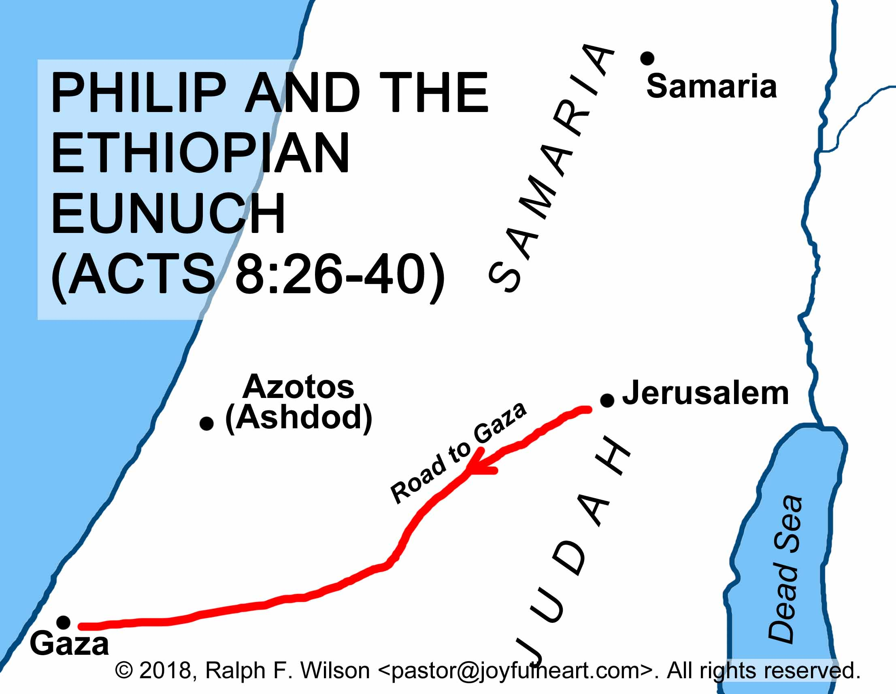
Notes:
Philip dragged away from the revival (to have a short conversation with one man)
No idea of the time lapse between Phil being in Samaria and then on the road between Jerusalem & Gaza

Slide 13
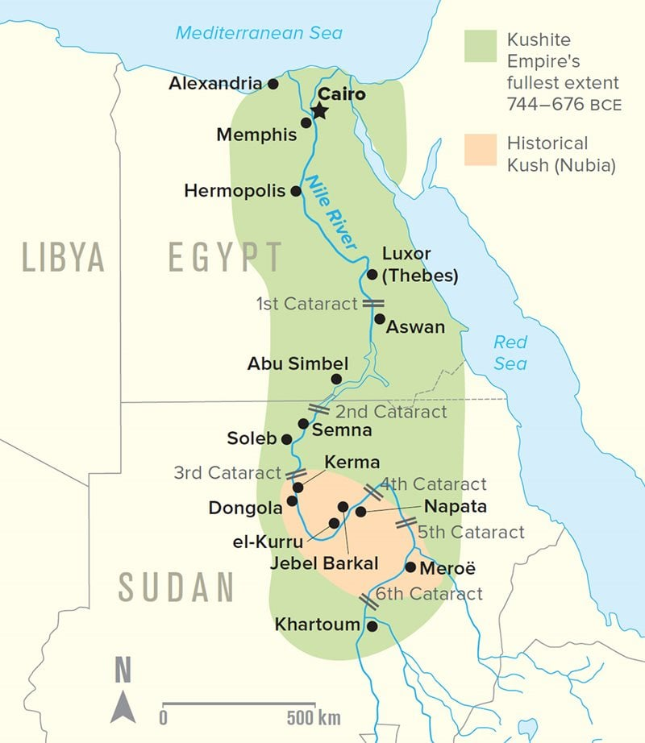
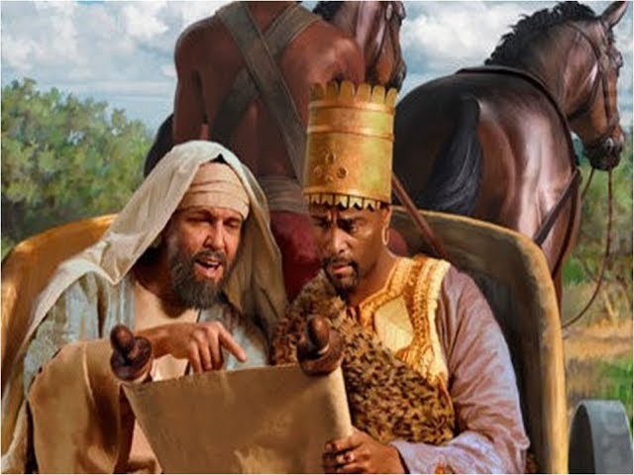
Philip & the Ethiopian Eunuch
“He who has been castrated by having his testicles crushed or his male organ cut off shall not enter the congregation of the LORD.
Deu 23:1 (AMP)
Notes:
Philip & the Ethiopian Eunuch
Eunuch – if you aren’t born into ruling elite, the only way to progress is to have your gentiles removed – this way you aren’t likely to take advantage of access to the ruling elite.
Chancellor of the Exchequer – important role, top of the ladder, dragged himself up
Yet there was something that missing in his life
Distance (1000 miles) & time (weeks) & expense & risk (safety on journey or being usurped at home) to travel
To go to the home of Jewish religion, to the temple
Only to find he wasn’t allowed in
Now you see a miraculous intervention

Slide 14
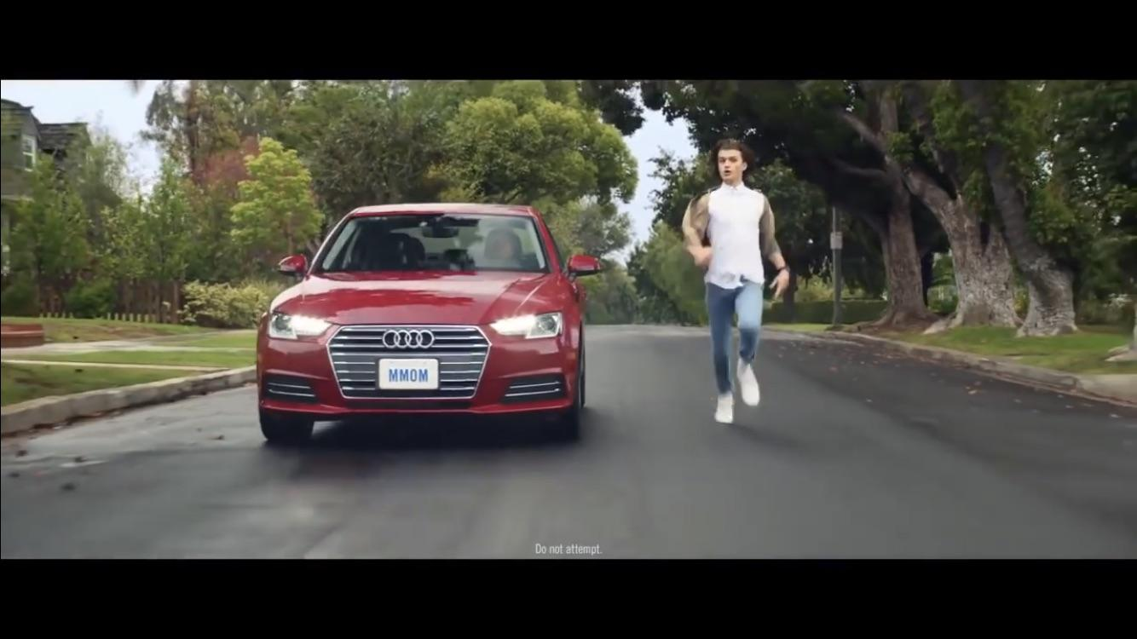
So…
whatcha reading?
Notes:
Work of the Spirit – just at time when reading & wondering, just so happens to be stuck on Isaiah’s prophecy of the coming messiah, Philip appears
Collaborating with Spirit – Philip had to run

Slide 15

Notes:
the Spirit of the Lord suddenly took Philip away - Philip, however, appeared at Azotus
God knows what He is up to – we are equipped to obey, not to understand

Slide 16
Question
Consider the week ahead of you, imagine how you will partner the Holy Spirit?

Slide 17

Isaiah 53
⁴ Surely he took up our pain and bore our suffering, yet we considered him punished by God, stricken by him, and afflicted.
⁵ But he was pierced for our transgressions, he was crushed for our iniquities; the punishment that brought us peace was on him, and by his wounds we are healed.
⁶ We all, like sheep, have gone astray, each of us has turned to our own way; and the Lord has laid on him the iniquity of us all.
¹⁰ Yet it was the Lord’s will to crush him and cause him to suffer, and though the Lord makes his life an offering for sin, he will see his offspring and prolong his days, and the will of the Lord will prosper in his hand.
¹¹ After he has suffered, he will see the light of life and be satisfied; by his knowledge my righteous servant will justify many, and he will bear their iniquities.
Notes:
Substitutionary sacrifice
For God so loved, he gave
Not for God so hated, he killed
Act of a loving god
Isaiah 40s-50s Servant songs
I like to imagine, as the Eunuch (the foreigner) continued his journey, reading Isaiah, in the light of Jesus being that Suffering Servant who had opened the way, what would he have thought when he turned to a few chapters later

Slide 18
Isaiah 56
⁴ For this is what the Lord says:
“To the eunuchs who keep my Sabbaths, who choose what pleases me
and hold fast to my covenant—
⁵ to them I will give within my temple and its walls a memorial and a name better than sons and daughters; I will give them an everlasting name that will endure forever.
⁶ And foreigners who bind themselves to the Lord to minister to him, to love the name of the Lord, and to be his servants, all who keep the Sabbath without desecrating it and who hold fast to my covenant—
⁷ these I will bring to my holy mountain and give them joy in my house of prayer.
Their burnt offerings and sacrifices will be accepted on my altar; for my house will be called a house of prayer for all nations.”
Notes:
God had a message for him
Where he was excluded he is now welcomed in
The curtain was torn – we now can all step into relationship with God

Slide 19

Jesus Christ the sinners friend
Does this kindness know no bounds
With your precious blood You have purchased me
Oh the mystery of the cross
You were punished You were crushed
But that punishment has become my peace
Yes that punishment has become my peace
And I love You for the cross
I'm overwhelmed by the mystery
I love You for the cost
That Jesus You would do this for me
When you were broken, You were beaten
You were punished, I go free
You were wounded and rejected
In Your mercy - I am healed
By Your wounds I am healed
For the cross, for the cross, for the cross I thank You
Oh Lord, for the cross, for the cross
I will love You for the cross
And I will love You for the cost
Man of sufferings
Bringer of my peace
You came into a world of shame
And paid the price we could not pay
Death that brought me life
Blood that brought me home
Death that brought me life
Blood that brought me home
And I love You for the cross
I'm overwhelmed by the mystery
I love You for the cost
That Jesus You would do this for me
When you were broken, You were beaten
You were punished, I go free
You were wounded and rejected
In Your mercy - I am healed

