Slide 1
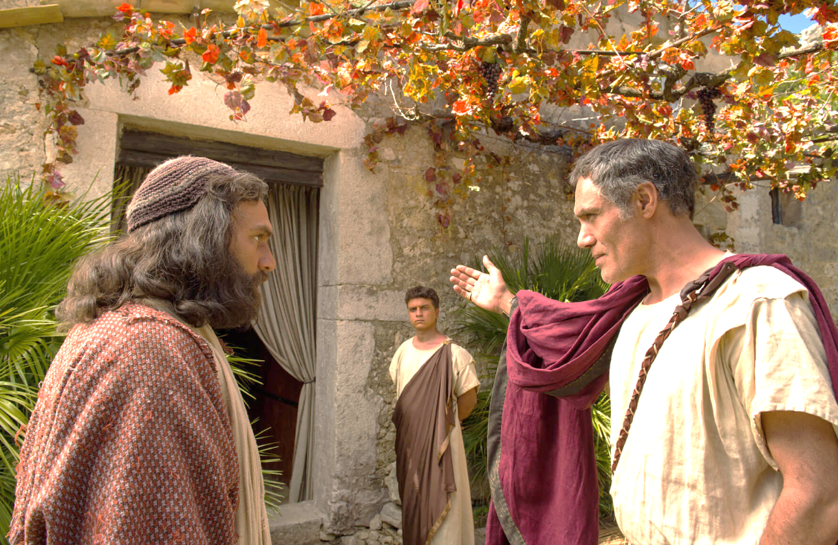
Acts 10

Slide 2
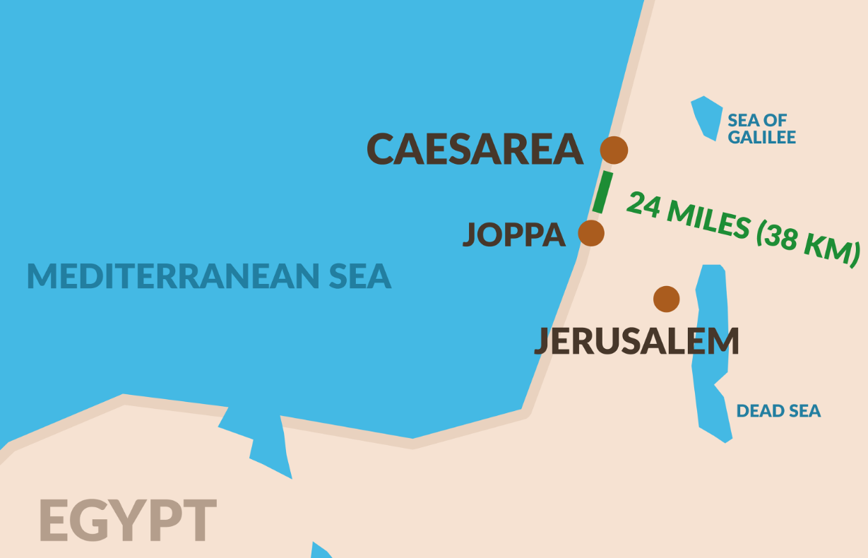
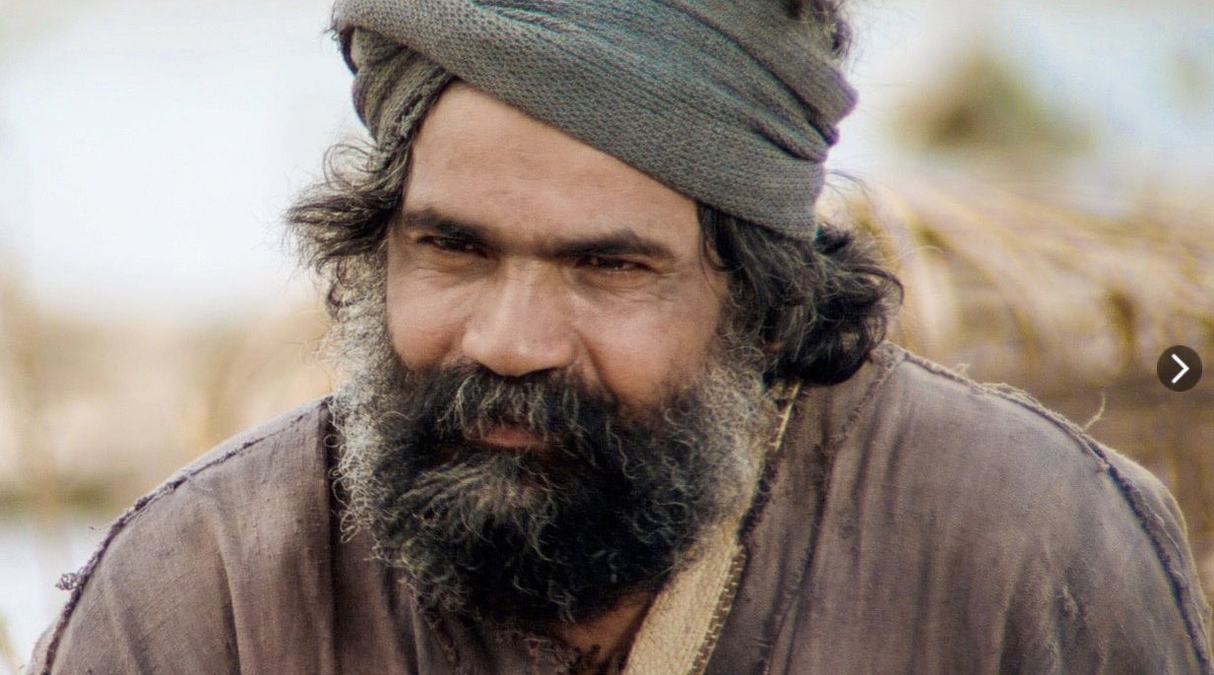
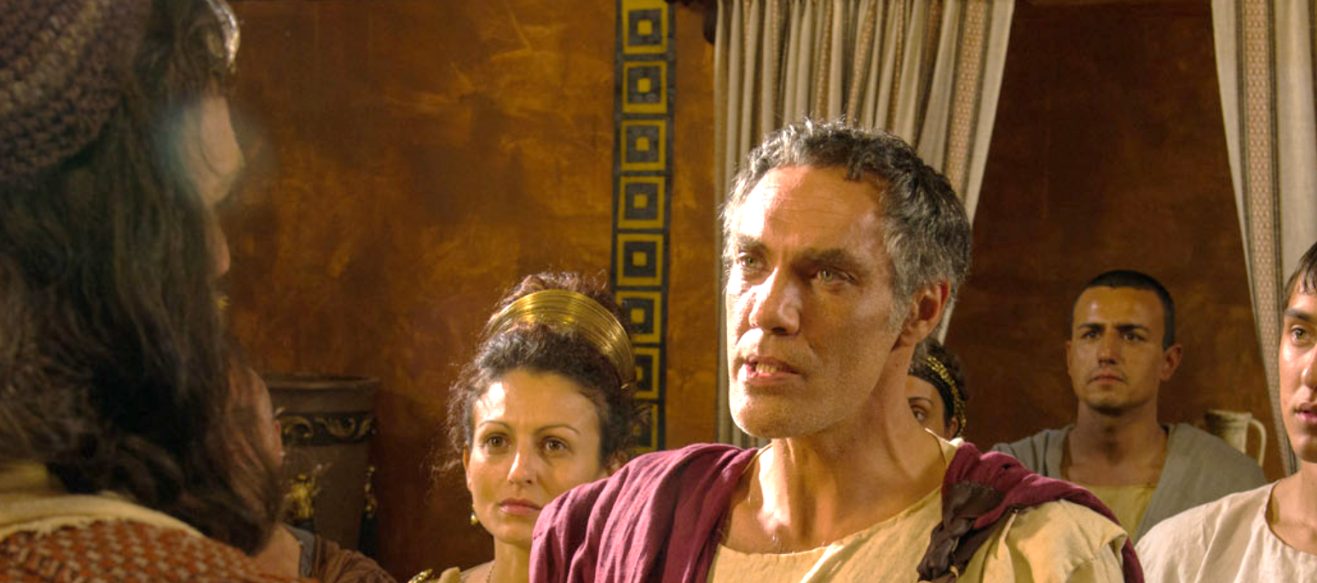
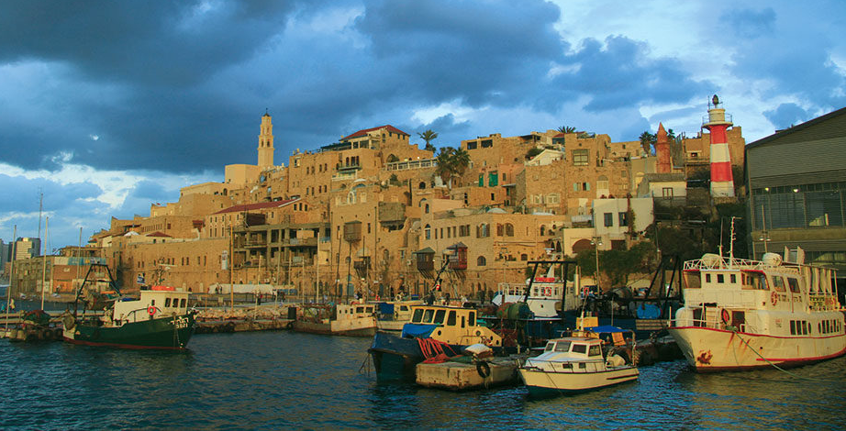
Peter
Cornelius

Slide 3
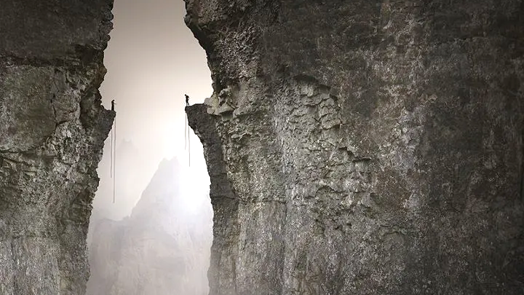

Slide 4
How does God join us into family?
A common hunger
Involving us
The same Holy Spirit

Slide 5
1. A common hunger
God joins us together through...

Slide 6
At Caesarea there was a man named Cornelius, a centurion in what was known as the Italian Regiment. 2 He and all his family were devout and God-fearing; he gave generously to those in need and prayed to God regularly. 3 One day at about three in the afternoon he had a vision. He distinctly saw an angel of God, who came to him and said, “Cornelius!”

Slide 7
4 Cornelius stared at him in fear. “What is it, Lord?” he asked.
The angel answered, “Your prayers and gifts to the poor have come up as a memorial offering before God. 5 Now send men to Joppa to bring back a man named Simon who is called Peter.

Slide 8
6 He is staying with Simon the tanner, whose house is by the sea.” 7 When the angel who spoke to him had gone, Cornelius called two of his servants and a devout soldier who was one of his attendants. 8 He told them everything that had happened and sent them to Joppa.

Slide 9
9 About noon the following day as they were on their journey and approaching the city, Peter went up on the roof to pray. 10 He became hungry and wanted something to eat, and while the meal was being prepared, he fell into a trance. 11 He saw heaven opened and something like a large sheet being let down to earth by its four corners. 12 It contained all kinds of four-footed animals, as well as reptiles and birds. 13 Then a voice told him, “Get up, Peter. Kill and eat.”

Slide 10
14 “Surely not, Lord!” Peter replied. “I have never eaten anything impure or unclean.”
15 The voice spoke to him a second time, “Do not call anything impure that God has made clean.”
16 This happened three times, and immediately the sheet was taken back to heaven.

Slide 11
19 While Peter was still thinking about the vision, the Spirit said to him, “Simon, three men are looking for you. 20 So get up and go downstairs. Do not hesitate to go with them, for I have sent them...”
23 Then Peter invited the men into the house to be his guests.

Slide 12
He has made everything beautiful in its time. He has also set eternity in the human heart...
- Ecclesiastes 3.11

Slide 13
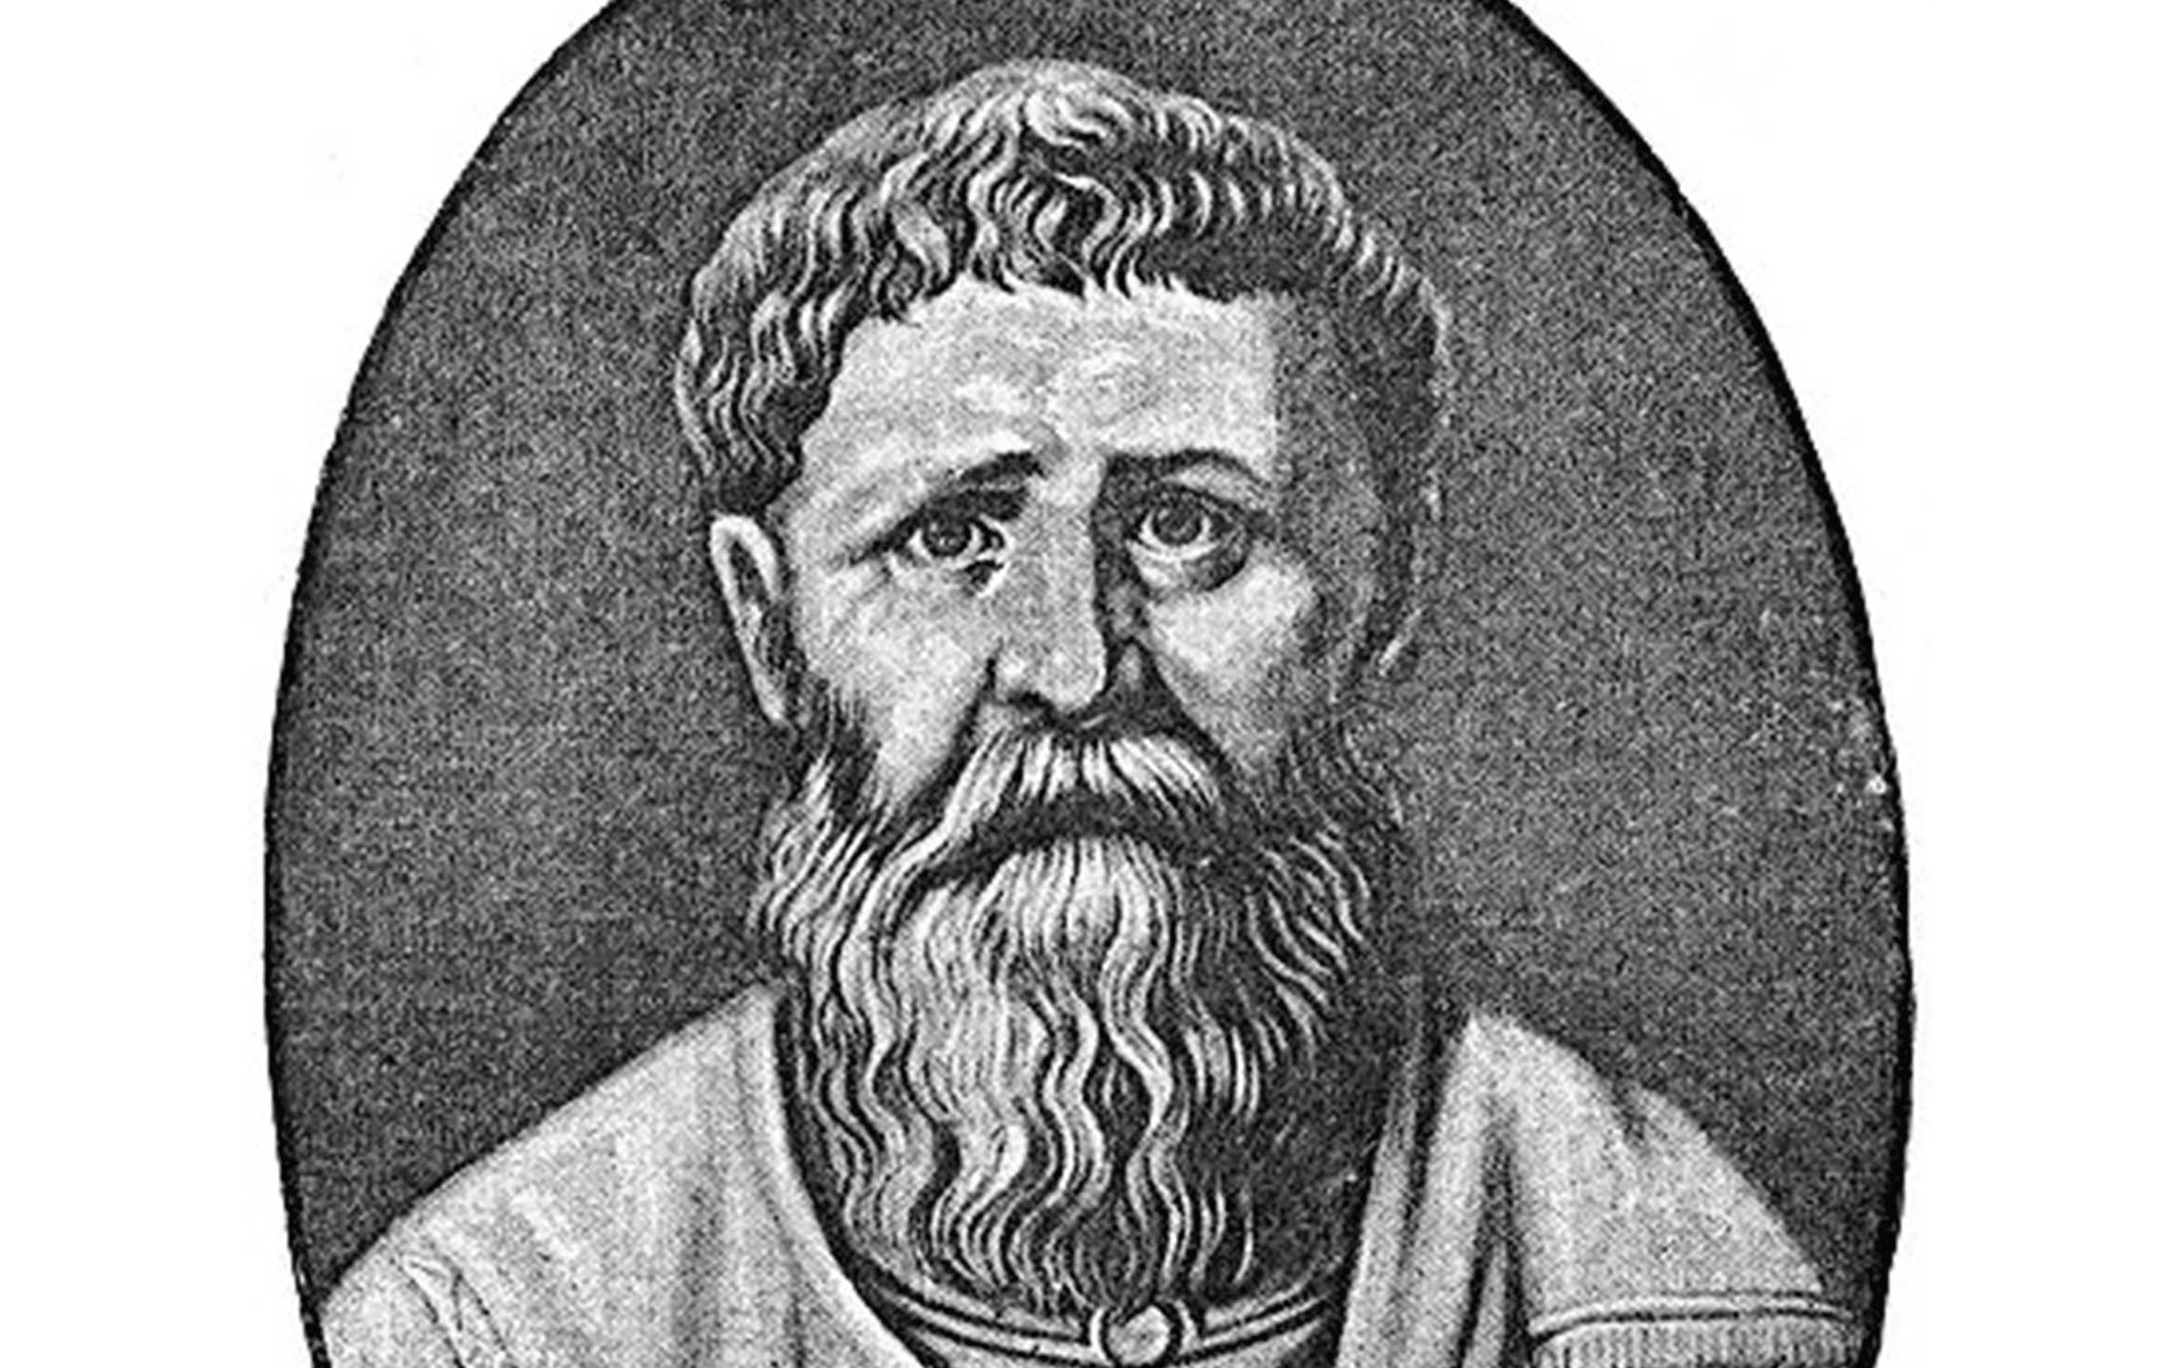
“You made us for yourself, and our hearts are restless until they find their rest in you...”
- Augustine of Hippo

Slide 14
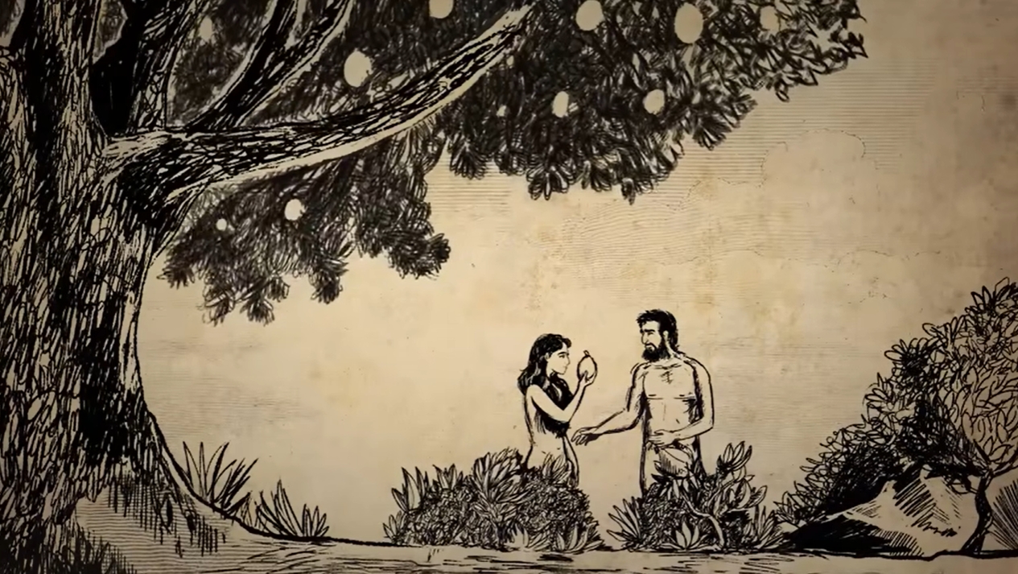

Slide 15
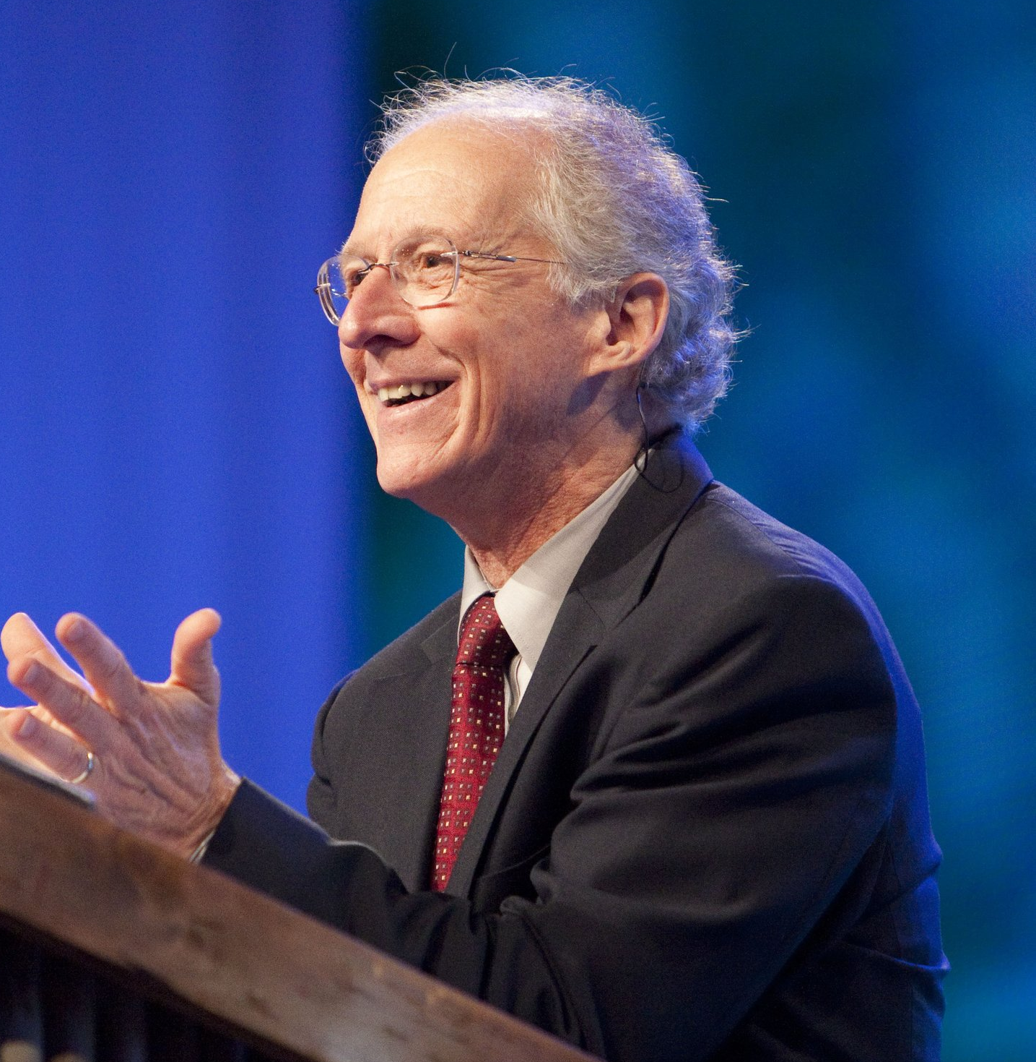
“...we have an inconsolable longing. We try to satisfy it with scenic vacations, accomplishments of creativity, stunning cinematic productions, sexual exploits, sports extravagansas, drugs, managerial excellence, etc. But the longing remains...”
- John Piper

Slide 16
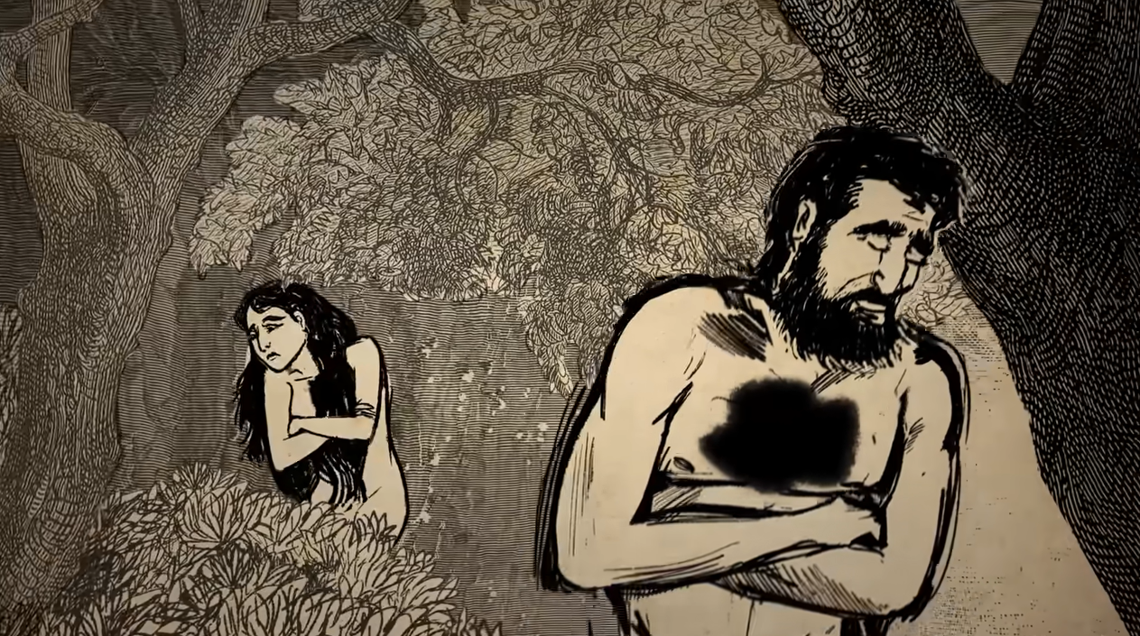
1. Misplaced hunger pulls us apart...

Slide 17
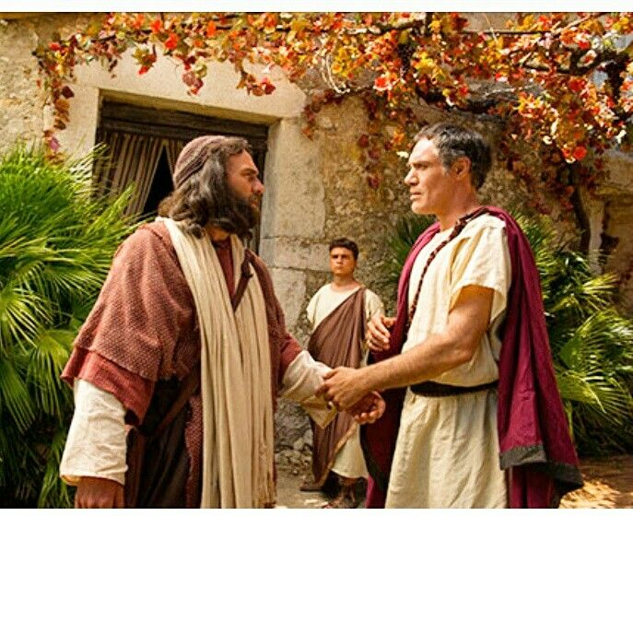
2. The hunger he gives draws us together...

Slide 18
Is anyone thirsty? Come and drink,
even if you have no money!
Come, take your choice of wine or milk!
Why spend your money on food that does not give you strength?
Why work hard for food that does not satisfy?
Listen to me, and you will eat what is good.
You will enjoy the finest food.
Come to me with your ears wide open.
Listen, and you will find life.
- Isaiah 55.1-3

Slide 19
God joins us together through...
2. Involving us

Slide 20
...The next day Peter started out with them, and some of the believers from Joppa went along. 24 The following day he arrived in Caesarea. Cornelius was expecting them and had called together his relatives and close friends. 25 As Peter entered the house, Cornelius met him and fell at his feet in reverence. 26 But Peter made him get up. “Stand up,” he said, “I am only a man myself.”

Slide 21
27 While talking with him, Peter went inside and found a large gathering of people. 28 He said to them: “You are well aware that it is against our law for a Jew to associate with or visit a Gentile. But God has shown me that I should not call anyone impure or unclean. 29 So when I was sent for, I came without raising any objection. May I ask why you sent for me?”

Slide 22
30 Cornelius answered: “Three days ago I was in my house praying at this hour, at three in the afternoon. Suddenly a man in shining clothes stood before me 31 and said, ‘Cornelius, God has heard your prayer and remembered your gifts to the poor. 32 Send to Joppa for Simon who is called Peter ... 33 So I sent for you immediately, and it was good of you to come. Now we are all here in the presence of God to listen to everything the Lord has commanded you to tell us.”

Slide 23
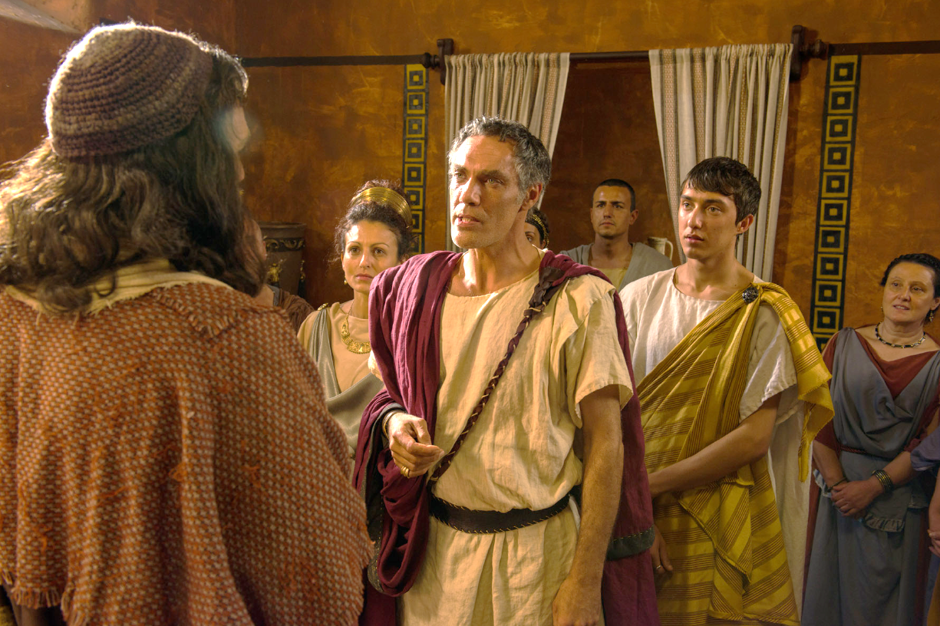

Slide 24
So Christ himself gave [the gifts] to equip his people for works of service, so that the body of Christ may be built up until we all reach unity in the faith ...
- Ephesians 4.11-13

Slide 25
We will grow to become in every respect the mature body of him who is the head, that is, Christ.
From him the whole body, joined and held together by every supporting ligament, grows and builds itself up in love, as each part does its work.
- Ephesians 4.15-16

Slide 26
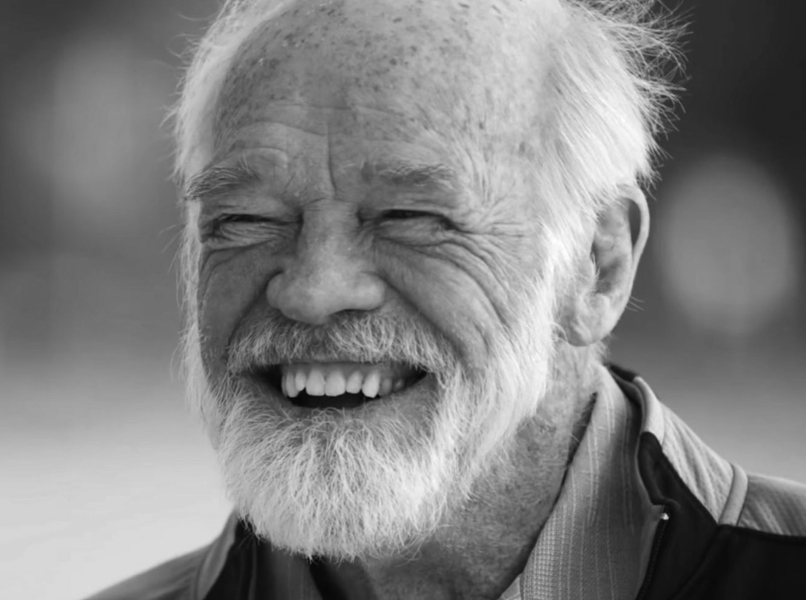
“I’m not myself by myself...”
- Eugene Peterson

Slide 27
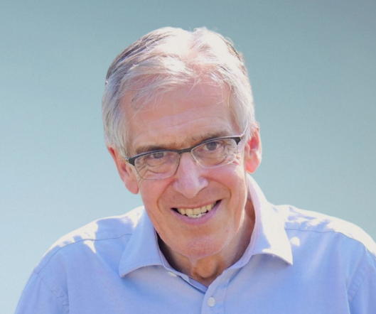
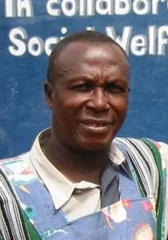
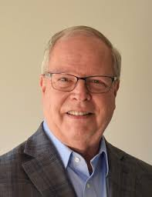
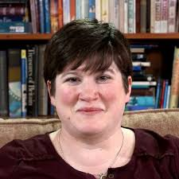

Slide 28
“We are all here in the presence of God to hear all that you have been commanded by the Lord...”
- Cornelius

Slide 29
God joins us together through...
3. The same Holy Spirit

Slide 30
34 Then Peter began to speak: “I now realize how true it is that God does not show favouritism 35 but accepts from every nation the one who fears him and does what is right. 36 You know the message God sent to the people of Israel, announcing the good news of peace through Jesus Christ, who is Lord of all. 37 You know what has happened throughout the province of Judea, beginning in Galilee after the baptism that John preached—

Slide 31
38 how God anointed Jesus of Nazareth with the Holy Spirit and power, and how he went around doing good and healing all who were under the power of the devil, because God was with him.
39 “We are witnesses of everything he did in the country of the Jews and in Jerusalem. They killed him by hanging him on a cross, 40 but God raised him from the dead on the third day and caused him to be seen.

Slide 32
42 He commanded us to preach to the people and to testify that he is the one whom God appointed as judge of the living and the dead. 43 All the prophets testify about him that everyone who believes in him receives forgiveness of sins through his name.”
44 While Peter was still speaking these words, the Holy Spirit came on all who heard the message.

Slide 33
45 The circumcised believers who had come with Peter were astonished that the gift of the Holy Spirit had been poured out even on Gentiles. 46 For they heard them speaking in tongues and praising God.
Then Peter said, 47 “Surely no one can stand in the way of their being baptized with water. They have received the Holy Spirit just as we have.”

Slide 34
...the Spirit said to him, “Simon ... get up and go downstairs. Do not hesitate to go with them, for I have sent them...
- Acts 10.19-20

Slide 35
...the Spirit you received brought about your adoption to sonship. And by him we cry, “Abba, Father.” The Spirit himself testifies with our spirit that we are God’s children.
- Romans 8.15-16
From orphans to family

Slide 36
And he died for all, that those who live should no longer live for themselves but for him who died for them and was raised again.
So from now on we regard no one according to the flesh ... if anyone is in Christ, the new creation has come: The old has gone, the new is here!
- 2 Corinthians 5.15-17
From death to life

Slide 37
Filled with the Holy Spirit.
Called to step out in love like Peter.
“I want to be hungry”

