Slide 1

Acts Series
Episode 14: Chpt 11
3rd Nov 2024
Notes:
This is going to be a bit taxing to follow today so you need to pay plenty of attention
A bit of word study today

Slide 2
Acts 11:1-4, 17-18
The apostles and the believers throughout Judea heard that the Gentiles also had received the word of God. So when Peter went up to Jerusalem, the circumcised believers criticized him and said, “You went into the house of uncircumcised men and ate with them.”
Starting from the beginning, Peter told them the whole story:
…
So if God gave them the same gift he gave us who believed in the Lord Jesus Christ, who was I to think that I could stand in God’s way?”
When they heard this, they had no further objections and praised God, saying, “So then, even to Gentiles God has granted repentance that leads to life.”

Slide 3
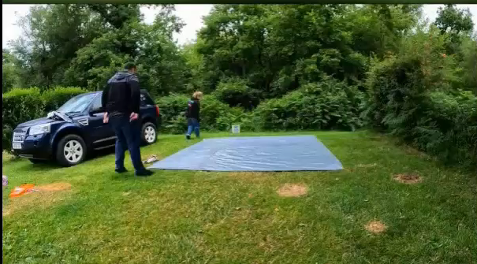
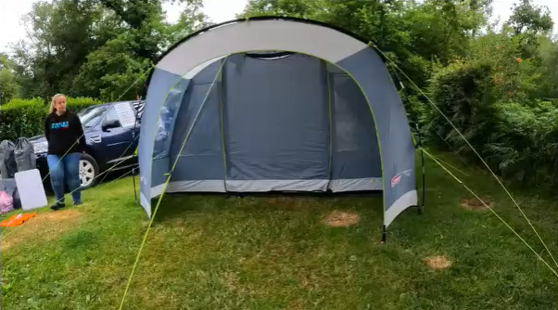



Move with the Cloud
Whenever the cloud lifted from above the tent, the Israelites set out; wherever the cloud settled, the Israelites encamped. At the Lord’s command the Israelites set out, and at his command they encamped. As long as the cloud stayed over the tabernacle, they remained in camp.
- Num 9:17-18
Question
Has God moved on from a position you are sticking to?
Has God stuck to a position you have moved on from?
Notes:
When God moves (pillar/cloud) I must move. Be ready to not stand on tradition if He has left. Don’t go before or behind
Get on the right side of HIS-STORY
Question
Has God moved on from a position you are sticking to?
Has God stuck to a position you have moved on from?

Slide 4
Acts 11:19-26
Now those who had been scattered by the persecution that broke out when Stephen was killed traveled as far as Phoenicia, Cyprus and Antioch, spreading the word only among Jews. Some of them, however, men from Cyprus and Cyrene, went to Antioch and began to speak to Greeks also, telling them the good news about the Lord Jesus. The Lord’s hand was with them, and a great number of people believed and turned to the Lord.
News of this reached the church in Jerusalem, and they sent Barnabas to Antioch. When he arrived and saw what the grace of God had done, he was glad and encouraged them all to remain true to the Lord with all their hearts. He was a good man, full of the Holy Spirit and faith, and a great number of people were brought to the Lord.
Then Barnabas went to Tarsus to look for Saul, and when he found him, he brought him to Antioch. So for a whole year Barnabas and Saul met with the church and taught great numbers of people. The disciples were called Christians first at Antioch.
Notes:
v19 - First time the gospel is brought to the non-bible believing Greeks

Slide 5
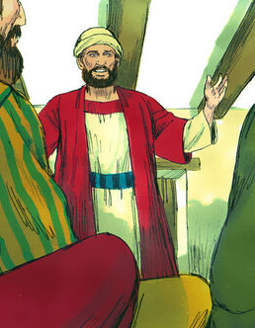
Barnabas, “son of encouragement”
News of this reached the church in Jerusalem, and they sent Barnabas to Antioch. When he arrived and saw what the grace of God had done, he was glad and encouraged them all to remain true to the Lord with all their hearts.
(Acts 11:22-23)
Renewal, send reinforcements
Saw & glad
Encourages
Notes:
Acts 4:36 Joseph, a Levite from Cyprus, whom the apostles called Barnabas (which means “son of encouragement”), ³⁷ sold a field he owned and brought the money and put it at the apostles’ feet.
Lots turning to God
I want to recognise what God is up to and rejoice in this (discern what God is doing in you)
Ps 118:23 the LORD has done this, and it is marvellous in our eyes.
Why send Barnabas, why send an encourager?

Slide 6
The ministry of Encouragement
Encourage = parakaleo = "from close-beside“ + "to call”
Translated
  Verb: Beseech, implore, beg, appeal, call upon, plead, comfort, exhort
  Noun: Helper, Comforter, Advocate
offering up evidence that stands up in God's court
Notes:
When lots of English words use – Greek richer than English
The reality is – this is a really important role and one that is difficult to get right

Slide 7



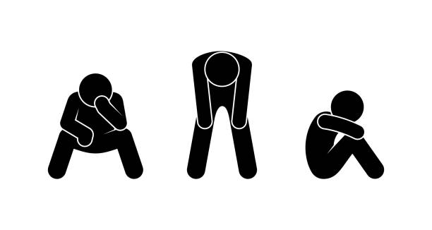
Sympathy or Truth
Oh, poor you!
This is what you need to know
Notes:
People tend to lean to one or the other
We know what it’s like to be ‘counselled’ by those with
(a) mostly sympathy – feel reassured that the hole you are in is terrible, but no way out (hopeless) – emotional intelligence
(b) Mostly ‘truth’ – feel beaten with sound advice but don’t feel understood
We have also counselled others like this
If I were in your situation, I would feel completely the same
“at least…” (silver lining)
Judgment – it’s really your own fault, finger pointing, oversimplifying
Manipulation
Shaming
Weaponised disappointment
It’s about you and your idea of the way forward
It’s so easy to get this wrong

Slide 8

Question
Where are you on the spectrum?
Sympathy
Truth

Slide 9
Parakaleo
He was a good man, full of the Holy Spirit…
- Acts 11:24
But the Advocate, the Holy Spirit, whom the Father will send in my name, will teach you all things and will remind you of everything I have said to you.
John 14:26
paraklétos
Notes:
So, if I don’t have what it takes within me to be the encourager I want to be, I need to look to someOne greater than
Barnabas was full of the Holy Spirit
How is the Holy Spirit described by Jesus?
The HS is the ultimate parakaleo, the encourager, the advocate

Slide 10
Sympathy and Truth
And I will pray the Father, and he shall give you another Comforter, that he may be with you for ever
John 14:16 (ASV)
when he, the Spirit of truth, comes, he will guide you into all the truth.
John 16:13
Notes:
Comfort – I need to know someone is with me (forever)
Truth – I need to know something is more real than my present circumstance
But the ministry of encouragement comes alongside and points to hope
Pointing out aeroplane
encouraged them all to remain true to the Lord with all their hearts
– the renewal is supercharged by encourager - and a great number of people were brought to the Lord.
Need soil of paraklesis to grow into who God has made us to be
Not cowardly (not willing to speak truth)
Not impatient (give advice too quickly)
Humility
That person really listened
I left feeling lighter and more hopeful (sure of a truth greater than my circumstance)

Slide 11
The First ‘parakaleo’
John 14:16
And I will ask the Father, and he will give you another advocate to help you and be with you forever—
1 John 2:1
My dear children, I write this to you so that you will not sin. But if anybody does sin, we have an advocate with the Father—Jesus Christ, the Righteous One.
Notes:
2nd Advocate is the Holy Spirit
1st Advocate is Jesus
Jesus = First advocate speaks to God for you
Holy Spirit = Second advocate speak to you for you – look at your first advocate

Slide 12
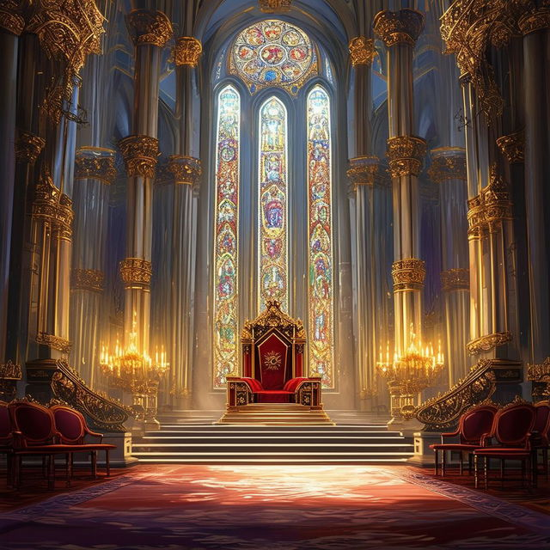
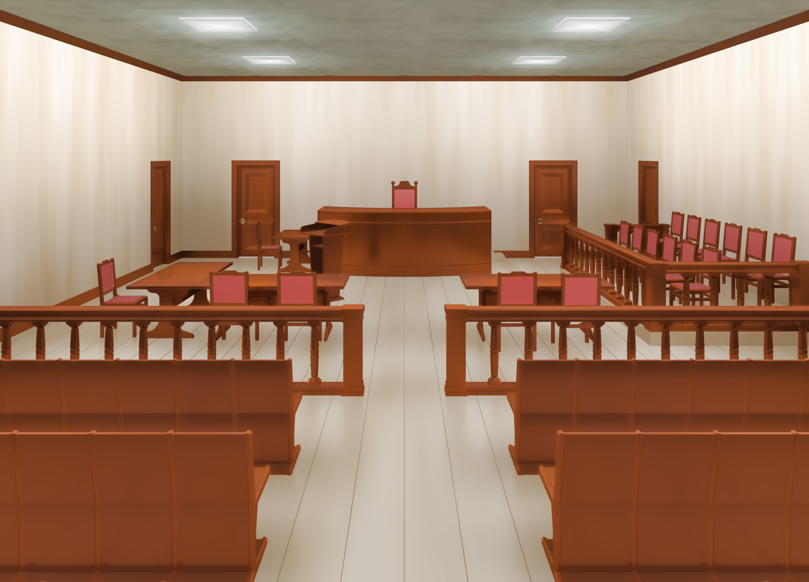
Notes:
Cases would have been heard before the throne of the king
Now it looks more like this – this is where we might see an ‘advocate’ at work
Before the throne drama
Jesus standing in your place – he is talking to the judgment seat
My people (those who believe in me) have sin
Your law says death
Here is my blood – I have paid their debt
It would be unjust to demand two payments for one debt
There your law demands acquittal

Slide 13
Before the throne of God
¹⁴ Since then we have a great high priest who has passed through the heavens, Jesus, the Son of God, let us hold fast our confession. ¹⁵ For we do not have a high priest who is unable to sympathize with our weaknesses, but one who in every respect has been tempted as we are, yet without sin. ¹⁶ Let us then with confidence draw near to the throne of grace, that we may receive mercy and find grace to help in time of need.
- Heb 4:14-16
Notes:
Hebrews 7:25: "Therefore he is able to save completely those who come to God through him, because he always lives to intercede for them".
Romans 8:34: "Jesus is at the right hand of God and is also interceding for us".

Slide 14


The Second ‘parakaleo’
Notes:
Look to what the first advocate achieved
Look at the cross and the empty tomb… therefore everything is different
Look at what He has done for you
Look at His love
Look at how righteous you are
Why are you upset/worried
Loss of power
Criticism
Ground your identity in Him
Your circumstance is not the greatest truth

Slide 15
…therefore…
Fear of desertion/rejection
Shame of past
Fear of Failure
“Who calls me poor? I am rich and I will stand before him as bold as a lion”
Notes:
Viewing my circumstance through the reality of the cross/empty tomb
Fear of desertion/rejection (Don’t want to upset the applecart, speak truth to loved ones, show your real self) – He will never leave me nor forsake me (Heb 13:5) – desire & ability to put wellbeing of other than myself
Shame of my past (hatred of what you’ve done) – there is no condemnation for those in christ jesus (rom 8:1)
Fear of failure (criticism/loss of power) – For when I am weak, then I am strong (2 cor 12:11), already passed only exam that matters, God takes care of the rest – no longer got to strive and fight for my life
Who calls me poor

Slide 16
Question
Think of a situation you recently faced.
How could the truth of the cross/empty tomb change your approach?

Slide 17
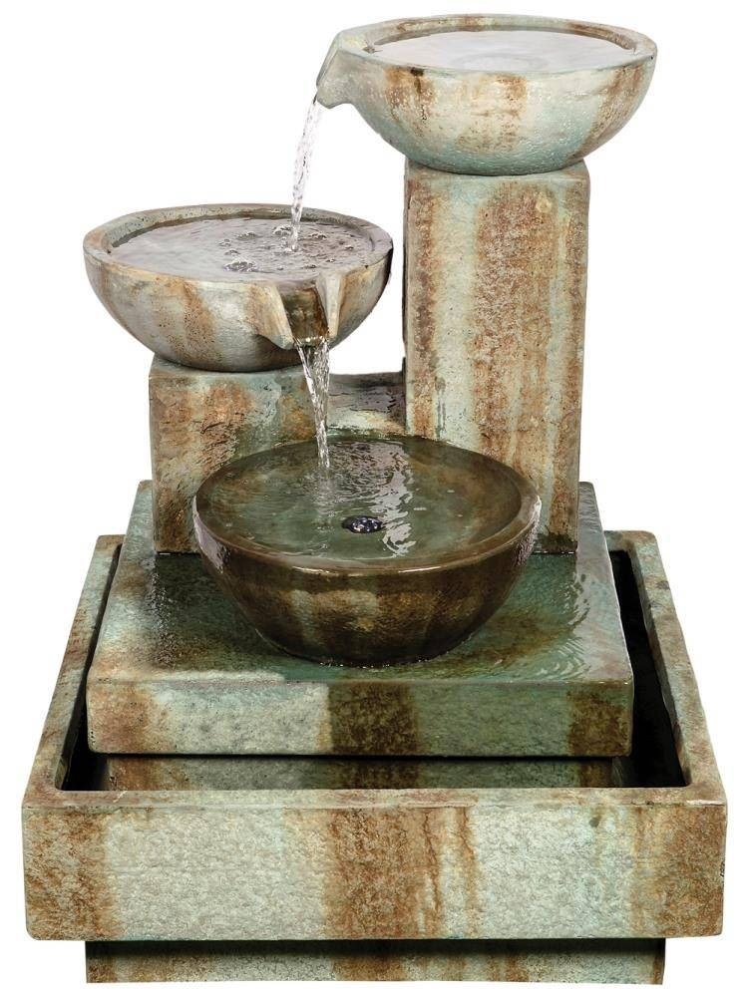
Encouragers need to be encouraged
…the God of all comfort, who comforts us in all our troubles, so that we can comfort those in any trouble with the comfort we ourselves receive from God
- 2 Cor 1:3-4

Slide 18
Before the throne of God above
I have a strong and perfect plea,
a great High Priest whose name is "Love,"
who ever lives and pleads for me.
My name is graven on His hands;
my name is written on His heart;
I know that while in heav'n He stands,
no tongue can bid me thence depart;
no tongue can bid me thence depart.
Behold Him there, the risen Lamb!
My perfect, spotless Righteousness;
the great unchangeable I AM,
the King of glory and of grace!
One with Himself I cannot die;
my soul is purchased with His blood;
my life is hid with Christ on high,
with Christ my Savior and my God;
with Christ my Savior and my God!
When Satan tempts me to despair,
and tells me of the guilt within,
upward I look and see Him there
who made an end of all my sin.
Because the sinless Savior died,
my sinful soul is counted free;
for God the Just is satisfied
to look on Him and pardon me;
to look on Him and pardon me.
Notes:
Let’s look back at what the Jesus, our 1st advocate has achieved
We will use this song as our response
“God, cause the reality of what Jesus has done affect my life this week”

