Slide 1
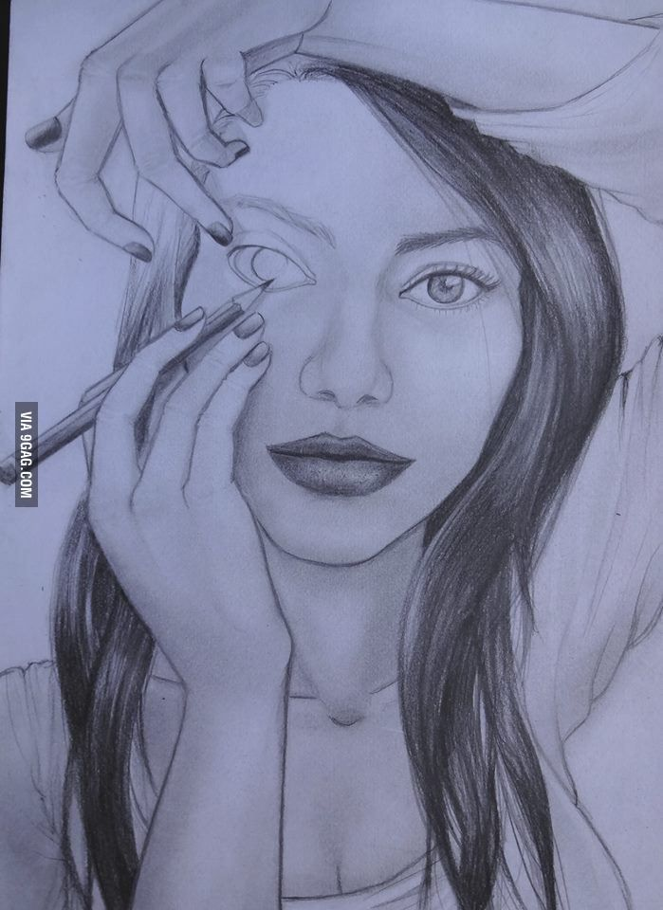
Acts Series
Episode 17: Chpt 14
5th Jan 2025

Slide 2
Acts 14:1-7
At Iconium Paul and Barnabas went as usual into the Jewish synagogue. There they spoke so effectively that a great number of Jews and Greeks believed. But the Jews who refused to believe stirred up the other Gentiles and poisoned their minds against the brothers. So Paul and Barnabas spent considerable time there, speaking boldly for the Lord, who confirmed the message of his grace by enabling them to perform signs and wonders. The people of the city were divided; some sided with the Jews, others with the apostles. There was a plot afoot among both Gentiles and Jews, together with their leaders, to mistreat them and stone them. But they found out about it and fled to the Lycaonian cities of Lystra and Derbe and to the surrounding country, where they continued to preach the gospel.

Slide 3
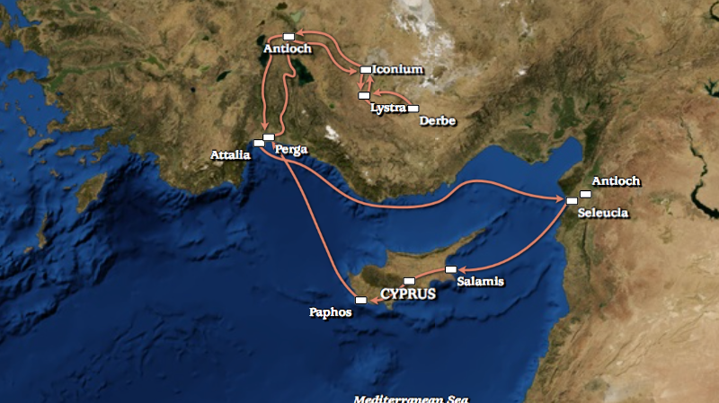
Notes:
In Acts 13 (Lydia & Neil) Paul & Barnabas were sent on first mission trip. New idea, dangerous. Chpt 14 continues this trip
Commentators estimate it took them between almost one year and nearly two years. They travelled a minimum of 500 miles by sea and 700 miles by land.
Iconium is an ancient name for the city of Konya in Turkey, and it literally translates to "City of the Image"
These towns were in region of Galatia and who Paul had in mind when he wrote Galatians

Slide 4
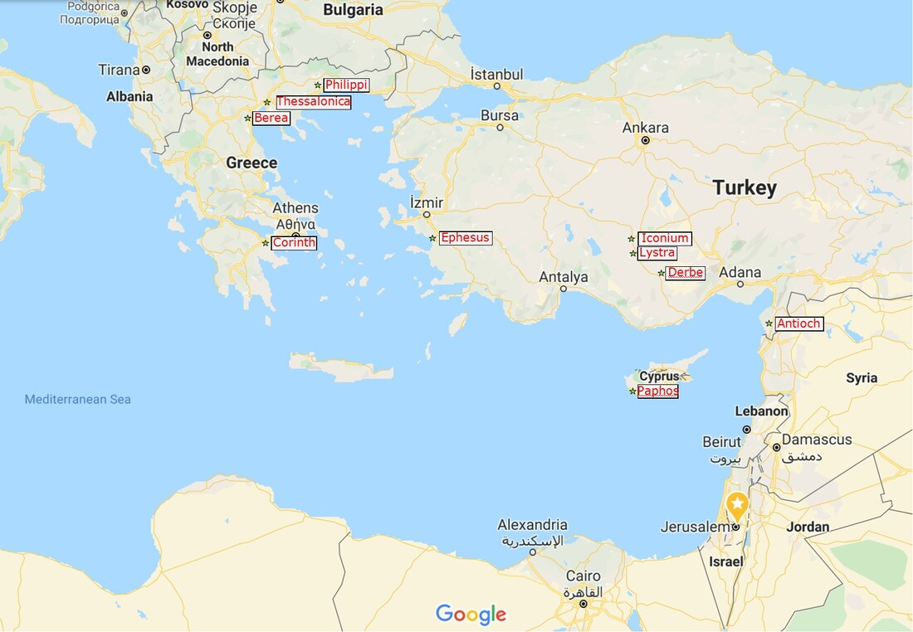

Slide 5

There they spoke so effectively that a great number of Jews and Greeks believed.
There was a plot afoot among both Gentiles and Jews, together with their leaders, to mistreat them and stone them.
Notes:
Preached effectively (saw fruit) yet still under threat
Opposition not necessarily result of poor presentation (Jesus was best representative of Himself and He was crucified)
Not just didn’t believe – ‘refused’ to believe – poisoned – no neutral positions to gospel
Messengers of Ultimate king have to flee…???

Slide 6
Acts 14:8-9
In Lystra there sat a man who was lame. He had been that way from birth and had never walked. He listened to Paul as he was speaking. Paul looked directly at him, saw that he had faith to be healed and called out, “Stand up on your feet!” At that, the man jumped up and began to walk.

Slide 7
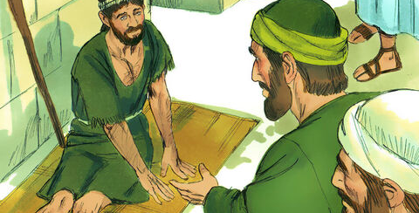
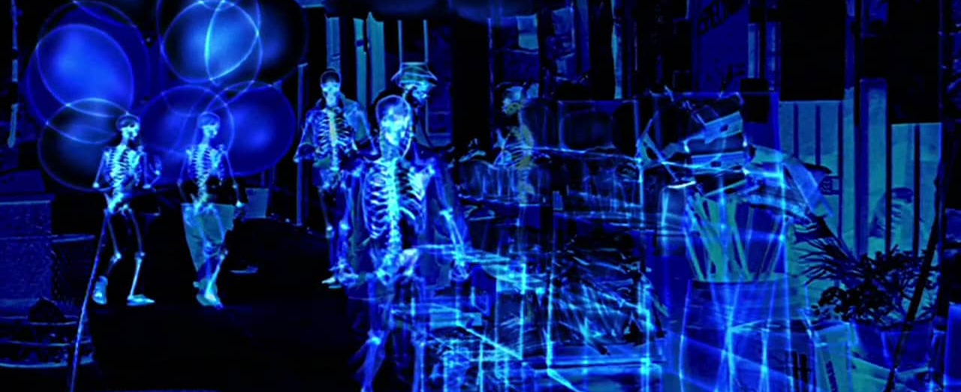
Paul looked directly at him, saw that he had faith…
Notes:
Paul’s words woke faith
Mirror Acts 3:4
To gaze intently, to look steadfastly, fixed gaze upon
Paul perceived the man had faith – I wonder what Paul saw
How do you perceive faith? Faith not the absence of facts, it’s the presence of conviction

Slide 8


Notes:
Ping pong ball pops back up
A proposed statement of faith – can’t be so delicate it can’t be exposed to facts or evidence – these should be poured on – not to extinguish but to stress test (not head in sand)
See if it pops back to the surface
Rom 4:19-20 Without weakening in his faith, he faced the fact that his body was as good as dead... ²⁰ Yet he did not waver through unbelief regarding the promise of God, but was strengthened in his faith …

Slide 9
Do you want to spot and nurture faith?
Notes:
Respect and Nurture faith in others
Look “directly” – what seeds of faith has been planted in others (what is God speaking to them about)
It might sound unconventional – test it, give it a go, get messy
- Maybe you are serving in some team – does your colleague have a new idea, a vision, an inspiration – draw it out, give space, interrupt the schedule

Slide 10
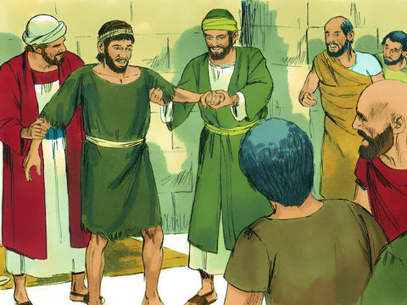
Do you want be a minister of the Spirit?
Notes:
Power evangelism – word and deed

Slide 11
Acts 14:10-18
When the crowd saw what Paul had done, they shouted in the Lycaonian language, “The gods have come down to us in human form!” Barnabas they called Zeus, and Paul they called Hermes because he was the chief speaker. The priest of Zeus, whose temple was just outside the city, brought bulls and wreaths to the city gates because he and the crowd wanted to offer sacrifices to them.
But when the apostles Barnabas and Paul heard of this, they tore their clothes and rushed out into the crowd, shouting: “Friends, why are you doing this? We too are only human, like you. We are bringing you good news, telling you to turn from these worthless things to the living God, who made the heavens and the earth and the sea and everything in them. In the past, he let all nations go their own way. Yet he has not left himself without testimony: He has shown kindness by giving you rain from heaven and crops in their seasons; he provides you with plenty of food and fills your hearts with joy.” Even with these words, they had difficulty keeping the crowd from sacrificing to them.

Slide 12

Presenting the gospel to a pagan audience
Notes:
First time addressing a predominantly gentile crowd (not started at the synagogue)
In Acts 13, when speaking to Jews in diaspora, Paul talked about failure to live up to God’s law
Acts 13:38 “Therefore, my friends, I want you to know that through Jesus the forgiveness of sins is proclaimed to you. ³⁹ Through him everyone who believes is set free from every sin, a justification you were not able to obtain under the law of Moses.
But here they don’t believe in God’s law
How do you present the gospel in a culture that doesn’t believe scripture?
Doesn’t talk about sin and need for forgiveness

Slide 13
“You are worshiping idols, and you need a new master”
Profession/Situation | God
Soldier | God of war
Merchant | God of commerce
Farmer | God of agriculture
Artist | God of music & art
Politician | God of power
Lonely | God of romance
Notes:
You are worshiping idols and you need a new master
A polytheistic society is one that believes in multiple gods – you worship the god that gives you what you need
Not just doing commerce but worshipping it

Slide 14

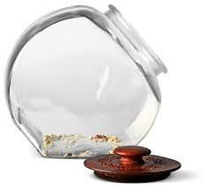
We are bringing you good news, telling you to turn from these worthless things to the living God
Notes:
Making highest allegiance to things which will ultimately leave them empty (deceptive, ineffective, promising fulfilment but falling short)
Worthless/empty – climb up for biscuit tin to discover nothing in it
These things take more than they give.
Now compare to God of all creation – He gives more than He requires – he has been giving you generously even though you haven’t acknowledged Him
You are controlled by what you live for
If you live for love you are controlled by the people who you want to love you
Power, career
False gods will enslave you but the real God will liberate you
This is what you say to relativists (don’t believe God, law of God, in sin/guilt, need for forgiveness, up to you to decide what is right)
You are living for something (you might not want to admit how important this something is for you)
This thing has mastered you – it’s the reason you always feel like an imposer, angry, disillusioned
The real God is the only one who can satisfy you (and if you fail Him, forgive you). If being a great parent is your god and you fail, it won’t die for you, it will punish you for the rest of your life
Christ is the only master who became a servant

Slide 15

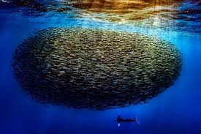
Identifying Idols
Imagination
Money
Disappointment
Uncontrollable emotions
Notes:
Identifying Idols
Imagination – where do my effortless thoughts go? What do you habitually think about?
Money – where does your money effortlessly flow toward heart’s greatest desire
Disappointment - How respond to unanswered prayer and frustrated hopes. What causes explosion of anger and despair.
Uncontrollable emotions – Fishermen know to look for fish where the water is roiling, look for your idols at bottom of most painful emotions, especially those that don’t seem to lift or drive you to do what you know to be wrong. I must have at all costs. Same with fear/despair/guilt

Slide 16
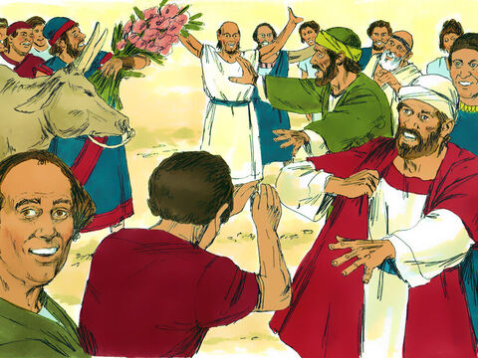
“The gods have come down to us in human form!”
Notes:
Fulfils longing
Acts 14:11 “The gods have come down to us in human form!”
They were wrong – but also right…
Thought Paul & Barn would fulfilling their fairytale
Why do fairytales grab out imagination?
Tolkein – 4 deep longings that realistic fiction can’t satisfy
Long to escape death (time travel)
Long to talk to non-human beings
Long for healing love (without parting)
Long for good to triumph over evil
Our time says not possible – when you die you rot
So why do these stories satisfy us – memory trace – Gen 1-3.
Even the pagans had ‘good dreams’ – something we can remember
There was a God who broke through into our world and promised to fulfil all these longings

Slide 17
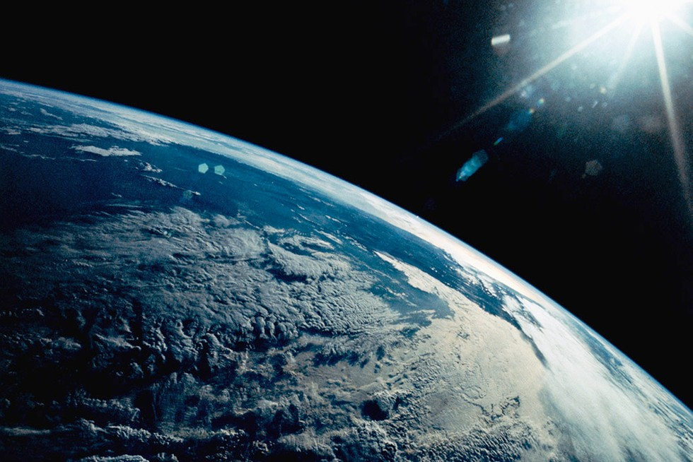
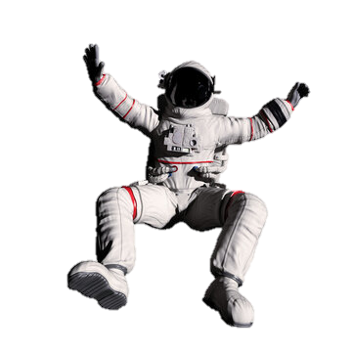
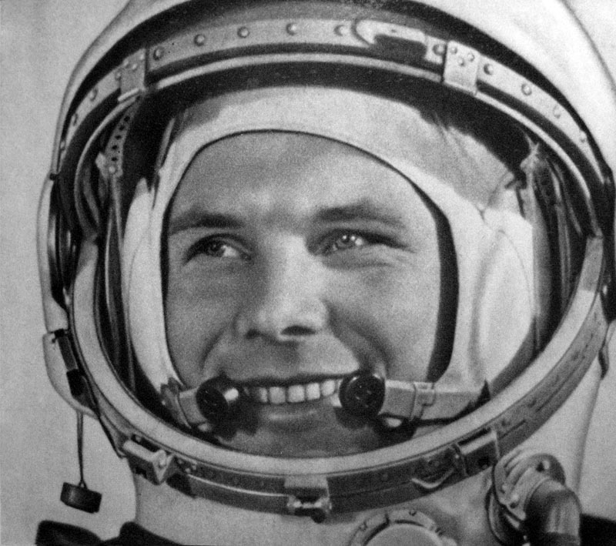
Notes:
When Yuri Gagarin became the first man to journey into outer space,

Slide 18
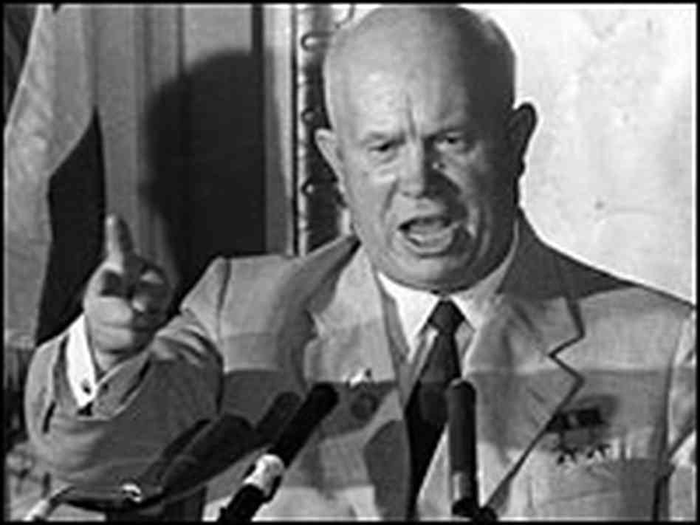
Notes:
Khrushchev declared “now we know there is no God because we have been to the heavens and not found him”.

Slide 19
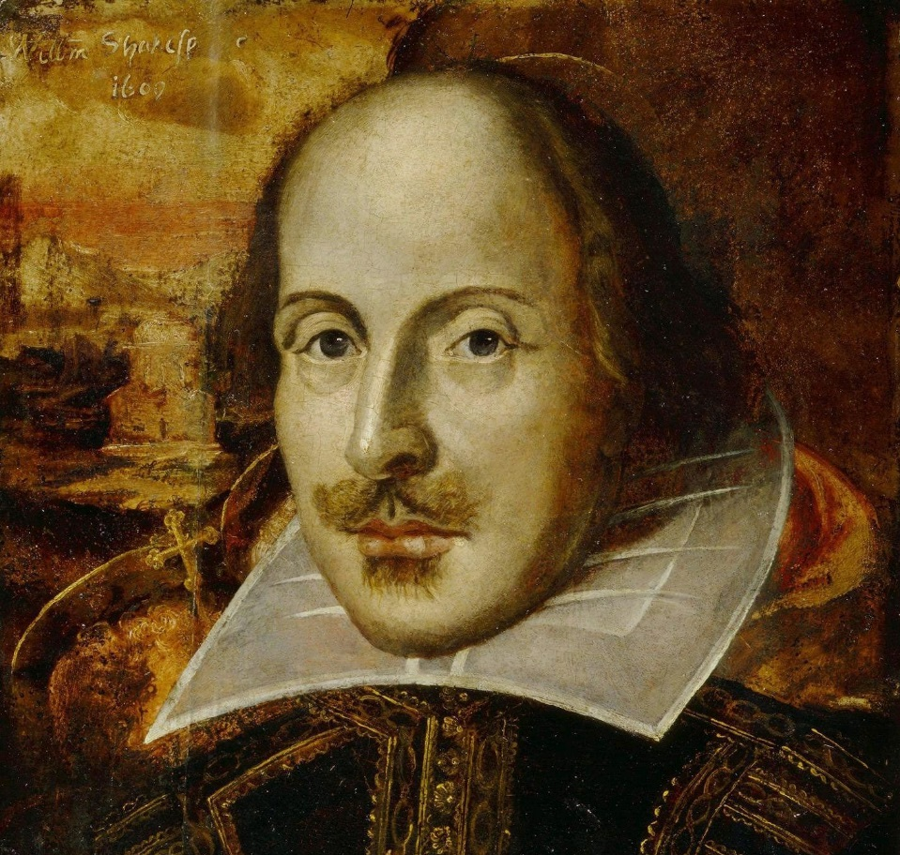
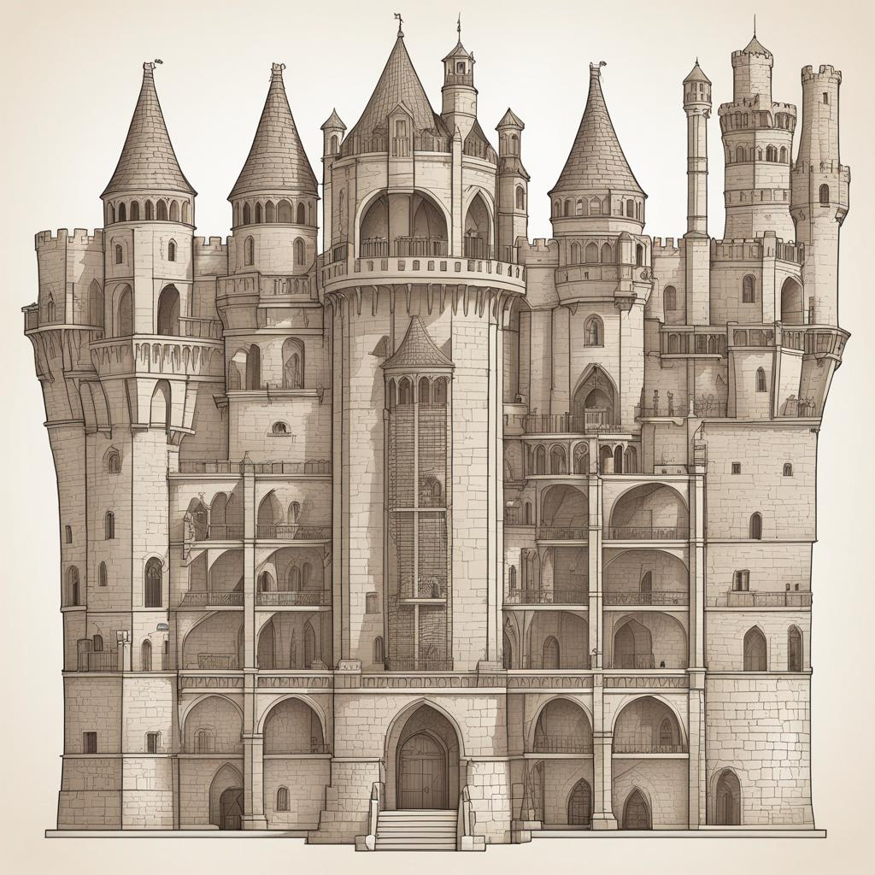

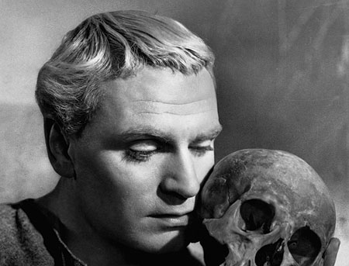
Notes:
CS Lewis remarked – it was like Hamlet trying to find Shakespeare by searching in the attic of his castle. It is a ridiculous idea. The only way the character of the story will become aware of the author is if the author writes Himself into His-story.

Slide 20
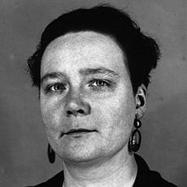
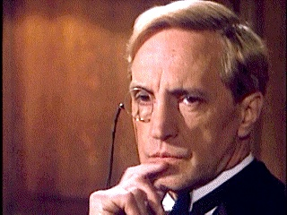
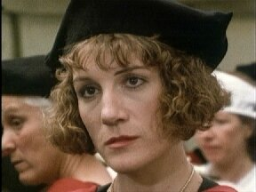
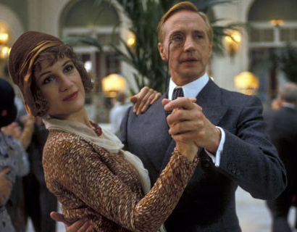
Would you like to be captured by the gospel anew?
Do you want to be a messenger of God?
Notes:
Dorothy L Sayers was one of the first women to graduate Oxford, she write crime fiction and was single. She created a sleuth called Lord Peter Wimsey, a brilliant detective but tortured and lonely. A new character arrives in the series, Harriet Vane. Harriet is one of the first women to graduate Oxford, is single and writes detective novels.
Dorothy L Sayers, saw that her creation (Wimsey) was lost and needed to be rescued so in love for him, she wrote herself into the story.
God wrote Himself into the story, in the form of Jesus, because he saw the creation he loved was lost and needed rescuing.
God did come down in human form to seek and save the lost (us)

Slide 21
Acts 14:19-22
Then some Jews came from Antioch and Iconium and won the crowd over. They stoned Paul and dragged him outside the city, thinking he was dead. But after the disciples had gathered around him, he got up and went back into the city. The next day he and Barnabas left for Derbe.
They preached the gospel in that city and won a large number of disciples. Then they returned to Lystra, Iconium and Antioch, strengthening the disciples and encouraging them to remain true to the faith. “We must go through many hardships to enter the kingdom of God,” they said.

Slide 22
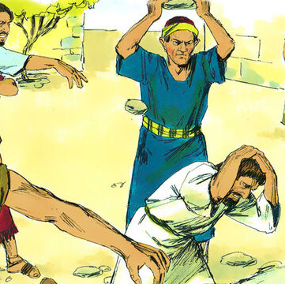
We must go through many hardships
Hardship used as purifying furnace
Nothing can separate us from His love
Testimony to the lost (especially in our culture)
Are you willing to take a new look at your suffering?
Notes:
Flees Iconium, stoned in Lystra – not good advert for messenger
Acts 9:16 I will show him how much he must suffer for my name.”
Hardships help us find the King and become like Him
Humility is a relief after hurt ego and trying desperately to save face
The purifying furnace
The way many Christians face hardship is a doorway to non-believers
Christians suffer and die better – not afraid of death and suffering
Cultural anthropologist Richard Shweder
Every culture gives you a story as to what life is about – western culture says its about (freedom to choose) happiness – gives us no resources to face suffering because it doesn’t help us achieve the story of life. Suffering an interruption not meaningful
Whiniest culture in history
[are you willing to take a new look at your suffering]

