Slide 1
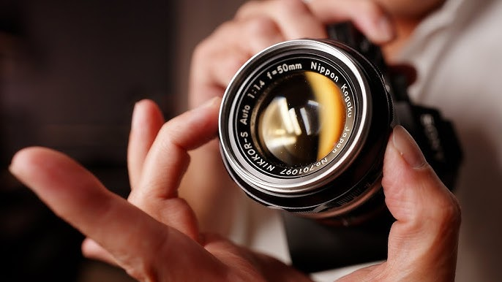
Acts Series
Episode 20: Chpt 16
23rd Feb 2025

Slide 2
Acts 16:16-24
Once when we were going to the place of prayer, we were met by a female slave who had a spirit by which she predicted the future. She earned a great deal of money for her owners by fortune-telling. She followed Paul and the rest of us, shouting, “These men are servants of the Most High God, who are telling you the way to be saved.” She kept this up for many days. Finally Paul became so annoyed that he turned around and said to the spirit, “In the name of Jesus Christ I command you to come out of her!” At that moment the spirit left her.
When her owners realized that their hope of making money was gone, they seized Paul and Silas and dragged them into the marketplace to face the authorities. They brought them before the magistrates and said, “These men are Jews, and are throwing our city into an uproar by advocating customs unlawful for us Romans to accept or practice.”
Notes:
Slave girl – correct but aggravating
Was Paul correct to cast demon out? Know God’s mind and moment – perhaps he would have had more time if he didn’t lose his temper!
Power of God through Paul!
Motive – money generation. Presented – concern for peace of city and compliance with Rome – Magistrates not spot (fear makes us pliable)

Slide 3
Acts 16:16-24
The crowd joined in the attack against Paul and Silas, and the magistrates ordered them to be stripped and beaten with rods. After they had been severely flogged, they were thrown into prison, and the jailer was commanded to guard them carefully. When he received these orders, he put them in the inner cell and fastened their feet in the stocks.
Notes:
Whip up mob – Madness of Crowds
No trial – authenticity is about speed of reaction (vs angry letter best not sent) – wait for facts to emerge before casting verdict
Jailer particularly cruel – not wash wounds, only asked to guard them carefully but he puts in inner cell & stocks

Slide 4
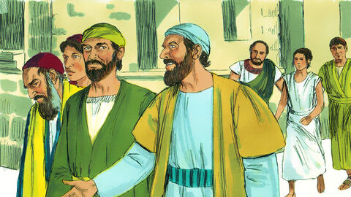
1. Power In Team
Notes:
¹⁶ Once when we were going to the place of prayer, we were met by a female slave who had a spirit by which she predicted the future. She earned a great deal of money for her owners by fortune-telling. ¹⁷ She followed Paul and the rest of us, shouting, “These men are servants of the Most High God, who are telling you the way to be saved.”
Luke joins Paul and Co in verse 10-11 = “we”
Power of team – who are you in team with?
Power In Team

Slide 5
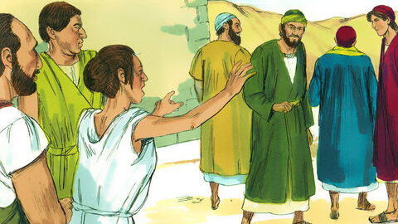
2. Power In the Name
Notes:
¹⁸ She kept this up for many days. Finally Paul became so annoyed that he turned around and said to the spirit, “In the name of Jesus Christ I command you to come out of her!” At that moment the spirit left her.
Power In the Name to set free!

Slide 6
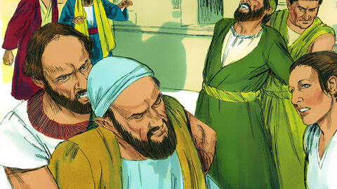
3. The Madness of Crowds
Notes:
¹⁹ When her owners realized that their hope of making money was gone, they seized Paul and Silas and dragged them into the marketplace to face the authorities. ²⁰ They brought them before the magistrates and said, “These men are Jews, and are throwing our city into an uproar ²¹ by advocating customs unlawful for us Romans to accept or practice.”
²² The crowd joined in the attack against Paul and Silas, and the magistrates ordered them to be stripped and beaten with rods.
The Madness of Crowds

Slide 7

The Madness of Crowds
James Thurber
‘The Day the Dam Broke’
Notes:
The Madness of Crowds – Douglas Murray
In 1933 James Thurber published ‘The Day the Dam Broke’, recalling his memories of 12 March 1913 when the whole of his town in Ohio went for a run. Thurber recalled how the rumour began that the dam had broken. Around noon ‘Suddenly somebody began to run. It may be that he had simply remembered, all of a moment, an engagement to meet his wife, for which he was now frightfully late.’ Soon somebody else began to run, ‘perhaps a newsboy in high spirits. Another man, a portly gentleman of affairs, broke into a trot’:
Inside of ten minutes, everybody on High Street, from the Union Depot to the Courthouse, was running. A loud mumble gradually crystallized into the dread word ‘dam’. ‘The dam has broke!’ The fear was put into words by a little old lady in an electric, or by a traffic cop, or by a small boy: nobody knows who, nor does it now really matter. Two thousand people were abruptly in full flight. ‘Go east!’ was the cry that arose – east away from the river, east to safety. ‘Go east! Go east! Go east!’
As the whole town stampedes to the east nobody stops to consider that the dam is so far away from their town that it could not cause a trickle of water to flow across the High Street. Nor does anybody notice the absence of water. The faster residents, who have put miles of distance between themselves and the town, eventually return home, as does everybody else. As Thurber says:
The next day the city went about its business as if nothing had happened, but there was no joking. It was two years or more before you dared treat the breaking of the dam lightly. And even now, twenty years after, there are a few persons . . . who will shut up like a clam if you mention the Afternoon of the Great Run.1

Slide 8
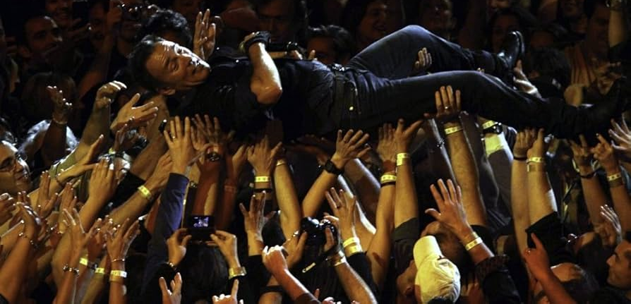
What makes you susceptible to the crowd?
Notes:
What makes you susceptible to the crowd?
Fear can make us malleable – covid compliance / magistrate
What others might think of us – try to keep under the radar
Not research facts for yourself - Silence is violence – immediate reaction is most authentic
Not bothering to come to own decision
None of these things are based on a desire to please God.

Slide 9
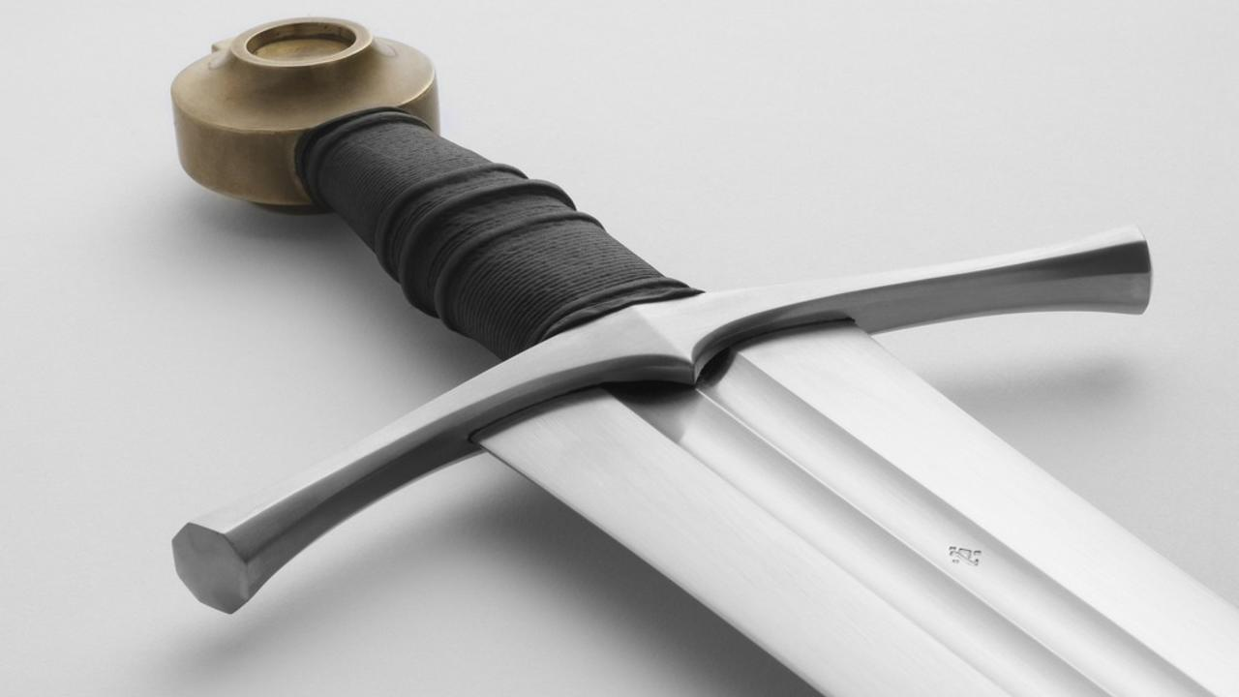
4. Necessity of Discernment
Notes:
Discernment
Motive – money generation. Presented – concern for peace of city and compliance with Rome – Magistrates not spot (fear makes us pliable)
Heb 4:12 For the word of God is alive and active. Sharper than any double-edged sword, it penetrates even to dividing soul and spirit, joints and marrow; it judges the thoughts and attitudes of the heart.

Slide 10
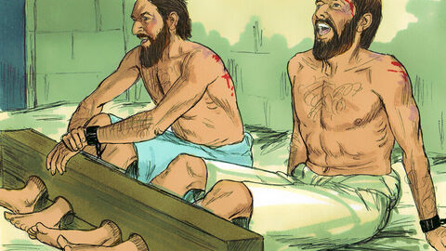
5. Shock of Singing in Stocks
Notes:
²⁴ When he received these orders, he put them in the inner cell and fastened their feet in the stocks.
²⁵ About midnight Paul and Silas were praying and singing hymns to God, and the other prisoners were listening to them.
Praying & singing – what has happened that this would be the response to the injustice they have faced from humans and the result of God’s orders
Body in chains but spirit free
Others listening when singing in stocks
Happiness = (temporary) emotional high derived from apparent positive circumstances
Joy = sustained confidence due to belief in a positive reality even if currently obscured by negative circumstances
TK – Joy = Not absence of trouble But the presence of god
Not merely consolation/ looking on bright side - we can know a reality which puts our present suffering in perspective

Slide 11
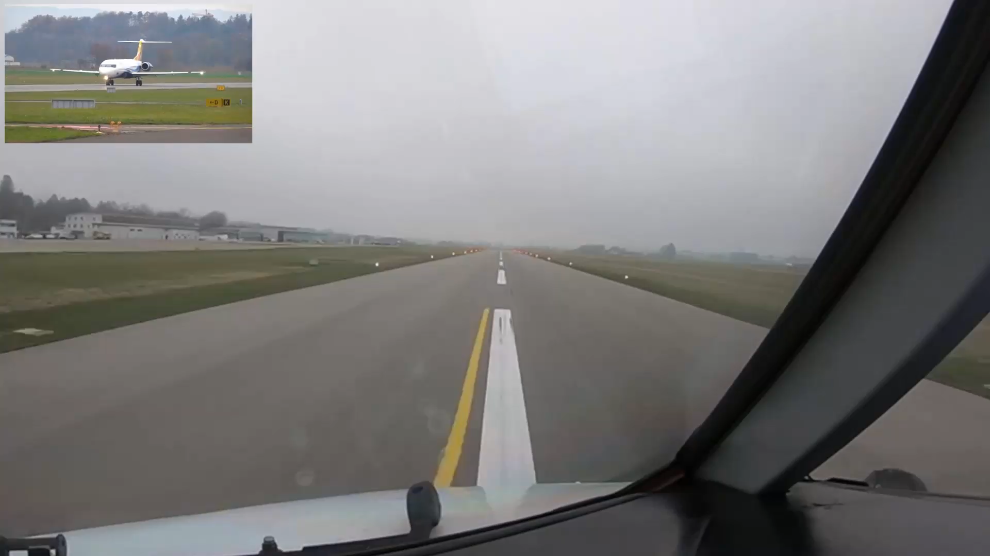
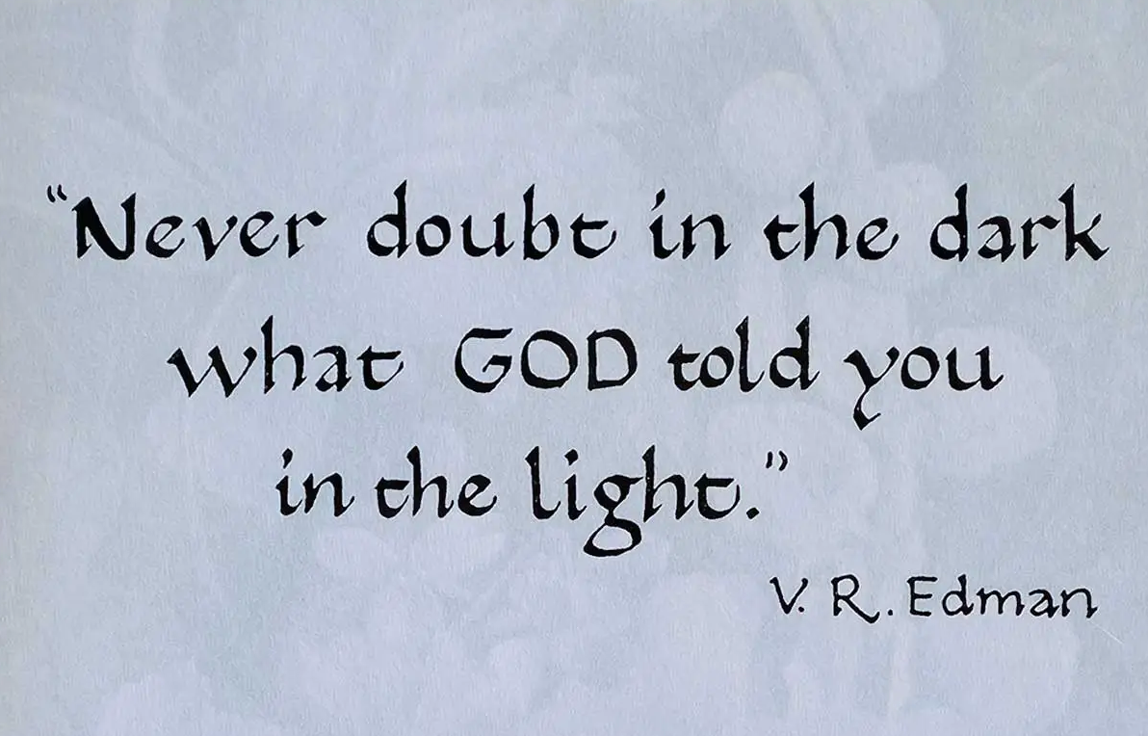
Notes:
Ab Lincoln – behind the clouds the sun is still shining

Slide 12
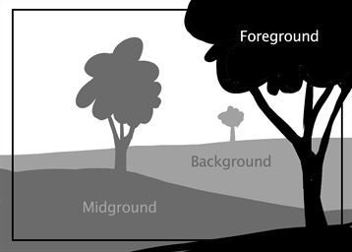
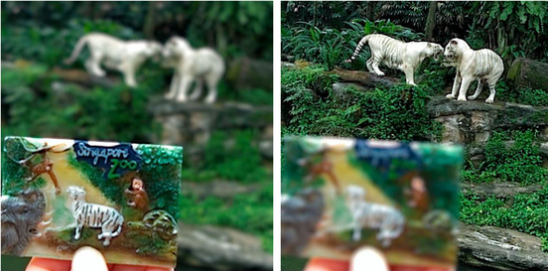
Notes:
Have to choose to manually focus
Psalm 42:5
New International Version
⁵ Why, my soul, are you downcast?
Why so disturbed within me?
Put your hope in God,
for I will yet praise him,
my Savior and my God.
Something in foreground occupied focus but he chose to adjust focus to remember greater truth

Slide 13
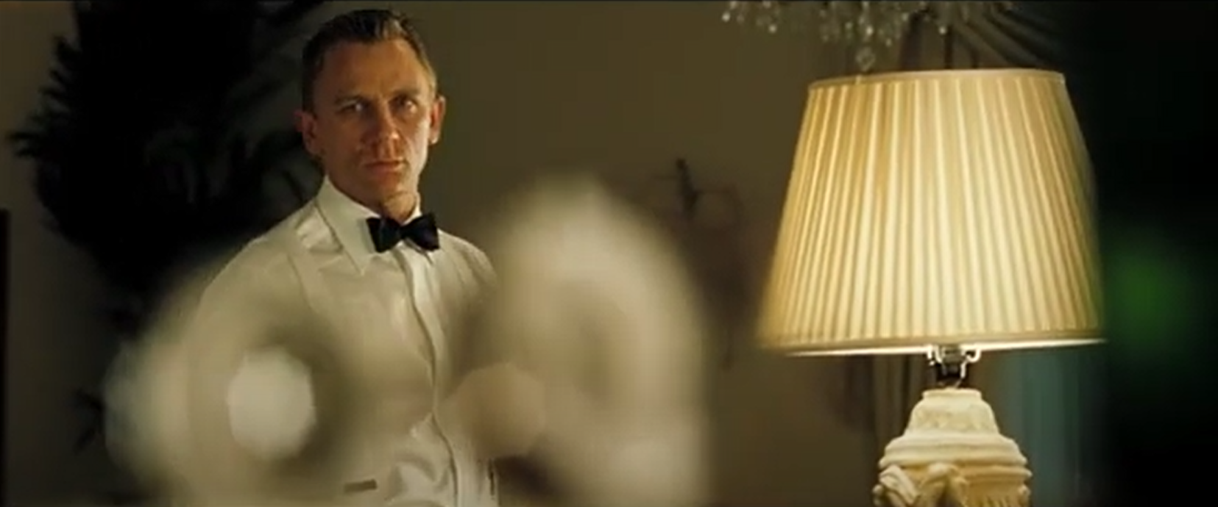
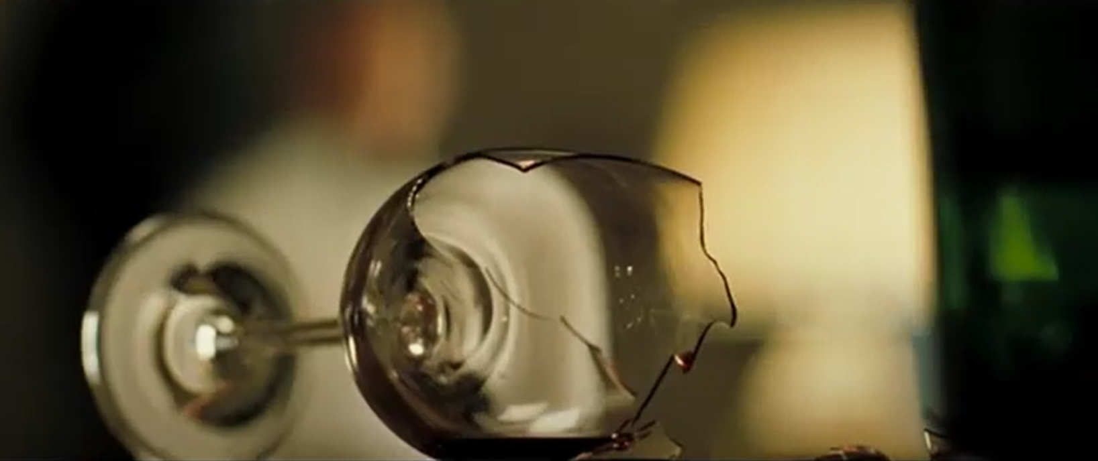

Slide 14
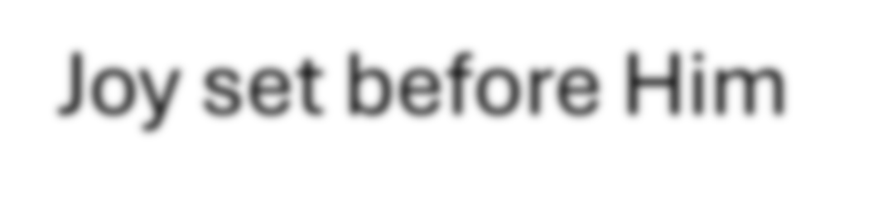
the cross
Notes:
the cross
Joy set before Him
present suffering
glory that will be revealed in us
When sorrows like sea billows roll
My sin, oh, the bliss of this glorious thought!
My sin, not in part but the whole
Is nailed to the cross, and I bear it no more
Praise the Lord, praise the Lord, o my soul!
Health troubles
Difficult job
Economic hardships
Broken relationships
Jesus has reconciled me to God
I’m Saved
I’m loved by Him
He will wipe away every tear
We will see Him face to face

Slide 15

Joy set before Him
Notes:
the cross
Joy set before Him
present suffering
glory that will be revealed in us
When sorrows like sea billows roll
My sin, oh, the bliss of this glorious thought!
My sin, not in part but the whole
Is nailed to the cross, and I bear it no more
Praise the Lord, praise the Lord, o my soul!
Health troubles
Difficult job
Economic hardships
Broken relationships
Jesus has reconciled me to God
I’m Saved
I’m loved by Him
He will wipe away every tear
We will see Him face to face

Slide 16
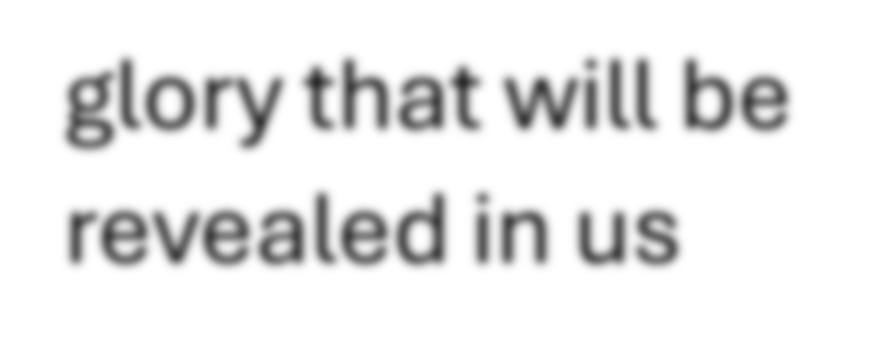
present suffering
Notes:
present suffering
glory that will be revealed in us
When sorrows like sea billows roll
My sin, oh, the bliss of this glorious thought!
My sin, not in part but the whole
Is nailed to the cross, and I bear it no more
Praise the Lord, praise the Lord, o my soul!
Health troubles
Difficult job
Economic hardships
Broken relationships
Jesus has reconciled me to God
I’m Saved
I’m loved by Him
He will wipe away every tear
We will see Him face to face

Slide 17
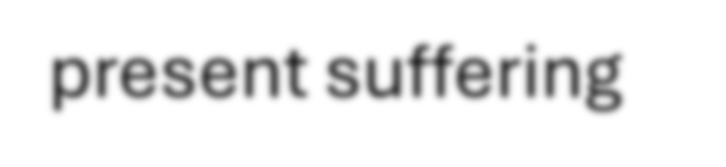
glory that will be revealed in us
Notes:
present suffering
glory that will be revealed in us
When sorrows like sea billows roll
My sin, oh, the bliss of this glorious thought!
My sin, not in part but the whole
Is nailed to the cross, and I bear it no more
Praise the Lord, praise the Lord, o my soul!
Health troubles
Difficult job
Economic hardships
Broken relationships
Jesus has reconciled me to God
I’m Saved
I’m loved by Him
He will wipe away every tear
We will see Him face to face

Slide 18
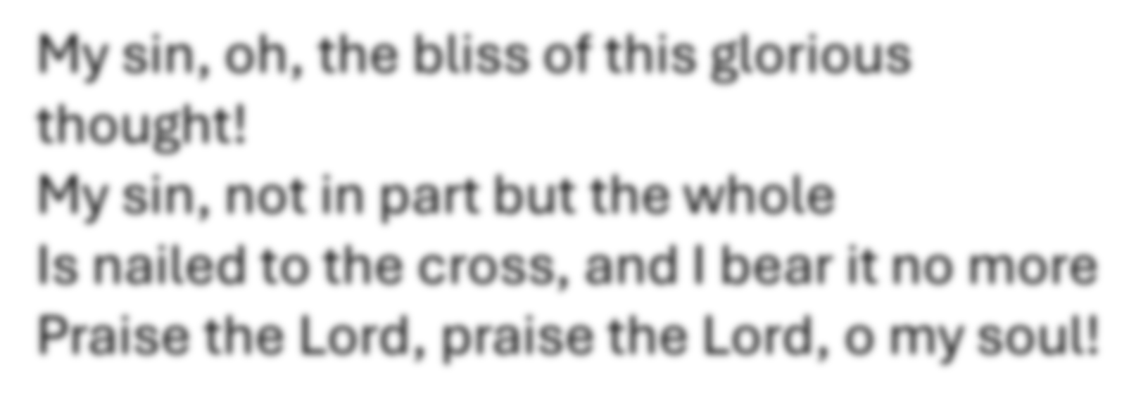
When sorrows like sea billows roll
Notes:
Health troubles
Difficult job
Economic hardships
Broken relationships
Jesus has reconciled me to God
I’m Saved
I’m loved by Him
He will wipe away every tear
We will see Him face to face

Slide 19
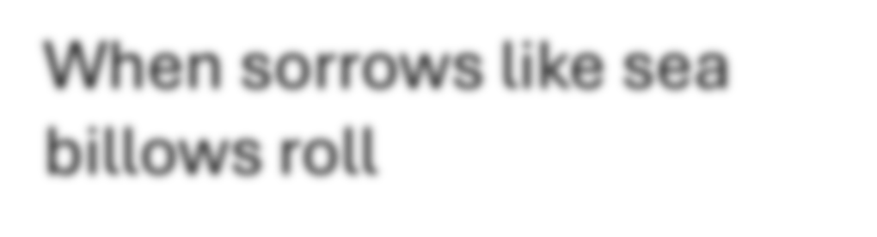
My sin, oh, the bliss of this glorious thought!
My sin, not in part but the whole
Is nailed to the cross, and I bear it no more
Praise the Lord, praise the Lord, o my soul!
Notes:
Health troubles
Difficult job
Economic hardships
Broken relationships
Jesus has reconciled me to God
I’m Saved
I’m loved by Him
He will wipe away every tear
We will see Him face to face

Slide 20
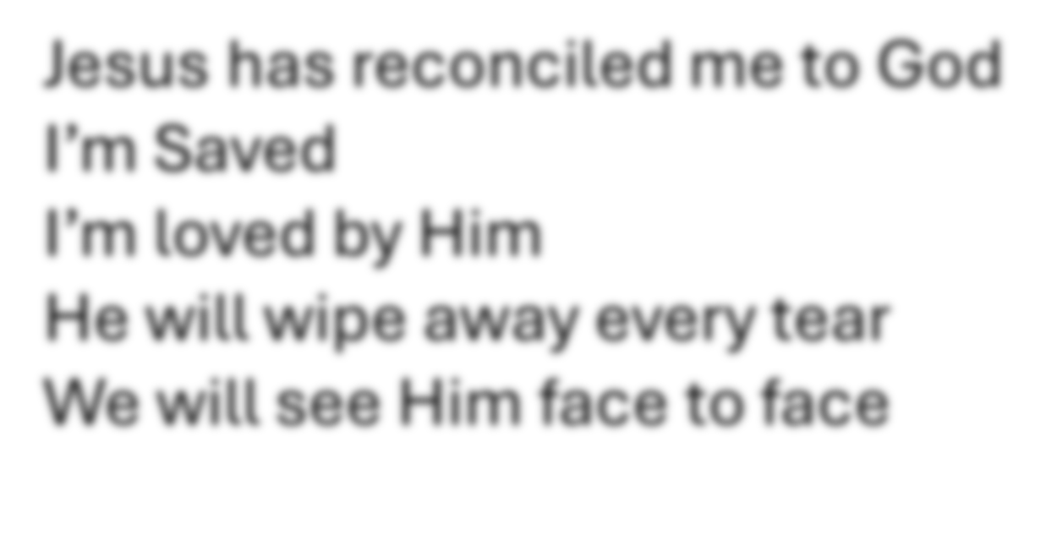
Health troubles
Difficult job
Economic hardships
Broken relationships

Slide 21
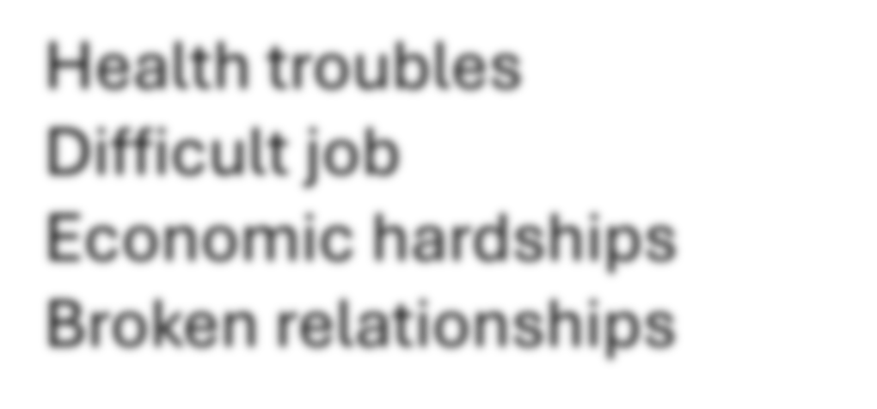
Jesus has reconciled me to God
I’m Saved
I’m loved by Him
He will wipe away every tear
We will see Him face to face

Slide 22
What is your reason for singing in stocks?

Slide 23
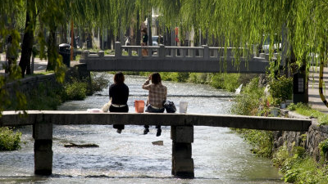
…your life is now hidden with Christ in God (Col 3:3)
Notes:
For you died, and your life is now hidden with Christ in God.

Slide 24
Acts 16:25-34
About midnight Paul and Silas were praying and singing hymns to God, and the other prisoners were listening to them. Suddenly there was such a violent earthquake that the foundations of the prison were shaken. At once all the prison doors flew open, and everyone’s chains came loose. The jailer woke up, and when he saw the prison doors open, he drew his sword and was about to kill himself because he thought the prisoners had escaped. But Paul shouted, “Don’t harm yourself! We are all here!”
The jailer called for lights, rushed in and fell trembling before Paul and Silas. He then brought them out and asked, “Sirs, what must I do to be saved?”

Slide 25
Acts 16:25-34
They replied, “Believe in the Lord Jesus, and you will be saved—you and your household.” Then they spoke the word of the Lord to him and to all the others in his house. At that hour of the night the jailer took them and washed their wounds; then immediately he and all his household were baptized. The jailer brought them into his house and set a meal before them; he was filled with joy because he had come to believe in God—he and his whole household.

Slide 26
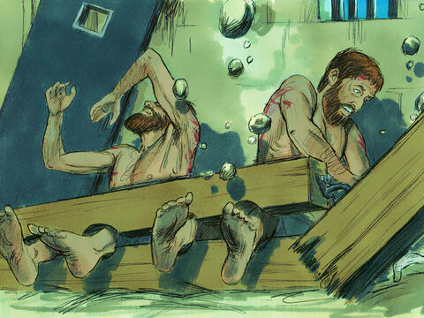
Notes:
²⁶ Suddenly there was such a violent earthquake that the foundations of the prison were shaken. At once all the prison doors flew open, and everyone’s chains came loose.
Earthquake – God wanted to get involved
Punishment for failing in guarding – execution so suicide avoids public shame
Paul concerned for his well-being when jailer had been cruel
Paul command spirits and prisons – why would they obey Paul? Heard him singing?
What must we do to be saved? A vulnerable, open hearted position - it’s not the language of negotiation. - do nothing other than rely on what he has done

Slide 27
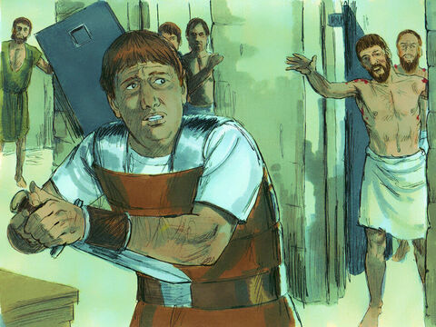
Notes:
²⁷ The jailer woke up, and when he saw the prison doors open, he drew his sword and was about to kill himself because he thought the prisoners had escaped. ²⁸ But Paul shouted, “Don’t harm yourself! We are all here!”
²⁹ The jailer called for lights, rushed in and fell trembling before Paul and Silas. ³⁰ He then brought them out and asked, “Sirs, what must I do to be saved?”
³¹ They replied, “Believe in the Lord Jesus, and you will be saved—you and your household.”
What must you do? Do nothing. And this is the hardest thing to do

Slide 28
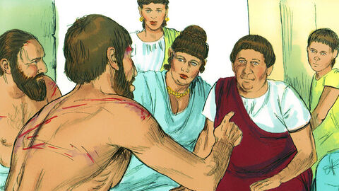
6. “you and your households”
Notes:
³² Then they spoke the word of the Lord to him and to all the others in his house. ³³ At that hour of the night the jailer took them and washed their wounds;
Whole family units coming to him
Children lead families

Slide 29
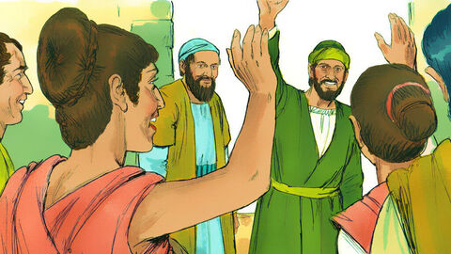
7. Unnatural communities
Notes:
Didn’t play his roman citizen card – chose to suffer along with the people (like Jesus did)
Now he plays the card – to protect the church he has planted – you mistreated me but don’t you dare mistreat them
God has create a space of protection for us
First church meeting in Phillipi – Lydia, slave girl, the jailer

Slide 30
Acts 16:35-40
When it was daylight, the magistrates sent their officers to the jailer with the order: “Release those men.” The jailer told Paul, “The magistrates have ordered that you and Silas be released. Now you can leave. Go in peace.”
But Paul said to the officers: “They beat us publicly without a trial, even though we are Roman citizens, and threw us into prison. And now do they want to get rid of us quietly? No! Let them come themselves and escort us out.”
The officers reported this to the magistrates, and when they heard that Paul and Silas were Roman citizens, they were alarmed. They came to appease them and escorted them from the prison, requesting them to leave the city. After Paul and Silas came out of the prison, they went to Lydia’s house, where they met with the brothers and sisters and encouraged them. Then they left.
Notes:
Magistrate emotional reaction biting butt – wish they had done the research – they were the ones you violated the law
Doesn’t use his rights to protect self – chooses to identify (Phil 2) - Like Jesus renounced his status to suffer for us to afford us the status we couldn’t have afforded ourselves
Paul uses Roman citizenship & shift in power balance to protect the church
Met with the church – Lydia (who wanted to give her resources e.g. home to be used by kingdom), salve girl, jailer – when would they have interacted before – now they are “brothers and sisters”

