Slide 1
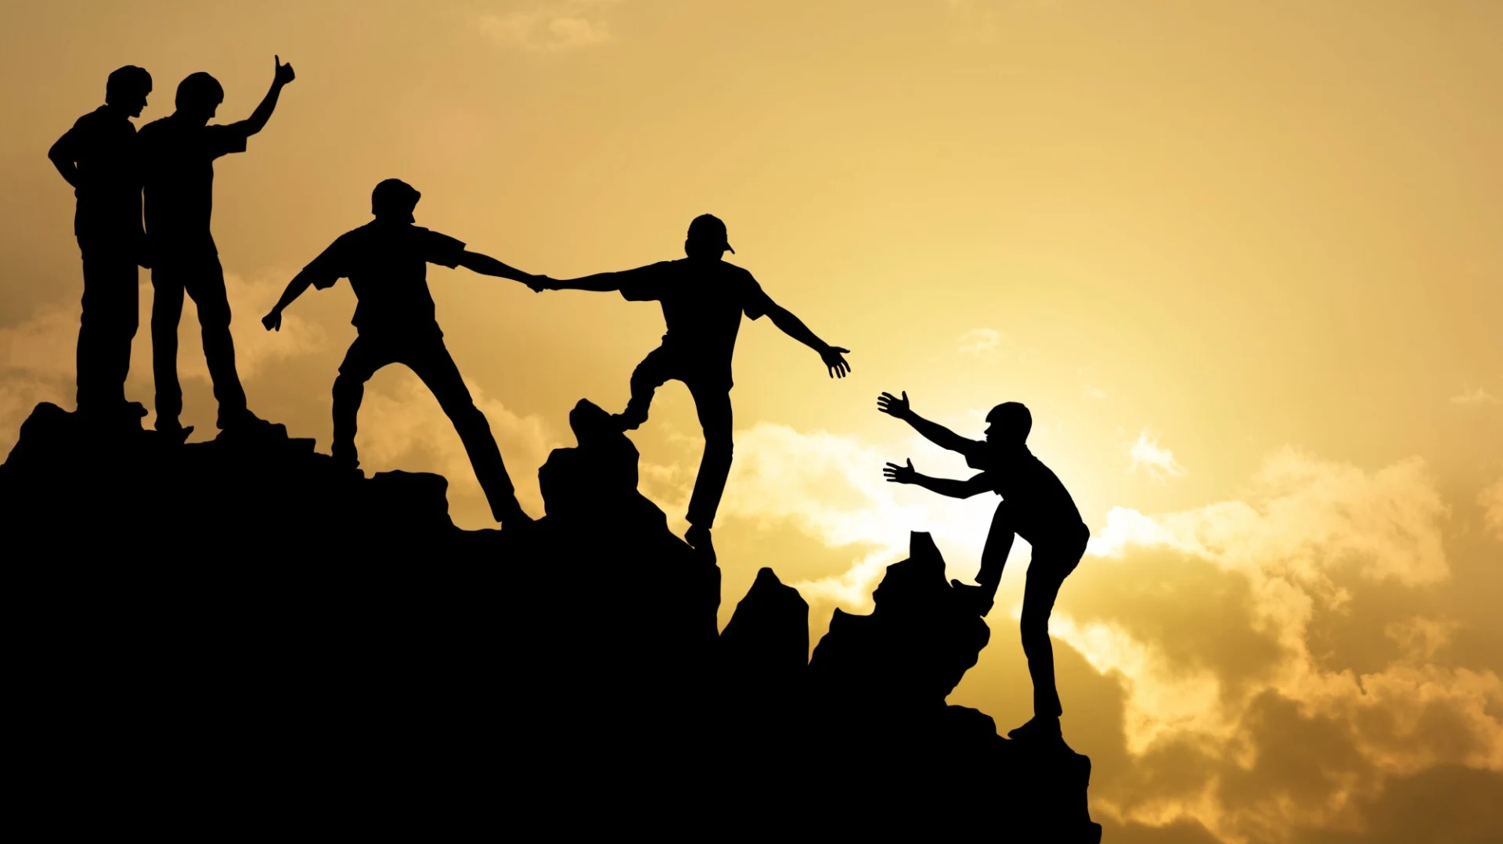
Acts Series
Episode 25: Chpt 21
13th April 2025
Notes:
This chapter gives an illustration of friendship between various groups of new Christian communities. In some cases, Paul and companions hadn’t met these folk before, but something had happened when God had turned their heart towards Him, He had also turned their hearts to each other. Their common allegiance to God supersedes any other common interest/class.
Not just some preacher on the circuit - real emotional involvement
We’ll see the critical nature and power of friendship. And how the tension of responding to God as an individual doesn’t negate the role of the corporate
Do you have friends like this?
Are you a friend like this

Slide 2
Acts 20:36-38, 21:1-6
When Paul had finished speaking, he knelt down with all of them and prayed. They all wept as they embraced him and kissed him. What grieved them most was his statement that they would never see his face again. Then they accompanied him to the ship.
After we had torn ourselves away from them, we put out to sea and sailed straight to Kos. The next day we went to Rhodes and from there to Patara. We found a ship crossing over to Phoenicia, went on board and set sail. After sighting Cyprus and passing to the south of it, we sailed on to Syria. We landed at Tyre, where our ship was to unload its cargo. We sought out the disciples there and stayed with them seven days. Through the Spirit they urged Paul not to go on to Jerusalem. When it was time to leave, we left and continued on our way. All of them, including wives and children, accompanied us out of the city, and there on the beach we knelt to pray. After saying goodbye to each other, we went aboard the ship, and they returned home.

Slide 3
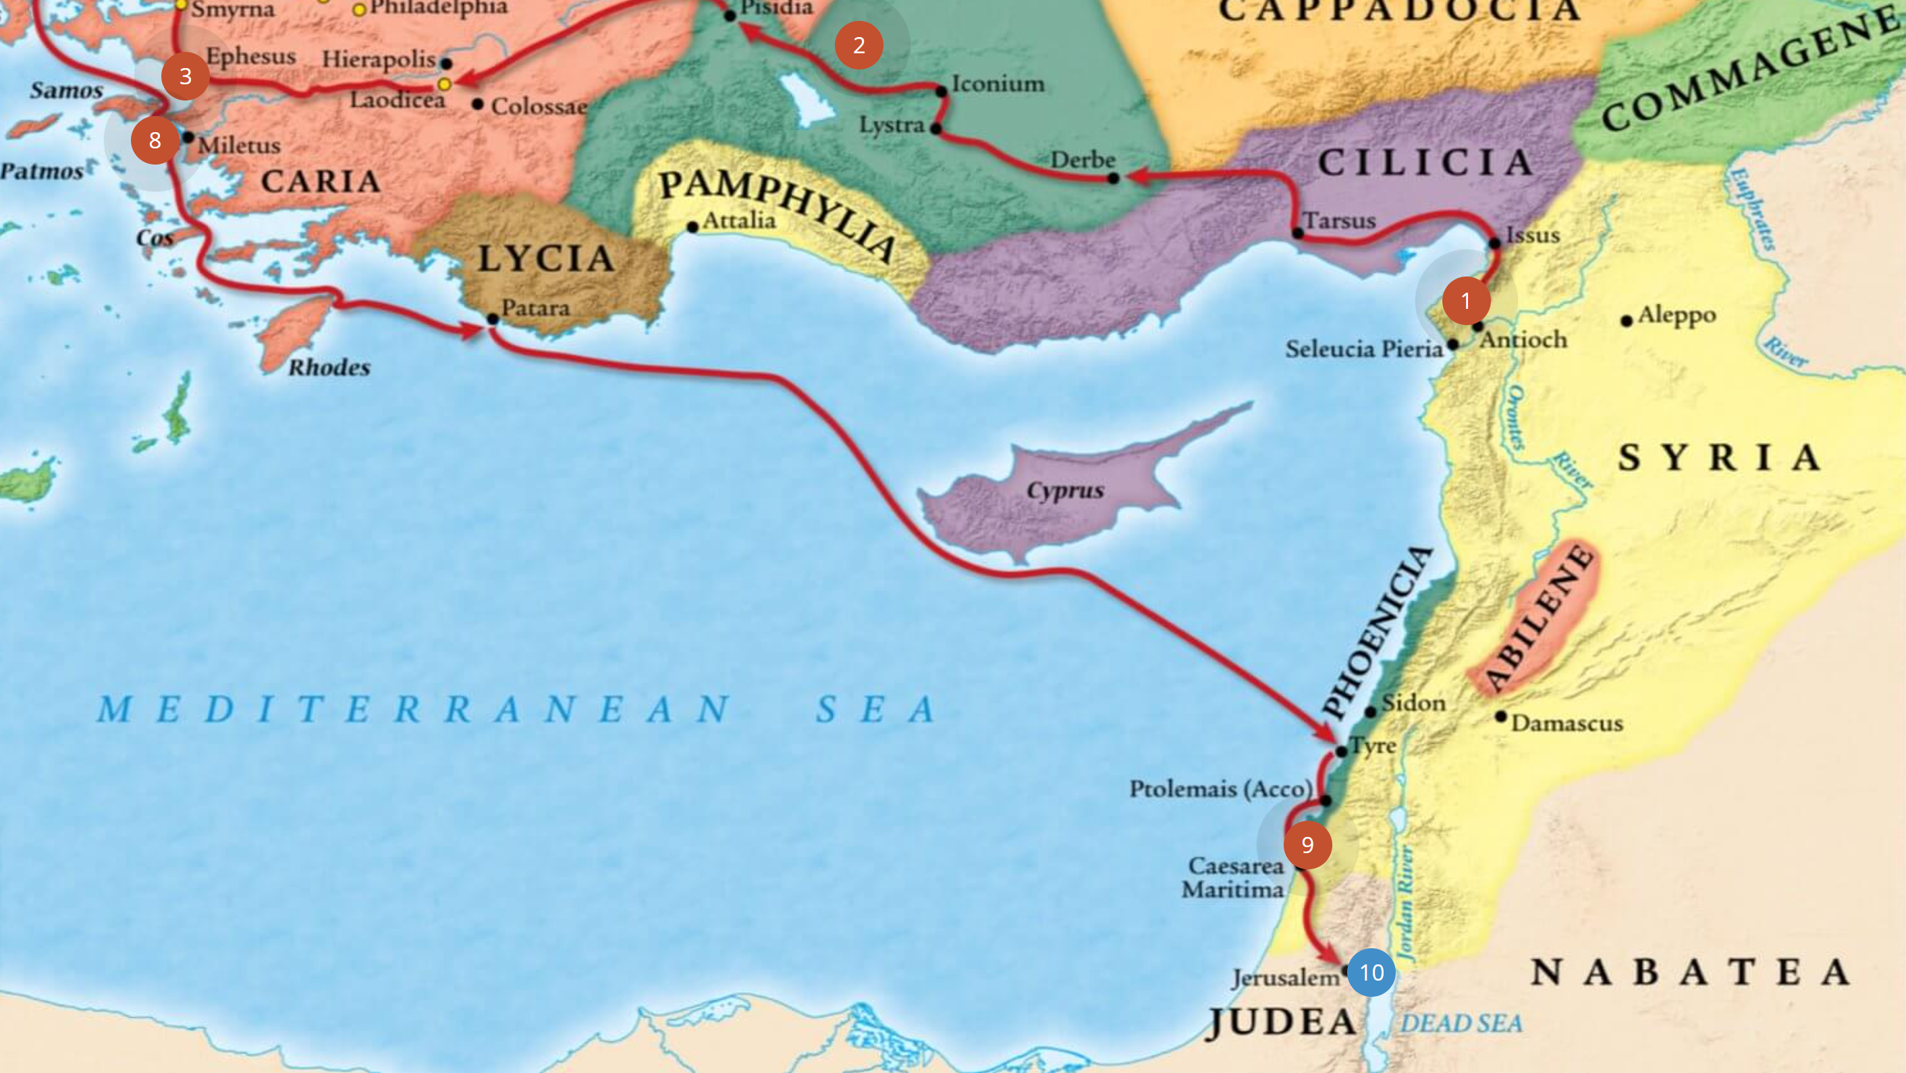
Notes:
Last leg of the third missionary journey
Continue on from Miletus – where Paul had been meeting the Ephesian leaders (whom he had to tear himself away from)
This passage highlight the nature of the friendship which exist in these baby churches. “Christianity” is only about 30 year old.

Slide 4
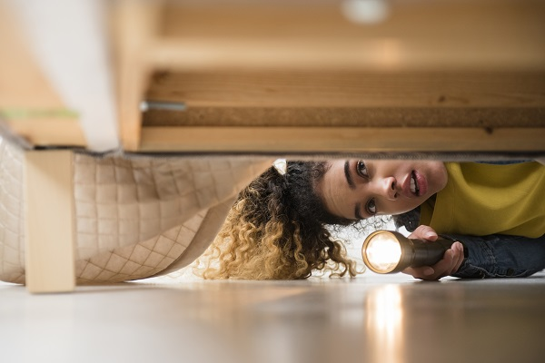

Notes:
:1 torn ourselves away
Hard to tear away because last time they will see Paul (impending death)
Left my heart in San Francisco
Tearing of a person – they were one by what Jesus has done for them – one body
Does the thought of long separation bother you?
:4 We sought out the disciples there
Went in search for. (Long Lost Families) Looking for siblings he had never met? When we discover our Father, we discover we have other siblings. Instant connection, beyond natural commonalities
Do you feel like you have discovered siblings? Or are your church brothers and sisters just happen to attend the same meetings as you? I wonder if God has anything more in store? Would you dare ask Him?

Slide 5
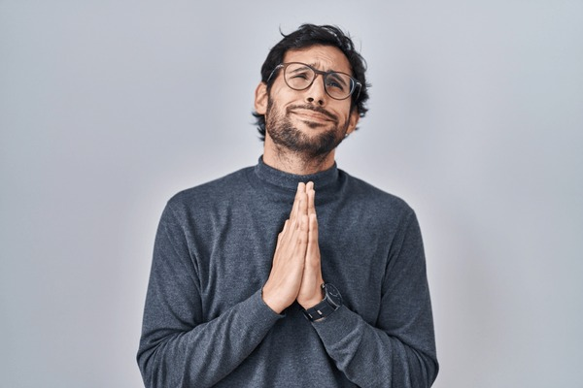
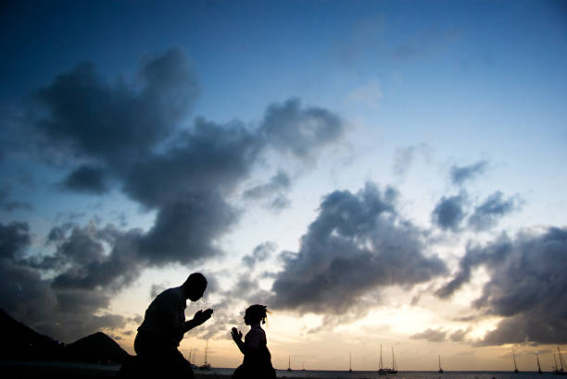
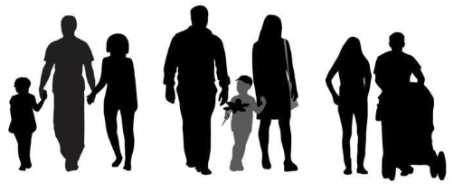
Notes:
:4 Through the Spirit they urged Paul not to go on to Jerusalem
Concern. Getting involved in Paul’s business out of love.
Are you allowing yourself to become disquieted by the course a friend is taking?
“Tolerance” another way of saying “am I my brother’s keeper”
:5 including wives and children
Is there a way to share with your family the work God has you involved with?
My parent eased me into caring by modelling, allowing our family to contribute, inviting me to play my part.
:5 there on the beach we knelt to pray
Seeking God together – a genuine desire to find God mind within the issues and beyond the issue that are directly affecting you.
Is this a feature of your friendship?

Slide 6
Acts 21:7-16
We continued our voyage from Tyre and landed at Ptolemais, where we greeted the brothers and sisters and stayed with them for a day. Leaving the next day, we reached Caesarea and stayed at the house of Philip the evangelist, one of the Seven. He had four unmarried daughters who prophesied.
After we had been there a number of days, a prophet named Agabus came down from Judea. Coming over to us, he took Paul’s belt, tied his own hands and feet with it and said, “The Holy Spirit says, ‘In this way the Jewish leaders in Jerusalem will bind the owner of this belt and will hand him over to the Gentiles.’”
When we heard this, we and the people there pleaded with Paul not to go up to Jerusalem. Then Paul answered, “Why are you weeping and breaking my heart? I am ready not only to be bound, but also to die in Jerusalem for the name of the Lord Jesus.” When he would not be dissuaded, we gave up and said, “The Lord’s will be done.”
After this, we started on our way up to Jerusalem. Some of the disciples from Caesarea accompanied us and brought us to the home of Mnason, where we were to stay. He was a man from Cyprus and one of the early disciples.
Notes:
Hosted by Christians in Tyre, Ptolemais and Caesarea

Slide 7
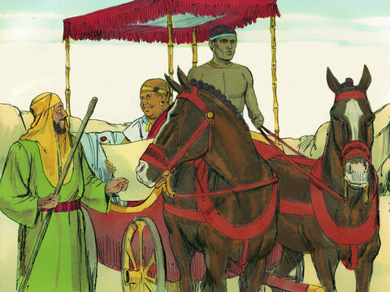
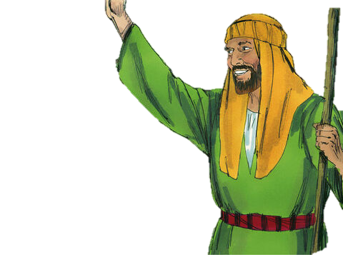
Philip the Evangelist
Notes:
Philip the Evangelist/Deacon
(Different from the Apostle/disciple)
Among 7 Selected by Apostles as deacon in Acts 6 (along with Stephen)
After Paul (Saul) persecution had gone to preach in Samaria, baptised Eunuch, last we heard he was in Caesarea (Acts 8)
Still in Caesarea (Acts 21) – 10-20 years later

Slide 8
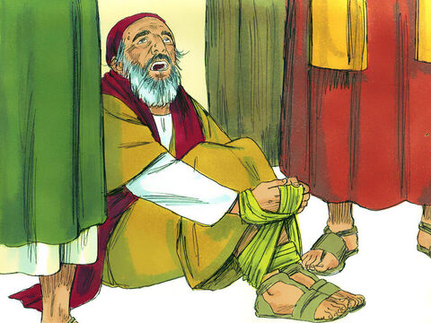
Notes:
:10 Agabus came down from Judea
Acts 11:27-28
In those days some prophets came down from Jerusalem to Antioch. / One of them named Agabus stood up and predicted through the Spirit that a great famine would sweep across the whole world. (This happened under Claudius.)
Paul collects money – opportunity to show what God is like (generous, sacrificial, unity) = glorifying God
Shaped by prophetic word
Joel 2:28 - Your sons and daughters will prophesy
Gift and significance of prophecy
Pour out the oil – shaped us as a community
We want to know what is on God’s mind so we can act and pray accordingly
Seek gifts
1 Cor 14:1 - Follow the way of love and eagerly desire gifts of the Spirit, especially prophecy.

Slide 9
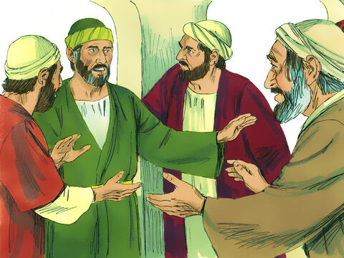
When we heard this, we and the people there pleaded with Paul not to go up to Jerusalem. Then Paul answered, “Why are you weeping and breaking my heart? I am ready not only to be bound, but also to die in Jerusalem for the name of the Lord Jesus.” When he would not be dissuaded, we gave up and said, “The Lord’s will be done.”
Notes:
Agabus’ word sets the cat among the pigeons – causes a panic – understandably Paul’s friends love him and fear for his safety

Slide 10
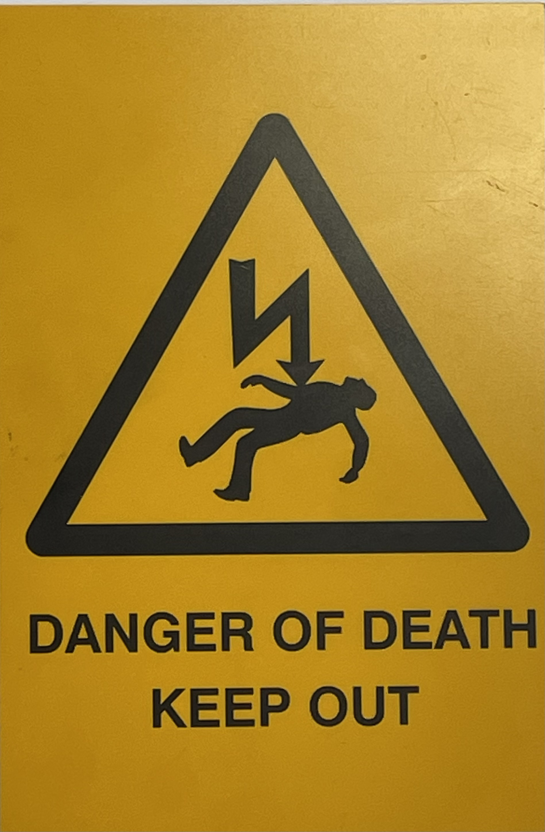
Reading the signs
Notes:
Warning doesn’t mean need to avoid
Paul knows what is coming
Acts 19:21 - Now after these things were finished, Paul resolved in the Spirit to go to Jerusalem after he had passed through Macedonia and Achaia, saying, “After I have been there, I must also see Rome.”
Acts 20:22 “And now, compelled by the Spirit, I am going to Jerusalem, not knowing what will happen to me there. (now he does know)
sometimes God wants us not to be ignorant of what we are facing (e.g. Garden of Gethsemane),

Slide 11
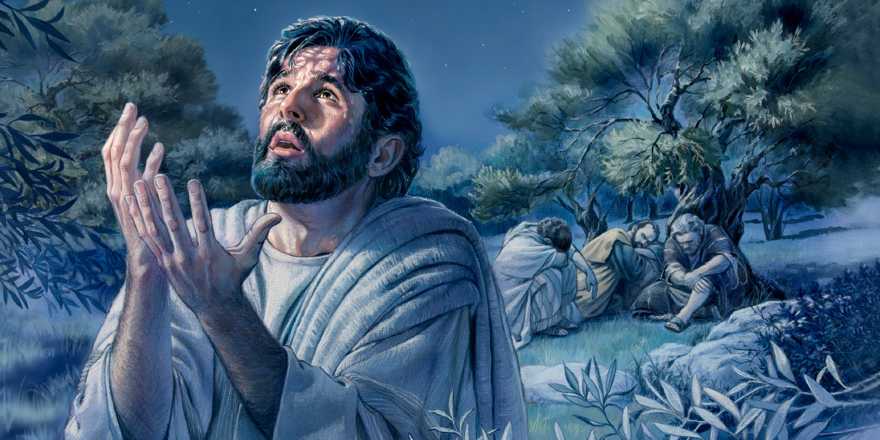
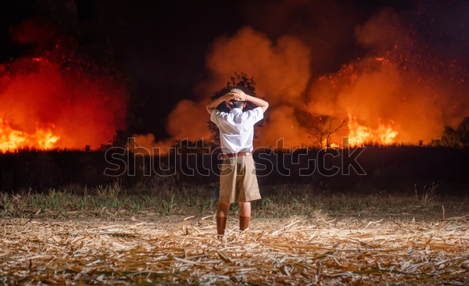
Notes:
Jesus got to see what was coming
“Troubled” is far too mild a translation. It is soul-crushing terror. And the reason is clear: Jesus is not merely anticipating physical suffering-He is staring into the abyss of divine judgment. William Lane says, “This is the horror of one who lived wholly for the Father, who came to be with his Father for a brief interlude before his death and found hell, rather than heaven, open before him.”
This is what's happening in the Garden of Gethsemane. God brought him and set him at the mouth of the furnace that he might look in and stand and view its fierce and raging flames and might see where he was going and might voluntarily enter into it and bear it for sinners as knowing what it was. If Christ had not fully known before he took it and drank it, it would not have properly been his own act as a man. But when he took that cup, knowing what he did, so was his love to us infinitely the more wonderful and his obedience to God infinitely the more perfect. It's almost as if God was saying to him, here is the cup that you were to drink. This is the furnace into which you will be cast if they are to be saved. There is no other way. Either they perish or you perish. See how terrible the heat is. See what pain and anguish you must endure. Is your love such that you will go on?" Now, why, why should we be looking at that? Because Jesus Christ in the dark, when no Jesus Christ in the dark when no one is looking but God.

Slide 12
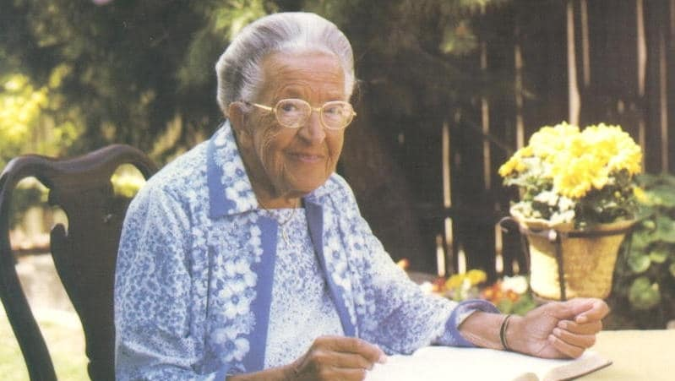
Notes:
sometimes wants us to know God has gone before (e.g. Corrie Ten Boom)
Nightmare become a reassurance
Deu 31:8 The LORD is the one who will go before you. He will be with you; he will not leave you or abandon you. Do not be afraid or discouraged.
God committed to make us more like Jesus (which is the best way to be) more than he is committed to protect us from suffering.
John 17:15 My prayer is not that you take them out of the world but that you protect them from the evil one.
There is a greater evil than the death these guys faced – greater evil = turning away from God

Slide 13


Your will be done
Your will be done
Notes:
“The Lord’s will be done.”
Luke 22:42
“Father, if You are willing, take this cup from Me. Yet not My will, but Yours be done.”
“There are only two kinds of people in the end: those who say to God, "Thy will be done," and those to whom God says, in the end, "Thy will be done." All that are in Hell, choose it. Without that self-choice there could be no Hell. No soul that seriously and constantly desires joy will ever miss it. Those who seek find. Those who knock it is opened.”
― C.S. Lewis, The Great Divorce
Luke 23:46
Jesus called out with a loud voice, “Father, into your hands I commit my spirit.” When he had said this, he breathed his last.
Commit my friend’s spirit

Slide 14
Spiritual Friendship

Slide 15
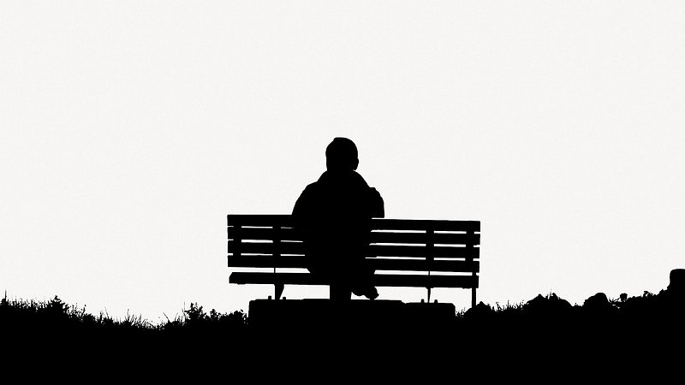


1. Needed
Notes:
This chapter is about friendship – discovery of, reconnecting
Needing friends not sign of weakness/immaturity
One thing before sin that is “not good” – Adam is alone
Adam not lonely because he was imperfect but because he was perfect
Joel Thomas – we don’t have to fetch water for anyone
Loneliness epidemic
Max Dickins called Billy No-Mates

Slide 16
How the hell had this happened to me? And how had I not noticed till now?
Looking back, it was because each step of my social disintegration had been so incredibly mundane. My journey to friendlessness was not dramatic, it was the logical endpoint of a very gentle curve.
It was feigning illness to get out of going to a party. It was turning down an invite to the football because ‘I’ve got work this weekend.’ It was bumping into an old friend and saying ‘We must have a drink – I’ll text you’, knowing I wouldn’t. Friendship has a rhythm and I had lost it. And the consequence, entirely by accident, was that I now had next to no social life.
The phone had stopped ringing.
My diary was empty.
Notes:
Max Dickins called Billy No-Mates
Dickins faces this issue when he needs to pick a best man and realises, he has no male friends.
It is very tempting to turn down a social opportunity and see it as a one-off but as you zoom out you can see how these one-offs form a pattern as you drift off the radar of others.
In the movie Click, Adam Sandler’s character discovers a remote control which can fast forward parts of life which seem inconvenient e.g. a child’s music recital.
How did the church become of one mind? All struck by a happy feeling or sacrifice?
Are you reflecting kingdom culture or our current culture – FOBO, no commitment
Let yourself need people

Slide 17
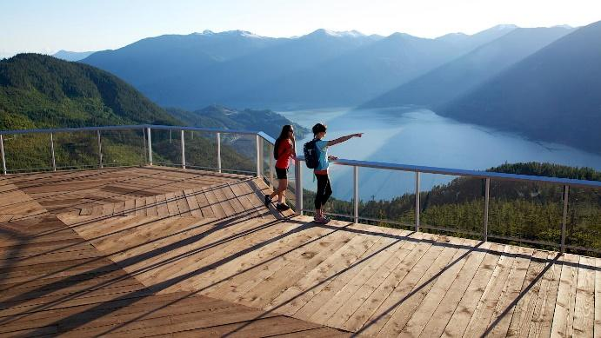
2. Discovered
What? You too? I thought I was the only one."
Notes:
“Friendship arises out of mere Companionship when two or more of the companions discover that they have in common some insight or interest or even taste which the others do not share and which, till that moment, each believed to be his own unique treasure (or burden). The typical expression of opening Friendship would be something like, "What? You too? I thought I was the only one."
― C.S. Lewis, The Four Loves
…The very condition of having Friends is that we should want something else besides Friends. Where the truthful answer to the question Do you see the same truth? would be ‘I see nothing and I don’t care about the truth; I only want a Friend’, no Friendship can arise – though Affection of course may. There would be nothing for the Friendship to be about, and Friendship must be about something... Those who have nothing can share nothing; those who are going nowhere can have no fellow-travellers.
Paul kneels and prays – something they have both discovered that bonds them

Slide 18
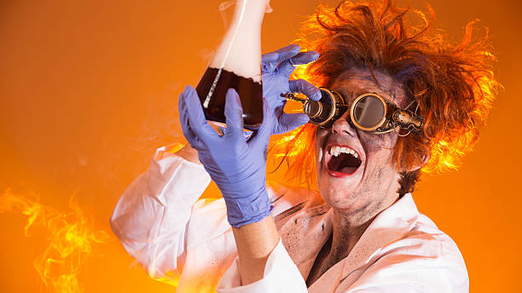
3. Made
Notes:
These people made/created/invested in friendship by sharing in 4 areas…

Slide 19


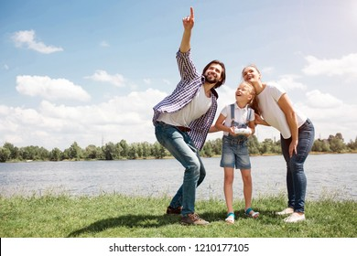

Feelings
Stuff
Shared
Faith
Decision
Notes:
share their feelings (Wept, kissed, embraced)
Share possessions (hospitality)
Share faith (encourage one another)
Heb 3:13 But encourage one another daily, as long as it is called “Today,” so that none of you may be hardened by sin’s deceitfulness.
(Parakaleo) from close-beside“ + "to call”
Remind each other of the gospel
4. Share the decision
How do we hear together? We have the mind of Christ
Love for Paul – natural advice – avoid harm
But Paul knows warnings, yet he is compelled by the Spirit
don’t play the “God-said card”
attempt to hear God must leave room for hearing God through friends
power of spiritual friendship – iron sharpens iron
most of my revelations/deepest character growth come from interaction with friends
:15 After this, we started on our way up to Jerusalem
“We” – Luke walked with him to his doom

Slide 20
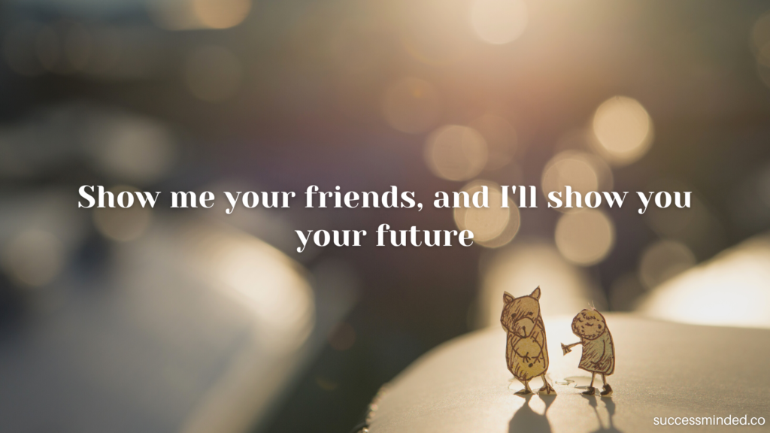
Notes:
Our choice of friends and how we choose to relate can tell a lot about us.
What are you thinking about this as we’ve explored this message?

Slide 21
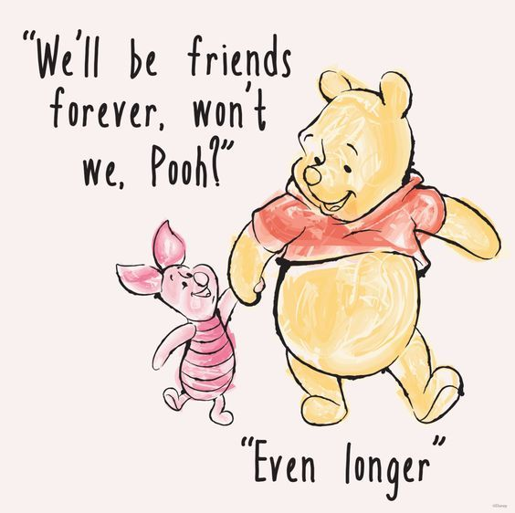
Notes:
What have you got to do to embrace friendship?
Is there are relationship you need to repair?
Have you shared your decisions or chosen to share in your friends?
Do you have friends like this?
Are you a friend like this?
Role to present mature
Lay down my life to ensure they lay down theirs
Friendships between believers will last beyond this lifetime

