Slide 1
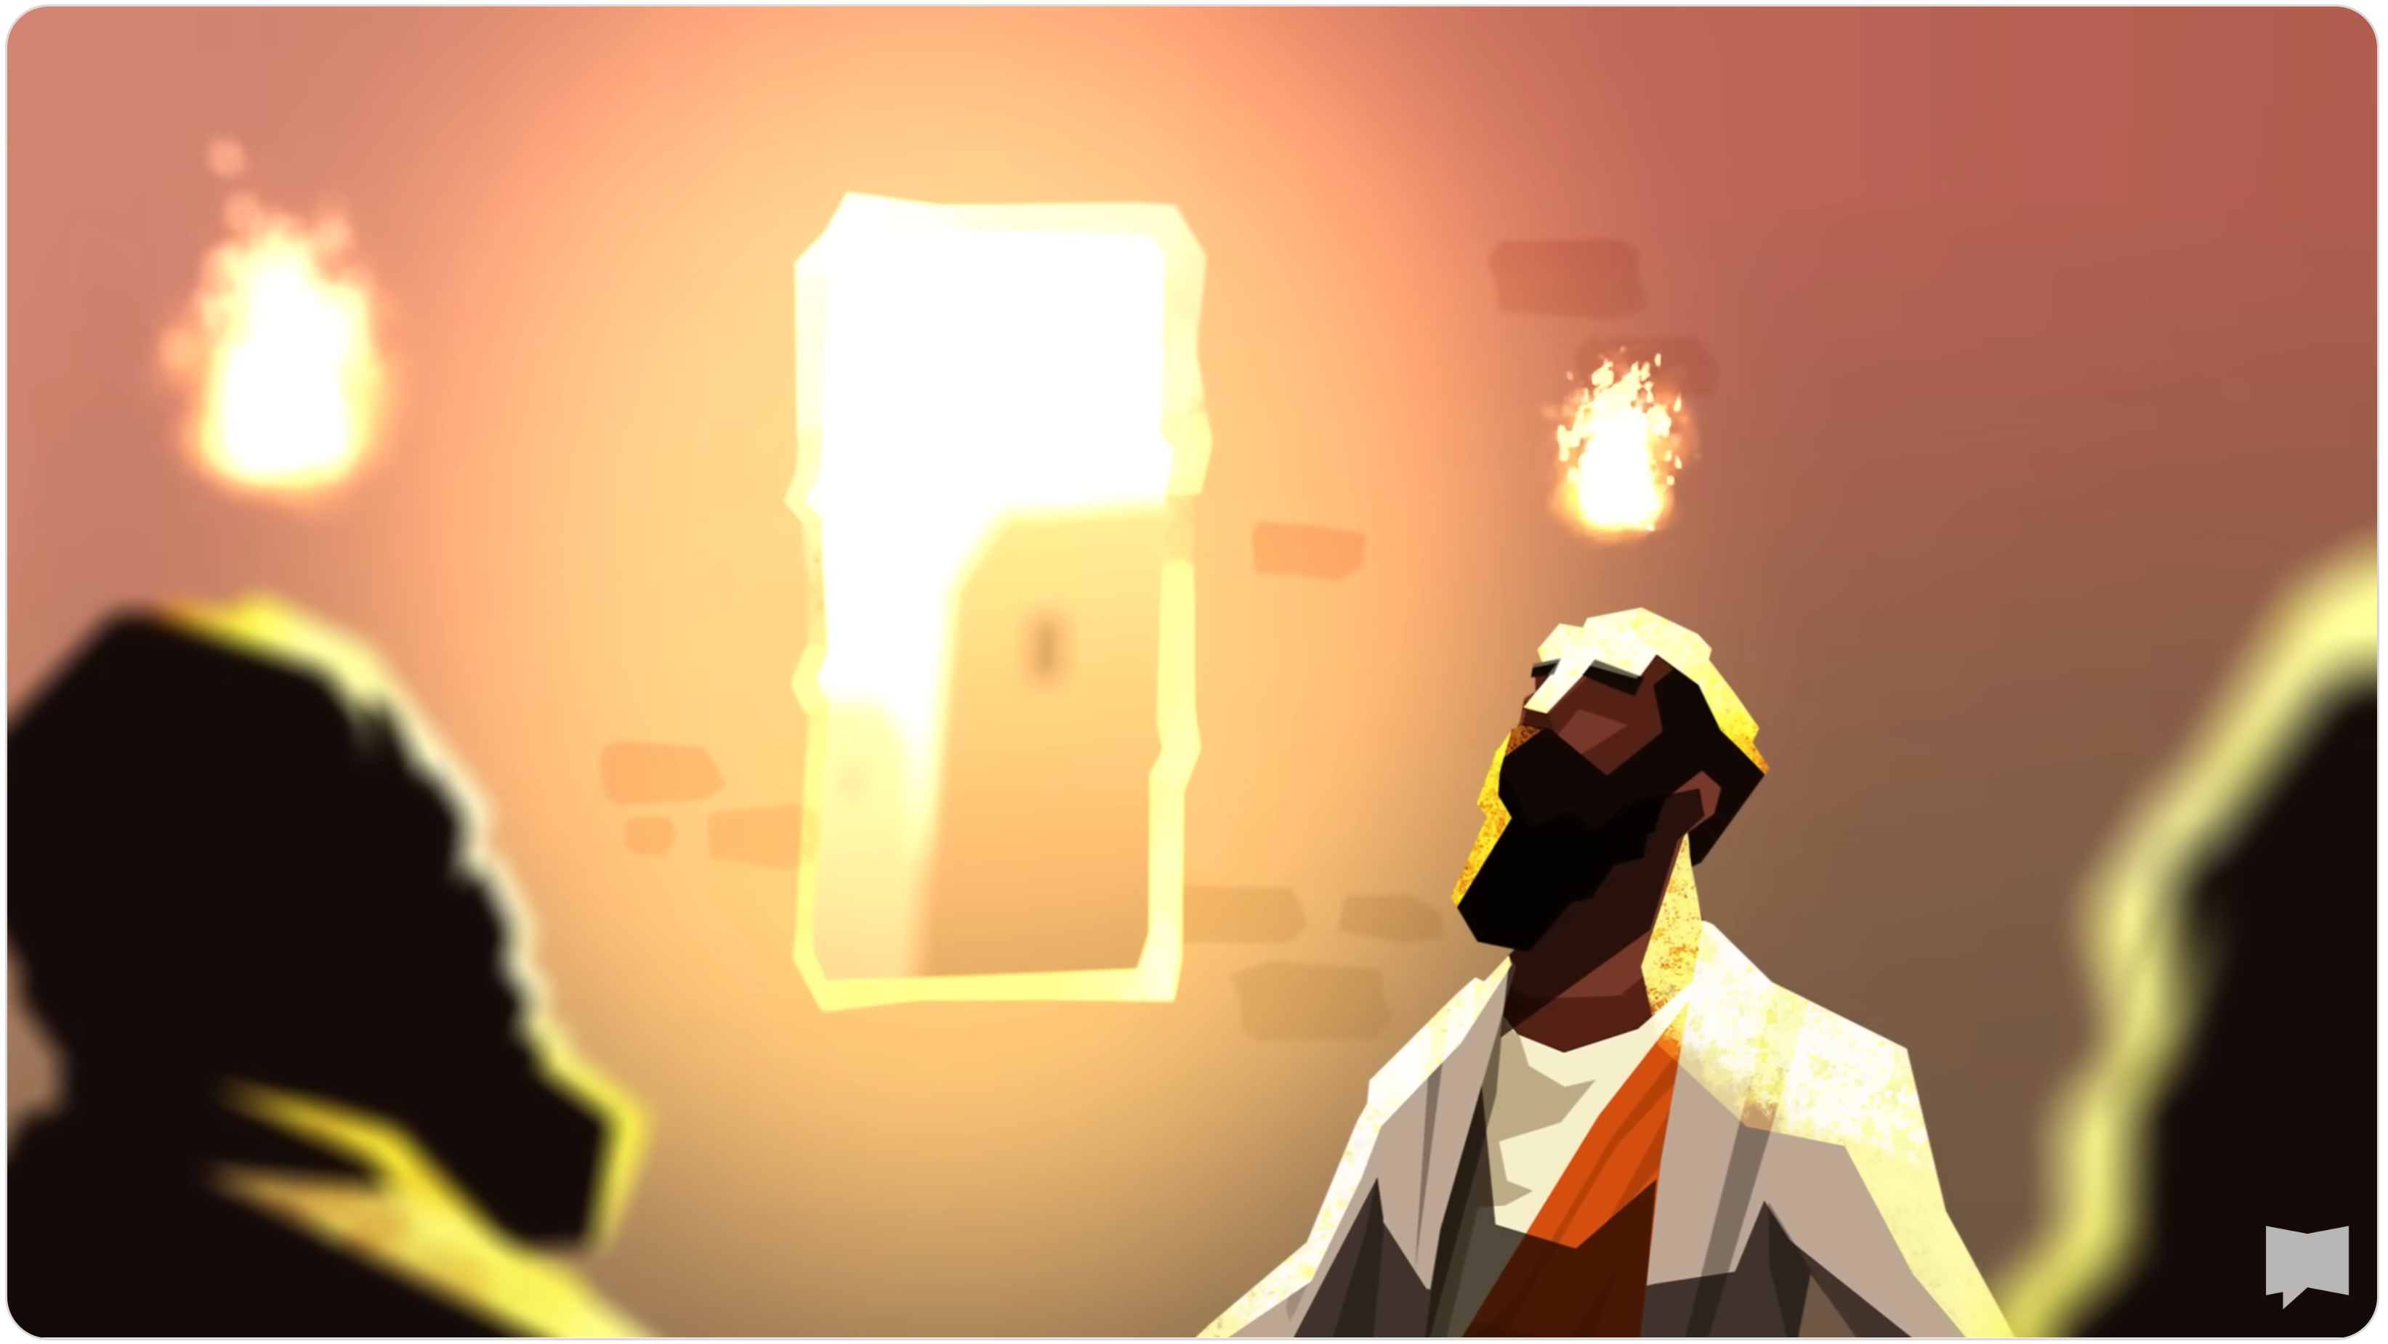
Acts Series
Episode 3: Chapter 2
23rd June 2024

Slide 2


Slide 3
Acts 2:1-5
When the day of Pentecost came, they were all together in one place. ² Suddenly a sound like the blowing of a violent wind came from heaven and filled the whole house where they were sitting. ³ They saw what seemed to be tongues of fire that separated and came to rest on each of them. ⁴ All of them were filled with the Holy Spirit and began to speak in other tongues as the Spirit enabled them.

Slide 4
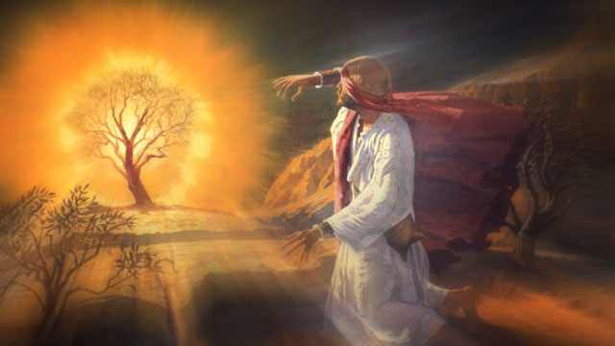
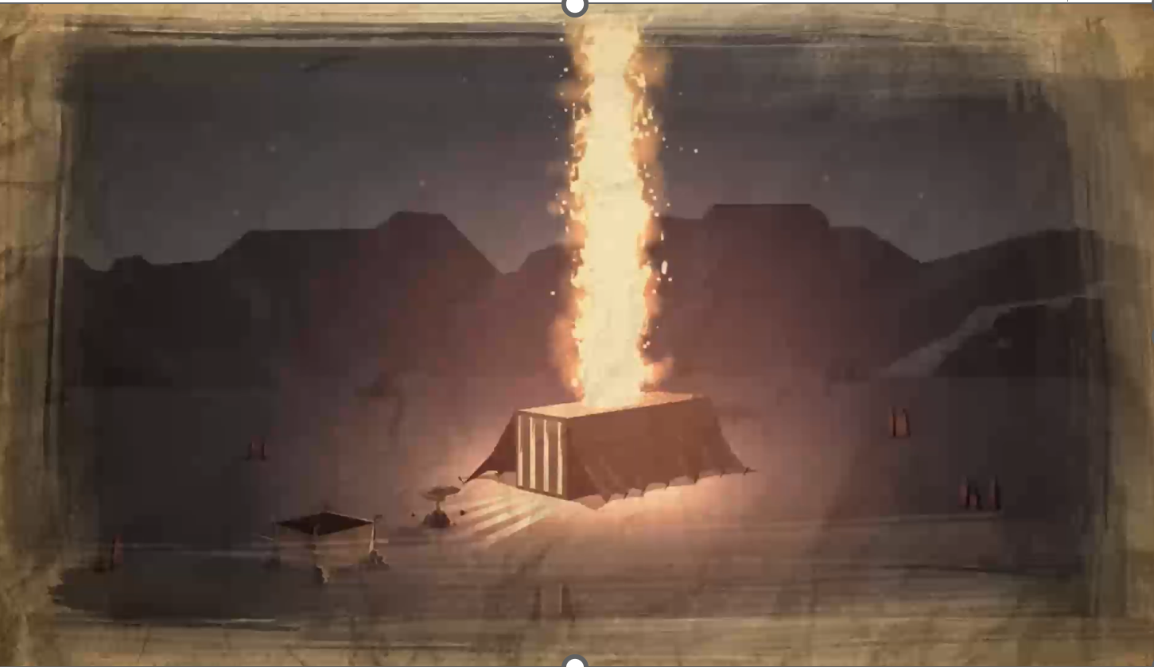

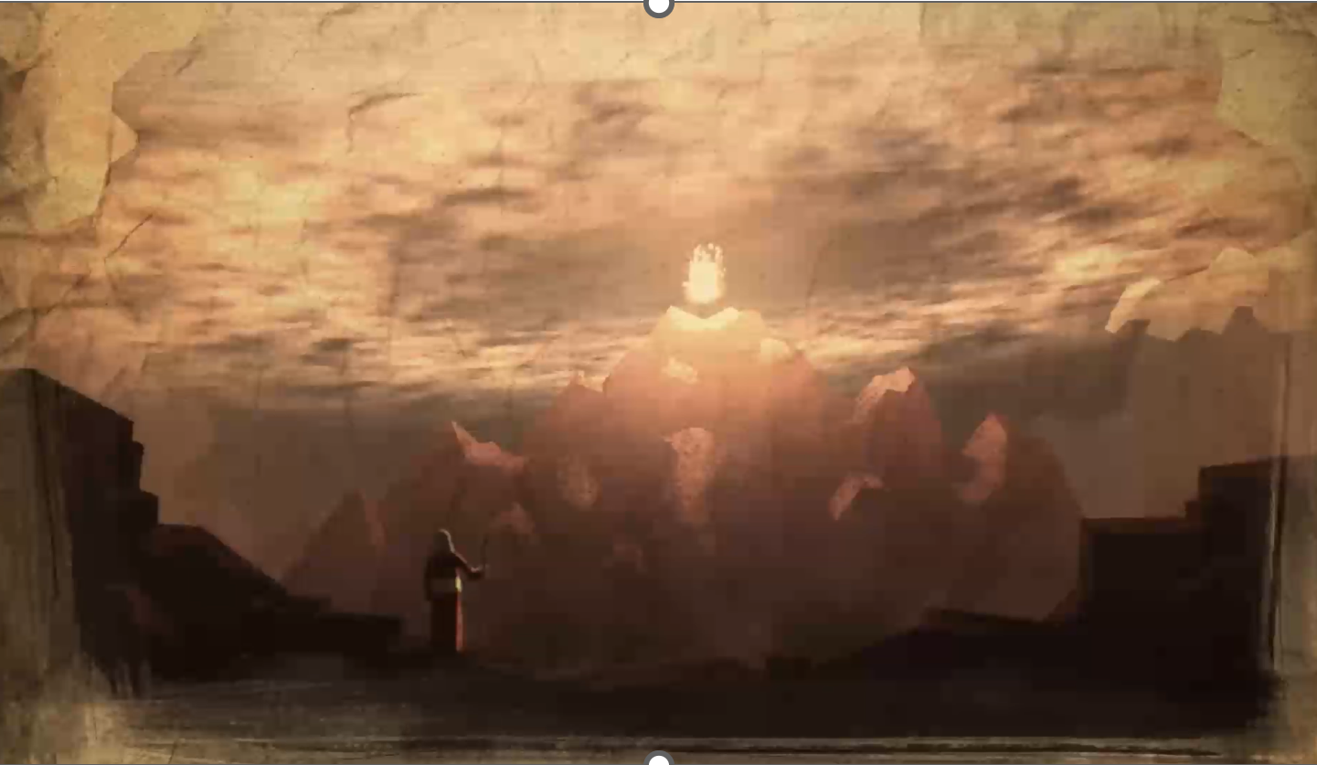
Notes:
For weeks Jesus kept teaching upside down kingdom that was launched through death and resurrection
Wait for new power so can be faithful witness
1000s jews pilgrims in town
OT theme – God presence rep by fire
Burning bush, descend on mountain, tent of meeting – stand back, His Holiness will consume you if you don’t follow His instructions
Mobile temples where Jesus dwells
Always God’s plan used unified children of Abraham to bring peace and justice to the world

Slide 5
Be careful not to forget the covenant of the Lord your God that he made with you; do not make for yourselves an idol in the form of anything the Lord your God has forbidden. For the Lord your God is a consuming fire, a jealous God.
Deu 4:23-24
Notes:
What it cost to forge the new covenant
The consuming fire fell on Jesus for our failure to live up to the covenant

Slide 6
The Day of Pentecost
Pentecost = 50
50 days after Passover is the Feast of Weeks (4th of 7 major festivals (Lev 23))
Celebrate the harvest (3,000 new believers)
Israelites celebrated God’s covenant with them (the giving of the law at Mount Sinai and faithfulness to providing the harvest)
Passover remembers God’s salvation (freed from Egyptian slavery)
  Jesus’s died on Passover as the ultimate sacrifice
Pentecost remembers God’s promise to live with us
  Holy Spirit confirm God’s new covenant to live within us
Notes:
Of the 364 other days when Christ could have sent the Spirit, why did he choose to do so on the 50th day after Passover, namely, during the Feast of Weeks?
Some scholars think 50 days after Passover was when the law (covenant) was given to Israel in wilderness
Israel told to celebrate harvest – can’t harvest until in the promised land – faithfulness of God to work with us as He promised
“The Holy Spirit also testifies to us about this. First he says: “This is the covenant I will make with them after that time, says the Lord. I will put my laws in their hearts, and I will write them on their minds.” Then he adds: “Their sins and lawless acts I will remember no more.” And where these have been forgiven, there is no longer any sacrifice for sin” ( Hebrews 10:15-18 )
The Holy Spirit does so many things in our lives but one of His most important roles is to testify and confirm the New Covenant to us. It is His job to reassure and remind us of what was promised. The Covenant we enjoy is vastly superior to the old one and was extremely costly for God to bring it to pass. Therefore He has made it the job of the Holy Spirit to constantly remind believers of the amazing things that are included.

Slide 7
The Inauguration of New Covenant

Slide 8

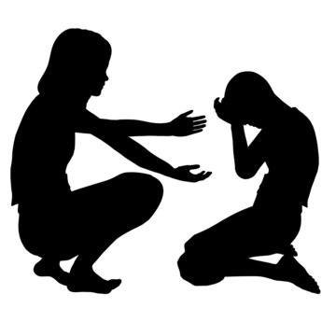

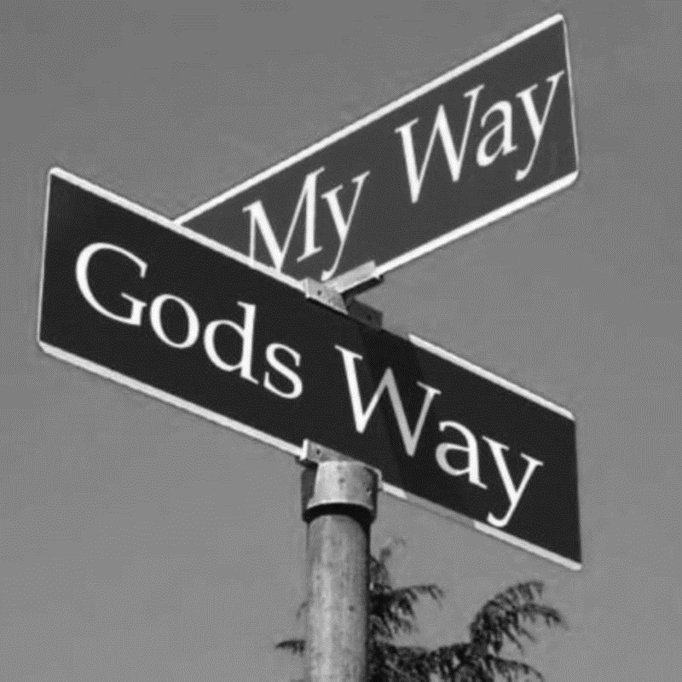


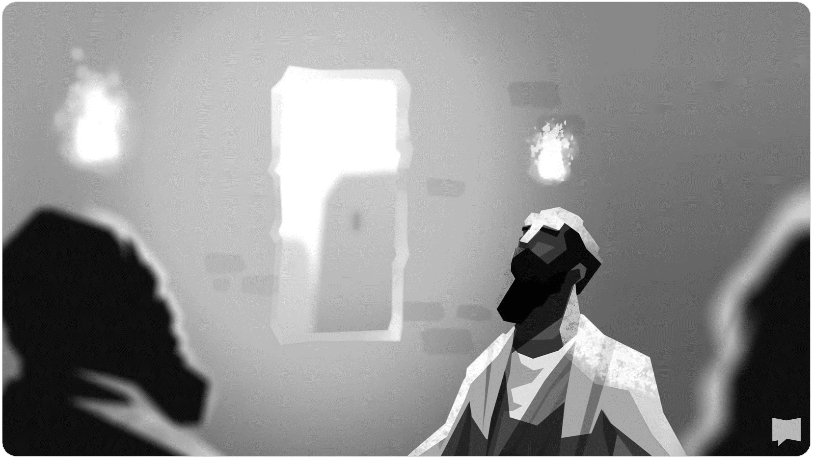
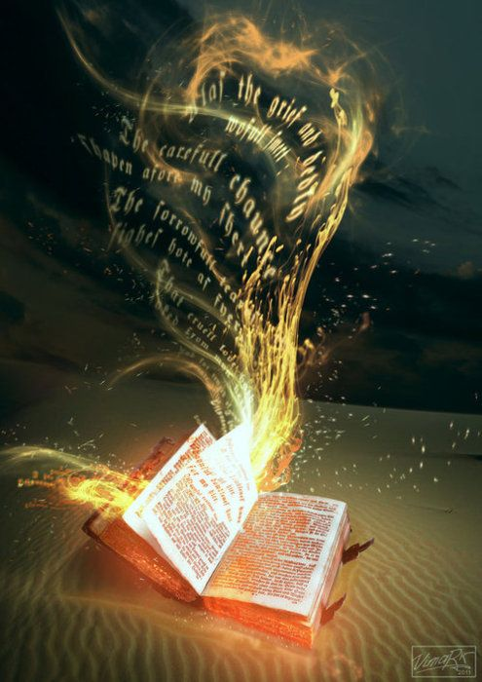
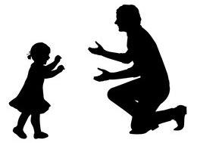
guides us
John 16:13
convicts us of our sin
John 16:8
comforts us
John 14:26
the desire to obey God
Eze 36:27
Makes us Christ-like
Gal 5:22
to understand God’s Word
1 Cor 2:12
Confirms we are God’s children
Rom 8:16
Notes:
convicts us of our sin
John 16:8 NASB And He, when He comes, will convict the world regarding sin, and righteousness, and judgment:
comforts us
John 14:26 But the Comforter, which is the Holy Ghost, whom the Father will send in my name, he shall teach you all things, and bring all things to your remembrance, whatsoever I have said unto you.
guides us
John 16:13 NIV. But when he, the Spirit of truth, comes, he will guide you into all the truth.
gives us spiritual gifts
1 Cor 12:1 …I want you to know about the gifts of the Holy Spirit.
the desire to obey God
And I will put my Spirit in you and move you to follow my decrees and be careful to keep my laws. Eze 36:27
If by the Spirit you put to death the deeds of the body, you will live. (Rom 8:14)
Walk by the Spirit, and you will not gratify the desires of the flesh. (Gal 5:16)
If we live by the Spirit, let us also walk by the Spirit. (Gal 54:25)
Makes us Christ-like
The fruit of the Spirit is love, joy, peace, patience … (Gal 5:22)
enables us to pray
In the same way, the Spirit helps us in our weakness. We do not know what we ought to pray for, but the Spirit himself intercedes for us through wordless groans. 27 And he who searches our hearts knows the mind of the Spirit, because the Spirit intercedes for God’s people in accordance with the will of God. (Rom 8:26-27)
to understand God’s Word.
What we have received is not the spirit of the world, but the Spirit who is from God, so that we may understand what God has freely given us. 13 This is what we speak, not in words taught us by human wisdom but in words taught by the Spirit, explaining spiritual realities with Spirit-taught words.[c]1 Cor 2:12
Confirms we are God’s children
The Spirit himself testifies with our spirit that we are God’s children. Rom 8:16
We have no hope in hell of fulfilling our mission without the Holy Spirit

Slide 9
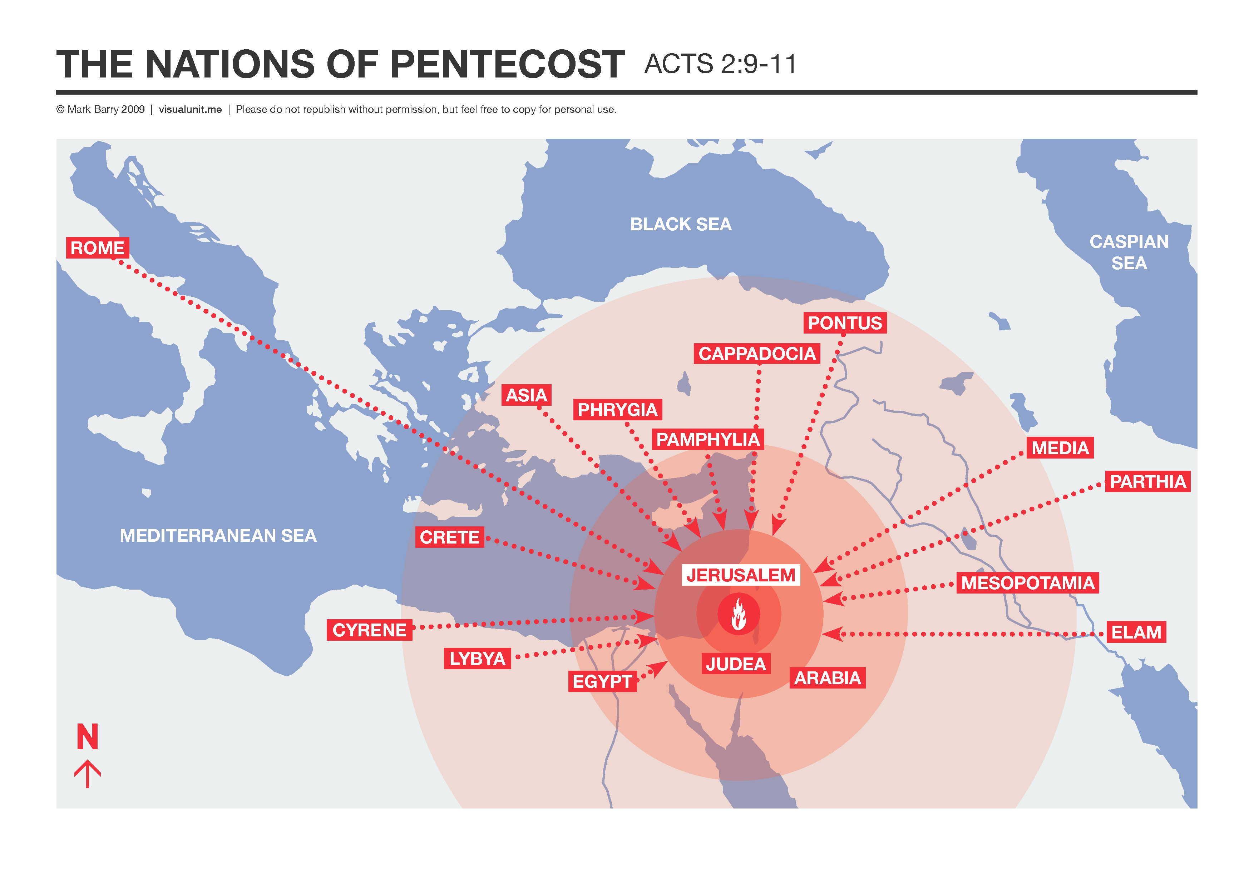
Notes:
Diaspora largely cause by conquering of Israel (Assyria) and Judea (Babylon)

Slide 10
“You will be amazed at what I can do with your ‘yes’!”

