Slide 1
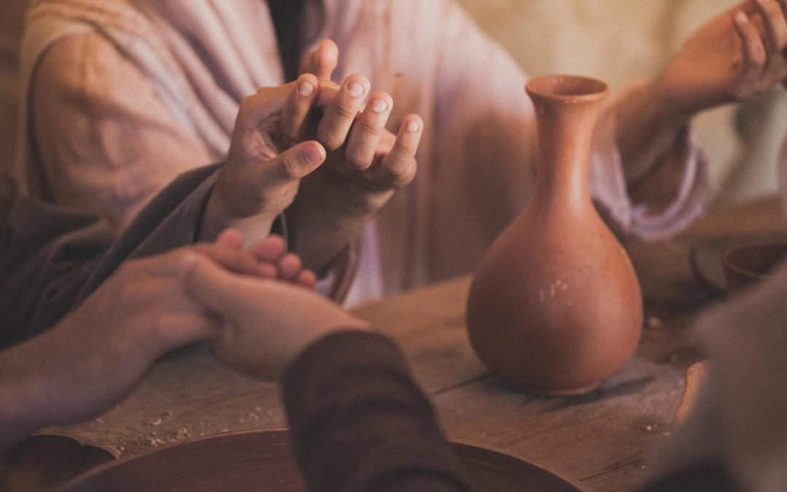
Acts Series
Episode 4: Chapter 2
14th July 2024

Slide 2


Slide 3
Acts 2:42-47
They devoted themselves to the apostles’ teaching and to fellowship, to the breaking of bread and to prayer. Everyone was filled with awe at the many wonders and signs performed by the apostles. All the believers were together and had everything in common. They sold property and possessions to give to anyone who had need. Every day they continued to meet together in the temple courts. They broke bread in their homes and ate together with glad and sincere hearts, praising God and enjoying the favor of all the people. And the Lord added to their number daily those who were being saved.
Notes:
Intro
One of the most important scriptures to us as a Church. One of the main parts that we would base ourselves on, draw from and seek to replicate.

Slide 4
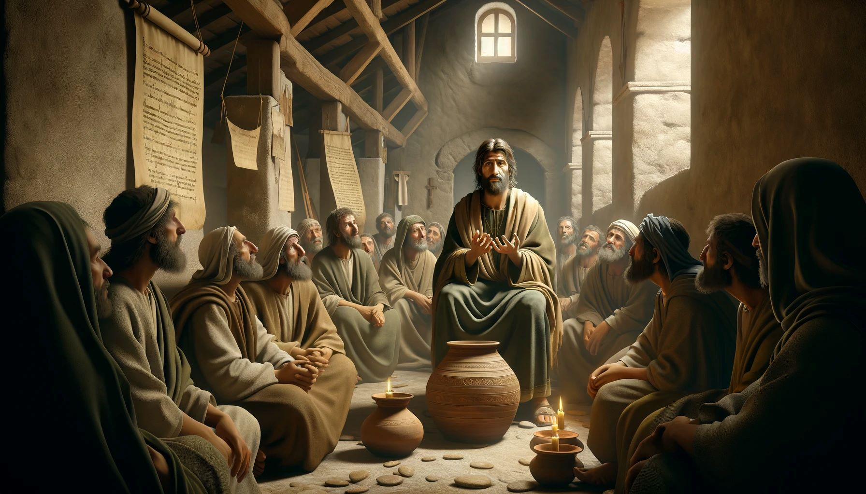
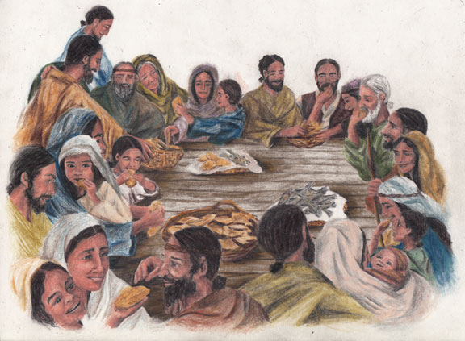
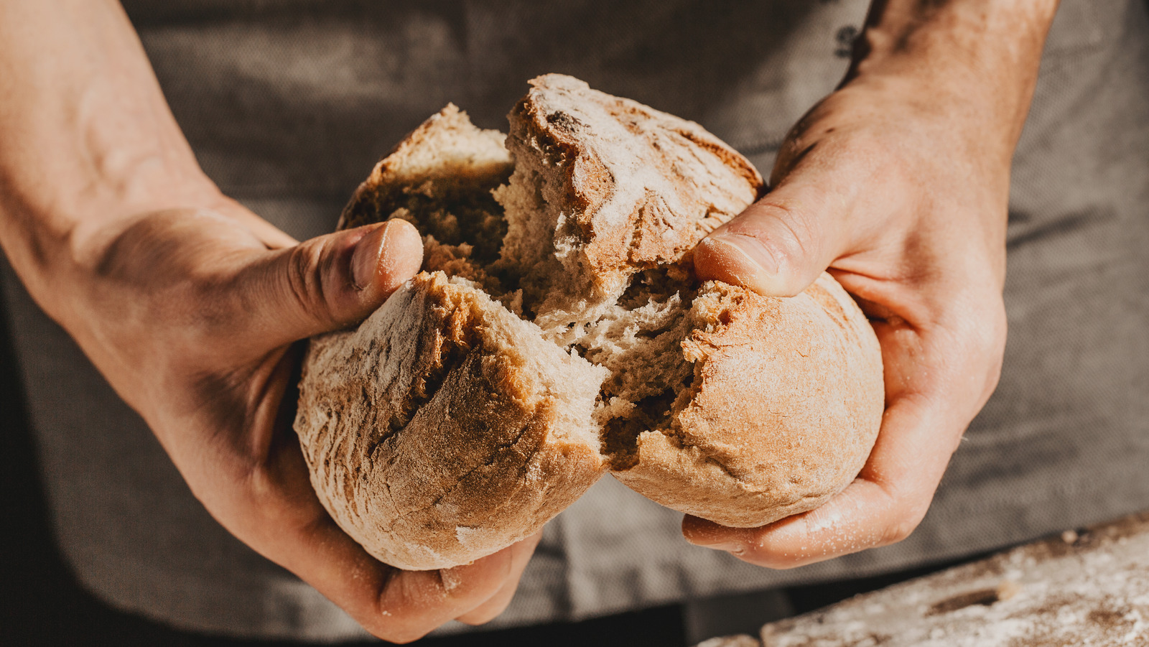
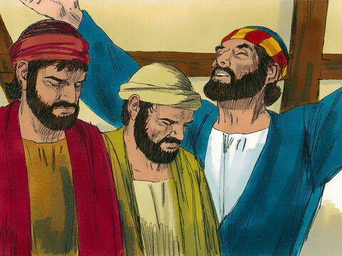

Slide 5
Apostle’s teaching
Apostle = sent
Teaching we are devoted to…
Love God & love each other & lives as though you do
Relationship
Serving
Integrity
Commitment
Leadership
God’s heart for children
Money matters
Notes:
All called to be witnesses
Apostle specific role – commission, release, empower
Eph 4:11-12 So Christ himself gave the apostles, the prophets, the evangelists, the pastors and teachers, ¹² to equip his people for works of service, so that the body of Christ may be built up

Slide 6
Fellowship
“To see the law by Christ fulfilled
And hear His pardoning voice,
Changes a slave into a child,
And duty into choice.”
- William Cowper
Overlapping lives
Not based on preference
“We just wanted to be together” - Dawn
Notes:
Intentional (devoted – a choice of one over another) – compelled and collaborate
Gave themselves to this desire (forfeiting other desires – e.g. desire to be part of your life and desire to watch tv)

Slide 7
Breaking of Bread
Centralising their community on the work of Jesus
Unifying
  Because there is one loaf, we, who are many, are one body, for we all share the one loaf. (1 Cor 10:17)
How did God make Himself real to you?
Notes:
can’t break bread while in disunity with someone in the body.

Slide 8
Prayer
Embracing relationship secured & reveal through Jesus (Abba, Father…)
Desire to get His mind
Desire to express ourselves
Belief God given us authority & prayer change things
Notes:
First reconcile with brother before you give to God
Slaves don’t know the master’s business
If we pray anything according
Prayer is as much about listening (conversation)

Slide 9
filled with awe at the many wonders and signs
Then the disciples went out and preached everywhere, and the Lord worked with them and confirmed his word by the signs that accompanied it. (Mark 16:20)
We want awe
We want more
Steve Adams – opportunity to pray & share gospel with security guard
Eli – shoulder pain & fear of driving healed
Sam G – want to make God top priority
Lucy B – not got to live with back problems, expectation that He can heal others
Myles – saying words
Alisha – healed ears
Hilary – forgive, revelation of His love, helped completed course & move towards new job
Alex – God’s plan for my future
Dan Jones – “you’ve got a brand-new knee”
More opportunities to share gospel
God meeting with children with SEND
Aiden – heard God and felt confident in school
Colby – hands healed
Belinda – God reassured me that he has been with me whole time
Breakthrough for those we’d been praying for
Fireside chat – expression of relationship
Kay – night terrors & drugs stopped
Notes:
Marvelous in our sight
This is my God at work!

Slide 10

They sold property and possessions to give to anyone who had need.
Year of Jubilee (Lev 25)
And I will put my Spirit in you and move you to follow my decrees and be careful to keep my laws.
(Ezek 37:26)
But the fruit of the Spirit is love…
(Gal 5:22)
…law might be fully met in us, who do not live according to the flesh but according to the Spirit.
(Rom 8:4)
The commandments… are summed up in this one command: “Love your neighbor as yourself.” …Therefore love is the fulfillment of the law.
(Rom 13:9-10)
“if all you have is a decision for Christ and no delight in Christ, you don't have Christ” – John Piper
Notes:
The Year of Jubilee in Leviticus 25 is one of the most radical ideas in the Bible. Every 50 years, every Israelite was supposed to return to their original piece of allotted land.
The jubilee would have effectively prevented cycles of intergenerational poverty and create a social and economic parity that would make Israel unique among all nations.
Jesus announced that he was enacting the Year of Jubilee when he launched his public ministry.
2 Cor 3:3 You show that you are a letter from Christ, the result of our ministry, written not with ink but with the Spirit of the living God, not on tablets of stone but on tablets of human hearts.
Eze 11:19 I will give them an undivided heart and put a new spirit in them; I will remove from them their heart of stone and give them a heart of flesh.
Decisionism vs delight – but today can be changed
Micah testimony

Slide 11
Learning to love one another
Not programmed
Not natural commonality
Learning and discovering
I can’t live up to this
  E.g. Bear one another’s burdens (Gal 6:2)
Romans 12:10 Be devoted to one another
Romans 12:16 Be of the same mind toward one another
Romans 13:8 Owe nothing but to love one another
Romans 14:13 Therefore let us not judge one another
Romans 15:17 Accept one another
1 Corinthians 12:25 Have the same care for one another
Galatians 5:13 through love, serve one another
Galatians 6:2 Bear one another’s burdens
Ephesians 4: 2 with all humility and gentleness with patience, showing forbearance to one another in love
Ephesians 4: 32 Be kind to one another
Ephesians 5: 19 Speaking to one another in psalms and hymns and spiritual songs
Ephesians 5:21 Be subject to one another in the fear of Christ
Philippians 2:3 with humility of mind let each of you regard one another as more important than himself
Colossians 3:13 bearing with one another
1 Thessalonians 3:12 may the lord cause you to increase and abound in love for one another
1 Thessalonians 4:18 comfort one another with these words
1 Thessalonians 5: 15 seek after that which is good for one another
Hebrews 3:13 encourage one another day after day
Hebrews10: 24 consider how to stimulate one another to love and good deeds
James 5:16 confess your sins to one another and pray for one another so that you may be healed
1 Peter 4:9 be hospitable to one another
Notes:
Every day they continued to meet together in the temple courts. They broke bread in their homes and ate together
52 love one another

Slide 12
‘Brother, I want you to know that I’m committed to you. You’ll never knowingly suffer at my hands. I’ll never say or do anything, knowingly, to hurt you. I’ll always in every circumstance seek to help and support you. If you’re down and I can lift you up, I’ll do that. Anything I have that you need, I’ll share with you; and if need be I’ll give it to you. No matter what I find out about you and no matter what happens in the future, either good or bad, my commitment to you will never change. And there’s nothing you can do about it. You don’t have to respond. I love you, and that’s what it means.’
what have I gotten myself into? Can I really keep my commitment to this man? When he’s all done pouring himself out to me, can I totally accept him and not think any less of him?
But while he was speaking, a strange thing happened. God gave me compassion for the man.
the Holy Spirit is giving me the capacity to love you. And because I love you, and that love has been placed in my heart by the Holy Spirit, God loves you and offers you complete forgiveness.’

Slide 13
D.A. Carson writes:
What binds us together is not common education, common race, common income levels, common politics, common nationality, common accents, common jobs, or anything else of that sort. Christians come together not because they form a natural alliance, but because they have all been saved by Jesus Christ and owe him a common allegiance...
. . . Christian love will stand out and bear witness to Jesus because it is a display, for Jesus’ sake, of mutual love among social incompatibles.
Notes:
(Love in Hard Places)

Slide 14


"How is it that the only place in the whole city that blacks and whites get along is my football team?"
Notes:
Revival in football team
Simon the zealot & matthew the tax collector
Common allegiance (to Christ) more significant than all other identifiers
For us age, socio-economic barriers

Slide 15

Glad and sincere hearts
Eph 5:2 - and walk in the way of love, just as Christ loved us and gave himself up for us as a fragrant offering and sacrifice to God.
As I give, I want to give more (prime the pump)
You sacrifice for what you love; you love what you sacrifice for

Slide 16

Appealing community
‘enjoying the favour of all the people’
‘added to their number daily those who were being saved’
  ‘Being’ – in the process, belong before they believe
  Being added = all by itself

Slide 17
Response
Cause me to love you and others more
Commit to live accordingly
Notes:
Who will commit – what is the one thing you can do this week – ask God

