Slide 1


Slide 2
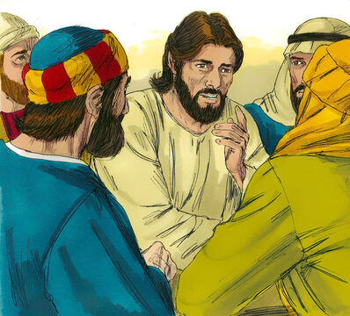
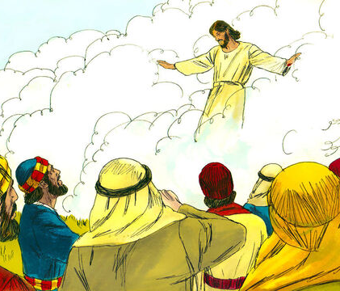
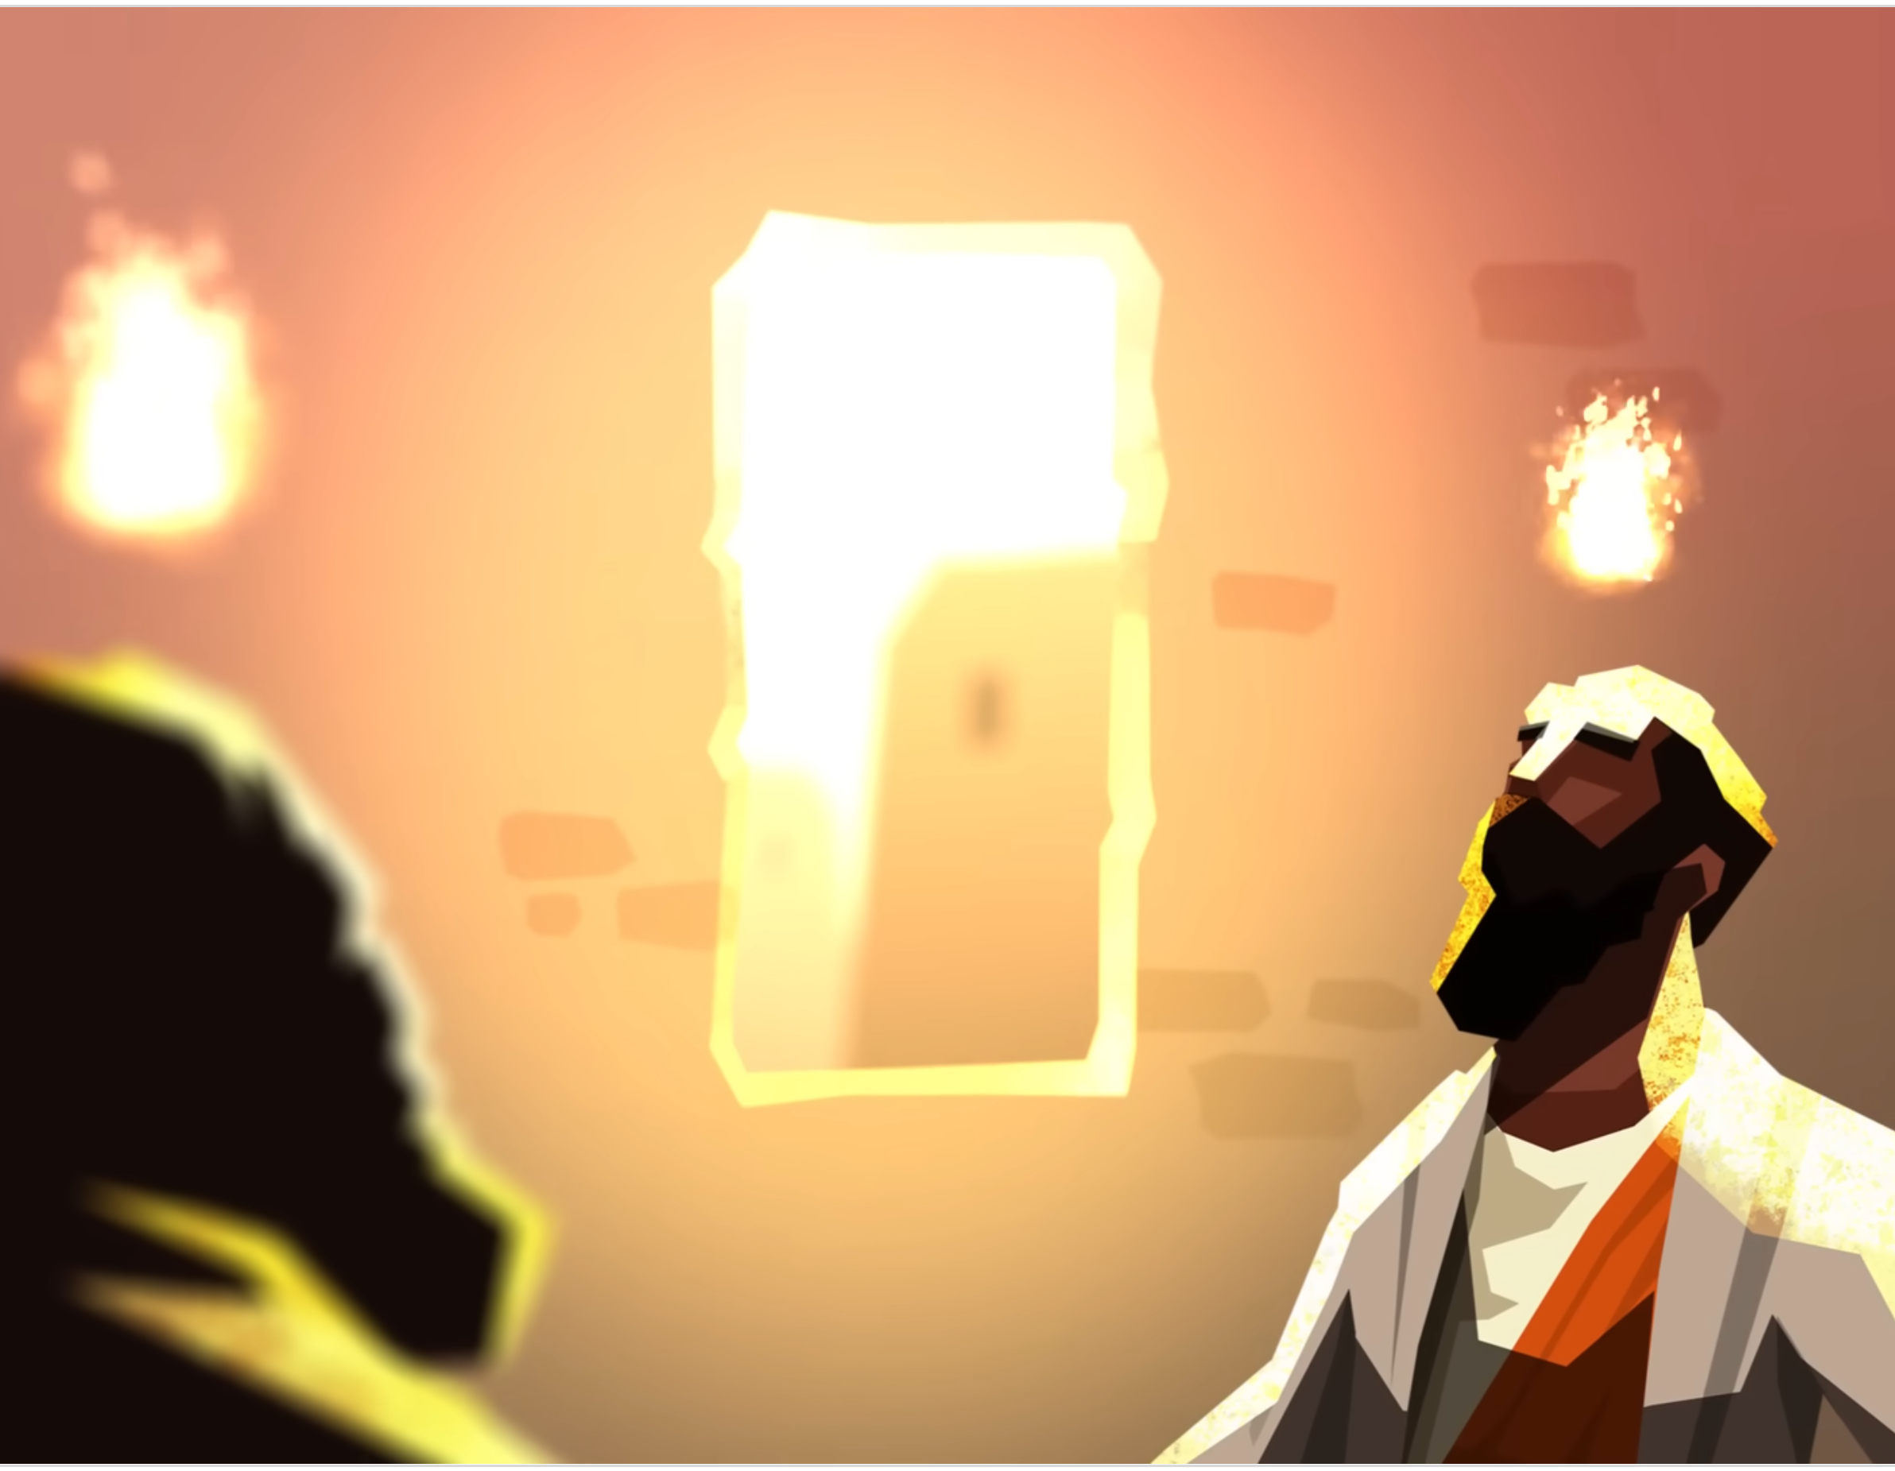
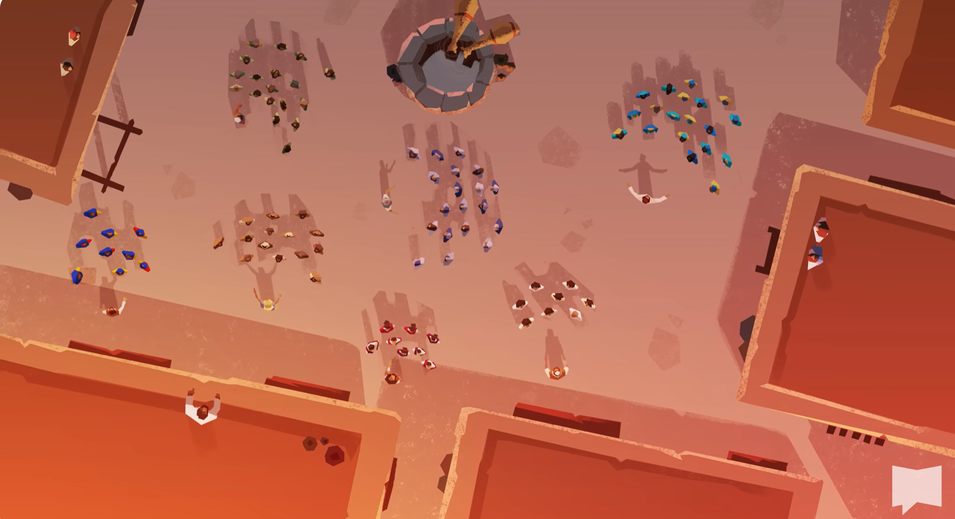
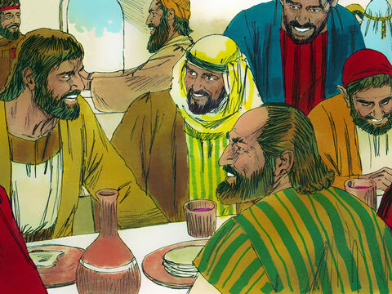
Notes:
Jesus born
Recruited a team
Ministered
Died
Rose again
Spent 40 days with disciples
Ascended
Pentecost – infilling of Spirit
Witness – 3000 were added
Believers form new community by sharing together

Slide 3
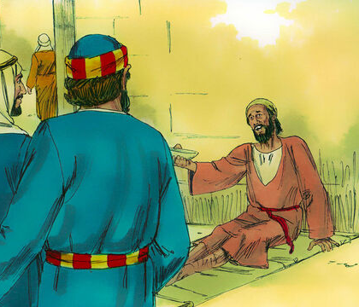
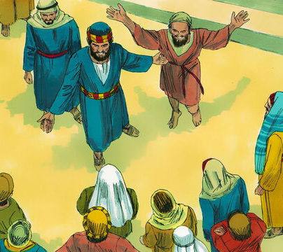
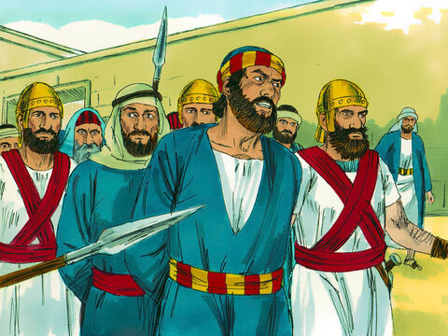
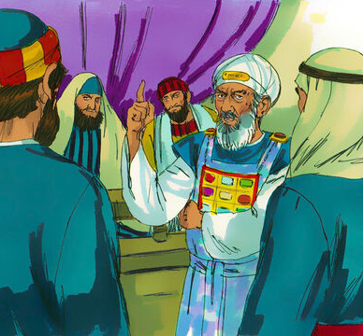
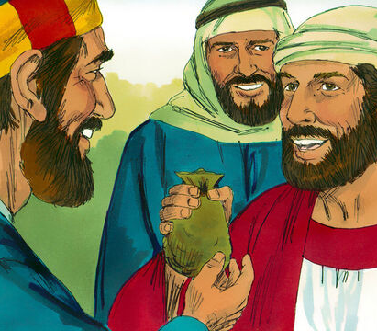
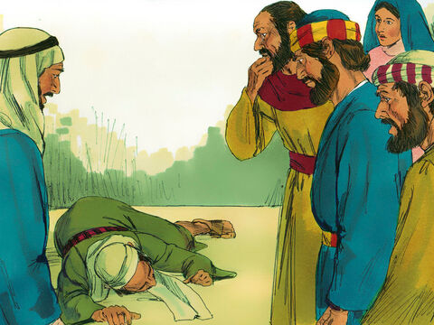
Notes:
Heal beggar outside temple
Opens the door to preaching to amazed crowd
Peter and John summoned before the Sanhedrin
Forbidden to preach about Jesus & threatened
Prayed they would have boldness to continue
More sacrificial giving in community e.g. Barnabas
Ananias & Sapphira sold property but secretly held back some of the money
Both died

Slide 4
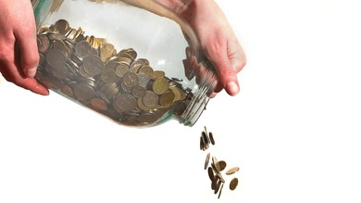
Acts Series
Episode 8: Chpt 5 pt2
15th Sept 2024
Notes:
Long passage so with give summary and then zoom into the particular text

Slide 5
Acts 5:11-42
Ananias & Sapphira had just died
Miraculous healing, Peter’s shadow
Jealous religious leaders, angry that they have continue to talk about Jesus, had them thrown in jail
In the night Angel opened jail and led them out, send them back to preach
In the morning leaders send for them but found the jail locked and guarded but empty
Apostles brought in front of religious leaders
Flogged
Came out rejoicing

Slide 6
(1) Serious business
¹¹ Great fear seized the whole church and all who heard about these events.
¹³ No one else dared join them, even though they were highly regarded by the people. ¹⁴ Nevertheless, more and more men and women believed in the Lord and were added to their number.

Slide 7
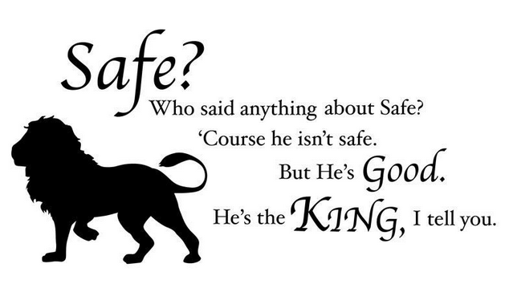
Great Fear
Notes:
Lion, witch & wardrobe
God, who has given me everything, is at liberty to demand anything
He is playing for keeps – this is serious
Children of Israel withdrew when God came close (Mount Sinai)
If you want Him at the centre, somethings in the middle will need to shift to make space for Him
Usurpers have to vacate the throne

Slide 8
Joined vs
Added
“You can choose your friends, but you can't choose your family”
- Harper Lee, To Kill a Mockingbird
Notes:
Joined – active, my choice
Were added – passive, God did, I merely recognise
Am I here by coincidence – my friends are here, its local, I was brought up here
Or has God placed me here?
If the latter – Am I treating this with the seriousness that is warranted?
You are my family, nothing I can do about it, but when He pour His love into me, and shows me who He is releasing you to be, it is a privilege to be on this journey with you…warts ‘n’ all

Slide 9
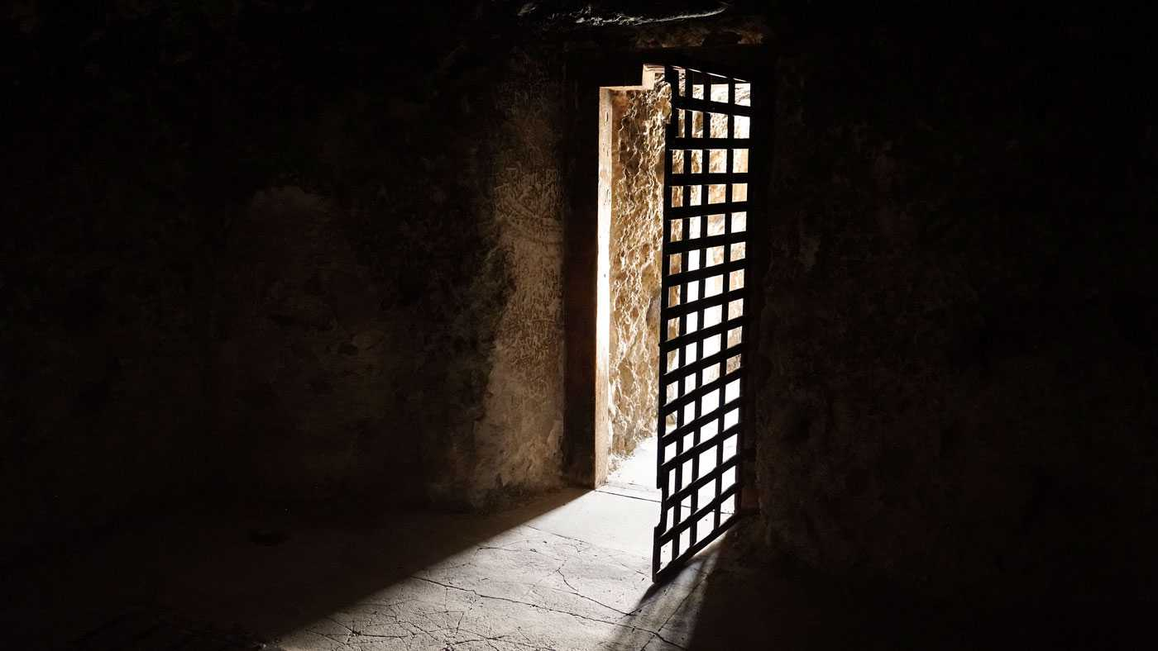
(2) No prison can restrict God
¹⁹ But during the night an angel of the Lord opened the doors of the jail and brought them out. ²⁰ “Go, stand in the temple courts,” he said, “and tell the people all about this new life.”
Notes:
Rom 8
³⁸ For I am convinced that neither death nor life, neither angels nor demons,^{[a]} neither the present nor the future, nor any powers, ³⁹ neither height nor depth, nor anything else in all creation, will be able to separate us from the love of God that is in Christ Jesus our Lord.
Prince – When God says ‘yes’, nobody can say ‘no’
Is there a prison that is restricting you from accomplishing His will?
Health
Guilt/shame
No situation can separate you
God sometimes send us into prisons to reach others

Slide 10

(3) What made the apostles so heroic?
²⁸ “We gave you strict orders not to teach in this name,” he said. “Yet you have filled Jerusalem with your teaching and are determined to make us guilty of this man’s blood.”
²⁹ Peter and the other apostles replied: “We must obey God rather than human beings! ³⁰ The God of our ancestors raised Jesus from the dead—whom you killed by hanging him on a cross. ³¹ God exalted him to his own right hand as Prince and Savior that he might bring Israel to repentance and forgive their sins. ³² We are witnesses of these things, and so is the Holy Spirit, whom God has given to those who obey him.”
³³ When they heard this, they were furious and wanted to put them to death.
⁴¹ The apostles left the Sanhedrin, rejoicing because they had been counted worthy of suffering disgrace for the Name.
Notes:
Acts 4
Hauled before High Priest – forbidden to preach in name of Jesus
Threatened
Acts 5
Put in prison (God broke them out)
Went straight back to teaching
Hauled in again – you are still teaching! (not intimidated)
Peter doesn’t pull punches – doubles down on what is rubbing religious leaders up the wrong way
Obey God rather than man – serious business
Wanted to kill them - Flogged them
Joyful for being considered worthy to suffer for Jesus

Slide 11
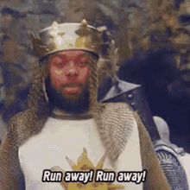

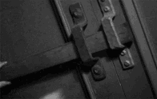
They weren’t always this courageous…
Then everyone deserted him and fled.
(Mark 14:50)
Peter said, “Man, I do not know what you are talking about.”
(Luke 22:60)
…disciples were together, with the doors locked for fear of the Jewish leaders
(John 20:19)

Slide 12
Where does your courage fail you?
Notes:
Where do you run away, deny or barricade yourself in?
Are you intimidated?
Where do you hold back
Not willing to stand up for what is right in the face of intimidation (bully at school/work? Sometimes the bully is faceless, and it is the culture – cancel culture)
Not willing to be honest/vulnerable in what is really going on inside? (what will they think of me if I am honest?)
Not willing to open up your time, energy, money, family/friendships (If I say ‘yes’ to this, I might not be able to maintain what I need)
Bury head in sand (what if there is no answer to my problem, best not to deal with it)
I’m anxious about my health, my children’s safety, money, job security, approval of others

Slide 13
Where did their courage come from?
³¹ God exalted him to his own right hand as Prince and Savior…
“Prince” = archego = “Captain” (Heb 2:10, KJV) / “Author” (Heb 12:2)
Champion / Hero
Hercules = Savior & Prince (fighting the one who wields death)
A hero sticks to their principles / the truth no matter the consequence
Notes:
A hero sticks to their principles / the truth no matter the consequence
Phil 2:7 emptied Himself
⁷ but emptied himself, by taking the form of a servant,^{[c]} being born in the likeness of men. ⁸ And being found in human form, he humbled himself by becoming obedient to the point of death, even death on a cross.

Slide 14
Look to Him
but emptied himself, by taking the form of a servant, being born in the likeness of men. And being found in human form, he humbled himself by becoming obedient to the point of death, even death on a cross.
- Phil 2:7-8
Notes:
Jesus loves you, and He did not shrink back from death, when that was necessary to save you
God doesn’t ask us to do anything he hasn’t already done
I don’t have this courage by looking inside myself – I look to someone who is greater than me
Acts 4:20 As for us, we cannot help speaking about what we have seen and heard

Slide 15
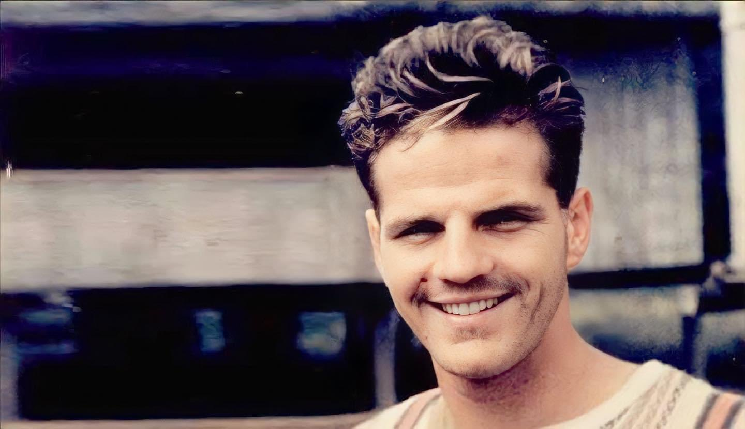
He is no fool who gives what he cannot keep to gain what he cannot lose.
- Jim Elliot
Notes:
Chpt 5 story of giving to God, not holding back – god use both but only the second was able to enjoy on going participation
Oh how I wish I’d given him everything

Slide 16
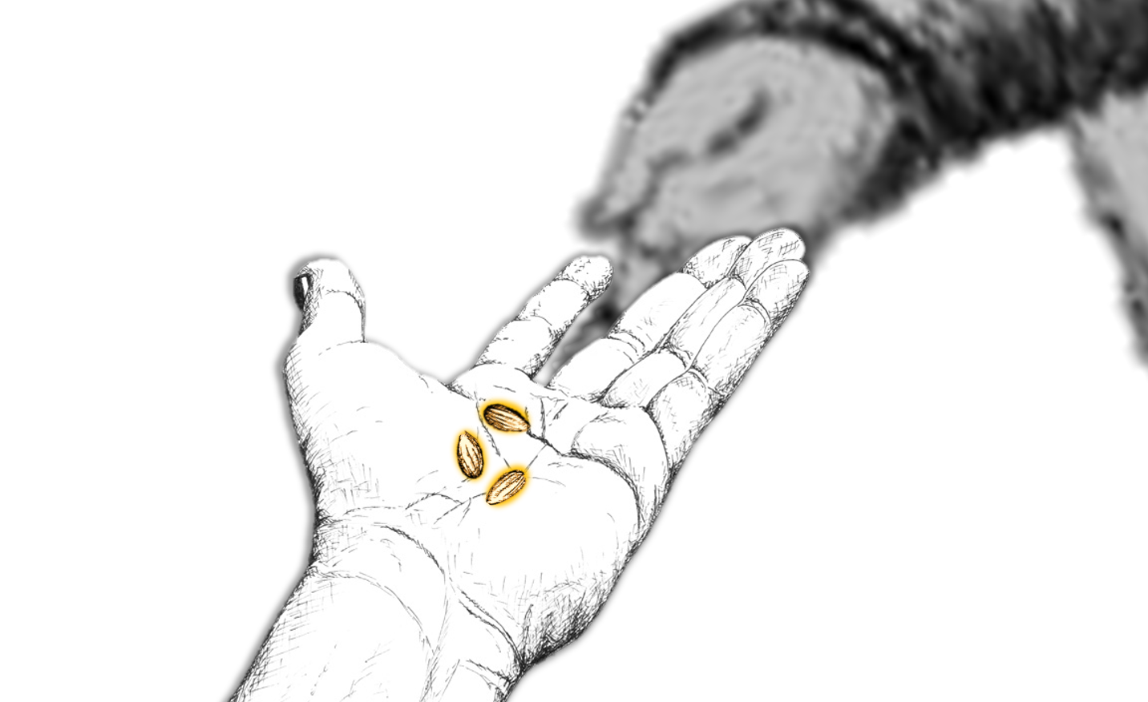
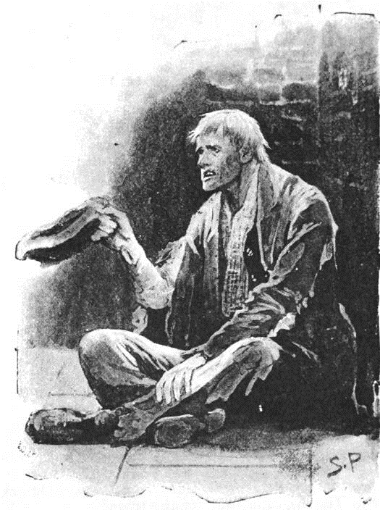
“O, how I wish I had given him all!”
Notes:
Don’t hold back – give Him everything – it’s the only reasonable response in the light of what He has done for you
Become heroic by fixing your eyes on the ultimate hero
Can you think of safer hands to put your life into than the hands which were pierced for your salvation?

Slide 17
Response
Do you need to respond to God with a greater seriousness?
Is there a prison that God is leading you out of today?
Do you want to be more courageous?
Notes:
How will you take God more seriously?
How will you take this community that He has placed you in more seriously? Give priority, make effort to come closer/serve
How do you embrace this jail break? “Yes, Lord” then move accordingly
A decision to count the cost considering His worth
Do you already know the stand you need to make?

