Slide 1
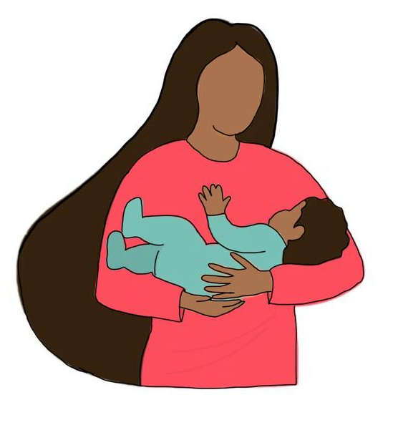
Within Arms of Love
17th March 2024

Slide 2

Notes:
It’s an impossible job
We are trying our best but often fail

Slide 3
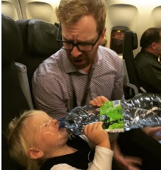
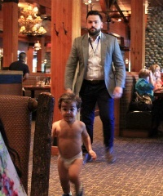
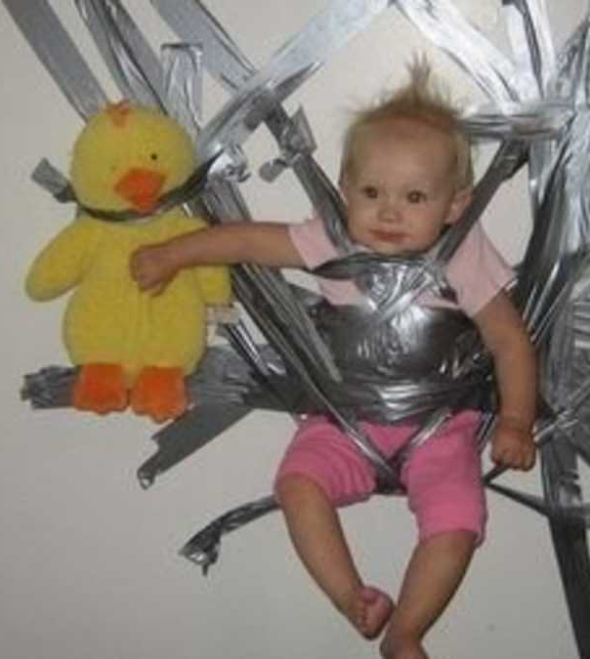
Parental Fails
Notes:
Ever water-boarded your own kid?
Ever found your lack of control has been outted in public?
Ever got so fed up trying to get them to stay still that you have just gaffer-ed them to the wall?

Slide 4
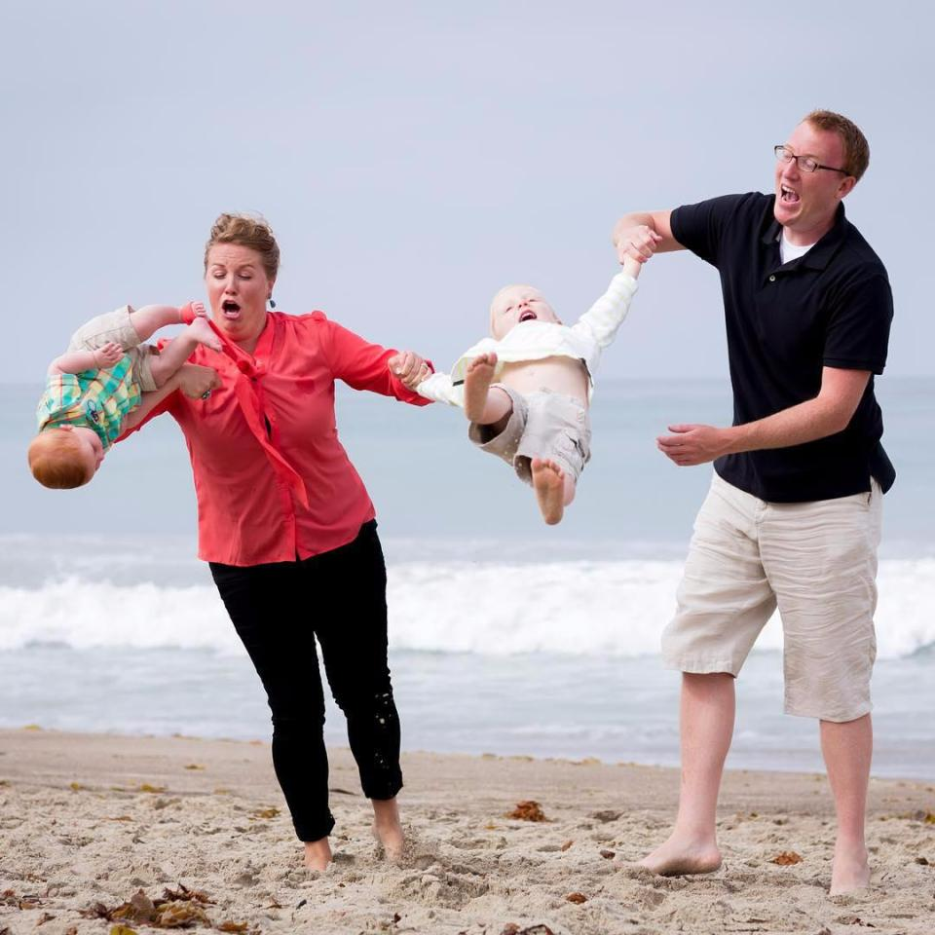
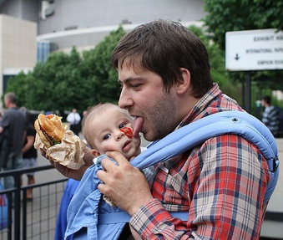
Parental Fails
Notes:
Ever struggled juggling two children?
Ever had to eat your lunch off your baby’s face?

Slide 5
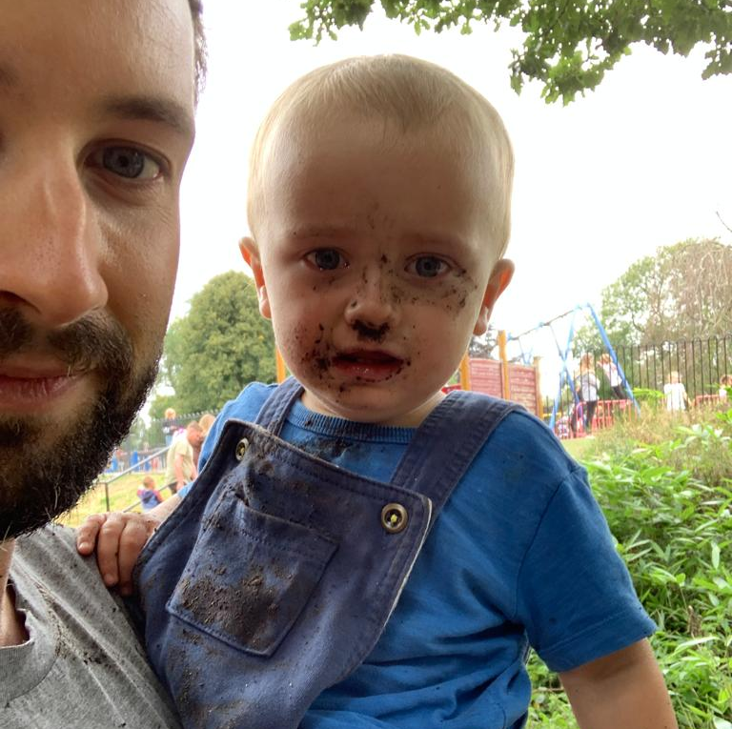
Parental Fail

Slide 6
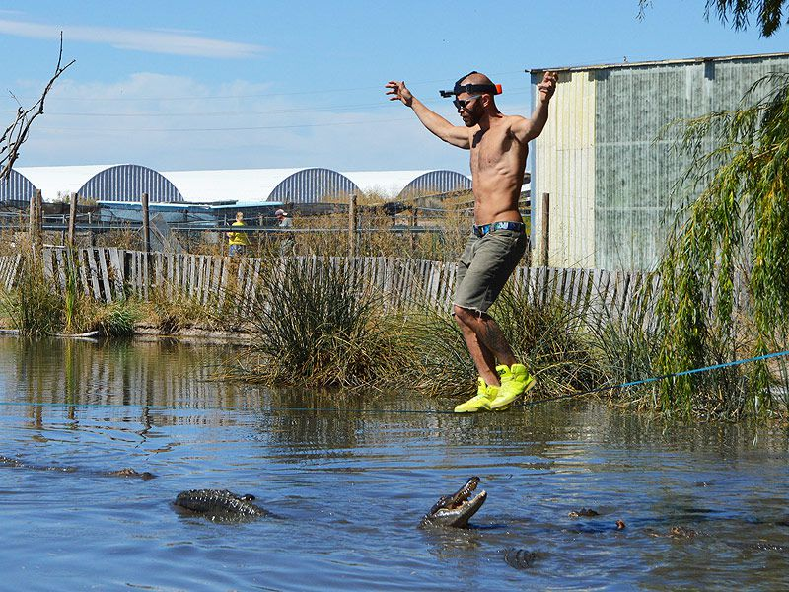
Notes:
Guilt/shame/failure
A thousand decisions every day
A hundred questions – some of which you don’t care about but suddenly need to have an opinion on
You try to educate a kids on one thing then discover they are policing the whole playground
Your children will put you back into situation you could have avoided since you became independent
You will mix with people and have opportunity to demonstrate the compassion you have experienced from God
Marriage reveals how selfish you are
Parenting rubs your face in it

Slide 7
(1) Our role in the raising of children

Slide 8
What is expected of us?
As parents
Deu 6:4-9
Hear, O Israel: The Lord our God, the Lord is one. Love the Lord your God with all your heart and with all your soul and with all your strength. These commandments that I give you today are to be on your hearts. Impress them on your children. Talk about them when you sit at home and when you walk along the road, when you lie down and when you get up. Tie them as symbols on your hands and bind them on your foreheads. Write them on the doorframes of your houses and on your gates
Notes:
“Be Jesus to your child” !!!
Show them how you live out your relationship with God
Can’t I just send them to Sunday school?
How am I getting on?
With all the stuff I’m already doing, I can’t get to this!
Sometimes I’m not living from this stuff
PKs – pastor kids – seen hypocrisy
Don’t walk but drive together – reaction to Backseat driver

Slide 9
What is expected of us?
As parents
Ephesians 6:1-4
Children, obey your parents in the Lord, for this is right. “Honor your father and mother” (this is the first commandment with a promise), “that it may go well with you and that you may live long in the land.” Fathers, do not provoke your children to anger, but bring them up in the discipline and instruction of the Lord.
Notes:
Children – honour, obey parents (in line with God’s law)
Fathers – don’t provoke, discipline, instruct
First role to lead, friendship will grow
Can worship children – idolise, live life in way to avoid upsetting a child, afraid to discipline, they are actually leading the family, you make their happiness the goal and your success is if they achieve your dreams (crushing burden on both because they have taken God’s place)
Can neglect child – disengage, more focus on doing the things that make your life meaningful, not take time to equip children to become powerful, fail to affirm

Slide 10
What is expected of us?
As parents
Proverbs 22:6
Start children off on the way they should go, and even when they are old they will not turn from it.
Notes:
Proverbs 22:6
"Start children off on the way they should go, and even when they are old they will not turn from it."
So if they turned away does this mean I did it wrong?
You can do all this and yet they still have free will! (How must God feel)
Heart ache, failure?

Slide 11
What is expected of us?
b. As the church family
“It takes a church to raise a parent”
- Rachel Turner
Notes:
“It takes a church to raise a parent”
Rachel Turner
Band of Aunts and Uncles
Take interest e.g. Andy Garland (make kids visible, pencil case), Fitch bday cards, Simon listened to Nick’s gangsta rap, martin smith - fishing
Engage with child (can’t just be Sunday morning)
Catch God’s vision – e.g. passion for my friends
Encourage parents as they catch vision, weep/rejoice

Slide 12
How do you measure up?
Notes:
As a parent - Your children will put you back into situation you could have avoided since you became independent
Marriage reveals how selfish you are
Parenting rubs your face in it
How often your kids reveal things about you
As a community – I haven’t taken the interest I need to you as parents, or your kids, do I have a sense of vision or expect your child to be god-connected
e.g. Andy Garland – made kids feel visible
No chance we can succeed
If this depended on me then we are all screwed!
Depressing if we finished the sermon here…

Slide 13
(2) God’s role

Slide 14
God’s Heart
Matt 19:13-15
Then people brought little children to Jesus for him to place his hands on them and pray for them. But the disciples rebuked them.
Jesus said, “Let the little children come to me, and do not hinder them, for the kingdom of heaven belongs to such as these.” When he had placed his hands on them, he went on from there.
Notes:
He has the time for children

Slide 15
God’s Heart
Matt 18:1-6
At that time the disciples came to Jesus and asked, “Who, then, is the greatest in the kingdom of heaven?”
He called a little child to him, and placed the child among them. And he said: “Truly I tell you, unless you change and become like little children, you will never enter the kingdom of heaven. Therefore, whoever takes the lowly position of this child is the greatest in the kingdom of heaven. And whoever welcomes one such child in my name welcomes me.
“If anyone causes one of these little ones—those who believe in me—to stumble, it would be better for them to have a large millstone hung around their neck and to be drowned in the depths of the sea.
Notes:
Protective of children
“Your child?!”
What is it Jesus loves about children (Model yourself on children)
“Daddy, I’m done!!!”
Kids don’t hide their mess, in fact they bring it to you for your to fix

Slide 16
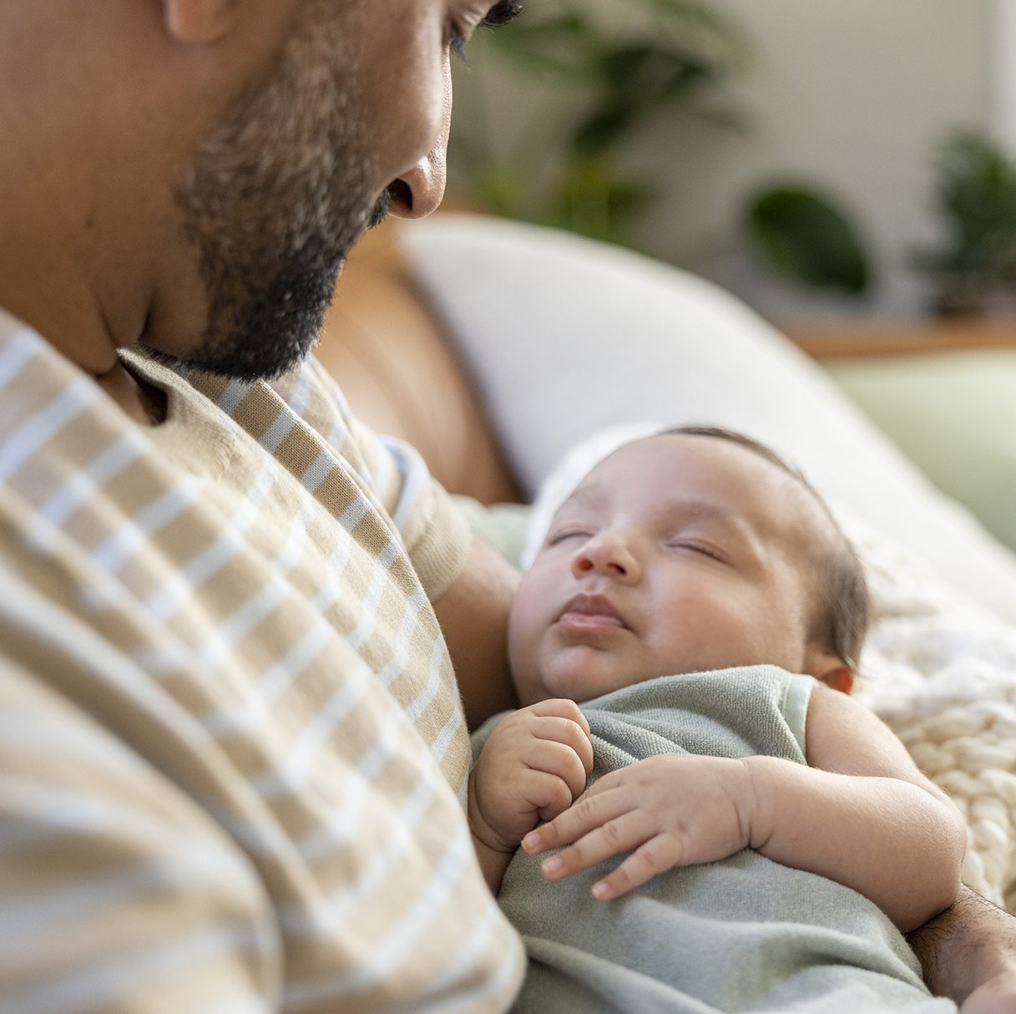
God’s Heart
Zeph 3:17
The LORD your God is with you, the Mighty Warrior who saves. He will take great delight in you; in his love he will no longer rebuke you, but will rejoice over you with singing.”
Notes:
God loves children, He loves parents and He wants to help us get it right

Slide 17
God’s Expectation
Num 14:31
As for your children that you said would be taken as plunder, I will bring them in to enjoy the land you have rejected.
Phil 2:14-16
…you may become blameless and pure, “children of God without fault in a warped and crooked generation.” Then you will shine among them like stars in the sky as you hold firmly to the word of life…
Psalm 127:3-4
Children are a heritage from the Lord, offspring a reward from him. Like arrows in the hands of a warrior are children born in one's youth.
Matt 10:16
I am sending you out like sheep among wolves.
Notes:
Conquer the land
Shine in wicked generation
Don’t wrap in cotton wool if God plans to work with and through them to reach the world He loves

Slide 18
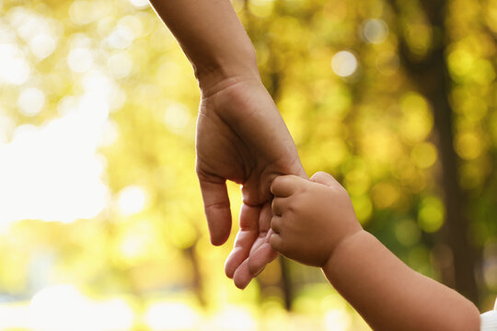










God’s Expectation
Notes:
“tell me more”
Own faith
God-connected
Colin pg 75
Asher

Slide 19

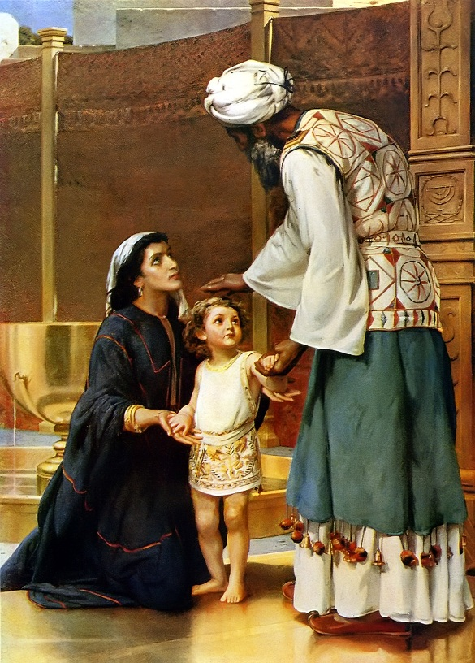
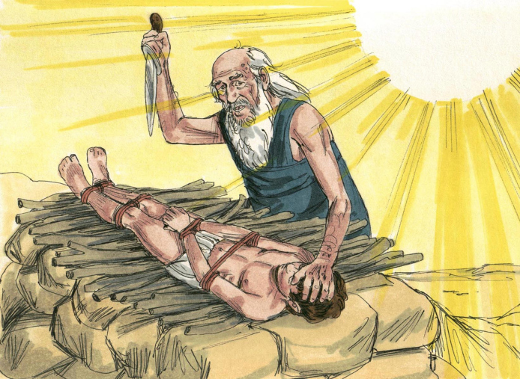
God’s Action
John 3:16
For God so loved the world that he gave his one and only Son, that whoever believes in him shall not perish but have eternal life.
Notes:
Abraham (Gen 22) willing to obey God and sacrifice the miraculous promised child
Gen 22:2
Then God said, “Take your son, your only son, whom you love—Isaac—and go to the region of Moriah. Sacrifice him there as a burnt offering on a mountain I will show you.”
Hannah (1 Sam 1) Offering child back to God (steward)
1 Sam 1:28 So now I give him to the Lord. For his whole life he will be given over to the Lord….
– no more than He was willing to do

Slide 20
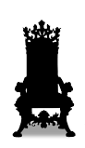

God’s Action
The Great Reversal
Jesus
Me
Notes:
The Great Reversal
Sin is when I put myself in His place (all acts of sin grow from my decision to serve myself, to act as if I’m in charge, to commit coup d-etat (coo day-tar)
Salvation is when He puts Himself in my place

Slide 21
(3) Confident & Active

Slide 22
Confident: He knows we are broken
1 Tim 1:15
Here is a trustworthy saying that deserves full acceptance: Christ Jesus came into the world to save sinners—of whom I am the worst.
Notes:
Thank God this doesn’t depend on me, but because he loves me and has invited me to participle, I have a role which He empowers me to fulfil
Begin to realise you are surrounded by sick people – shouldn’t be surprised in a hospital!
We are here because we have come to the conclusion we need help
Fever – vacuuming
We aren’t here because we are the best, but cus we know we are the worst
We don’t need to (and are unable) to fool Him

Slide 23
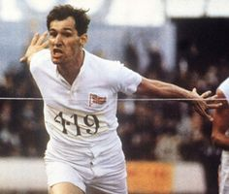
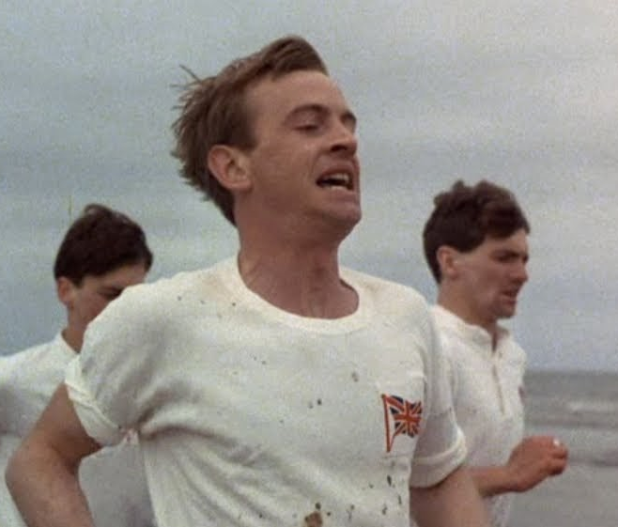
Confident: He accepts us
Runs to be accepted
Runs because he is accepted
Notes:
Chariots of Fire
Abrahams – runs in order to be accepted
“I have 10 seconds to justify my existence”
Already accepted
Last Episode we saw two clips from
Liddle – runs because he’s accepted
“When I run I feel His pleasure”

Slide 24
“The gospel is this: We are more sinful and flawed in ourselves than we ever dared believe, yet at the very same time we are more loved and accepted in Jesus Christ than we ever dared hope.”
- Tim Keller

Slide 25
Confident: He wants to partner with us
Phil 4:13
I can do all things through him who strengthens me.
Notes:
By myself I can do nothing. I’m an utter failure
Yet because He loves me, He wants to involve me, so He empowers me
I work with Him because I feel His pleasure, I don’t have to justify my existence
He gives me divine calling to be a parent/community wrapping around parent
- I look to him for patience, security, willingness to sacrifice

Slide 26
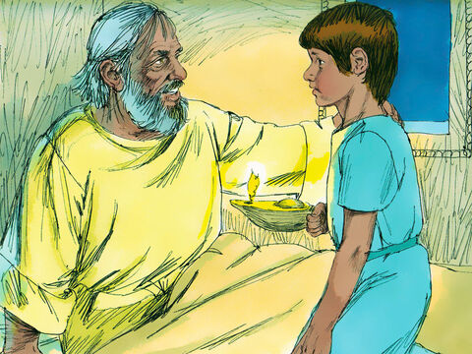
Action: Encourage God-Connectedness
Notes:
Eli calling

Slide 27

Action: Compassion
Notes:
Compassion for your child, your parent, your community
Also those you are meeting – you never know what is going on
Careful not to compare or judge
Curiosity
7 Habits of Highly effective people

Slide 28
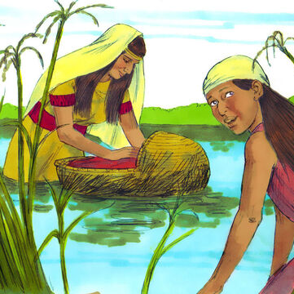
Action:
Open-handed

Slide 29
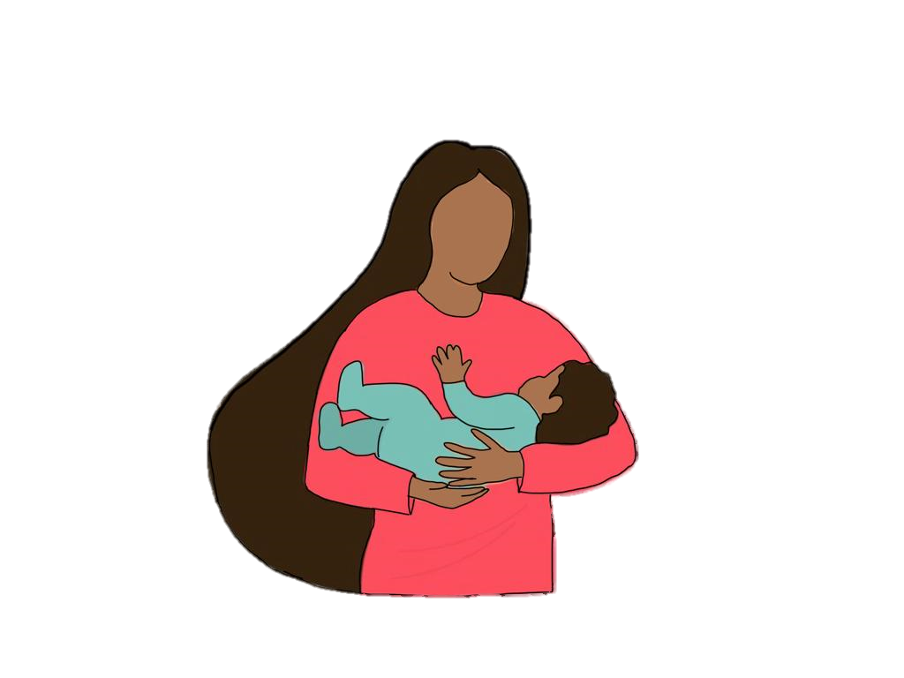

Slide 30
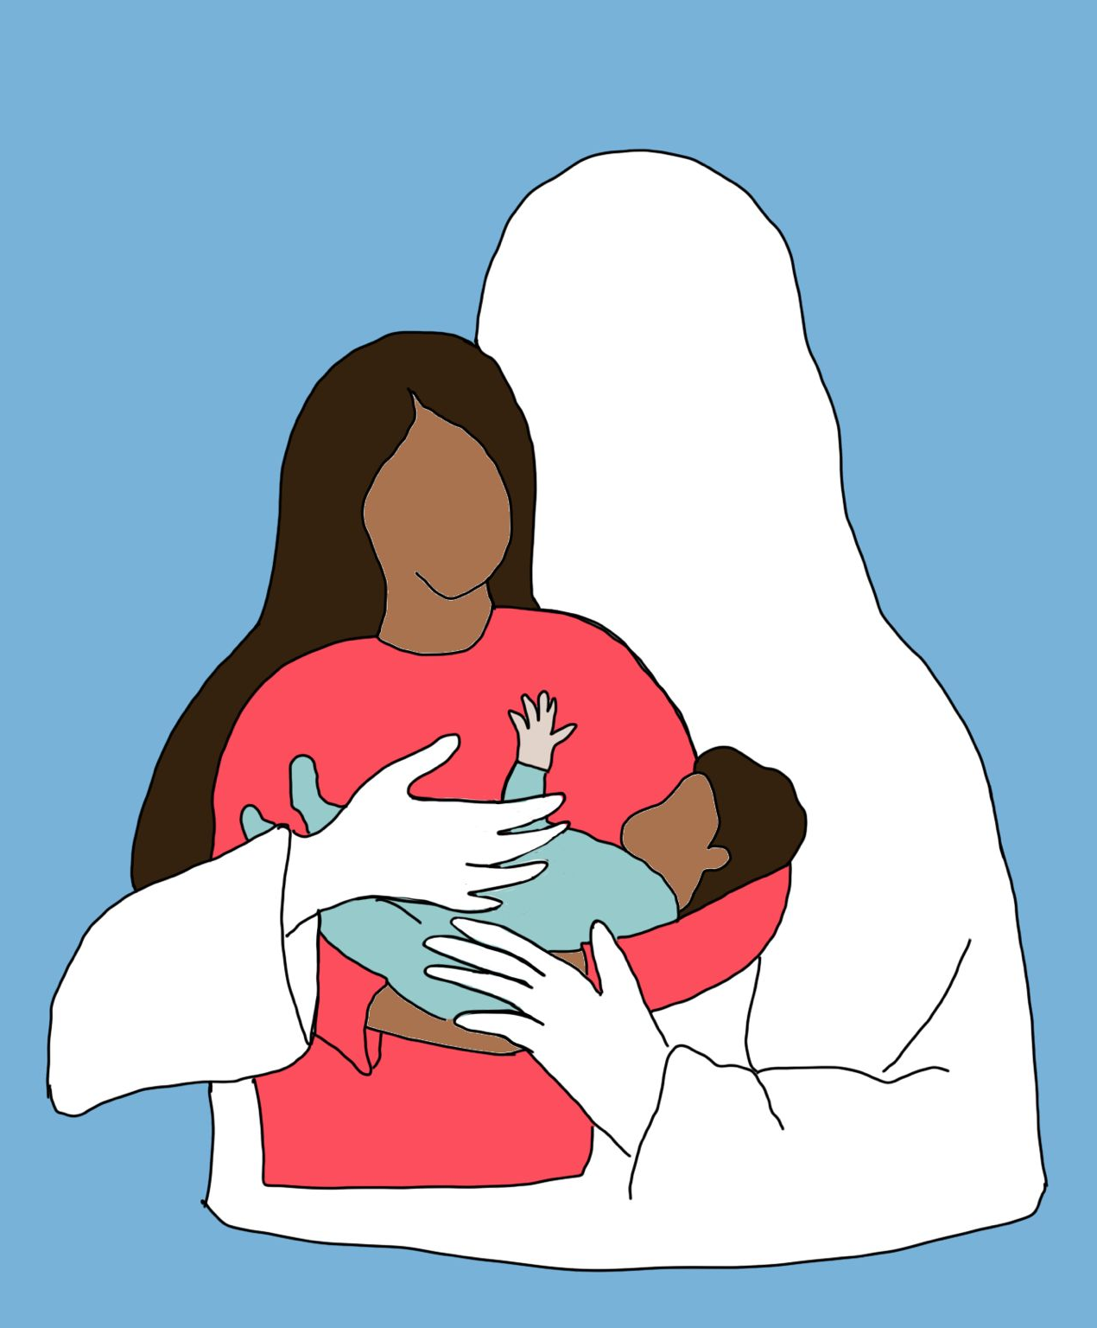
Ps 94:1-6
I will say of the Lord, “He is my refuge and my fortress,
my God, in whom I trust.”
Surely he will save you
from the fowler’s snare
and from the deadly pestilence.
He will cover you with his feathers,
and under his wings you will find refuge;
his faithfulness will be your shield and rampart.
You will not fear the terror of night,
nor the arrow that flies by day,
nor the pestilence that stalks in the darkness,
nor the plague that destroys at midday.
Notes:
Psalms 91:4 TPT
His massive arms are wrapped around you, protecting you. You can run under his covering of majesty and hide. His arms of faithfulness are a shield keeping you from harm.

Slide 31
Response
Swap guilt for adventurous calling
Choose to believe He has seen me at my worst and yet still accepts me
Ask to live in confidence
Take action (e.g. of compassion & curiosity)
Notes:
Households vision – removal of guilt

