Slide 1
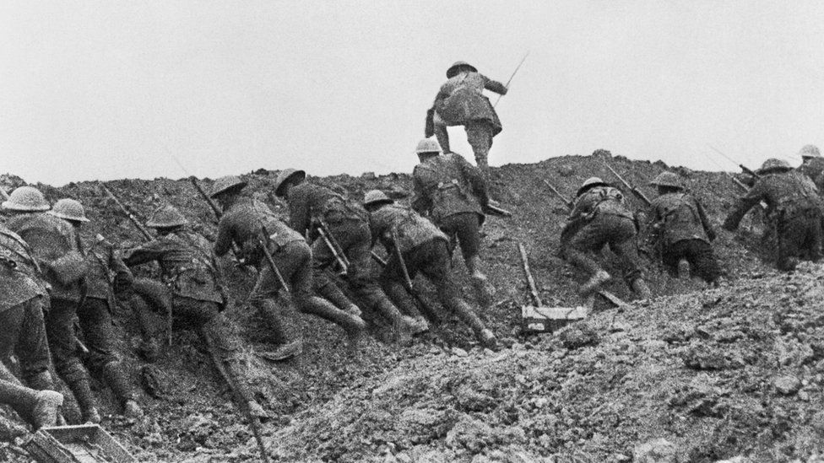
The Battle Cry
Sunday 29th January

Slide 2
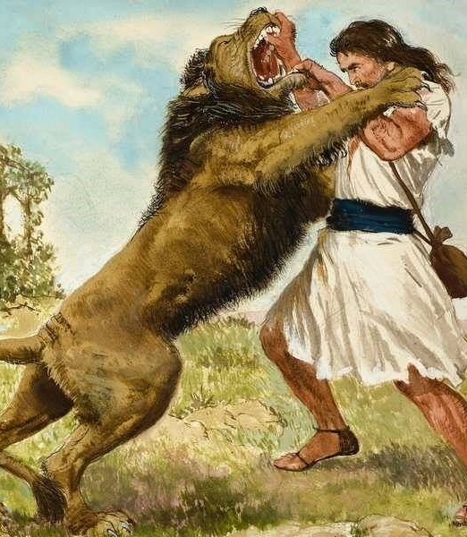
‘Must haves’ to respond to battle cry
A fighting spirit
    1 Sam 17:34-35
    But David said to Saul, “Your servant has been keeping his father’s sheep. When a lion or a bear came and carried off a sheep from the flock, I went after it, struck it and rescued the sheep from its mouth. When it turned on me, I seized it by its hair, struck it and killed it.

Slide 3

‘Must haves’ to respond to battle cry
2. Responsiveness
    1 Sam 17:20
    Early in the morning David left the flock in the care of a shepherd, loaded up and set out, as Jesse had directed. He reached the camp as the army was going out to its battle positions, shouting the war cry.
    Isaiah 30:21
    Whether you turn to the right or to the left, your ears will hear a voice behind you, saying, “This is the way; walk in it.”

Slide 4
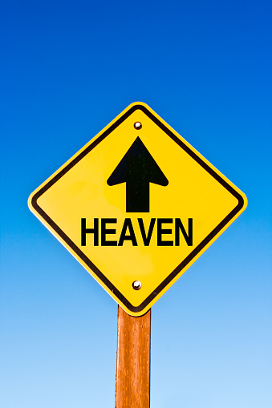
‘Must haves’ to respond to battle cry
3. Clear motivation
    1 Sam 17:46
    …and the whole world will know that there is a God in Israel.
GOD

Slide 5
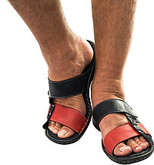
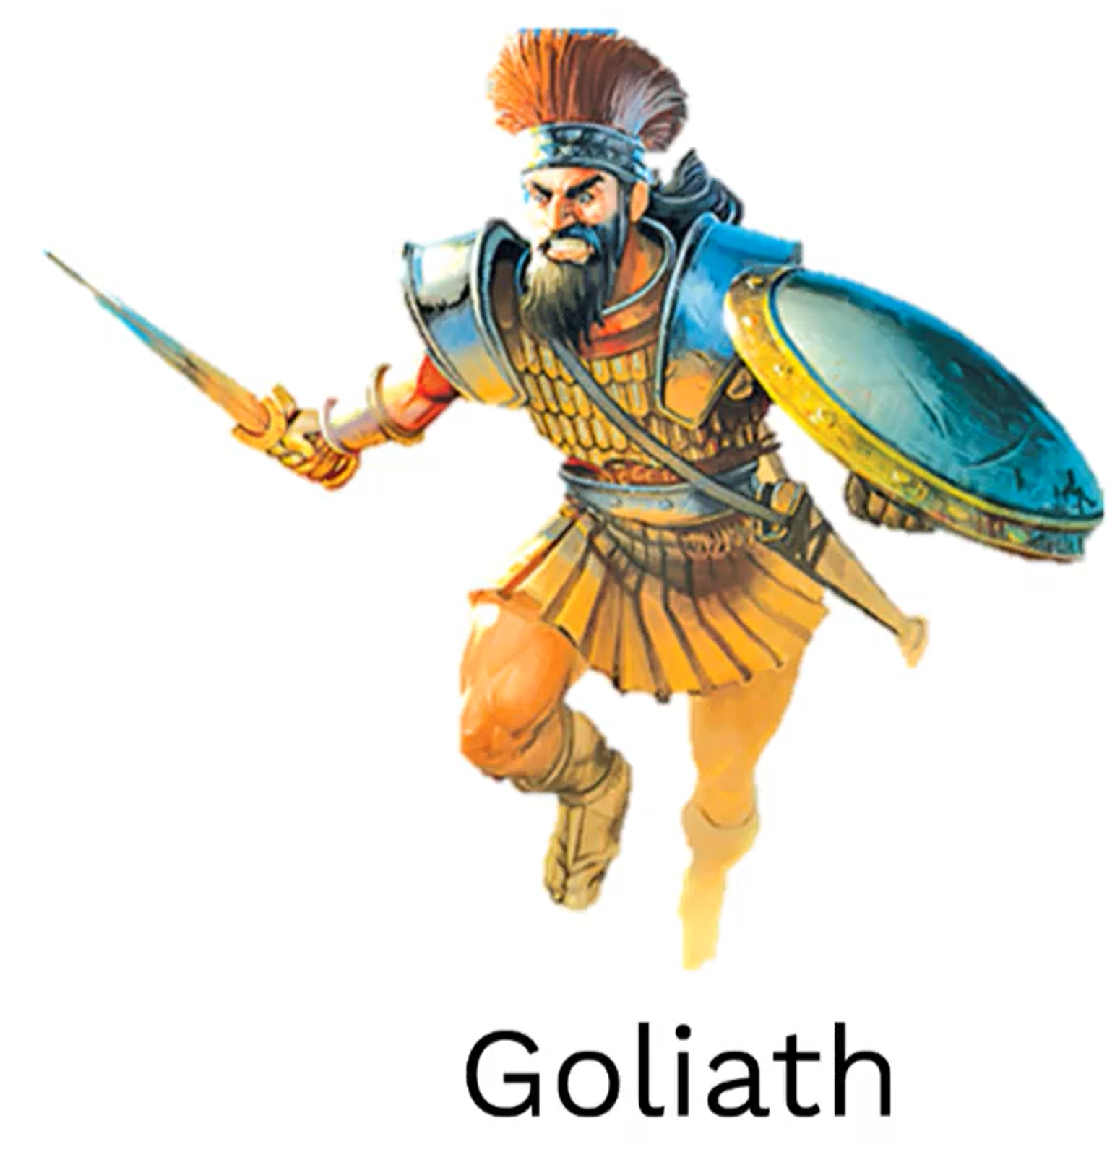
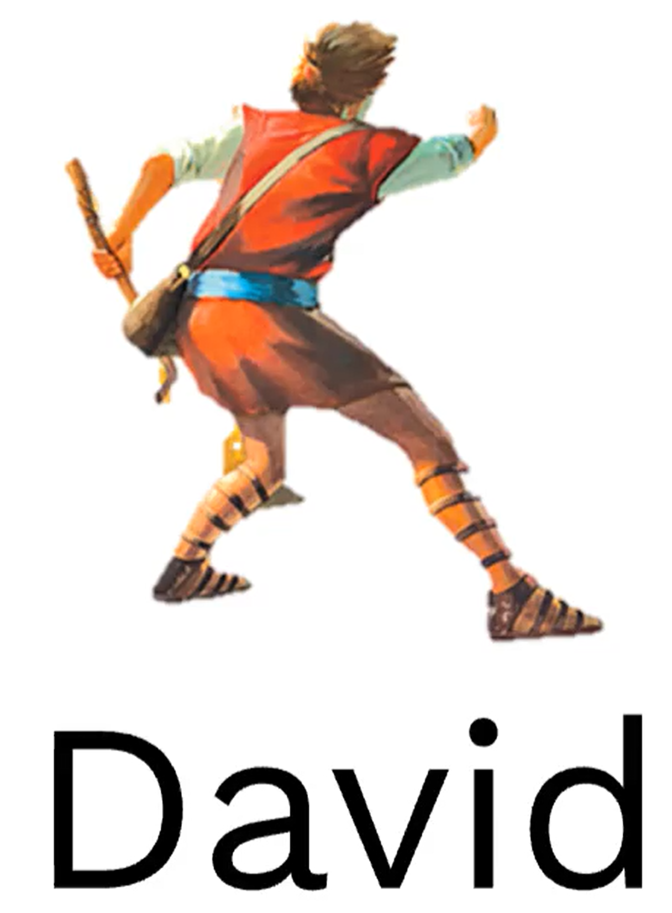
‘Must haves’ to respond to battle cry
4. Confidence in God
    1 Sam 17:46
    This day the Lord will deliver you into my hands…
God

Slide 6
‘Must haves’ to respond to battle cry
5. Thankfulness

Slide 7
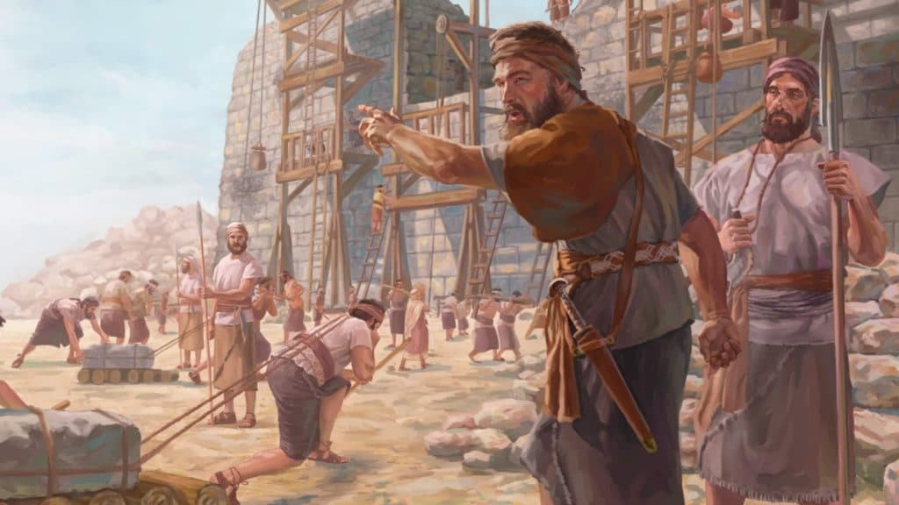
‘Must haves’ to respond to battle cry
6. Single-mindedness
Neh 6:3
…“I am carrying on a great project and cannot go down. Why should the work stop while I leave it and go down to you?”

Slide 8
Result of responding to battle cry
Accuracy leading to breakthrough
Release others

Slide 9
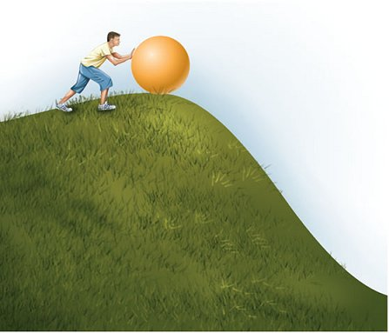
On the verge

Slide 10
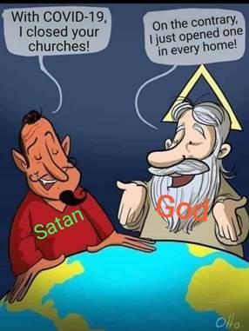
Our Great Project
Households together with Christ at the centre
  Parents will be released from sense of failure & embrace their God-given call to lead family
  Households comprise of individuals/families of different backgrounds & stages of life where new people quickly belong
  Households will be a consistent place where we experience His presence & get equipped for reaching out

Slide 11
Our Great Project
2. Ministering the Spirit
  Naturally operating in supernatural gifts which
    strengthen the church
    awaken a hunger in the lost
  Increased of awareness & submission to the Spirit
  Able to show not just describe God
  The Spirit enables us to believe God’s promises
  New authority from realising the Spirit within is breaking out

Slide 12
Our Great Project
3. Sharper Witness
  Have to explain the ‘source of our power’ to remain relevant.

Slide 13
Response
The battle cry is going out – will you respond
You can’t generate the ‘must haves’. You don’t need to.
You just have to say “I will follow you wherever you go.” (Luke 9:57)

