Slide 1

Becoming a Conduit of
Grace
6th Oct 2024
Jamie Singleton
Notes:
A lot of you guys are pastors and would have taught on the topic of grace (many of you for longer than the youngest here have been talking).
But I think God wants to invite us into a new or refreshing depth of grace today.
It is possible to know about grace and even experience it and yet it stops there.

Slide 2

Blocker or Conduit of Grace

Slide 3
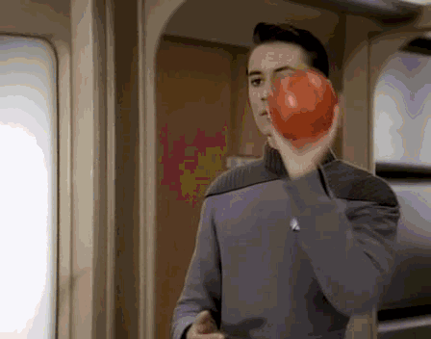
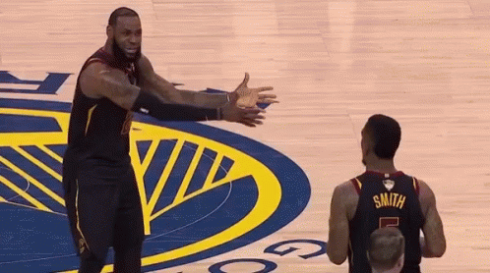
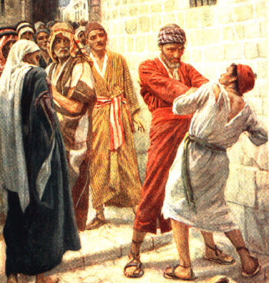
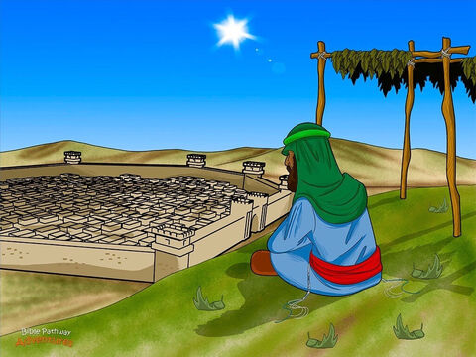
Failure to Receive
Failure to pass on
Notes:
Failure to accept grace
Don’t need it – those with more issues need grace (I can trust in my own righteousness)
Too good to be true
Unforgiving servant – acts as if his debt hadn’t been forgiven
Don’t deserve it
Failure to afford it to others (pride is a blocker)
Jonah
Numbers on head
Aves

Slide 4
Overwhelmed
Defensive
Failure

Slide 5

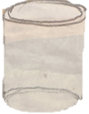

Slide 6
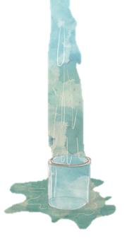


Slide 7
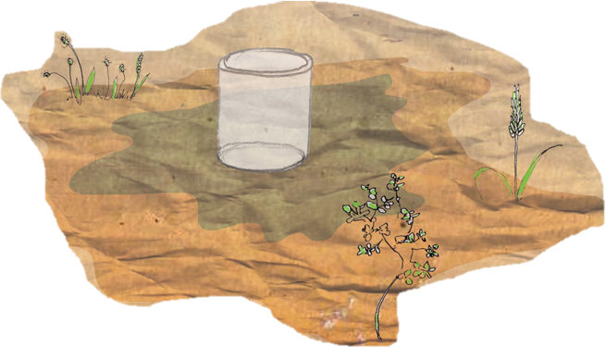
Notes:
God’s intention was always that we would work with Him to show the world what He is like.
TK – God transforms you, in order to transform through you
We have been invited in and commissioned to invite others
Eph 3:10,
role of children of Israel
you will be my witnesses
(Jesus didn’t do a ‘Damascus Road’ experience for all the believers – most were added through the God’s people)
To be a conduit – you need to receive and pass on.

Slide 8
Question
What behaviours indicate you have stopped being a conduit of grace?
Notes:
Overwhelmed
Defensive
Failure
Talk about God rather than to Him
Talk about church (structure/programme)
Disappointed
Frustrated
Exaggerate my role (pride/failure)
Legalism/externalism
Anxiety

Slide 9

The Necessity of Grace
Grace is God’s undeserved goodness to us!
Notes:
I couldn’t deny it
I couldn’t shift the blame
I couldn’t fix my mistakes
Isa 54:6 all our righteous acts are like filthy rags
Rom 3:23 for all have sinned and fall short of the glory of God,

Slide 10

For it is by grace you have been saved, through faith and this not from yourselves, it is the gift of God - not by works, so that no one can boast.
- Ephesians 2: 8-9
Notes:
Rom 5 – ‘Perfect time’ – still swinging punches, I brought nothing to the table, I did nothing to endear myself to Him

Slide 11
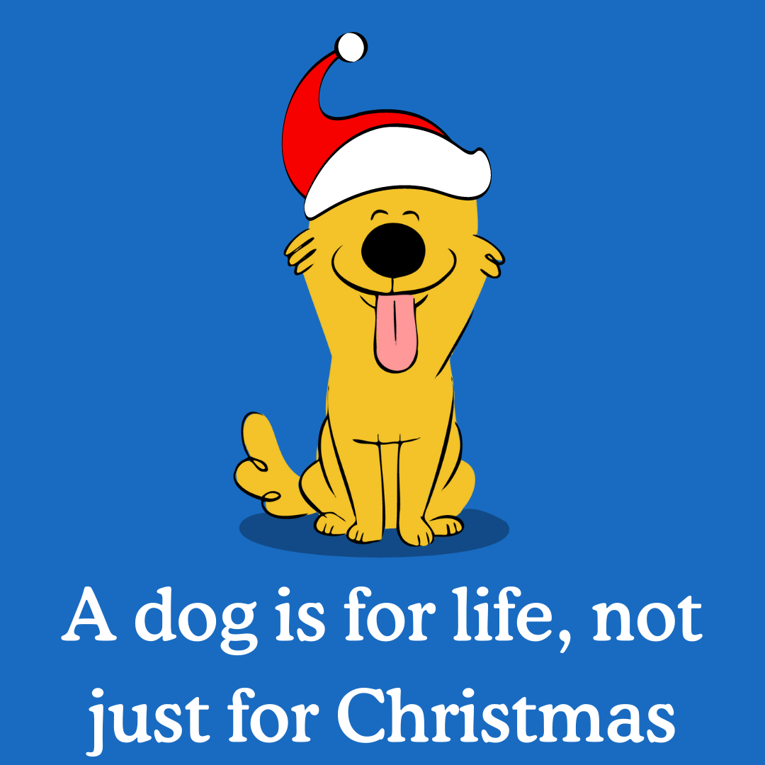
Grace is for life, not just for salvation
Notes:
being confident of this, that he who began a good work in you will carry it on to completion until the day of Christ Jesus. Phil 1:6
We don’t make ourselves holier by our own effort

Slide 12
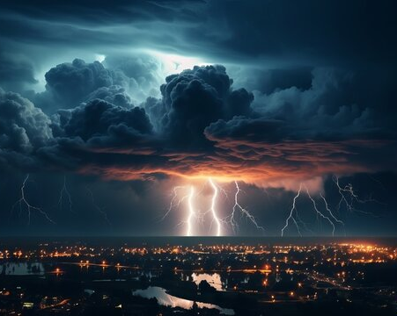
The Threat of Grace
Notes:
The gospel of grace is more wondrous and threatening than I ever understood.

Slide 13
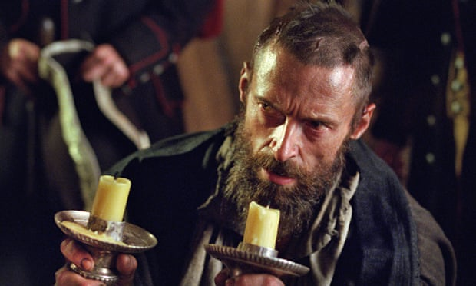
Notes:
Bishop: With this treasure I bought your soul for good not evil
Val Jean knew pardon of Bishop was greatest attack, most formidable assault on his heart he had ever sustained
He knew the hardness of heart will be complete if he resists this kindness, No longer middle ground. Would have to mount higher than bishop or fall lower than galley slave.
If he became good he’d be an angel, if he became evil he’d become a monster
While he wept a light grew brighter in his mind
He realised he was looking on Satan by the light of paradise
Valjean needed to change or he would be damning himself
Bishop changed course of Valjean’s life at cost of candlesticks

Slide 14
“I asked her what was so scary about unmerited free grace? She replied something like this: "If I was saved by my good works -- then there would be a limit to what God could ask of me or put me through. I would be like a taxpayer with rights. I would have done my duty and now I would deserve a certain quality of life. But if it is really true that I am a sinner saved by sheer grace -- at God's infinite cost -- then there's nothing he cannot ask of me.”
- Tim Keller
Notes:
A lady came up to Keller after his teaching and said she was uncomfortable with the idea of grace

Slide 15
HAD
to
do
it
GLAD to do it
Notes:
He HAD to do it – humbles me
He was GLAD to do it – affirms me

Slide 16

Notes:
I want to be re-enchanted by his amazing grace all over again
Not shaking head and tutting

Slide 17
Question
Have you ever felt the ‘threat’ of grace?
Notes:
- “It’s none of your business”

Slide 18
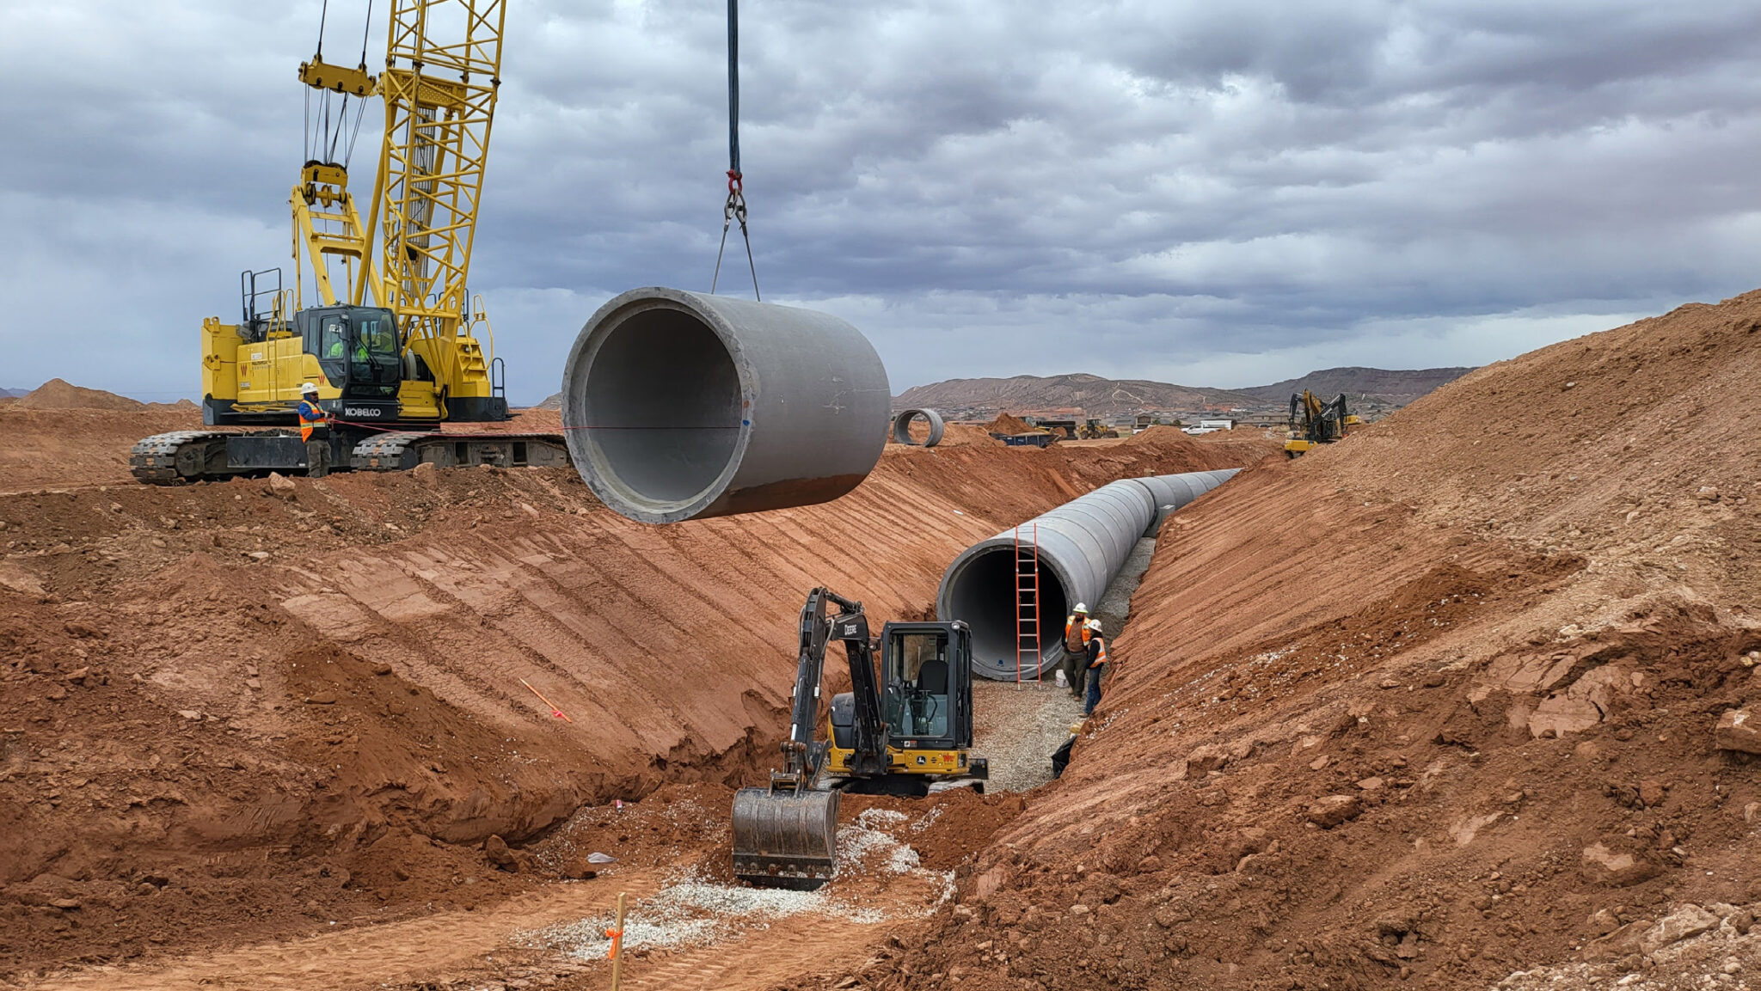
How to become a conduit

Slide 19
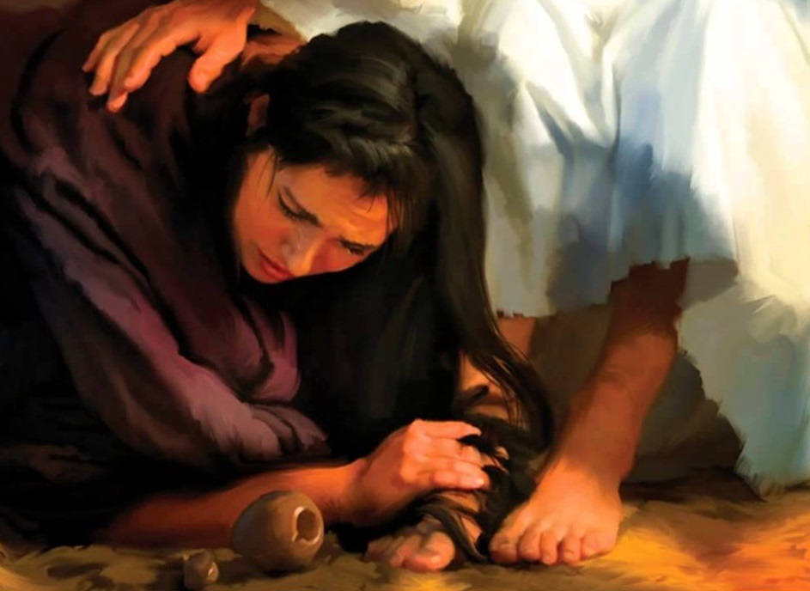
a. Stop trying to figure it out & enjoy it!
For he chose us in him before the creation of the world to be holy and blameless in his sight. In love he predestined us for adoption to sonship through Jesus Christ, in accordance with his pleasure and will— to the praise of his glorious grace, which he has freely given us in the One he loves.
Eph 1:4-6
Therefore I tell you, her sins, which are many, are forgiven—for she loved much. But he who is forgiven little, loves little.
Luke 7:47
Notes:
Stop trying to figure it out and enjoy it!
Whoever been forgiven much loves much (vs unforgiving servant)
He has chosen to you/me, I have no idea why
But He seems to have decided to love us!

Slide 20
He takes delight in you!
The LORD your God is with you, the Mighty Warrior who saves. He will take great delight in you; in his love he will no longer rebuke you, but will rejoice over you with singing
Zephaniah 3:17
He brought me out into a spacious place; he rescued me because he delighted in me.
Psalm 18:19

Slide 21
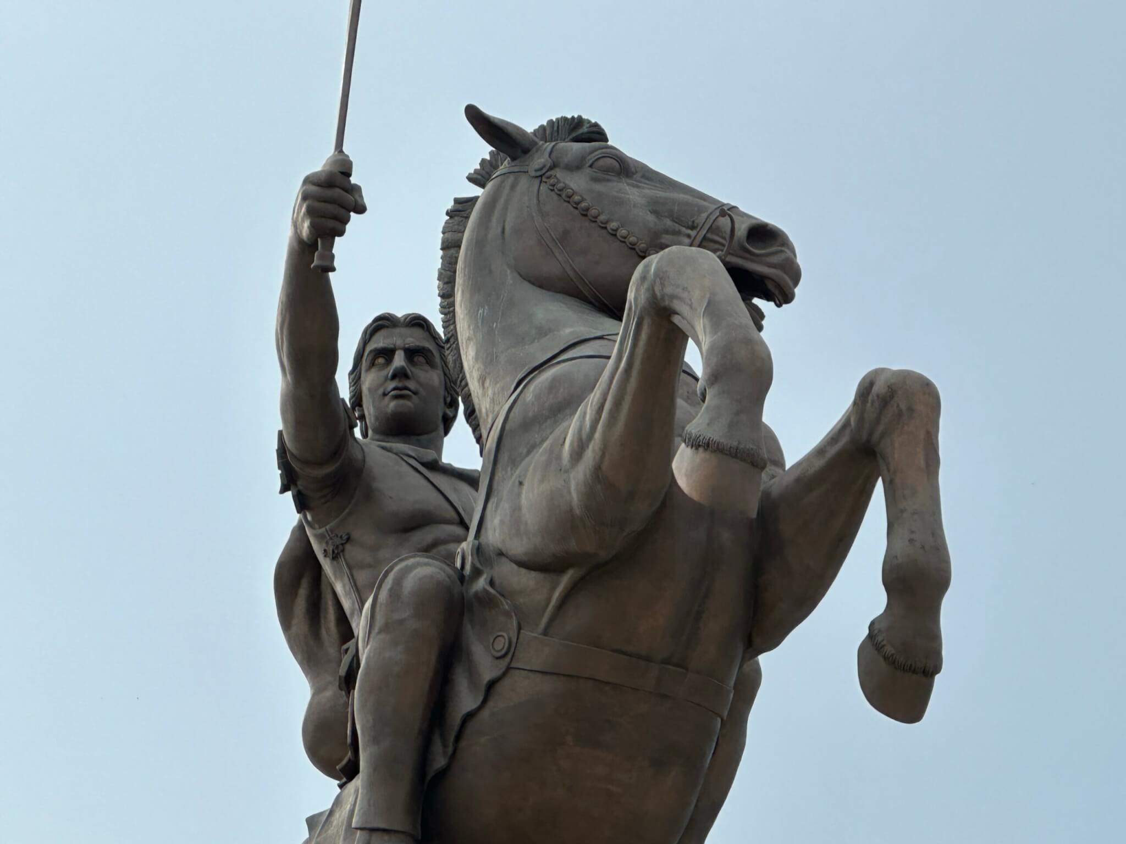
b. Focus on Him
"Copper coins would suit the beggar's need, but gold coins suit Alexander's giving.“
- Alexander the Great
Notes:
As the reality of His lavish love (1 John 3:1) soaks in, He becomes our delight. Because He first loves us (1 John 4:19)
Alexander the Great - Suit His giving
Not about what I deserve or don’t its about God expressing Himself
The poor, wretched beggar had no claim upon the ruler, yet the Emperor threw him several gold coins. A noble man traveling with the ruler was shocked at his generosity and said, "Sir, a copper coin would meet the beggar's need. Why give him gold?"
Alexander the Great responded as a king responds, "Copper coins would suit the beggar's need, but gold coins suit Alexander's giving."

Slide 22

Find your delight in Him!
Notes:
The question is not “Am I good enough?” The only thing that matters is that Jesus is good enough
Phil 3:8 What is more, I consider everything a loss because of the surpassing worth of knowing Christ Jesus my Lord, for whose sake I have lost all things. I consider them garbage, that I may gain Christ
Something happens when I see Him – When He becomes the object of my affection
Snot Sucker
Disgusting, boring, over the top
Beautify, joy, appropriate
Listened to Mozart to make money, now make money to listen to Mozart

Slide 23

Living Graciously
Notes:
Wind in your sail

Slide 24

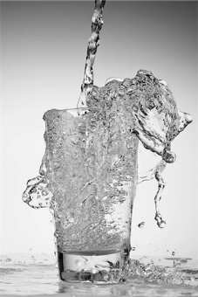
Notes:
Refilled from the supply
You have not because you ask not - James 4:2
I should have what I need
your Father knows what you need before you ask him. Matt 6:8
Luke 6:38 Give, and it will be given to you. A good measure, pressed down, shaken together and running over, will be poured into your lap.
I can give generously because I know God is generously resupply me

Slide 25


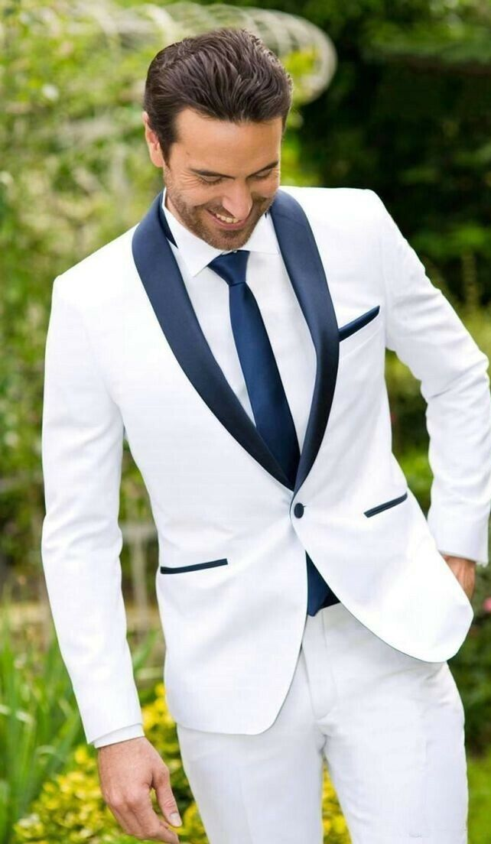
Notes:
Avoiding sin doesn’t make me clean
Because God has made me clean (grace), I want to avoid sin
Abrahams vs Lidle

Slide 26
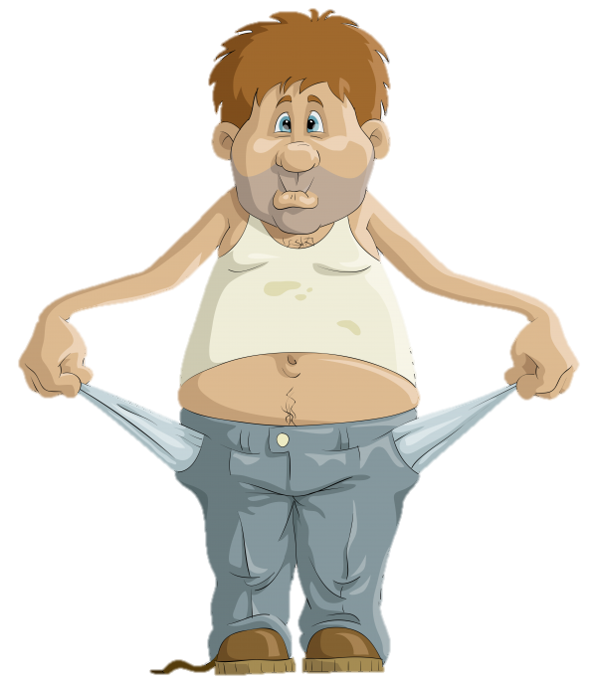
$100
$20
?
Notes:
Grace to give Him the $100 He demands
He knows what we have and don’t have
- Matt 6:8 Do not be like them, for your Father knows what you need before you ask him.
There is the grace of God to do the will of God
Phil 2:13 for it is God who works in you to will and to act in order to fulfill his good purpose.
Grace is sufficient (2 Cor 12:9)

Slide 27
Heb 4:16
Let us then approach God’s throne of grace with confidence, so that we may receive mercy and find grace to help us in our time of need.
John 15:5
“I am the vine; you are the branches. If you remain in me and I in you, you will bear much fruit; apart from me you can do nothing.

Slide 28
Response
I want to be a conduit and not a blocker of grace
  I choose to receive God’s grace (accept I need it, I don’t deserve it, but it's in His nature)
  I choose to pass on God’s grace (repent of self-righteousness & self-protection)
I want Jesus to become ever more my delight
I choose to give God what He wants
Notes:
2. Might include re-enchanted by grace (threat – humbled and affirmed)

