Slide 1
ONE RANDOM THOUGHT
THAT LED TO ANOTHER
Notes:
For those that are expecting a highly polished 3 point sermon that has a fantastic start and interesting mid-section and awesome endingf you’ve come to the wrong week. James is speaking next week no pressure James

Slide 2
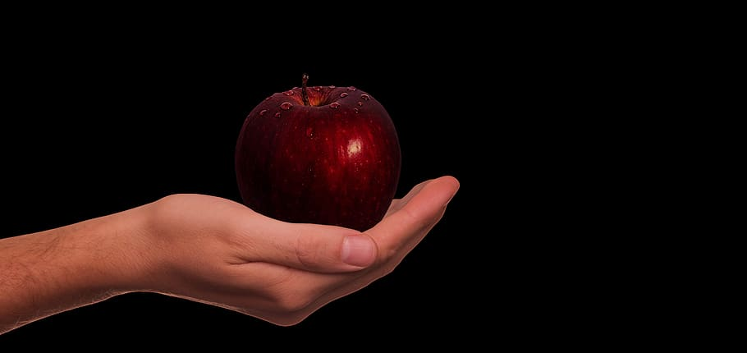
DID GOD ACTUALLY SAY?
Notes:
I don’t know about you but recently I read through Genesis (1st Book of the Bible) I have thought about the garden of Eden and wondered if I would have done any better?
I mean you live in paradise you have a perfect partner
You get to walk with God in the cool of the evening
You have an all you can eat buffet
Now I've been to a couple of 6* holiday resorts, but I think the garden of eden would have trumped that
Death doesn’t exist
And yet 1 phrase managed to wreck it all. They were caught out with a simple phrase
DID GOD ACTUALLY SAY –
THE ENEMY RIGHT FROM THE BEGINNING HAS BEEN TO ATTACK ON GODS WORD IN FAVOR OF MAKING US GODS
So God usually talks to me in a situation an this situation rose out of me supporting my football team Tottenham Hostspur

Slide 3
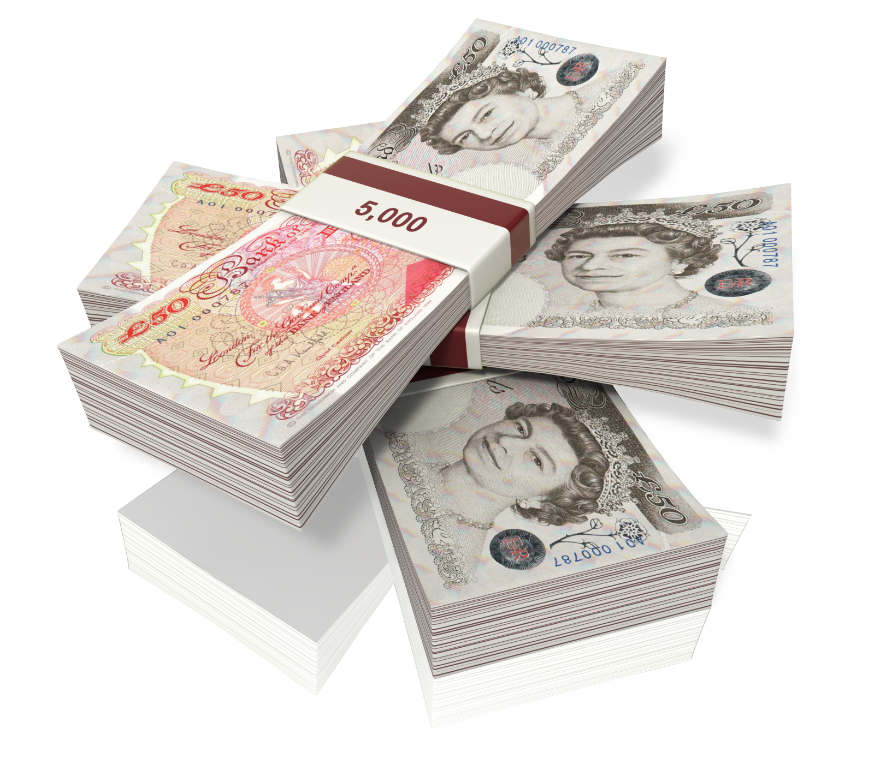
DEFENITION OF COUNTERFEIT
“IMITATE FRAUDULENTLY”
Notes:
made in exact imitation of something valuable with the intention to deceive or defraud

Slide 4
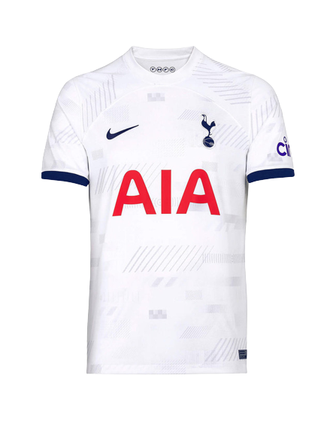
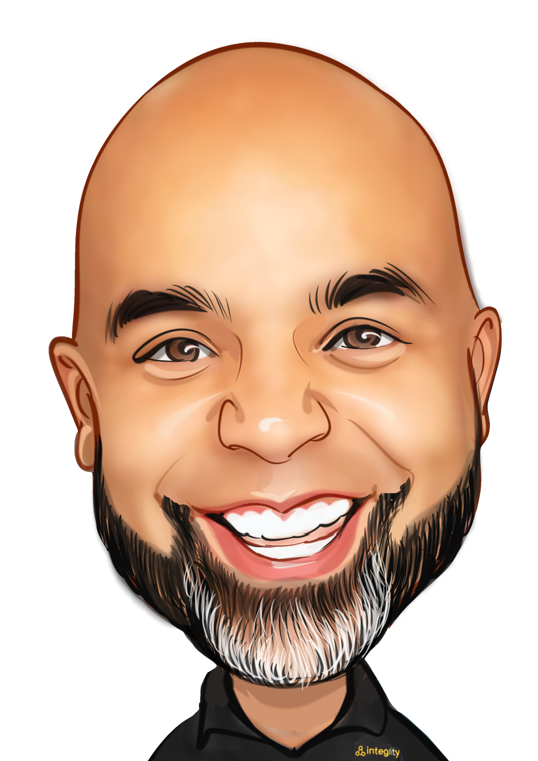

Slide 5
= £80/£120

Slide 6


Slide 7
= £12.50

Slide 8
WHAT COULD POSSIBLY
GO WRONG …

Slide 9
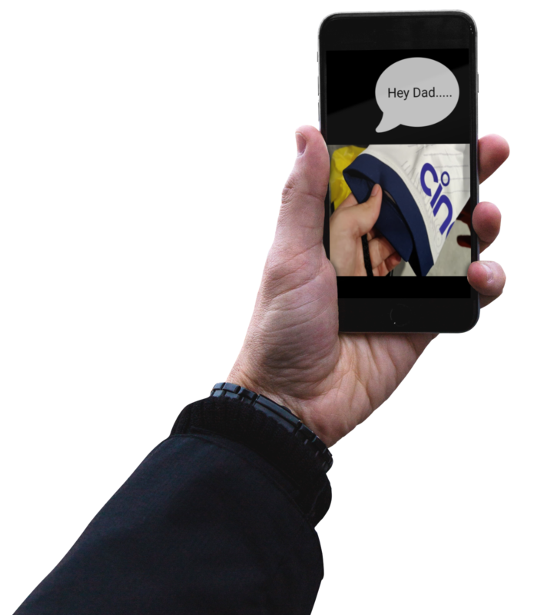
Photo of me
READ THE 4TH COMMANDMENT

Slide 10
I COULD BLEND IN UNNOTICED
BUT I KNOW
THAT’S ALL I NOW SEE
Notes:
I cant see the 99% that looks ok I can only see the 1% error- I was thinking that the Holy Spirit
Many of us that don’t know Jesus would say I’m pretty good problem is God wants perfection
Are any of us sitting here this morning feeling convicted, blending in on the outside but knowing that something isn’t quite right

Slide 11
THE ENEMY IS NOT A CREATOR HE CAN ONLY COUNTERFEIT
Notes:
He’s has continued to use the same tactic from the garden of Eden to today
. If he can get you discard GODS word you end up in the same predicament as Adam and Eve
HE WANTS TO TRAP US WHOS GOING TO KNOW ANYWAY

Slide 12
LUKE 12:2
There is nothing concealed that will not be disclosed, or hidden that will not be made known.
Notes:
There will come a time when all things will be revealed

Slide 13

BATTLE BETWEEN TWO FOUNDATIONS
MAN’S WORD
GOD’S WORD
Notes:
Most of us have a secular world view

Slide 14


WHY DO WE ATTEMPT TO LIVE WITHOUT THE INSTRUCTION MANUAL ?
Notes:
MANY TIME WE

Slide 15

“YOU HAVEN’T GOT TIME FOR THAT…”
2TIM 3 :16
All Scripture is God-breathed and is useful for teaching, rebuking, correcting and training in righteousness.
“THAT’S A DATED WAY OF THINKING”
“DON’T BE SO RELIGIOUS….”
Notes:
MANY TIME WE

Slide 16
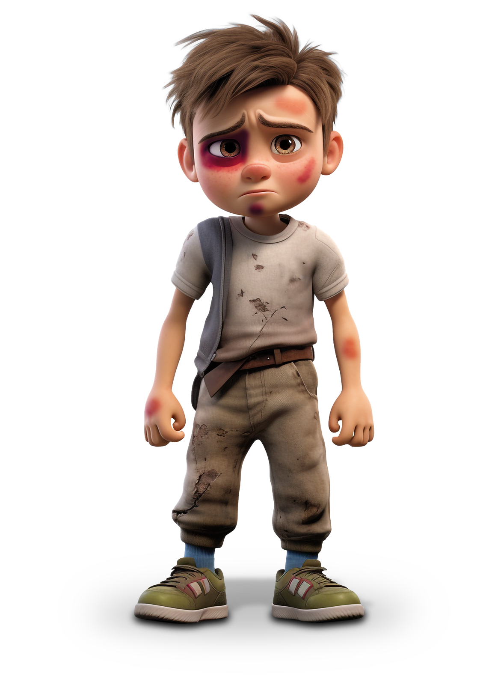
JOHN 16 8-11
And when He comes, He will convict the world in regard to sin and righteousness and judgment: in regard to sin, because they do not believe in Me; in regard to righteousness, because I am going to the Father and you will no longer see Me; and in regard to judgment, because the prince of this world has been condemned.
Notes:
MANY TIME WE

Slide 17

THE HOLY SPIRIT CONVICTS THE WORLD BECAUSE THEY DO NOT BELIEVE IN
JESUS
Notes:
We are clean
Dressing in white not because of anything we have done but what JESUS has done for us

Slide 18
THE HOLY SPIRIT REMINDS US OF OUR RIGHTEOUSNESS
IN CHRIST
Notes:
We are clean
Dressing in white not because of anything we have done but what JESUS has done for us

Slide 19

GOD’S APPROVAL
BEARER OF HIS RIGHTEOUSNESS
JUSTIFIED
BECAUSE OF WHAT JEUSUS HAS DONE
CAN WE GET A LITTLE BIT EXCITED!

Slide 20
FALIURE
TRAPPED
THE ENEMY
ACCUSES US OF
SIN
CONDEMNATION
GUILTY
Notes:
The enemy of the other hand accuses us and makes us forget about righteousness

Slide 21
THE ENEMY
HAS NO RIGHTS
TO CONDEM US
HE IS CONDEMMED AND THE HOLY SPIRIT REMINDS HIM OF JUDGEMENT
Notes:
MANY TIME WE

Slide 22
THE CONTERFEIT OF CONVICTION IS
ACCUSATION
Notes:
Conviction leads to repentance that leads to FREEDOM

Slide 23

“Dad you can’t say that….”
Notes:
Thought number 2

Slide 24


Slide 25
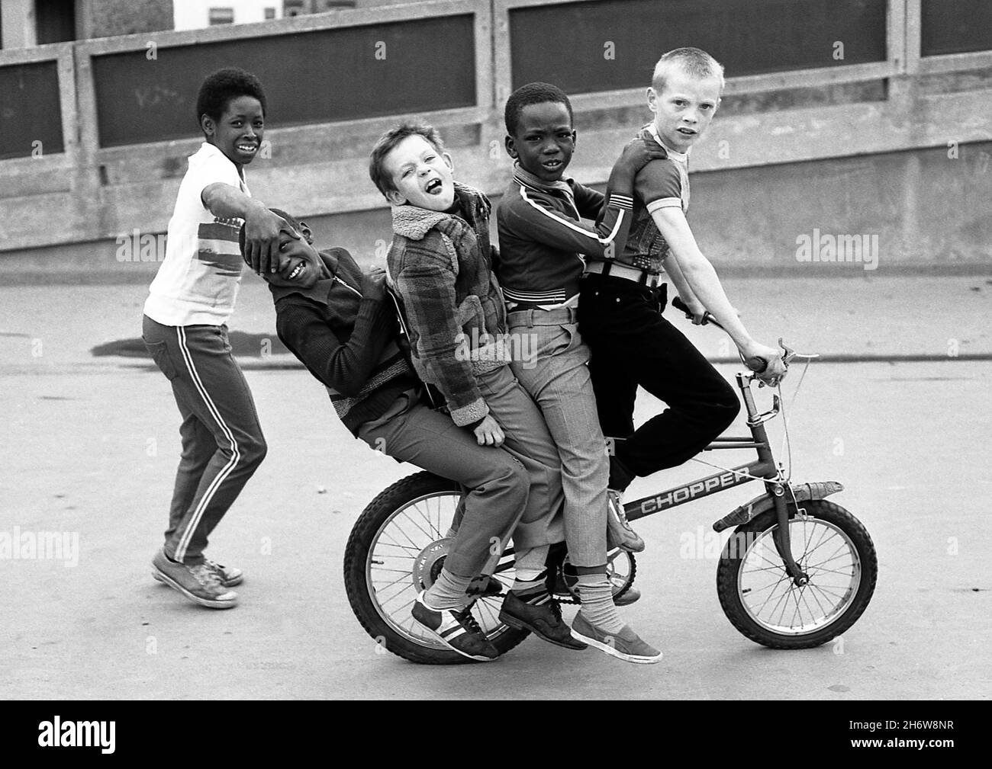

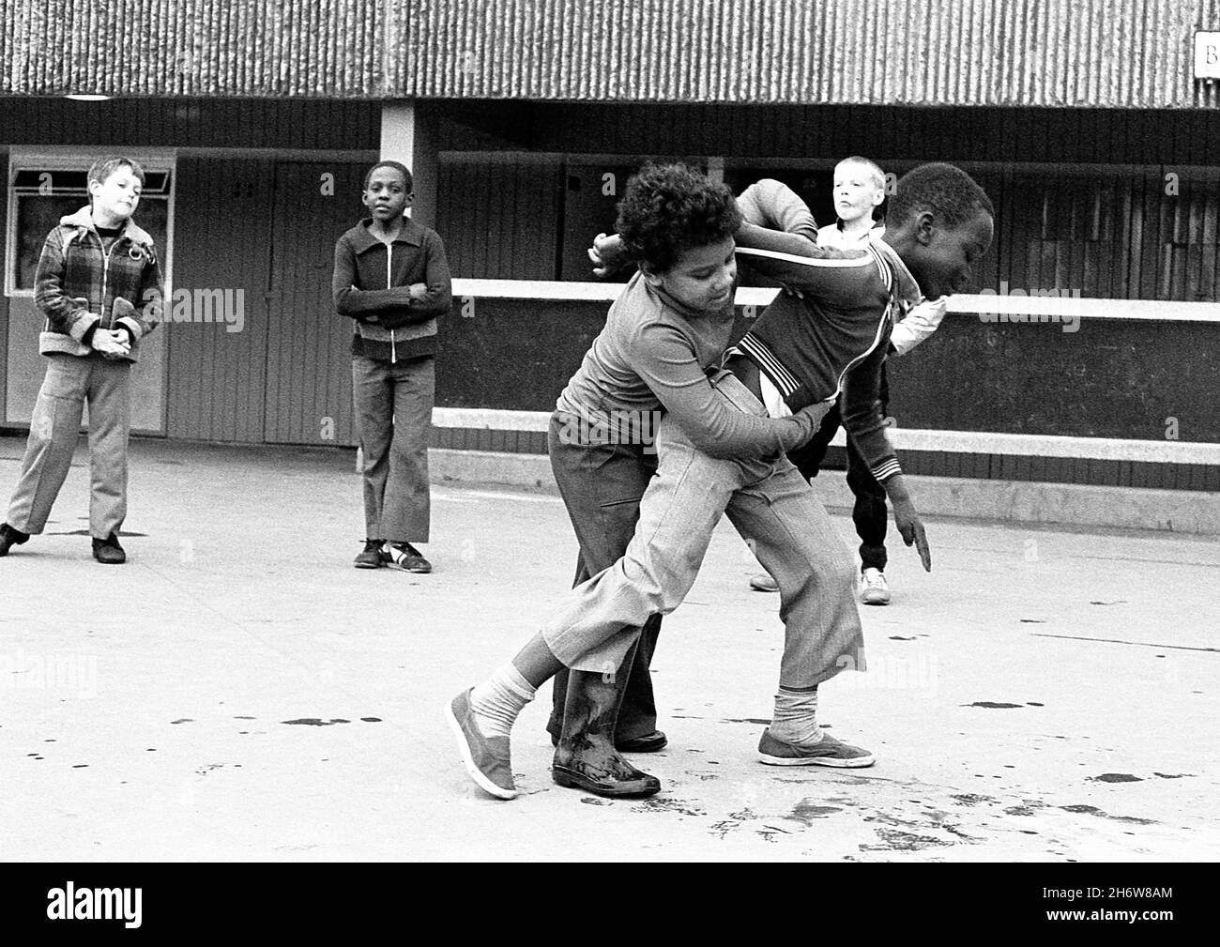
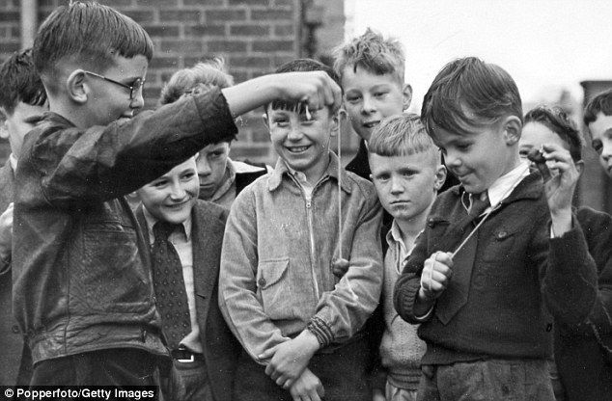
Notes:
FUSION
Give your mate a backie
Fights were with fists and not knives -
3 channels on TV
Conkers didn’t have to have a health and safety policy
The world had changed in the last 35 years
BUT
The enemy hasn’t It was all about him we made it all about us

Slide 26







Slide 27
GENESIS 1-11

Slide 28
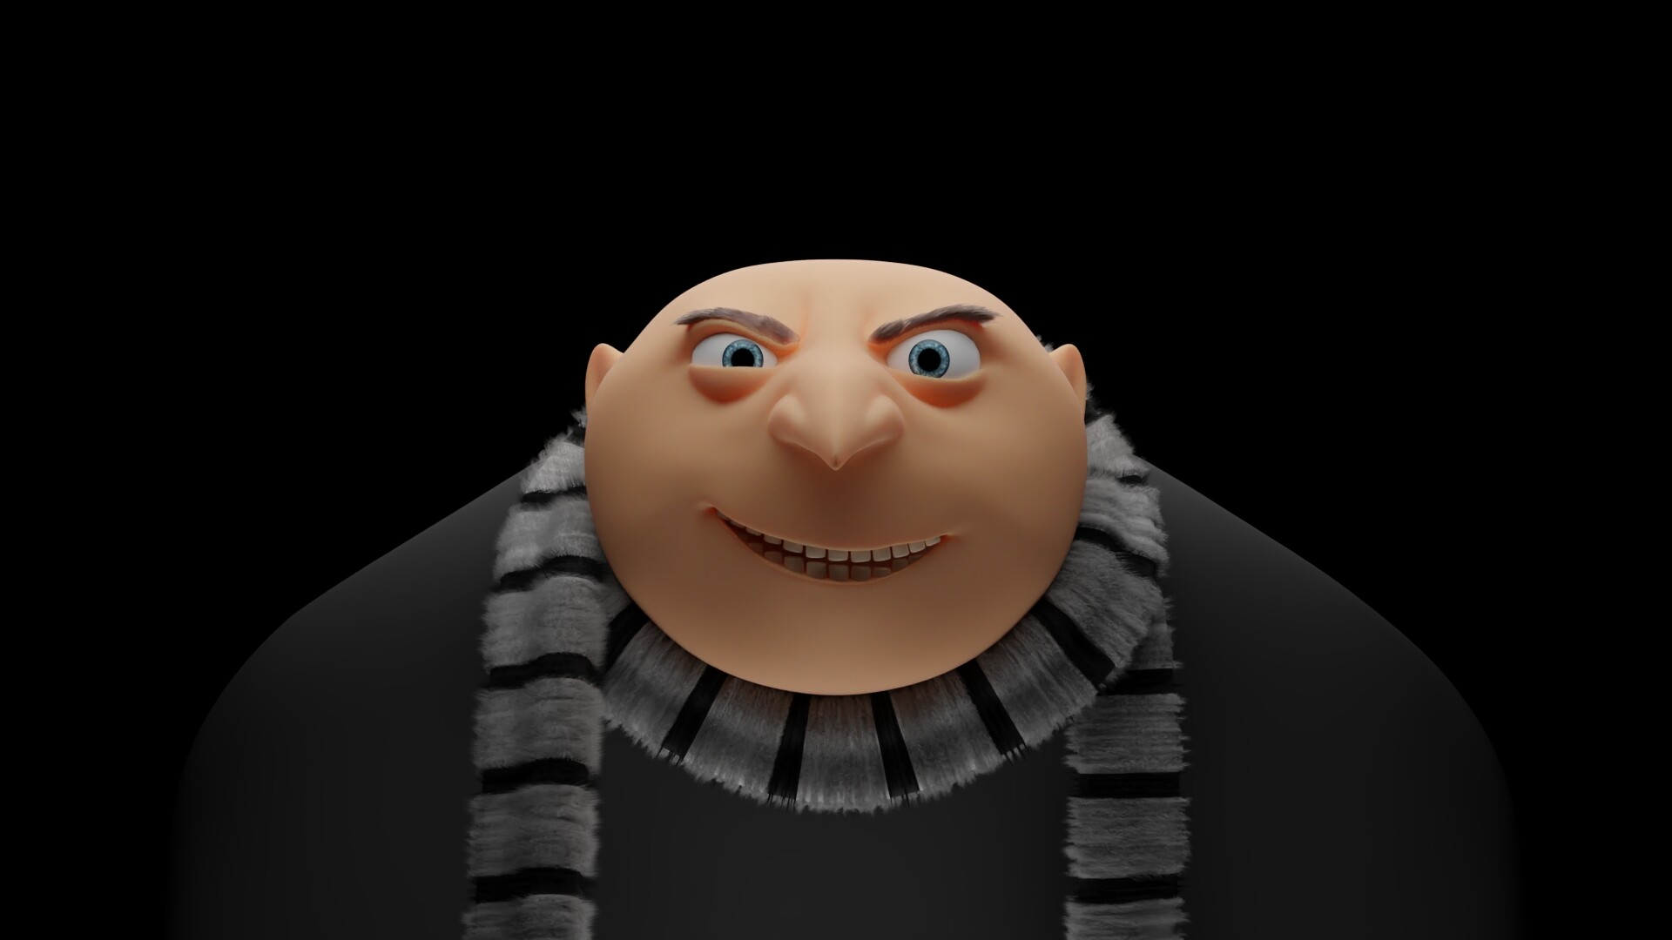
SPIRIT OF THE AGE
ME
Notes:
Sin has been dealt with for the world it’s their Sin of unbelief in Jesus that sends them to hell

Slide 29
IT’S ALL ABOUT ME JESUS
AND ALL THIS IS FOR ME FOR MY GLORY AND MY FAME
ITS NOT ABOUT YOU
AS IF I SHOULD DO THINGS YOUR WAY
I ALONE AM GOD
AND I WILL DO THINGS MY OWN WAY
Notes:
MANY TIME WE

Slide 30
Who me?
I IDENTIFY AS…
Notes:
The very phrase of I identify as means
DID GOD REALLY SAY

Slide 31
GENESIS 5:2
He created them male and female, and blessed them and called them Mankind in the day they were created
GENESIS 2:24
That is why a man leaves his father and mother and is united to his wife, and they become one flesh.
107 GENDERS
COLOSSIANS 3:3
For you died, and your life is now hidden with Christ in God
LIE WITH BEFORE BUY WITH
BE WHO YOU WANT TO BE
Notes:
SO GOD BEING OUR CREATOR SAYS THERE ARE TWO
.06% - Have XX Genetic Disorders
Hebrews 13:4 considers sex outside of marriage to be immoral

Slide 32
IDENTITY
Notes:
DO YOU WANT TO BE IN MY GANG

Slide 33
A CHILD OF GOD
REDEEMED
CHOSEN
I AM FORGIVEN
A FRIEND OF JESUS
I AM A NEW CREATION
I AM NOT CONDEMNED
I AM RIGHTEOUS
A TEMPLE OF THE HOLY SPIRIT
FREE
I AM A CO HEIR WITH CHRIST
I AM CHOSEN BY GOD
I AM HIS WORKMANSHIP
I AM ACCEPTED
I AM BLAMELESS
I AM FREE FROM SIN
I AM THE TRUE VINE
I AM A CONQUEROR
I AM A SAINT
I AM BELOVED
I AM REMARKABLY MADE
LOVED
VICTORIOUS
Notes:
You may not feel like it but feelings don’t com into this this is who Gods says we are

Slide 34
ITS ALL ABOUT
HIM
AND NOT ABOUT ME
(WE HAVE MADE HIM LORD HAVEN’T WE)

Slide 35
QUESTIONS
ARE YOU LIVING LIFE ACCEPTING THE COUNTERFEIT?
DO YOU FEEL ACCUSED?
IS THE WORLD AFFECTING YOU RATHER THAN YOU AFFECTING THE WORLD?
Notes:
MANY TIME WE

