Slide 1
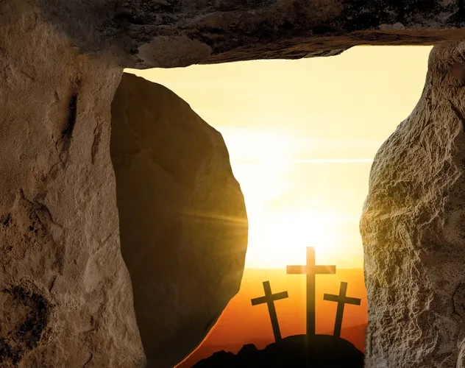
EASTER SUNDAY
The greatest story ever told, but is it true and what difference would it make to me if it was?

Slide 2

‘Yet it was the Lord’s will to crush him and cause him to suffer… to give his life as an offering for sin’
Isaiah 53v10

Slide 3

When the Sabbath was over, Mary Magdalene, Mary the mother of James, and Salome bought spices so that they might go to anoint Jesus’ body. Very early on the first day of the week, just after sunrise, they were on their way to the tomb and they asked each other, “Who will roll the stone away from the entrance of the tomb?”
But when they looked up, they saw that the stone, which was very large, had been rolled away. As they entered the tomb, they saw a young man dressed in a white robe sitting on the right side, and they were alarmed.
“Don’t be alarmed,” he said. “You are looking for Jesus the Nazarene, who was crucified. He has risen! He is not here. See the place where they laid him. But go, tell his disciples and Peter, ‘He is going ahead of you into Galilee. There you will see him, just as he told you.’
MARK
16:1-7

Slide 4
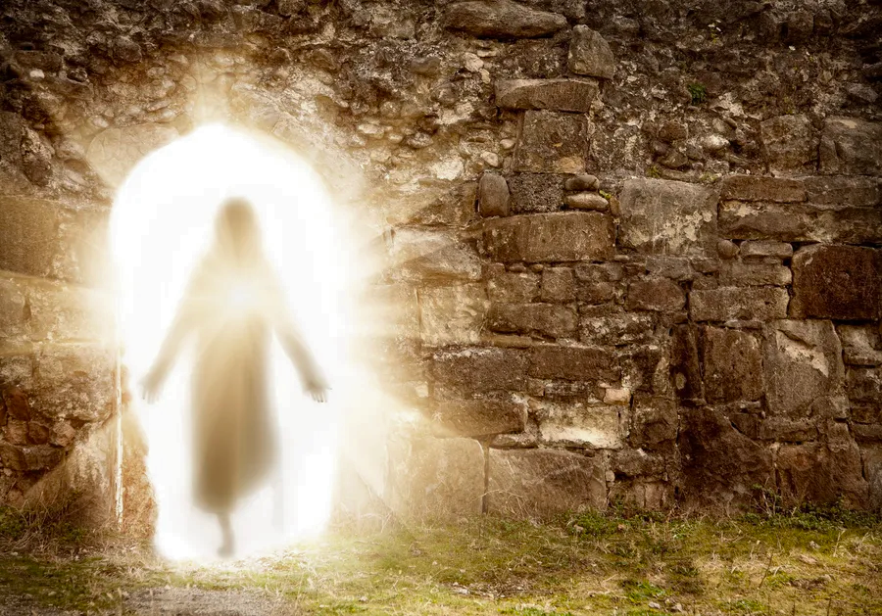

‘HE IS RISEN!’

Slide 5
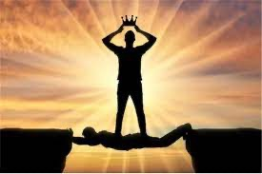
‘ IF CHRIST HAS NOT BEEN RAISED, YOUR FAITH IS FUTILE; YOU ARE LOST IN YOUR SINS.’
1 CORINTHIANS 15:17
SIN

Slide 6

Jesus replied, “Very truly I tell you, everyone who sins is a slave to sin. ³⁵ Now a slave has no permanent place in the family, but a son belongs to it forever. ³⁶ So if the Son sets you free, you will be free indeed.
JOHN 8:34-36

Slide 7



23 For everyone has sinned; we all fall short of God’s glorious standard. 24 Yet God, in his grace, freely makes us right in his sight. He did this through Christ Jesus when he freed us from the penalty for our sins. 25 For God presented Jesus as the sacrifice for sin. People are made right with God when they believe that Jesus sacrificed his life, shedding his blood.
ROMANS 3:23-5
Jesus came ‘to give his life as a ransom for many’
Mark 10:45

Slide 8
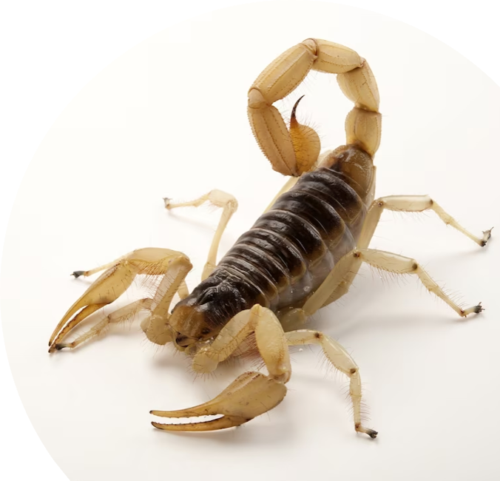
‘Death has been swallowed
up in victory.’
‘Where, O death, is your victory?
Where, O death, is your sting?’
1 Corinthians 15:54

Slide 9
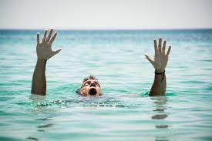
THE RESURRECTION BRINGS US HOPE
‘HOPE IS TO THE SOUL WHAT OXYGEN IS TO THE LUNGS’
‘Three things will last forever—faith, hope, and love—and the greatest of these is love’
1 Corinthians 13:13
MY TESTIMONY

Slide 10

ARE WE HOPING IN SOMETHING THAT IS NOT TRUE?
Was Karl Marx right that religion is just ‘the opium of the people’ to make us feel good, or is there any proof?
We don’t have blind faith – there is a lot of evidence for the resurrection
We all put faith in something
Even an atheist has faith … believes that we are here by chance.

Slide 11
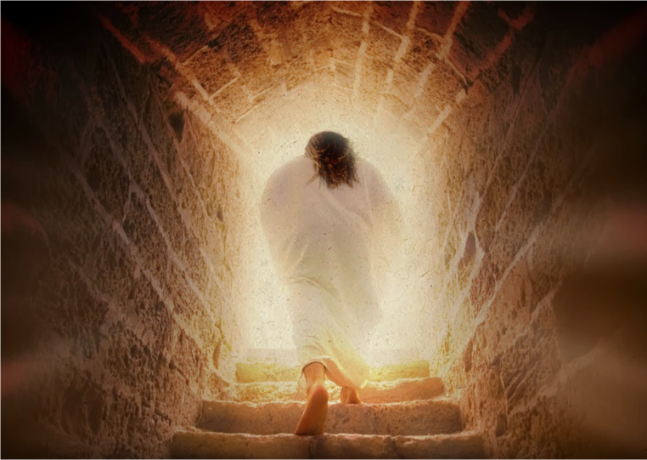
DID THE RESURRECTION OF JESUS REALLY HAPPEN?

Slide 12

We know he was a real person, a Jew from Nazareth who was crucified around 33AD - Tacitus and Josephus
We measure time from his birth - 2024
We have the only bank holiday Friday to remember his death
He’s the most famous person in history
His birthday is celebrated worldwide
2.5 Billion followers – over a quarter of the human race
FACTS
His tomb was/is empty
His body was never found
His followers died for saying he had risen from the dead
There are 1.4 million churches in the world built to worship him

Slide 13
THEORIES
  Wrong tomb
  Disciples stole the body
  Hallucination
  Not dead
  Lookalike
  He actually rose
  OCKHAM’S RAZOR

Slide 14

?
SO IF HE DID ACTUALLY RISE HOW SHOULD WE RESPOND TO JESUS?

Slide 15

I AM THE GOOD SHEPHERD
I AM THE LIGHT OF THE WORLD
I AM THE DOOR
JESUS SAID...
I AM THE BREAD OF LIFE
I AM THE WAY, THE TRUTH AND THE LIFE, NO ONE GETS TO THE FATHER EXCEPT THROUGH ME
WAS HE MAD, BAD, OR TELLING THE TRUTH?
I AM THE RESURRECTION AND THE LIFE

Slide 16


C.S. Lewis wrote:
“I am trying here to prevent anyone saying the really foolish thing that people often say about Him: I’m ready to accept Jesus as a great moral teacher, but I don’t accept his claim to be God. That is the one thing we must not say. A man who was merely a man and said the sort of things Jesus said would not be a great moral teacher. He would either be a lunatic — on the level with the man who says he is a poached egg — or else he would be the Devil of Hell. You must make your choice. Either this man was, and is, the Son of God, or else a madman or something worse. You can shut him up for a fool, you can spit at him and kill him as a demon or you can fall at his feet and call him Lord and God, but let us not come with any patronizing nonsense about his being a great human teacher. He has not left that open to us. He did not intend to.”
YOU DECIDE WHICH!

Slide 17
QUESTIONS TO CONSIDER
WHO DO YOU THINK JESUS WAS?
IF HIS CLAIMS ARE TRUE ARE YOU READY TO FOLLOW HIM?
IF YOU’RE NOT READY WHAT’S STOPPING YOU?
DO YOU NEED FRESH HOPE?

