Slide 1
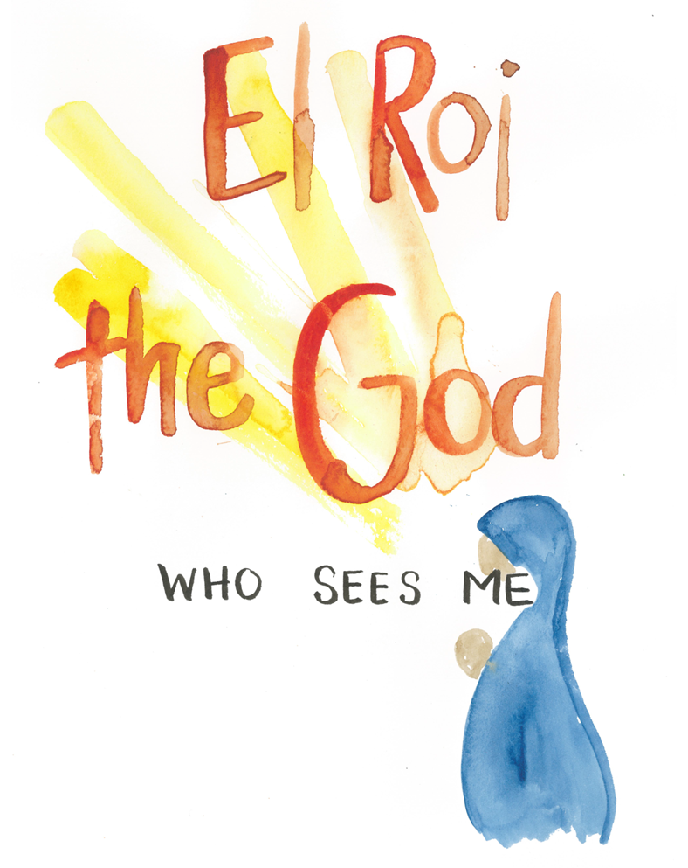

Slide 2
Genesis 16
Now Sarai, Abram’s wife, had borne him no children. But she had an Egyptian slave named Hagar; so she said to Abram, “The Lord has kept me from having children. Go, sleep with my slave; perhaps I can build a family through her.”
Abram agreed to what Sarai said. So after Abram had been living in Canaan ten years, Sarai his wife took her Egyptian slave Hagar and gave her to her husband to be his wife. He slept with Hagar, and she conceived.
When she knew she was pregnant, she began to despise her mistress. Then Sarai said to Abram, “You are responsible for the wrong I am suffering. I put my slave in your arms, and now that she knows she is pregnant, she despises me. May the Lord judge between you and me.”
“Your slave is in your hands,” Abram said. “Do with her whatever you think best.” Then Sarai mistreated Hagar; so she fled from her.
The angel of the Lord found Hagar near a spring in the desert; it was the spring that is beside the road to Shur. And he said, “Hagar, slave of Sarai, where have you come from, and where are you going?”
“I’m running away from my mistress Sarai,” she answered.

Slide 3
Then the angel of the Lord told her, “Go back to your mistress and submit to her.” The angel added, “I will increase your descendants so much that they will be too numerous to count.”
The angel of the Lord also said to her:
“You are now pregnant and you will give birth to a son.
You shall name him Ishmael, for the Lord has heard of your misery.
He will be a wild donkey of a man; his hand will be against everyone
and everyone’s hand against him, and he will live in hostility toward all his brothers.”
She gave this name to the Lord who spoke to her: “You are the God who sees me,” for she said, “I have now seen the One who sees me.” That is why the well was called Beer Lahai Roi; it is still there, between Kadesh and Bered.
So Hagar bore Abram a son, and Abram gave the name Ishmael to the son she had borne. Abram was eighty-six years old when Hagar bore him Ishmael.

Slide 4
insignificant
full of pride and contempt
rejected
Hagar’s predicament
afraid
mistreated
vulnerable
no way back …or forward
alone
Notes:
What does God see? Knows her name, sees her sin – pride, lowest point, has a plan

Slide 5

…more than being seen with the eyes
Being noticed
Empathy
Unconditional love
Not alone
Compassion
Leads to:
Encouragement
Hope
Value
Purpose

Slide 6
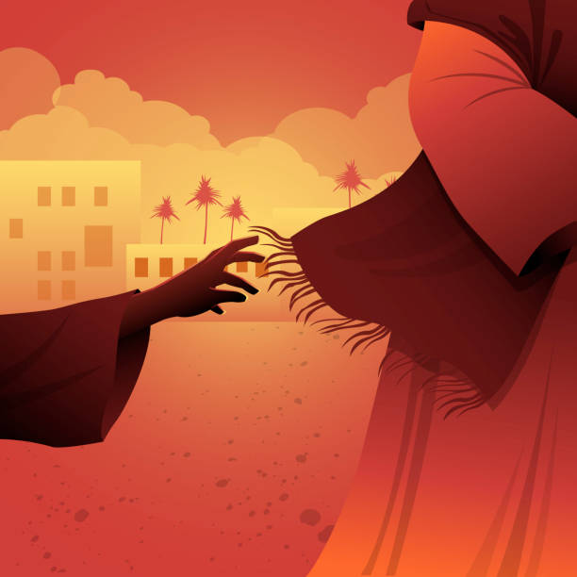
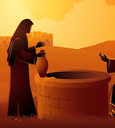
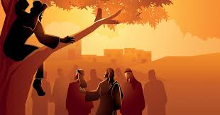
Jesus sees and singles out the marginalised
Good news to the poor, freedom for captives, sight for the blind, freedom for the oppressed (Luke 4:18-19)
Luke 8:43-48
John 4:1-42
Luke 19:1-10

Slide 7
You have searched me, Lord,
and you know me. You know when I sit and when I rise; you perceive my thoughts from afar. You discern my going out and my lying down; you are familiar with all my ways.
Before a word is on my tongue you, Lord, know it completely. You hem me in behind and before, and you lay your hand upon me.
Such knowledge is too wonderful for me, too lofty for me to attain. Where can I go from your Spirit? Where can I flee from your presence? If I go up to the heavens, you are there; if I make my bed in the depths, you are there. If I rise on the wings of the dawn, if I settle on the far side of the sea, even there your hand will guide me, your right hand will hold me fast.
If I say, “Surely the darkness will hide me and the light become night around me,” even the darkness will not be dark to you; the night will shine like the day, for darkness is as light to you.
For you created my inmost being; you knit me together in my mother’s womb. I praise you because I am fearfully and wonderfully made; your works are wonderful, I know that full well. My frame was not hidden from you when I was made in the secret place, when I was woven together in the depths of the earth. Your eyes saw my unformed body; all the days ordained for me were written in your book before one of them came to be.
How precious to me are your thoughts, God! How vast is the sum of them! Were I to count them, they would outnumber the grains of sand—when I awake, I am still with you.
Psalm 139

Slide 8
Response
Be honest before Him:
Search me, God, and know my heart;
test me and know my anxious thoughts.
See if there is any offensive way in me,
and lead me in the way everlasting.
Psalm 139:23-24
Be willing to submit to his plan

