Slide 1

Acts Series
Episode 24: Chpt 20
6th April 2025

Slide 2
Previously in Acts…
Notes:
Acts 20:1 “When the uproar had ended…”
What uproar is this? Lydia didn’t have chance to mention last week
Let us take a minute to understand about Ephesus which is where Paul was for the whole of chapter 19

Slide 3
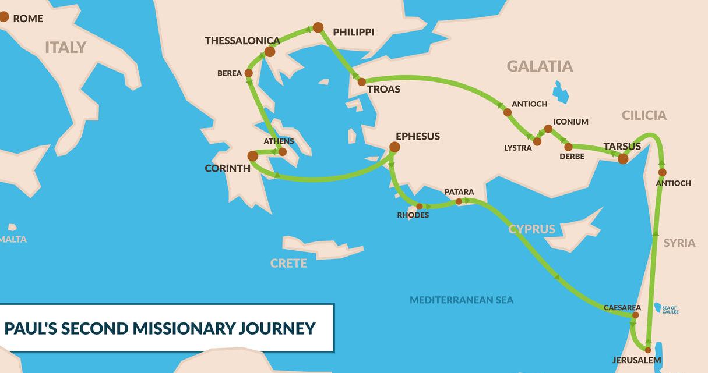
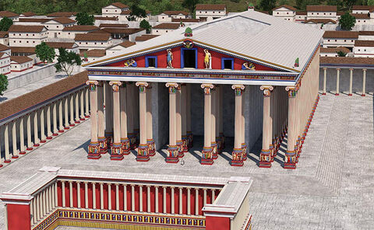
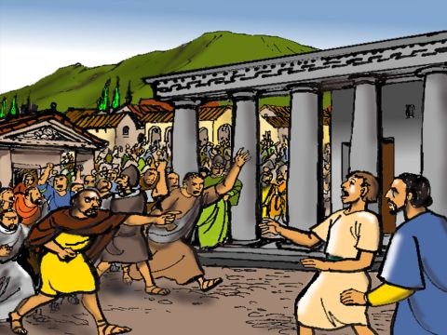
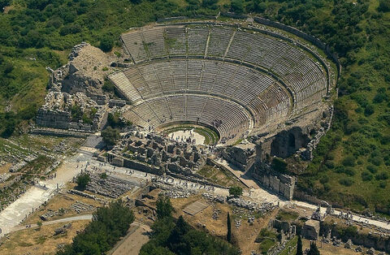
Notes:
Had briefly visited Ephesus at end of 2nd missionary trip
Share gospel in synagogue
left Priscilla and Aquila
promised to return if God’s will (Acts 18:19)
Paul started 3rd missionary journey Acts 18:24
Paul makes his way through Turkey to Ephesus (2.5-3 years)
Plants church
Saw some incredible things happen
Disciples who only had John’s baptism received HS
Seven sons of Sceva
handkerchiefs and aprons
sorcery books burned
Riot
Silversmith – self interest
Theatre, 2 hours shouting
Reasoned with by city clerk

Slide 4
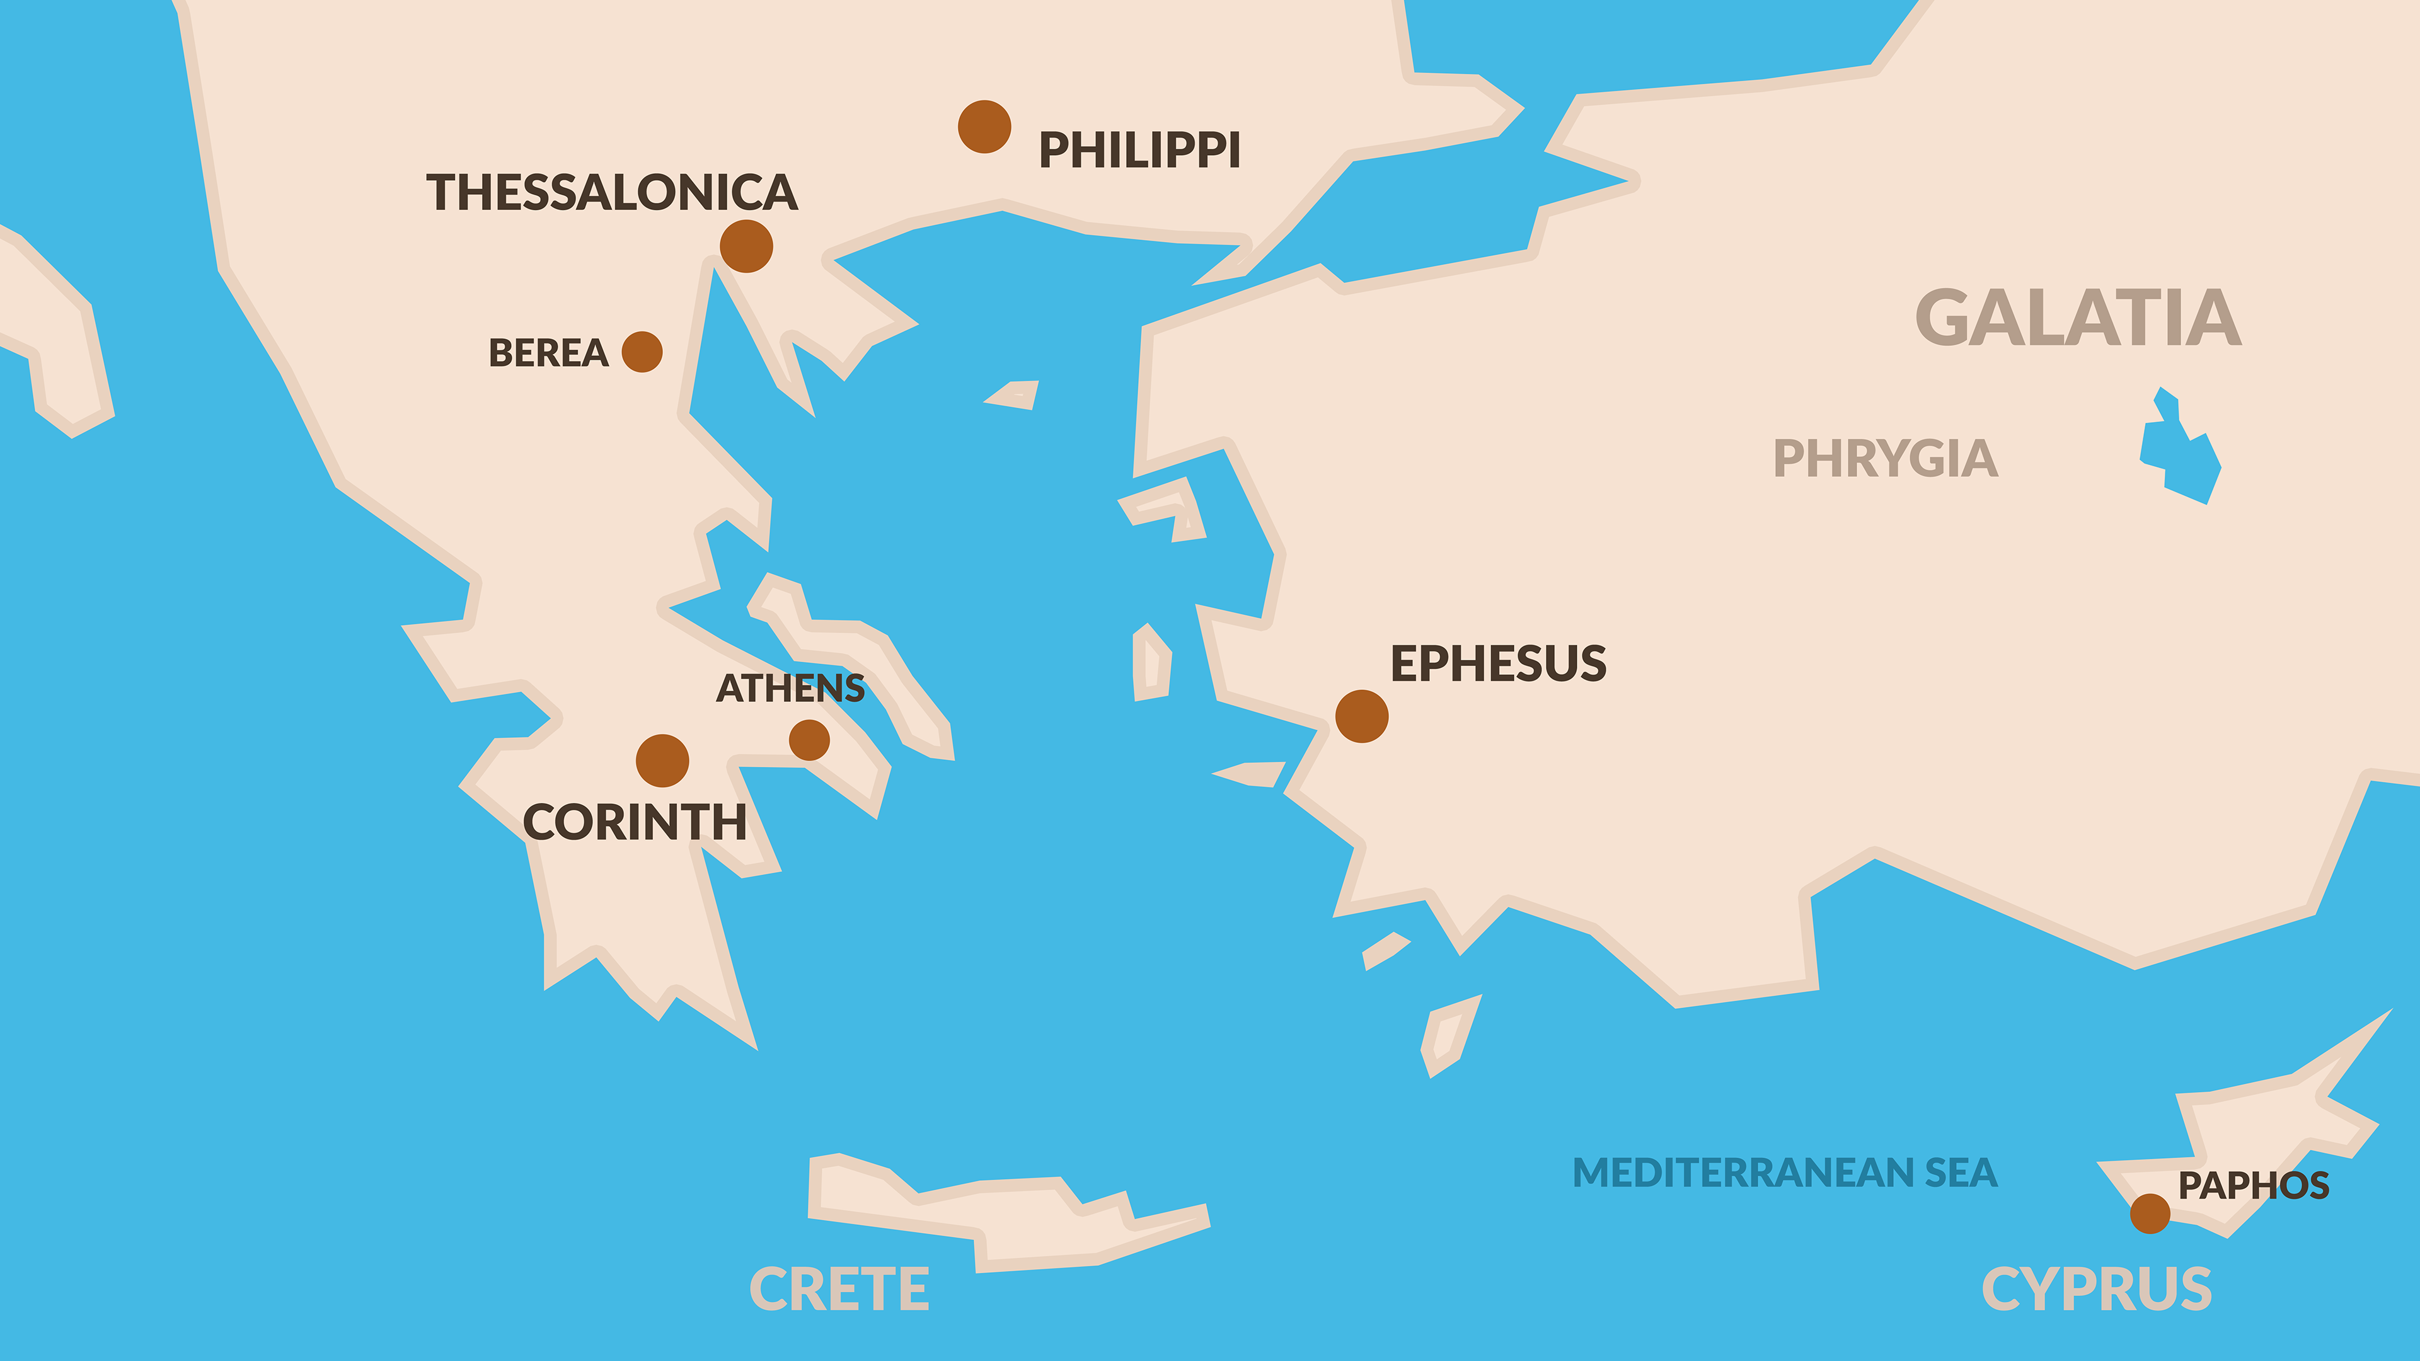
TROAS
MILETUS
Notes:
Probably lived in Ephesus for 2.5 years (wrote 1 Cor during this time) – left after riot
After leaving Ephesus, visits church planted on previous mission trip
Scholars think Paul wrote 2 Cor whilst in Philippi
Spends 3 months in Corinth
Planned to sail straight back to Israel from Greece but heard about plot so retraced steps
Didn’t want to venture into Ephesus so called leaders to meet him at Miletus. Gives farewell speech. Then continued on journey

Slide 5
Acts 20:4
He was accompanied by Sopater son of Pyrrhus from Berea, Aristarchus and Secundus from Thessalonica, Gaius from Derbe, Timothy also, and Tychicus and Trophimus from the province of Asia.
Notes:
Who were these guys

Slide 6
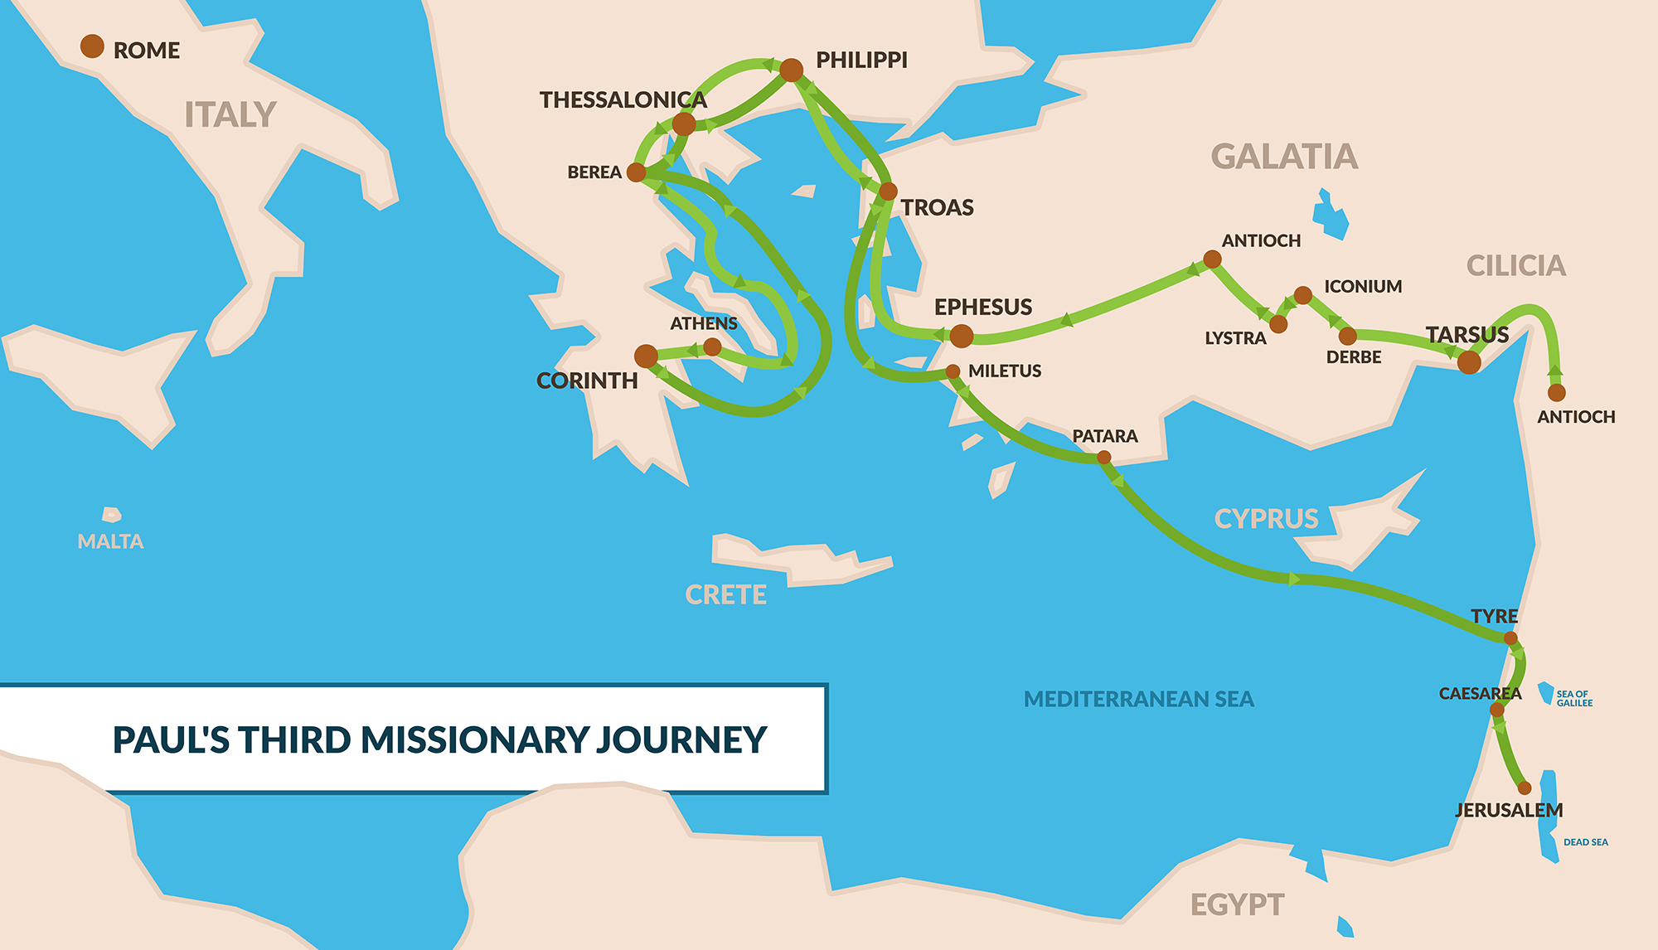
Tychicus & Trophimus?
Aristarchus & Secundus
Gaius
Sopater
Timothy
Notes:
Picking up and developing these young guys as he goes
All seemed to accompany Paul on his 3rd missionary journey

Slide 7




With Paul when he wrote Romans whilst in Corinth (Rom 16:21)
Aristarchus
Sopater
Paul's traveling companions who were seized by an angry mob during a riot in Ephesus
(Acts 19:29)
with Paul on the ship bound for Rome (Acts 27:2)
"my fellow prisoner“(Col 4:10)
"my fellow laborer“ (Philemon 1:24)
Secundus
Paul's traveling companions who were seized by an angry mob during a riot in Ephesus (Acts 19:29)
Baptised by Paul (1 Cor 1:14)
Gaius

Slide 8

Sent to Ephesus (2 Tim 4:12) & Titus on Crete (Titus 3:12)
Discovered by Paul & Barn on first missionary trip (possibly in his late teens or early twenties)
Timothy
Tychicus
Delivered the letters to the Ephesians, Colossians and Philemon
Accompanied on 2nd missionary trip (with Silas)
With Paul when he writes 1 & 2 Thes, Phil, Philemon & Col (Rome), 1 & 2 Cor, Romans
Mentioned as released (Heb 13:23)
Sent to Macedonia (Acts 19:22) /Corinth (1 Cor 4:17 / 1 Cor 16:10) on Paul’s behalf because he gets him
Travels with Paul to Jerusalem – provokes riot because Jews think Paul took him into the temple
Trophimus
Paul forced to leave Trophimus sick in Miletus (2 Tim 4:20)

Slide 9
Meaningful Roles
Delivered letters
Sent to represent Paul (having learned Paul’s ways)
Suffered
With Paul through journey & as wrote letters
Money collection & transport
Support each other
Future church leaders

Slide 10
Paul’s Nurturing
Affection
Intimate involvement
Defend & Promote
Encourage
Notes:
Paul didn’t protect them from potential harm – they all knew what they were signing up to
Affection
To Timothy, my dear son (1 Tim 1:2)
1 Tim 1:3-4
I constantly remember you in my prayers.
I long to see you, so that I may be filled with joy.
Not mere function – genuine love, leaves an impression on Paul, thinks about when away from
E.g. just enjoy being together – SL games night (don’t underestimate what this communicates)
Paul’s intimate involvement
1 Tim 5 –
22Do not be hasty in the laying on of hands, and do not share in the sins of others. Keep yourself pure.
23Stop drinking only water, and use a little wine because of your stomach and your frequent illnesses.
24The sins of some are obvious, reaching the place of judgment ahead of them; the sins of others trail behind them.
E.g. Jeremy – JWS learn to drive
Total involvement – not only within a particular role, interested in all of the person
Defend & Promote
When Timothy comes, see to it that he has nothing to fear while he is with you, for he is carrying on the work of the Lord, just as I am. (1 Cor 16:10)
For this reason I have sent to you Timothy, my son whom I love, who is faithful in the Lord. He will remind you of my way of life in Christ Jesus (1 Cor 4:17)
Prepare the way
Uses his own credibility to create the space for Timothy to contribute
E.g. JWS giving me space to bring illustrations / will challenge critics / patiently offer advice & challenge attitude
First on hands and knees moping up the mess, not criticising for spilling
Encourage
Don’t let anyone look down on you because you are young (1 Tim 4:12)
For this reason I remind you to fan into flame the gift of God, which is in you through the laying on of my hands. (1 Tim 1:6)
I am reminded of your sincere faith, which first lived in your grandmother Lois and in your mother Eunice and, I am persuaded, now lives in you also. (1 Tim 1:5)
Spotting and affirming. Building up so can operate stronger without me.
E.g. JWS – sensitive spirit

Slide 11
Who are you nurturing?
Who’s nurturing are you embracing?

Slide 12
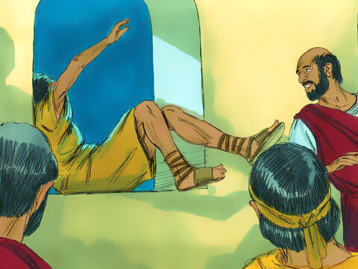
Acts 20:7-12
On the first day of the week we came together to break bread. Paul spoke to the people and, because he intended to leave the next day, kept on talking until midnight. There were many lamps in the upstairs room where we were meeting.
Seated in a window was a young man named Eutychus, who was sinking into a deep sleep as Paul talked on and on. When he was sound asleep, he fell to the ground from the third story and was picked up dead. Paul went down, threw himself on the young man and put his arms around him. “Don’t be alarmed,” he said. “He’s alive!” Then he went upstairs again and broke bread and ate. After talking until daylight, he left. The people took the young man home alive and were greatly comforted.
Notes:
What do you take as the moral of this story?
Preacher don’t go on and on?
If you know you there is a chance you might fall asleep, make sure you are secure?
If your overrun sermon proves fatal you can bring the victim back to life?
Eutychus, means "fortunate" or "lucky,"

Slide 13
Acts 20:22-38
Paul had decided to sail past Ephesus to avoid spending time in the province of Asia, for he was in a hurry to reach Jerusalem, if possible, by the day of Pentecost.
From Miletus, Paul sent to Ephesus for the elders of the church. When they arrived, he said to them: “You know how I lived the whole time I was with you, from the first day I came into the province of Asia. I served the Lord with great humility and with tears and in the midst of severe testing by the plots of my Jewish opponents. You know that I have not hesitated to preach anything that would be helpful to you but have taught you publicly and from house to house. I have declared to both Jews and Greeks that they must turn to God in repentance and have faith in our Lord Jesus.
“And now, compelled by the Spirit, I am going to Jerusalem, not knowing what will happen to me there. I only know that in every city the Holy Spirit warns me that prison and hardships are facing me. However, I consider my life worth nothing to me; my only aim is to finish the race and complete the task the Lord Jesus has given me—the task of testifying to the good news of God’s grace.

Slide 14
“Now I know that none of you among whom I have gone about preaching the kingdom will ever see me again. Therefore, I declare to you today that I am innocent of the blood of any of you. For I have not hesitated to proclaim to you the whole will of God. Keep watch over yourselves and all the flock of which the Holy Spirit has made you overseers. Be shepherds of the church of God,[a] which he bought with his own blood. I know that after I leave, savage wolves will come in among you and will not spare the flock. Even from your own number men will arise and distort the truth in order to draw away disciples after them. So be on your guard! Remember that for three years I never stopped warning each of you night and day with tears.
“Now I commit you to God and to the word of his grace, which can build you up and give you an inheritance among all those who are sanctified. I have not coveted anyone’s silver or gold or clothing. You yourselves know that these hands of mine have supplied my own needs and the needs of my companions. In everything I did, I showed you that by this kind of hard work we must help the weak, remembering the words the Lord Jesus himself said: ‘It is more blessed to give than to receive.’ ”
When Paul had finished speaking, he knelt down with all of them and prayed. They all wept as they embraced him and kissed him. What grieved them most was his statement that they would never see his face again. Then they accompanied him to the ship.

Slide 15
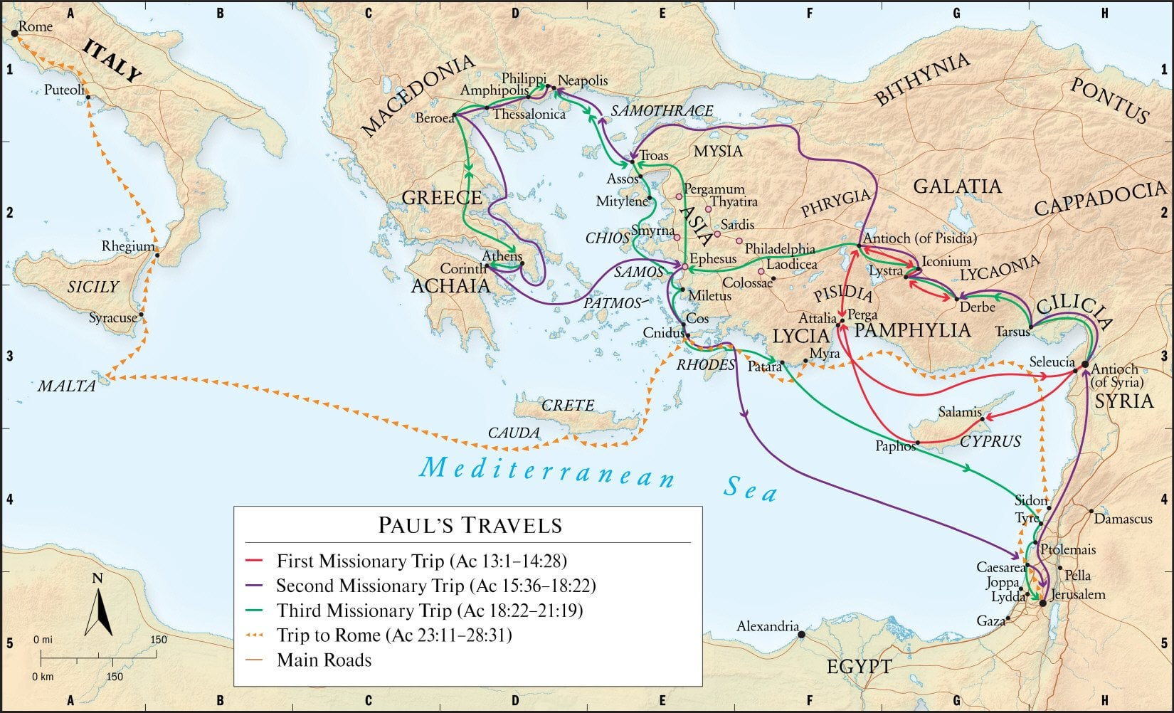
Notes:
Missionary journeys about 15 years

Slide 16
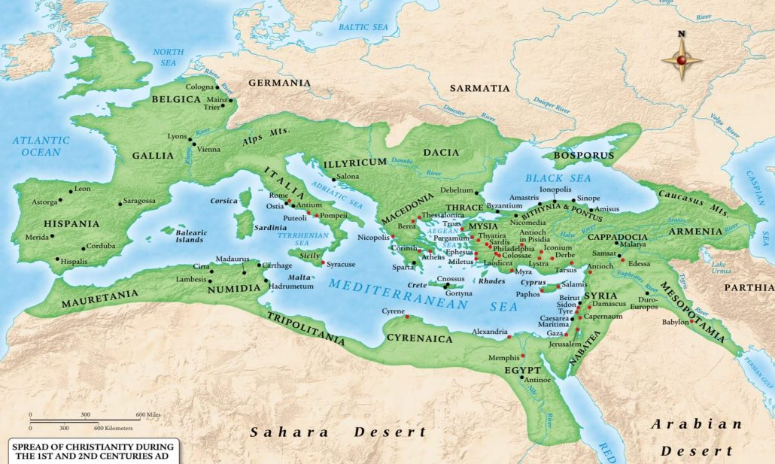
Notes:
Look how far spread in 100-130 years after

Slide 17
Paul’s work endured
Finish the race
Leave it all on the field
Don’t flinch from suffering
Inspired by the Holy Spirit
Find the blessing in the work
Notes:
What clues can we glean from his farewell speech to Ephesians leaders retreat about why his work endured?

Slide 18
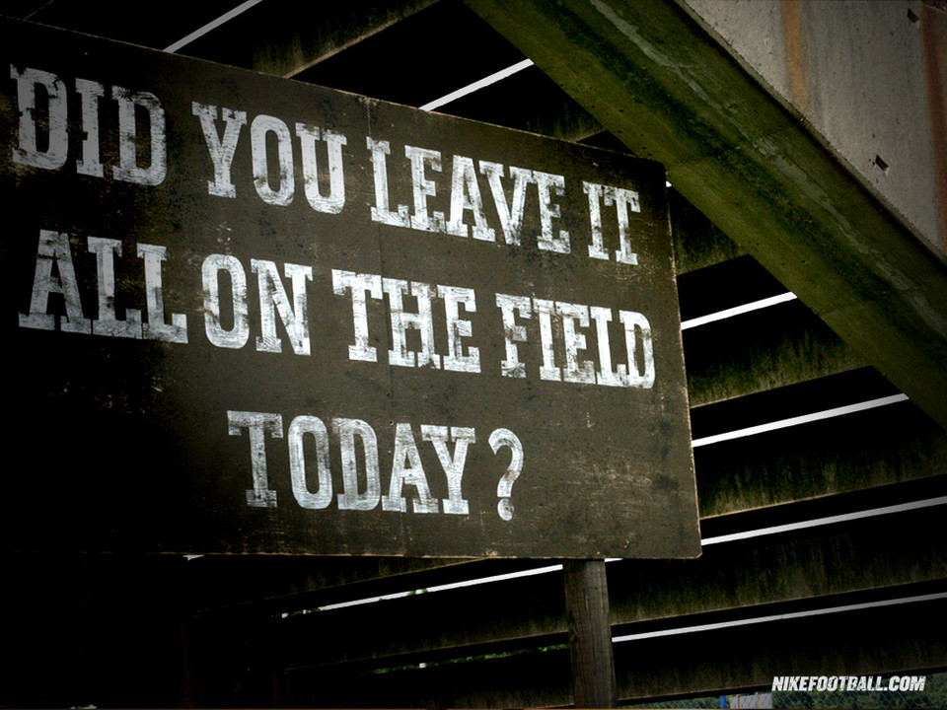
Notes:
I don’t want to come off this football pitch with energy left in my tank. “I could have done another 10k…”
Schindler's List – “I could have done more”
I have not hesitated to preach anything that would be helpful
I never stopped warning each of you night and day with tears
- love and care, being moved for the people (distressed)
Troas – preached through the night
2 Cor 11:23
I have worked much harder, been in prison more frequently, been flogged more severely, and been exposed to death again and again. ²⁴ Five times I received from the Jews the forty lashes minus one. ²⁵ Three times I was beaten with rods, once I was pelted with stones, three times I was shipwrecked, I spent a night and a day in the open sea, ²⁶ I have been constantly on the move. I have been in danger from rivers, in danger from bandits, in danger from my fellow Jews, in danger from Gentiles; in danger in the city, in danger in the country, in danger at sea; and in danger from false believers. ²⁷ I have labored and toiled and have often gone without sleep; I have known hunger and thirst and have often gone without food; I have been cold and naked. ²⁸ Besides everything else, I face daily the pressure of my concern for all the churches.
I’m not here for my own entertainment
Ambassador (2 Cor 5:20)
Soldier
No one serving as a soldier gets entangled in civilian affairs, but rather tries to please his commanding officer. (2 tim 2:4)
This is not my final resting place
Store treasures in heaven (Matt 6)
Well done good and faithful servant

Slide 19
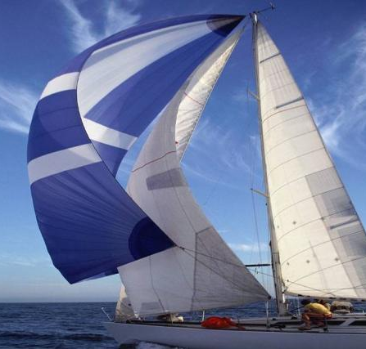
Inspired by Holy Spirit
Notes:
I can’t make the boat move but I can resist it moving
“And now, compelled by the Spirit,
Phil 2:13 For it is God who works in you both to will and to work, for his good pleasure
You can resist/grieve – take down the sails, put down an anchor
Take hands off the wheel
e.g. compassion for Darren – their victory is mine too

Slide 20
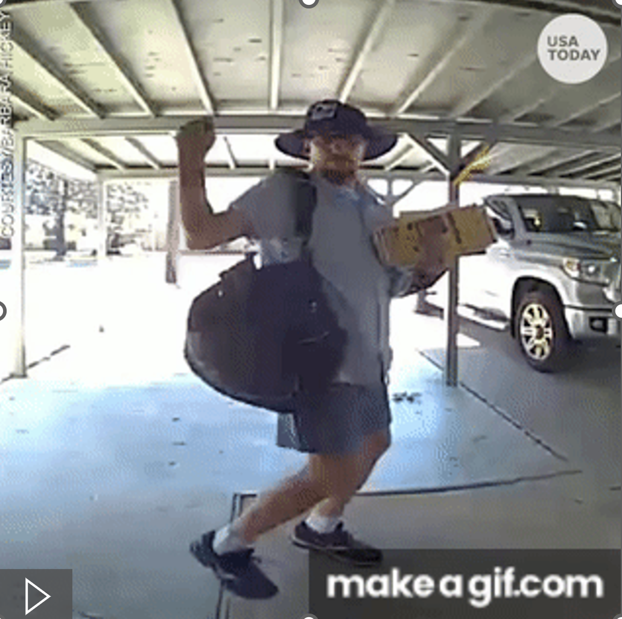
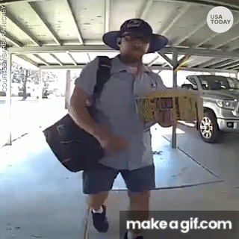
Find the blessing in the work
Notes:
Some postman is grooving to our love letters
Lord Jesus himself said: ‘It is more blessed to give than to receive.’ ”
- Servant leadership - not being a burden
e.g. JWS dancing at deliverance
My food is to do my fathers will
If you can only describe how much it costs to do God’s will you haven’t discovered the joy yet
I don’t need to be recompensated by you – I see what God has in store. I see the bigger plan
What great news we have to declare
And he has committed to us the message of reconciliation. (2 Cor 5:19)

Slide 21
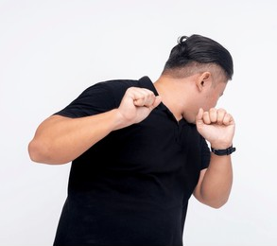
Don’t flinch from suffering
Notes:
I am going to Jerusalem, not knowing what will happen to me there. ²³ I only know that in every city the Holy Spirit warns me that prison and hardships are facing me.
Paul has sense of what is coming his way but he don’t flinch/retract – drum beat is getting louder
Acts 9:16
I will show him how much he must suffer for My name.”
Corrie Ten Boon
James 1
2Consider it pure joy, my brothers and sisters, ª whenever you face trials of many kinds, 3because you know that the testing of your faith produces perseverance. 4Let perseverance finish its work so that you may be mature and complete, not lacking anything.
Rom 5:3-5
³ Not only so, but we^{[a]} also glory in our sufferings, because we know that suffering produces perseverance; ⁴ perseverance, character; and character, hope. ⁵ And hope does not put us to shame, because God’s love has been poured out into our hearts through the Holy Spirit, who has been given to us.
Phil 3
⁷ But whatever were gains to me I now consider loss for the sake of Christ. ⁸ What is more, I consider everything a loss because of the surpassing worth of knowing Christ Jesus my Lord, for whose sake I have lost all things. I consider them garbage, that I may gain Christ ⁹ and be found in him, not having a righteousness of my own that comes from the law, but that which is through faith in^{[a]} Christ—the righteousness that comes from God on the basis of faith. ¹⁰ I want to know Christ—yes, to know the power of his resurrection and participation in his sufferings, becoming like him in his death, ¹¹ and so, somehow, attaining to the resurrection from the dead.
e.g. I want to be free from this pain but only if You have completed what you want to use this for

Slide 22

Finish the race
Notes:
²⁴ However, I consider my life worth nothing to me; my only aim is to finish the race and complete the task the Lord Jesus has given me—the task of testifying to the good news of God’s grace.
“I have fought the good fight, I have finished the race, I have kept the faith” (2 Timothy 4:7)
1 Cor 9:24-27
24Do you not know that in a race all the runners run, but only one gets the prize? Run in such a way as to get the prize. 25Everyone who competes in the games goes into strict training. They do it to get a crown that will not last, but we do it to get a crown that will last forever. 26Therefore I do not run like someone running aimlessly; I do not fight like a boxer beating the air. 27No, I strike a blow to my body and make it my slave so that after I have preached to others, I myself will not be disqualified for the prize.
Dedicated, determined
I want to play my part
To live with this verse as your priority makes you untouchable to enemy schemes.
e.g. If I can save that marriage it will be great for the kingdom

Slide 23
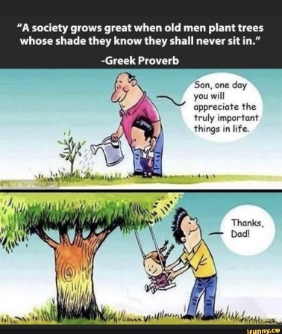
Not just MY race but THE race
Notes:
Not just how can God improve my life?
Seek first the kingdom – I exist for Him, to make Him comfortable

Slide 24
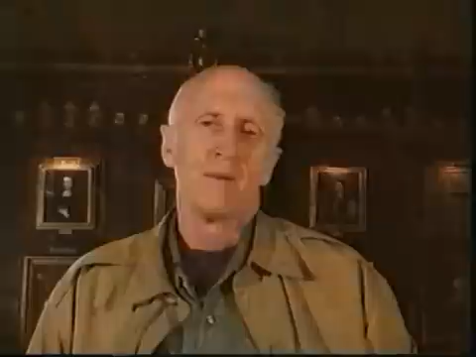
Building for a time that is yet to come
Notes:
Paul sensed his time was coming to an end – urgency to set up the work to continue beyond him
Video: Oxford great hall beams https://www.youtube.com/watch?v=YqH4eWR7jDQ
Love for the King and His Kingdom meant he wanted to spend himself equipping the work to continue after him.
Not just for now – building for a time that is yet to come
David not permitted to build the temple but go everything ready so Solomon
Moses not permitted into the promise land but brought people to the edge ready for Joshua
Martin Luther King
April 3, 1968
“We’ve got some difficult days ahead. But it really doesn’t matter with me now, because I’ve been to the mountaintop … I’ve seen the Promised Land. I may not get there with you. But I want you to know tonight, that we, as a people, will get to the Promised Land”
Paul built for time to come – invested in young guys, commissioned leaders (inspired and warned)

Slide 25





Slide 26
Option 1
Notes:
Repeating Patterns of Christian History
Option 1: All do what is right in own eyes

Slide 27

Option 2
Notes:
Option 2: Fortify the campsite (become denomination)

Slide 28
Option 3
Notes:
Option 3: Keep movement going
I need to love the destination (because I fell in with the same God who Paul/JWS has. The God who has won my heart) - More than this body of people, more than the lessons I’ve been taught,
– Can my heart be caught by the same thing that caught my father’s heart. I want to stand before God in Zion.
I want to be faithful to the DNA, identity God has given this local expression of His body, but I’m faithful not by doing what they have done but seeing Him like they also saw Him. Not about defending the ground that the forefather have taken but loving the God that they have loved. I see a passion for a value – I want that passion (e.g. collecting from airport)

Slide 29
Who are you setting up to continue the race (beyond you)?
Who are you learning from so you can run well?
Notes:
What/who are you investing, now?
Paul didn’t leave behind procedure but call to love
No plan B – not courses, but genuine love stimulated and empowered by the holy spirit
We have young people who are yet to be inspired – who is inspiring them?
We have young people who are inspired – who is willing to shape them?
Like Paul – Affection, intimate involvement, Defend & Promote (create space), Encourage

