Slide 1
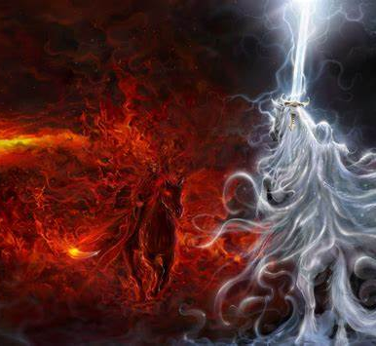
ACTS 4
KINGDOM ADVANCE AND THE GROWTH OF THE CHURCH

Slide 2
THE STORY OF ACTS SO FAR…
WRITTEN BY LUKE , AUTHOR OF THE 3RD GOSPEL, A COMPANION OF PAUL AND PROBABLY A DOCTOR
DESCRIBES THE EVENTS AFTER THE CRUCIFIXION AND RESURRECTION.
ACTS DESCRIBES HOW THE FIRST CHRISTIANS LIVE AND GROW
CHAPTER 1 THE ASCENSION OF JESUS INTO HEAVEN
CHAPTER 2 THE COMING OF THE HOLY SPIRIT AT PENTECOST FULFILLING JOEL’S PROPHECY
3000 BECOMING CHRISTIANS IN ONE DAY
CHAPTER 3 PETER, AN ORDINARY FISHERMAN WHO WEEKS EARLIER HAD DENIED JESUS SPEAKS TO THE CROWD WITH BOLDNESS AND IN THE NAME OF JESUS HEALS A BEGGAR WHO HAD BEEN CRIPPLED SINCE BIRTH.
EVEN THOUGH JESUS IS ASCENDED ACTS SHOWS MIRACLES CAN STILL HAPPEN AND THEY ARE STILL HAPPENING TODAY

Slide 3
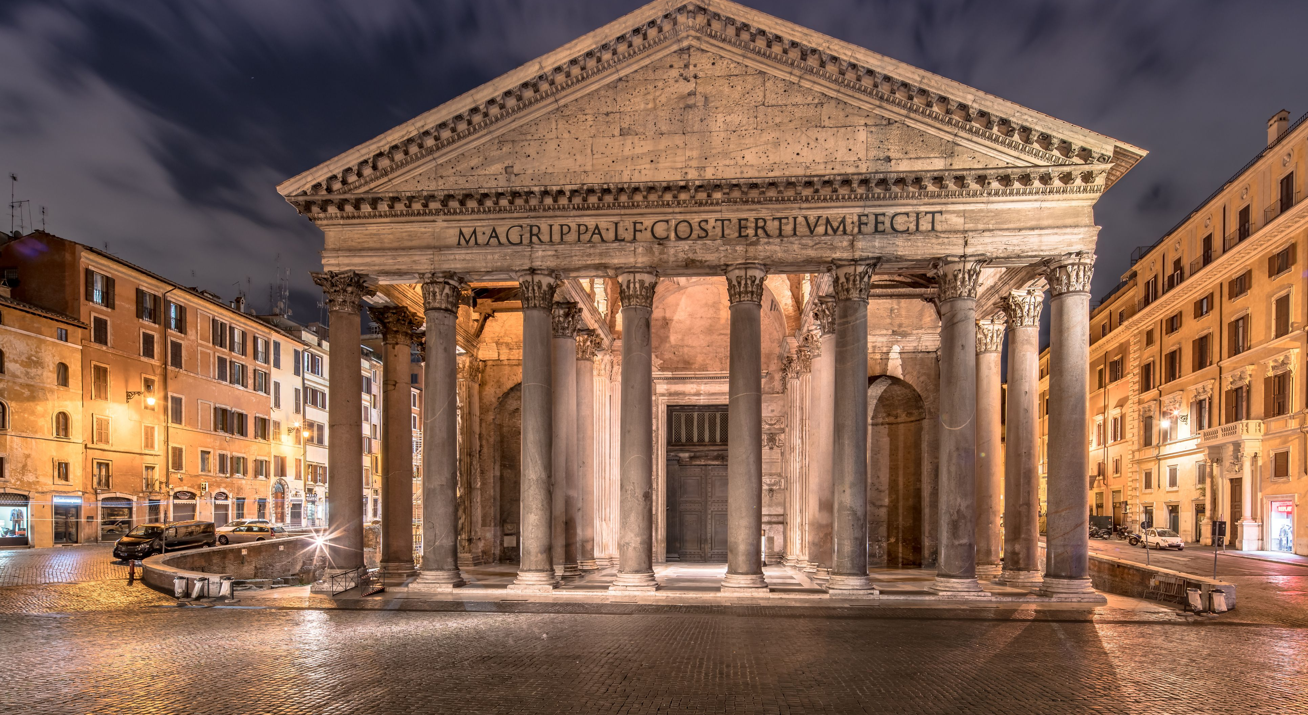
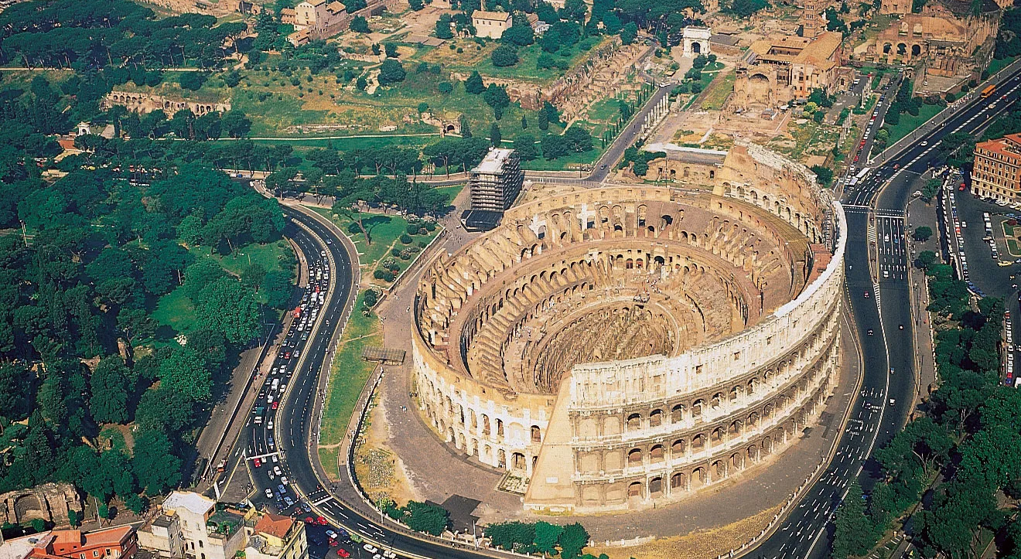
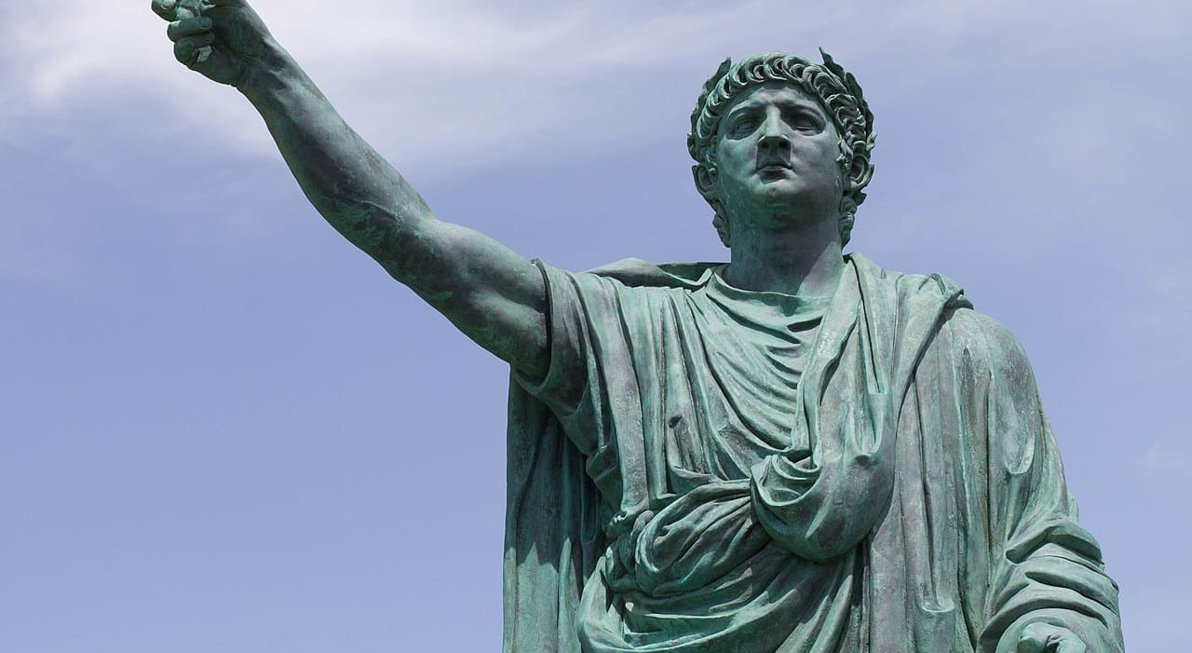
BACKGROUND…POWER STRUGGLE BOTH EARTHLY AND SPIRITUAL
TWO MAIN PLAYERS IN ISRAEL AT THIS TIME WERE :
ROME

Slide 4
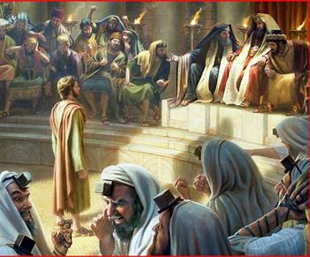
2 THE SANHEDRIN … (THE JEWISH COUNCIL)

Slide 5
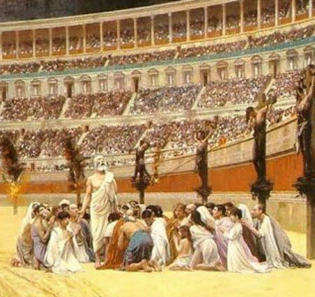

Slide 6
LET’S SEE HOW THEY ADVANCE GOD’S KINGDOM IN ACTS CHAPTER 4
The priests and the captain of the temple guard and the Sadducees came up to Peter and John while they were speaking to the people. ² They were greatly disturbed because the apostles were teaching the people, proclaiming in Jesus the resurrection of the dead. ³ They seized Peter and John and, because it was evening, they put them in jail until the next day. ⁴ But many who heard the message believed; so the number of men who believed grew to about five thousand.
⁵ The next day the rulers, the elders and the teachers of the law met in Jerusalem. ⁶ Annas the high priest was there, and so were Caiaphas, John, Alexander and others of the high priest’s family. ⁷ They had Peter and John brought before them and began to question them: “By what power or what name did you do this?”

Slide 7
OF THE GOSPEL
⁸ Then Peter, filled with the Holy Spirit, said to them: “Rulers and elders of the people! ⁹ If we are being called to account today for an act of kindness shown to a man who was lame and are being asked how he was healed, ¹⁰ then know this, you and all the people of Israel: It is by the name of Jesus Christ of Nazareth, whom you crucified but whom God raised from the dead, that this man stands before you healed. ¹¹ Jesus is
“‘the stone you builders rejected,
which has become the cornerstone.’^{[a]}
¹² Salvation is found in no one else, for there is no other name under heaven given to mankind by which we must be saved.”

Slide 8
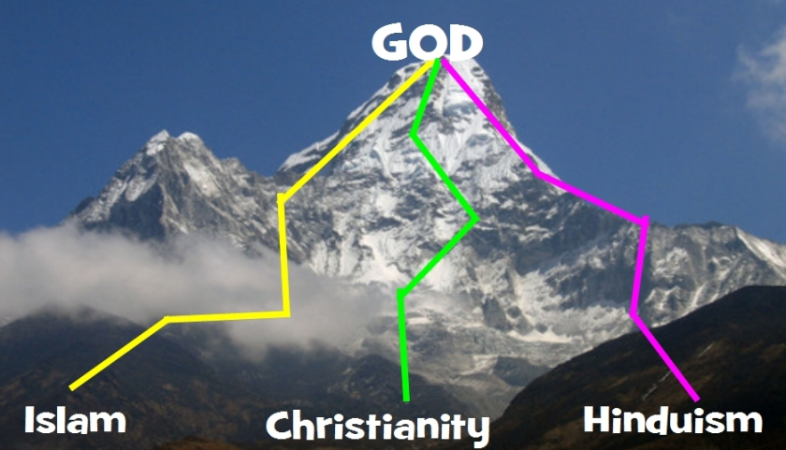
INCLUSIVISM IS THE ENEMY OF KINGDOM ADVANCE
John 14:6
Jesus answered, “I am the way and the truth and the life. No one comes to the Father except through me
¹² Salvation is found in no one else, for there is no other name under heaven given to mankind by which we must be saved.”

Slide 9
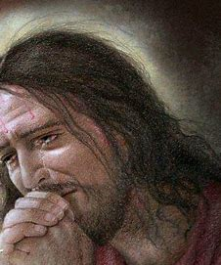
IF YOU CAN GET TO GOD ANOTHER WAY JESUS DIDN’T NEED TO DIE
HE COULD HAVE RUN AWAY IN THE GARDEN OF GETHSEMANE

Slide 10
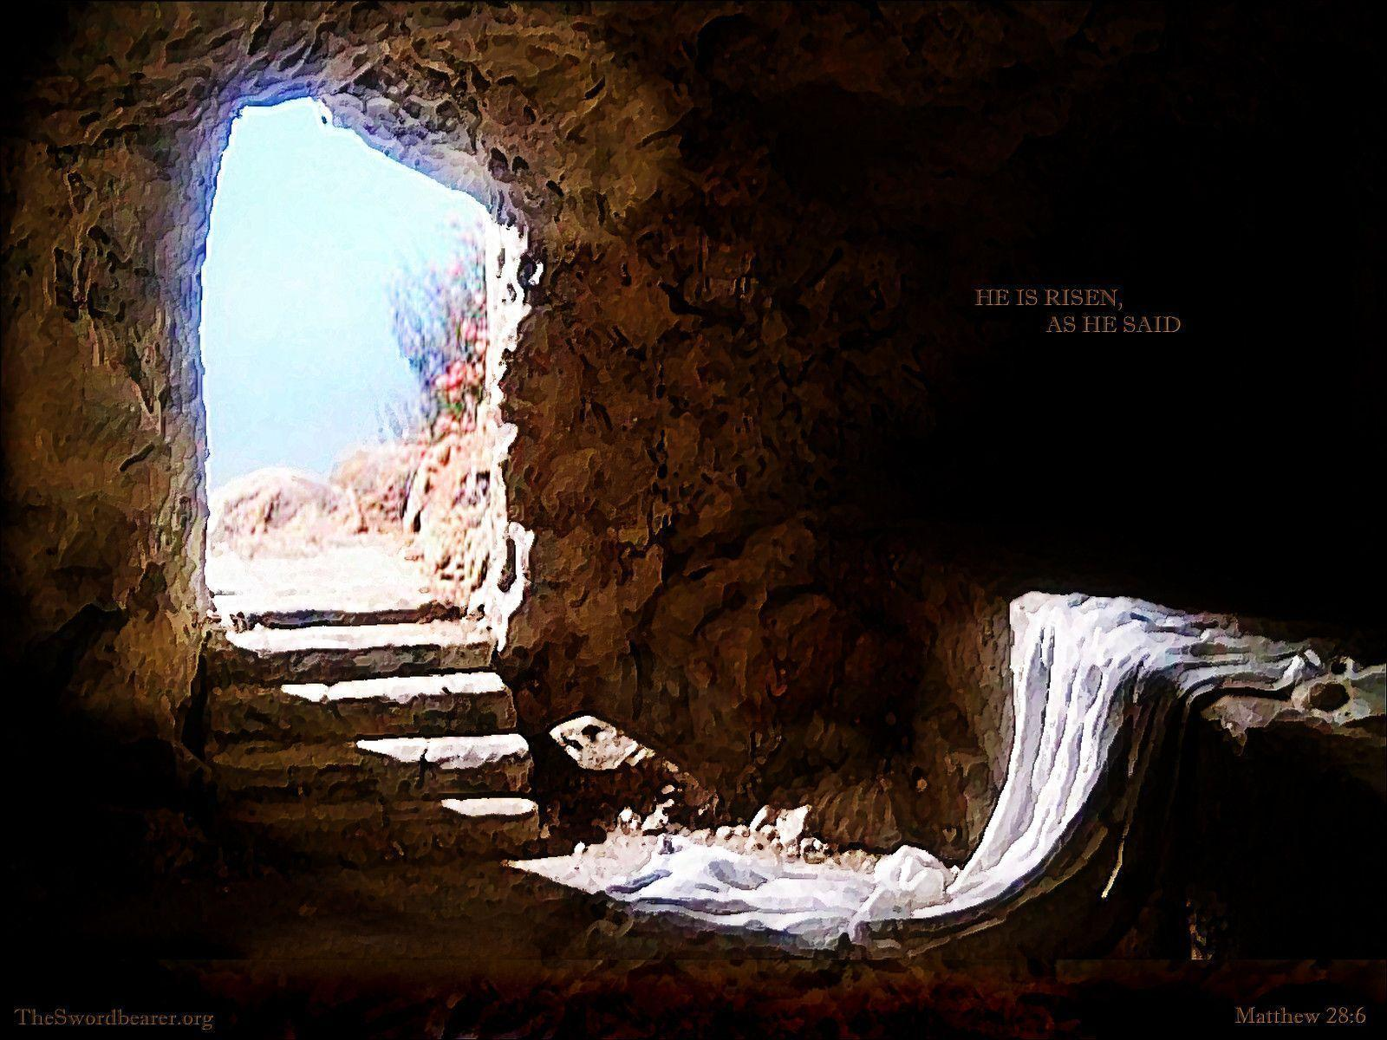
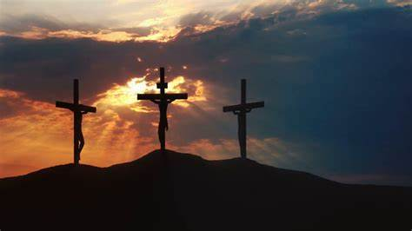
PETER HAD UNDERSTOOD THE TRUTH THAT JESUS HAD DIED AND RISEN AGAIN TO SAVE US FROM OUR SIN AND ETERNAL DEATH. ALL WE HAVE TO DO IS BELIEVE. GOOD ACTIONS FOLLOW AS A RESPONSE TO THAT AMAZING ACT OF UNCONDITIONAL LOVE
John 3:16 For God so loved the world that he gave his one and only Son, that whoever believes in him shall not perish but have eternal life

Slide 11
¹³ When they saw the courage of Peter and John and realized that they were unschooled, ordinary men, they were astonished and they took note that these men had been with Jesus. ¹⁴ But since they could see the man who had been healed standing there with them, there was nothing they could say. ¹⁵ So they ordered them to withdraw from the Sanhedrin and then conferred together. ¹⁶ “What are we going to do with these men?” they asked. “Everyone living in Jerusalem knows they have performed a notable sign, and we cannot deny it. ¹⁷ But to stop this thing from spreading any further among the people, we must warn them to speak no longer to anyone in this name.”
¹⁸ Then they called them in again and commanded them not to speak or teach at all in the name of Jesus. ¹⁹ But Peter and John replied, “Which is right in God’s eyes: to listen to you, or to him? You be the judges! ²⁰ As for us, we cannot help speaking about what we have seen and heard.”

Slide 12
²¹ After further threats they let them go. They could not decide how to punish them, because all the people were praising God for what had happened. ²² For the man who was miraculously healed was over forty years old
²³ On their release, Peter and John went back to their own people and reported all that the chief priests and the elders had said to them. ²⁴ When they heard this, they raised their voices together in prayer to God. “Sovereign Lord,” they said, “you made the heavens and the earth and the sea, and everything in them. ²⁵ You spoke by the Holy Spirit through the mouth of your servant, our father David:
“‘Why do the nations rage
and the peoples plot in vain?
²⁶ The kings of the earth rise up
and the rulers band together
against the Lord
and against his anointed one.
²⁷ Indeed Herod and Pontius Pilate met together with the Gentiles and the people of Israel in this city to conspire against your holy servant Jesus, whom you anointed. ²⁸ They did what your power and will had decided beforehand should happen. ²⁹ Now, Lord, consider their threats and enable your servants to speak your word with great boldness. ³⁰ Stretch out your hand to heal and perform signs and wonders through the name of your holy servant Jesus.”
³¹ After they prayed, the place where they were meeting was shaken. And they were all filled with the Holy Spirit and spoke the word of God boldly

Slide 13
The Believers Share Their Possessions
³² All the believers were one in heart and mind. No one claimed that any of their possessions was their own, but they shared everything they had. ³³ With great power the apostles continued to testify to the resurrection of the Lord Jesus. And God’s grace was so powerfully at work in them all ³⁴ that there were no needy persons among them. For from time to time those who owned land or houses sold them, brought the money from the sales ³⁵ and put it at the apostles’ feet, and it was distributed to anyone who had need.
³⁶ Joseph, a Levite from Cyprus, whom the apostles called Barnabas (which means “son of encouragement”), ³⁷ sold a field he owned and brought the money and put it at the apostles’ feet.

Slide 14
Imitating Christ’s Humility
Philippians 2:2-7
2 Therefore if you have any encouragement from being united with Christ, if any comfort from his love, if any common sharing in the Spirit, if any tenderness and compassion, 2 then make my joy complete by being like-minded, having the same love, being one in spirit and of one mind. 3 Do nothing out of selfish ambition or vain conceit. Rather, in humility value others above yourselves, 4 not looking to your own interests but each of you to the interests of the others.
5 In your relationships with one another, have the same mindset as Christ Jesus:
6 Who, being in very nature God, did not consider equality with God something to be used to his own advantage;7 rather, he made himself nothing by taking the very nature of a servant

Slide 15
JESUS’ RADICAL MESSAGE FOR ‘THY KINGDOM COME’ TURNS THE WORLD UPSIDE DOWN
John 17:16-24
16 They are not of the world, even as I am not of it
KINGDOM OF GOD | KINGDOM OF THIS WORLD
RELYING ON GOD IS STRENGH THE GREATEST AMONG YOU IS THE SERVANT OF ALL – HUMILITY BLESSED ARE THE PEACEMAKERS LOVE YOUR ENEMIES PRAY FOR THOSE WHO HURT YOU UNCONDITIONAL LOVE DYING TO SELF BRINGS TRUE LIFE GIVE SACRIFICIALLY INTERDEPENDENCE | DESPISES RELYING ON ANYONE PUT MYSELF FIRST – I WANT STATUS WAR AND AGGRESSION EXHIBIT POWER HATE YOUR ENEMIES TAKE REVENGE CONDITIONAL LOVE – I’LL LOVE YOU IF YOU LOVE ME LIVE FOR YOURSELF GRAB AND KEEP INDEPENDENCE

Slide 16
IN ACTS 4 PETER AN ORDINARY FISHERMAN FROM GALILEE IS SEEMINGLY AT THE MERCY OF THE SANHEDRIN BUT IN FACT HE, FILLED WITH THE HOLY SPIRIT, IS THE ONE IN CHARGE BRINGING GOD’S RULE UNDERMINING BOTH THEIR EARTHLY AND SPIRITUAL AUTHORITY

Slide 17
RESPONSE
SO HOW DO WE GET KINGDOM ADVANCE LIKE PETER AND JOHN AND THE OTHER DISCIPLES?
‘Ask and you will receive’ Matthew 7v7
ASK TO BE FILLED WITH THE HOLY SPIRIT TODAY AND OFTEN
Do not get drunk on wine, which leads to debauchery. Instead, be filled with the Spirit
Ephesians 5v18
ASK GOD FOR HELP TO BE BOLD AND COURAGEOUS IN PROCLAIMING THE EXCLUSIVE TRUTH OF THE GOSPEL. For I am not ashamed of the gospel, because it is the power of God that brings salvation to everyone who believes Romans 1v16
ASK GOD TO HELP US LIVE DIFFERENTLY TO THE WORLD SHARING WHAT WE HAVE WITH SACRIFICIAL LOVE WITH THE SAME ATTITUDE AS JESUS
By this everyone will know that you are my disciples, if you love one another.” John 13v35
In your relationships with one another, have the same mindset as Christ Jesus Philippians 2v5

