Slide 1

Search me O God and know my heart
Acts 5

Slide 2
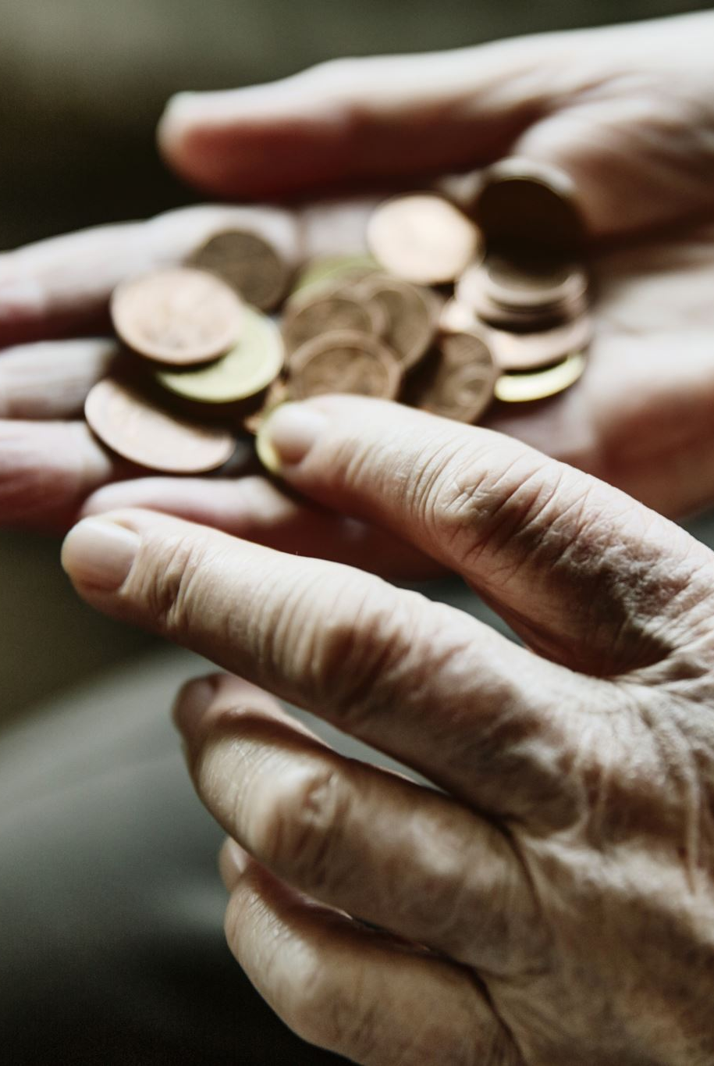
Acts 5:1-11
Now a man named Ananias, together with his wife Sapphira, also sold a piece of property. ² With his wife’s full knowledge he kept back part of the money for himself, but brought the rest and put it at the apostles’ feet.
³ Then Peter said, “Ananias, how is it that Satan has so filled your heart that you have lied to the Holy Spirit and have kept for yourself some of the money you received for the land? ⁴ Didn’t it belong to you before it was sold? And after it was sold, wasn’t the money at your disposal? What made you think of doing such a thing? You have not lied just to human beings but to God.”
⁵ When Ananias heard this, he fell down and died. And great fear seized all who heard what had happened. ⁶ Then some young men came forward, wrapped up his body, and carried him out and buried him.
Notes:
Set scene. Hebraic and Hellenistic Jews. Tension of those with something to share vs those receiving. A+S had something to sell. Example of Barnabas just before. A+S are seeking the same praise as Barnabas.
It is the lie that is so abhorrent to God, Peter says the field was always theirs to keep or sell as they wished – they did not have to give the money to the apostles.
Their hearts are divided, 1 Kings 3 A Wise Ruling, the true mother was only happy with all or none of the baby while the false mother would settle for half. God will not settle for half of your heart, he wants it all.
Potential – connect to Joshua 7:21 Achan.
God's got more for me than I could dream of – water illustration. A and S thought Peter signing off on them was the goal. God wants to be your delight, you don't have to scrimp, save, hide, and hoard. Seek first the kingdom and know that all things.
How do I spot if God is the end or the means to end?
He has already delighted in us, we need a revelation of the God who delights in us, repentance is there, lying is a symptom of idolatry
'if I'd known I'd have given him everything' - as I've trusted, I've been free to invest, he returned gold for the grains, that is His nature
Do you think that God has withheld from you in the past?

Slide 3

Acts 5:1-11
⁷ About three hours later his wife came in, not knowing what had happened. ⁸ Peter asked her, “Tell me, is this the price you and Ananias got for the land?”
“Yes,” she said, “that is the price.”
⁹ Peter said to her, “How could you conspire to test the Spirit of the Lord? Listen! The feet of the men who buried your husband are at the door, and they will carry you out also.”
¹⁰ At that moment she fell down at his feet and died. Then the young men came in and, finding her dead, carried her out and buried her beside her husband. ¹¹ Great fear seized the whole church and all who heard about these events.
Notes:
Set scene. Hebraic and Hellenistic Jews. Tension of those with something to share vs those receiving. A+S had something to sell. Example of Barnabas just before. A+S are seeking the same praise as Barnabas.
It is the lie that is so abhorrent to God, Peter says the field was always theirs to keep or sell as they wished – they did not have to give the money to the apostles.
Their hearts are divided, 1 Kings 3 A Wise Ruling, the true mother was only happy with all or none of the baby while the false mother would settle for half. God will not settle for half of your heart, he wants it all.
Potential – connect to Joshua 7:21 Achan.
God's got more for me than I could dream of – water illustration. A and S thought Peter signing off on them was the goal. God wants to be your delight, you don't have to scrimp, save, hide, and hoard. Seek first the kingdom and know that all things.
How do I spot if God is the end or the means to end?
He has already delighted in us, we need a revelation of the God who delights in us, repentance is there, lying is a symptom of idolatry
'if I'd known I'd have given him everything' - as I've trusted, I've been free to invest, he returned gold for the grains, that is His nature
Do you think that God has withheld from you in the past?

Slide 4

So, what does all of this mean?
Notes:
Set scene. Hebraic and Hellenistic Jews. Tension of those with something to share vs those receiving. A+S had something to sell. Example of Barnabas just before. A+S are seeking the same praise as Barnabas.
It is the lie that is so abhorrent to God, Peter says the field was always theirs to keep or sell as they wished – they did not have to give the money to the apostles.
Their hearts are divided, 1 Kings 3 A Wise Ruling, the true mother was only happy with all or none of the baby while the false mother would settle for half. God will not settle for half of your heart, he wants it all.
Potential – connect to Joshua 7:21 Achan.
God's got more for me than I could dream of – water illustration. A and S thought Peter signing off on them was the goal. God wants to be your delight, you don't have to scrimp, save, hide, and hoard. Seek first the kingdom and know that all things.
How do I spot if God is the end or the means to end?
He has already delighted in us, we need a revelation of the God who delights in us, repentance is there, lying is a symptom of idolatry
'if I'd known I'd have given him everything' - as I've trusted, I've been free to invest, he returned gold for the grains, that is His nature
Do you think that God has withheld from you in the past?

Slide 5
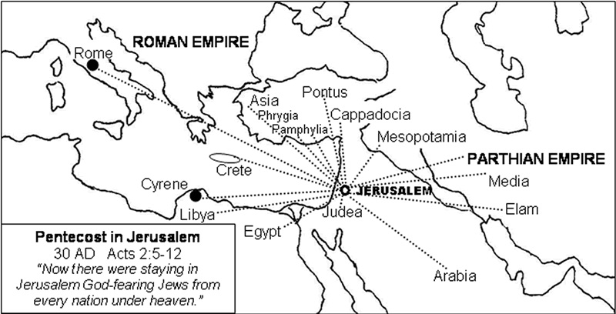
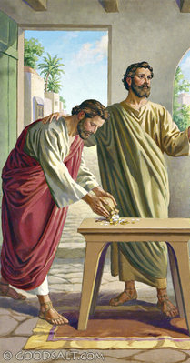
Setting the scene
Hebraic vs. Hellenistic Jews
Barnabas – son of encouragement
Notes:
Set scene. Hebraic and Hellenistic Jews. Tension of those with something to share vs those receiving. A+S had something to sell. Example of Barnabas just before. A+S are seeking the same praise as Barnabas.
It is the lie that is so abhorrent to God, Peter says the field was always theirs to keep or sell as they wished – they did not have to give the money to the apostles.
Their hearts are divided, 1 Kings 3 A Wise Ruling, the true mother was only happy with all or none of the baby while the false mother would settle for half. God will not settle for half of your heart, he wants it all.
Potential – connect to Joshua 7:21 Achan.
God's got more for me than I could dream of – water illustration. A and S thought Peter signing off on them was the goal. God wants to be your delight, you don't have to scrimp, save, hide, and hoard. Seek first the kingdom and know that all things.
How do I spot if God is the end or the means to end?
He has already delighted in us, we need a revelation of the God who delights in us, repentance is there, lying is a symptom of idolatry
'if I'd known I'd have given him everything' - as I've trusted, I've been free to invest, he returned gold for the grains, that is His nature
Do you think that God has withheld from you in the past?

Slide 6
Ananias and Saphira were serving the idol of approval and status
Looking for external approval recognition rather than having heart set on serving God
Notes:
Set scene. Hebraic and Hellenistic Jews. Tension of those with something to share vs those receiving. A+S had something to sell. Example of Barnabas just before. A+S are seeking the same praise as Barnabas.
It is the lie that is so abhorrent to God, Peter says the field was always theirs to keep or sell as they wished – they did not have to give the money to the apostles.
Their hearts are divided, 1 Kings 3 A Wise Ruling, the true mother was only happy with all or none of the baby while the false mother would settle for half. God will not settle for half of your heart, he wants it all.
Potential – connect to Joshua 7:21 Achan.
God's got more for me than I could dream of – water illustration. A and S thought Peter signing off on them was the goal. God wants to be your delight, you don't have to scrimp, save, hide, and hoard. Seek first the kingdom and know that all things.
How do I spot if God is the end or the means to end?
He has already delighted in us, we need a revelation of the God who delights in us, repentance is there, lying is a symptom of idolatry
'if I'd known I'd have given him everything' - as I've trusted, I've been free to invest, he returned gold for the grains, that is His nature
Do you think that God has withheld from you in the past?

Slide 7
What have you rationalised that God wants to reveal His truth in?
Is God the ultimate prize in your life?
Notes:
Set scene. Hebraic and Hellenistic Jews. Tension of those with something to share vs those receiving. A+S had something to sell. Example of Barnabas just before. A+S are seeking the same praise as Barnabas.
It is the lie that is so abhorrent to God, Peter says the field was always theirs to keep or sell as they wished – they did not have to give the money to the apostles.
Their hearts are divided, 1 Kings 3 A Wise Ruling, the true mother was only happy with all or none of the baby while the false mother would settle for half. God will not settle for half of your heart, he wants it all.
Potential – connect to Joshua 7:21 Achan.
God's got more for me than I could dream of – water illustration. A and S thought Peter signing off on them was the goal. God wants to be your delight, you don't have to scrimp, save, hide, and hoard. Seek first the kingdom and know that all things.
How do I spot if God is the end or the means to end?
He has already delighted in us, we need a revelation of the God who delights in us, repentance is there, lying is a symptom of idolatry
'if I'd known I'd have given him everything' - as I've trusted, I've been free to invest, he returned gold for the grains, that is His nature
Do you think that God has withheld from you in the past?

Slide 8
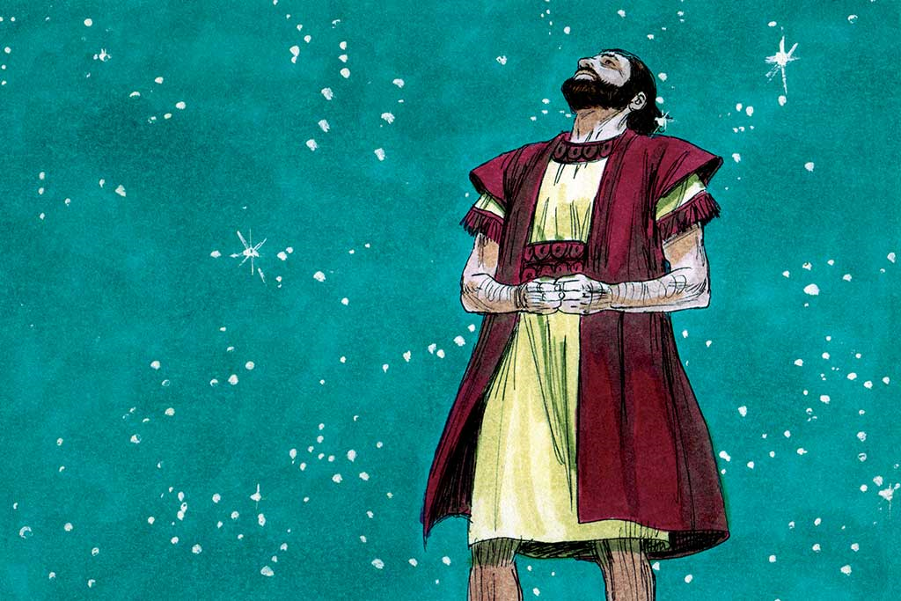
The first call of Abraham
Genesis 12:1 Go from your country, your people and your father’s household to the land I will show you.
v.7 To your offspring I will give this land.
Abraham was asked to give up nearly all the wordly hopes and things that a human heart desires, and he did.
But God's call also gave him a new hope – a son.

Slide 9

The second call of Abraham
Had he been sacrificing for God, or for the boy?
Had he learned to trust God alone, to love God for himself, not just for what he could get out of God? Not yet.
Genesis 22:2 - Take your son, your only son, whom you love—Isaac—and go to the region of Moriah. Sacrifice him there as a burnt offering on a mountain I will show you

Slide 10
This test was about loving God supremely
Genesis 22:12 - Do not lay a hand on the boy,” he said. “Do not do anything to him. Now I know that you fear God, because you have not withheld from me your son, your only son
Something is safe to maintain in our lives only if it has really stopped being an idol

Slide 11
Counterfeit Gods, Tim Keller
Abraham took that journey, and only after that could Abraham love Isaac well and wisely. If Isaac had become the main hope and joy of Abraham’s life, his father would’ve either over disciplined him
(because he needed his son to be "perfect") or underdisciplined him (because he couldn’t bear his sons displeasure) or both. He would’ve overindulged him but also become overly angry and cruel, perhaps even violent when his son disappointed him. Why? Idols enslave. Isaac's love and success would have become Abraham's only identity and joy. He would’ve become inordinately angry, anxious, and depressed if Isaac ever failed to obey and love him. And fail he would have, since no child can bear the full weight of godhood. Abraham's expectations would’ve driven him away or twisted and disfigured his spirit.
Notes:
Set scene. Hebraic and Hellenistic Jews. Tension of those with something to share vs those receiving. A+S had something to sell. Example of Barnabas just before. A+S are seeking the same praise as Barnabas.
It is the lie that is so abhorrent to God, Peter says the field was always theirs to keep or sell as they wished – they did not have to give the money to the apostles.
Their hearts are divided, 1 Kings 3 A Wise Ruling, the true mother was only happy with all or none of the baby while the false mother would settle for half. God will not settle for half of your heart, he wants it all.
Potential – connect to Joshua 7:21 Achan.
God's got more for me than I could dream of – water illustration. A and S thought Peter signing off on them was the goal. God wants to be your delight, you don't have to scrimp, save, hide, and hoard. Seek first the kingdom and know that all things.
How do I spot if God is the end or the means to end?
He has already delighted in us, we need a revelation of the God who delights in us, repentance is there, lying is a symptom of idolatry
'if I'd known I'd have given him everything' - as I've trusted, I've been free to invest, he returned gold for the grains, that is His nature
Do you think that God has withheld from you in the past?

Slide 12
Abraham's agonising walk into the mountains was therefore the final stage of a long journey in which God was turning him from an average man into one of the greatest figures in history. The three great monotheistic faiths of the world today, Judaism, Islam, and Christianity, name Abraham as founder. Over half of the people in the human race consider him a spiritual father. That would never have happened unless God had dealt with the idol of Abraham's heart.
Counterfeit Gods, Tim Keller
Notes:
Set scene. Hebraic and Hellenistic Jews. Tension of those with something to share vs those receiving. A+S had something to sell. Example of Barnabas just before. A+S are seeking the same praise as Barnabas.
It is the lie that is so abhorrent to God, Peter says the field was always theirs to keep or sell as they wished – they did not have to give the money to the apostles.
Their hearts are divided, 1 Kings 3 A Wise Ruling, the true mother was only happy with all or none of the baby while the false mother would settle for half. God will not settle for half of your heart, he wants it all.
Potential – connect to Joshua 7:21 Achan.
God's got more for me than I could dream of – water illustration. A and S thought Peter signing off on them was the goal. God wants to be your delight, you don't have to scrimp, save, hide, and hoard. Seek first the kingdom and know that all things.
How do I spot if God is the end or the means to end?
He has already delighted in us, we need a revelation of the God who delights in us, repentance is there, lying is a symptom of idolatry
'if I'd known I'd have given him everything' - as I've trusted, I've been free to invest, he returned gold for the grains, that is His nature
Do you think that God has withheld from you in the past?

Slide 13
Here, then, is a practical answer to our own idolatries, to the "Isaacs" in our lives, which are not spiritually safe to have and hold. We need to offer them up. We need to find a way to keep from clutching them too tightly, of being enslaved to them. We will never do so by mouthing abstractions about how great God is. We have to know, to be assured, that God so loved, cherishes, and delights in us that we can rest our hearts in him for our significance and security and handle anything that happens in life.
Counterfeit Gods, Tim Keller
Genesis 22:12 - Now I know that you fear God, because you have not withheld from me your son, your only son
When the magnitude of what He did dawns on us, it makes it possible to finally rest our hearts in him
Notes:
Set scene. Hebraic and Hellenistic Jews. Tension of those with something to share vs those receiving. A+S had something to sell. Example of Barnabas just before. A+S are seeking the same praise as Barnabas.
It is the lie that is so abhorrent to God, Peter says the field was always theirs to keep or sell as they wished – they did not have to give the money to the apostles.
Their hearts are divided, 1 Kings 3 A Wise Ruling, the true mother was only happy with all or none of the baby while the false mother would settle for half. God will not settle for half of your heart, he wants it all.
Potential – connect to Joshua 7:21 Achan.
God's got more for me than I could dream of – water illustration. A and S thought Peter signing off on them was the goal. God wants to be your delight, you don't have to scrimp, save, hide, and hoard. Seek first the kingdom and know that all things.
How do I spot if God is the end or the means to end?
He has already delighted in us, we need a revelation of the God who delights in us, repentance is there, lying is a symptom of idolatry
'if I'd known I'd have given him everything' - as I've trusted, I've been free to invest, he returned gold for the grains, that is His nature
Do you think that God has withheld from you in the past?

Slide 14
The Beggar
& the King

Slide 15
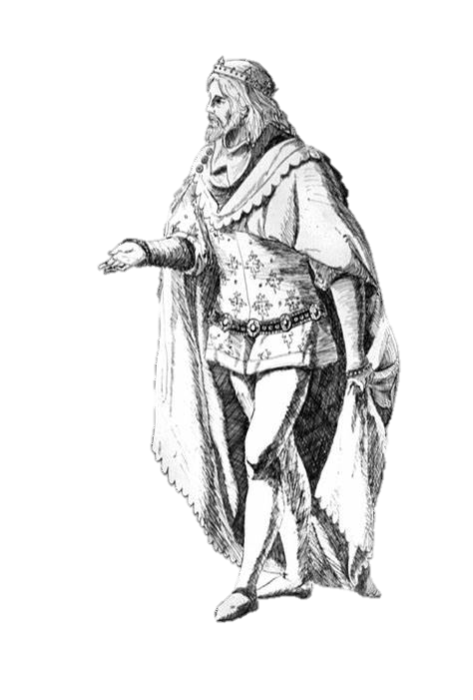
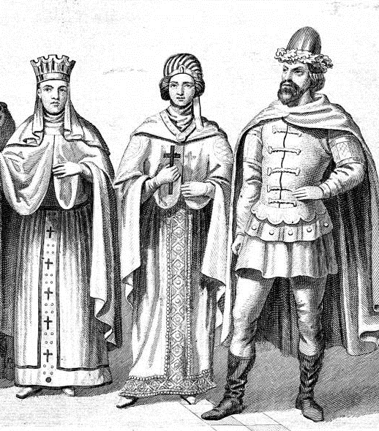
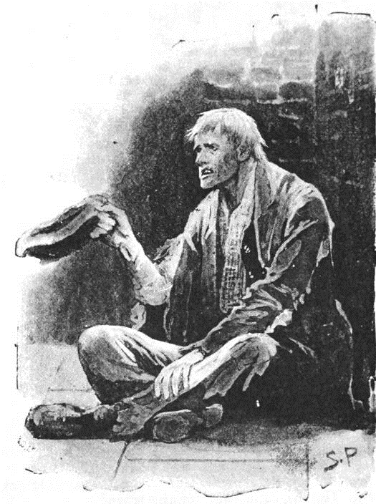

Slide 16
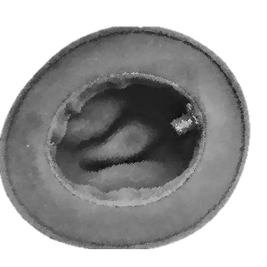
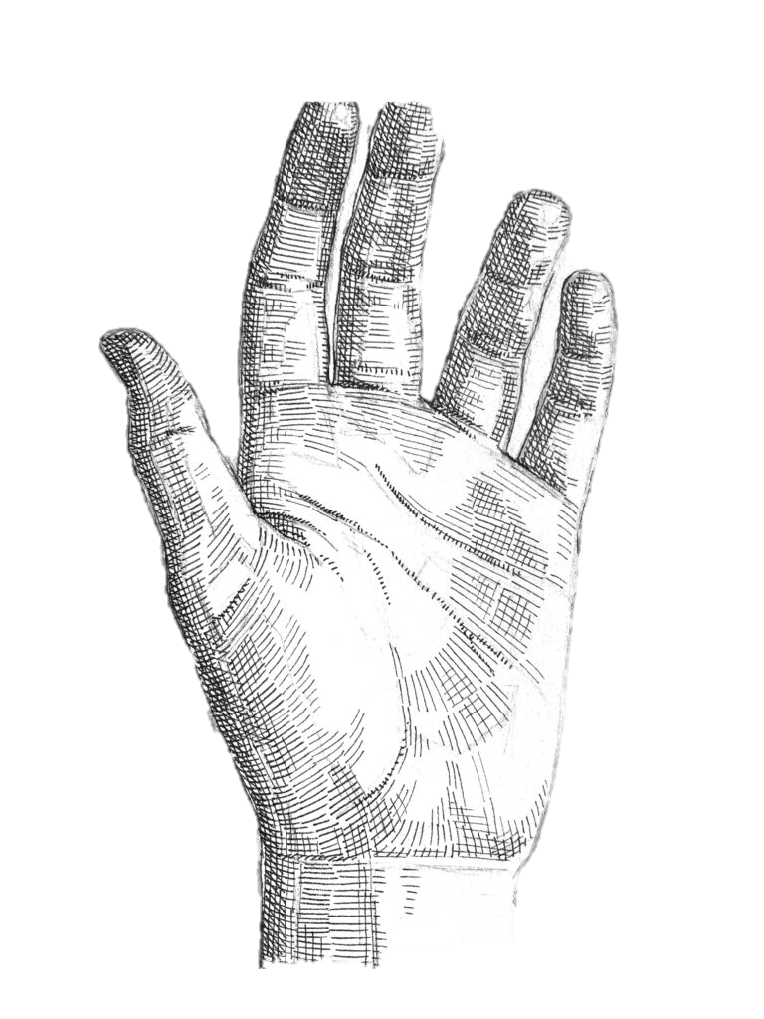
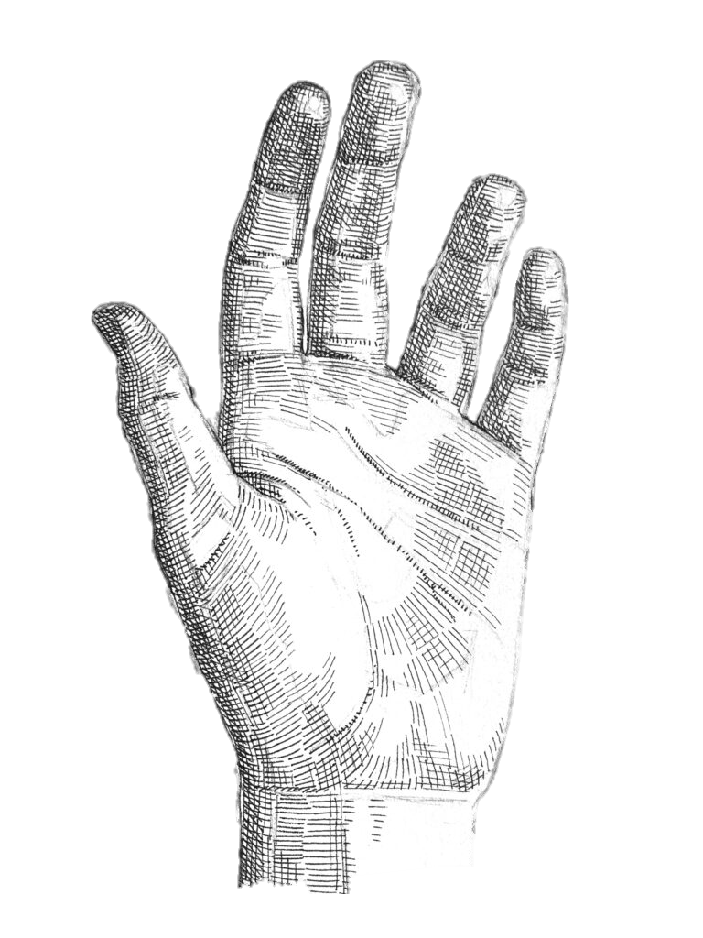
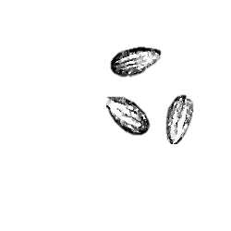

Slide 17

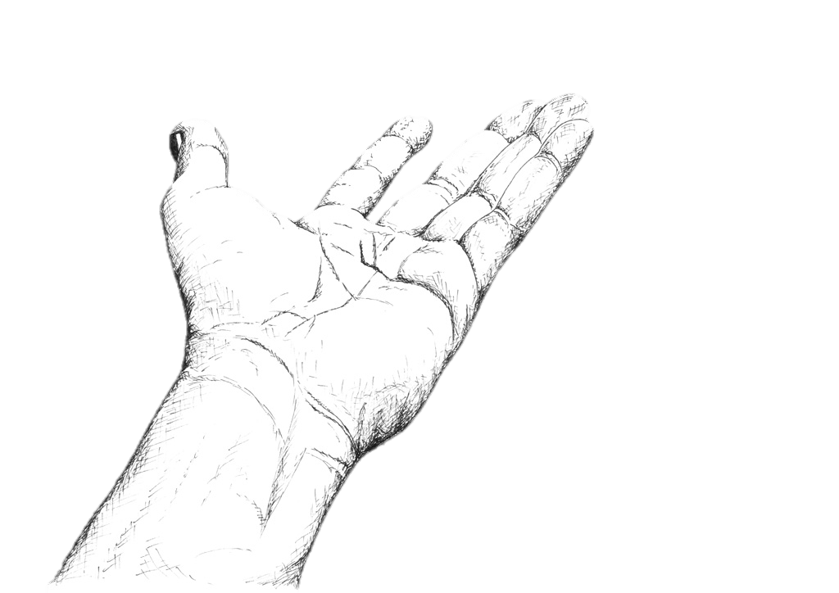


Slide 19
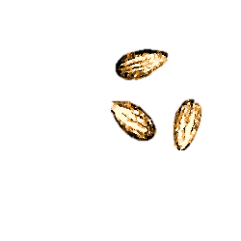

Slide 20
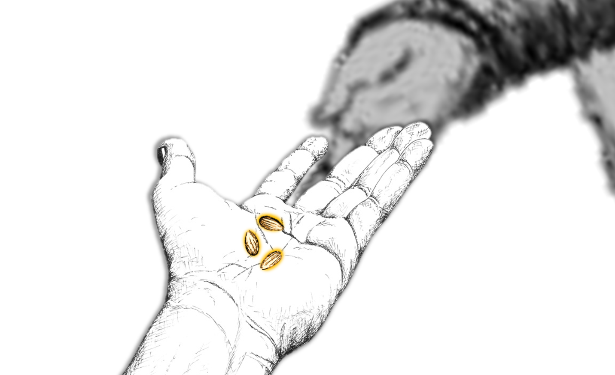
“O, how I wish I had given him all!”

Slide 21
Search me O God and know my heart, find if there is any wicked way in me and lead me in your way everlasting
Psalm 139:23

