Slide 1
God’s Masterpiece
Subtitle

Slide 2
Ephesians 2:10
¹⁰ For we are God’s masterpiece. He has created us anew in Christ Jesus, so we can do the good things he planned for us long ago.

Slide 3
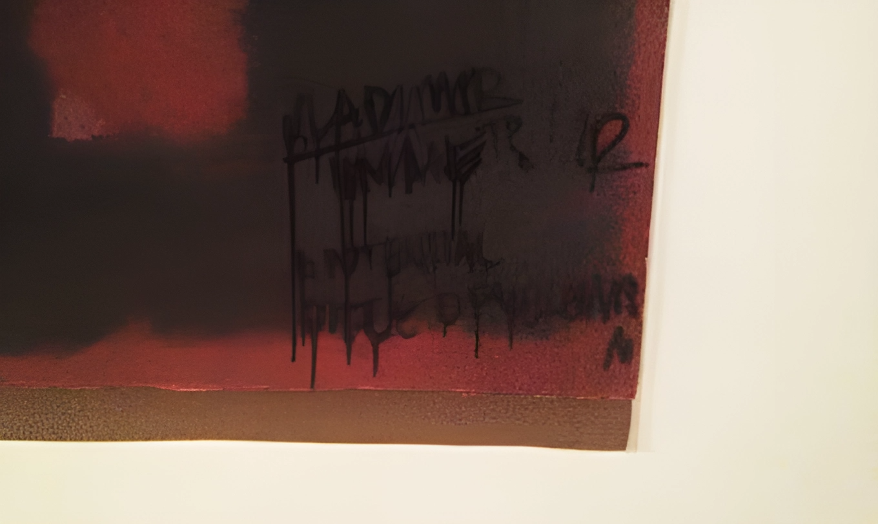
Mark Rothko's abstract masterpiece, "Black On Maroon”
Wlodzimierz Umaniec, a self-proclaimed Yellowism advocate, defaced the painting with a black marker. Umaniec spent a year behind bars for his artistic intervention.

Slide 4
Moses - Numbers 20:1-13
​ ¹ In the first month the whole Israelite community arrived at the Desert of Zin, and they stayed at Kadesh. There Miriam died and was buried.
² Now there was no water for the community, and the people gathered in opposition to Moses and Aaron. ³ They quarreled with Moses and said, “If only we had died when our brothers fell dead before the LORD! ⁴ Why did you bring the LORD’s community into this wilderness, that we and our livestock should die here? ⁵ Why did you bring us up out of Egypt to this terrible place? It has no grain or figs, grapevines or pomegranates. And there is no water to drink! ”
⁶ Moses and Aaron went from the assembly to the entrance to the tent of meeting and fell facedown, and the glory of the LORD appeared to them. ……

Slide 5
⁷ The LORD said to Moses, ⁸ “Take the staff, and you and your brother Aaron gather the assembly together. Speak to that rock before their eyes and it will pour out its water. You will bring water out of the rock for the community so they and their livestock can drink.”
⁹ So Moses took the staff from the LORD’s presence, just as he commanded him. ¹⁰ He and Aaron gathered the assembly together in front of the rock and Moses said to them, “Listen, you rebels, must we bring you water out of this rock?” ¹¹ Then Moses raised his arm and struck the rock twice with his staff. Water gushed out, and the community and their livestock drank.
¹² But the LORD said to Moses and Aaron, “Because you did not trust in me enough to honor me as holy in the sight of the Israelites, you will not bring this community into the land I give them.”
¹³ These were the waters of Meribah, where the Israelites quarreled with the LORD and where he was proved holy among them.

Slide 6
Forgetting and Grumbling Damages the Masterpiece
Moses was God’s representative
The people had forgotten God’s provision and complained
Moses had forgotten all that G0d had done through him for Israel, and the heart God had for Israel
Moses grumbled and complained about the people

Slide 7
Guarding the Masterpiece
Abraham Sacrifices Isaac – Genesis 22:1-8
Paul Shipwrecked – Acts 27:27 – 36
³³ Just before dawn Paul urged them all to eat. “For the last fourteen days,” he said, “you have been in constant suspense and have gone without food—you haven’t eaten anything. ³⁴ Now I urge you to take some food. You need it to survive. Not one of you will lose a single hair from his head.” ³⁵ After he said this, he took some bread and gave thanks to God in front of them all. Then he broke it and began to eat. ³⁶ They were all encouraged and ate some food themselves.

Slide 8
Guarding the Masterpiece
Abraham – No gossip, grumbling or complaining
Paul – Broke bread, and gave thanks

Slide 9
Fear of Damaging the Masterpiece
The church then had peace throughout Judea, Galilee, and Samaria, and it became stronger as the believers lived in the fear of the Lord. And with the encouragement of the Holy Spirit, it also grew in numbers. Acts 9:31
Peace
Stronger
Grew in Numbers

Slide 10
1 Samuel 12:24
But be sure to fear the LORD and serve him faithfully with all your heart; consider what great things he has done for you

Slide 11
Philipians 2:12-15
¹² Therefore, my dear friends, as you have always obeyed—not only in my presence, but now much more in my absence—continue to work out your salvation with fear and trembling, ¹³ for it is God who works in you to will and to act in order to fulfill his good purpose. ¹⁴ Do everything without grumbling or arguing, ¹⁵ so that you may become blameless and pure, “children of God without fault in a warped and crooked generation.”

Slide 12
What does it mean to Live in Fear of Damaging the Masterpiece
Remember all He has done for me
Be Thankful
No grumbling or complaining

Slide 13
Living in the Fear of the Lord Brings Security
Psalms 144:1-2
¹ Praise the LORD, who is my rock.
He trains my hands for war
and gives my fingers skill for battle.
² He is my loving ally and my fortress,
my tower of safety, my rescuer.
He is my shield, and I take refuge in him.
He makes the nations submit to me.

Slide 14
Living in the Fear of the Lord makes us satisfied
¹ LORD, my heart is not proud;
my eyes are not haughty.
I don’t concern myself with matters too great
or too awesome for me to grasp.
² Instead, I have calmed and quieted myself,
like a weaned child who no longer cries for its mother’s milk.
Yes, like a weaned child is my soul within me.
³ O Israel, put your hope in the LORD—
now and always. Psalms 131:3

Slide 15
Response
What are you doing to the preserve the masterpiece that is your life?
What do you need to ask God to help you remember?
Where do you need to choose to be thankful?

