Slide 1
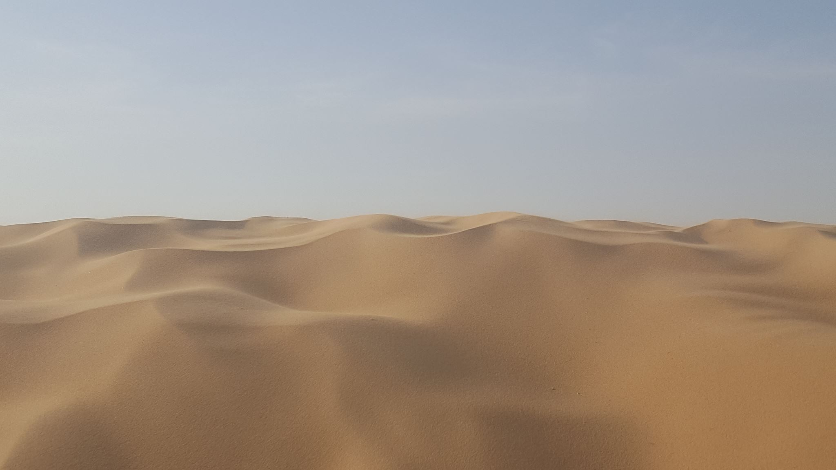
LIVING IN THE DESERT

Slide 2
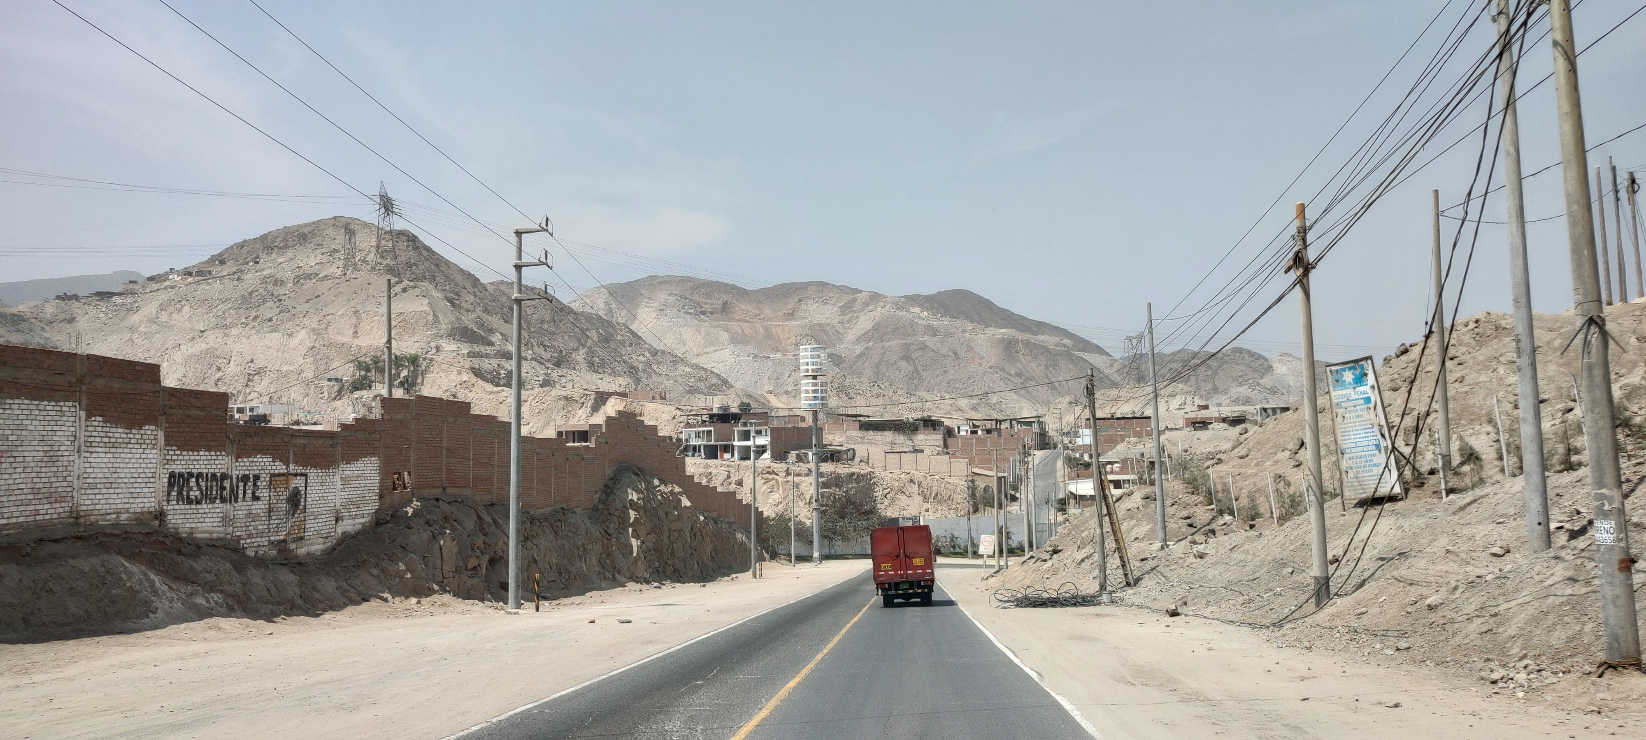

Slide 3
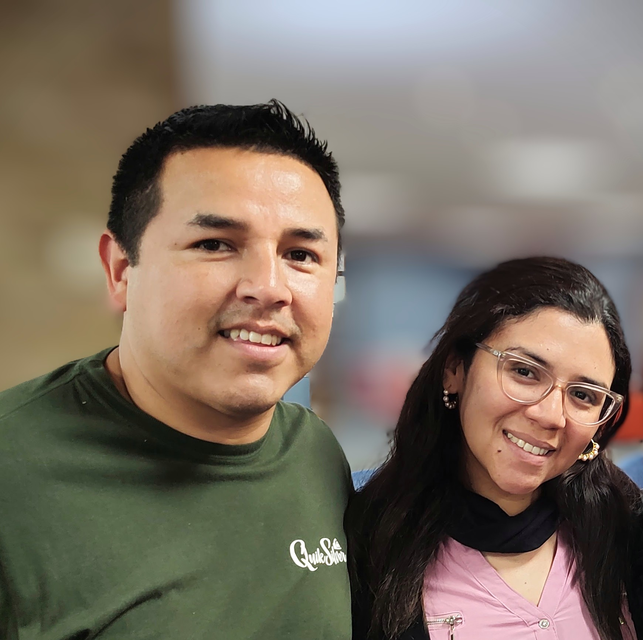
Augusto and Claudia

Slide 4
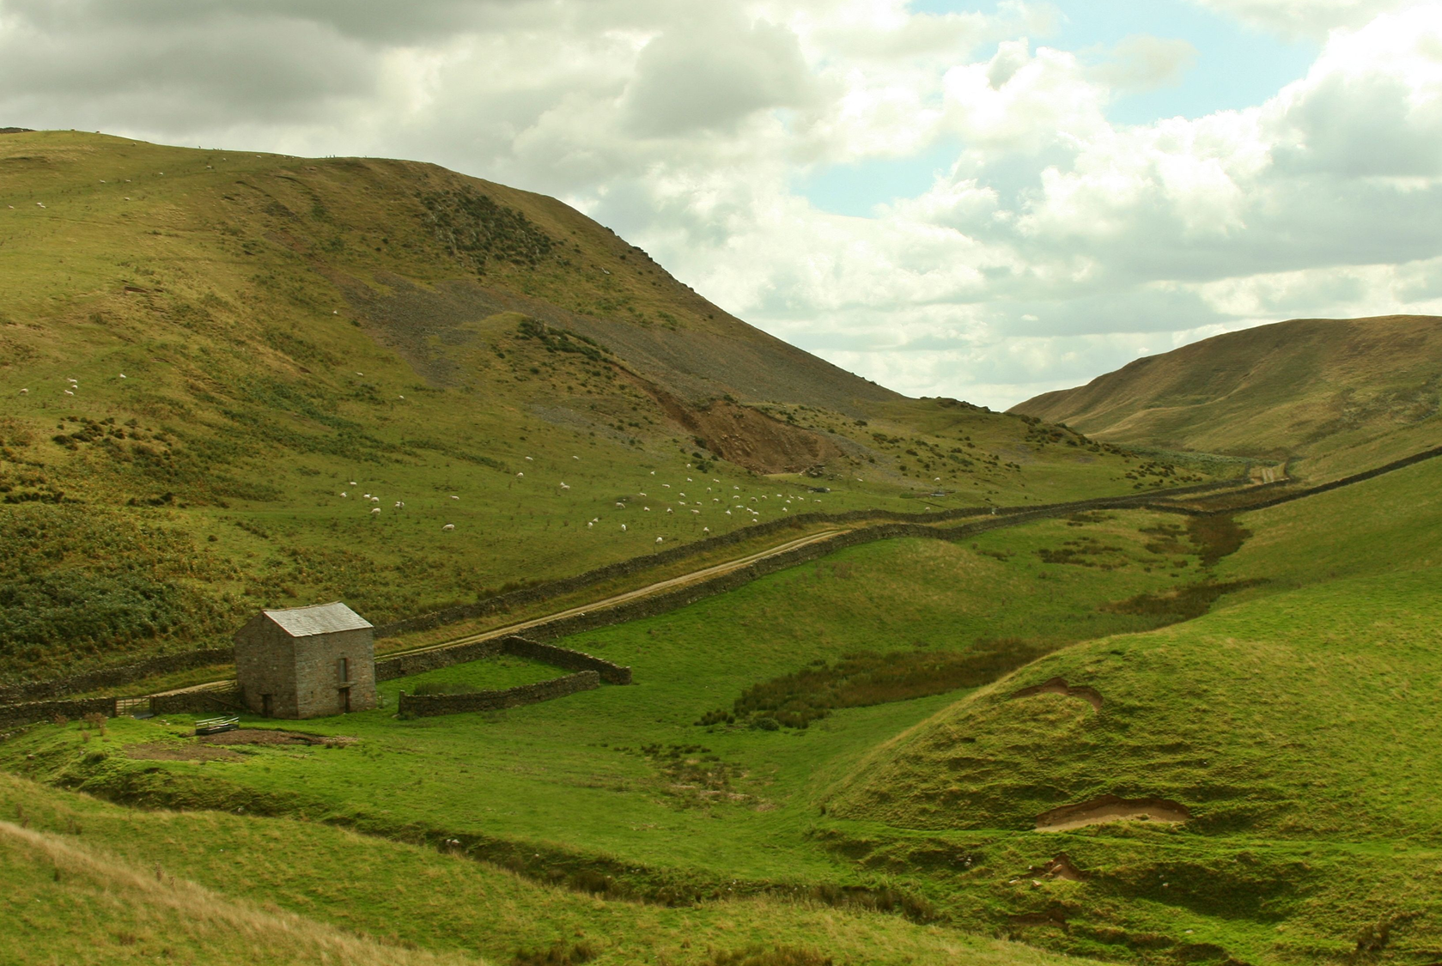

Slide 5
Annual Rainfall

Slide 6
We live in a Spiritual Desert
Nothing can satisfy
Creation living under God’s curse Romans 8:20
The world around us is under the control of the evil one 1 John 5:19
Who’s purpose is to steal, kill and destroy John 10:10
Notes:
The desert is living in hope, Romans says that the earth is groaning as in childbirth, we are groaning as in childbirth in anticipation of the return of the King

Slide 7
Jesus is the source of life in the desert
¹⁰ I (Jesus) came that they may have life, and have it abundantly. John 10:10

Slide 8
Losing sight of God in the Desert
Numbers 20: 1 – 5
​¹ In the first month the whole Israelite community arrived at the Desert of Zin, and they stayed at Kadesh. There Miriam died and was buried.
² Now there was no water for the community, and the people gathered in opposition to Moses and Aaron. ³ They quarrelled with Moses and said, “If only we had died when our brothers fell dead before the LORD! ⁴ Why did you bring the LORD’s community into this wilderness, that we and our livestock should die here? ⁵ Why did you bring us up out of Egypt to this terrible place? It has no grain or figs, grapevines or pomegranates. And there is no water to drink! ”

Slide 9
Losing Sight of God in the Desert
Time of disappointment and disillusionment
Time of Grief (Miriam – Moses’ sister dies)
Loss of hope
Promises unfulfilled - Exodus 3:8
Needs not seemingly met
Grumbling and Complaining

Slide 10
God is in the Desert
God met Moses in the Desert
¹ Now Moses was tending the flock of Jethro his father-in-law, the priest of Midian, and he led the flock to the far side of the wilderness and came to Horeb, the mountain of God. ² There the angel of the LORD appeared to him in flames of fire from within a bush Exodus 3:1-2
God met us when we were in the Desert
Notes:
Eva may be, Agne story definitely

Slide 11
God is in the Desert
God wants us to be totally dependent on Him
The desert is a place where we cannot survive without God. When we are in the Desert we either turn to Him or we die
He wants us to grow and thrive in the Desert
Notes:
My story here?

Slide 12
The Rock
⁸ Speak to that rock “before their eyes” and it will pour out its water.
¹¹ Then Moses raised his arm and struck the rock twice with his staff. Water gushed out, and the community and their livestock drank. Numbers 20:8,11
Notes:
Rock BEFORE THEIR EYES

Slide 13
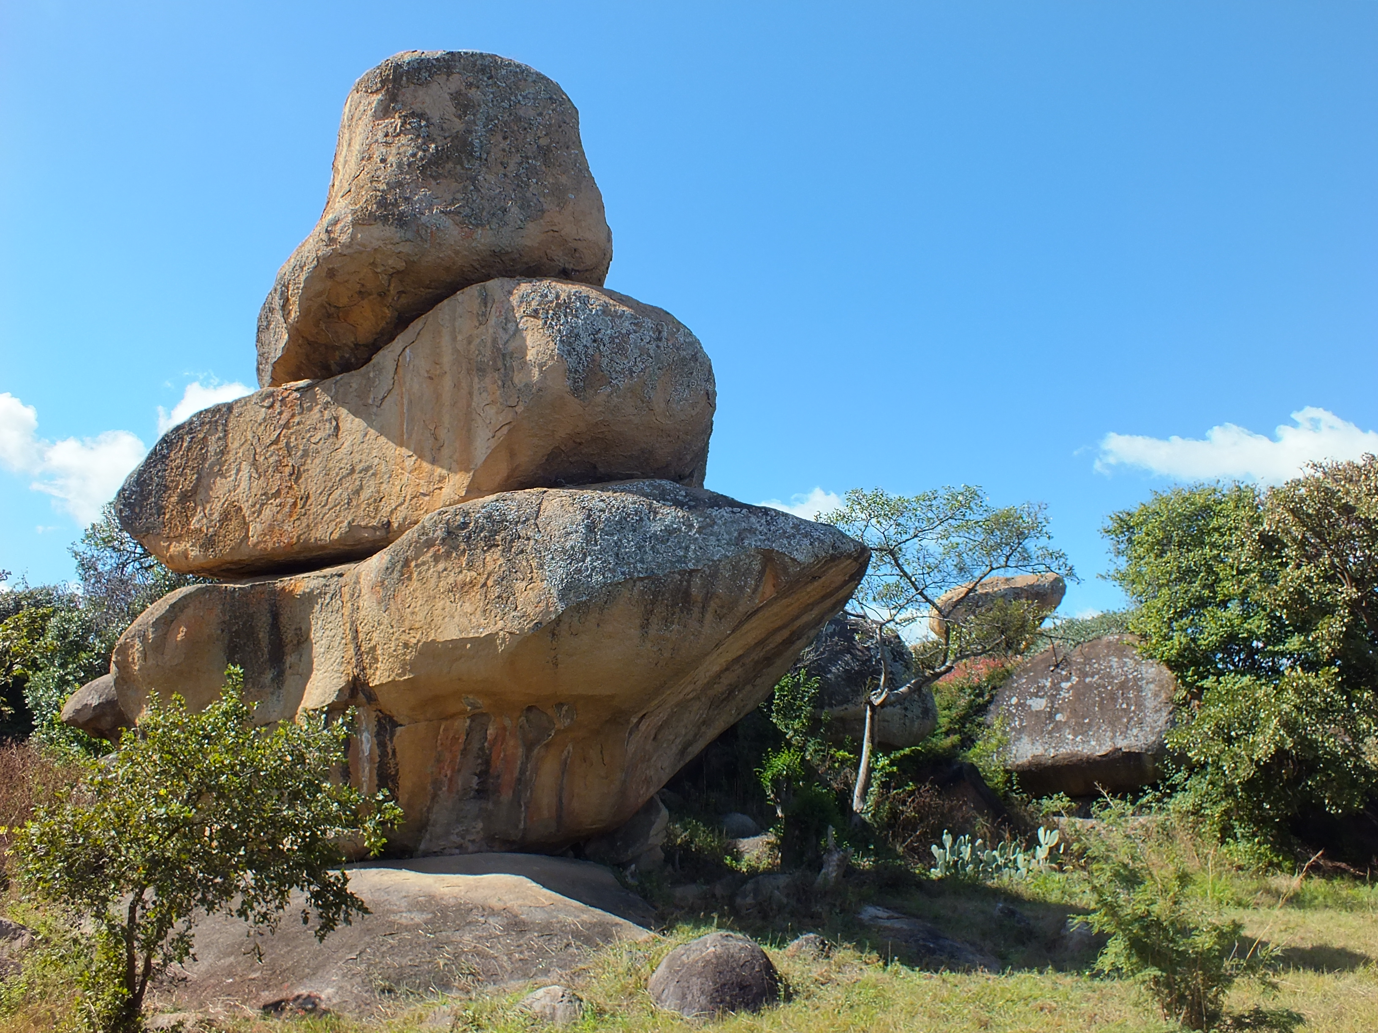
There was a Rock

Slide 14
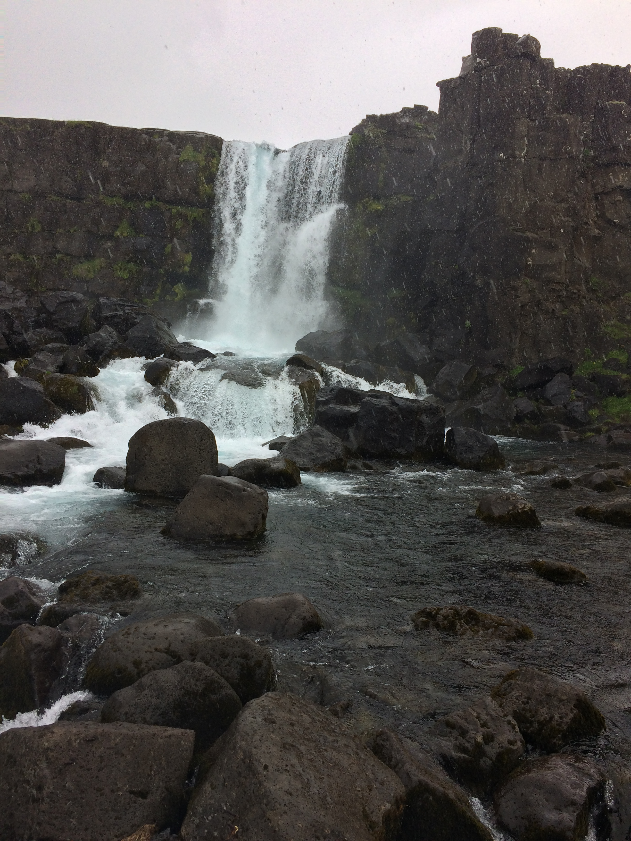
God was in the Rock “before their eyes”

Slide 15
Seeing God Right Before our Eyes
If God is “before our eyes in the desert” why don’t we always see Him?
Distracted
Consumed with other things
Trying to find our own way and resolve it ourselves

Slide 16
Where can we find Him?
²⁰ For where two or three gather in my name, there am I with them. Matthew 18:20
¹⁸ Open my eyes, that I may see
Wondrous things from Your law. Psalms 119:18
⁵ Why am I discouraged?
Why is my heart so sad?
I will put my hope in God!
I will praise him again—
my Savior and my God! Psalms 43:5
Notes:
Confess your need of Him

Slide 17
Where can we find Him?
Meet and Share Life together
Engage regularly with His Word
Express Thankfulness and Praise to Him
Notes:
Confess your need of Him

Slide 18
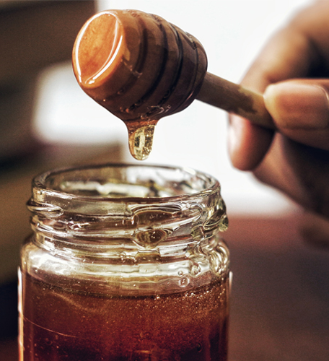
More than Just a rescue
There is “HONEY” in the Rock
This Photo by Unknown Author is licensed under CC BY-SA-NC

Slide 19
More than a rescue
Deuteronomy 32:10,13
¹⁰ "He (God) found him (Jacob) in a desert land
and in the wasteland, a howling wilderness;
He encircled him, He instructed him,
He kept him as the apple of His eye. Deuteronomy 32:10
¹³ "He made him ride in the heights of the earth,
That he might eat the produce of the fields;
He made him draw honey from the rock,
And oil from the flinty rock;
Psalm 81:16
But you would be fed with the finest of wheat;
with honey from the rock I would satisfy you
Notes:
Apple of His eye, Draw equals suck, Moses had to hit the rock – the Rock does not just give us water to sustain life, it is a place for nourishment, growth and development – a sweet place. When we decided no children, when Sue’s back was bad – it was a time to suck honey from the rock

Slide 20
Do you feel lost in the Desert?
God is here before our eyes :- we are
  Gathered
  Focussed on His word
  Praising His name

Slide 21
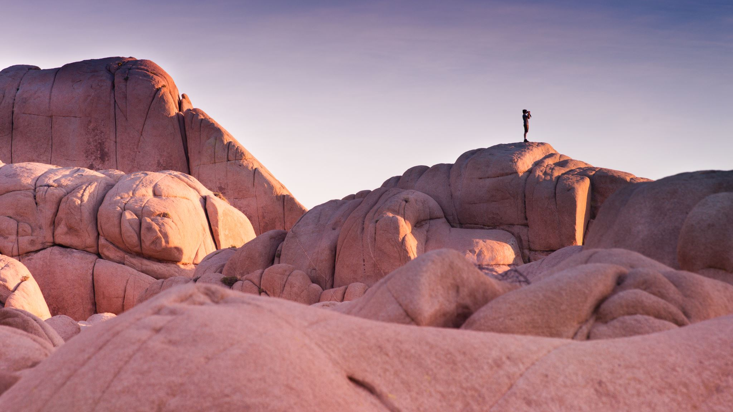
A Response
Are you lost in the Desert and need God to reveal Himself to you?
Where do you need to stop complaining and ask God for help?
What is the “honey” God wants you to draw from Him, and what changes do you need to make to do it?

