Slide 1
In Pursuit of Holiness

Slide 2
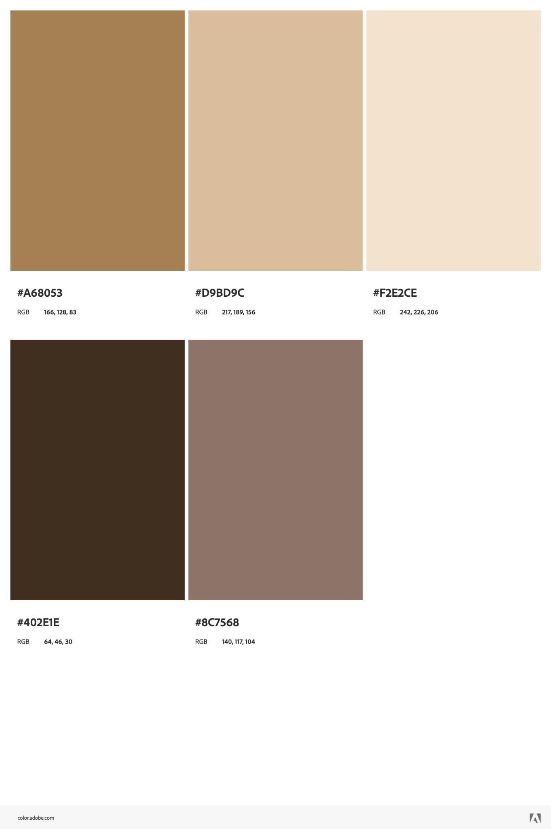

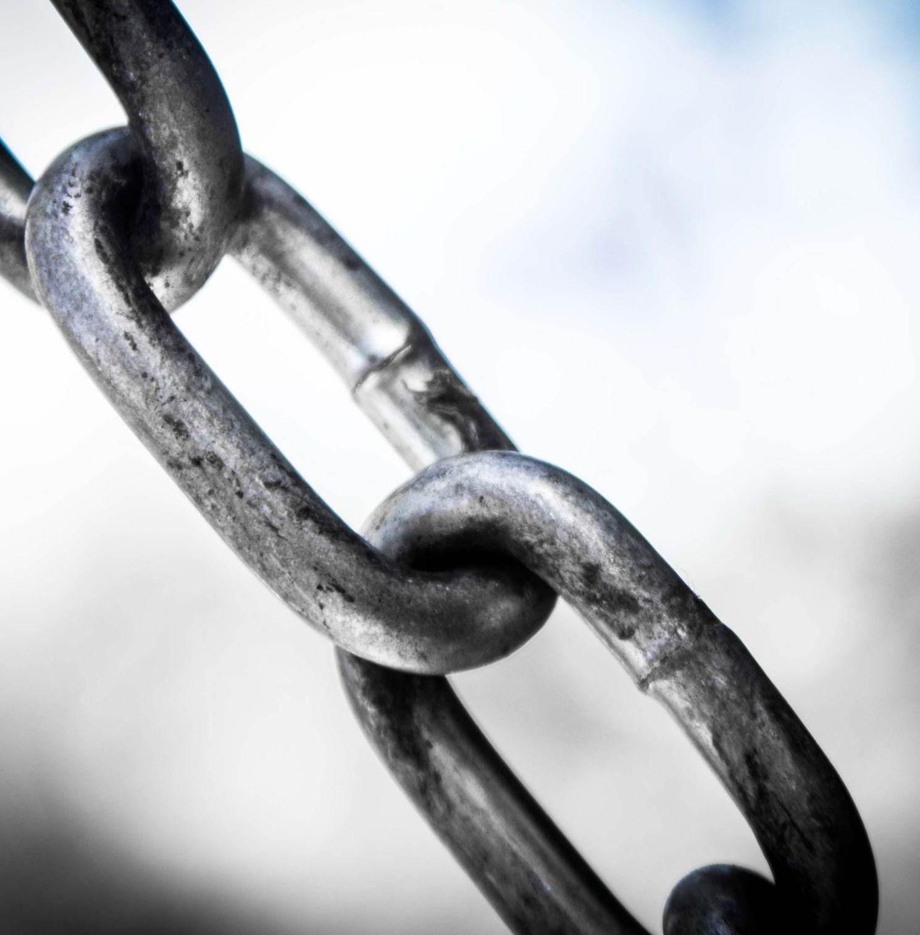
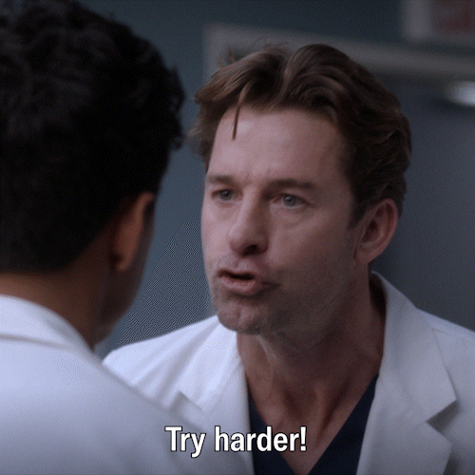
Why this topic?
Untangle a wrong notion
Learnings from a personal journey
This is NOT about…

Slide 3
An invitation
+
A story

Slide 4
An invitation
I am the Lord your God; consecrate yourselves and be holy, because I am holy... I am the Lord, who brought you up out of Egypt to be your God; therefore be holy, because I am holy
— Leviticus 11:44-45
Therefore, with minds that are alert and fully sober, set your hope on the grace to be brought to you when Jesus Christ is revealed at his coming. As obedient children, do not conform to the evil desires you had when you lived in ignorance. But just as he who called you is holy, so be holy in all you do; for it is written: “Be holy, because I am holy.”
—1 Peter 1:13-16

Slide 5
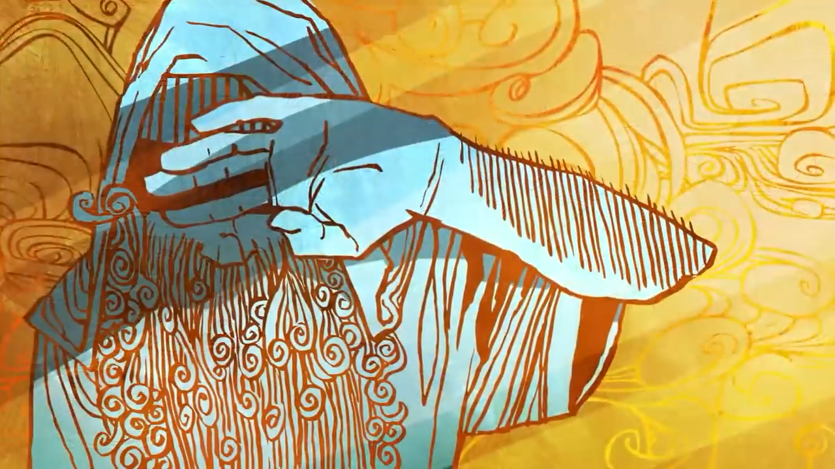
A story — Isaiah 6:1-7
Source: The Bible Project — What the Idea of "Holiness" Means in the Bible

Slide 6
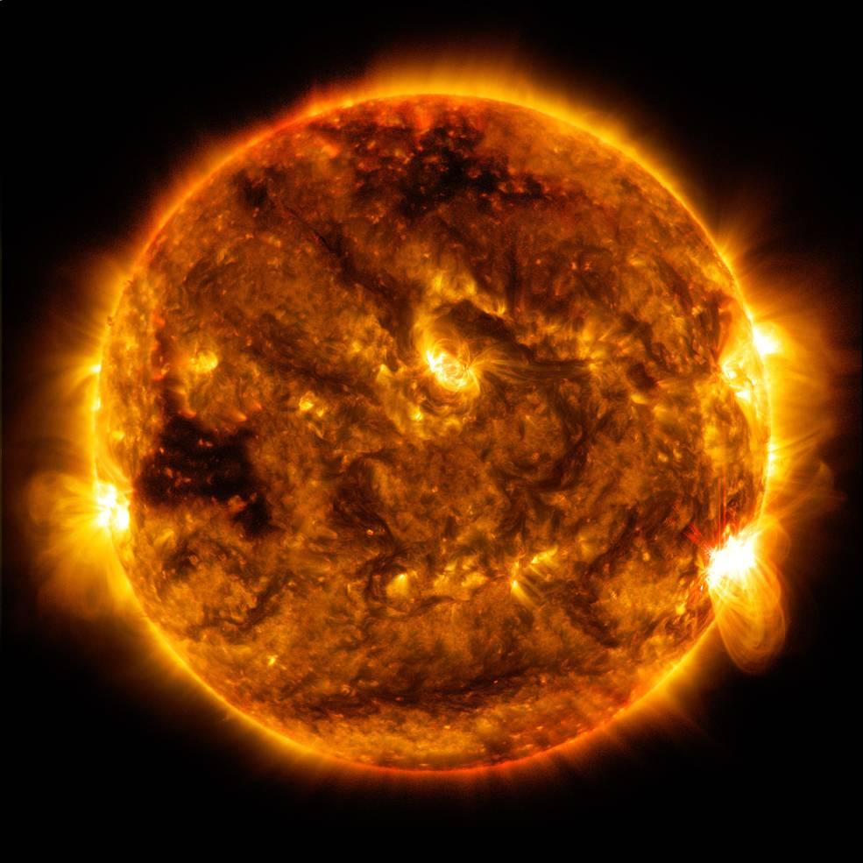
Holiness = Who He is

Slide 7
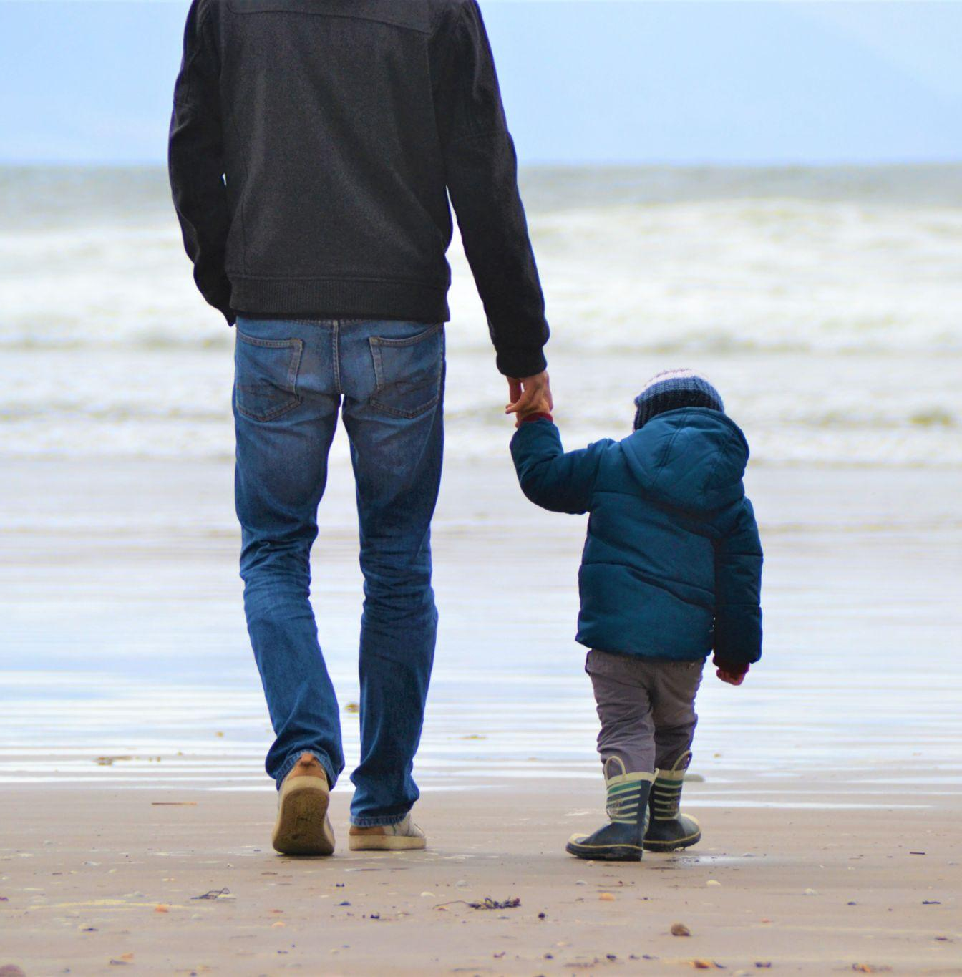

Why pursue Holiness?
Love for the Father
Ezekiel’s River
—Ezekiel 47 and Revelation 22

Slide 8
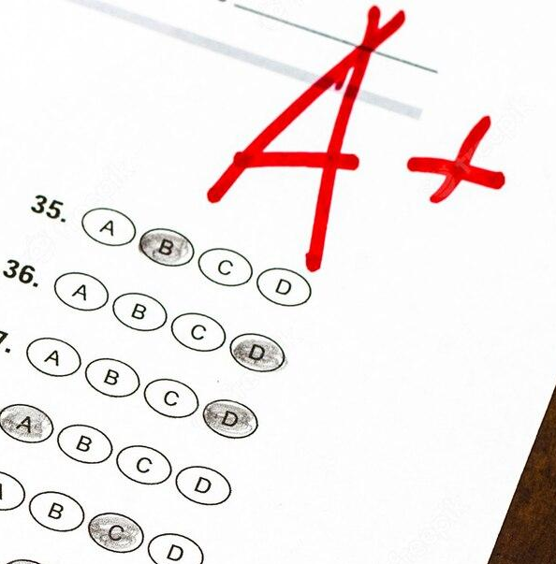
The pursuit of Holiness
Is not

Slide 9
As far as the east is from the west, so far does he remove our transgressions from us
— Psalm 103:12
Child of God
We are His workmanship, created in Christ Jesus for good works
— Ephesians 2:10
The Spirit himself testifies with our spirit that we are God’s children.
— Romans 8:16
Blameless
Forgiven
Chosen
You are mine
— Isaiah 43:1
Therefore, since we have been justified by faith, we have peace with God through our Lord Jesus Christ.
— Romans 5:1 ESV
Fearfully and wonderfully made
— Psalm 139:14
Redeemed
Justified
Don’t you know that you yourselves are God’s temple and that God’s Spirit dwells in your midst?
— 1 Corinthians 3:16
Bought with a price
— 1 Corinthians 6:20
Loved

Slide 10
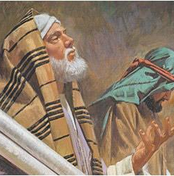
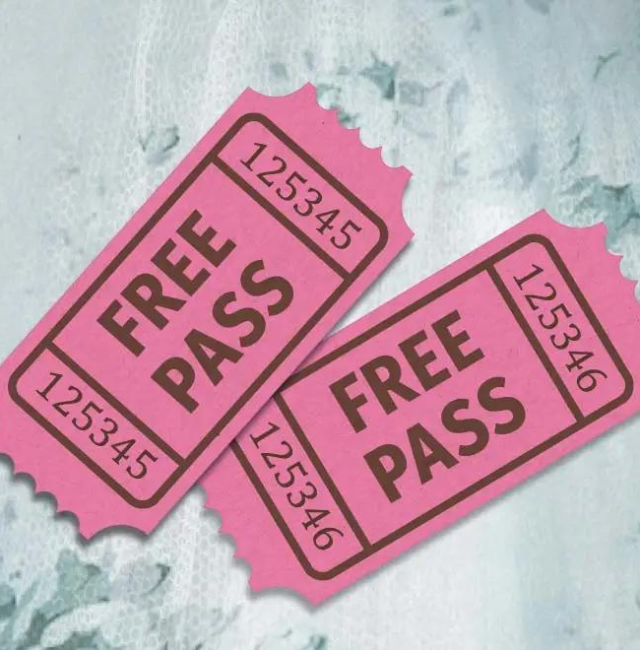
Some untrue assumptions
Modern Pharisee
A free pass
— Romans 6:1-4

Slide 11




How do we pursue Holiness?
Search Me
— Psalm 139
Confession and Accountability
Renewing our minds
Counter Cultural and Counter-intuitive

Slide 12
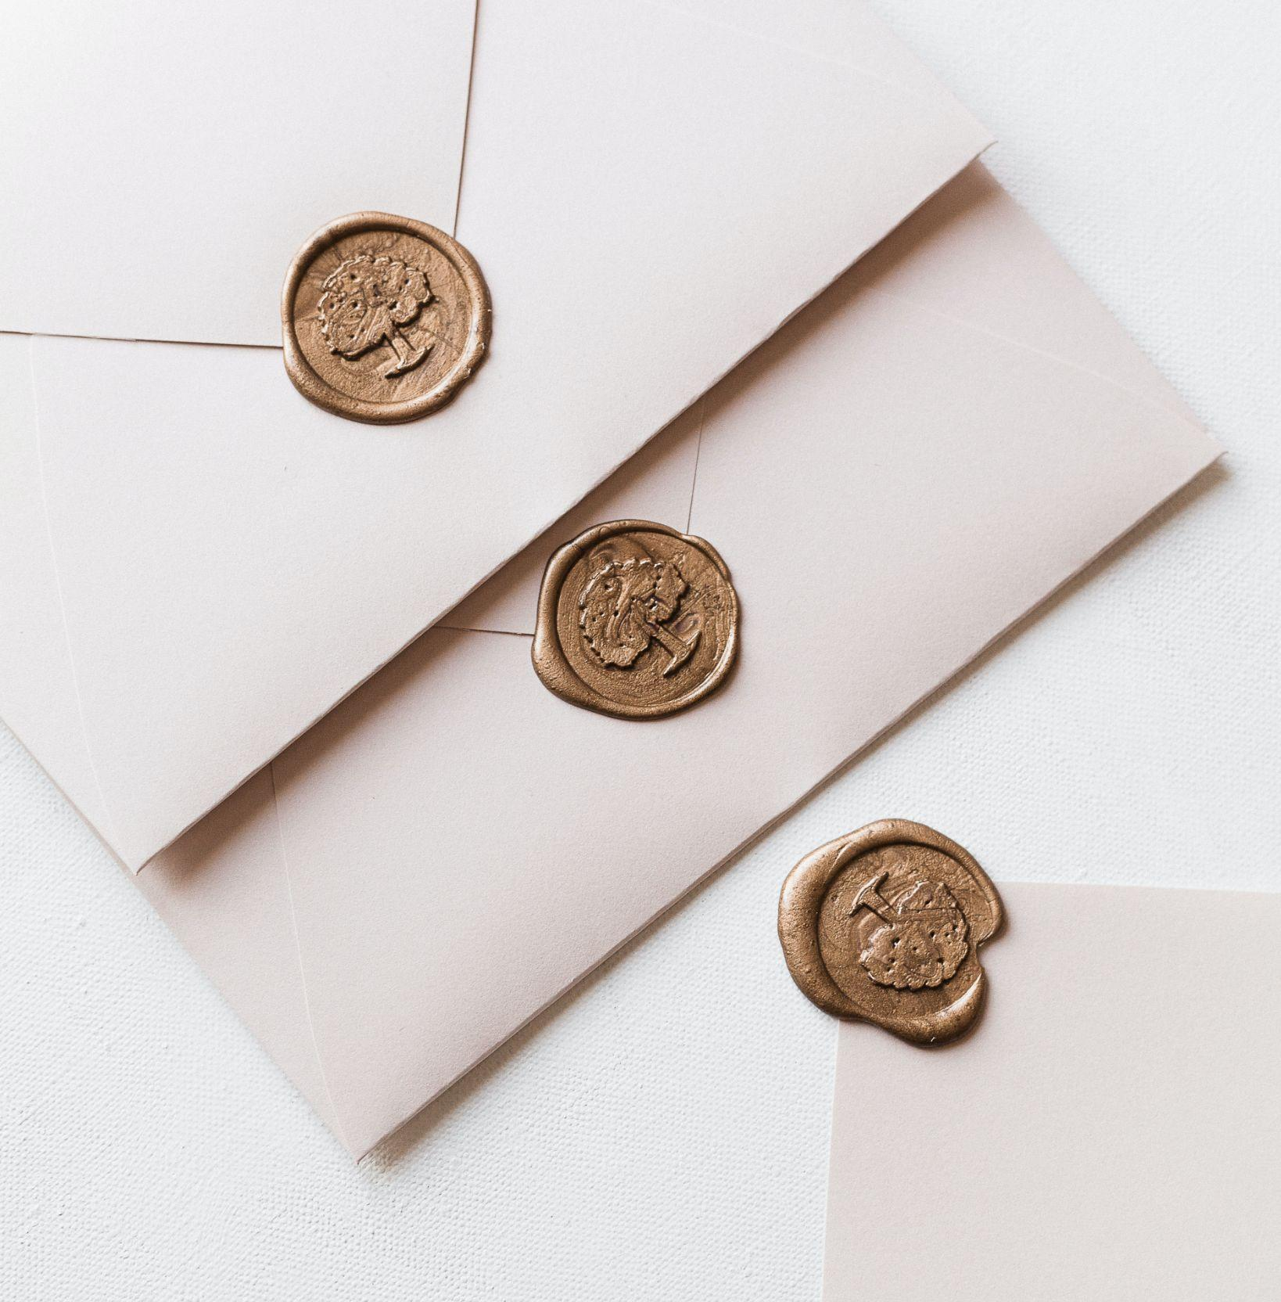
The Invitation + The Story
“Be holy as I am holy”
“Behold, this has touched your lips; your guilt is taken away, and your sin atoned for”

Slide 13
Responses
I want to repent of an untrue assumption I have about holiness, either:
‘I'll be better one day’ or ‘what’s the point?’
I want to accept the invite to be Holy as He is Holy
Spirit, search me and show me how I can pursue Holiness

Slide 14
Responses
I want to repent of an untrue assumption I have about holiness, either:
‘I'll be better one day’ or ‘what’s the point?’
I want to accept the invite to be Holy as He is Holy
Spirit, search me and show me how I can pursue Holiness
By grace alone somehow I stand
Where even angels fear to tread
Invited by redeeming love
Before the throne of God above
He pulls me close with nail-scarred hands
Into His everlasting arms
When condemnation grips my heart
And Satan tempts me to despair
I hear the voice that scatters fear
The Great I am the Lord is here
Oh praise the One who fights for me
And shields my soul eternally
Boldly I approach Your throne
Blameless now I'm running home
By Your blood I come
Welcomed as Your own
Into the arms of majesty
This is the art of celebration
Knowing we're free from condemnation
Oh praise the One, praise the One
Who made an end to all my sin

