Slide 1
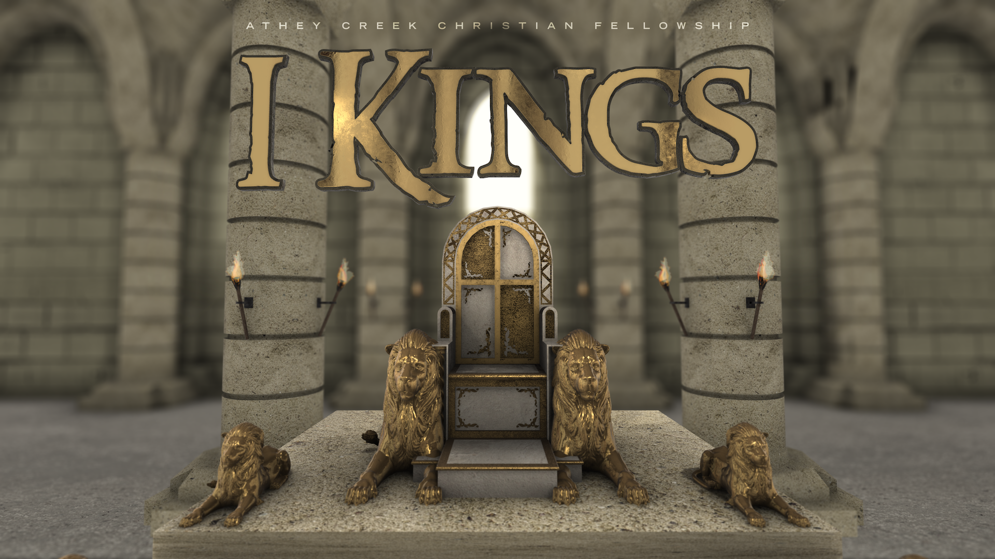
The Kings Study
Episode 1

Slide 2
Today
About the series
How did we arrive at Kings
Key Characters

Slide 3
(1) About the Series
Why do a series on Kings?
Always relevant
Great experience before
Sink our teeth into a series
Word of warning when studying the bible
power to transform
not sanitised for your approval or preference
Report doesn’t mean condone
Don’t expect to find a hero
Won’t explore all bunny trail
Additional to Sunday teaching
Podcast
questions
to kick about with your friends
Notes:
We will get a few episodes in before the summer then restart in Sept. Occasionally we’ll interrupt the series if we feel there is something else we need to bring.
It is God’s word – therefore has power to transform us
The bible is not sanitised – there are many gory and upsetting stories
Bible wasn’t given for our approval or preference. There hasn’t existed a time and culture where everything God says through the bible affirms their mindset or way of life. The bible pulls the rug from under all of us
Just because the bible reports it, doesn’t mean God condones the action (e.g. God’s intention for marriage was clear from Genesis yet there are plenty of cases where the people God worked with/through had multiple marriages. The bible doesn’t often directly condemn polygamy but you will see it always leads to disaster).
Don’t expect to find a hero, whose perfect character & decisions we are encouraged to emulate. The bible is full of failures, losers and some down right mean people who God has works with. The knack to ‘getting’ the bible is actually to see its about God who faithfully works with corrupt humans at a huge cost to Himself.
We won’t go down every bunny trail that was available – want to hear God’s word for our community at this time

Slide 4
(2) How did we arrive at Kings?

Slide 5
(3) Key Characters

Slide 6

Key Characters
1 Kings 1-2

Slide 7

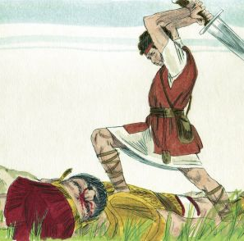
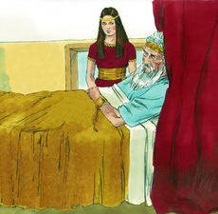
Name: David
Position: King (aged)
Reigned 40 years
8 wives (+concubines)
19 sons

Slide 8

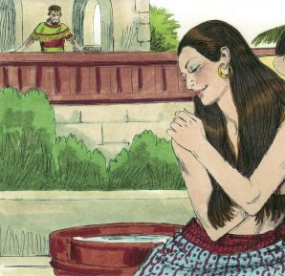
Name: Bathsheba
Position: Wife of David
Married to Uriah
David gets her pregnant & has Uriah murdered
David marries
First son dies
Mother of Solomon (who God names via Nathan)

Slide 9

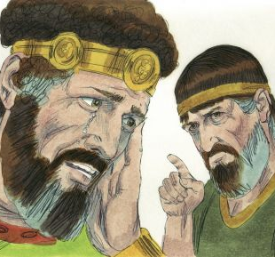
Name: Nathan
Position: Prophet
Prophet during David (voice of God into David’s reign)
Speaks God’s word regarding building a temple and David’s lineage
Confront David’s sin regarding Bathsheba & Uriah
Notes:
Nathan (the Prophet)
Prophet during David (voice of God into David’s reign)
God speaks to David through Nathan regarding David’s desire to build a temple and God’s promise to work through David’s lineage (2 Sam 7)
God uses Nathan to confront David’s sin regarding Bathsheba & Uriah (2 Sam 12:7-14)
Consequence of David’s sin
the sword will never depart from your house
Out of your own household I am going to bring calamity on you
I will take your wives and give them to one who is close to you
the son born to you will die

Slide 10

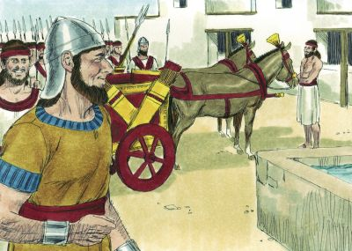
Name: Adonijah
Position: Prince
David’s 4th son
Next in line for the throne
Notes:
1st son Amnon murdered by Absalom,
2nd son Daniel not mentioned,
3rd son Absalom killed whilst leading a coup by Joab

Slide 11

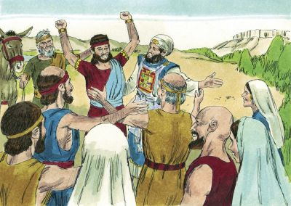
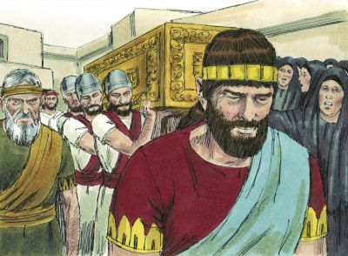
Name: Solomon
Position: Prince
David’s ?^{th} son
Son of Bathsheba
Names by Nathan
Succeeds David as king

Slide 12
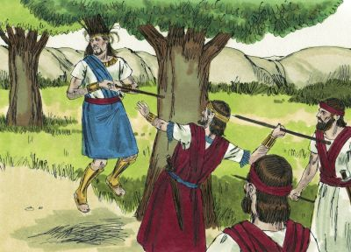
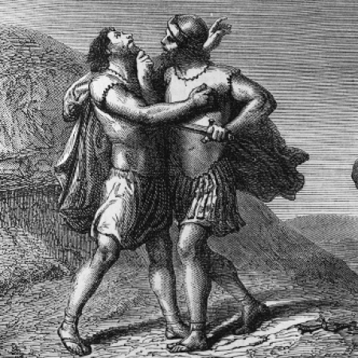
Name: Joab
Position: The General
One of David’s mighty men
Killed Abner in cold blood in revenge
(David disapproved but didn’t feel strong enough to challenge Joab)
Conspired with David to have Uriah killed
Reconnected David & Absalom
Led David’s men against Absalom’s uprising – killed Absalom
Joab murders Amasa
Tried dissuade king’s census
Joined Adonijah
Notes:
Joab (the General)
One of David’s mighty men, fighting alongside him whilst David on run from Saul
Killed Abner (Ish-Bosheth (Saul’s son) General) in cold blood in revenge because Abner had killed Joab’s brother in battle – displeased David - Abner was seeking to bring the all Israel under David. David didn’t feel strong enough to challenge Joab
Conspired with David to have Uriah killed in battle
Play role in re-establishing relationship between David & Absalom after Absalom fled having murdered Amnon
Lead men loyal to David against Absalom’s uprising – personally dispatching Absalom
David replaces Joab with Amasa
Joab murders Amasa
Tried to convince king not to do a census of the military but was overrule – God punished David for this
Sided with Adonijah when he declares himself king

Slide 13
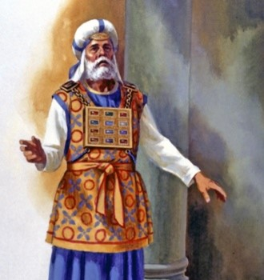
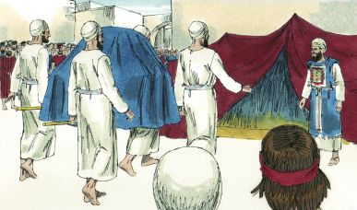
Name: Abiathar & Zadok
Position: Priests
Abiathar join David in wilderness
Brought Ark out as David fled Jerusalem (sent back as spies)
Abiathar joined Team-Adonijah
Zadok didn’t
Notes:
Abiathar (priest)
Fled Saul’s massacre of priests because they had helped David and joined David in hiding
Served as a priest for David whilst in exile and continued once David ascending to the throne
Brought Ark out as David fled Jerusalem from Absalom – David sends him and Ark back so they can serve the ark and share Absalom secrets to David
Conspired with Adonijah to put him on the throne
Zadok (priest)
Serve alongside Abiathar
Didn’t join Adoniah

Slide 14
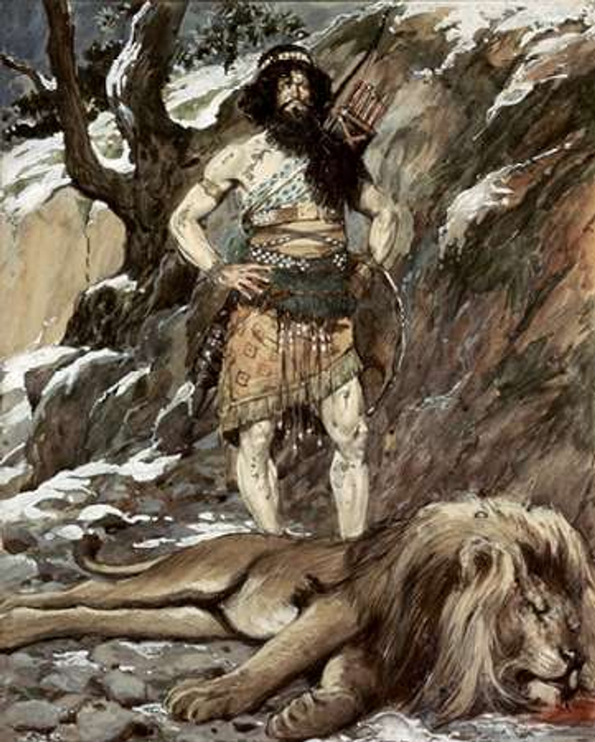
Name: Benaiah
Position: Captain
One of David’s mighty men
Killed Moab’s two mightiest warrior
killed a lion on a snowy day.
Killed Egyptian giant with his own spear
Served under Joab Didn’t join Adonijah
Notes:
Benaiah son of Jehoiada
One of David’s mighty men
struck down Moab’s two mightiest warrior
He also went down into a pit on a snowy day and killed a lion.
Killed Egyptian giant with his own spear
Army officer under Joab with specific command over Kerethites and Pelethites
Didn’t join Adonijah

