Slide 1

The Kings Series - Episode 12
5th Nov 2023
Notes:
So, we will look at chapter 11 today which is the downfall of Solomon. It has been like the narrator has tried a few different techniques to highlight the failure of Solomons character – hyperbole, sarcasm but now in chapter 11 he completely lifts the curtain on Solomon.
We will scan through the chapter then I want unpack the 2nd half of the chapter first then move back to the start.
God becomes angry with Solomon (we will go back and look at the details – what caused God to become angry).
He tells Solomon “I will tear the kingdom away from you, leaving you with just one tribe”

Slide 2
1 Kings 11:14
And the Lord raised up an adversary against Solomon

Slide 3
(1) On the wrong side of a ruthless God
Notes:
God raises up 3 adversaries

Slide 4

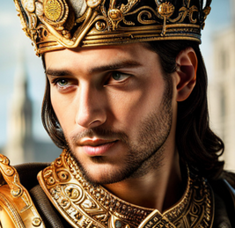
Name: Hadad the Edmonite
Escaped David’s defeat of Edom, fled to Egypt
Pharoah gave sister-in-law in marriage
Requested to return to Edom when David died
Laid in wait to avenge
Attacked Israel from South
Notes:
Hadad the Edmonite
Escape the campaign of David (Solomon’s father) where 18,000 Edomite men were killed (2 Sam 8:13) – David had established a garrison in Edom
fled to Egypt
Found favour with Pharoah who gave him marriage to his sister-in-law
Hadad’s son grew up with Pharoah’s children
When he heard David had died, Hadad requested Pharoah’s permission to return to Edom
Lay in wait for opportunity to avenge…
Attacked from the South

Slide 5

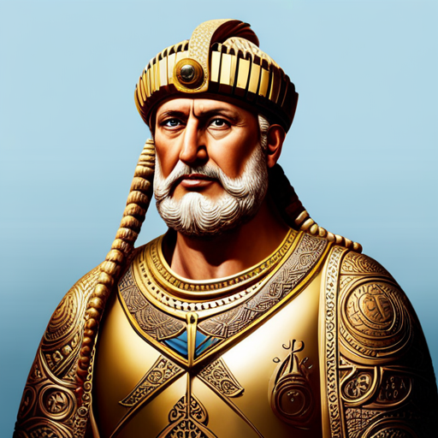
Name: Rezon the son of Eliada
Fled from Hadadezer king of Zobah (a king David had defeat 2 Sam 8)
Assembled crew of bandits (fellow survivors)
Attacked from the North
Notes:
(2) Rezon the son of Eliada
Fled from Hadadezer king of Zobah (a king David had defeat 2 Sam 8)
Assembled crew of bandits (fellow survivors)
Attacked from the North

Slide 6

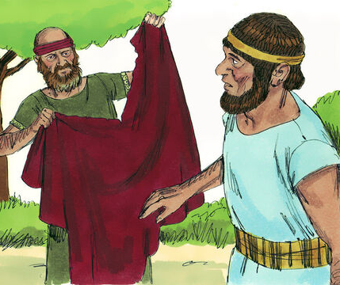
Name: Jeroboam
Ephraimite (an Israelite) = enemy from within
Appointed by Solomon Prophet tells him God is about to give him 10 tribes to rule over – (God offers same promise)
Solomon turned on kill, fled to Egypt until Solomon died
Notes:
(3) Jeroboam the son of Nebat
Ephraimite – an Israelite = enemy from within
Had been spotted for ability and appointed by Solomon to powerful position
Prophet tells him God is about to give him 10 tribes to rule over – and offers same promise that God had given Solomon
Solomon turned on J so he fled to Egypt until Solomon died
Did Solomon, infatuated with his luxury, foreign wives and gods take eyes off the ball?
Solomon acting like Saul – tries to kill the man God has selected to take place. Got an enemy in form of new band of merry men.

Slide 7
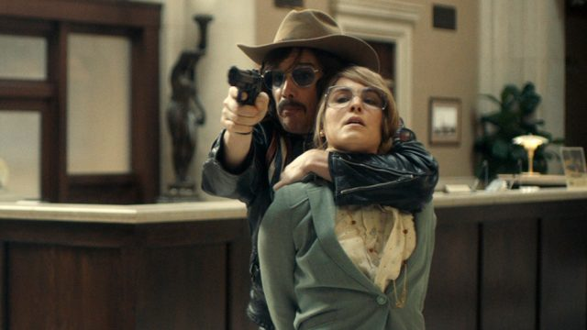
The Ruthlessness of God
Question
(1) Could some of the negative things in your life be allowed by God to nudge you in a different direction?
Notes:
God takes credit for raising up these enemies but you can also see how Solomon was also culpable for this. (We’ll see this time and again in Kings – God works within our foolish decisions to bring correction but He is sovereign, He shows He is still working)
1 Kings 11:39 And I will afflict the offspring of David because of this, but not forever.
God means business. He is a jealous God. Ruthless pursuit of what He wants (i.e. us). He rolled up his sleeves and disciplined the house of David. But if he gave Solomon & co what they deserved they would have been obliterated.
Terrifying! God declares war on whatever seeks to draw us away from Him. Best not to be in close proximity to the obstruction that God is about to destroy
God still ruthlessly pursues what he wants
And what He wants is us but we have given ourselves over to other ‘abusive-lovers’
Illustration: Hostage scenario - sin holding me but I’m also holding sin. Jesus can’t ‘take the shot’ without risking hitting me. He lays down His gun. Allows sin to leave me and come towards Him, He takes sin down by letting it enter Him. He rises from the dead but sin doesn’t.
[2 guns, 3 volunteers]
Ruthless right to the end = Jesus on the cross
God declares war on anything that keeps me from Him
Question – (1) Could it be the suffering you are currently facing is being used by a ruthless, jealous God determined to bring you back to where you belong (i.e. in relationship with Him)?

Slide 8
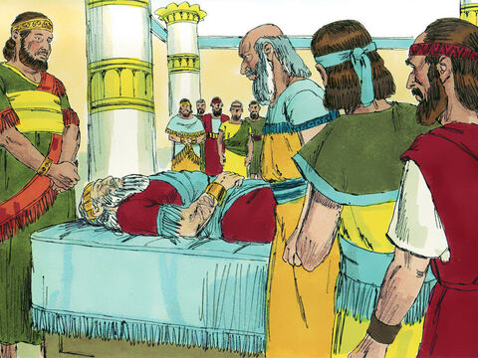
1 Kings 11:41-43
Now the rest of the acts of Solomon, and all that he did, and his wisdom, are they not written in the Book of the Acts of Solomon? And the time that Solomon reigned in Jerusalem over all Israel was forty years. And Solomon slept with his fathers and was buried in the city of David his father. And Rehoboam his son reigned in his place.
Notes:
Solomon died
He left a kingdom of incredible wealth but cracks appearing and a fed-up people
Solomon leaves no insight or advice for his son Rehoboam

Slide 9
So, what angered God?

Slide 10
1 Kings 11:9
The Lord became angry with Solomon because his heart had turned away from the Lord, the God of Israel, who had appeared to him twice.

Slide 11
(2) A stubborn, divided heart

Slide 12
(a) Ignore warning at your own peril
As a dog returns to its vomit, so fools repeat their folly.
(Prv 26:11)
Question
(2) Is there a warning you are yet to heed?
Notes:
Prv 26:11 As a dog returns to its vomit, so fools repeat their folly.
How often have we been warned/received revelation/given a choice - when we turn away from that warning we fall hard
Question
(2) Is there a warning you are yet to heed? – let’s heed it today!
- sins of omission / commission

Slide 13
(b) A turned heart
Heart = decision making (not merely emotions)
God sought “a man after his own heart” (1 Sam 13:14)
  Not about perfection but love for God
  Have doubts/fears/anger but addresses pain to God
  God is the prize, not just His gifts
  God not just a part, He is the whole
Solomon’s heart was the heart of the problems – led to symptoms (e.g. foreign wives, idols)
Repentance is a gift – heart disease is a great diagnosis!
Notes:
Heart = not just emotion (Western) but in biblical imagination = decision making
Heart not fully devoted - leaves us vulnerable to all compromises
Devoted Heart = David had devoted heart (not about perfection), when angry/scare/upset with God he addresses his pain to God, David knew where his ‘home’ was, prodigal son, seek first the kingdom - love for God that causes one to put what He wants first. Relational more than legal issue - Not just concerned about breaking the law but breaking His heart. Not about what can I ‘get away with’ but how to delight
God is an important part - but He is just a part
God isn’t His treasure
Heart was divided = cause/cancer
The wives = symptom
If you are deceived about the corruption of your heart you are in grave danger but the heart is deceptive - I need Him to search me
Response: God change my heart, recognise my heart is corrupt and I can’t fix it
Gift of repentance – great news, a diagnosed heart disease means there is a way out cus god specialises in transplants

Slide 14
So, what turned Solomon’s heart?

Slide 15
1 Kings 11:1-8
Now King Solomon loved many foreign women, along with the daughter of Pharaoh: Moabite, Ammonite, Edomite, Sidonian, and Hittite women, from the nations concerning which the Lord had said to the people of Israel, “You shall not enter into marriage with them, neither shall they with you, for surely they will turn away your heart after their gods.” Solomon clung to these in love. He had 700 wives, who were princesses, and 300 concubines. And his wives turned away his heart. For when Solomon was old his wives turned away his heart after other gods, and his heart was not wholly true to the Lord his God, as was the heart of David his father. For Solomon went after Ashtoreth the goddess of the Sidonians, and after Milcom the abomination of the Ammonites. So Solomon did what was evil in the sight of the Lord and did not wholly follow the Lord, as David his father had done. Then Solomon built a high place for Chemosh the abomination of Moab, and for Molech the abomination of the Ammonites, on the mountain east of Jerusalem. And so he did for all his foreign wives, who made offerings and sacrificed to their gods.

Slide 16
(3) What are you clinging to?

Slide 17
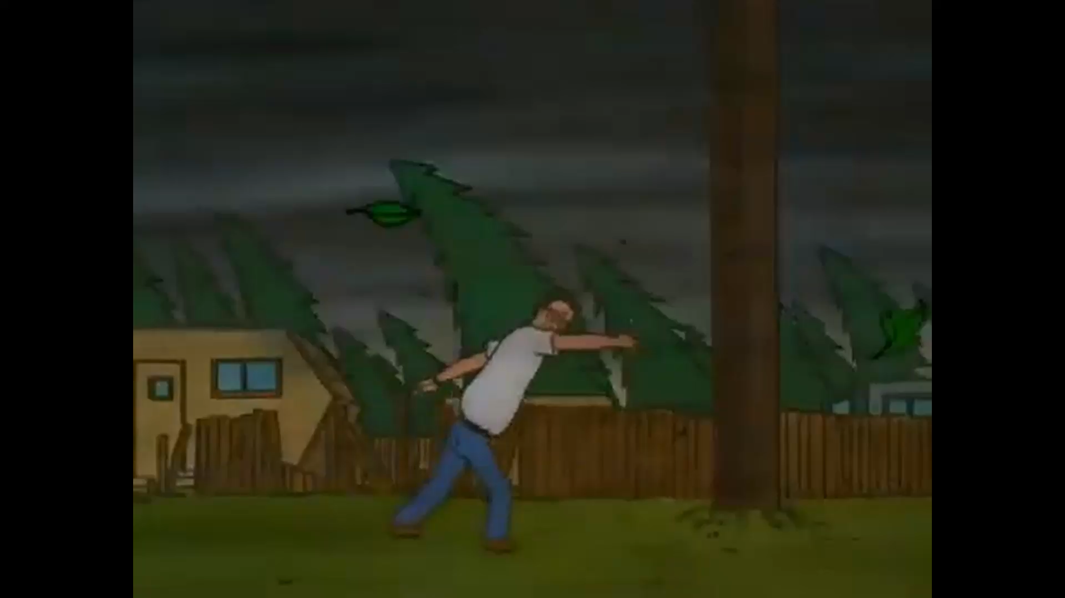
“Clung”
Notes:
Clung/held fast (NAS)
The word ‘clung’ infers a depth of feeling.
Solomon hadn’t just taken these wives in a political move to strengthen Israel (1 kings 3:1) – he was emotionally, physically, psychologically, spiritual invested.
You cling to something which you think will provide you refuge/safety in a storm
King of the Hill
What do you reach for when storms come into your life? (Even when you are about to lose your trousers) What makes you feel safe or that your life is meaningful?

Slide 18
God wants us to “cling” to Him
Psalms 63:8 NIV
  I cling to you; your right hand upholds me.
Ps 119:31
  I cling to your testimonies, O LORD; let me not be put to shame!
Ps 91:14
  “Because he holds fast [DELIGHTS] to me in love, I will deliver him; I will protect him, because he knows my name.
Notes:
God wants to be the one we cling to…
Psalms 63:8 NIV
I cling to you; your right hand upholds me.
Ps 119:31
I cling to your testimonies, O LORD; let me not be put to shame! (ESV)
Ps 91:14 (ESV)
“Because he holds fast [DELIGHTS] to me in love, I will deliver him; I will protect him, because he knows my name.
Remember Jeremy’s point – Solomon fulfilled David’s plan but not his purpose. We see Solomon didn’t delight in God.
Solomon didn’t give his heart to God, therefore it was vulnerable to be taken by something/one else
If I don’t delight in God, if I don’t cling to Him – I am engaging in idol worship!

Slide 19
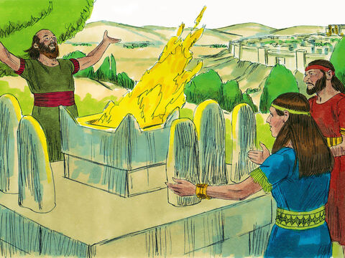
Idol worship
Idol = a good thing that has become the ultimate thing
Notes:
Tim Keller – great stuff in counterfeit gods

Slide 20
Our culture is filled with idols
Shrines
Sacrifices
Gods
Office towers
Spas
Gyms
Unis
Studios
Stadiums
Must be made to secure blessings or ward off disaster
Beauty
Power
Money
Achievement
Self-actualisation
Family
Reputation
Comfort
Noble cause
Romantic relationship
Virtue
Health
Ministry
Helping others
Notes:
Culture Filled with Idols
Each has its own priesthoods
Shines, Sacrifices, Gods
Might not kneel before Aphrodite but young women driven into depression/eating disorders by body image
Not burn incense to Artemis but neglect family (child sacrifice) to achieve higher place in business
Anything Can Be an Idol
Field army officer – so pursued physical discipline he broke morale of troops
Woman who had experienced poverty overlooked good relationships for those with financial security
Baseball player – took steroids and broke body in quest to make Hall of Fame

Slide 21
Identifying Idols
Idol = anything more important to you than God
Anything you seek to give you what only God can give
If you lose it, will make life feel hardly worth living
Spend resource (thinking, energy, emotion, financial) without second thought.
What makes us uncontrollably angry, anxious, despondent, guilty?
For what ‘object’ would we be tempted to violate values?
Notes:
Idol = anything more important to you than God
Anything you seek to give you what only God can give
If you lose it, will make life feel hardly worth living
Spend resource (thinking, energy, emotion, financial) without second thought.
your money (resources) flow effortlessly toward heart’s greatest desire
What makes us uncontrollably angry, anxious, despondent, guilty?
Fishermen know to look for fish where the water is roiling, look for your idols at bottom of most painful emotions
For what ‘object’ would we be tempted to violate values?
We would not lie unless we first had made something - human approval, reputation, power over others, financial advantage - more important and valuable to our hearts than the grace and favour of God.
Many things we call “psychological problems” are issues of idolatry – perfectionism, workaholism, indecisiveness, need to control others

Slide 22
What idolatry sounds like…
“I’ve worked all my life to get to this place in my career, and now it’s all gone!”
“If I only had ___ then I would be satisfied”
“I’ve slaved my whole life to give that girl a good life, and this is how she repays me!”
“I will trust God if…”
“I know God forgives me, but I can’t forgive myself”
“Let me just get my ducks in a row then I can….”
“God, I trusted You but…”
Notes:
“I’ve worked all my life to get to this place in my career, and now it’s all gone!”
“I’ve slaved my whole life to give that girl a good life, and this is how she repays me!”
“If I only had _____ then I would be satisfied”
“I know God forgives me, but I can’t forgive myself” – means I have failed an idol whose approval is more important than God’s
“Let me just get my ducks in a row then I can….”
“God, I trusted you but…”
“I will trust God if…” – the ‘if’ is therefore the ultimate thing. (God is a means to an end, He is a way to reach the thing in which you delight, He isn’t your delight in and of Himself)
Need to keep appeasing with sacrifices
When has an idol loved or forgiven you?
Counterfeit gods always disappoint, and often destructively so.

Slide 23
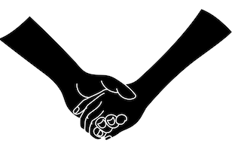
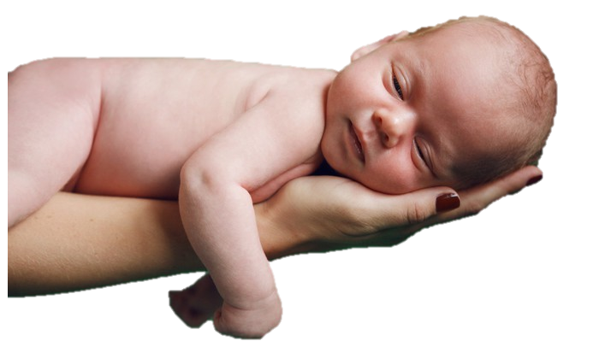
Letting go of my idols
For I, the Lord your God, hold your right hand; it is I who say to you, “Fear not, I am the one who helps you.” (Isa 41:13)
My Father, who has given them to me, is greater than all, and no one is able to snatch them out of the Father's hand. (John 10:29)
Notes:
You actually change what you cling to
and more importantly it is about Who now clings to you
Isaiah 41:13 ESV
For I, the Lord your God, hold your right hand; it is I who say to you, “Fear not, I am the one who helps you.”
John 10:29 ESV
My Father, who has given them to me, is greater than all, and no one is able to snatch them out of the Father's hand.
Revelation that - He clung to me! He forsook heaven, unity with father, life itself to cling to us

Slide 24
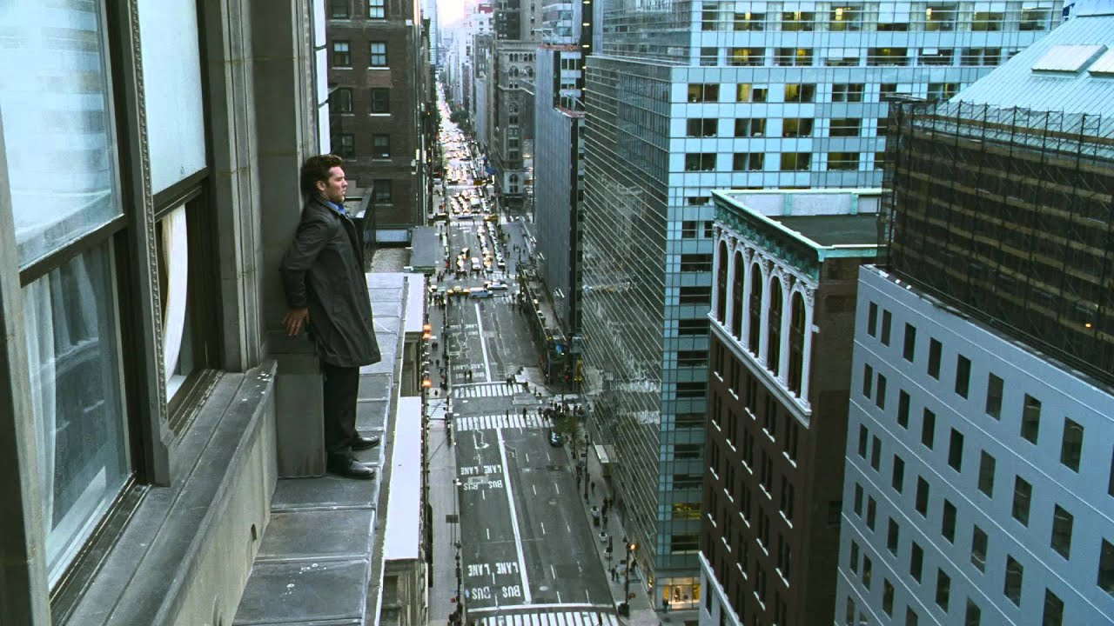
Notes:
This is what it feels like to let go of idols
Illustration: Let go of your handle
Fall into His arms -
[handle, table, catchers]
…switch what you cling to (trusting Him to cling to you)

Slide 25
“You have made us for Yourself, O Lord, and our heart is restless until it rests in You.”
- Saint Augustine
Question
(3) What do you need to let go of in order to cling to the One who has clung to you?
Notes:
Every human being must live for something. Unless the HS intervenes that object will never be God.
(Not about trying harder)
Jesus must become more beautiful to your imagination, more attractive to your heart, than your idol
Rejoicing and repentance must go together.
Question
(3) What do you need to let go of in order to cling to the One who has clung to you?

Slide 26
Nothing I Hold Onto
I lean not on my own understanding My life is in the hands of the Maker of heaven
I give it all to You God trusting that you'll make something beautiful out of me
There's nothing I hold on to
Notes:
Song: I lean not on to my understanding
Who did He say He is? I need to meditate on His Word (scripture and personally)
I need to reckon with who He says He is
I need to discover what He says about Himself
I need to decide to believe – belief = willing to build on this reality

Slide 27
Response
I need to see You afresh
I need to respond according to who I know You to be
  Could some of the negative things in your life be allowed by God to nudge you in a different direction?
  Is there a warning you are yet to heed?
  What do you need to let go of in order to cling to the One who has clung to you?

