Slide 1
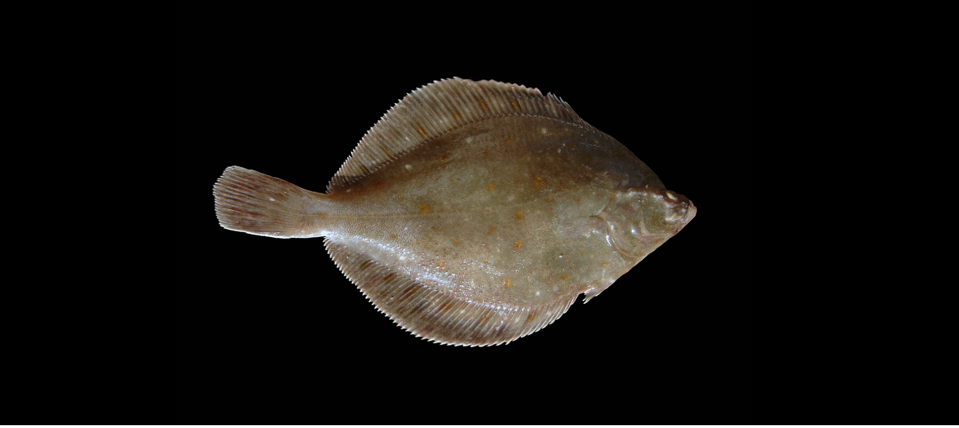

Slide 2
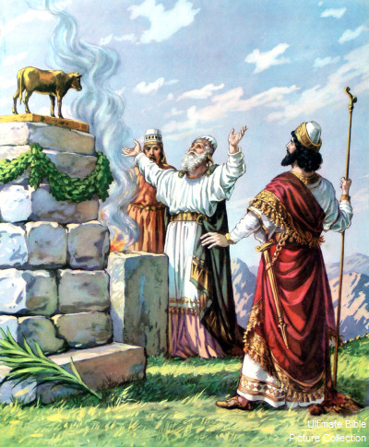
1 Kings 13

Slide 3
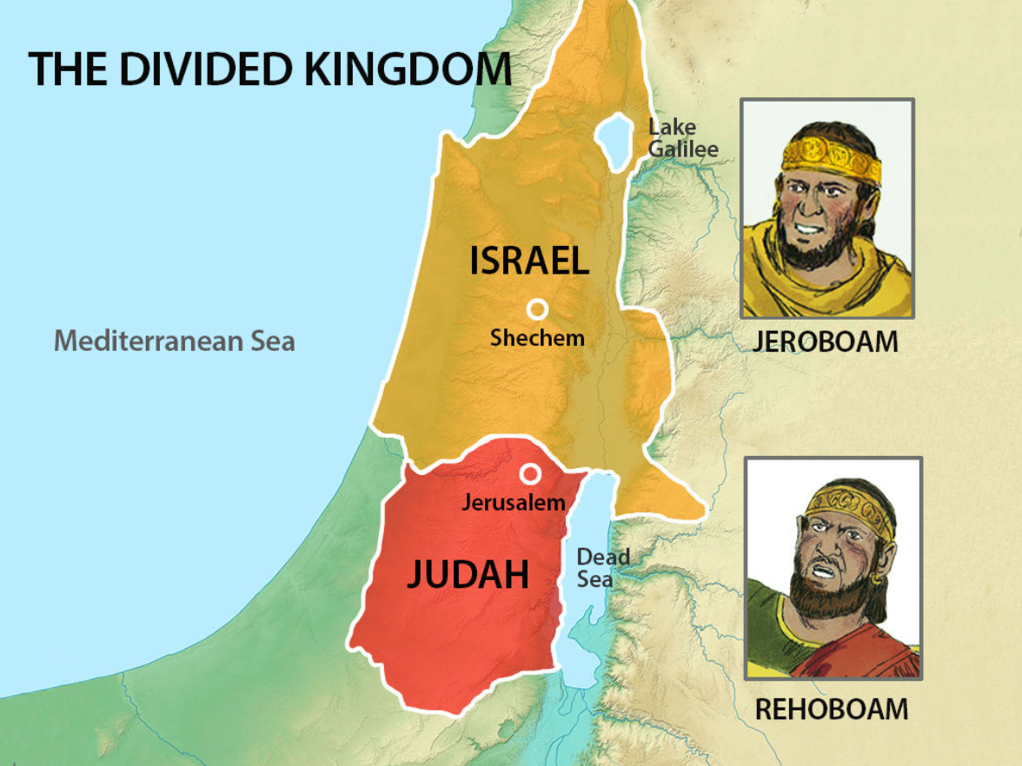
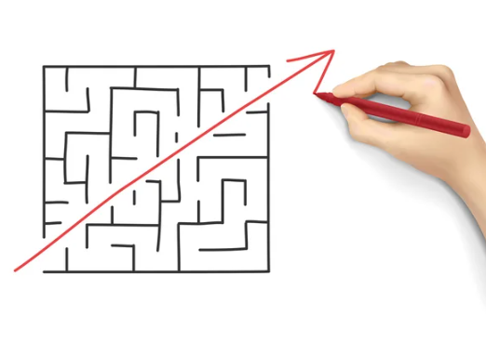
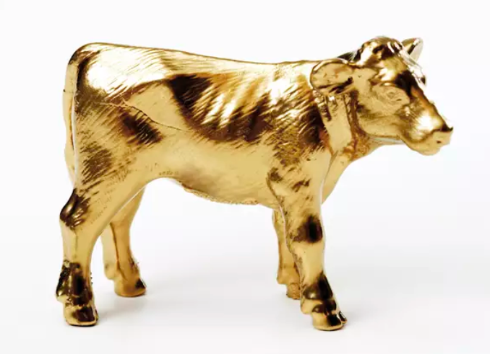
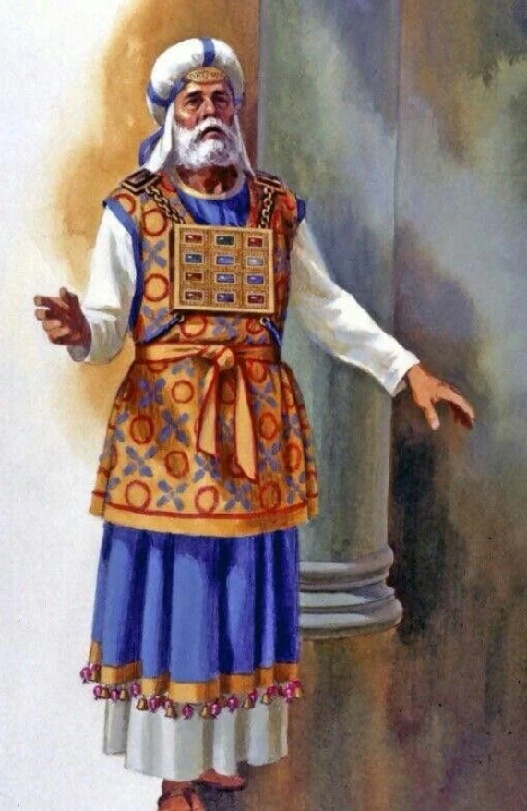

Slide 4
“Any who would he ordained to be priests of the high places...”
- 1 Kings 13.32

Slide 5
TRUTH
God speaks to us, and as long as God is speaking there is hope

Slide 6
“Josiah was eight years old when he began to reign ... and walked in all the way of David his father, and did not turn aside to the right or to the left...”
- 2 Kings 22.1,2

Slide 7
“My sheep hear my voice, and I know them, and they follow me”
- 1 John 10.27

Slide 8
“No longer will they teach their neighbour, or say to one another, ‘Know the Lord, because they will all know me, from the least of them to the greatest...”
- Jeremiah 31.24

Slide 9
Q. Is God reminding me of something He’s spoken?
Q. Do I want to hear his hope-giving voice?

Slide 10
WARNING
We can miss God speaking to us

Slide 11
“I will take you, and you shall reign over all that your soul desires, and you shall be King over Israel.”
- 1 Kings 11.37

Slide 12
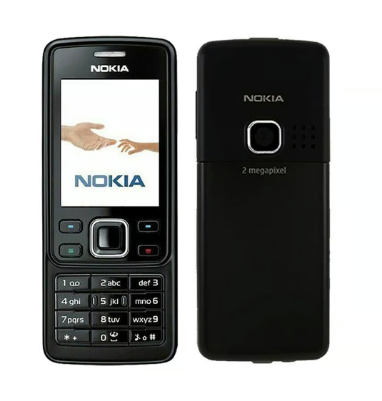

Slide 13
1. We miss the value of the people God has placed in our lives

Slide 14
“He appointed priests from among the people who were not of the Levites.”
- 1 Kings 12.31

Slide 15
“...but we have the mind of Christ.”
- 1 Corinthians 2.16

Slide 16
“Plans fail for lack of counsel, but with many advisers they succeed.”
- Proverbs 15.22

Slide 17
Q. Who has God placed in my life at this time?

Slide 18
2. Something other than God has captured our heart

Slide 19
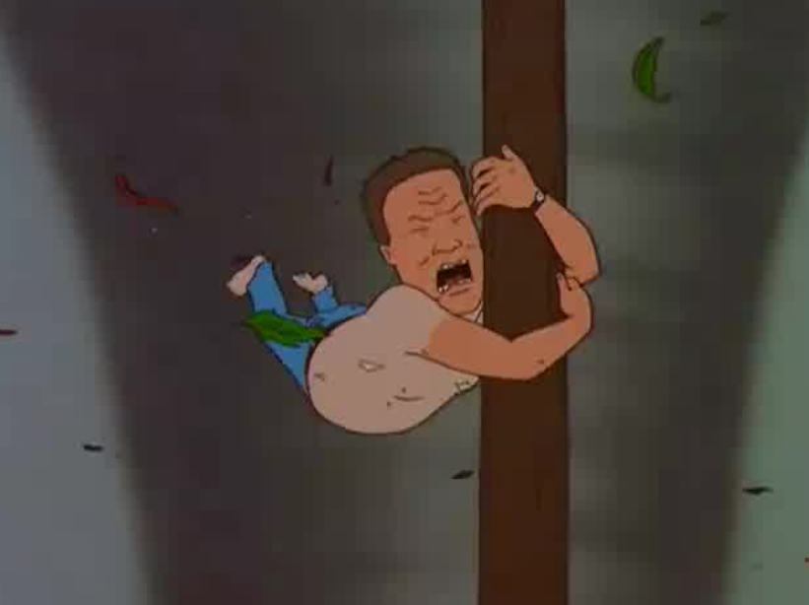
1. Something we cling to in a storm...
2. A good thing that has become the ultimate thing...
Beauty
Power
Money
Achievement
Self-actualisation
Family
Reputation
Comfort
Noble causes
Romantic relationships
Virtue
Health
Ministry
Helping others

Slide 20
I confused my feelings (preference) for His word (conviction)

Slide 21
Q. Is there something I’m treasuring that’s in the way of me hearing God?
Q. Am I confusing my feelings (preference) for His word (conviction)?

Slide 22
PROMISE
He passionately pursues us

Slide 23
“For to us a child is born, to us a son is given; and the government shall be upon his shoulder, and his name shall be called, Wonderful Counsellor, Mighty God, Everlasting Father, Prince of Peace. Of the increase of his government and of peace there shall be no end, on the throne of David and over his kingdom, to establish it and to uphold it with justice and righteousness from this time forth and forevermore. The zeal of the Lord of hosts will do this.”
- Isaiah 9.6-7

Slide 24
INVITATION
Will we trust His leadership?

Slide 25
1. I desire to hear His life-giving, hope-giving voice.
2. I want to draw deeper into the community God has placed around me.
3. I want to surrender to the King who gave Himself for me.

