Slide 1
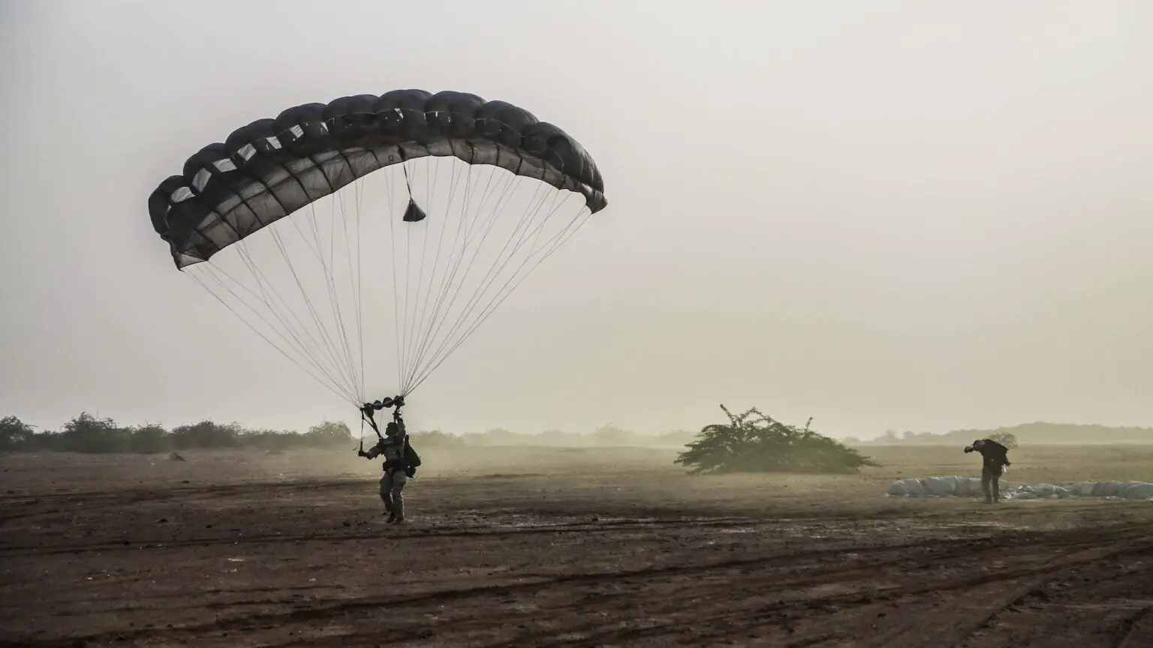
The Kings Series - Episode 16
28th Jan 2024

Slide 2
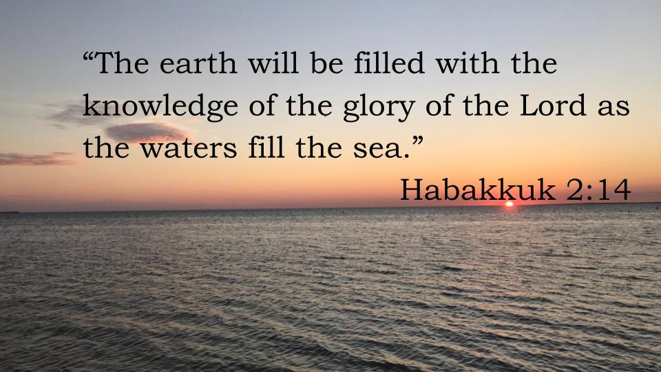
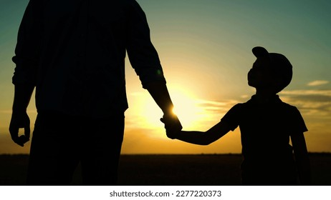
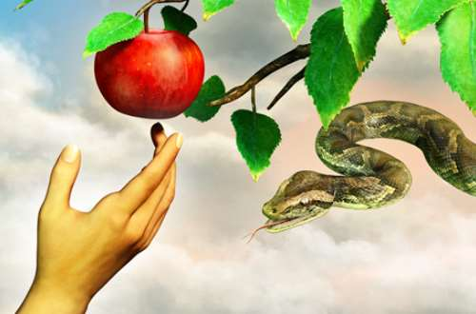
The Story So Far…
Notes:
God created everything to reveal what He is like
Out of His love He created mankind and invited us into close relationship with Him – He created us like Him and let us experience what He is like so we could join Him in His plans to fill the earth with His likeness
But mankind rebelled and decided they wanted to create a world about ourself

Slide 3
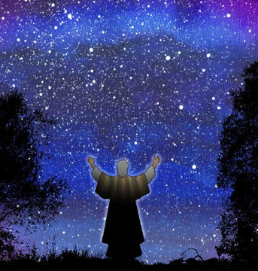
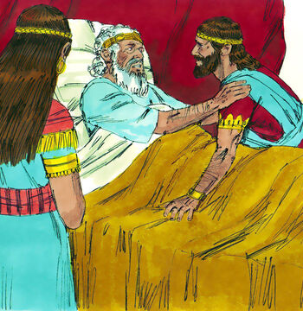
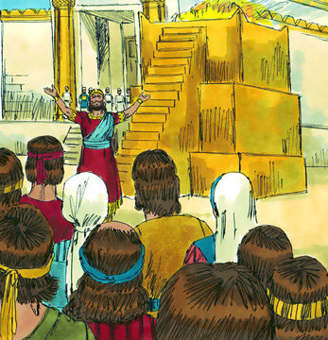
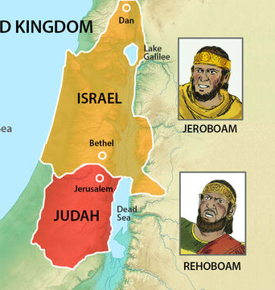
The Story So Far…
Notes:
God selected one man, Abraham and promised to make a nation from his descendants (Israel) through whom God would reunite Himself with the world
By the beginning of 1 Kings the current king of Israel David hands the kingdom over to his son, Solomon
Solomon oversees the golden period of the country (builds the temple) but his devotion to God is half-heart
By the time he his son, Rehoboam, takes over the kingdom is riddled with false gods and Reho has no interest in serving God
This leads to the kingdom being split – Israel to the north (representing 10 tribes) and Judah to the south, led by David’s family, (representing 2 tribes)

Slide 4
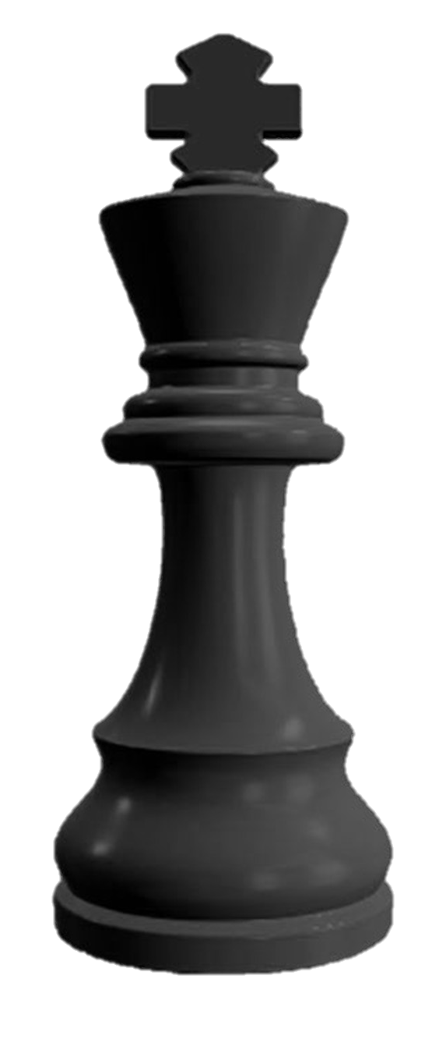
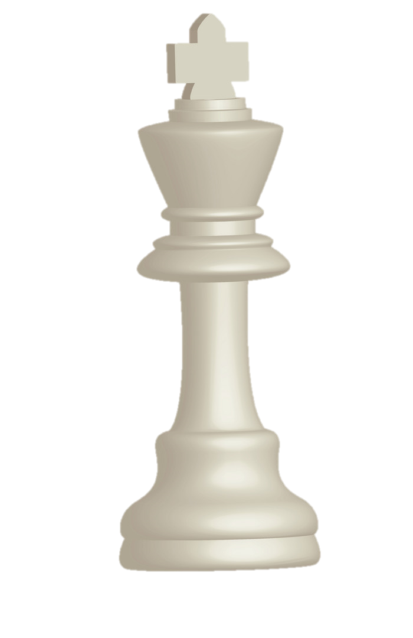
North
Jeroboam
Nadab
Baasha
Elah
Zimri
Omri
Ahab
South
Rehoboam
Adijah
Asa
Notes:
We are skipping chapters 15 and 16
North – Jeroboam succeeded by Nadab (son), Coup Baasha, succeeded by Elah (son), Coup Zimri, Coup Omri, Ahab (son)
South – Rehoboam succeeded by Adijah (son), succeeded by Asa (son),

Slide 5
1 Kings 17:1-6
Elijah the Tishbite, from Tishbe in Gilead, said to Ahab, “As the Lord, the God of Israel, lives, whom I serve, there will be neither dew nor rain in the next few years except at my word.”
Then the word of the Lord came to Elijah: “Leave here, turn eastward and hide in the Kerith Ravine, east of the Jordan. You will drink from the brook, and I have directed the ravens to supply you with food there.”
So he did what the Lord had told him. He went to the Kerith Ravine, east of the Jordan, and stayed there. The ravens brought him bread and meat in the morning and bread and meat in the evening, and he drank from the brook.

Slide 6
(1) Darker the night, brighter the light
Dire situation
Ahab in power
  did more evil in the eyes of the Lord than any of those before him
  commit the sins of Jeroboam
  Married Jezebel (Sidon) brings her gods (Baal) with her
  did more to arouse the anger of the Lord, the God of Israel, than did all the kings of Israel before him.
  Was the leader in power when Hiel of Bethel rebuilt Jericho at cost of two of his sons

Slide 7
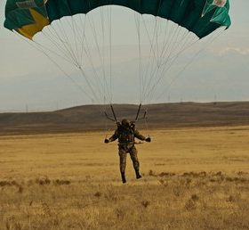
So sad was the character both of the princes and people of Israel, as described in the foregoing chapter, that one might have expected God would cast off a people that had so cast him off; but, as an evidence to the contrary, never was Israel so blessed with a good prophet as when it was so plagued with a bad king.
- Matthew Henry
(Bible Commentator)
Notes:
It was in this darkness that God sent Elijah

Slide 8
Isa 7:14
…and will call Him Immanuel.
Ps 16:8
I keep my eyes always on the LORD. With him at my right hand, I will not be shaken.
Ps 23:4 Even though I walk through the valley of the shadow of death, I fear no evil, for You are with me
Deu 31:6
…the Lord your God goes with you; he will never leave you nor forsake you
Ps 139:7-10
Where can I go from your Spirit?
Where can I flee from your presence?
If I go up to the heavens, you are there; if I make my bed in the depths, you are there.
If I rise on the wings of the dawn, if I settle on the far side of the sea,
even there your hand will guide me, your right hand will hold me fast.
Matt 28:20
…And surely I am with you always, to the very end of the age.”
Isa 41:10 Fear not, for I am with you; be not dismayed, for I am your God; I will strengthen you, I will help you, I will uphold you with my righteous right hand.
Notes:
God is commitment to us, to never leave or forsake us, no matter the mess we choose. He keeps sending His love, in this time via the prophet Elijah, but eventually He rolls up His sleeves and sends His Son.
Isa 9:2 The people walking in darkness have seen a great light; on those living in the land of deep darkness a light has dawned.
And now He packs you with His Holy Spirit and send you into a desperate, dying world.
“Man! this place is so messed up!” – Yes, other wise He would send you somewhere else!
If you want comfort you have signed up to advanced the wrong kingdom, you have committed to present the wrong king (one who loved the world to the point He laid down His life for it!)

Slide 9
Questions
(1) Do you want to know He is with you?
(2) Will you accept that He has sent you to be His light in dark places?
(3) How might this affect how you think/act?
Notes:
Question
Do you want to know He is with you?
Will you accept that He has sent you to be His light in dark places? How might this affect how you think/act?

Slide 10
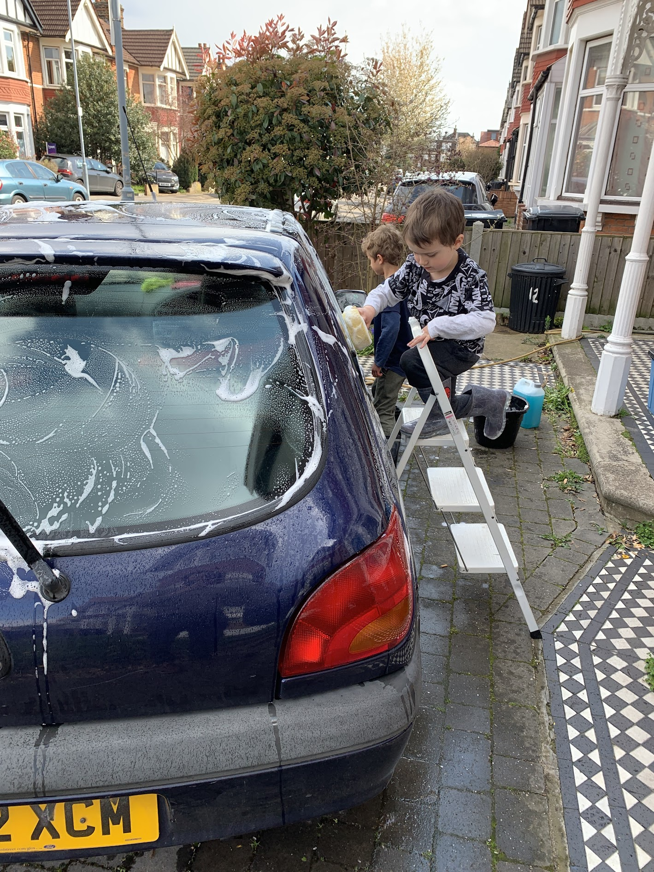

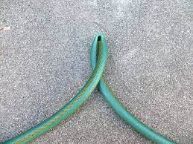
Notes:
Declares drought – as He had promised
Deut 11:17
Then the Lord’s anger will burn against you, and he will shut up the heavens so that it will not rain and the ground will yield no produce, and you will soon perish from the good land the Lord is giving you.
e.g. Washing car with William and Arthur. They start using hose on each other and not listening and soaking other cars and passers-by – I turn off the water. They protest but then I can get their attention and reestablish them in the correct order. I want to work with them because I love them.

Slide 11
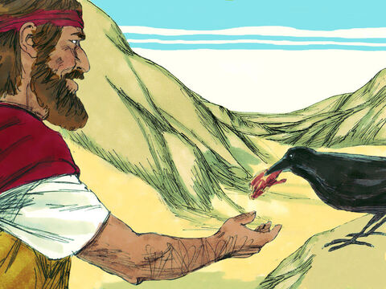

Notes:
When you know He is your Father, He is your provider (don’t need hauled)
If Elijah had planned, he wouldn’t have come up with this idea
UberEATS (ravens forgo their meat!)
Elijah danger make brook the source but when it dries he doesn’t panic
Opportunity for God to take further on journey
Terror to adventure if you know the guy behind the wheel
Need to know difference between source and channel

Slide 12
(2) Source & Channel

Slide 13
Source = God
Friends & family
Channels
Cost Cutting
Tax rebate
Wage
Raise
Ravens
Needed resource
Resource
Notes:
Need to be clear about difference between Source and Channel
God is the source and He gets resources to us via various channels
We need wisdom to put our bucket under the correct channel to catch the resource
e.g. Baltazar – tax rebate

Slide 14
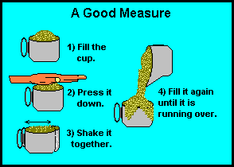
Notes:
Your lovely, heavenly father knows what you need (which resource you lack). He is willing and able to meet your need. Don’t act like He doesn’t know, don’t care or is unable to meet your need.
But because you know and believe He has you safe in the palm of His hand, it frees you up to give your attention to what He asks of you (i.e. seek first the kingdom, give your last flour to stranger)
Knowing the Source
“Which of you, if your son asks for bread, will give him a stone? Or if he asks for a fish, will give him a snake? If you, then, though you are evil, know how to give good gifts to your children, how much more will your Father in heaven give good gifts to those who ask him! - Matt 7:9-11
So do not worry, saying, ‘What shall we eat?’ or ‘What shall we drink?’ or ‘What shall we wear?’ For the pagans run after all these things, and your heavenly Father knows that you need them. But seek first his kingdom and his righteousness, and all these things will be given to you as well. - Matt 6:31-33
…your Father knows what you need before you ask him - Matt 6:8

Slide 15
1 Kings 17:7-16
Some time later the brook dried up because there had been no rain in the land. Then the word of the Lord came to him: “Go at once to Zarephath in the region of Sidon and stay there. I have directed a widow there to supply you with food.” So he went to Zarephath. When he came to the town gate, a widow was there gathering sticks. He called to her and asked, “Would you bring me a little water in a jar so I may have a drink?” As she was going to get it, he called, “And bring me, please, a piece of bread.”
“As surely as the Lord your God lives,” she replied, “I don’t have any bread—only a handful of flour in a jar and a little olive oil in a jug. I am gathering a few sticks to take home and make a meal for myself and my son, that we may eat it—and die.”

Slide 16
1 Kings 17:7-16
Elijah said to her, “Don’t be afraid. Go home and do as you have said. But first make a small loaf of bread for me from what you have and bring it to me, and then make something for yourself and your son. For this is what the Lord, the God of Israel, says: ‘The jar of flour will not be used up and the jug of oil will not run dry until the day the Lord sends rain on the land.’”
She went away and did as Elijah had told her. So there was food every day for Elijah and for the woman and her family. For the jar of flour was not used up and the jug of oil did not run dry, in keeping with the word of the Lord spoken by Elijah.

Slide 17
(3) A miraculous God (working behind the scenes)
Verse 8
Then the word of the Lord came to him: “Go at once to Zarephath in the region of Sidon and stay there. I have directed a widow there to supply you with food.”
Verse 7
Some time later the brook dried up because there had been no rain in the land.
Notes:
How would you feel between verse 7 & 8? Anxious, panic, adventure
Dawn – logbook of God’s miraculous provision, served its purpose
Sent to Sidon with His God
God has sent me here to a widow who will feed you – when she says she doesn’t have resources
Make assessment based on what God has required rather than what I think I can manage
I can’t see how I can afford to tithe, but God commands it so I start with what pleases Him and trust He knows and can meet your needs (He is willing and able).
“I have commanded” – but she has no idea but yet she found it in her heart
Didn’t have the command in your head/ear, but had it in her heart (Follow from nudge beyond rational thinking)

Slide 18
Miracles
Asks for water in a drought
She was a widow – had own hardship
Ask by Jew and she was a gentile
FIRST give to me (before your son)
Notes:
Yet she was willing to respond
Then Elijah ups the stakes
Only had enough for her and child but told to FIRST give to Elijah
Give of first fruits
Trust in God’s provision
Obvious God is behind this – totally unreasonable
Do not fear – released a power of peace
Not her God (yet)
God flicks the switch of the channel He uses – miracle flour until rain starts

Slide 19
1 Kings 17:17-24
Some time later the son of the woman who owned the house became ill. He grew worse and worse, and finally stopped breathing. She said to Elijah, “What do you have against me, man of God? Did you come to remind me of my sin and kill my son?”
“Give me your son,” Elijah replied. He took him from her arms, carried him to the upper room where he was staying, and laid him on his bed. Then he cried out to the Lord, “Lord my God, have you brought tragedy even on this widow I am staying with, by causing her son to die?” Then he stretched himself out on the boy three times and cried out to the Lord, “Lord my God, let this boy’s life return to him!”

Slide 20
1 Kings 17:17-24
The Lord heard Elijah’s cry, and the boy’s life returned to him, and he lived. Elijah picked up the child and carried him down from the room into the house. He gave him to his mother and said, “Look, your son is alive!”
Then the woman said to Elijah, “Now I know that you are a man of God and that the word of the Lord from your mouth is the truth.”

Slide 21
(4) Tragedy, not for nothing
Tragedy is real (Heb 4:15)
Address your complaint correctly (Ps 13)
God works good through tragedy (Rom 8:28)
We can still serve our purpose during tragedy (John 9:1-3)
Notes:
Does God cause tragedy, or does he work within tragedy?
Tragedy is real
The woman has no husband. The death of her son will be the end of her - no way to be provided for.
He empathises with our weakness (Heb 4:15)
(2) Address complaint correctly
‘What do you have against me?’ aimed at Elijah.
Elijah then asks God what’s going on - aimed at God
Elijah not need to defend God but asked Him about it (address complaint to right person – keep speaking to Him about it – Psalms)
Psalm 13.
How long, Lord? Will you forget me forever?
How long will you hide your face from me?
How long must I wrestle with my thoughts
and day after day have sorrow in my heart?
How long will my enemy triumph over me?
Look on me and answer, Lord my God.
Give light to my eyes, or I will sleep in death,
and my enemy will say, “I have overcome him,”
and my foes will rejoice when I fall.
But I trust in your unfailing love;
my heart rejoices in your salvation.
I will sing the Lord’s praise,
for he has been good to me.
(3) God works good through tragedy
And we know that in all things God works for the good of those who love him, who have been called according to his purpose. Rom 8:28
(4) We can still serve our purpose during tragedy

Slide 22
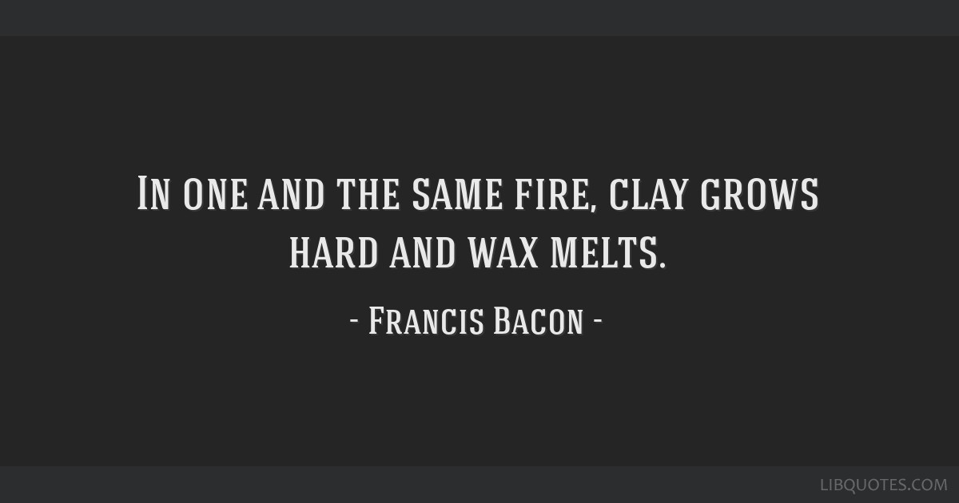
Notes:
No guarantee adverse conditions will soften and improve my character
The key thing is that I turn to Him in such times and ask that He will be glorified
Whether we face tragedy or not. Whether we know why we face tragedy or not. None of these scenarios detract from our purpose – to display God’s glory
Am I in this for the removal of pain, or for the glorification of God?

Slide 23
Fiqeret’s Story
Priority to glorified God meant he grew from the experience
  Anxiety relief
  More committed to integrity
God was the source
He used a variety of channels
Notes:
You became a Christian a few years ago and you did the Doulos Course. You were taught that God has and loves integrity (honesty and transparency). What was your reaction to this teaching?
Felt convicted
Quit well paying job to shock and unbelief of colleagues
You quit this job in October, how did things work out for you?
Apart from a few days work I had no regular work or prospect of work
By December savings whittling down
I was anxious (e.g. Turning off lights)
During this time
Fraud on account
Car broke down
How did you feel?
Wondering if I’d made wrong decision but still knew God wants integrity
Ex colleagues offer chance to return – Tempting (financial security was a huge pull)
But as you were faithful to God, God proved Himself faithful to you
Brother drove from Luton to fix the part
On 15th dec Gordon Brewer prayed for work (I wasn’t expecting because construction industry slows down near Christmas)
By end of the day - 3 offers for work
Job I took, I was the only worker kept on right to Christmas eve and given Christmas bonus
What did this show you of God?
I’ve never had to be anxious about money since

Slide 24
Questions
(4) Do you want to know the closeness of God in your current challenge?
(5) Are you willing to make goal of this challenge about His glory over your deliverance from pain?

Slide 25
Response
(1) Do you want to know He is with you (especially in your trials)?
(2) Will you accept that He has sent you to be His light in dark places?
(3) Are you willing to make goal of this challenge about His glory over your deliverance from pain?

