Slide 1
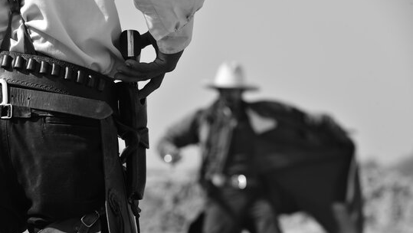
The Kings Series - Episode 17
4th Feb 2024

Slide 2
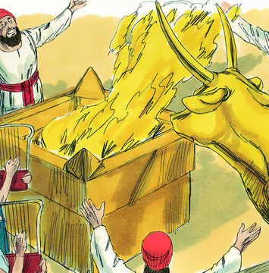
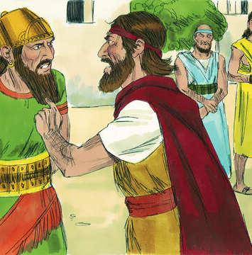
Notes:
Ahab = King of Israel
Along with wife, Jezebel, promoted Baal worship and sought to crush God’s prophets
Elijah sent to confront Ahab and declare famine

Slide 3
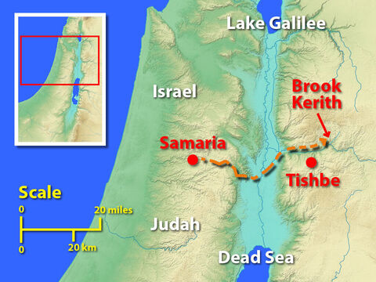
Notes:
After confronting Ahab in the capital, Samaria, God sends Elijah to Kerith

Slide 4
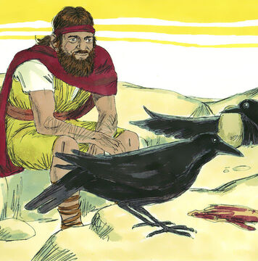
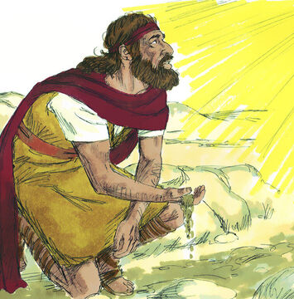
Notes:
There he drinks from a brook and fed by ravens
Until day it dries up

Slide 5
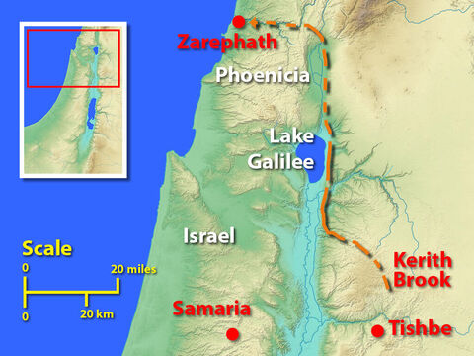
Notes:
Sent to Sidon where God had commanded a widow to feed him

Slide 6
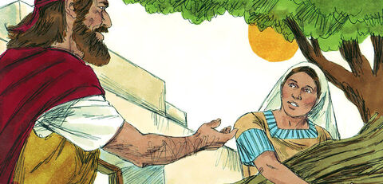
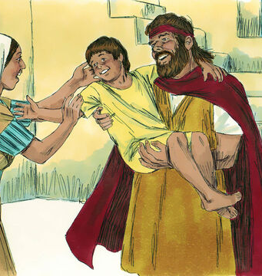
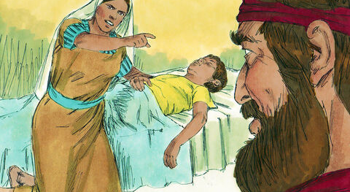
Notes:
Meets widow collecting wood – she agrees to take him in and God meets her need with miraculous supply of flour/oil
But whilst staying there the widows boy dies
God, through Elijah, brings him back to life
Chpt 18
Elijah comes out of hiding - if he had not known before, he found out talking to Obadiah that he is a wanted man!
Doesn’t seems anxious
Really buzzing - seen some amazing things (ravens, magic flour, boy raised from the dead)
Come out of hiding - needs to know God’s mind and His moment

Slide 7
1 Kings 18:16-21
So Obadiah went to meet Ahab and told him, and Ahab went to meet Elijah. When he saw Elijah, he said to him, “Is that you, you troubler of Israel?”
“I have not made trouble for Israel,” Elijah replied. “But you and your father’s family have. You have abandoned the Lord’s commands and have followed the Baals. Now summon the people from all over Israel to meet me on Mount Carmel. And bring the four hundred and fifty prophets of Baal and the four hundred prophets of Asherah, who eat at Jezebel’s table.”
So Ahab sent word throughout all Israel and assembled the prophets on Mount Carmel. Elijah went before the people and said, “How long will you waver between two opinions? If the Lord is God, follow him; but if Baal is God, follow him.”
But the people said nothing.

Slide 8
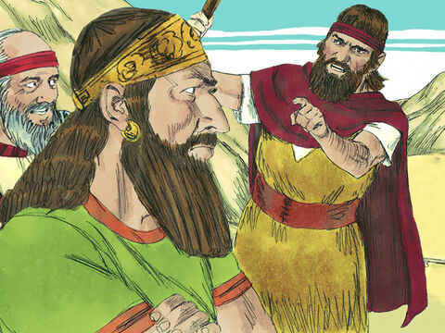
(1) Am I a Troubler?
I have not made trouble for Israel. But you and your father’s family have.
Is that you, you troubler of Israel?
Notes:
Why would Ahab accuse Elijah of being a ‘troubler’
Wouldn’t submit to the prevailing culture/ ‘get with the programme’ / ‘right side of history’
you rocked the boat
There is a very direct attack on God and His mouth pieces on earth
Jezebel (not Ahab) been killing prophets (v4)
Not just offering alternative but actively looking to silence

Slide 9
Intolerant
Judgmental
Exclusive
Notes:
Undermining today
Today we aren’t (currently) under physical threat for being followers of Christ. There isn’t a direct attack.
But it is subtle appeal to dilute our position/belief on the account of ‘tolerance’. Intolerance of faith groups (incl. Christians) has been the damaging to society and if you want to play a part in society leave you faith beliefs at home.
The is an effort to present followers of Christ in a certain kind of light
Judgmental
Uncompassionate
Exclusive
We can be intimidated by this accusation of being the troubler of society – backed into a corner and become apologetic and quiet
Not planning to address this here but if you are you interested post a question and we can take more time on this. But if I were to be clear like Elijah I would want to
Note the hypocrisy of these claims of intolerance
Our ‘tolerant’ society has produced an intolerant cancel culture – if you don’t subscribe to my way of thinking (around ‘tolerance’) you should no longer have a voice.
To conclude someone is judgmental, you must make a judgment
Exclusive – any type of association (formal or informal) has to have a basis for coming together and rules (written or unwritten) for how members are expected to participate.
I don’t get to play for my sons under 8s team
Those getting together to cross-stitch together, won’t appreciate me attending complaining its boring and trying to convince them to play Fortnite
No one leaves their beliefs at home
Our beliefs are answers to huge questions in life – what we think on these things affect everything we do
Why are we here?
What is right and wrong?
What is wrong with human race and how can it be fixed?
What should we be using time to doing?
Other beliefs are being fed to us every day
Discover who you are inside and assert that on the world – I’m just being true to myself!
My sexuality is my identity

Slide 10
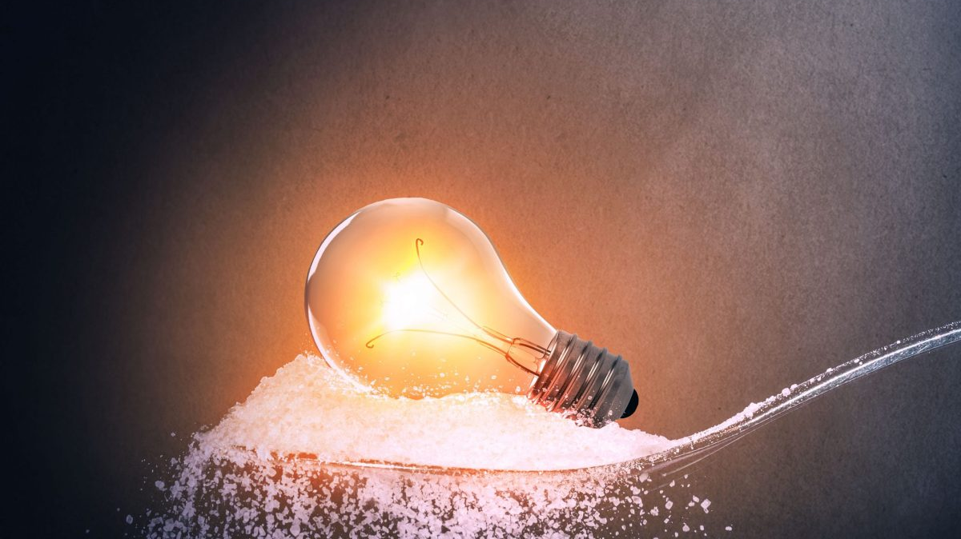
Notes:
Our job
We are not called to judge those outside the church, as that is for God to do. 1 Corinthians 5:9-13 - We aren’t protest movement
our ethics are different to that of the world
we are called to be out of step with the cultural norms around us– we need to be salty
To share good news of Jesus (by word and deed)
…Instead he is patient with you, not wanting anyone to perish, but everyone to come to repentance (1 Pet 3:9)
For God so loved the world that he gave his one and only Son, that whoever believes in him shall not perish but have eternal life. (John 3:16)
inviting others into the relationship we enjoy with God

Slide 11
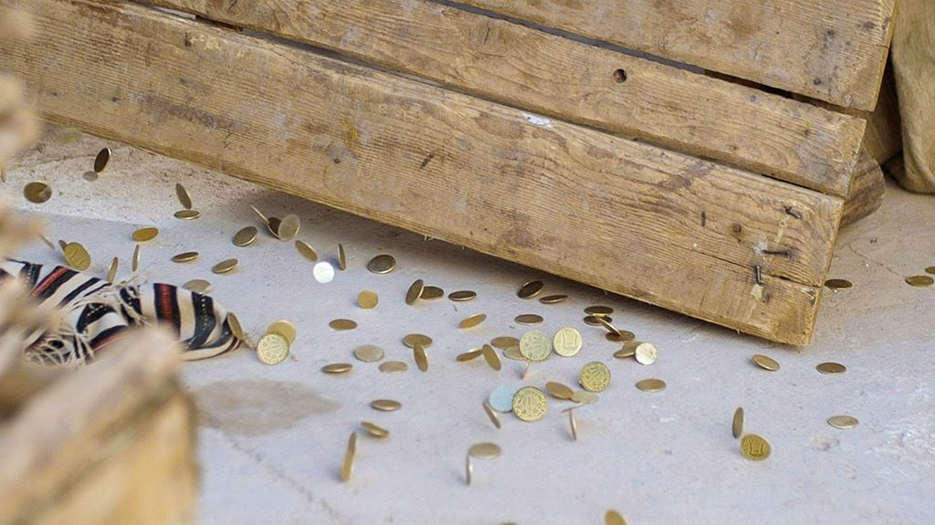
Notes:
Am I a troubler?
- As we declare the works of Christ has brought peace between God and man, we might end up provoking conflict (sometimes the table ‘culture/theology/philosophy’ of the day need to be turned)
I am not the cause of the problem here. But as I have been captured and being restored by His love, I can point you towards Him. He is the solution
(But to those unwilling to repent we will remain the ‘troublers’)
Missed the chance to repent
Ahab heart hard – the famine didn’t lead to his repentance (still killing prophets and feasting with Baal prophets and blaming Elijah)
Jesus was prince of peace and he was killed exactly because of this message – don’t be surprised if you follow similar fate

Slide 12
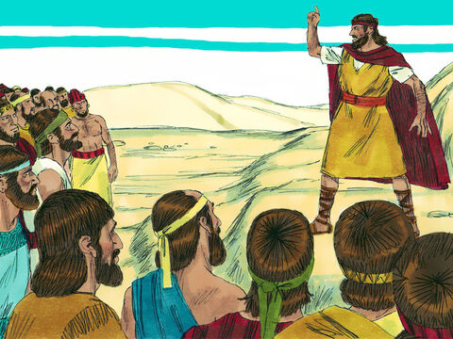
(2) Waver
How long will you waver between two opinions?
But the people said nothing
Notes:
God is intent that me make a decision

Slide 13

Revelation 3:15-16
I know your deeds, that you are neither cold nor hot. I wish you were either one or the other! So, because you are lukewarm—neither hot nor cold—I am about to spit you out of my mouth.
James 1:6-8
But when you ask, you must believe and not doubt, because the one who doubts is like a wave of the sea, blown and tossed by the wind. That person should not expect to receive anything from the Lord. Such a person is double-minded and unstable in all they do.
Notes:
John 24:15
choose for yourselves this day whom you will serve

Slide 14
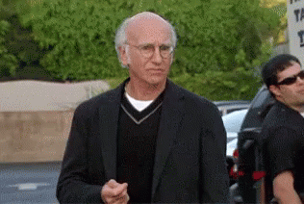
You love commitment…
FOBO (Fear Of Better Offer)
FOMO (Fear Of Missing Out)
“I trusted You…
… but this situation got worse!”
God is my provider/protector…
…but redundancy/ health diagnosis has made me panic
God can do the impossible …
… but let’s be pragmatic here
Notes:
Maybe we won’t flip back and forth between worship a false god like Baal but we can still waver.
FOMO and FOBO
Our reaction to circumstance often betray our claimed beliefs
“I trusted You, God, but…”
God is my provider/protector – but I redundancy/health diagnosis has made me panic
E.g. Was I depend on God providing the funds or did I find my safety in the budget? God loves me too much to allow me to believe pragmatism saves the day and instead invited me into an adventure where He shows His nature.
Can’t really believe Jesus saved us and be lukewarm (cognitive dissonance)

Slide 15
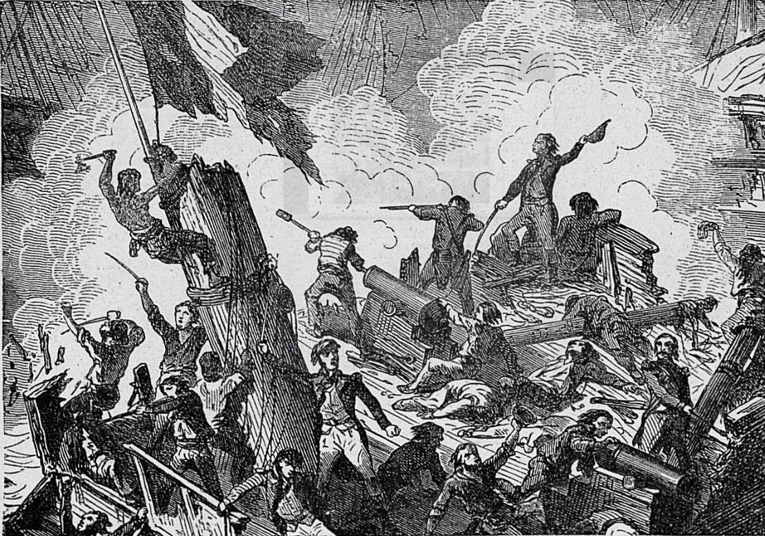
Question 1:
Is there an area in your life where you would like to nail your colours to the mast today?
Nailing colours to the mast
Notes:
Nailing colours to the mast = no surrender
No matter what happens if the situation looks bleak – You are still Lord and I love you to the very end
even if He doesn’t…

Slide 16
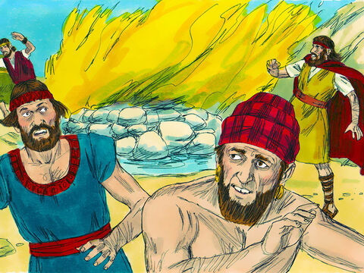
(3) Mercifully submits evidence
Question 2:
Do you want God to confirm His nature to you (again or for the first time)?
Notes:
Maybe we are wavering – God is merciful to give us evidence
Jesus tell his disciples to remember the evidence of His miracles when worried about not packing bread
Father of demonised child – Jesus completes
Mark 9:21-24
Jesus asked the boy’s father, “How long has he been like this?”
“From childhood,” he answered. “It has often thrown him into fire or water to kill him. But if you can do anything, take pity on us and help us.”
“‘If you can’?” said Jesus. “Everything is possible for one who believes.”
Immediately the boy’s father exclaimed, “I do believe; help me overcome my unbelief!”
Thomas allowed to touch Jesus wounds
Jesus doesn’t ask us to follow blindly – when the pharisees ask Him for another sign He says none shall be given but he had just given them miracles. His challenge was because they weren’t honest with the evidence they have been given – not being reliable witness

Slide 17
(4) How did I end up here? My choice or His?
Us
God
²¹ …If the Lord is God, follow him; but if Baal is God, follow him.”
³⁷ Answer me, Lord, answer me, so these people will know that you, Lord, are God, and that you are turning their hearts back again.”
Or
Notes:
You make the choice vs/& You’ve turned the heart back

Slide 18


Slide 19


Slide 20
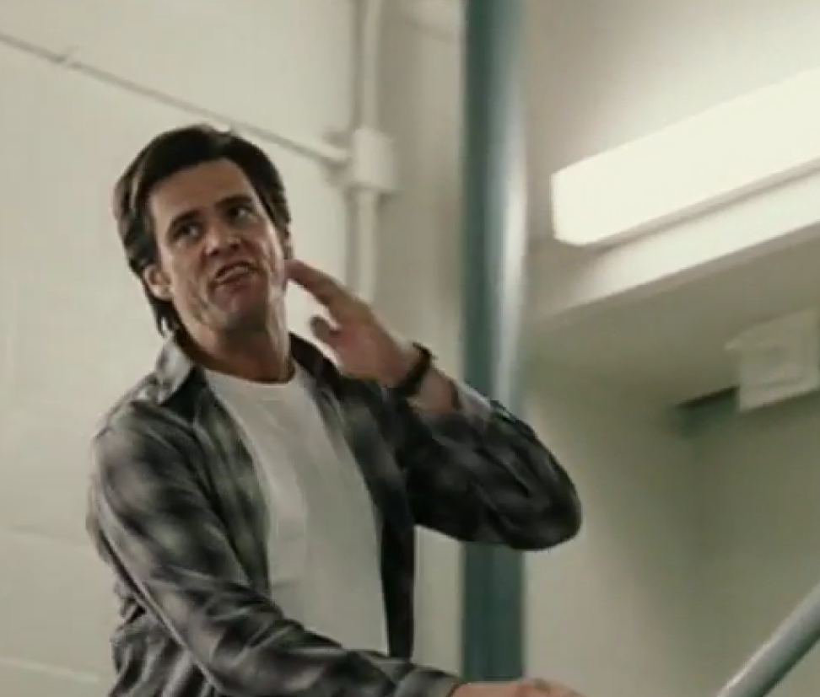
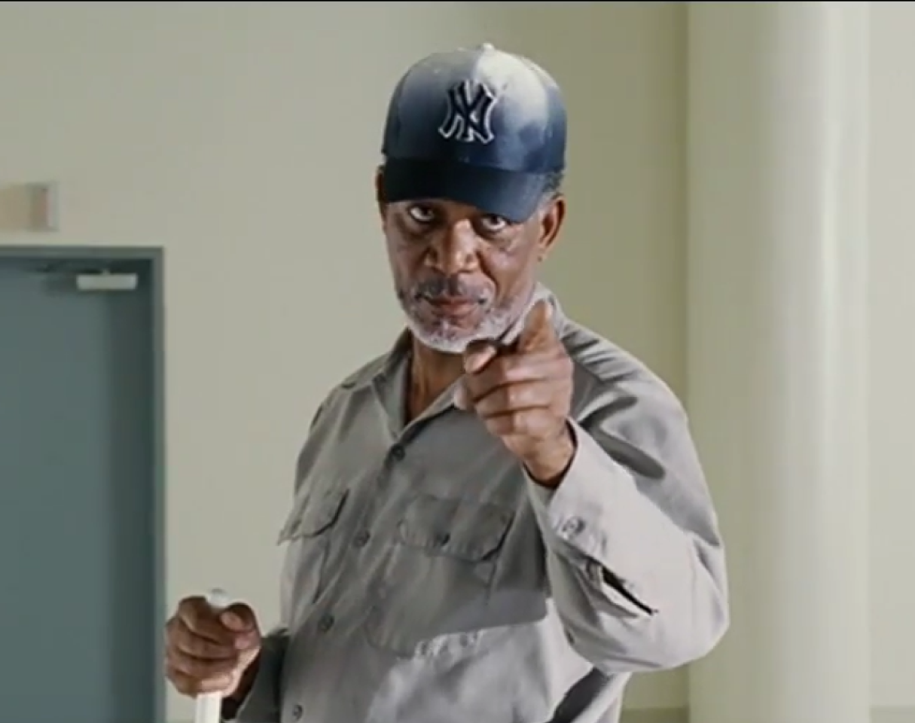
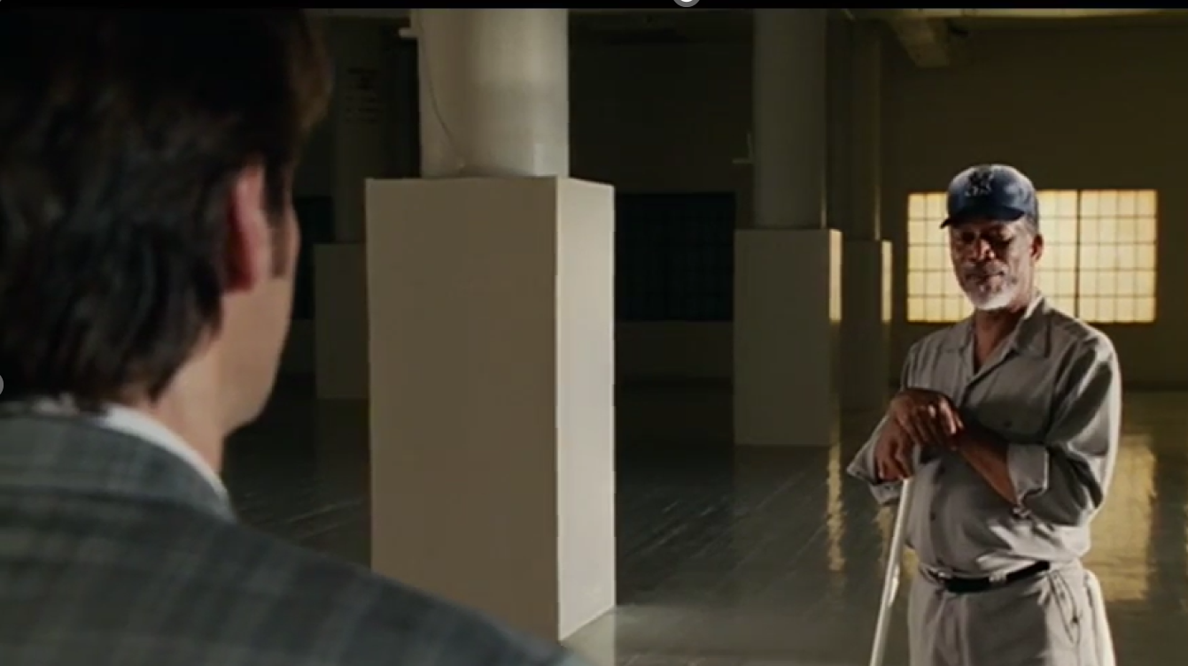
The 7th at 7
I’ll hold you to it
You are right on time
Notes:
Both are true

Slide 21
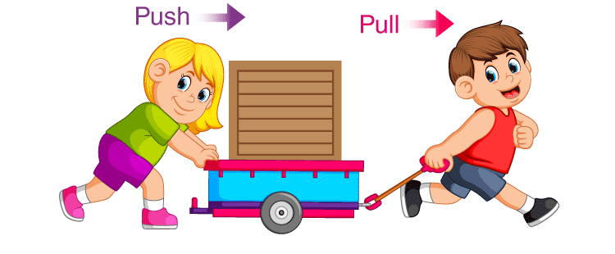
Notes:
Roms 3:10-12
…“There is no one righteous, not even one;…there is no one who seeks God.
Phil 2:13
for it is God who works in you to will and to act in order to fulfill his good purpose.
Prodigal son – came to his senses and discovered Father was watch and waiting for Him
Deu 30:6
The LORD your God will circumcise your hearts and the hearts of your descendants, so that you may love him with all your heart and with all your soul, and live.
James 4:2
…You do not have because you do not ask God
The spirit works in us but we can resist the spirit
I need Him to soften my heart towards Him
He put the desire in me to want to soften my heart towards Him
But I have to choose to act on this want – I can refuse, I can choose to believe I am self-sufficient and not in need of Him, I can refuse to accept Him as Lord and He will respect my decision to withdraw from Him

Slide 22
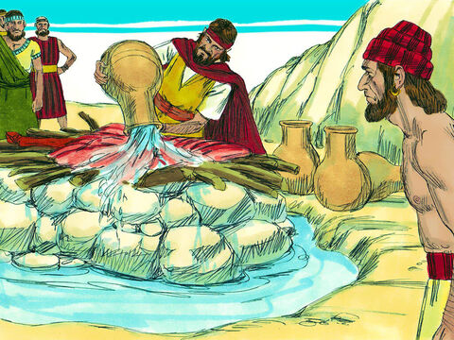
(5) Water on the altar
Question 3:
Do you want to fix your eyes and hope on the Miracle Maker?
Notes:
Can’t make the impossible more impossible - Water on the altar
Nor can I make the impossible more possible
Phil 4:13 I can do all this through him who gives me strength.
Luke 18:26-27
Those who heard this asked, “Who then can be saved?”
Jesus replied, “What is impossible with man is possible with God.”
If it needed a miracle before, we need no more of a miracle now
Stop thinking pragmatically, stop scheming, stop angst-ing over how you can make this situation slightly better and rest in Him
Question 3: Do you want to fix your eyes and hope on the miracle worker?

Slide 23
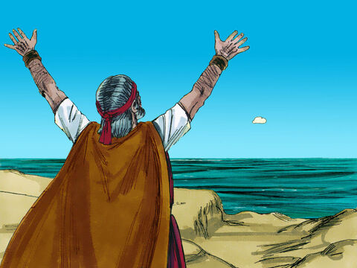
(6) Catching His drift
Go and tell Ahab, ‘Hitch up your chariot and go down before the rain stops you.’

Slide 24
Steve & Lisa’s Story
Steve catch God’s drift
Troublemaker – turned the tables
Hope for the impossible brewed up (more convincing that other facts)
Hope contagious
Question 4:
Do you want to bring contagious seed of hope/faith to impossible situations?
Notes:
Lisa you are the sister of Laura. In 2012 Laura gave birth to a baby boy. This should have been a joyful occasion but why was it not?
Meningitis
Baby was fitting
Planning to turn off life support
This is a horrific situation. Steve, you got the call whilst you were at work and you headed straight to the hospital. How were you feeling?
Upset
Not sure what I’m going to find when I arrive at hospital
But something happened whilst you were on the train?
I thought about this verse and begun to think God is able to heal the baby and He is going to do it
I felt expectant, hopeful, excited
What happened when you got to the hospital?
By the time I got there everyone was distraught and weeping
The atmosphere was that of despair
I got Lisa to come out the room so I could talk to her and explained that God was going to heal the baby and Lisa started to believe
Lisa, tell us about Steve’s arrival, from your perspective and what happened next?
Burst through the doors sweating
Calls me out the room and his words injected me with a hope that I just wasn’t expecting
I suddenly had hope that God was going to do a miracle so I spoke to Laura and she started to believe, she stopped crying
Then I told my dad (who isn’t a believer in Jesus) and suddenly he stopped crying
One of my church friends called to console me and I told them not to because God is going to heal the baby
I felt a joy welling up in me
How did this chapter of the story end?
Joe is now 11 years old and a blessing to us all
What did God show you about Himself in this event?

Slide 25
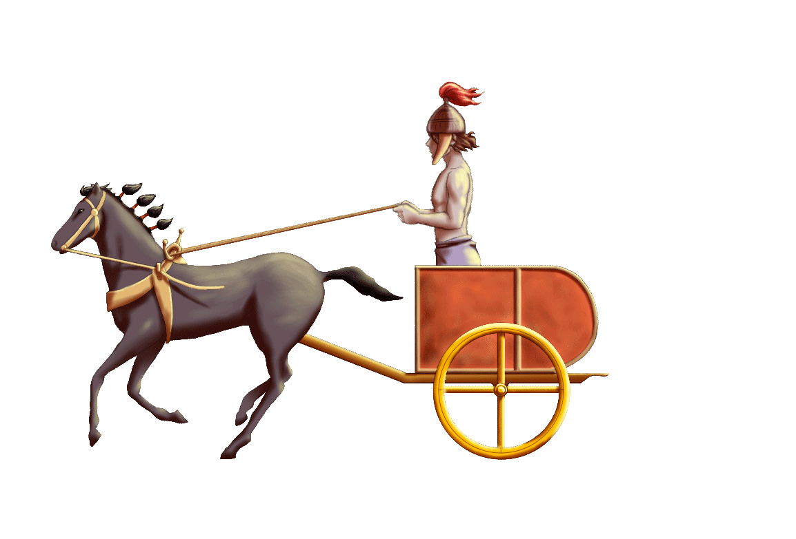

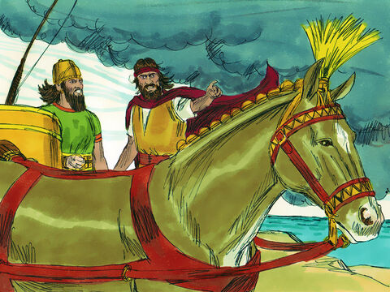
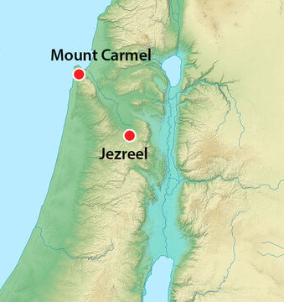
Notes:
Jezreel is around 50 km from Mount Carmel

Slide 26
Response
I will nail your colours to the mast on this matter
Ask God to make Himself evident
Fix your eyes on the Miracle Maker & so you can bring hope/faith to impossible situations?

