Slide 1
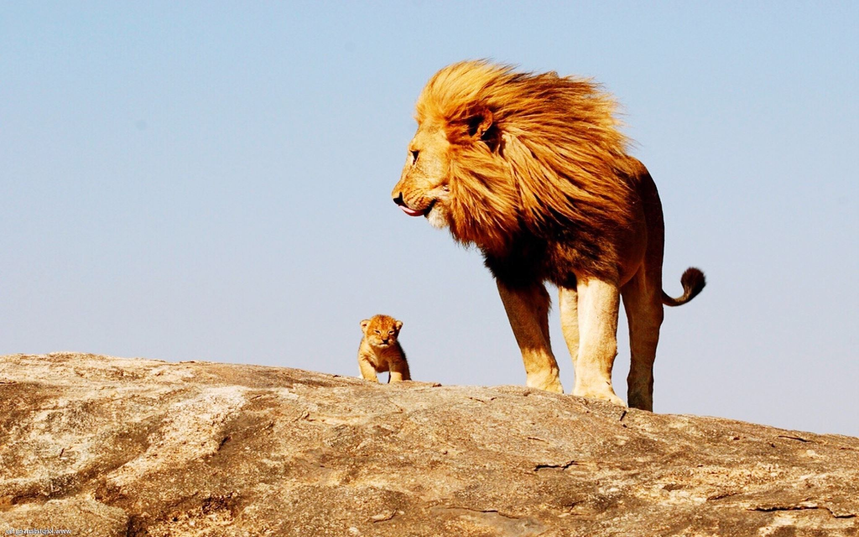
Silencing the spirit of intimidation
1 Kings 20 - Lydia Jaques-Large

Slide 2
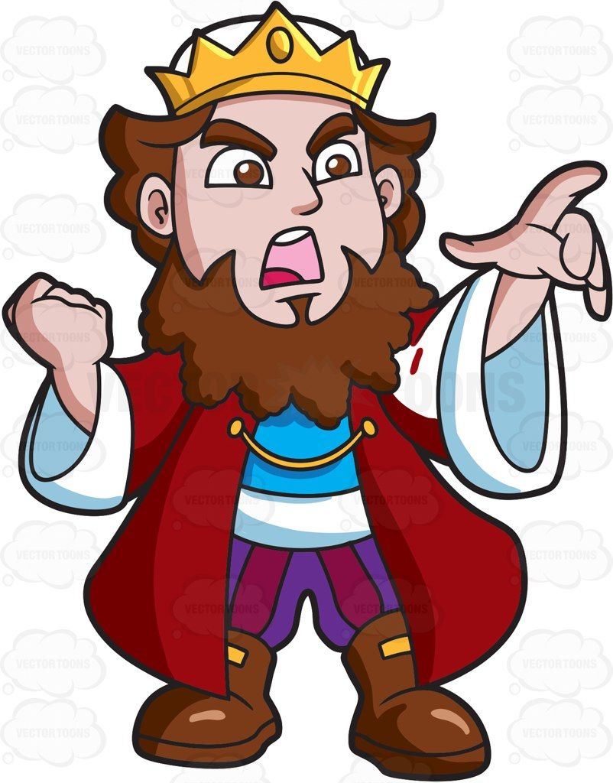
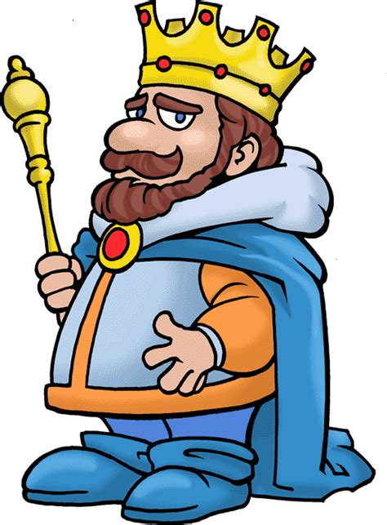

Who's who?
King Ben-Hadad
Son of Hadad
King of Aram [Syria]
Wants to attack Samaria
Unnamed prophet
Might be Elijah, Elisha or one of the 7000
Advisor to Ahab
King Ahab
King of Israel [including Samaria]
"Did more evil in the eyes of the Lord than any of those before him" (1 Kings 16:30)

Slide 3
1 Kings 20:1-12 – Ben-Hadad attacks Samaria
Now Ben-Hadad king of Aram mustered his entire army. Accompanied by thirty-two kings with their horses and chariots, he went up and besieged Samaria and attacked it. He sent messengers into the city to Ahab king of Israel, saying, “This is what Ben-Hadad says: ‘Your silver and gold are mine, and the best of your wives and children are mine.’”
The king of Israel answered, “Just as you say, my lord the king. I and all I have are yours.”
The messengers came again and said, “This is what Ben-Hadad says: ‘I sent to demand your silver and gold, your wives and your children. But about this time tomorrow I am going to send my officials to search your palace and the houses of your officials. They will seize everything you value and carry it away.’”
The king of Israel summoned all the elders of the land and said to them, “See how this man is looking for trouble! When he sent for my wives and my children, my silver and my gold, I did not refuse him.”

Slide 4
1 Kings 20:1-12
The elders and the people all answered, “Don’t listen to him or agree to his demands.”
So, he replied to Ben-Hadad’s messengers, “Tell my lord the king, ‘Your servant will do all you demanded the first time, but this demand I cannot meet.’” They left and took the answer back to Ben-Hadad.
Then Ben-Hadad sent another message to Ahab: “May the gods deal with me, be it ever so severely, if enough dust remains in Samaria to give each of my men a handful.”
The king of Israel answered, “Tell him: ‘One who puts on his armour should not boast like one who takes it off.’”
Ben-Hadad heard this message while he and the kings were drinking in their tents,^{[a]} and he ordered his men: “Prepare to attack.” So they prepared to attack the city.

Slide 6
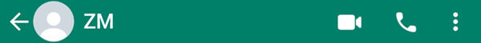
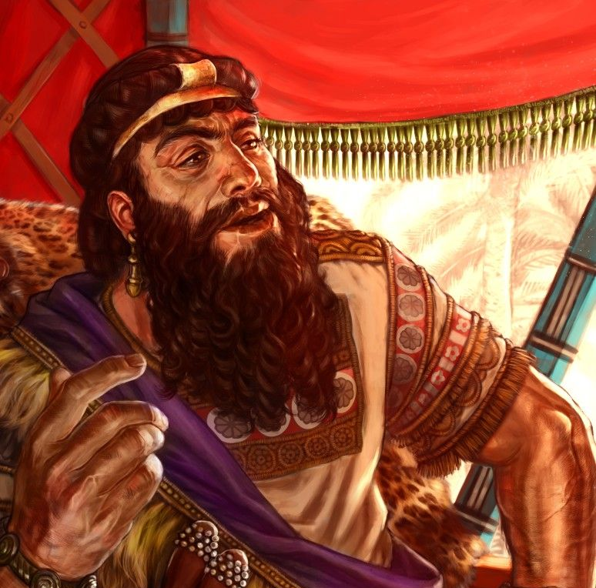
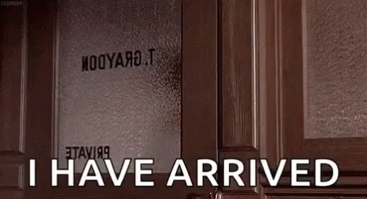
Ben-Hadad
I’m coming for your gold and silver and your best wives and children. 🤑🥇🥈👩‍👧‍👦

Slide 7

Ben-Hadad
I’m coming for your gold and silver and your best wives and children. 🤑🥇🥈👩‍👧‍👦
K.
Actually, my men will search everything and take all you value.
I’m coming for your gold and silver and your best wives and children. 🤑🥇🥈👩‍👧‍👦

Slide 8
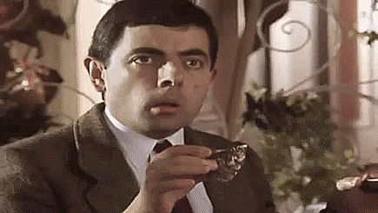
I’m coming for your gold and silver and your best wives and children. 🤑🥇🥈👩‍👧‍👦
K.
K.
Ben-Hadad
Actually, my men will search everything and take all you value.
I’m coming for your gold and silver and your best wives and children. 🤑🥇🥈👩‍👧‍👦

Slide 9
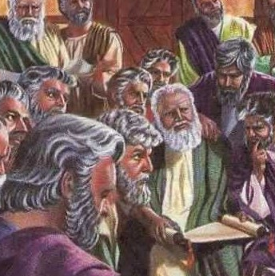
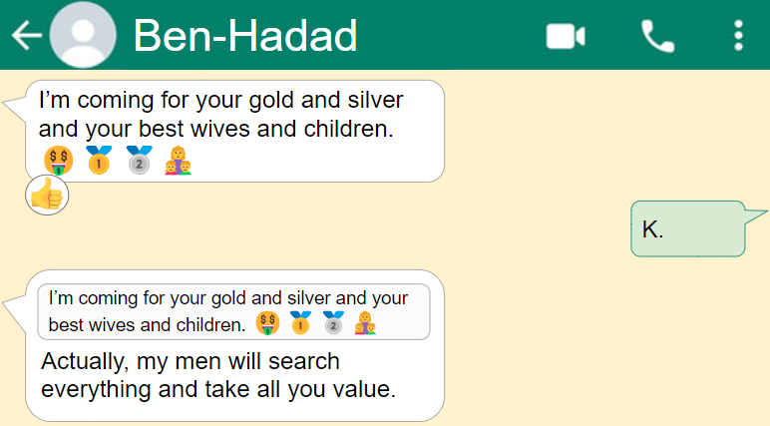
Elders of Samaria
😡2
😱😤

Slide 10
Elders of Samaria
😡👎😲5
😡👎3
😡2
😱😤
Elder 1
no wayyyyyyy
Elder 2
THE. AUDACITY.

Slide 11
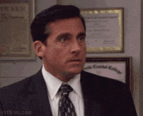
😡👎😲5
😱😤
Elder 1
no wayyyyyyy
Elders of Samaria
Elder 2
THE. AUDACITY.
Right?!
Elder 3
😬😬😬
Elder 1

Slide 12
Right?!
Elder 3
😬😬😬
Elders of Samaria
Elder 1
Elder 4
Don’t listen to him or agree to his demands!

Slide 13
Elder 1
Elders of Samaria
Elder 4
Don’t listen to him or agree to his demands!
1
2
3
5
7

Slide 14
Ben-Hadad
Absolutely not! I could do your first command, but that was a step too far. 👎
NO.
I swear… I will crush you and all of Samaria beyond dust! 💪⚔️🥊

Slide 15
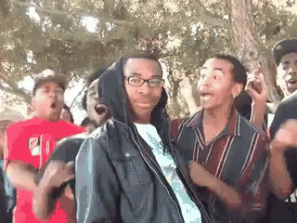
Absolutely not! I could do your first command, but that was a step too far. 👎
Ben-Hadad
NO.
I swear… I will crush you and all of Samaria beyond dust! 💪⚔️🥊
Easier said than done. Don’t get ahead of yourself… you haven’t won yet.

Slide 16
I swear… I will crush you and all of Samaria beyond dust! 💪⚔️🥊
Easier said than done. Don’t get ahead of yourself… you haven’t won yet.
Ben-Hadad
😡
…

Slide 18
Do not give the enemy a foothold
This the enemy's strategy – give him an inch and he'll take a mile
Hugh Osgood – the mountain you are facing may be a stronghold that God wants to break​
Stop letting your problems speak to you and start speaking to them

Slide 19
Speak to the mountains
What is the mountain that you're facing that it's time to speak to this morning?
Anxiety, sickness, work stress, family disputes, self-pity, trauma

Slide 20
Speak to the mountains
Why would I worry when giants come calling my name?​
My God is so much bigger than troubles I face​
Why would I hunger for power or riches or fame?​
My God is so much better than all of these things​
​
I won't be shaken​, I won't be moved​
My God is faithful​, His promise is true​
So I speak to the mountains​, It's time to move​
My God is bigger, better, stronger, greater than you​
​
My enemies scatter, 'cause they know the battle is done
My God is stronger, the victory's already won​
He died for my ransom and rose up on the third day​
'Cause my God is greater than death, hell, and the grave

Slide 21
1 Kings 20:22
“Strengthen your position and see what must be done, because next spring the king of Aram will attack you again.”
Notes:
Jesus said – in this world you will face troubles, but take heart, I have overcome the world

Slide 22
Strengthen your position
God has said that we need to take up our positions and stand firm – August 2023, 2 Chronicles 20:17
We strengthen our position by delighting more in who God is and by doing the things that delight him.
What moves your heart, Lord?
Where are you moving?

Slide 23
1 Kings 20:28
Because the Arameans think the Lord is a god of the hills and not a god of the valleys, I will deliver this vast army into your hands, and you will know that I am the Lord.

Slide 24

'the Arameans think the Lord is a god of the hills and not a god of the valleys'
Are there places we think God isn't God?
This is a strategy of the intimidator
This is a deception the world lives under
Notes:
It’s a strategy of the intimidator to make us think there are places that God’s power doesn’t reach.
The world lives in that deception

Slide 25
Zephaniah 3:17
The Lord your God is with you,
the Mighty Warrior who saves.
He will take great delight in you;
in his love he will no longer rebuke you,
but will rejoice over you with singing.”
Notes:
It’s a strategy of the intimidator to make us think there are places that God’s power doesn’t reach.
The world lives in that deception

Slide 26
1 Kings 20:31-34
His officials said to him, “Look, we have heard that the kings of Israel are merciful. Let us go to the king of Israel with sackcloth around our waists and ropes around our heads. Perhaps he will spare your life.”
Wearing sackcloth around their waists and ropes around their heads, they went to the king of Israel and said, “Your servant Ben-Hadad says: ‘Please let me live.’”
The king answered, “Is he still alive? He is my brother.”
The men took this as a good sign and were quick to pick up his word. “Yes, your brother Ben-Hadad!” they said.
“Go and get him,” the king said. When Ben-Hadad came out, Ahab had him come up into his chariot.
“I will return the cities my father took from your father,” Ben-Hadad offered. “You may set up your own market areas in Damascus, as my father did in Samaria.”
Ahab said, “On the basis of a treaty I will set you free.” So he made a treaty with him, and let him go.

Slide 27
Our King is merciful
His officials said to him, “Look, we have heard that the kings of Israel are merciful. Let us go to the king of Israel with sackcloth around our waists and ropes around our heads. Perhaps he will spare your life.”

Slide 28

Many-fold Mercy
Yet in Your manifold mercies you did not forsake them in the wilderness.
Nehemiah 9:19

Slide 29
2. Nothing justifies us but Jesus
Wearing sackcloth around their waists and ropes around their heads, they went to the king of Israel and said, “Your servant Ben-Hadad says: ‘Please let me live.’”

Slide 30
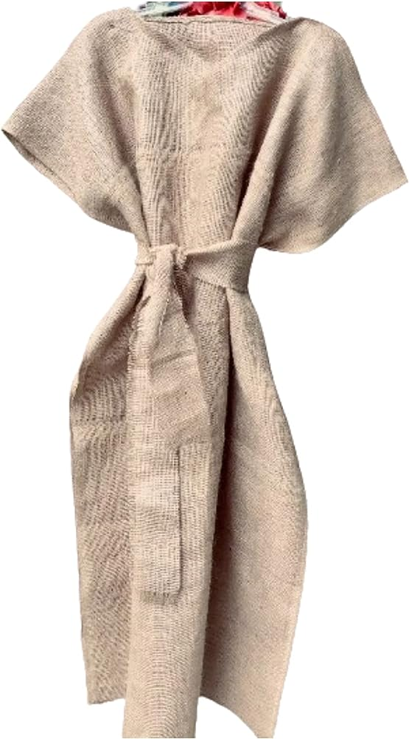
1 Kings 20: 32 Isaiah 3:24
Wearing sackcloth around their waists and ropes around their heads, they went to the king of Israel
In that day the Lord will snatch away their finery: …
instead of fine clothing, sackcloth;
instead of beauty, branding.

Slide 31

What do we have in our hands before our King? Promise upon promise and assurance of our salvation
Hebrews 6:19 - We have this hope as an anchor for the soul, firm and secure. It enters the inner sanctuary behind the curtain.
John 11:25 - I am the resurrection and the life. The one who believes in me will live, even though they die.
John 8:12 - I am the light of the world. Whoever follows me will never walk in darkness, but will have the light of life.”
Hebrews 4:16 Let us then approach God’s throne of grace with confidence, so that we may receive mercy and find grace to help us in our time of need.
Hope = rope

Slide 32
3. Our reception will be so much greater
“Your servant Ben-Hadad says: ‘Please let me live.’”
The king answered, “Is he still alive? He is my brother.”
The men took this as a good sign and were quick to pick up his word. “Yes, your brother Ben-Hadad!” they said.
“Go and get him,” the king said. When Ben-Hadad came out, Ahab had him come up into his chariot.
“I will return the cities my father took from your father,” Ben-Hadad offered. “You may set up your own market areas in Damascus, as my father did in Samaria.”
Ahab said, “On the basis of a treaty I will set you free.” So he made a treaty with him, and let him go. - 1 Kings 20:31-34

Slide 33
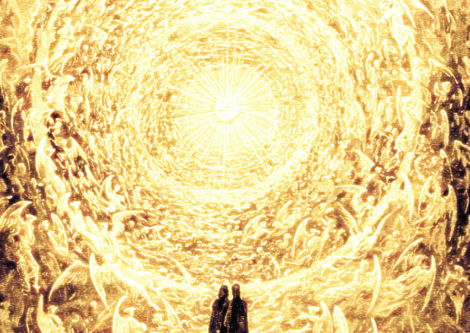
"Trust Jesus;
trust Jesus just as you are for everything,
and you are saved;
and we will meet again in that land where they wear no sackcloth, nor ropes on their necks,
but where their heads are crowned with immortal honor, and their bodies are robed in immortality.
Christ is the way, the truth, and the life.
Look to him, all the ends of the earth, look to him and live. The Lord will enable you to do so"
Charles M. Spurgeon

Slide 34

Response
What is the mountain that you're facing that it's time to speak to this morning?
Ask Him: What pleases you Lord? Where are you moving?
Are there places we think God isn't God?
Do you know that God is a merciful God? Is your hope in him?

Slide 35
Speak to the mountains
Why would I worry when giants come calling my name?​
My God is so much bigger than troubles I face​
Why would I hunger for power or riches or fame?​
My God is so much better than all of these things​
​
I won't be shaken​, I won't be moved​
My God is faithful​, His promise is true​
So I speak to the mountains​, It's time to move​
My God is bigger, better, stronger, greater than you​
​
My enemies scatter, 'cause they know the battle is done​
My God is stronger, the victory's already won​
He died for my ransom and rose up on the third day​
'Cause my God is greater than death, hell, and the grave

