Slide 1
1 kings 21

Slide 2
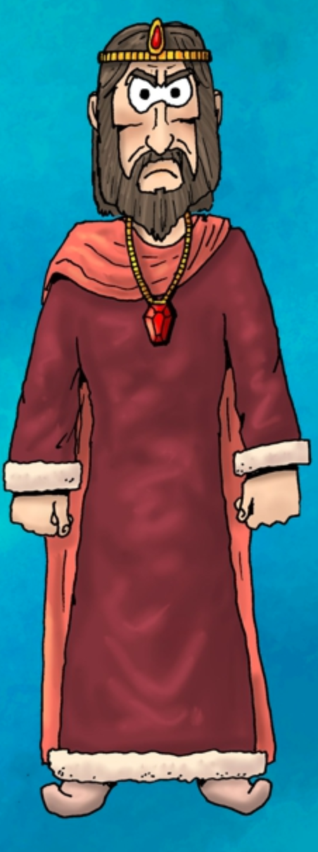
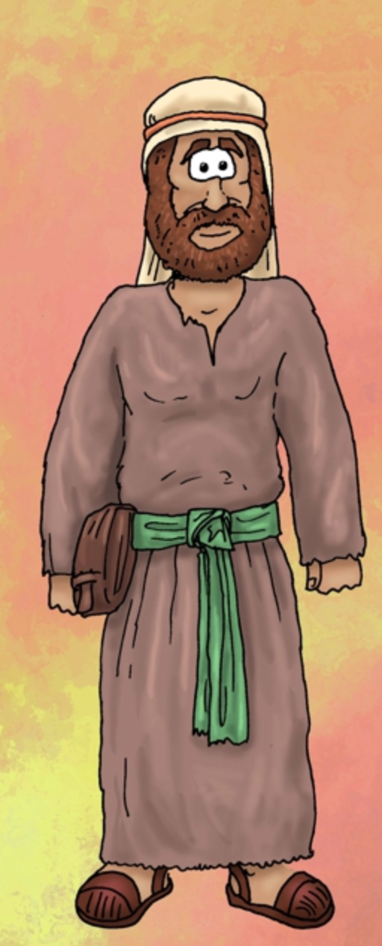
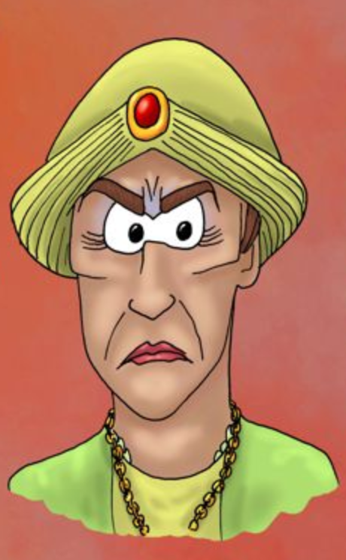
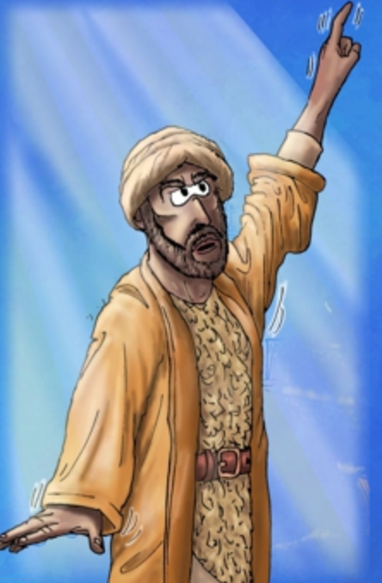
Who’s who?
KING AHAB
King of Israel
‘Did more evil in the eyes of the Lord before any of those before him’.
Defeated King of Syria with God’s help in the previous chapter.
Decides that he wants something that’s not his
NABOTH
Came from Jezreel, the capital of Ahab’s Kingdom
Owns a vineyard near Ahab’s palace, which Ahab decides he wants, but Naboth refuses to give it to him
JEZEBEL
King Ahab’s wife
Comes from Sidon, and introduces Israel to worship other gods, such as Baal.
Not a very nice lady
Comes up with a scheme for Ahab to get Naboth’s vineyard
ELIJAH
Prophet
Showdown with Prophets of Baal on Mount Carmel
Ran away when he heard Jezebel wanted to kill him
Encountered God in a cave in Mount Horeb
Brings God’s word to Ahab in this chapter

Slide 3
1 Kings 21:1-3
Some time later there was an incident involving a vineyard belonging to Naboth the Jezreelite. The vineyard was in Jezreel, close to the palace of Ahab king of Samaria. ² Ahab said to Naboth, “Let me have your vineyard to use for a vegetable garden, since it is close to my palace. In exchange I will give you a better vineyard or, if you prefer, I will pay you whatever it is worth.”
³ But Naboth replied, “The Lord forbid that I should give you the inheritance of my ancestors.”

Slide 4
AHAB’S DESIRE FOR MORE

Slide 5
1 Kings 20:28
‘…I will deliver this vast army into your hands, and you will know that I am the Lord.’

Slide 6
Philippians 4:12-13
¹² I know what it is to be in need, and I know what it is to have plenty. I have learned the secret of being content in any and every situation, whether well fed or hungry, whether living in plenty or in want. ¹³ I can do all this through him who gives me strength.

Slide 7
Luke 22:42-43
Father, if you are willing, take this cup from me; yet not my will, but yours be done.” ⁴³ An angel from heaven appeared to him and strengthened him.

Slide 8
What am I chasing after? What do I desire? Am I bringing that to God?

Slide 9
NABOTH’S STANCE

Slide 10
1 Kings 21:3
³ But Naboth replied, “The Lord forbid that I should give you the inheritance of my ancestors.”

Slide 11
Leviticus 25:23
“The land must not be sold permanently”

Slide 12
Numbers 36:7
“No inheritance in Israel is to pass from one tribe to another, for every Israelite shall keep the tribal inheritance of their ancestors”

Slide 13
Exodus 20:17
You shall not covet your neighbour’s house…or anything that belongs to your neighbour.

Slide 14
Are there areas or situations in your life where God is giving you the opportunity to stand up for what is right, even if it may come at great cost to you?

Slide 15
1 Kings 21:4-16
⁴ So Ahab went home, sullen and angry because Naboth the Jezreelite had said, “I will not give you the inheritance of my ancestors.” He lay on his bed sulking and refused to eat.
⁵ His wife Jezebel came in and asked him, “Why are you so sullen? Why won’t you eat?”
⁶ He answered her, “Because I said to Naboth the Jezreelite, ‘Sell me your vineyard; or if you prefer, I will give you another vineyard in its place.’ But he said, ‘I will not give you my vineyard.’”
⁷ Jezebel his wife said, “Is this how you act as king over Israel? Get up and eat! Cheer up. I’ll get you the vineyard of Naboth the Jezreelite.”
⁸ So she wrote letters in Ahab’s name, placed his seal on them, and sent them to the elders and nobles who lived in Naboth’s city with him. ⁹ In those letters she wrote:
“Proclaim a day of fasting and seat Naboth in a prominent place among the people. ¹⁰ But seat two scoundrels opposite him and have them bring charges that he has cursed both God and the king. Then take him out and stone him to death.”

Slide 16
¹¹ So the elders and nobles who lived in Naboth’s city did as Jezebel directed in the letters she had written to them. ¹² They proclaimed a fast and seated Naboth in a prominent place among the people. ¹³ Then two scoundrels came and sat opposite him and brought charges against Naboth before the people, saying, “Naboth has cursed both God and the king.” So they took him outside the city and stoned him to death. ¹⁴ Then they sent word to Jezebel: “Naboth has been stoned to death.”
¹⁵ As soon as Jezebel heard that Naboth had been stoned to death, she said to Ahab, “Get up and take possession of the vineyard of Naboth the Jezreelite that he refused to sell you. He is no longer alive, but dead.” ¹⁶ When Ahab heard that Naboth was dead, he got up and went down to take possession of Naboth’s vineyard.

Slide 17
AHAB’S RESPONSE

Slide 18
‘Sullen and angry’

Slide 19
1 Kings 20:43
Sullen and angry, the king of Israel went to his palace in Samaria.

Slide 20
Lord, is there anywhere that I have been sulking, turning my face away from you, and putting more emphasis on my will than yours?

Slide 21
AHAB’S VULNERABLE STATE

Slide 22
Where do you go to when you’re feeling crushed / disappointed / fragile?

Slide 23
AHAB’S ABDICATION OF RESPONSIBILITY

Slide 24
⁷ Jezebel his wife said, “Is this how you act as king over Israel? Get up and eat! Cheer up. I’ll get you the vineyard of Naboth the Jezreelite.”

Slide 25
⁸ So she wrote letters in Ahab’s name, placed his seal on them, and sent them to the elders and nobles who lived in Naboth’s city with him.

Slide 26
What has God given me responsibility for?

Slide 27
Are there blind spots where I’ve failed to recognise areas of responsibility that God has laid before me?

Slide 28
1 Kings 21:17-28
¹⁷ Then the word of the Lord came to Elijah the Tishbite: ¹⁸ “Go down to meet Ahab king of Israel, who rules in Samaria. He is now in Naboth’s vineyard, where he has gone to take possession of it. ¹⁹ Say to him, ‘This is what the Lord says: Have you not murdered a man and seized his property?’ Then say to him, ‘This is what the Lord says: In the place where dogs licked up Naboth’s blood, dogs will lick up your blood—yes, yours!’”
²⁰ Ahab said to Elijah, “So you have found me, my enemy!”
“I have found you,” he answered, “because you have sold yourself to do evil in the eyes of the Lord. ²¹ He says, ‘I am going to bring disaster on you. I will wipe out your descendants and cut off from Ahab every last male in Israel—slave or free.^{[a]} ²² I will make your house like that of Jeroboam son of Nebat and that of Baasha son of Ahijah, because you have aroused my anger and have caused Israel to sin.’

Slide 29
²³ “And also concerning Jezebel the Lord says: ‘Dogs will devour Jezebel by the wall of Jezreel.’
²⁴ “Dogs will eat those belonging to Ahab who die in the city, and the birds will feed on those who die in the country.”
²⁵ (There was never anyone like Ahab, who sold himself to do evil in the eyes of the Lord, urged on by Jezebel his wife. ²⁶ He behaved in the vilest manner by going after idols, like the Amorites the Lord drove out before Israel.)
²⁷ When Ahab heard these words, he tore his clothes, put on sackcloth and fasted. He lay in sackcloth and went around meekly.
²⁸ Then the word of the Lord came to Elijah the Tishbite: ²⁹ “Have you noticed how Ahab has humbled himself before me? Because he has humbled himself, I will not bring this disaster in his day, but I will bring it on his house in the days of his son.”

Slide 30
ELIJAH’S ROLE

Slide 31
AHAB’S RESPONSE

Slide 32
GOD’S MERCY

Slide 33
Ezekiel 18:21-23
But if a wicked person turns away from all the sins they have committed and keeps all my decrees and does what is just and right, that person will surely live; they will not die. ²² None of the offenses they have committed will be remembered against them. Because of the righteous things they have done, they will live. ²³ Do I take any pleasure in the death of the wicked? declares the Sovereign Lord. Rather, am I not pleased when they turn from their ways and live?

Slide 34
RESPONSE
What do I desire? Is that what God has for me? Am I bringing it to him?
Are there areas or situations in your life where God is giving you the opportunity to stand up for what is right, even if it may come at great cost to you?
Lord, is there anywhere that I have been sulking, turning my face away from you, and putting more emphasis on my will than yours?
Lord, are there blind spots where I’m failing to see the areas of responsibility that you’ve laid before me? God, reveal these to me so I can repent and access your grace to change
Lord, I want to encounter you, be changed you by you.

