Slide 1


Slide 2

The Kings Series:
Episode 21
Deciphering
&
Deceiving

Slide 3

Micaiah’s lies

Slide 4
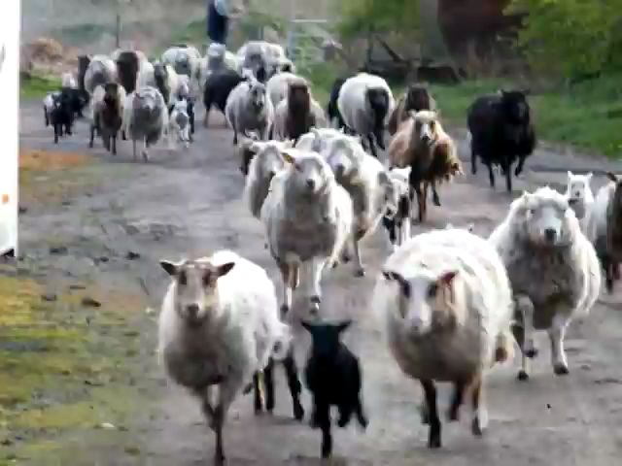

Slide 5
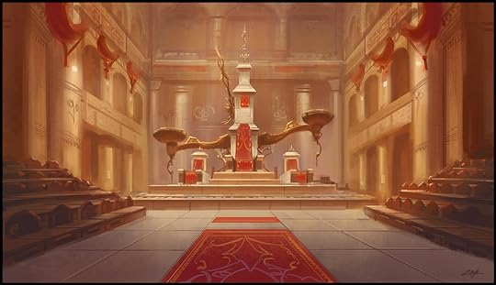









Who will entice Ahab?
this
that
I know!
I know!
Pick me!

Slide 6


Slide 7

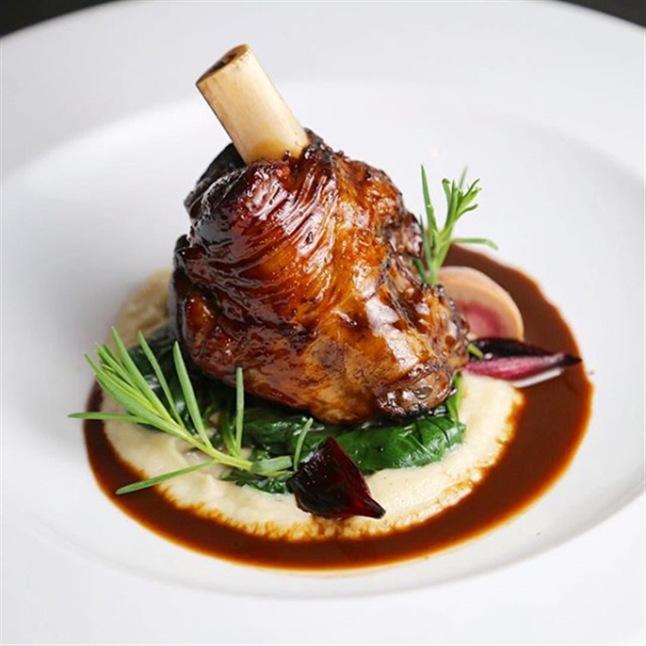
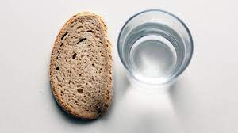

His Majesty’s Prison
Menu
Lamb Shank Redemption
Penne Tentiary Chicken
Banged-up Mash

Slide 8
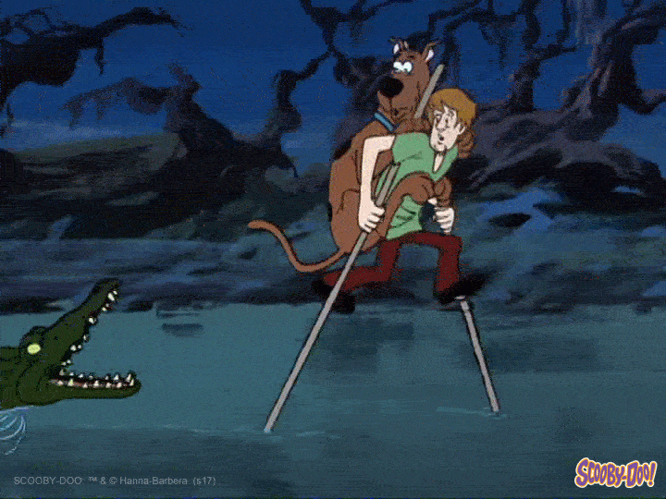
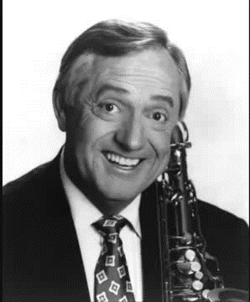

Slide 9
“Every man to his town. Every man to his land!”

Slide 10
The Kings Series - Episode 21
Deciphering & Deceiving
10th March 2024

Slide 11
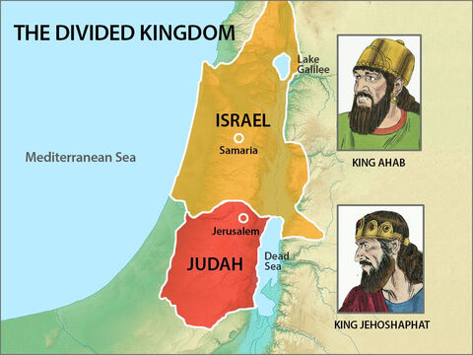

Ahab son of Omri did more evil in the eyes of the Lord than any of those before him. (1 Kings 16:30)
The Lord was with Jehoshaphat because he followed the ways of his father David before him. He did not consult the Baals but sought the God of his father and followed his commands rather than the practices of Israel. (2 Chron 17:3-4)

Slide 12
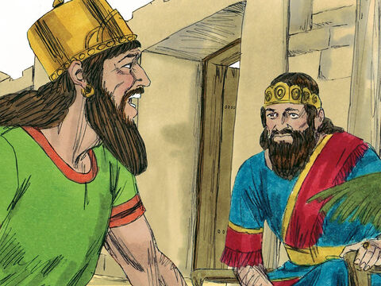
1 Kings 22:1-4
For three years there was no war between Aram and Israel. But in the third year Jehoshaphat king of Judah went down to see the king of Israel. The king of Israel had said to his officials, “Don’t you know that Ramoth Gilead belongs to us and yet we are doing nothing to retake it from the king of Aram?”
So he asked Jehoshaphat, “Will you go with me to fight against Ramoth Gilead?”
Jehoshaphat replied to the king of Israel, “I am as you are, my people as your people, my horses as your horses.”
Notes:
Israel & Judah now friends?!?
Civil war starts in chpt 15.
2 Chron 16 - Judah (Asa) and Israel (Baasha) at war - both appealing to Ben-Hadad (Aram) to support them against the other
Now both coming together to take on former Colonial master
(Find out more about Jehoshaphat from 2 Chron 17-18)
Jehoshaphat a pretty good king but foolish decision to bind himself to corrupt king Ahab

Slide 13
(1) Pick your friends wisely
“Show me your friends, and I’ll show you your future”
- Anonymous
Notes:
Not looking for perfection – if that were the case you wouldn’t qualify

Slide 14
(1) Pick your friends wisely
We have privilege & responsibility to help our friends to love and obey God better
Carry each other’s burdens, and in this way you will fulfill the law of Christ.
(Gal 6:2)
And let us consider how we may spur one another on toward love and good deeds
(Heb 10:24)
He is the one we proclaim, admonishing and teaching everyone with all wisdom, so that we may present everyone fully mature in Christ. (Col 1:28)
Notes:
We have privilege & responsibility to help our friends to love and obey God better
Carry each other’s burdens, and in this way you will fulfill the law of Christ. (Gal 6:2)
And let us consider how we may spur one another on toward love and good deeds (Heb 10:24)
He is the one we proclaim, admonishing and teaching everyone with all wisdom, so that we may present everyone fully mature in Christ. (Col 1:28)

Slide 15

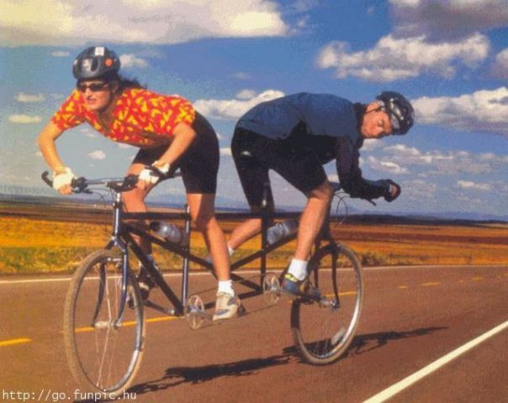

(1) Pick your friends wisely
Notes:
By being aware of your friend’s weaknesses and strengths you can encourage and support – ignorance/blind spot means you are both vulnerable to fall down same pit
e.g. William’s friend is a great storyteller but let’s not rely on his witness statement
Don’t make yourself vulnerable to the same vulnerabilities your friend is already vulnerable to
Track record, character - weigh accordingly
Some friendships are incompatible with the direction you are heading

Slide 16
(1) Pick your friends wisely
“I am as you are, my people as your people, my horses as your horses.”
- Jehoshaphat
Question 1: Do you need to re-evaluation a relationship?
Notes:
Careful who you ally with and what you agree on
e.g. gossip, complaint

Slide 17
1 Kings 22:5-9
But Jehoshaphat also said to the king of Israel, “First seek the counsel of the Lord.”
So the king of Israel brought together the prophets—about four hundred men—and asked them, “Shall I go to war against Ramoth Gilead, or shall I refrain?”
“Go,” they answered, “for the Lord will give it into the king’s hand.”
But Jehoshaphat asked, “Is there no longer a prophet of the Lord here whom we can inquire of?”
The king of Israel answered Jehoshaphat, “There is still one prophet through whom we can inquire of the Lord, but I hate him because he never prophesies anything good about me, but always bad. He is Micaiah son of Imlah.”
“The king should not say such a thing,” Jehoshaphat replied.
So the king of Israel called one of his officials and said, “Bring Micaiah son of Imlah at once.”
Notes:
Then a bizarre scene follow – we aren’t gong to spend a long time on this part but so we can address what might be an elephant in the room
Who will entice Ahab
entice, seduce, persuade - open up a path to destruction
Rom 1:24 God gave them over in the sinful desires
God unlocked the gate that was there for their protection and they burst through to embrace the destruction that comes from their own desires
Lord has put a deceiving spirit
Is this a trap?
But surely if God wanted to deceive He could do it more successfully than this meagre attempt!
Left with no excuse

Slide 18

(2) Are ears all it takes to hear?
(a) Ready to Act
They have ears, but they don't hear… (Jer 5:21)
Shema = listen AND OBEY
Notes:
You don’t hear because you aren’t prepared to ACT on what you hear

Slide 19
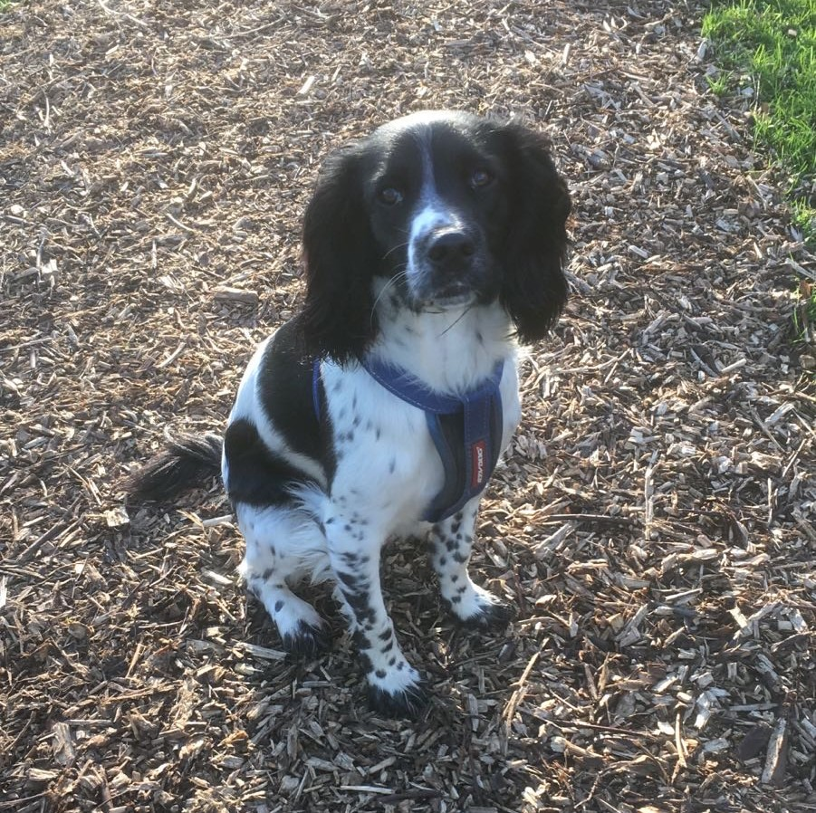
(2) Are ears all it takes to hear?
(a) Ready to Act
Shema = listen AND OBEY
Notes:
You don’t hear because you aren’t prepared to ACT on what you hear

Slide 20
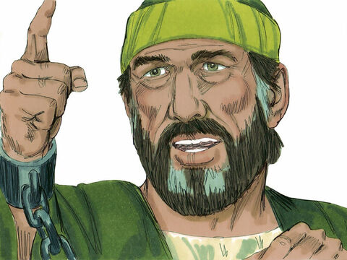
(2) Are ears all it takes to hear?
(a) Ready to Act
Ahab
Jehoshaphat
Micaiah
Notes:
A – not bothered about enquiring (it was only because J suggests that they enquire, it wasn’t in Ahab’s heart, and then he was reluctant to enquire of M)
J – enquires but don’t act according to what he hears (pushes through until hears the word of God i.e. battle will end in disaster, but still goes ahead anyway)
M – hears and acts (says what God tells him to say even though he knows it could have negative consequences). Refuses to go with the majority
When He says “jump”, I say “how high” on the way up
I exist for His glory – He is Lord and I have come to realise this and therefore my life about serving Him
God doesn’t exist to fulfil my life, but I live for Him

Slide 21
(2) Are ears all it takes to hear?
(b) Order…
“First seek the counsel of the Lord.” (1 Kings 22:5)
But seek first his kingdom and his righteousness, and all these things will be given to you as well. (Matt 6:33)
In all ways acknowledge him and he will direct your paths (Prov 3:6)

Slide 22
(2) Are ears all it takes to hear?
(b) Order…
Notes:
Decision tree – how many decisions have we made before we enquire?

Slide 23
(2) Are ears all it takes to hear?
(c) Single-minded
But when you ask, you must believe and not doubt, because the one who doubts is like a wave of the sea, blown and tossed by the wind. That person should not expect to receive anything from the Lord. Such a person is double-minded and unstable in all they do.
(James 1:6-8)
Notes:
Do you really want to know what God wants?...
How might I be double minded when I enquire?
I’ve already made my decision and just want God to rubber stamp
1st mind = appear to want God’s opinion.
2nd mind = only want His opinion if it matches my own
Claim to want to hear God but then avoid those who might tell me something I don’t want to hear, choose to perceive them as against me
Ahab re: M and Elijah

Slide 24

(2) Are ears all it takes to hear?
(c) Single-minded
The divine coin toss
vs
let Him set the agenda
An answer
vs
A relationship
He might choose to speak
- on your Matter
- in your Moment
- via your Method
Notes:
The divine coin toss
Do I set out the yes/no question and ask Him to pick one
I’m talking to Him but He isn’t talking to me
What are you saying to Him?
Which uni should I go to?
Perhaps He has something else He wants to talk to you about?
Do I let Him set the agenda
Illustration in discovering His will
CSI conquering a crime scene – keep emotions out of it, unmoved by findings
Boy walking across the mall to ask out the girl he likes – findings has immediate impact on him
Seeking RELATIONSHIP not an answer
He might not choose to speak on your Matter, in your Moment, or via your Method – take your restrictions off Him – Let God, be God
Do I really want to know what He thinks? It might require me to change! Is He really Lord?

Slide 25
(2) Are ears all it takes to hear?
(d) Can we hear God’s ‘voice’?
He has more thoughts for you than there are grains of sand (Ps 139:17)
“My sheep hear my voice, and I know them, and they follow me.” (John 10:27)
God put His Holy Spirit in us who
  Guides & speaks to us (John 16:13)
  Reminds what He has shown us previously (John 14:26)
Notes:
What does His ‘voice’ sound like?
Assurance, confidence we can hear Him
He loves you, you are His child and He wants a relationship!
This is mysterious, scandalous, outlandish (that we, who sit here in this building in Dagenham, can speak with God of the universe) yet (if it is true that He has adopted us,) it is completely logical!
He has more thoughts for you than there are grains of sand (Ps 139:17)
“My sheep hear my voice, and I know them, and they follow me.” (John 10:27)
God put His Holy Spirit in us who
Guides & speaks to us (John 16:13)
Reminds what He has shown us previously (John 14:26)

Slide 26
(2) Are ears all it takes to hear?
(d) Can we hear God’s ‘voice’?
Feel on skin
Memories
Audible (Acts 9:4)
gut
Methods of Communication
Writing on wall (Dan 5)
ears & eyes
feeling/emotion
Dreams (Gen 37:6)
Nudges
Movie clips
Notes:
God chooses different ways to communicate with different people
Rachel Turner “catch God”
Examples of deducing God’s will
Acts 16:6-10
Paul and his companions traveled throughout the region of Phrygia and Galatia, having been kept by the Holy Spirit from preaching the word in the province of Asia. 7When they came to the border of Mysia, they tried to enter Bithynia, but the Spirit of Jesus would not allow them to. 8So they passed by Mysia and went down to Troas. 9During the night Paul had a vision of a man of Macedonia standing and begging him, “Come over to Macedonia and help us.” 10After Paul had seen the vision, we got ready at once to leave for Macedonia, concluding that God had called us to preach the gospel to them.
- Proactive – pushing on the doors to see which one opens
- Trial and error method of discovering God’s will
Acts 15:28
It seemed good to the Holy Spirit and to us…
- A settling in peace
Col 3:15 Let the peace of Christ rule in your hearts…
- Sense of team

Slide 27
(2) Are ears all it takes to hear?
(d) Can we hear God’s ‘voice’?
Principles
God helps us
Hear in part
Sin can hinder
God won’t contradict Word
Weigh
Could be illogical
Secure – not afraid of questions
Notes:
1 Cor 13:9,12 - hear (prophecy) in part, don’t always have full picture – do the best we can. But know God loves us and guides us and works all things for good (Rom 8:28)
E.g. J & A discern what they are being told isn’t the word of God
Hidden/unconfessed sin can hinder our hearing (Ps 66:18)
Won’t contradict His word – Does this sound like something God would say? Does it match the bible and His nature (as revealed through scripture)
Weigh it (1 Cor 14:29)
Even if someone tells you it is the word of God you still need to weigh
See if it settles
Seek counsel (Pro 15:22)
Sometimes bring something that is hard to hear – submission means work it through, looking to come to place of surrender to God (won’t just write off input). John Guido – submission to leader
Doesn’t have to seem logical to us
Peace, not threatened, not need to defend, Not afraid to face questions on what you’ve heard
Illustration – pouring ‘fact’s on floating ping pong ball – faith still bobs back up to the surface

Slide 28



Slide 29


Slide 31
(2) Are ears all it takes to hear?
(d) Can we hear God’s ‘voice’?
Pleasing God
Leads to faith
Beauty of hearing God
Move mountains
Partner God
Question 2: Do you want to take off the handbrake in listening to God (by making your engagement relational and obedient and giving Him priority and letting Him set the agenda)?
Notes:
Find yourself partnering with God
E.g. Eli lasagna

Slide 32
1 Kings 22:29-38
So the king of Israel and Jehoshaphat king of Judah went up to Ramoth Gilead. The king of Israel said to Jehoshaphat, “I will enter the battle in disguise, but you wear your royal robes.” So the king of Israel disguised himself and went into battle.
Now the king of Aram had ordered his thirty-two chariot commanders, “Do not fight with anyone, small or great, except the king of Israel.” When the chariot commanders saw Jehoshaphat, they thought, “Surely this is the king of Israel.” So they turned to attack him, but when Jehoshaphat cried out, the chariot commanders saw that he was not the king of Israel and stopped pursuing him.

Slide 33
1 Kings 22:29-38
But someone drew his bow at random and hit the king of Israel between the sections of his armor. The king told his chariot driver, “Wheel around and get me out of the fighting. I’ve been wounded.” All day long the battle raged, and the king was propped up in his chariot facing the Arameans. The blood from his wound ran onto the floor of the chariot, and that evening he died. As the sun was setting, a cry spread through the army: “Every man to his town. Every man to his land!”
So the king died and was brought to Samaria, and they buried him there. They washed the chariot at a pool in Samaria (where the prostitutes bathed), and the dogs licked up his blood, as the word of the Lord had declared.

Slide 34
(3) Integrity
(a) Defining Integrity
“Integrity is a life where your beliefs and intentions are aligned with your words and actions.”
- Stephen Lovegrove, top Civil Servant
wholeness of heart where our thoughts, attitudes, reactions and actions genuinely reflect what we believe
Say what you mean,
mean what you say,
and
do what you believe
Transparency
Notes:
Say what you mean, mean what you say, and do what you believe
What you do when no one is watching
William Temple - Religion is what you do with your solitude
Albert Tucker – when trying to work out what a company exists for, I don’t look at their mission statement, I look at their accounts.

Slide 35
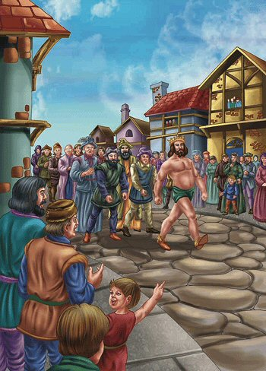

(3) Integrity
(b) Simplicity of Synchronicity
“If you tell the truth, you don't have to remember anything.”
- Mark Twain
Truth has a liberating effect (John 8:32)
Notes:
Say what you mean, mean what you say, and do what you believe

Slide 36
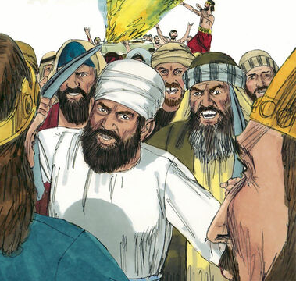
(3) Integrity
Micaiah
Ahab
Jehoshaphat
400 Prophets
Notes:
How did the characters in this story reveal their integrity?
M – committed to only say what God told him to say
Presents as one who is presenting the word of God – He delivers the word of God, regardless of consequences
A – presents king but dresses as other
Presents idea that A & J go to battle as equals, yet leaves J as only distinguishable king
J - Presents that he wants to hear Gods word but doesn’t receive the warning
Prophets – say what they think wants to be heard

Slide 37

(3) Integrity
(c) Disguise
How
Lie (Exaggerate, ‘half-truths’, ‘white’ lies)
Present yourself or case in favourable way
Condon through silence
Use of resources don’t match your beliefs
Omission/Commission
Why
Protection (e.g. Ahab)
Manipulate favourable terms (e.g. Gibeonites/Joshua)
Cover shame (e.g. Adam & Eve)
Project an image (Israelite army vs Goliath)
Notes:
Disguise (unsynchronised)
Ask the audience: How might you put on a disguise?
- Are you really what you appear to be? E.g., if someone has upset you, do you try your hardest to cover up your feelings when you next see them … or do you set out to resolve any problems with them at the first opportunity?
- “I always say what I think/feel” e.g. I’ll tell someone they are liar
- ok, but do your actions and words fit with your belief? E.g. correct in gentleness (2 Tim 2:25), love/accept/forgive
Not ok just to get it off your chest – Gal 6:2 ch
- if I choose not to do something (action) because I don’t feel like it is not necessarily living with integrity if I believe that I exist to do God’s will and that He graces me to complete His will. I would be violating my beliefs.
- use of resources (time, money, energy) – Albert Tucker – does my accounts/diary show you what I believe?
e.g. Young Jonty – split personality between Sunday and rest of the week
AT UNI - FORCED TO MAKE CHOICES WHEN OUTSIDE THE CULTURE WHICH HELD BEHAVIOUR IN CHECK, REALISED IMPACT ON OTHERS, FACED THE IMCOMPATIBILITY OF 2 PERSONALITIES (KNEW REAL ME WAS THE SUNDAY), UNI FIREBREAK – CHANCE TO CHANGE BUT NOT DEPENDENT ON GOING OFF TO UNI/FRESH ENVIRONMENT – THE FIREBREAK IS DECISION TO PUT JESUS FIRST AND BE HONEST ABOUT REPENTENCE
Ask the audience: Why might you put on a disguise?
How are you doing? I’m not doing so great.
If you took a cross section of my brain – would my thoughts match my belief that you are worthy of God’s love? How can I live up to this?

Slide 38

(3) Integrity
(d) Synchronise by knowing the Truth
He is my provider
He is my protector
He exchanged my shame
“I am the truth”
– Jesus
“The gospel is this: We are more sinful and flawed in ourselves than we ever dared believe, yet at the very same time we are more loved and accepted in Jesus Christ than we ever dared hope.”
- Tim Keller
Notes:
I am the truth – Jesus
I don’t need to coerce, manipulate, snatch for myself – He gives freely to me. If He hasn’t allotted it to me, I wouldn’t want it anyway.
I don’t have to present that I have got it all together – the only one whose opinion really matters has seen me at my worst and has loved me to the sky

Slide 39

(3) Integrity
(e) Power of integrity
Able to achieve purpose
Guided by God
Whoever walks in integrity walks securely, but he who makes his ways crooked will be found out.
(Proverbs 10:9)
Unity with God & each other (1 John 1:7)
At random = integrity
Question 3: What can you do today to become a person of even greater integrity?
Notes:
Guided by God
Proverbs 10:9 ESV
Whoever walks in integrity walks securely, but he who makes his ways crooked will be found out.
Ahab sought to deceive but was found out by the arrow
- JWS refused to lie for the partner. Could have been passed over for promotion. In the end he was asked to intercede in a dispute because they felt they could trust him.
Unity with God & each other
1 John 1:7
But if we walk in the light, as he is in the light, we have fellowship with one another, and the blood of Jesus, his Son, purifies us from all^{[a]} sin.
Can’t be bought off – so able to achieve purpose
American Gangster
At random = integrity

Slide 40
Response
Do you need to re-evaluation a relationship?
Do you want to take off the handbrake in listening to God?
What can you do today to become a person of even greater integrity?

