Slide 1
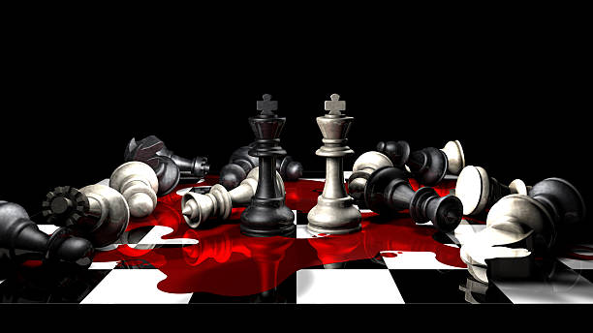
The Kings Study
Episode 3
9th July 2023

Slide 2
1 Kings 2:1-4
¹ When the time drew near for David to die, he gave a charge to Solomon his son.
² “I am about to go the way of all the earth,” he said. “So be strong, act like a man, ³ and observe what the Lord your God requires: Walk in obedience to him, and keep his decrees and commands, his laws and regulations, as written in the Law of Moses. Do this so that you may prosper in all you do and wherever you go ⁴ and that the Lord may keep his promise to me: ‘If your descendants watch how they live, and if they walk faithfully before me with all their heart and soul, you will never fail to have a successor on the throne of Israel.’

Slide 3
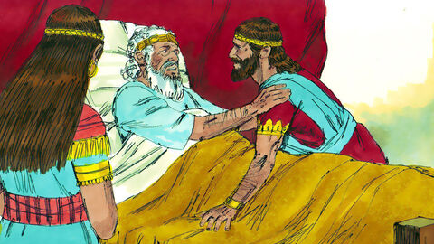

Be strong, act like a man
Observe what the Lord your God requires
Walk in obedience
keep his decrees and commands, his laws and regulations
Question
(1) Is there an area in your life where you need to stand up for what you believe is right?
Notes:
Be a man = standing up for what you believe is right (not macho)
Not blurring the difference between man and woman but promoting the characteristic God wants – world wants to set one against the other but God called us to partnership
Strong = Chazak (khaw-zak) Valiant, conquer, courage, consistent, grow firm
Question
e.g. I need to speak up when the culture in my workplace is dishonest
Observe what the Lord requires – learning, seeking, discerning (He not I determines what is required) (we now have the Holy Spirit which leads us to all righteousness – we choose to surrender (not automatic))
Walk in his way – act on (to know is not enough) Feature of ministering the spirit – lag between hearing and doing would become shorter
Conditional promise “if”
God has chosen to allow our choices to matter
Give and it will be given
Forgive and you will be forgiven
Knock and door will be answered
Parable of the talents – faith with few given more

Slide 4
1 Kings 2:5-9
⁵ “Now you yourself know what Joab son of Zeruiah did to me—what he did to the two commanders of Israel’s armies, Abner son of Ner and Amasa son of Jether. He killed them, shedding their blood in peacetime as if in battle, and with that blood he stained the belt around his waist and the sandals on his feet.
⁶ Deal with him according to your wisdom, but do not let his gray head go down to the grave in peace. ⁷ “But show kindness to the sons of Barzillai of Gilead and let them be among those who eat at your table. They stood by me when I fled from your brother Absalom.
⁸ “And remember, you have with you Shimei son of Gera, the Benjamite from Bahurim, who called down bitter curses on me the day I went to Mahanaim. When he came down to meet me at the Jordan, I swore to him by the Lord: ‘I will not put you to death by the sword.’ ⁹ But now, do not consider him innocent. You are a man of wisdom; you will know what to do to him. Bring his gray head down to the grave in blood.”

Slide 5
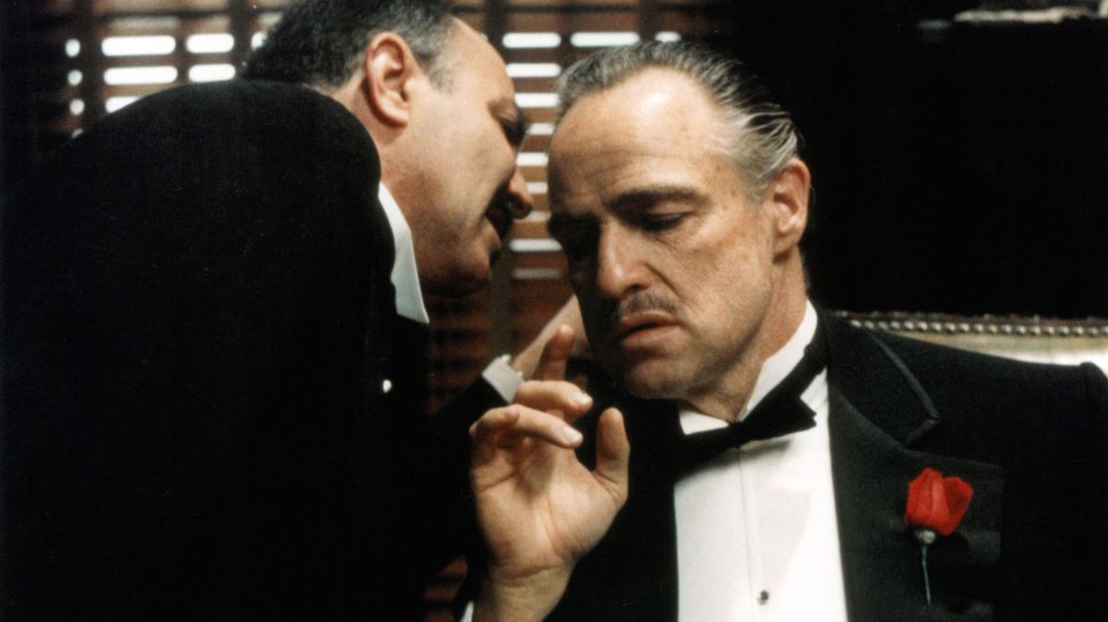

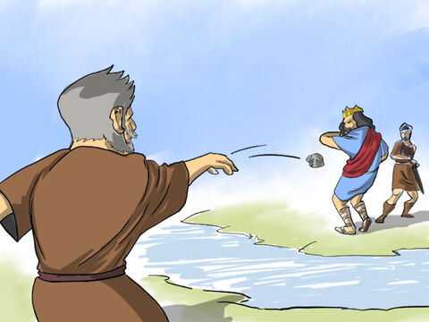
Joab
Sons of Barzillai
Shimei
Notes:
Advice suddenly takes a dark turn – given a hit list by a mob boss
Deal with him according to your wisdom, but do not let his gray head go down to the grave in peace
You are a man of wisdom; you will know what to do to him. Bring his gray head down to the grave in blood
Where has the focus on obeying God gone?
Obey God – now go and carry out political assassinations
Joab - kill
Sons of Barzillai – show kindness
Shimei – kill
2 SAMUEL 16 – Shiemi, relative of saul, as David fled Absalom coup cursed and threw stones at David. David wondered if Shimei might be used by God and refused his men's request to ‘cut off his head’
(Hasn’t every king eliminated opponents like this? Perhaps, but these are the covenant people – they were meant to be different)
Just because bible accounts for it doesn’t mean it approves - Is this what God wanted?

Slide 6
1 Kings 2:10-12
¹⁰ Then David rested with his ancestors and was buried in the City of David. ¹¹ He had reigned forty years over Israel—seven years in Hebron and thirty-three in Jerusalem. ¹² So Solomon sat on the throne of his father David, and his rule was firmly established.

Slide 7
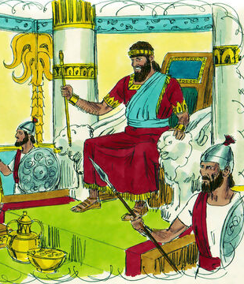
David rested
his rule was firmly established
Questions
(2) Is there an area in your life where you are tempted to give God a ‘helping hand’?
Notes:
David rested with his ancestors – no fear of death (fall asleep)
“Rule firmly established”
We are tempted (though we claim to trust God) to give him a helping hand by nudging along (e.g. God establish Solomon throne but help God with political assassinations. E.g. Abraham & sarah)
Question
e.g. I’m trusting God for my finances but I’m hoarding money

Slide 8
1 Kings 2:13-22
¹³ Now Adonijah, the son of Haggith, went to Bathsheba, Solomon’s mother. Bathsheba asked him, “Do you come peacefully?”
He answered, “Yes, peacefully.” ¹⁴ Then he added, “I have something to say to you.”
“You may say it,” she replied.
¹⁵ “As you know,” he said, “the kingdom was mine. All Israel looked to me as their king. But things changed, and the kingdom has gone to my brother; for it has come to him from the Lord. ¹⁶ Now I have one request to make of you. Do not refuse me.”
“You may make it,” she said.
¹⁷ So he continued, “Please ask King Solomon—he will not refuse you—to give me Abishag the Shunammite as my wife.”
¹⁸ “Very well,” Bathsheba replied, “I will speak to the king for you.”

Slide 9
¹⁹ When Bathsheba went to King Solomon to speak to him for Adonijah, the king stood up to meet her, bowed down to her and sat down on his throne. He had a throne brought for the king’s mother, and she sat down at his right hand.
²⁰ “I have one small request to make of you,” she said. “Do not refuse me.”
The king replied, “Make it, my mother; I will not refuse you.”
²¹ So she said, “Let Abishag the Shunammite be given in marriage to your brother Adonijah.”
²² King Solomon answered his mother, “Why do you request Abishag the Shunammite for Adonijah? You might as well request the kingdom for him—after all, he is my older brother—yes, for him and for Abiathar the priest and Joab son of Zeruiah!”

Slide 10

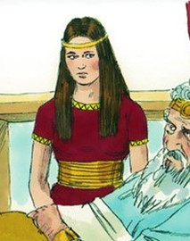
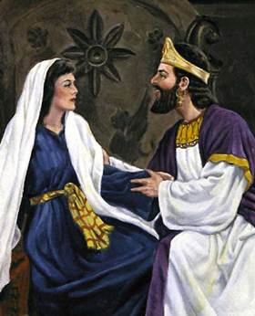
Question
(3) Would you like to be more discerning?
Notes:
Bathsheba – not discern
Adonijah ‘kingdom was mine’ – not repentant (Solomon looking for fruits of repentance, Bath didn’t). How can it be ‘mine’ if God gave it to Solomon.
Emotional appeal – her son is now on the throne, lets down guard, can be emotionally sympathetic to Adonijah
Vulnerable to being tool in enemy’s hand
What might it look like to be led by emotions? E.g. in anger you speak harsh words which aren’t God’s truth over someone. E.g. someone has been nice to you so it is hard to challenge their attitude
Please ask cus he won’t refuse you – not faith position (like crowning himself), manipulative
We don’t want to use manipulation or should be used by manipulation (we manipulate because we don’t trust God has what is best for us)
Abishag – political chip – if you can show you can have the kings wife shows you could have the kingdom (you can fill his shoes)
Do not refuse me – not inviting discussion and benefit from wisdom
Question
E.g. I could meet your presented need, but I see God wants to do something even better than what you are asking for

Slide 11
1 Kings 2:23-27
²³ Then King Solomon swore by the Lord: “May God deal with me, be it ever so severely, if Adonijah does not pay with his life for this request! ²⁴ And now, as surely as the Lord lives—he who has established me securely on the throne of my father David and has founded a dynasty for me as he promised—Adonijah shall be put to death today!” ²⁵ So King Solomon gave orders to Benaiah son of Jehoiada, and he struck down Adonijah and he died.
²⁶ To Abiathar the priest the king said, “Go back to your fields in Anathoth. You deserve to die, but I will not put you to death now, because you carried the ark of the Sovereign Lord before my father David and shared all my father’s hardships.” ²⁷ So Solomon removed Abiathar from the priesthood of the Lord, fulfilling the word the Lord had spoken at Shiloh about the house of Eli.

Slide 12
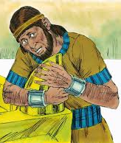
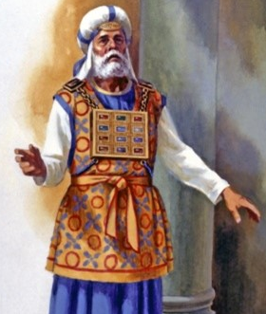
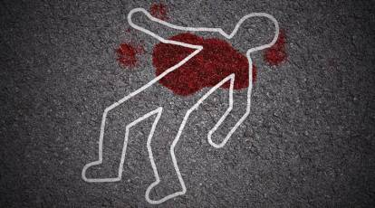

Adonijah
Abiathar
Notes:
Adonijah
Abiathar - 1 Samuel 2:31-36, it is foretold to Eli that his family, to which Abiathar belonged, should be deprived of the priest’s office
“Solomon removed Abiathar from the priesthood” same phrase (Gen 3:24) After he drove the man out, he placed on the east side of the Garden of Eden cherubim and a flaming sword flashing back and forth to guard the way to the tree of life.
Both Adam & Abiathar had taken what, in their own eyes, seemed good – was not a consideration of what God wanted (but even beyond lack of consideration, there was a doubt God wanted the best for them)
e.g. reach out take for ourselves – try to make a relationship work, church leader tried to take for himself (submit to God’s will rather than minister)

Slide 13
1 Kings 2:28-35
²⁸ When the news reached Joab, who had conspired with Adonijah though not with Absalom, he fled to the tent of the Lord and took hold of the horns of the altar. ²⁹ King Solomon was told that Joab had fled to the tent of the Lord and was beside the altar. Then Solomon ordered Benaiah son of Jehoiada, “Go, strike him down!”
³⁰ So Benaiah entered the tent of the Lord and said to Joab, “The king says, ‘Come out!’”
But he answered, “No, I will die here.”
Benaiah reported to the king, “This is how Joab answered me.”
³¹ Then the king commanded Benaiah, “Do as he says. Strike him down and bury him, and so clear me and my whole family of the guilt of the innocent blood that Joab shed.

Slide 14
³² The Lord will repay him for the blood he shed, because without my father David knowing it he attacked two men and killed them with the sword. Both of them—Abner son of Ner, commander of Israel’s army, and Amasa son of Jether, commander of Judah’s army—were better men and more upright than he. ³³ May the guilt of their blood rest on the head of Joab and his descendants forever. But on David and his descendants, his house and his throne, may there be the Lord’s peace forever.”
³⁴ So Benaiah son of Jehoiada went up and struck down Joab and killed him, and he was buried at his home out in the country. ³⁵ The king put Benaiah son of Jehoiada over the army in Joab’s position and replaced Abiathar with Zadok the priest.

Slide 15
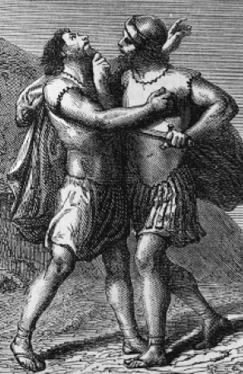
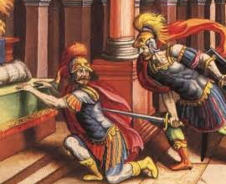
Adonijah
Abiathar
Joab
Notes:
Joab – Grabbing the horn worked for Adonijah
Refuge not as good as repentance
Exodus 21 12“Anyone who strikes a person with a fatal blow is to be put to death. 13However, if it is not done intentionally, but God lets it happen, they are to flee to a place I will designate. 14But if anyone schemes and kills someone deliberately, that person is to be taken from my altar and put to death.
Purity laws
Benaiah tried to get Joab to come away from the altar but he refused. Solomon was happy for him to be put to death where he was
e.g. Focused on pursuing the body I want more than honour what God want
e.g. career prospect
Did Solomon have other options?
More interested in sealing power than honouring what is sacred

Slide 16
1 Kings 2:36-46
³⁶ Then the king sent for Shimei and said to him, “Build yourself a house in Jerusalem and live there, but do not go anywhere else. ³⁷ The day you leave and cross the Kidron Valley, you can be sure you will die; your blood will be on your own head.”
³⁸ Shimei answered the king, “What you say is good. Your servant will do as my lord the king has said.” And Shimei stayed in Jerusalem for a long time.
³⁹ But three years later, two of Shimei’s slaves ran off to Achish son of Maakah, king of Gath, and Shimei was told, “Your slaves are in Gath.” ⁴⁰ At this, he saddled his donkey and went to Achish at Gath in search of his slaves. So Shimei went away and brought the slaves back from Gath.

Slide 17
⁴¹ When Solomon was told that Shimei had gone from Jerusalem to Gath and had returned, ⁴² the king summoned Shimei and said to him, “Did I not make you swear by the Lord and warn you, ‘On the day you leave to go anywhere else, you can be sure you will die’? At that time you said to me, ‘What you say is good. I will obey.’ ⁴³ Why then did you not keep your oath to the Lord and obey the command I gave you?”
⁴⁴ The king also said to Shimei, “You know in your heart all the wrong you did to my father David. Now the Lord will repay you for your wrongdoing. ⁴⁵ But King Solomon will be blessed, and David’s throne will remain secure before the Lord forever.”
⁴⁶ Then the king gave the order to Benaiah son of Jehoiada, and he went out and struck Shimei down and he died.
The kingdom was now established in Solomon’s hands.

Slide 18
Adonijah
Abiathar
Joab
Shimei
Notes:
Shimei
Solomon receives David’s advise – he finds his own way of coming to the same conclusion – gives Shimei chance to live under house arrest but then kills him
How does all this bloodshed apply to us today? Cancel culture
Crowned in chapter 1 but kingdom not established until end chapter 2

