Slide 1

The Kings Study
Episode 4
16th July 2023

Slide 2



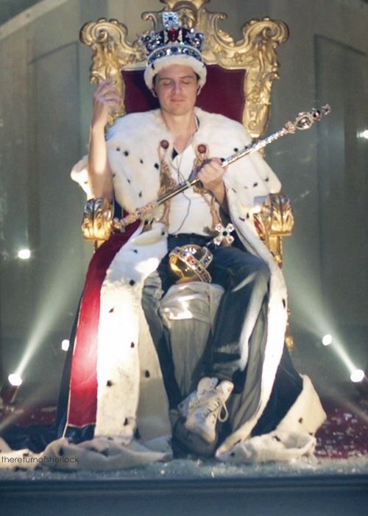
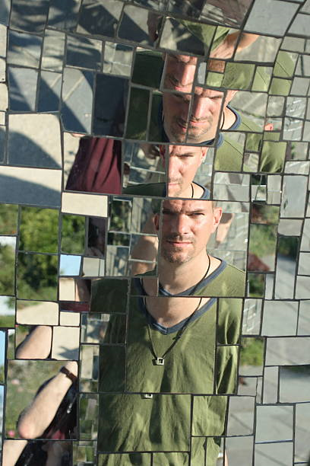
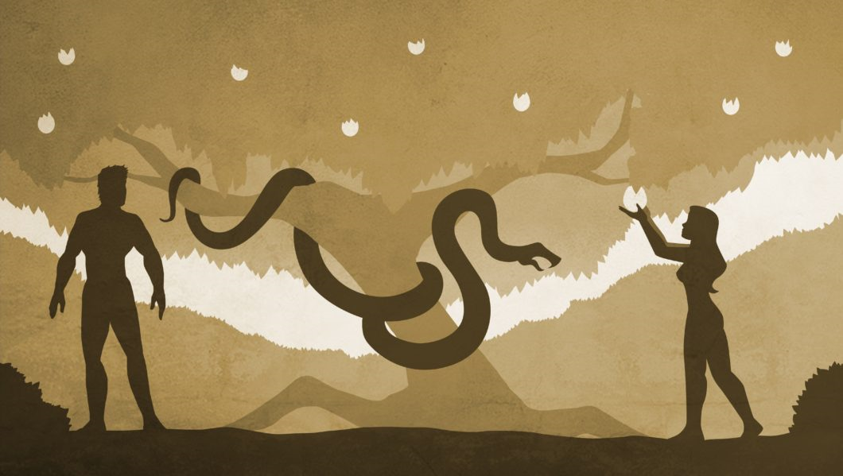
Recap

Slide 3
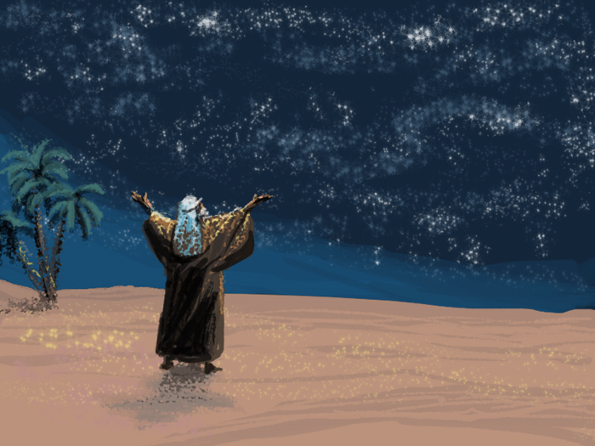
“through your offspring all nations on earth will be blessed”

Slide 4
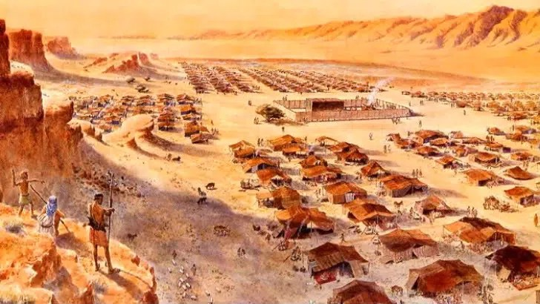
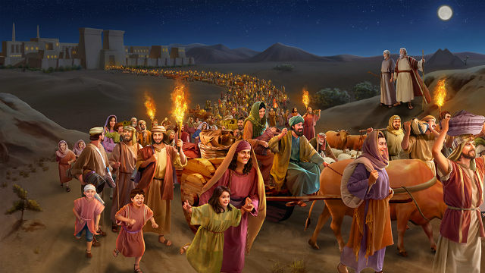
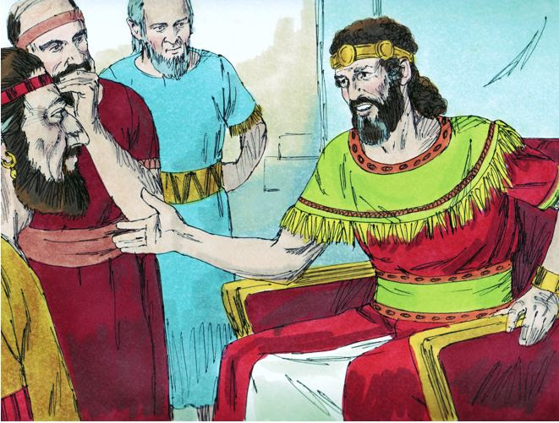
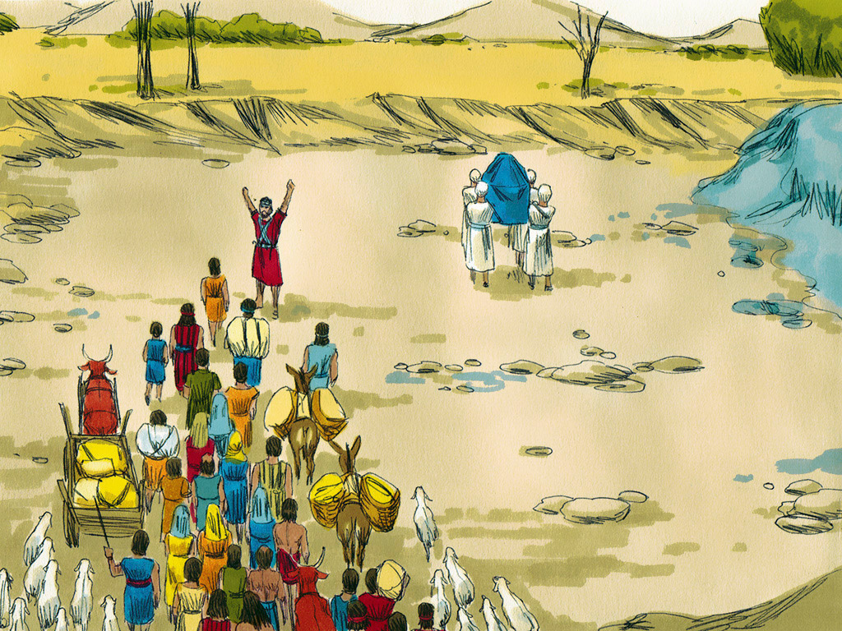
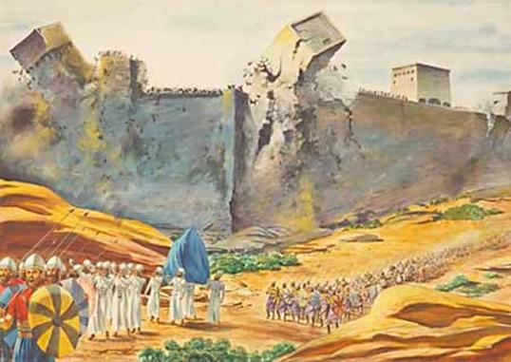

Slide 5
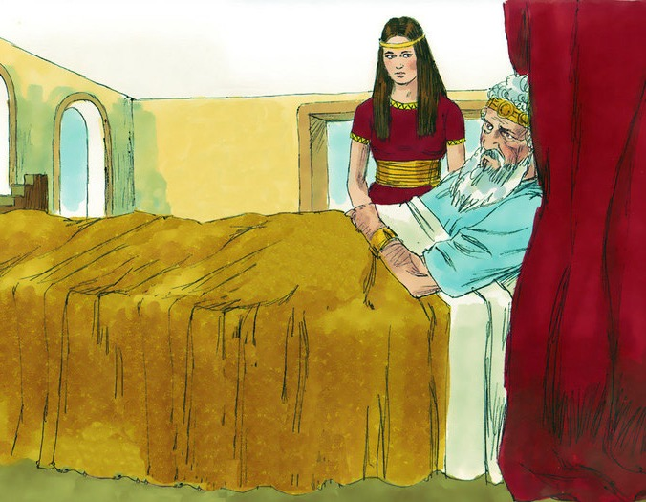
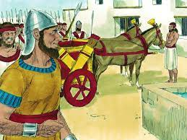
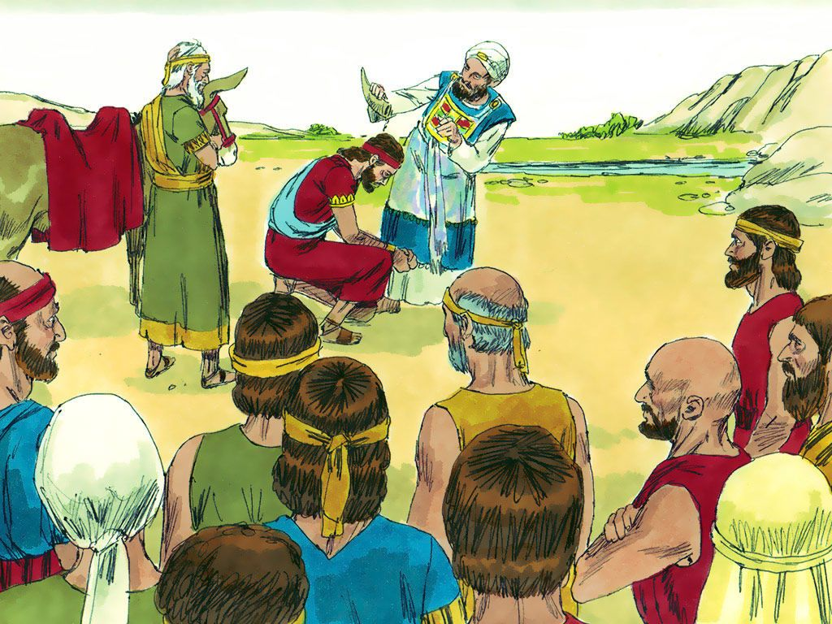
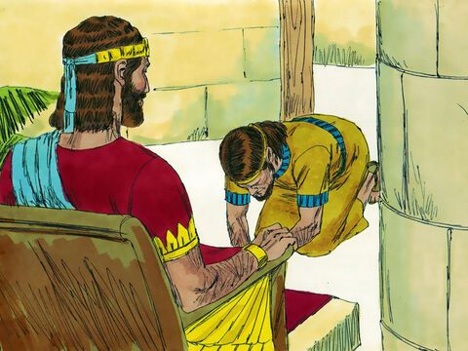

Slide 6
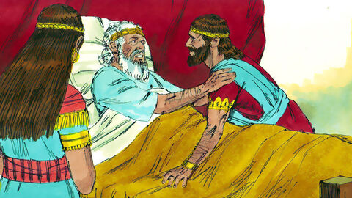
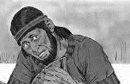
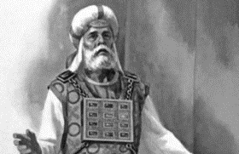
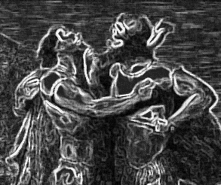
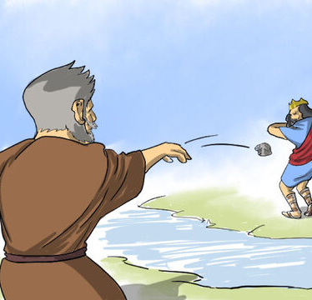
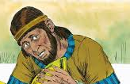
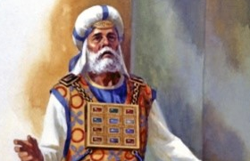
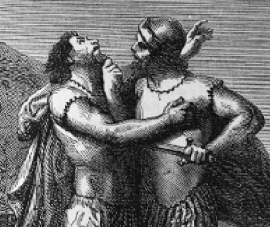
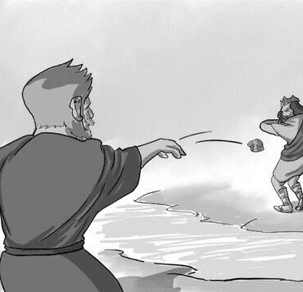

Slide 7
1 Kings 3:1-3
Solomon made an alliance with Pharaoh king of Egypt and married his daughter. He brought her to the City of David until he finished building his palace and the temple of the Lord, and the wall around Jerusalem. ² The people, however, were still sacrificing at the high places, because a temple had not yet been built for the Name of the Lord. ³ Solomon showed his love for the Lord by walking according to the instructions given him by his father David, except that he offered sacrifices and burned incense on the high places.

Slide 8

Alliances
Exodus 34:16
¹⁵ “Be careful not to make a treaty with those who live in the land; for when they prostitute themselves to their gods and sacrifice to them, they will invite you and you will eat their sacrifices. ¹⁶ And when you choose some of their daughters as wives for your sons and those daughters prostitute themselves to their gods, they will lead your sons to do the same.
Nehemiah 13:26
²⁶ Was it not because of marriages like these that Solomon king of Israel sinned? Among the many nations there was no king like him. He was loved by his God, and God made him king over all Israel, but even he was led into sin by foreign women.
Question (1)
Have you made any dodgy alliances?
Notes:
Solomon making alliance with Egypt – God freed them from Egypt
Can deal but not unequally yoked
dodgy alliance
Exodus 34:16 / Nehemiah 13:26
taking foreign wives are beginning of the end (yet God is about to bless)
Blessing not sign of approval
Have you made any dodgy alliances?
e.g. gossiping lips and gossiping ear
e.g. Compromising what you believe in order to fit in better
e.g. Help someone justify a thought which isn’t God
e.g. open a door allow influence – draw line at adultery but where to we stand on what we read/watch

Slide 9
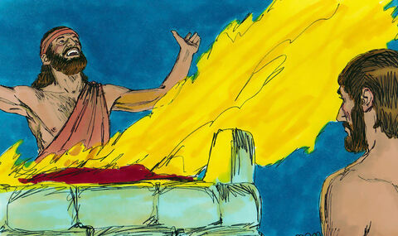
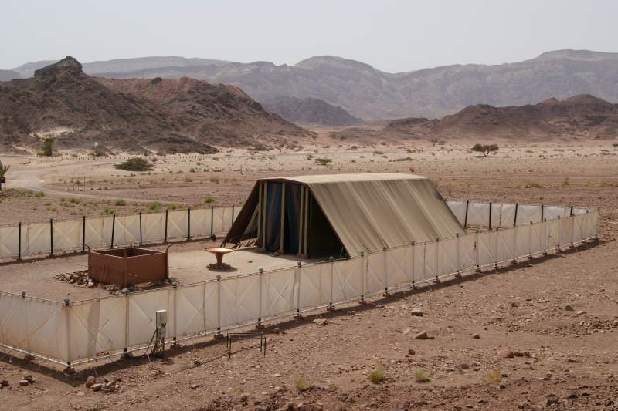
High Places
Deu 12:1-5
These are the decrees and laws you must be careful to follow in the land that the Lord, the God of your ancestors, has given you to possess—as long as you live in the land. ² Destroy completely all the places on the high mountains, on the hills and under every spreading tree, where the nations you are dispossessing worship their gods. ³ Break down their altars, smash their sacred stones and burn their Asherah poles in the fire; cut down the idols of their gods and wipe out their names from those places.
⁴ You must not worship the Lord your God in their way. ⁵ But you are to seek the place the Lord your God will choose from among all your tribes to put his Name there for his dwelling. To that place you must go
Question (2)
What are the high places in your life?
Notes:
High places – back in Gen there are some examples of key characters sacrificing in worship to God on high placed (e.g. Noah, Abraham)
But with the introduction of tabernacle God wants to use tabernacle (Deu 12:4) as the place. Superseding the old idea of sacrificing in high places
High place = ‘honouring’ God at your convenience
e.g. attend many meetings – but realised we worship Him in our everyday life
e.g. I rate a time of worship if I feel energised (I worship Him for what I get out of it)
What are the high places in your life?
Did you know worship can become an idol when it becomes more important than God Himself
e.g. I serve because what it looks like to others/what I get out of it
Unifying – not my preference but this is what family does (e.g. church holiday, Sunday mornings). Pattern set in early church – not individualistic (just me and God) – going house to house, meeting together, encouraging each other
Heb 10:25, “do not forsake assembling,” (Sunday morning & households, prayer meeting)
Kingdom flourishing…but there is just this little issues (high places)
What is worship?
Isn’t it incredible that we can worship – and it smells sweet to Him (Rom 12:1 present your bodies as a living sacrifice, holy and acceptable to God)
We don’t get to choose how, where I worship (might say ‘but God sees my heart’)
We worship in giving, serving, joining together corporately, not engaging in gospel but speaking truth in love
Worship = saying ‘no’ to me, ‘yes’ to Him

Slide 10

Wholeheartedness (No exceptions)
Question (3)
Do you have a divided heart?
Notes:
Follow with your whole heart
Solomon showed love the Lord by action EXCEPT (can’t pick and choose – obey is better than sacrifice)
What is a divided heart?
I have two conflicting desires that I’m pursuing at the same time
What would you say are your priorities?
Are those priorities reflected in how you use time, money, energy, thoughts, what company do I keep?
If not reflect you probably have a divided heart
Would you happy for Jesus to come with you wherever you were going, to listen in our every conversation, to have a window into your attitude
God is keen on wholeheartedness
David urged Solomon
1 Chronicles 28:9
“As for you, my son Solomon, know the God of your father, and serve Him with a whole heart and a willing mind; for the Lord searches all hearts, and understands every intent of the thoughts.
We’ll see that it was a divided heart that lead to Solomon’s downfall
As Solomon grew old, his wives turned his heart after other gods, and his heart was not fully devoted to the LORD his God, as the heart of David his father had been. (1 Kings 11:4)
Jesus urges
Love the Lord your God with all your heart and with all your soul and with all your mind and with all your strength.’ (Matt 12:30)
What do you do when you realise your heart is divided?
Confession (owning up to yourself & God)
Repent (change the way I think)
Ask God to give undivided heart (I can’t do it myself)
God promises, through Ezekiel, that we can have a devoted heart
I will give them an undivided heart and put a new spirit in them; I will remove from them their heart of stone and give them a heart of flesh. (Ezekiel 11:19)

Slide 11
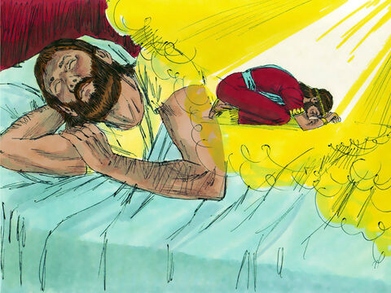
1 Kings 3:4-9
⁴ The king went to Gibeon to offer sacrifices, for that was the most important high place, and Solomon offered a thousand burnt offerings on that altar. ⁵ At Gibeon the Lord appeared to Solomon during the night in a dream, and God said, “Ask for whatever you want me to give you.”

Slide 12
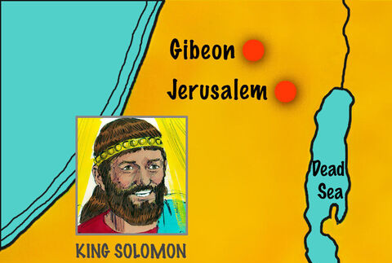
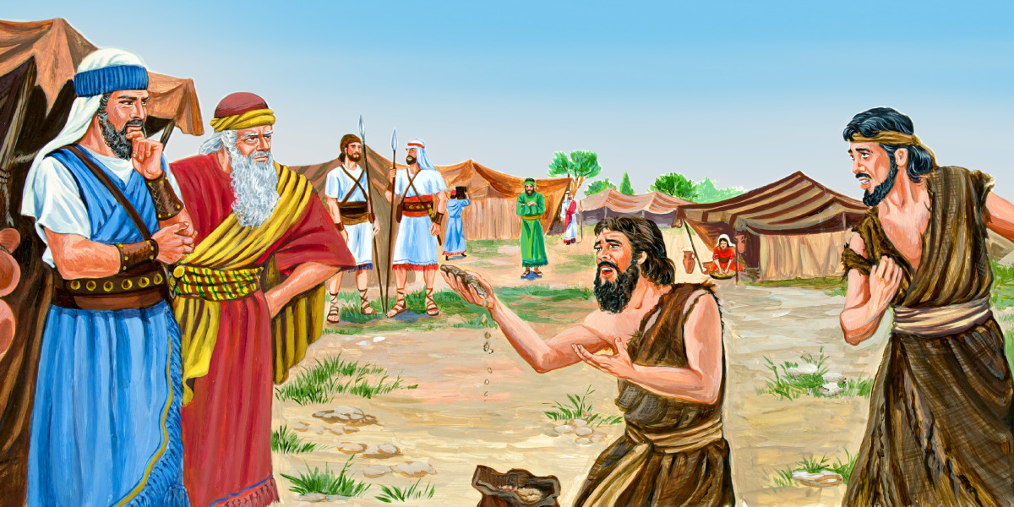

Exuberant worship
Notes:
Gibeon (152km north-west of Jerusalem) - place of compromise/making oath with enemy without inquiring God
blessing not = approval (even when we get it wrong God doesn’t condemn us)
Exuberant worship – lots of sacrifice. If you truly love Him – it is a joy to give to Him (not begrudge) – Tim Keller listened to classic music to make money, now spend money to listen to music
e.g. Felt had to take on Sunday school class, not keen – but God used me to pioneer something new which becomes a joy

Slide 13
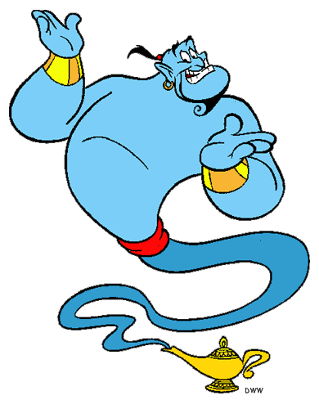

“Ask for whatever you want me to give you.”
Question (4)
What would you ask for?
Notes:
Verse 5
what would you ask for? (step carefully)
My attitude to this question would be very different if I see God as
A genie
A loving Father who knows what is best and has the will and ability to bring it about (not self protect or provide)
God’s not answering my question – perhaps He wants to talk about something else [what He wants for me is better than what I want for me]
If all you want is a spiritual coin toss to help you make a decision you aren’t following whole-heartedly – you want what he wants
test - what do you want? (humility in response – He knows better e.g. Ezekiel can these bones live?)

Slide 14
1 Kings 3:6-9
⁶ Solomon answered, “You have shown great kindness to your servant, my father David, because he was faithful to you and righteous and upright in heart. You have continued this great kindness to him and have given him a son to sit on his throne this very day.
⁷ “Now, Lord my God, you have made your servant king in place of my father David. But I am only a little child and do not know how to carry out my duties. ⁸ Your servant is here among the people you have chosen, a great people, too numerous to count or number. ⁹ So give your servant a discerning heart to govern your people and to distinguish between right and wrong. For who is able to govern this great people of yours?”

Slide 15

Notes:
humility - not puffed up by title or ceremony
Servant with duties, child, not know how to act, remember God’s kindness (God put him on the throne), great people (quality and love for those he serves – is this how we think of kids within the class? Is it a privilege to serve them?)
sees being king is about bigger than himself (the story started before him and will continue after) - part of a great work
God gives us things beyond our ability (so we rely on Him) – I might be able to do a task to my ability, but I want to do it to His ability
e.g. know God’s heart for person even though they are being very difficult
Humble – listened to advice of those who loved and were mature in faith
David planted the idea for Solomon to seek "discretion and understanding" from the Lord (1 Chron 22:12)
e.g. grandfather exampled something I didn’t appreciate at the time but later became the basis of what we are doing today (shared life, reaching into the community) – moving focus from big church, big ministry but God had planted desire for something

Slide 16

Notes:
Sightedness/wisdom/discernment
discerning heart
distinguish between right and wrong
Help us see it as You see it – Jacob said surely the lord was here the whole time and I WASN’T AWARE (Gen 28:16) Jacob on the run, not a holy place
Need to know God’s mind and moment – constantly looking what He wants
e.g. how do you decide if you go away for uni or not (consider: what does God wants?)
Lean not to your own understanding

Slide 17
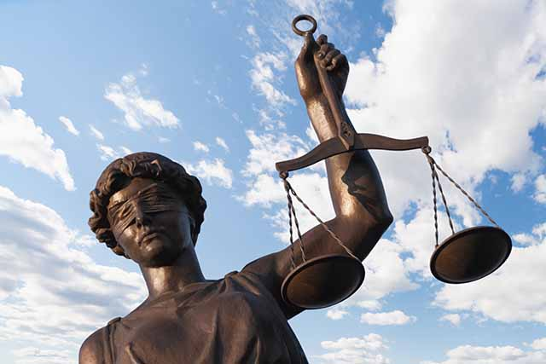
Notes:
Administer justice
Ps 72 – Solomon describes why he wants wisdom – to administer justice, show God’s love for the oppressed, [put God’s attributes on display – i.e. glorify God]
Blessing = resourced to do what God wants of you
A fast car is only a blessing if God wants you to get from A to B quickly
Solomon wants the resource to fulfil his purpose (i.e. to glorify God – to put his attributes on display e.g. justice). Not asking for self indulgence
What is your wish list dominated with – what you need to glorify God or self-indulgence?
e.g. John’s failed engagement

