Slide 1

A Wise Ruling
The Kings Study - Episode 5
3rd September 2023
Notes:
Recap, look at Solomon’s request for wisdom, but focus on the wise ruling and

Slide 2
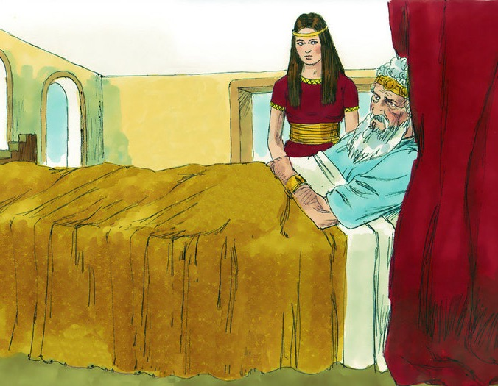
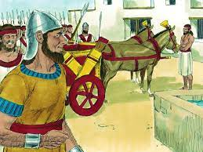
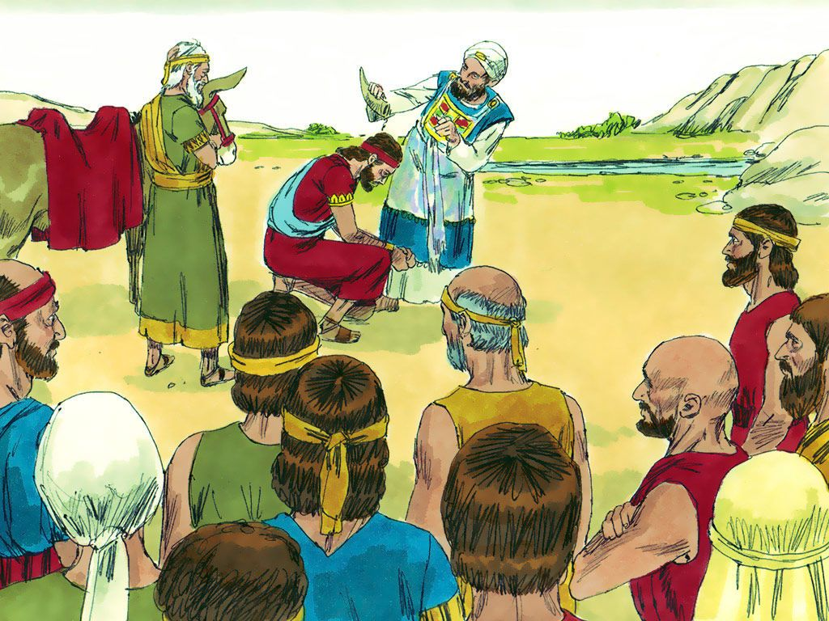
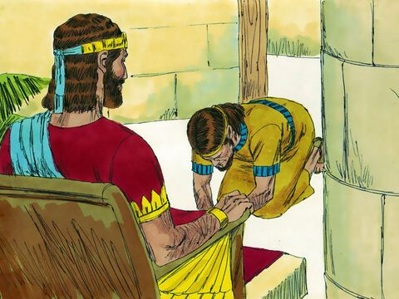

Slide 3
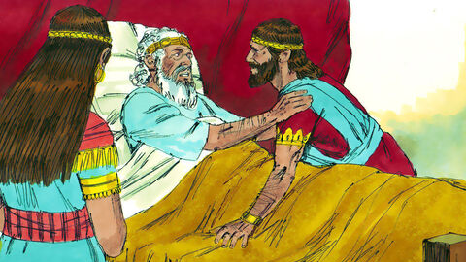
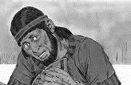
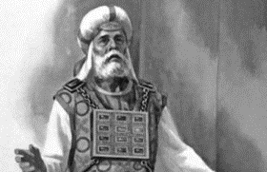
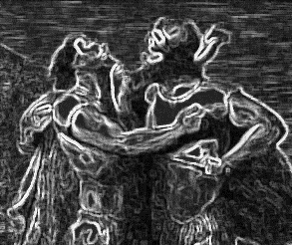
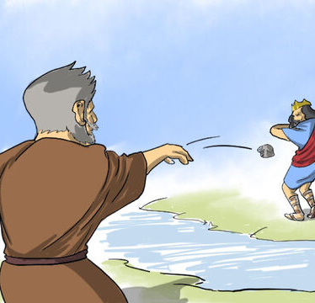
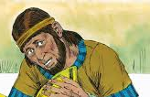
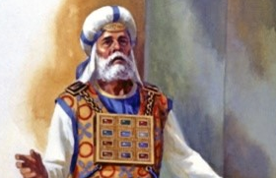
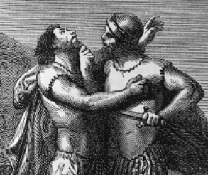
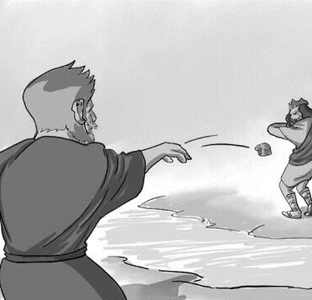

Slide 4
1 Kings 3:6-9
⁶ Solomon answered, “You have shown great kindness to your servant, my father David, because he was faithful to you and righteous and upright in heart. You have continued this great kindness to him and have given him a son to sit on his throne this very day.
⁷ “Now, Lord my God, you have made your servant king in place of my father David. But I am only a little child and do not know how to carry out my duties. ⁸ Your servant is here among the people you have chosen, a great people, too numerous to count or number. ⁹ So give your servant a discerning heart to govern your people and to distinguish between right and wrong. For who is able to govern this great people of yours?”
Notes:
‘I am only a little child and do not know how to carry out my duties’ – Spanish. Are we okay if God using us means we look a little foolish?

Slide 5
1 Kings 3:10-15
¹⁰ The Lord was pleased that Solomon had asked for this. ¹¹ So God said to him, “Since you have asked for this and not for long life or wealth for yourself, nor have asked for the death of your enemies but for discernment in administering justice, ¹² I will do what you have asked. I will give you a wise and discerning heart, so that there will never have been anyone like you, nor will there ever be. ¹³ Moreover, I will give you what you have not asked for—both wealth and honor—so that in your lifetime you will have no equal among kings. ¹⁴ And if you walk in obedience to me and keep my decrees and commands as David your father did, I will give you a long life.” ¹⁵ Then Solomon awoke—and he realized it had been a dream.
He returned to Jerusalem, stood before the ark of the Lord’s covenant and sacrificed burnt offerings and fellowship offerings. Then he gave a feast for all his court.
Notes:
God loves to pour his blessing into channels not only receptacles – what is our wish list dominated with – self-indulgence or what we need to glorify God?

Slide 6
1 Kings 3:16-28 – A wise ruling
¹⁶ Now two prostitutes came to the king and stood before him. ¹⁷ One of them said, “Pardon me, my lord. This woman and I live in the same house, and I had a baby while she was there with me. ¹⁸ The third day after my child was born, this woman also had a baby. We were alone; there was no one in the house but the two of us.
¹⁹ “During the night this woman’s son died because she lay on him. ²⁰ So she got up in the middle of the night and took my son from my side while I your servant was asleep. She put him by her breast and put her dead son by my breast. ²¹ The next morning, I got up to nurse my son—and he was dead! But when I looked at him closely in the morning light, I saw that it wasn’t the son I had borne.”
²² The other woman said, “No! The living one is my son; the dead one is yours.”
But the first one insisted, “No! The dead one is yours; the living one is mine.” And so they argued before the king.

Slide 7
1 Kings 3:16-28 – A wise ruling
²³ The king said, “This one says, ‘My son is alive and your son is dead,’ while that one says, ‘No! Your son is dead and mine is alive.’”
²⁴ Then the king said, “Bring me a sword.” So they brought a sword for the king. ²⁵ He then gave an order: “Cut the living child in two and give half to one and half to the other.”
²⁶ The woman whose son was alive was deeply moved out of love for her son and said to the king, “Please, my lord, give her the living baby! Don’t kill him!”
But the other said, “Neither I nor you shall have him. Cut him in two!”
²⁷ Then the king gave his ruling: “Give the living baby to the first woman. Do not kill him; she is his mother.”
²⁸ When all Israel heard the verdict the king had given, they held the king in awe, because they saw that he had wisdom from God to administer justice.

Slide 8
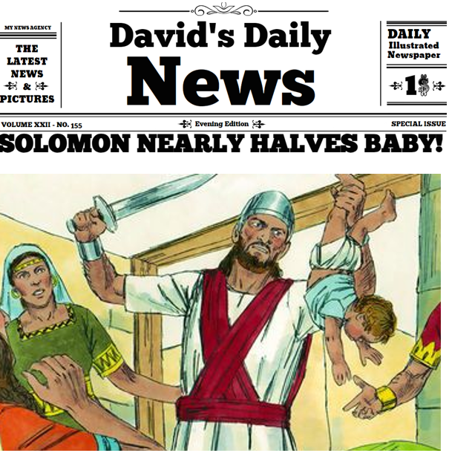
1. God’s wisdom does not equate to worldly wisdom
Isaiah 40:28 – His wisdom is so beyond our ability to comprehend that we don’t even have a comparison in anyone or anything.
Can you think of a time when God has directed you to act against conventional wisdom?
Notes:
Might not have worked, but Solomon knew that it would. He depended on God’s wisdom and risked his reputation in the process.
The judgements of God can seem strange, dangerous, or even foolish at times. Even the act of salvation through Jesus on the cross is deemed as ‘foolish’ to non-believers (1 Cor 1:18) Solomon is quite the dramatist here, he asks for the sword and then reveals what he will do with it. It was not for everyone to understand but the result was that the child was reunited with his mother. Our solutions don’t have to look perfect.
Wouldn’t the other woman also cry out to save the baby? Solomon had wisdom – Isaiah 40:28
How do you make decisions? as a leader what do you do when difficult matters are brought before you? Do you judge by sight? We see Solomon make such a wise ruling here because he humbled himself and the wisdom of god was at work in his life. He was willing to stake his reputation.

Slide 9

2.“Bring me a sword”
1 Kings 3:24
Then the king said, “Bring me a sword.” So they brought a sword for the king. ²⁵ He then gave an order: “Cut the living child in two and give half to one and half to the other.”
Hebrews 4:12
For the word of God is alive and active. Sharper than any double-edged sword, it penetrates even to dividing soul and spirit, joints and marrow; it judges the thoughts and attitudes of the heart.
Can you think of a situation where you could ask for a ‘sword’ to empower you to respond/act differently to your instincts?
Notes:
When Solomon says ‘bring me a sword’. He uses the sord not to divide but to decide who is the right mother. When there is a dispute do we always say ‘bring me a sword’, for the word of God is sharper than any sword (Hebrews 4:12) When we need wisdom or there’s a problem in front of us, is our first action to turn to Gods word. Some people use the scripture to divide, others for unity love and discernment.
An alternative to my natural reaction

Slide 10

3. “Come boldly before the throne”
1 Kings 3:16
Now two prostitutes came to the king and stood before him.
Hebrews 4:16
Let us then approach God’s throne of grace with confidence, so that we may receive mercy and find grace to help us in our time of need.
What are the challenges that prevent us from coming before Him now?
Notes:
The thing that always strikes me about this passage is that two prostitutes were able to come before the king with an issue. Now we are not sure if they definitely were prostitutes, in other translations they are recorded as two women. But in any case, as they are two women without husbands and with children they would have been in a very low standing in society. It’s striking that they were able to have an audience with the king.
But isn’t it even more incredible that we can come before God, present our issues to him and see his wisdom at work in our lives. Again, from Hebrews 4, we are told to come ‘boldly before the throne of grace’

Slide 11

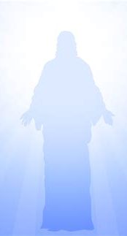
4. Solomon disappoints, but Jesus fulfils
1 Kings 11:4
As Solomon grew old, his wives turned his heart after other gods, and his heart was not fully devoted to the LORD his God, as the heart of David his father had been.
Have you been disappointed by putting your faith in things other than God? It’s time to come back to Him
Notes:
No character in the new testament disappoints us as much as Solomon, he wasted the gifts that god gave him. Though he accomplished much, he could have accomplished much more, his heart was led away from god in the end. His problem really centred around his personal relationships with his wives, and by the time we get to chapter 11, his heart with be turned away from God.

Slide 12
What is God speaking to you about?
Can you think of a situation where you could ask for a ‘sword’ to empower you to respond/act differently to your instincts?
What are the challenges that prevent us from coming before Him now?
Have you been disappointed by putting your faith in things other than God? It’s time to come back to Him.
Can you think of a time when God has directed you to act against conventional wisdom?

