Slide 1
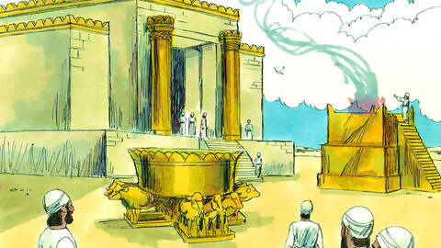
The Kings Series
Episode 9
The Kings Study – Episode 9
8th Oct 2023
Notes:
1 Kings 8
In previous chapters we have seen Solomon setup his government (chpt 4), start prep for building temple (chpt 5), then built the temple (chpt 6), then furnish it (chpt 7). Now is the big dedication ceremony – the grand opening. Again we won’t read verse by verse because there is a lot of detail (66 verses). But we will pick out some themes and zoom into a few verses based on what I feel God wants us to get from this scripture at this time.
Key themes
Heart of the matter is the heart
His presence is overwhelming and leaves a mark
Who is the star of the show?
The scandal of forgiveness

Slide 2
1 Kings 8:1-7
Then King Solomon summoned into his presence at Jerusalem the elders of Israel, all the heads of the tribes and the chiefs of the Israelite families, to bring up the ark of the Lord’s covenant from Zion, the City of David. ² All the Israelites came together to King Solomon at the time of the festival in the month of Ethanim, the seventh month.
³ When all the elders of Israel had arrived, the priests took up the ark, ⁴ and they brought up the ark of the Lord and the tent of meeting and all the sacred furnishings in it. The priests and Levites carried them up, ⁵ and King Solomon and the entire assembly of Israel that had gathered about him were before the ark, sacrificing so many sheep and cattle that they could not be recorded or counted.
⁶ The priests then brought the ark of the Lord’s covenant to its place in the inner sanctuary of the temple, the Most Holy Place, and put it beneath the wings of the cherubim. ⁷ The cherubim spread their wings over the place of the ark and overshadowed the ark and its carrying poles
Notes:
Ark (representing God’s presence) moved from the tabernacle into the temple

Slide 3
(1) Heart of the matter is the heart

Slide 4
Solomon followed David’s PLAN but missed his PURPOSE
- Jeremy
Notes:
Last week Jeremy made the point Solomon followed David’s PLAN but missed his PURPOSE
This is so important for us
Keeping the movement going
Blessing vs birthright (love the form or the King/Kingdom)
Do we love the same things that caused our spiritual forefathers to start the journey?
But looking at the scripture we just read – aren’t we being a little harsh on Solomon – it doesn’t say he did anything wrong?
We see another example of Solomon missing the purpose – why did David want to bring the ark/presence of God to Jerusalem in the first place?

Slide 5
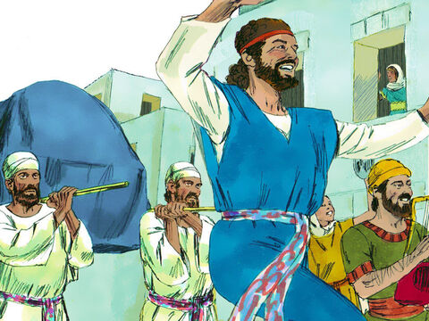
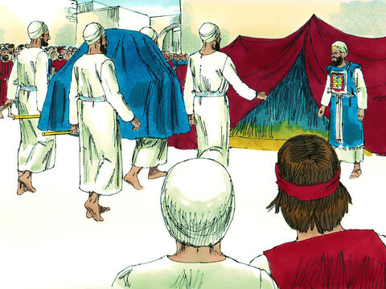
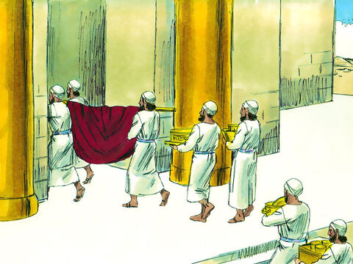
2 Sam 6
1 Kings 8
Notes:
Both David and Solomon moved the ark
Early on in the book of 1 sam some corrupt Israelite priest take the ark into battle (as if they can use God as they please), they lose the battle, the enemy captures the ark, but God starts causing them a problem so they send it back to Israel and it sits at some guys house for 20 years until David brings it to Jerusalem
Solomon brings ark from tabernacle into the temple
Compare David bring ark to Jerusalem with Solomon bringing the ark into the temple – spot the difference
David humble (strips off) & joyful (dancing)
2 Sam 6:13 …So David went to bring up the ark of God from the house of Obed-Edom to the City of David with rejoicing.
2 Sam 6:14-15 ¹⁴ Wearing a linen ephod, David was dancing before the Lord with all his might, 15 while he and all Israel were bringing up the ark of the Lord with shouts and the sound of trumpets. David’s abandonment embarrassed his wife
Solomon still all about appearance, exuberant display
David enjoyed God - Heart fully devoted to God - relationship
Solomon served (used) God - Divided heart – religious – this theme of Solomon’s divided/corrupt heart has been throughout the chpts so far and will come clearer in next chpts. Solomon didn’t love the presence of God like David

Slide 6
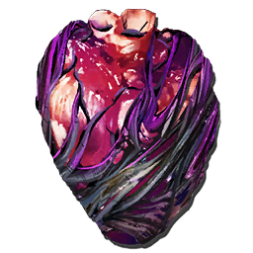
There is a battle over your heart
The heart is deceitful above all things and beyond cure. Who can understand it?
- Jeremiah 17:9
Notes:
The bible offers and damning and accurate assessment of the human heart
(By heart we mean our decision making – not just emotion like in modern day use)

Slide 7
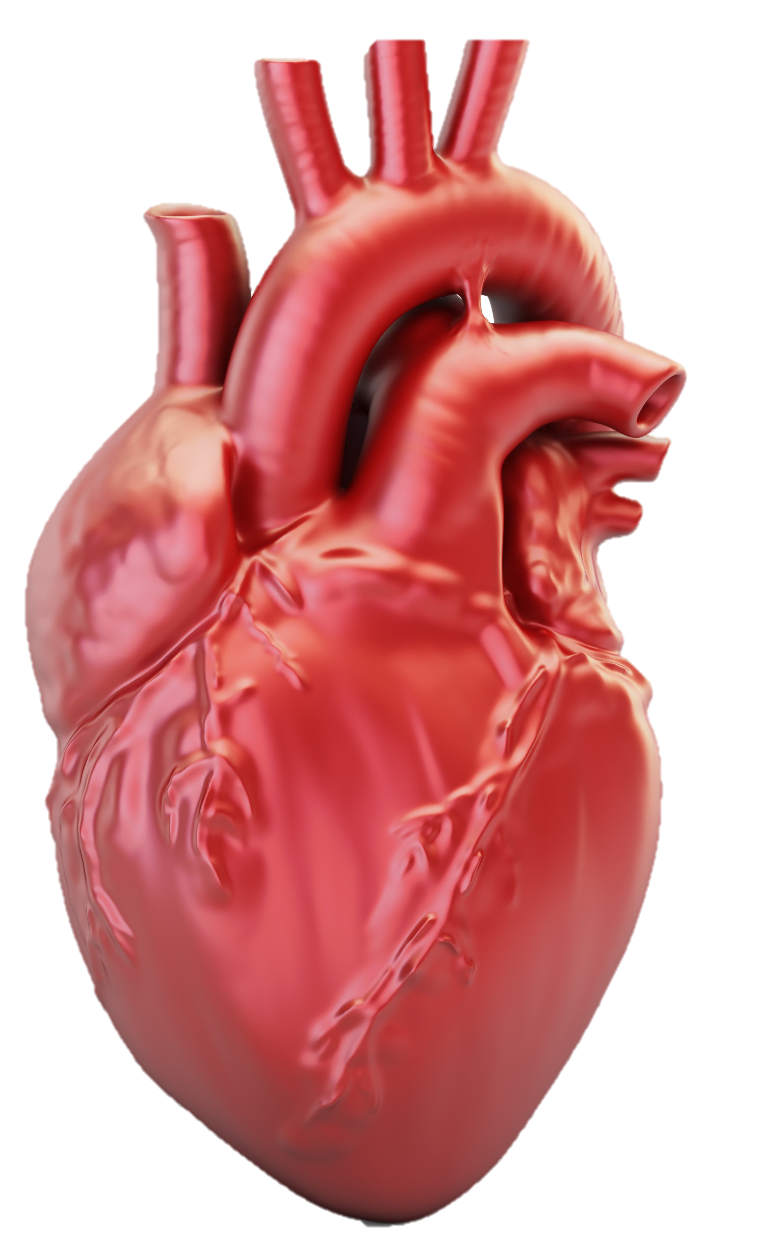
There is a battle over your heart
Then I will give you a new heart and put a new spirit in you; I will remove from you your heart of stone and give you a heart of flesh. And I will put my Spirit in you and move you to follow my decrees and be careful to keep my laws. Then you will live in the land I gave your ancestors; you will be my people, and I will be your God
- Eze 36:26-28

Slide 8

“And afterward,
I will pour out my Spirit on all people.
Your sons and daughters will prophesy,
your old men will dream dreams,
your young men will see visions.
Even on my servants, both men and women,
I will pour out my Spirit in those days.
- Joel 2:28-29
They saw what seemed to be tongues of fire that separated and came to rest on each of them. All of them were filled with the Holy Spirit and began to speak in other tongues as the Spirit enabled them.
- Acts 2:3-4
Notes:
God kept promising – in those days….
Then it happens – the Spirit is poured out
Impact of the Spirit (see Rom 8 – its dense!)

Slide 9

in order that the righteous requirement of the law might be fully met in us, who do not live according to the flesh but according to the Spirit.
- Rom 8:4
The Spirit himself testifies with our spirit that we are God’s children.
- Rom 8:16
Notes:
Other benefits of being filled with Spirit
We please God
Desire what He wants
We come to believe we are children of God (v16 The Spirit himself testifies with our spirit that we are God’s children.)

Slide 10
Question:
(1) Do you want God to give you a new heart, devoted to Him?
Notes:
Our hearts are corrupt – we can’t please God, we fail to do the good we know we should do, we go through motions, our heart can’t be cured
God promises a heart transplant – He gives us a new heart and spirit
He pours His spirit into us
This means we have a new heart and spirit and now know we are His children (intimacy) and we can please Him
Response
A new heart, is a work of His spirit in you
If you want to be genuine in your pursuit of Him (not just going through the motions)
When I taught from chpt 6 I talked about being the temple of the holy spirit, carrying the spirit into every situation we are in
Perhaps you have never been filled with His spirit
Perhaps you have already decided to make Jesus Lord (which is a work of the spirit in you) but you suspect there is more
Perhaps you have had times of knowing the infilling of His presence but historically and not recently/currently – bible says be being fill
You will soon have opportunity to respond

Slide 11
(2) Obstructive Presence

Slide 12
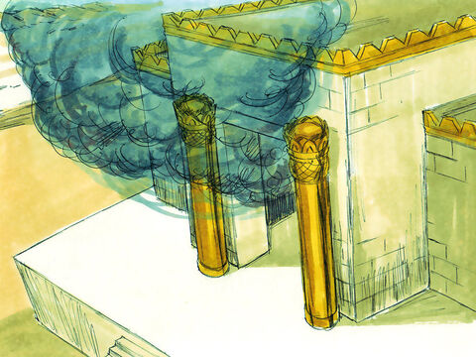
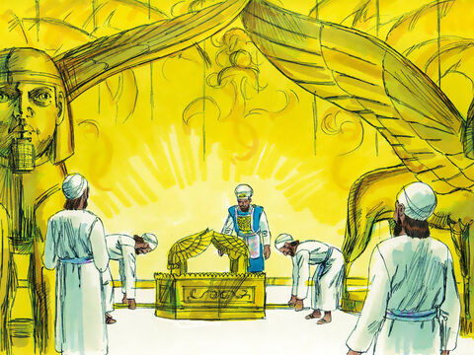
1 Kings 8:10-11
When the priests withdrew from the Holy Place, the cloud filled the temple of the Lord. And the priests could not perform their service because of the cloud, for the glory of the Lord filled his temple.
Question:
(2) Do you want to be more aware of Him than activities of worship?
Notes:
Priests couldn’t perform service because the cloud
Wouldn’t it be great to be caught up in the presence of God
If I reached out I could touch
e.g. SAS – same power that held back the red sea is in you – A level motivation
He has done everything necessary to make it possible for us to enter His presence
We can’t afford to get hung up on chords, keys and song preferences - the curtain has been torn! the tomb is empty! We have been invited into the intimate union of the Father, Son and Spirit.
It’s not just sunday mornings - it can be on our own or can be when we are together
We collectively are the temple that He fills now - 2 or more gathered
Application: I want to be more conscious of God than the activities of worship. Let's invite Him now
(Let’s stand in recognition someone of honour has just entered the room like in verse 14)
Holy Spirit You are welcome here
Come flood this place and fill the atmosphere
Your Glory God is what our hearts long for
To be overcome by Your Presence Lord
Do you want the spirit to confirm you are His child? That you belong to Him
Fill for first time or refreshing?
[Raise your hand where you stand]

Slide 13
(3) Cameo or Star

Slide 14
1 Kings 8:27
“But will God really dwell on earth? The heavens, even the highest heaven, cannot contain you. How much less this temple I have built!
Notes:
Ps 127:1 Unless the LORD builds the house, its builders labor in vain.
He says this but is still a little over focused on the impressive structure
Double minded = unstable

Slide 15
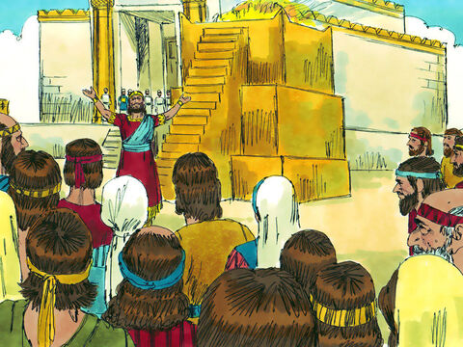
I have provided a place
I sit on the throne
I have built
I have indeed built a magnificent temple
Question:
(3) Is there anywhere you have worshipped the created rather than the creator?
Notes:
It’s all about me
“I have…” A lot of Solomon in this passage - making himself the starring role rather than the cameo he is.
:13
I have indeed built a magnificent temple for you
completely missed what was right in front of his face - the presence of the creator of the universe was right in front of him and he thinks the build is the magnificent thing
You can be here and still miss it
Compare to 1 Peter 4:11 If anyone speaks, they should do so as one who speaks the very words of God. If anyone serves, they should do so with the strength God provides, so that in all things God may be praised through Jesus Christ. To him be the glory and the power for ever and ever. Amen.
- everything we do is for His glory and fame
Q: anywhere you have worshipped the created rather than the creator?
- did you know we can worship worship?
- an idol is any good thing which becomes the ultimate thing – as long as this thing is not God (the creator) it is created
- anything you will give priority to over God (friendship, children, career, education, ‘me-time’)

Slide 16


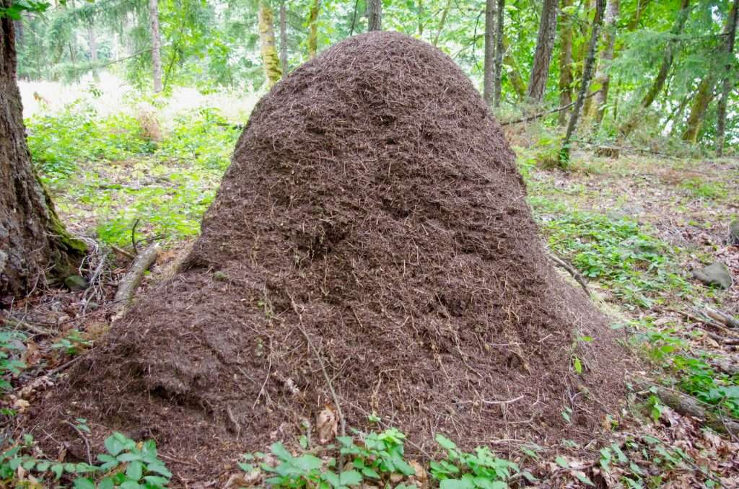
Question:
(4) Do you want God to create a hunger for Him?
Notes:
Solomon’s ego was hogging the stage
But how do I battle against my ego? My need to be centre of attention? The star?
Ant picture
When its not all about you, you are free to give generously to the next generation – to keep the movement going
David – stocked the nails for the doors even though he wouldn’t get to build
I get to invest in next generation – helping them to experience more of Him, greater devotion to Him, be part of God’s kingdom which starts before me and continues after me – not all about me
Application: God, create a hunger for you and your presence rather than externals (Birthright vs blessing) - phil 3:7-10 - to know HIM
⁷ But whatever were gains to me I now consider loss for the sake of Christ. ⁸ What is more, I consider everything a loss because of the surpassing worth of knowing Christ Jesus my Lord, for whose sake I have lost all things. I consider them garbage, that I may gain Christ ⁹ and be found in him, not having a righteousness of my own that comes from the law, but that which is through faith in^{[a]} Christ—the righteousness that comes from God on the basis of faith. ¹⁰ I want to know Christ—yes, to know the power of his resurrection and participation in his sufferings, becoming like him in his death,
Phil 2:13 - it is God who creates the desire (not working harder)

Slide 17
(4) The Scandal of Forgiveness
Notes:
Theme of forgiveness in dedication prayer (v30, 34, 36, 39, 50)

Slide 18
In Him we have redemption through His blood, the forgiveness of sins, in accordance with the riches of God’s grace
- Eph 1:7

Slide 19
Forgiveness vs Consequences
Notes:
Difference between forgiveness and consequences

Slide 20
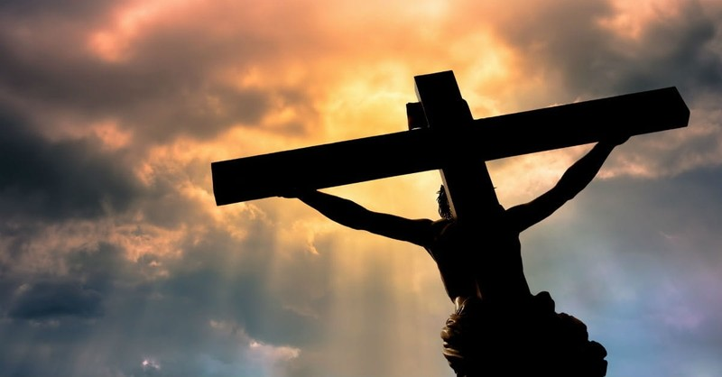
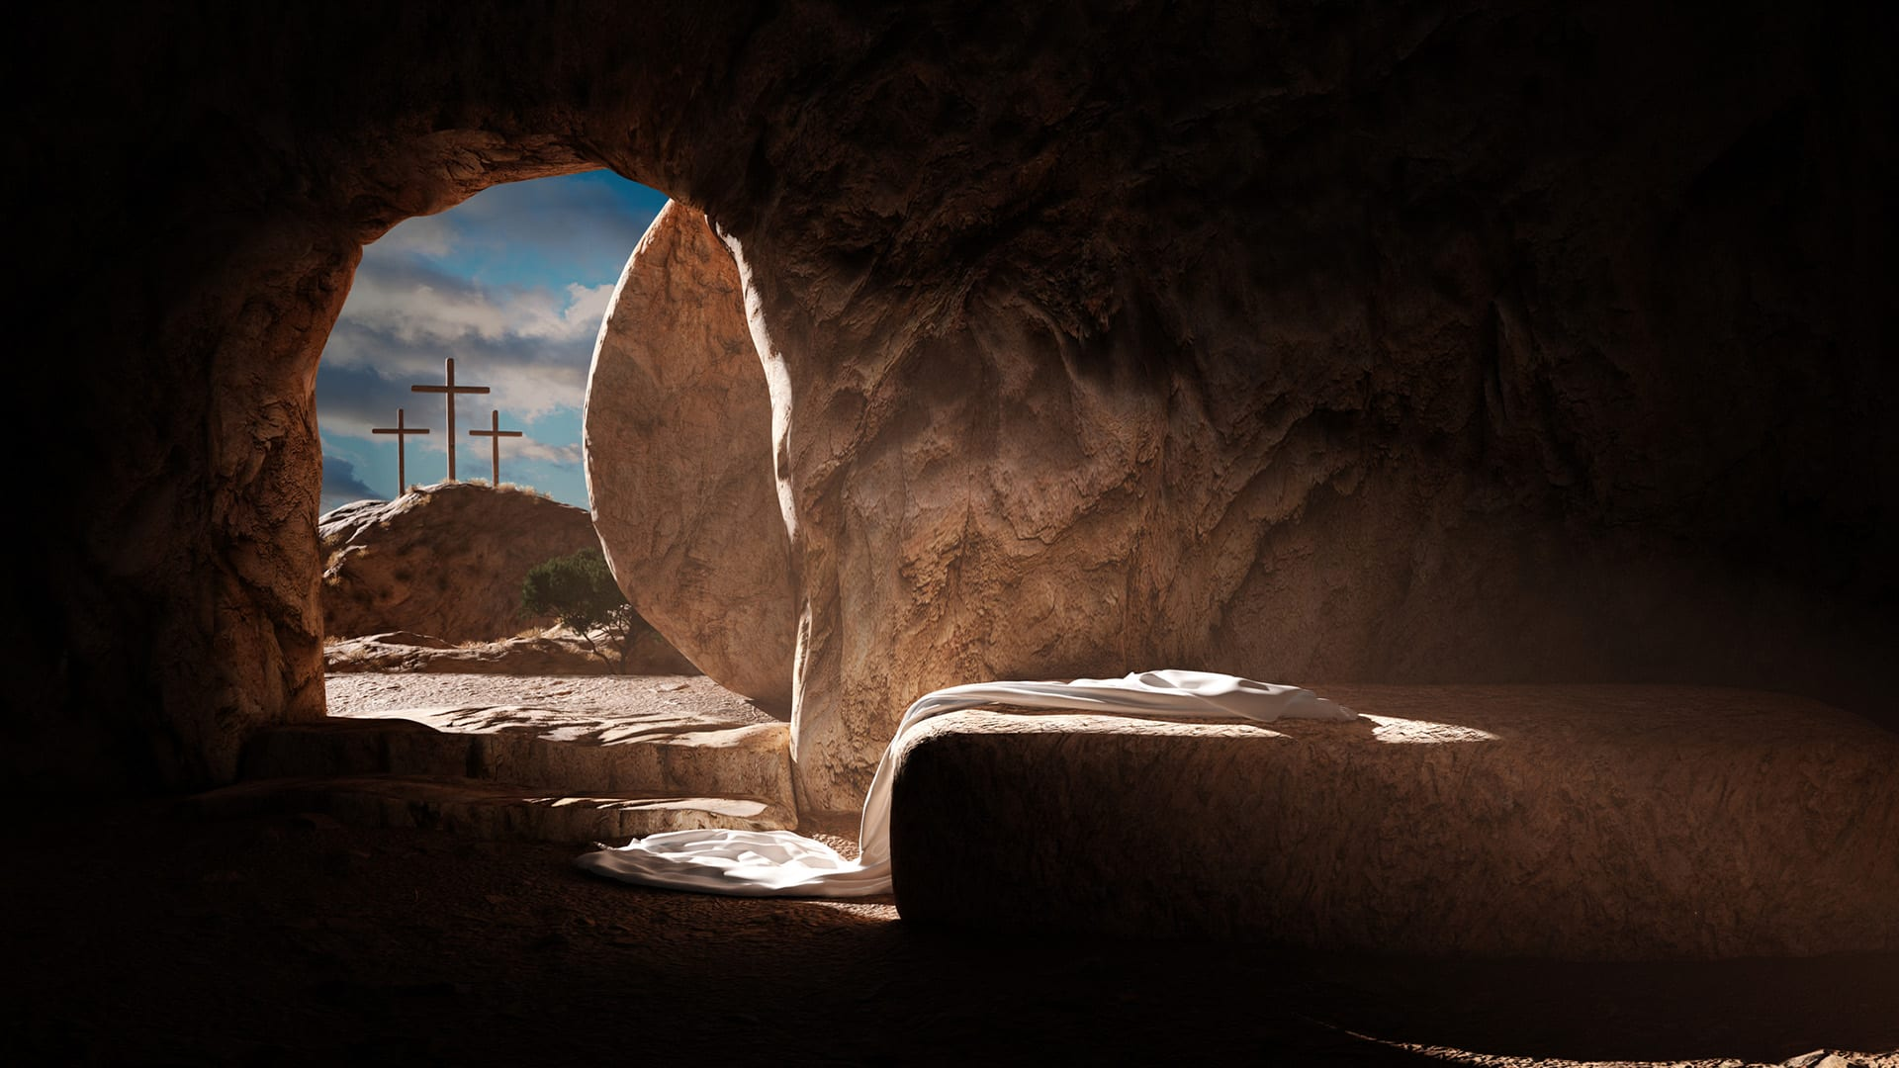
Sin is a big deal
Notes:
Sin cost the Son of God
Not ‘what can I get away with?’
Seeing Jesus hanging on the cross answers the question “does God take sin seriously?”
The resurrection confirmed that the power of sin had been broken

Slide 21
Forgiveness & freedom from sin
Rom 5:20-6:2
…But where sin increased, grace increased all the more
What shall we say, then? Shall we go on sinning so that grace may increase? By no means! We are those who have died to sin; how can we live in it any longer?
Col 1:9-10
God to fill you with the knowledge of his will through all the wisdom and understanding that the Spirit gives, so that you may live a life worthy of the Lord and please him in every way
Notes:
Grace for forgiveness & grace (empowering) to live (by His Spirit) in a way pleasing to Him

Slide 22
1 Kings 8:46-50
“When they sin against you…you become angry with them and give them over to their enemies, who take them captive to their own lands, far away or near; and if they have a change of heart in the land where they are held captive, and repent and plead with you in the land of their captors and say, ‘We have sinned, we have done wrong, we have acted wickedly’; and if they turn back to you with all their heart… then from heaven, your dwelling place, hear their prayer... And forgive your people, who have sinned against you; forgive all the offenses they have committed against you, and cause their captors to show them mercy;

Slide 23
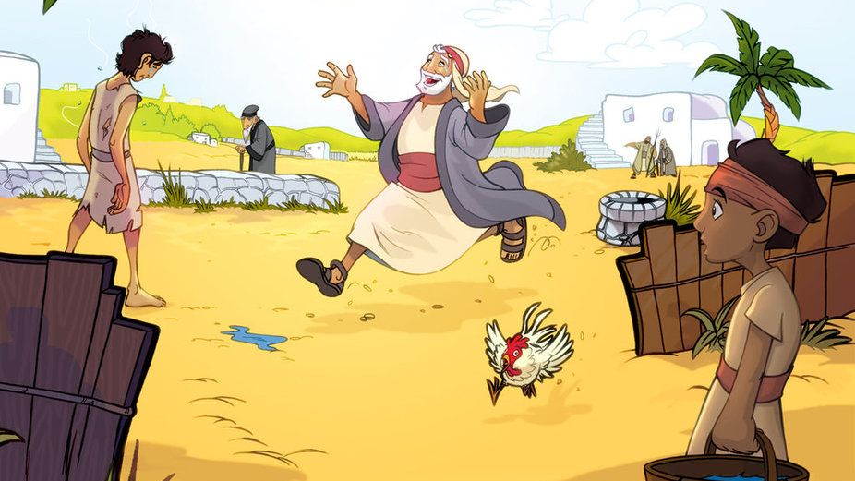
Question:
(5) Do you have someone in your heart who seems so far away?
Notes:
Even if due to rebellion now in captivity – can still have change of heart
Prodigal Son
Loved ones who are far away could still have change of heart whilst in captivity – God still responses. Not too late and never too far
I turn and find He is there (and had been there the whole time)
Application: Have you got someone in your heart who seems so far away?
Song: Speak the name of Jesus

Slide 24
Response
Do you want God to give you a new heart, devoted to Him?
Do you want to be more aware of Him than activities of worship?
Is there anywhere you have worshipped the created rather than the creator?
Do you want God to create a hunger for Him?
Do you have someone in your heart who seems so far away?

