Slide 1
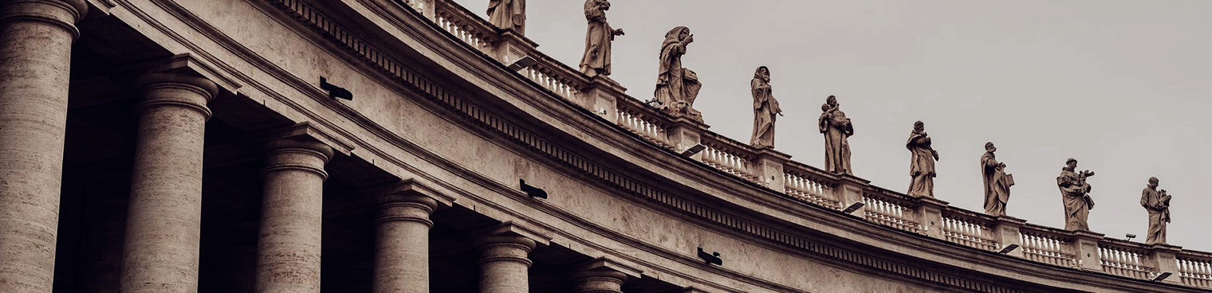
Lessons from 1 Kings 9!
Notes:
1

Slide 2
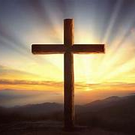
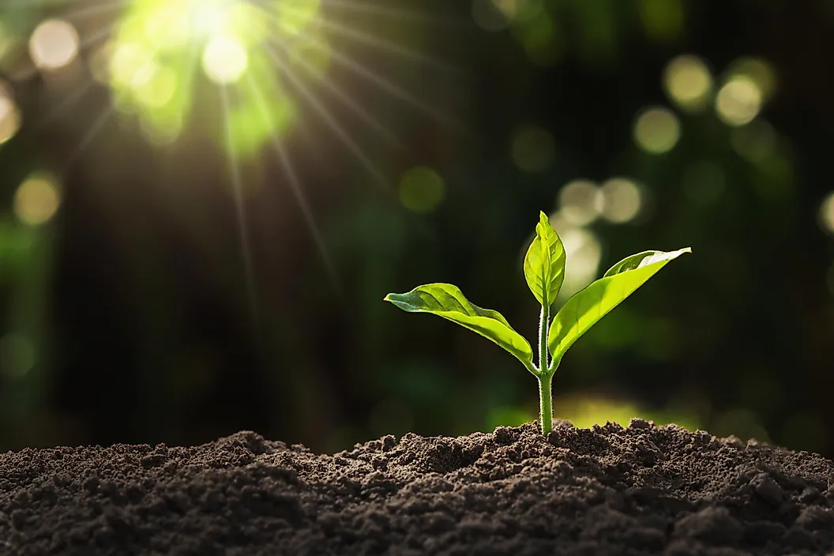




Lessons…
Faithfulness
And Obedience
Blessings
God’s Presence
Warning!
1 Kings 9
2
2023
Notes:
2

Slide 3
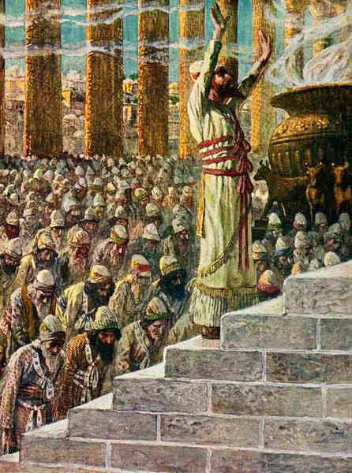
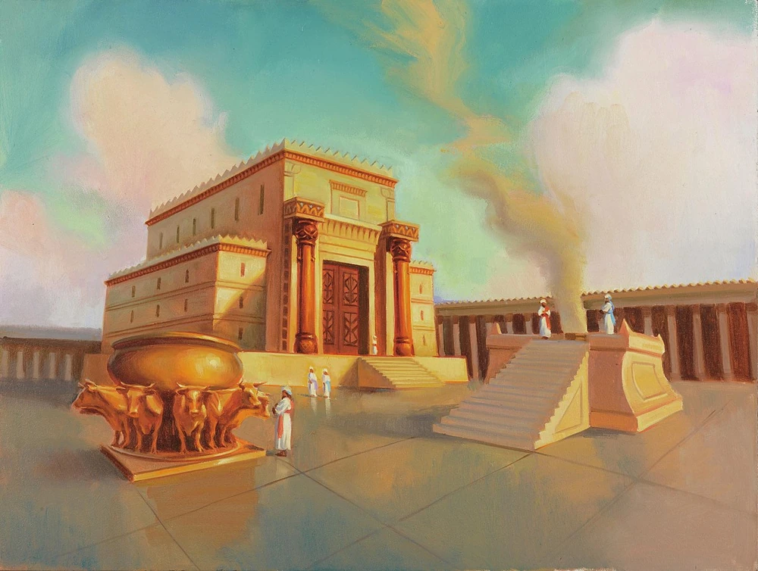
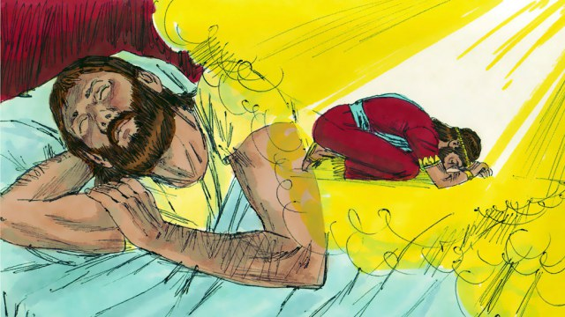
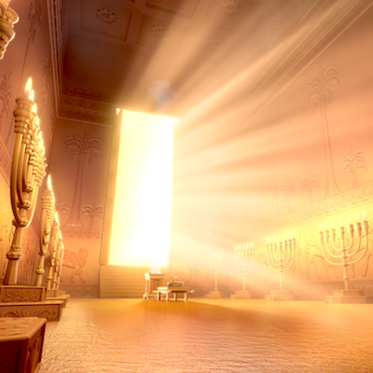
Faithfulness and Obedience!
1 Kings 9
1 Kings 3-5:14
1Kings 8 - 22-61
“I have heard your prayer and your petition. I have set this Temple apart to be holy—this place you have built where my name will be honoured forever. I will always watch over it, for it is dear to my heart” 1 Kings 9:1-3
“As for you, IF you walk before me faithfully with integrity of heart and godliness, as David your father did, obeying all my commands, decrees, and regulations, then I will establish the throne of your dynasty over Israel forever. For I made this promise to your father, David: ‘One of your descendants will always sit on the throne of Israel.” 1Kings 9:4-5
Notes:
3

Slide 4
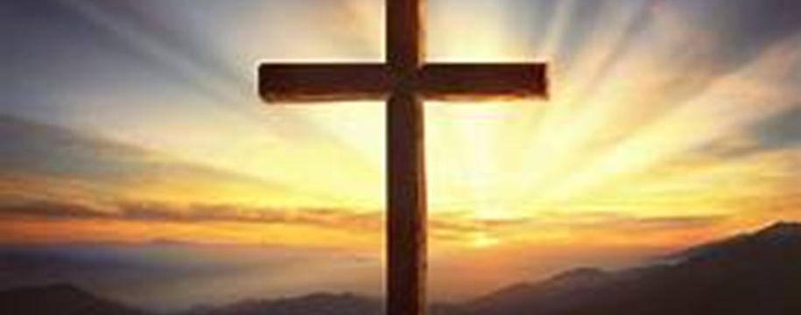
“Without faith, it is impossible to please God” Heb 11
Is there any unforgiveness you're holding onto, whether it's directed at others or towards yourself?
"God is faithful, who has called you into fellowship with his Son, Jesus Christ our Lord.“ 1 Cor 1:9
"For If you forgive other people when they sin against you, your heavenly Father will also forgive you. But If you do not forgive others their sins, your Father will not forgive your sins.“ Matt 6:14
“Not everyone who calls out to me, ‘Lord! Lord!’ will enter the Kingdom of Heaven. Only those who actually do the will of my Father in heaven will enter”. Matt 7:21
Is there a Conditional Promise?
Jesus replied, "'You must love the Lord your God with all your heart, all your soul, and all your mind.' This is the first and greatest commandment. A second is equally important: 'Love your neighbour as yourself.” Matt 22:37-40
Notes:
Obedience shows our faith and love for Christ!
1 Cor 1-9 - This verse from the New Testament, underscores the faithfulness of God in calling believers into a close relationship and fellowship with His Son, Jesus Christ. It highlights God's trustworthiness and reliability in fulfilling His promises and in maintaining this vital connection with His followers. In 1 kings God kept his faithfulness that he promised David
Explore the concept of the new covenant in Jesus' blood (Matthew 26:28, Hebrews 8:6-13), emphasizing God's enduring commitment to His people.
This verse in Matthew 7:21-27, where Jesus emphasizes the importance of obeying His words, and how this leads to a solid foundation.
Matthew 28:20 (the Great Commission) Jesus commands us to build and expand His kingdom
4

Slide 5
Blessings in obedience!
God's Presence (1 Kings 9:3)
A Lasting Dynasty (1 Kings 9:4)
Prosperity: material wealth
"And being found in appearance as a man, He humbled himself by becoming obedient to death—even death on a cross! Therefore, God exalted Him to the highest place and gave Him the name that is above every name, that at the name of Jesus every knee should bow, in heaven and on earth and under the earth, and every tongue acknowledge that Jesus Christ is Lord, to the glory of God the Father.“ Phil 2:8-11 (NIV)
2023
Notes:
4. Lesson 4: Blessings in Outreach
5

Slide 6
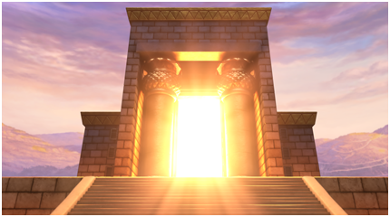
God’s Presence!
1 Kings 9:3
“Do you not know that your bodies are temples of the Holy Spirit, who is in you, whom you have received from God? You are not your own” 1Cor 6:19
6
20XX
Notes:
1 Kings 9: Discuss the significance of God's presence filling the Temple during its dedication.
Explore passages like Matthew 28:20 (the Great Commission) Jesus commands us to build and expand His kingdom.
6

Slide 7
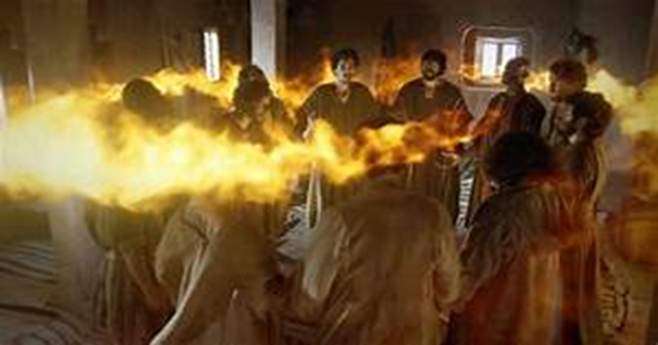
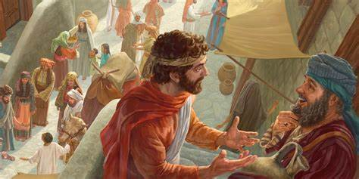
Receiving God’s Presence
Do you ever feel hesitant to share the Gospel with someone? What are the reasons behind that hesitation?
"But you will receive power when the Holy Spirit comes on you, and you will be my witnesses in Jerusalem, and in all Judea and Samaria, and to the ends of the earth.“ Acts1:8
" 'Do not leave Jerusalem, but wait for the gift my Father promised, which you have heard me speak about. For John baptized with water, but in a few days, you will be baptized with the Holy Spirit.“ Acts 1:4-5
Matthew 28 (the Great Commission)
Notes:
Key Differences:
In 1 Kings 9:3, God's presence was concentrated in a specific place (the Temple) and was primarily associated with the Israelite nation.
In Acts 1:8, the promise is of the Holy Spirit coming upon believers, regardless of their location, ethnicity, or nationality. This represents a more universal and inclusive aspect of God's presence.
7

Slide 8
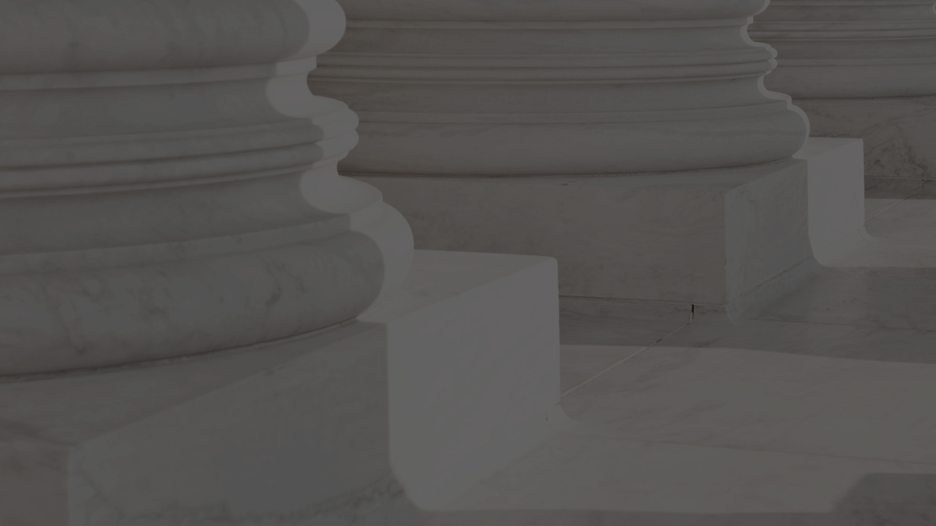

God's Warning and Consequences!
“But IF you or your descendants abandon me and disobey the commands and decrees, I have given you, and if you serve and worship other gods,
then I will cut off Israel from the land I have given them and will reject this temple I have sanctified for my Name. I will make Israel an object of mockery and ridicule among the nations”. 1 Kings 9:6-7
Is there anything that God has pointed out to you, that you aren't sure about or are struggling to give up? It's a great time to ask the Holy Spirit today to set you free from this. Whatever it is, let it go
Notes:
15 “If you love me, obey my commandments.
16 And I will ask the Father, and he will give you another Advocate, who will never leave you.
17 He is the Holy Spirit, who leads into all truth
Build Your House on the Rock
24 “Everyone then who hears these words of mine and does them will be like a wise man who built his house on the rock. 25 And the rain fell, and the floods came, and the winds blew and beat on that house, but it did not fall, because it had been founded on the rock. 26 And everyone who hears these words of mine and does not do them will be like a foolish man who built his house on the sand. 27 And the rain fell, and the floods came, and the winds blew and beat against that house, and it fell, and great was the fall of it.”
8

Slide 9
Reflection Questions!
Is there any unforgiveness you're holding onto, whether it's directed at others or towards yourself?
Do you ever feel hesitant to share the Gospel with someone? What are the reasons behind that hesitation?
Is there anything that God has pointed out to you, that you aren't sure about or are struggling to give up? It's a great time to ask the Holy Spirit today to set you free from this. Whatever it is, let it go!
9
2023
Notes:
9

