Slide 1
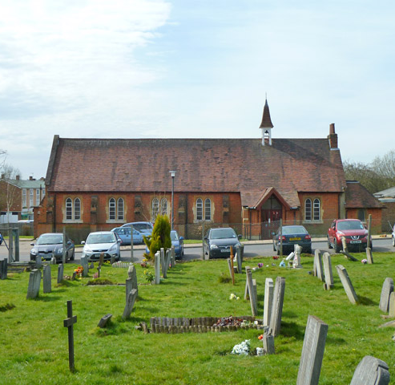
St Stephen
Have you heard of him?
What do you know about him?

Slide 2
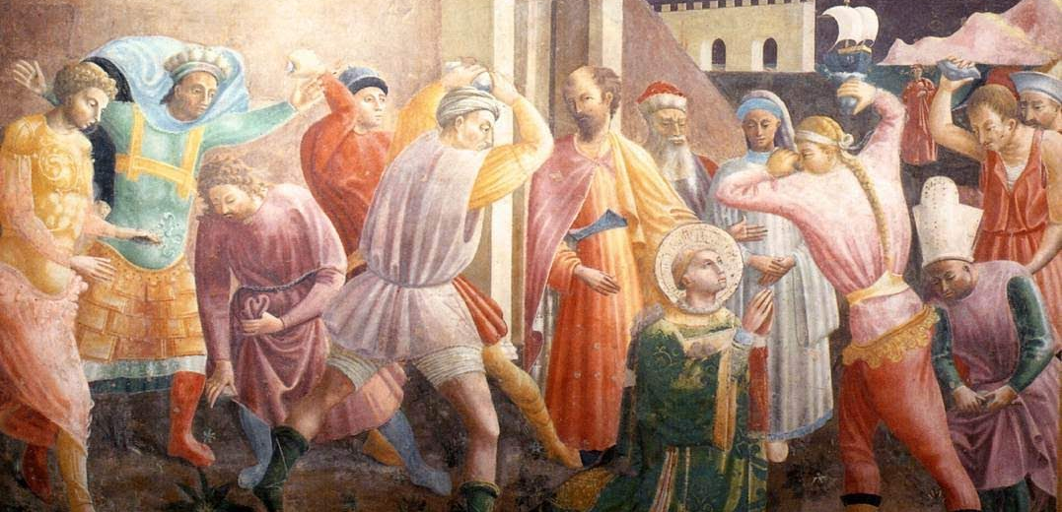
Lessons from the life of Stephen
2nd April 2023
This Photo by Unknown Author is licensed under CC BY-SA-NC

Slide 3
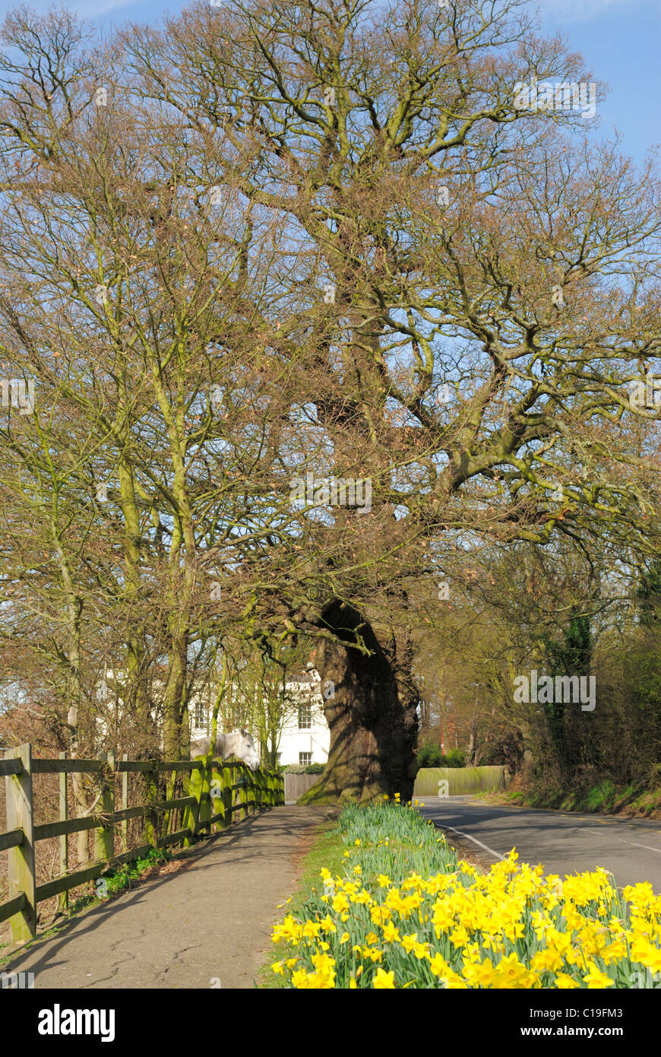


Making a fresh start
Notes:
There is something wonderful about bulbs that throughout the year they lay dormant, sleeping. But they know the seasons change, and that first glimpse of a snowdrop pushing through the dull days of January and February, never ceases to take my breath away.
On my way to school I drive past a wonderful old oak tree – known as the Charles dickens Oak in Vicarage lane, Chigwell..
It’s the place Dickens described as the most wonderful place in the world. It’s a remnant of ancient long forgotten hedgerows that marked the field boundaries long ago.
Each day I drive past It has become a way mark on my journey, its changes marking the changes of the season.
It must be 400 years old or more
My favourite season is spring, because beneath the arms of this tree, along side the road, lies a wonderful bank of daffodils.
In February, whatever the year has been like, these start to show through the grass, and right now they are a blaze of colour.
How many of us are asleep in the earth, just waiting for the change in the season?
2 Cor6 ² For he says,
“In the time of my favor I heard you,
and in the day of salvation I helped you.”^{[a]}
I tell you, now is the time of God’s favor, now is the day of salvation.
Eid is a significant time for Moslems, Of how for them the process of prayer and fasting leads to them making a new start
and this year it is surrounding the time when we particularly celebrate the death and resurrection Jesus
And I started thinking about the new start that God gives us by his grace.
Grace – isn’t earnt by our activities. It isn’t what we deserve, but it is a gift of God to us, because of what his Son has done.
He paid the price, so that we can know him. My faith isn’t based on my effort to get to him, but on all he has done to reach out to us.

Slide 4
Acts 6
6 In those days when the number of disciples was increasing, the Hellenistic Jews^{[a]} among them complained against the Hebraic Jews because their widows were being overlooked in the daily distribution of food. ² So the Twelve gathered all the disciples together and said, “It would not be right for us to neglect the ministry of the word of God in order to wait on tables. ³ Brothers and sisters, choose seven men from among you who are known to be full of the Spirit and wisdom. We will turn this responsibility over to them ⁴ and will give our attention to prayer and the ministry of the word.”
⁵ This proposal pleased the whole group. They chose Stephen, a man full of faith and of the Holy Spirit; also Philip, Procorus, Nicanor, Timon, Parmenas, and Nicolas from Antioch, a convert to Judaism. ⁶ They presented these men to the apostles, who prayed and laid their hands on them.
⁷ So the word of God spread. The number of disciples in Jerusalem increased rapidly, and a large number of priests became obedient to the faith.
Notes:
Acts – the second book by Luke
The gospel of the church andthe holy spirit
Picking up in Acts 6.
Full of the HSWe use that expression often, perhaps more than we realize. FULL OF….
Full of joy. A peaceful smile. Warm words.
Full of himself. Arrogant. Talks about himself too much. Looks down on others.
Full of rage. Boiling mad. Red faced. Screaming profanities.
We know what these look like.

Slide 5

Qualification for serving
Our qualification to serve comes from God
It’s the same qualification for anything:
  Need to be full of the Holy Spirit and wisdom

Slide 6
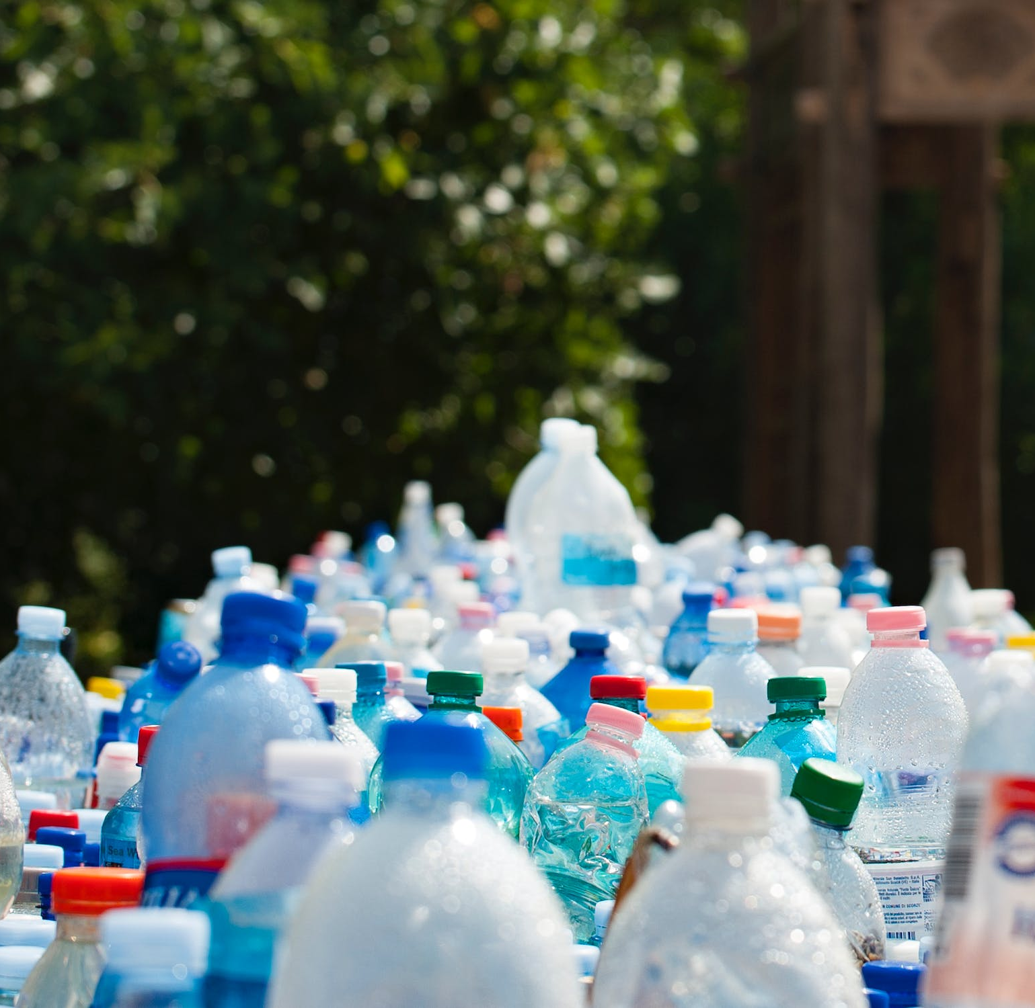
Containers are made to hold something!
God designed us to be full of the Holy Spirit
Gen 2: 7 Then the Lord God formed a man from the dust of the ground and breathed into his nostrils the breath of life, and the man became a living being.
What am I full of?
Notes:
We use that expression often, perhaps more than we realize. FULL OF….
Full of joy. A peaceful smile. Warm words.
Full of himself. Arrogant. Talks about himself too much. Looks down on others.
Full of rage. Boiling mad. Red faced. Screaming profanities.
We know what these look like.
The container isn’t the treasure, what is inside is!
Some people collect bottles that are empty – but that isn’t the point of them is it?

Slide 7
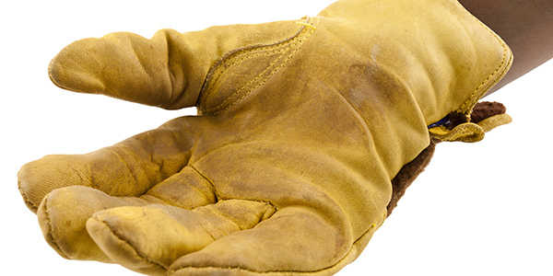
How can you tell what you’re full of?
“Being filled with the Spirit is allowing the Spirit to be the driver.
It is yielding to his will, his commands, his desires, his agenda, his timing, his wisdom.
It is allowing him to have control of us.
It is impossible to be filled with yourself and with the Spirit at the same time.”
Gal 5 ²² But the fruit of the Spirit is love, joy, peace, patience, kindness, goodness, faithfulness, ²³ gentleness and self-control.
Notes:
What comes out when your vessel is shaken?
^{Gal 5 16} So I say, walk by the Spirit, and you will not gratify the desires of the flesh. ¹⁷ For the flesh desires what is contrary to the Spirit, and the Spirit what is contrary to the flesh. They are in conflict with each other, so that you are not to do whatever^{[c]} you want. ¹⁸ But if you are led by the Spirit, you are not under the law.
¹⁹ The acts of the flesh are obvious: sexual immorality, impurity and debauchery; ²⁰ idolatry and witchcraft; hatred, discord, jealousy, fits of rage, selfish ambition, dissensions, factions ²¹ and envy; drunkenness, orgies, and the like. I warn you, as I did before, that those who live like this will not inherit the kingdom of God.
²² But the fruit of the Spirit is love, joy, peace, forbearance, kindness, goodness, faithfulness, ²³ gentleness and self-control. Against such things there is no law. ²⁴ Those who belong to Christ Jesus have crucified the flesh with its passions and desires. ²⁵ Since we live by the Spirit, let us keep in step with the Spirit. ²⁶ Let us not become conceited, provoking and envying each other.

Slide 8
Acts 6 cont’d
⁸ Now Stephen, a man full of God’s grace and power, performed great wonders and signs among the people. ⁹ Opposition arose, however, from members of the Synagogue of the Freedmen (as it was called)—Jews of Cyrene and Alexandria as well as the provinces of Cilicia and Asia—who began to argue with Stephen. ¹⁰ But they could not stand up against the wisdom the Spirit gave him as he spoke.
¹¹ Then they secretly persuaded some men to say, “We have heard Stephen speak blasphemous words against Moses and against God.”
¹² So they stirred up the people and the elders and the teachers of the law. They seized Stephen and brought him before the Sanhedrin. ¹³ They produced false witnesses, who testified, “This fellow never stops speaking against this holy place and against the law. ¹⁴ For we have heard him say that this Jesus of Nazareth will destroy this place and change the customs Moses handed down to us.”
¹⁵ All who were sitting in the Sanhedrin looked intently at Stephen, and they saw that his face was like the face of an angel.
Notes:
Now he is even more full than before. V8. We know when we are in the right place because serving doesn’t burn us out. It feeds us and feeds our faith.
He might have been given the job of sharing out the food, but he doesn’t stop there.
He is happy to get on with the job he is given, but there is more in is heart and it spills out as he serves.
God want us to serve with what we have.
Now, in addition to his duties in helping in the church to distribute food, Stephen is being used by God to perform miracles among the people. And he is preaching the gospel. And his work finds opposition, just like Jesus found opposition and like the apostles. The opponents are members of a local synagogue. They begin arguing with Stephen, probably about who Jesus was, what he did, and what the Scriptures said about him.
Please note – Jesus never promised that when we followed him life would get easier, or that there wasn’t any cost
Here is this gifted young man, happy to wait on tables if that is what is needed, performing miracles in his spare time. Finds himself persecuted having never done anything wrong. His treatment is very similar to that of christ.

Slide 9
The face of an angel
Notes:
We can respond to pressure in many ways – not many of them are good!
But when the Holy Spirit truly lives inside of us, he can’t help but come out when we are under scrutiny
Luke says in v15 that Stephen has the face of an angel – it probably means shining, or radiant in the language
What a comment! All these angry men who hated Jesus and hated the apostles and now hated Stephen noticed something heavenly about Stephen. “His face was like that of an angel.” There was something holy, something majestic and even glorious about Stephen’s appearance. In the face of these lies and false accusations Stephen isn’t ruffled.
Everyone has turned on him.
All the leaders he once respected.
But he doesn’t respond in fear, justification or excuse
Perhaps he knows he has come to the kingdom for such a time as this.
He knows he has a purpose that is bigger than himself and his situation.

Slide 10
A sermon to die for?
In Acts 7:1-50 Stephen traces the history of the Jewish people that have led them to this point, through Abraham, and Joseph, to Moses, David then Solomon.
It is unlikely he just came up with his story on the spot.
A long answer doesn’t work for everyone! But we do need to ask God how to answer questions.
1 Peter 3:14 But even if you should suffer for what is right, you are blessed. “Do not fear their threats; do not be frightened.” ¹⁵ But in your hearts revere Christ as Lord. Always be prepared to give an answer to everyone who asks you to give the reason for the hope that you have. But do this with gentleness and respect, ¹⁶ keeping a clear conscience, so that those who speak maliciously against your good behaviour in Christ may be ashamed of their slander.
Notes:
Friday
My mum and dad are religious – it’s very sad?
Wednesday
Feeling like giving up
Last week
So do you go to some kind of watered down presbyterian church?
Have you thought about what to say when people ask you questions?
People are hungry
The spirit is on the move
Questions are coming … are you ready?
Being led by the spirit brought Stephen revelation as he was speaking
⁵¹ “You stiff-necked people! Your hearts and ears are still uncircumcised. You are just like your ancestors: You always resist the Holy Spirit! ⁵² Was there ever a prophet your ancestors did not persecute? They even killed those who predicted the coming of the Righteous One. And now you have betrayed and murdered him— ⁵³ you who have received the law that was given through angels but have not obeyed it.”

Slide 11
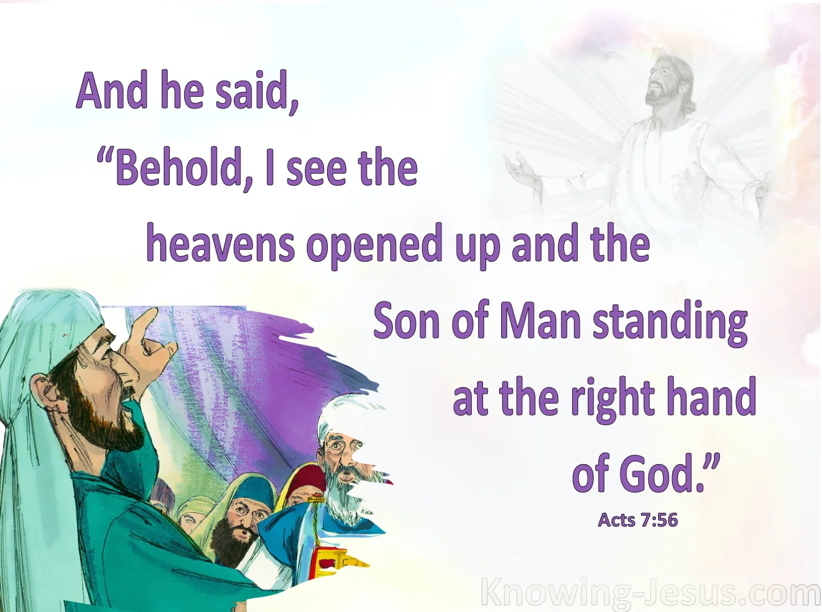
Acts 7
⁵⁴ When the members of the Sanhedrin heard this, they were furious and gnashed their teeth at him. ⁵⁵ But Stephen, full of the Holy Spirit, looked up to heaven and saw the glory of God, and Jesus standing at the right hand of God. ⁵⁶ “Look,” he said, “I see heaven open and the Son of Man standing at the right hand of God.”
Notes:
⁵¹ “You stiff-necked people! Your hearts and ears are still uncircumcised. You are just like your ancestors: You always resist the Holy Spirit! ⁵² Was there ever a prophet your ancestors did not persecute? They even killed those who predicted the coming of the Righteous One. And now you have betrayed and murdered him— ⁵³ you who have received the law that was given through angels but have not obeyed it.”
Matthew 26:63-65
New International Version
⁶³ But Jesus remained silent.
The high priest said to him, “I charge you under oath by the living God: Tell us if you are the Messiah, the Son of God.”
⁶⁴ “You have said so,” Jesus replied. “But I say to all of you: From now on you will see the Son of Man sitting at the right hand of the Mighty One and coming on the clouds of heaven.”^{[a]}
⁶⁵ Then the high priest tore his clothes and said, “He has spoken blasphemy! Why do we need any more witnesses? Look, now you have heard the blasphemy.

Slide 12
Standing at the right hand of god
Jesus isn’t unaware of the challenges we face
  He is with us
  He prays for us
  He is watching and cheering us on
Heb 12 Therefore, since we are surrounded by such a great cloud of witnesses, let us throw off everything that hinders and the sin that so easily entangles. And let us run with perseverance the race marked out for us, 2 fixing our eyes on Jesus, the pioneer and perfecter of faith. For the joy set before him he endured the cross, scorning its shame, and sat down at the right hand of the throne of God.
Notes:
12 Therefore, since we are surrounded by such a great cloud of witnesses, let us throw off everything that hinders and the sin that so easily entangles. And let us run with perseverance the race marked out for us, ² fixing our eyes on Jesus, the pioneer and perfecter of faith. For the joy set before him he endured the cross, scorning its shame, and sat down at the right hand of the throne of God.

Slide 13
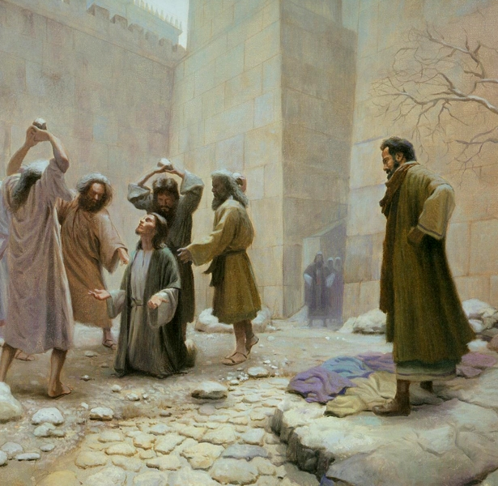
“the prayer that saved saul”
⁵⁷ At this they covered their ears and, yelling at the top of their voices, they all rushed at him, ⁵⁸ dragged him out of the city and began to stone him. Meanwhile, the witnesses laid their coats at the feet of a young man named Saul.
⁵⁹ While they were stoning him, Stephen prayed, “Lord Jesus, receive my spirit.” ⁶⁰ Then he fell on his knees and cried out, “Lord, do not hold this sin against them.” When he had said this, he fell asleep.
Notes:
The Church Persecuted and Scattered
Acts 8 On that day a great persecution broke out against the church in Jerusalem, and all except the apostles were scattered throughout Judea and Samaria. ² Godly men buried Stephen and mourned deeply for him. ³ But Saul began to destroy the church. Going from house to house, he dragged off both men and women and put them in prison.

Slide 14
Recap -Being full of the spirit
Enables him to show the fruit of the spirit
Enables him to serve as there is need(Acts 6:5)
Enables him to perform signs and wonders (Acts 6:8)
Gives him wisdom and insights that no one else can cope with (Acts 6:10)
Gives him a sight of Jesus when he needed it most (Acts 7:56)
Allows him to forgive and pray for those who are against him (Acts 7:60)
It doesn’t avoid difficulties or hardship
And it doesn’t help you to blend in with the spirit of the age.
But the Kingdom of God is established as we lay down our lives for him
Notes:
What do we remember about Stephen?
We don’t remember his sermon. Its recorded elsewhere if we wanted to look.
And today it doesn’t really scratch where it itches as an evangelistic message
We remember the way he died and gave up his life
What we do communicates more than we say. (commitment – example of Manuel and dialysis)

