Slide 1
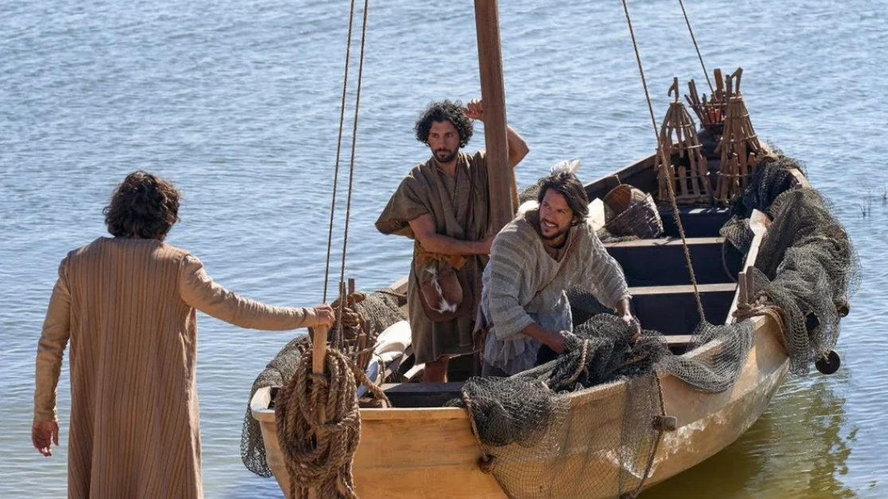
Luke 5

Slide 2
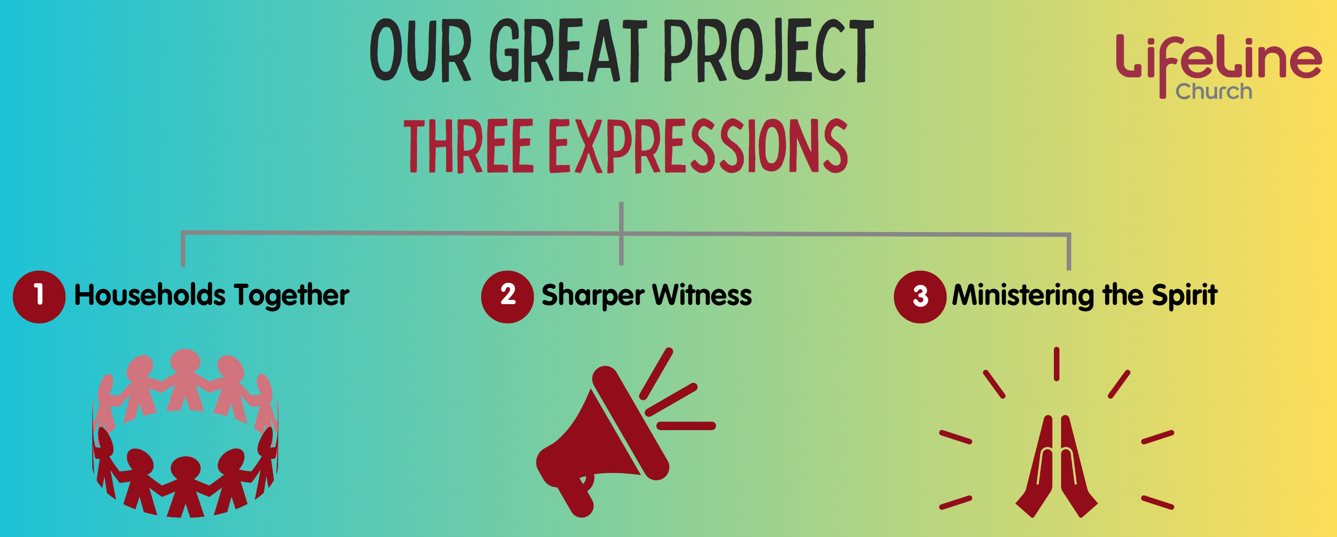
Notes:
Three emphases:
Families together, Christ at the centre
Ministering the Spirit
Sharper witness
Everything we do. Living out of these emphases HAS to flow from encounter.
If not we’re just engaging in behaviour modification. We’re just piling on the guilt: must do better.
As we look at Acts, as we seek more of His Spirit, his presence, as we spur one another on to good words, we have to remember that it stems from His presence, from encounter.

Slide 3
1 On one occasion, while the crowd was pressing in on him to hear the word of God, he was standing by the lake of Gennesaret, 2 and he saw two boats by the lake, but the fishermen had gone out of them and were washing their nets.
Notes:
Read passage.

Slide 4
3 Getting into one of the boats, which was Simon's, he asked him to put out a little from the land. And he sat down and taught the people from the boat. 4 And when he had finished speaking, he said to Simon, “Put out into the deep and let down your nets for a catch.”
Notes:
Read passage.

Slide 5
5 And Simon answered, “Master, we toiled all night and took nothing! But at your word I will let down the nets.” 6 And when they had done this, they enclosed a large number of fish, and their nets were breaking. 7 They signaled to their partners in the other boat to come and help them. And they came and filled both the boats, so that they began to sink.
Notes:
Read passage.

Slide 6
8 But when Simon Peter saw it, he fell down at Jesus' knees, saying, “Depart from me, for I am a sinful man, O Lord.” 9 For he and all who were with him were astonished at the catch of fish that they had taken, 10 and so also were James and John, sons of Zebedee, who were partners with Simon.
Notes:
Read passage.

Slide 7
And Jesus said to Simon, “Do not be afraid; from now on you will be catching men.” 11 And when they had brought their boats to land, they left everything and followed him.
Notes:
Read passage.

Slide 8
What can we learn from this story about being ready for everyday encounter with Jesus?
Notes:
If all stems from every day awareness. If that’s so central. How do we position ourselves?
Disclaimer: no formula! No formula. It’s relationship.
But I believe there are postures of the heart that position us to see Him in the everyday of our lives.
Postures that Peter demonstrates here in his actions and reactions, and which we can learn from.

Slide 9
Be willing to make space
Be ready to say “yes” to Him
Follow Jesus fingerprints to His feet
Notes:
Read passage.

Slide 10
1. Be willing to make space

Slide 11
1 On one occasion, while the crowd was pressing in on him to hear the word of God, he was standing by the lake of Gennesaret, 2 and he saw two boats by the lake, but the fishermen had gone out of them and were washing their nets. 3 Getting into one of the boats, which was Simon's, he asked him to put out a little from the land. And he sat down and taught the people from the boat.
Notes:
Read passage.

Slide 12
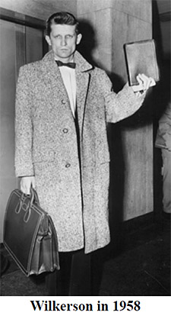
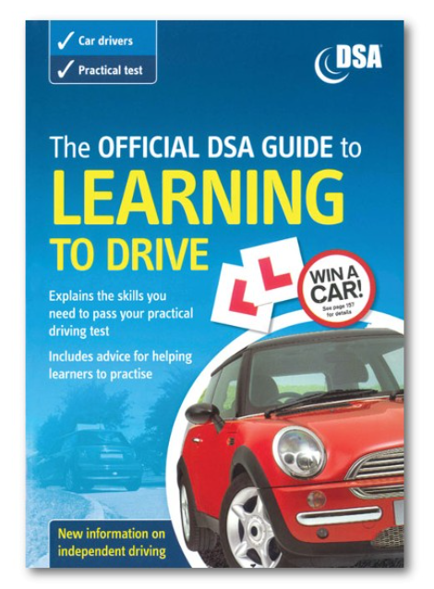
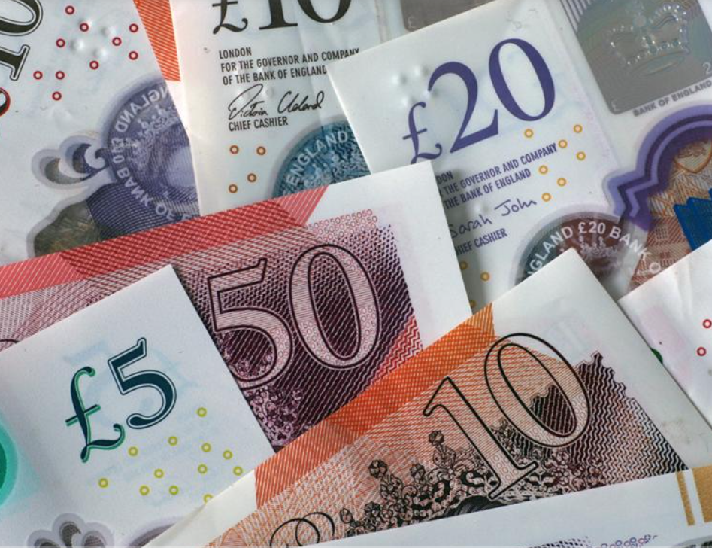
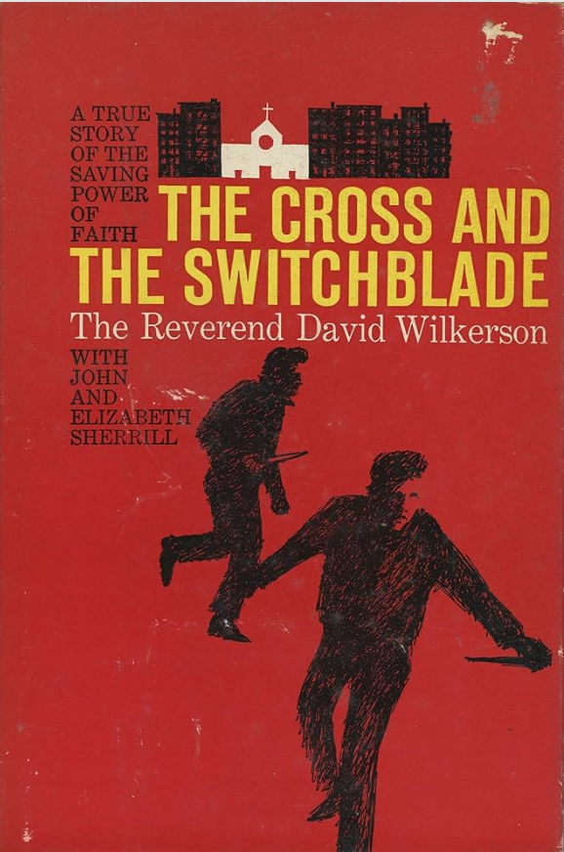
David Wilkerson
“If we confess our sins to one another he is faithful and just to forgive...”
- 1 John 1.9
Opening
up
Giving
time
Notes:
Passage.

Slide 13
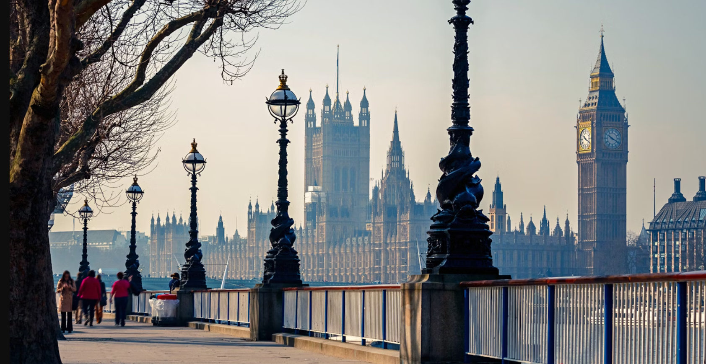
Part 1...

Slide 14
2. Be ready to say “yes” to Him

Slide 15
4 When he had finished speaking, he said to Simon, “Put out into deep water, and let down the nets for a catch.”
5 Simon answered, “Master, we’ve worked hard all night and haven’t caught anything. But because you say so, I will let down the nets.”
Notes:
Read passage.

Slide 16
“...take my yoke upon you ... For my yoke is easy, my burden is light.”
- Matthew 11.28-30
Notes:
Passage.

Slide 17
God wants us to work with Him, not for Him
Notes:
Passage.

Slide 18
“...I am with you always, to the end of the age.”
- Matthew 28.20
Notes:
Passage.

Slide 19
Part 2...

Slide 20
3. Follow Jesus’ fingerprints to His feet

Slide 21
5 ...But at your word I will let down the nets.
6 And when they had done this, they enclosed a large number of fish, and their nets were breaking. 7 They signalled to their partners in the other boat to come and help them. And they came and filled both the boats, so that they began to sink.
Notes:
Read passage.

Slide 22
8 But when Simon Peter saw it, he fell down at Jesus' knees, saying, “Depart from me, for I am a sinful man, O Lord.” 9 For he and all who were with him were astonished at the catch of fish that they had taken, 10 and so also were James and John, sons of Zebedee, who were partners with Simon.
Notes:
Read passage.

Slide 23
And Jesus said to Simon, “Do not be afraid; from now on you will be catching men.” 11 And when they had brought their boats to land, they left everything and followed him.
Notes:
Read passage.

Slide 24
Do I need to make space for Jesus in any part of my life?
Do I want to say “yes” and receive His grace to obey?
Do I want to turn to Him?
                “Don’t be afraid”
                Fresh commissioning
                Relationship
Notes:
Response

