Slide 1
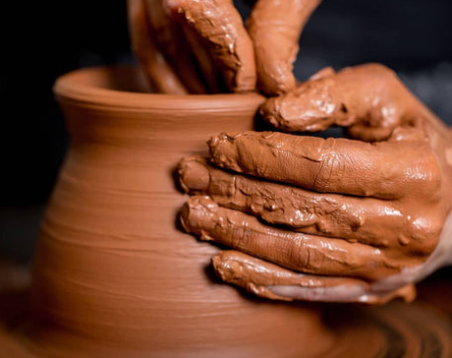
Magic Moments
22/12/24
Jamie Singleton

Slide 2
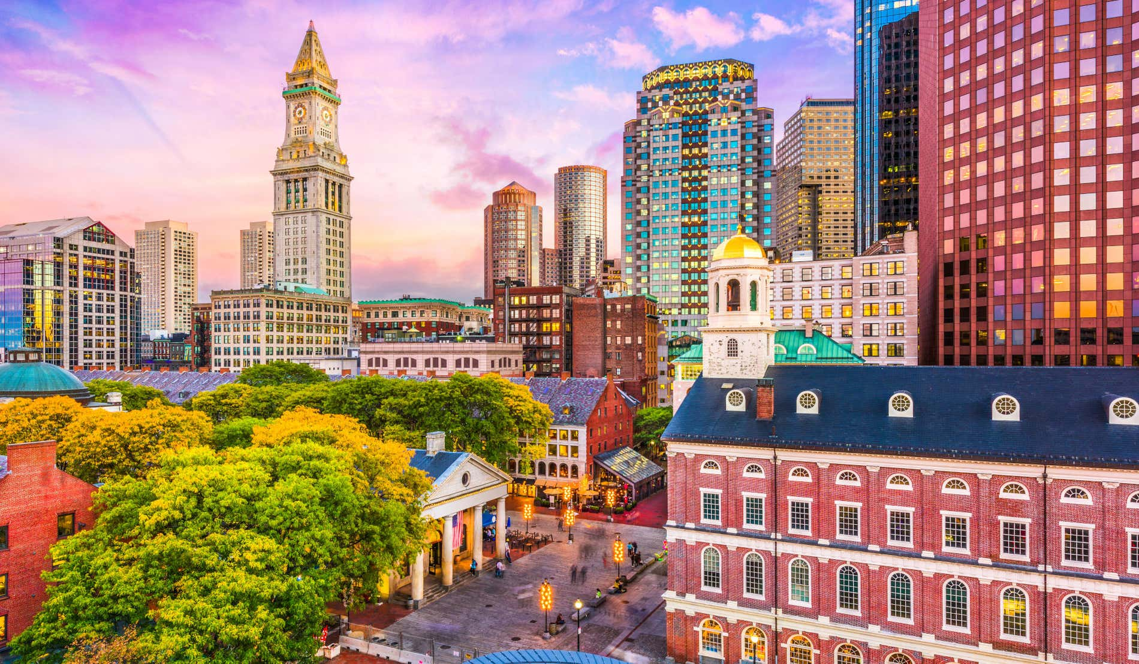
Notes:
Story of a let down
Boston YMCA

Slide 3
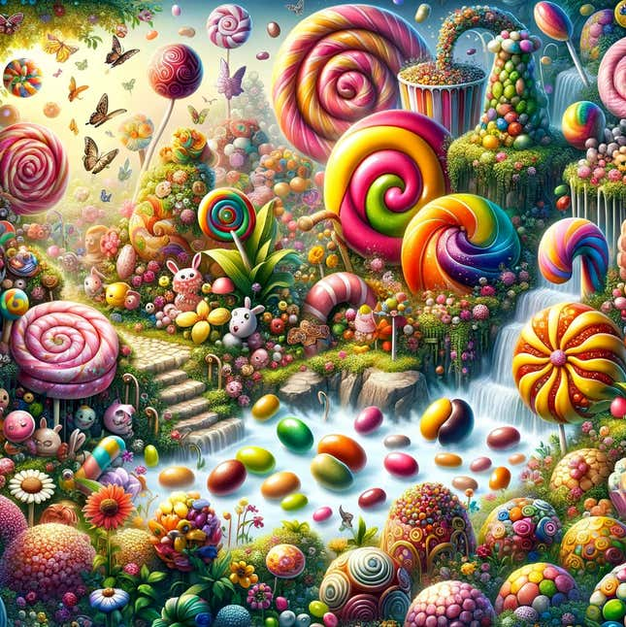
Notes:
Disconcerting when we are expecting a moment to be a certain way and discover it is completely different.
We can unconsciously assume things are meant to happen in a way. We compare our situation to others. And then feel disappointed or even offended when it doesn’t happen.

Slide 4
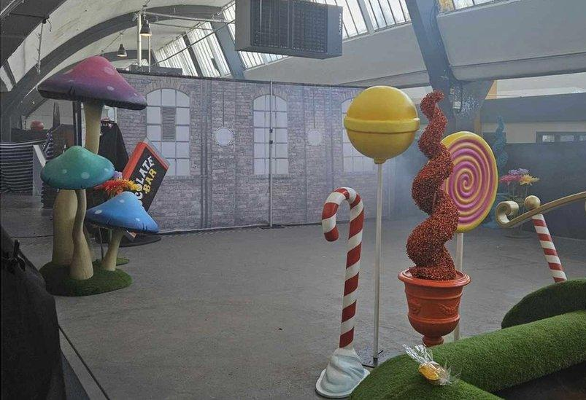
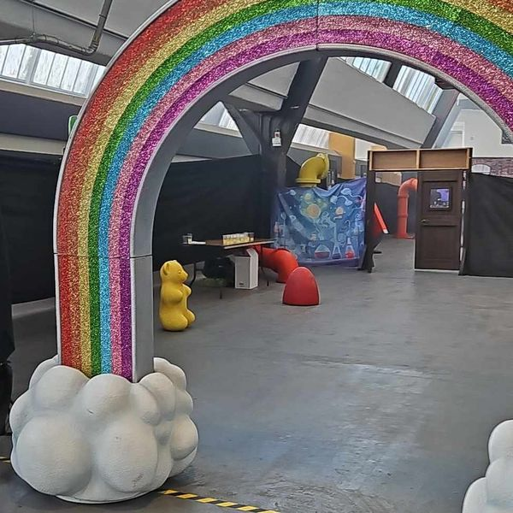
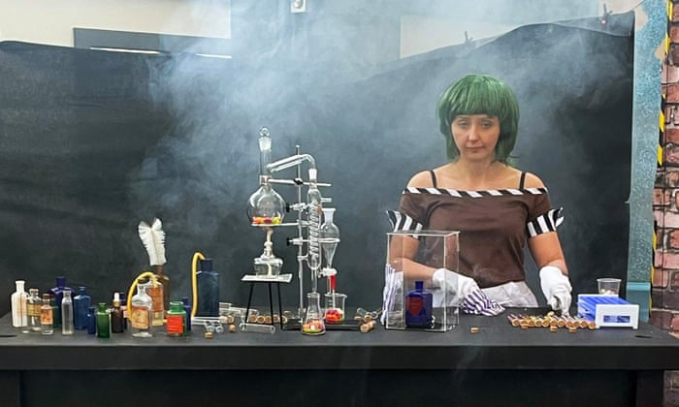

Slide 5
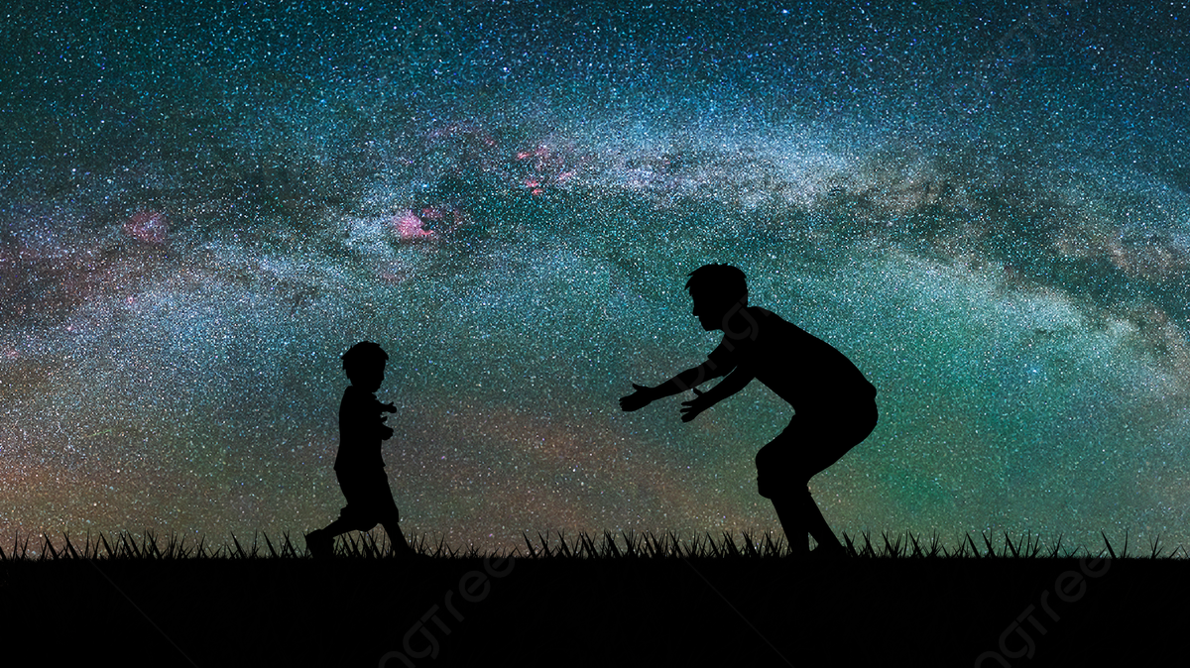
Notes:
It can be similar when we are approaching God
We are expecting something specific
Sensation
Laughing, crying, falling over
Writing on the wall
We look over at the people next to us and think – ‘well they are obviously experiencing something’
How about those people that seem to get every prayer answered?!
Then we find ourselves entertaining darker thoughts – maybe God doesn’t want to meet me (as much as them)? is God real? Have I not got enough faith?
What started as a genuine response has been hijacked by an enemy determined to bring the focus on you and off Him

Slide 6


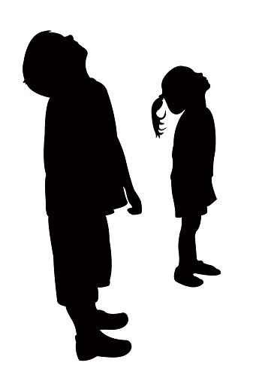


Notes:
Not the only one who were looking the ‘wrong way’ when God arrived
Upside down kingdom
Jesus’ birth (silent as snow fall)
Peter – you won’t die
Followers – will you now establish kingdom
He is unconventional

Slide 7

Notes:
We have tied God’s hands
We have prescribed how God can work
How does this happen?
This might also reveal our goal in approaching God
Looking for experience vs become Christ-like/seek first kingdom
I come with my own agenda
So what can we do about it?

Slide 8

Let God, be God
⁸ “For my thoughts are not your thoughts,
neither are your ways my ways,”
declares the Lord.
⁹ “As the heavens are higher than the earth,
so are my ways higher than your ways
and my thoughts than your thoughts.
Isaiah 55:8-9

Slide 9
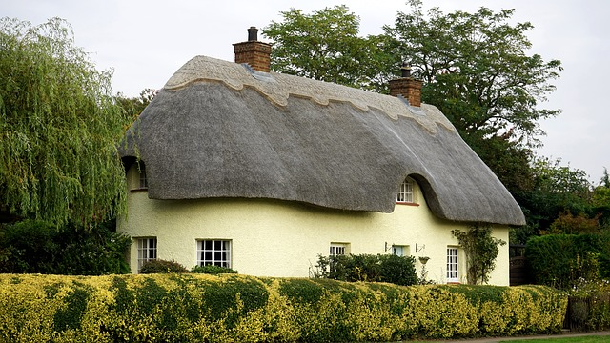
Notes:
“Imagine yourself as a living house. God comes in to rebuild that house. At first, perhaps, you can understand what He is doing. He is getting the drains right and stopping the leaks in the roof and so on; you knew that those jobs needed doing and so you are not surprised. But presently He starts knocking the house about in a way that hurts abominably and does not seem to make any sense. What on earth is He up to? The explanation is that He is building quite a different house from the one you thought of - throwing out a new wing here, putting on an extra floor there, running up towers, making courtyards. You thought you were being made into a decent little cottage: but He is building a palace. He intends to come and live in it Himself.”
― C.S. Lewis, Mere Christianity

Slide 10
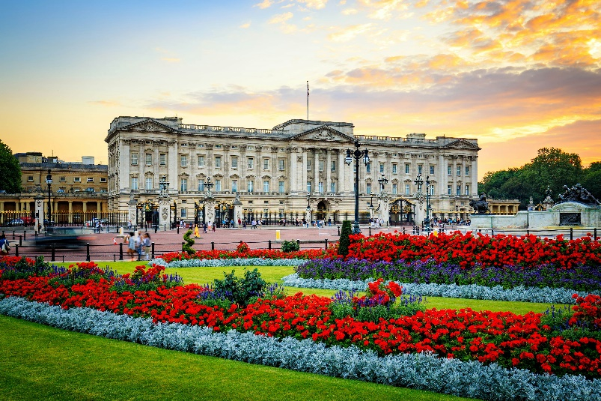

Slide 11
Moment
Method
Matter
Notes:
Let God decide the
Moment
method
Matter

Slide 12
Moment
Notes:
The moment [timing]
Sam
Sedi
Too fast or too slow

Slide 13

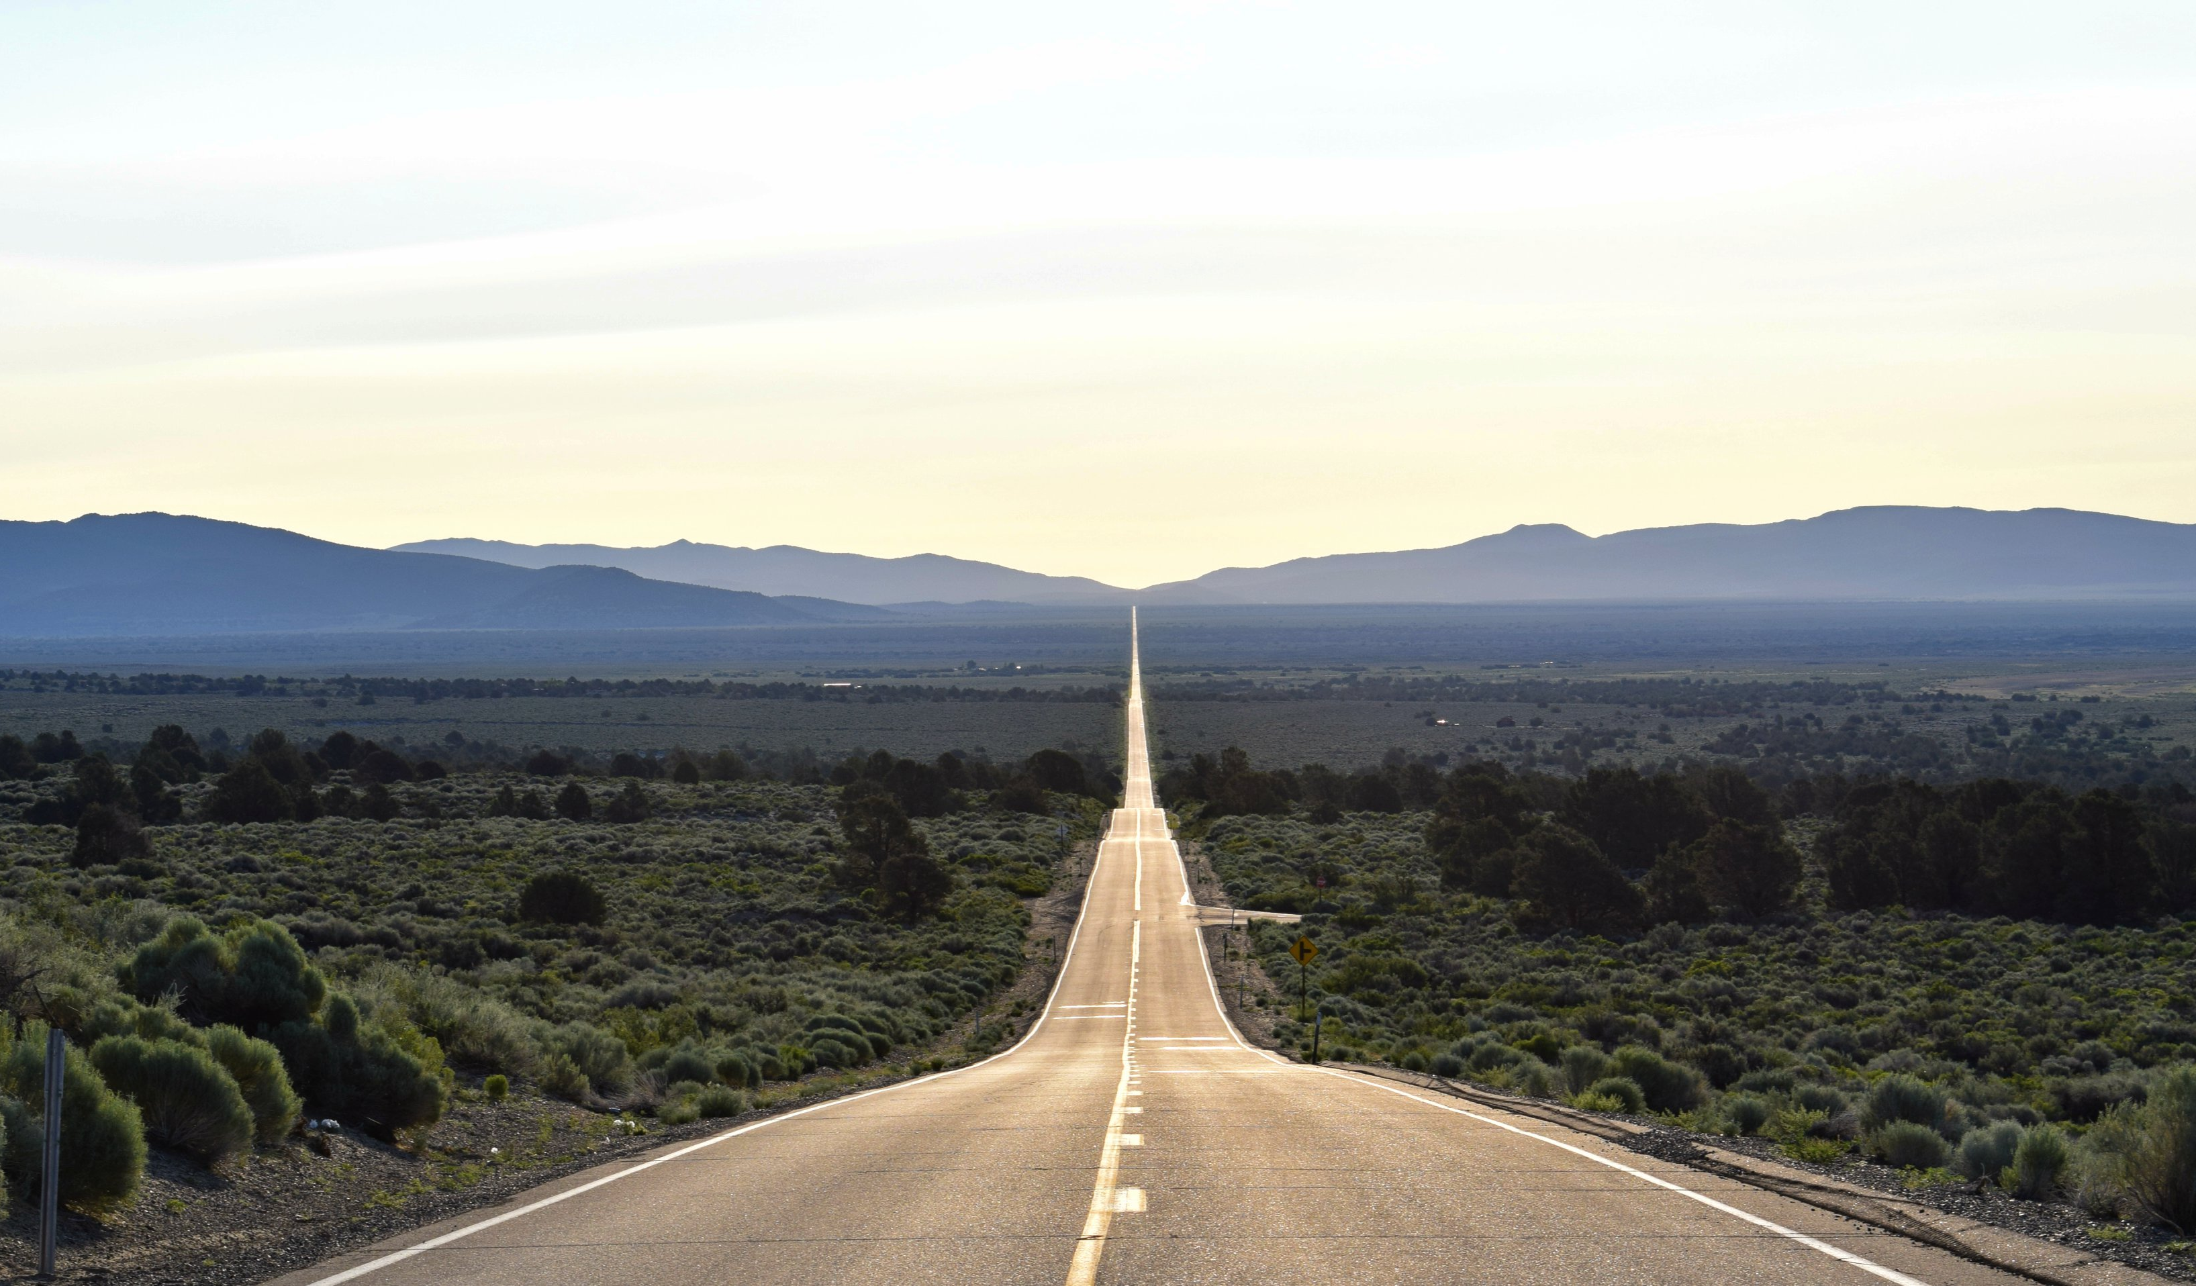
“I might not be where I want to be but thank God I’m not where I used to be”
– Joyce Meyer
Notes:
The moment [timing]
Sam
Sedi
Too fast or too slow
Celebrating distance cover – climbing sand dune – looking up feels like long way to go but when look back see how far you’ve come (role of friends)
e.g. Simon & Belinda
I might not be where I want to be but thank God I’m not where I used to be – Joyce Meyer

Slide 14
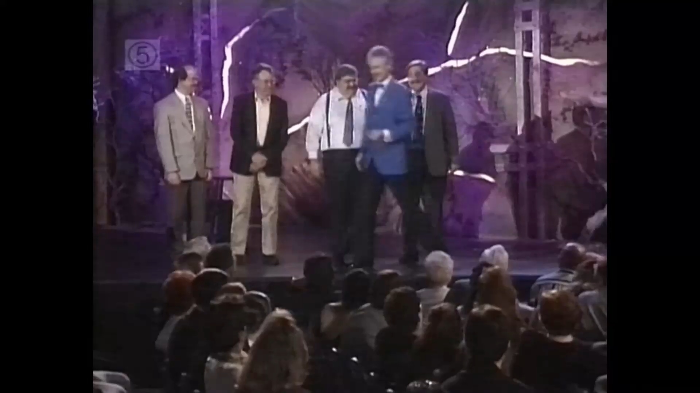
Notes:
Pickpocketed my sin
Weaknesses swept away in power of your love
Only realise how much trouble you were in until you have been rescued from it

Slide 15
Method
Notes:
Elijah – still small voice
Elisha/Elijah deaths
- Jesus spoke to farmers about farming and fishermen about fishing
God can use unconventional methods to get across His point

Slide 16

Notes:
Karate kid (I don’t appreciate your methods!)
Herding sheep – learning his voice

Slide 17

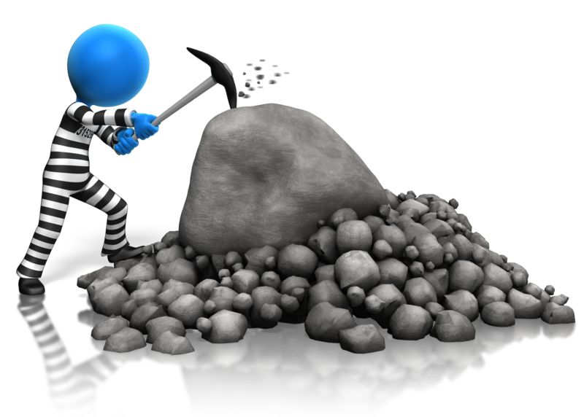
Breakthrough
Process
Notes:
Breakthrough Moments: God miraculously accelerate your maturity, what would normally take years is done in seconds (e.g. Saul from persecutor to preacher). Set free from inhabitation.
Often freedom & healing.
Beautiful but rare. Maybe rare because lack of faith in individual or community, distracted, or more likely that some character traits can only be changed through the crucible of everyday life.
Process Moments: Unglamorous, mundane, slow. Repentance, discipline.
Often about deep character change. Rarely see these character changes in one dramatic encounter. Not in one big moment but a thousand small moments.
Do not despise these small beginnings, for the LORD rejoices to see the work begin, to see the plumb line in Zerubbabel’s hand.” Zech 4:10
Ps 118:23 the LORD has done this, and it is marvelous in our eyes.
Mark & Teah
Which experienced the grace of God?

Slide 18
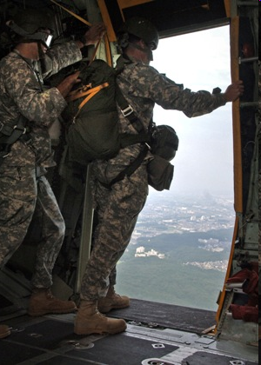
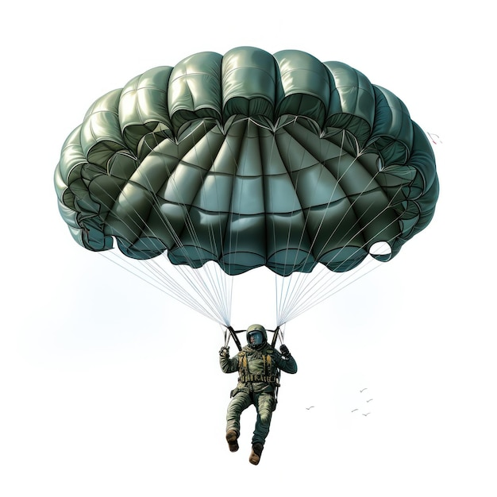
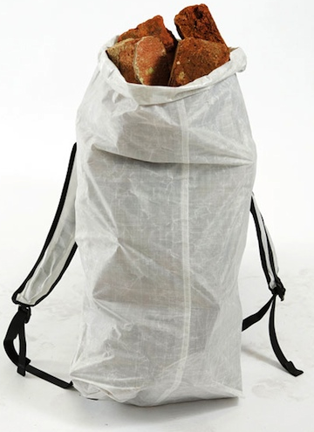
Notes:
Bricks or parachute

Slide 19
Matter
Notes:
Oscar
Blessed and broken – this is about trust not setting out a plan
Jesus – its not for you to know, but wait for HS (changes the subject)

Slide 20
Response
Make Him the prize (end and not merely the means)
Notes:
If this describes you – what should you do?
Don’t miss what God is up to because you are looking for something He has chosen not to do this time.
He becomes to prize
(the end not merely the means to the end)
- Repent for using instead of worshipping God (searching for uplift in emotions rather than wanting to become christ like)

Slide 21
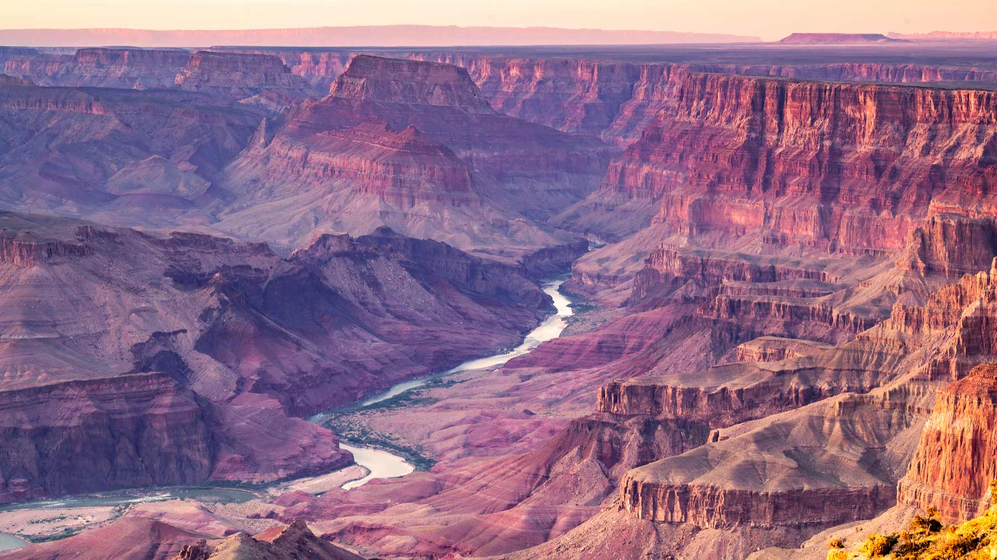
Notes:
Grand Canyon
Not here to make you feel good about yourself but here to make you feel so good about Him that you forget about yourself and make
No one goes to Grand Canyon to improve their self-esteem – but I’m made for wonder and awe. Heaven isn’t going to be a hall of mirrors where you like what you see.

Slide 22
Response
Make Him the prize (end and not merely the means)
Put yourself in the potter’s hands

Slide 23
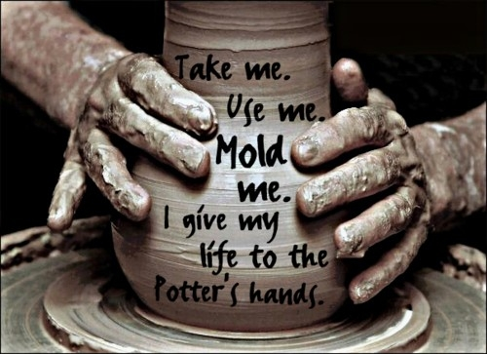
Notes:
Yet you, LORD, are our Father. We are the clay, you are the potter; we are all the work of your hand. Isaiah 64:8
Embrace the process – potter, clay
Make something beautiful out of me

Slide 24
Response
Make Him the prize (end and not merely the means)
Put yourself in the potter’s hands
Remember His love for you surpasses knowledge
Notes:
Eph 3:19 - and to know this love that surpasses knowledge—that you may be filled to the measure of all the fullness of God.

Slide 25
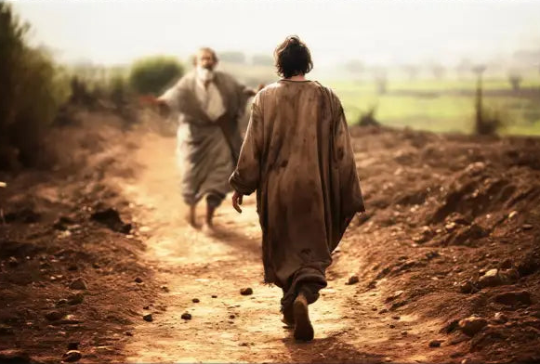
Notes:
1 John 4:19 - We love because he first loved us.
John 6:44
⁴⁴ “No one can come to me unless the Father who sent me draws them, and I will raise them up at the last day.
1 John 3:1 See what great love the Father has lavished on us, that we should be called children of God! And that is what we are!...
Romans 8:37-39 - No, in all these things we are more than conquerors through him who loved us. For I am sure that neither death nor life, nor angels nor rulers, nor things present nor things to come, nor powers, nor height nor depth, nor anything else in all creation, will be able to separate us from the love of God in Christ Jesus our Lord.

