Slide 1

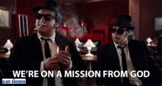
Acts 13
Life on a mission from God
1st December 2024
Notes:
In the Blues brothers the heroes of the story are trying to save the orphanage where they grew up. And get their band back together.
AD 33
Acts 1 8 But you will receive power when the Holy Spirit comes on you; and you will be my witnesses in Jerusalem, and in all Judea and Samaria, and to the ends of the earth.”
2024 – we’re still on that mission from God – Say to one another – we’re on a mission from God
34 AD Stephen killed (approved by Saul)
¹⁹ Now those who had been scattered by the persecution that broke out when Stephen was killed traveled as far as Phoenicia, Cyprus and Antioch, spreading the word only among Jews. ²⁰ Some of them, however, men from Cyprus and Cyrene, went to Antioch and began to speak to Greeks also, telling them the good news about the Lord Jesus. ²¹ The Lord’s hand was with them, and a great number of people believed and turned to the Lord.
We pick up the story in 46AD

Slide 2
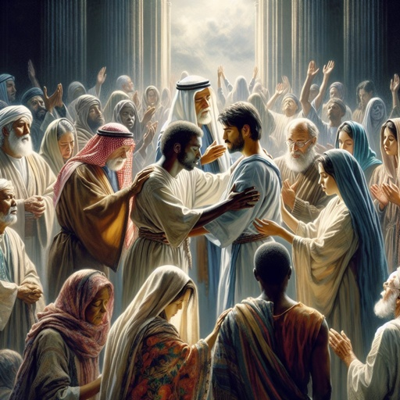
Acts 13
¹Now in the church at Antioch there were prophets and teachers: Barnabas, Simeon called Niger, Lucius of Cyrene, Manaen (who had been brought up with Herod the tetrarch) and Saul.
²While they were worshiping the Lord and fasting, the Holy Spirit said, “Set apart for me Barnabas and Saul for the work to which I have called them.”
³So after they had fasted and prayed, they placed their hands on them and sent them off.

Slide 3
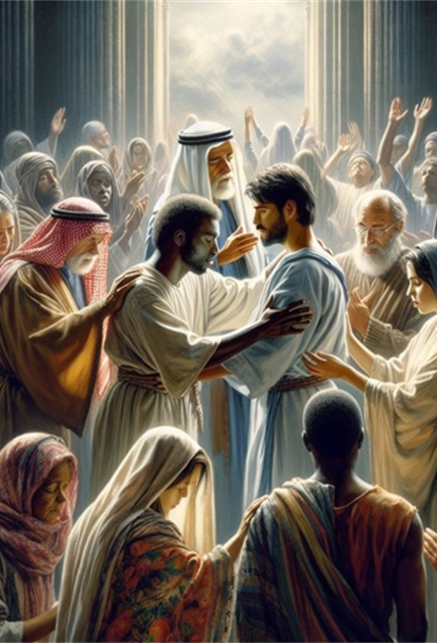
What was the Church like in 46 AD?
Full of all kinds of people, joined together by God (v1)
  Barnabas, Simeon called Niger, Lucius of Cyrene, Manaen (who had been brought up with Herod the tetrarch) and Saul
Together
Worshipping the Lord and fasting (v2)
Laying on hands, praying sending (v3)
Notes:
Full of all kinds of people, joined together by God (v1)
Barnabas, Simeon called Niger, Lucius of Cyrene,
Manaen (who had been brought up with Herod the tetrarch)
and Saul
Together
Worshipping the Lord and fasting (v2)
Laying on hands, praying sending (v3)
Fourteen years pass between Acts 11:19–20 and Acts 13. But follow the story closely. The gospel starts in Jerusalem. Believers end up in Antioch, due to persecution from Saul. The Antioch church grows. Gentiles are coming to faith. Barnabas travels there to help and recruits Saul—the cause of believers being there in the first place. And now that church, founded by those whom Saul persecuted, sends him out as its missionary.
The church in Antioch, founded by those whom Saul persecuted, sends him out as its missionary.
It hasn’t even been that long. Some of the believers laying hands on Saul would’ve been those who were forced to move because of him. Some of them would have known Stephen. But the gospel had so transformed them that they were able to learn from him for a year and then send him out with their blessing.

Slide 4

The prophetic word
Received during worship
After being weighed and settled, it produced an action
Barnabas and Paul had been in Antioch for a year (see Acts 11.26)
But when the Spirit sends, the church let them go.
Change in direction requires prophetic insight:
Amos 3:7 Surely the Lord God does nothing unless he reveals his secrets to his servants the prophets
Hearing God is about heart position not about a technical action.
Notes:
The operation of prophecy differs in the Old and New Testaments. In the Old Testament we see individuals who God appointed as prophets to the nations of Israel and Judah. There are some instances of others prophesying but primarily the gift was reserved for individuals. This changes significantly with the arrival of Christ and the out-pouring of the Holy Spirit, available to all believers. Paul made it clear in 1 Cor. 14 that all may prophesy and encouraged believers to eagerly desire the gift. He identifies the purpose of prophecy as being to strengthen, to encourage, to comfort and to build up one another. These are all the functions of prophecy by members of the body. 1Cor 14:3.
Prophecy is essentially tuning in to what God thinks and is saying about a given situation and sharing that with others around you. It doesn’t have to be confined to a meeting context and indeed in these days we should expect to see God showing us more of His thoughts about the day-to-day situations we find ourselves in.
Amos 3:7 Surely the Lord God does nothing unless he reveals his secrets to his servants the prophets
How much of what God does is outside of this? Nothing means nothing. God is looking for a prophetic people to download his intentions and purposes to. He could act sovereignly but he chooses to do so through us!
We are co-workers with Christ 2 Cor 6:1 this is an incredible privilege but also responsibility. Word from which we get synergy. Changes our expectation of what we can do in life.
Hearing God is crucial in the prophetic process. John 10:27 affirms that the sheep know the shepherd’s voice. Confusion and unclear communication is not our destiny. We were born with the ability to hear God.
We need to be in a position where we can tune in to what God is saying now. Hearing God is about heart position not about a technical action.
It will affect our expectations and our attitude and ultimately our effectiveness

Slide 5
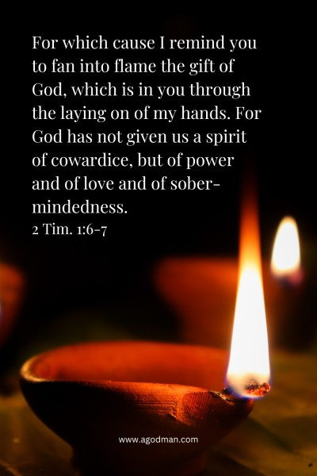
Why “lay on hands”?
Like fasting, the laying on of hands and anointing with oil go hand in hand with prayer.
Can be a means of grace in healing – it’s a sign promised for us as believers Mark 16:17-18
It is the opposite of washing one’s hands like Pilate did. When the elders lay their hands on Paul and Barnabas, they both commission him to a particular role of service and they commend him to those among whom he will serve.
It also provides a point in our lives we can reach back to when things get tough 2 Tim 1 :6-7.
Notes:
https://www.desiringgod.org/articles/the-laying-on-of-hands
^{Mark 16 17} And these signs will accompany those who believe: In my name they will drive out demons; they will speak in new tongues; ¹⁸ they will pick up snakes with their hands; and when they drink deadly poison, it will not hurt them at all; they will place their hands on sick people, and they will get well.”
Like fasting, the laying on of hands and anointing with oil go hand in hand with prayer. Because of the way God has made the world, and wired our own hearts, on certain special occasions we reach for something tangible, physical, and visible to complement, or serve as a sign of, what is happening invisibly and what we’re capturing with invisible words.
Because of the way God has made us, on certain special occasions we reach for something tangible, physical, and visible to complement what is happening in the unseen.
As the gospel makes progress from Jerusalem and Judea, to Samaria, and then beyond, to the ends of the earth (Acts 1:8), God uses the apostles’ laying on of hands as a visible marker and means of the coming of the Spirit among new people and places — first in Samaria (Acts 8:17) and then beyond, in Ephesus (19:6).
Laying on of hands is the opposite of washing one’s hands like Pilate did. When the elders lay their hands on a candidate for ministry, they both commission him to a particular role of service and they commend him to those among whom he will serve.
It serves as a means of grace to the candidate in affirming God’s call through the church and in providing a tangible, physical moment to remember when ministry gets hard. It’s also a means of God’s grace to the commissioning leaders, who extend and expand their heart and work through a faithful candidate. And it’s a means of God’s grace to the congregation, and beyond, in clarifying who are the official leaders to whom they will seek to submit to (Hebrews 13:7, 17).
And in it all, the giver and blesser is God. He extends and expands the ministry of the leaders. He calls, sustains, and makes fruitful the ministry of the candidate. And he enriches, matures, and catalyzes the congregation to love and good works, to minister to each other, and beyond, served by the teaching, wisdom, and faithful leadership of the newly appointed elder, deacon, or missionary.

Slide 6

Being sent raises our impact
Important to send rightly:
You will do well to send them on their way in a manner worthy of God. .. Therefore we ought to support such men, that we may be fellow workers with the truth. (3 John 6–8 NASB)
Not all who go are sent.
Needs prophetic insight and sense of peace.
“The mark of a great church is not its seating capacity, but its sending capacity.”
Notes:
Notes on An Apostolic Community
Receives grace from Jesus the apostle (Heb. 3:1)
Prepared for good works Eph. 2:10
Being taken forward to maturity Heb. 6:1
Following a mandate given by God and shaped by the Apostle
Every one carries the same internal vision
All expressions of life fulfil the common purpose and direction of the community
Knows it has been ‘sent’ by God
Has a world view with an International influence and attitude
Has no gap between ‘Hearing’ the word of God and ‘Seeing’ the word of God worked out in practice (Psalm 48 v8)
Has a Radical Lifestyle based on consistent biblical values
expressed through attitudes to Money, Integrity, Serving, Relationship and Righteousness
Brings to earth the mind of God
Are Confident in their calling
Is able to draw from many sources, to receive the good and reject the bad
Thrusts forward with new expectations for the future; are Reformers and Pioneers
Produces more than it consumes
What we do together matters:
Worship and prayer
Seeking God’s face together to find out what He is saying – prophetic dialogue
Giving Testimony to the goodness of God and what he has done
Having fun
Living in and enjoying the grace of God together
Dealing with offence; keeping short accounts

Slide 7
Acts 13: 4-5
⁴ The two of them, sent on their way by the Holy Spirit, went down to Seleucia and sailed from there to Cyprus. ⁵ When they arrived at Salamis, they proclaimed the word of God in the Jewish synagogues. John (John Mark) was with them as their helper.

Slide 8
Acts 13: 4-5
⁴ The two of them, sent on their way by the Holy Spirit, went down to Seleucia and sailed from there to Cyprus. ⁵ When they arrived at Salamis, they proclaimed the word of God in the Jewish synagogues. John (John Mark) was with them as their helper.
Original Word: ὑπηρέτης
Transliteration: hupéretés
Pronunciation: hoo-per-ay'-tace
Word Origin: Derived from ὑπό (hypo, "under") and ἐρέτης (eretes, "rower"), literally meaning "under-rower."

Slide 9
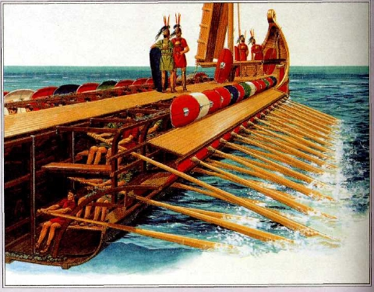
Being an under-rower
The Roman war ships were common sights to the early church.
These war ships were propelled mainly by rowing.
The early church knew that the lowest deck of the ship was filled with two long rows of benches where dozens of rowers sat chained to the ship and to each other.
The under-rowers fixed their eyes on the captain, and did whatever the Captain commanded.

Slide 10
Being an under-rower
"Under-Rowers," "Galley Slaves"—That’s the word Paul chooses to describe John-Mark, and later himself.
1 Corinthians 4:1a - This, then, is how you ought to regard us: as servants of Christ.
Hupéretés is discipleship position
We can be under-rowers like John-Mark was to Barnabas and Paul, and we are all under-rowers to Christ.

Slide 11
How can we be a helper/under-rower like John-Mark?
Listening under > serving under
Not about self-promotion, but focussed on furthering his Kingdom
We can tap into the grace God has apportioned for those we are submitting to
Are we taking opportunity to ‘listen under’?
Are we inviting others to join in our ministry?

Slide 12
Acts 13: 6-12
⁶ They traveled through the whole island until they came to Paphos. There they met a Jewish sorcerer and false prophet named Bar-Jesus, ⁷ who was an attendant of the proconsul, Sergius Paulus. The proconsul, an intelligent man, sent for Barnabas and Saul because he wanted to hear the word of God. ⁸ But Elymas the sorcerer (for that is what his name means) opposed them and tried to turn the proconsul from the faith. ⁹ Then Saul, who was also called Paul, filled with the Holy Spirit, looked straight at Elymas and said,

Slide 13
Acts 13: 6-12
¹⁰ “You are a child of the devil and an enemy of everything that is right! You are full of all kinds of deceit and trickery. Will you never stop perverting the right ways of the Lord? ¹¹ Now the hand of the Lord is against you. You are going to be blind for a time, not even able to see the light of the sun.”
Immediately mist and darkness came over him, and he groped about, seeking someone to lead him by the hand. ¹² When the proconsul saw what had happened, he believed, for he was amazed at the teaching about the Lord.

Slide 14
Acts 13: 6-12
Bar-Jesus
= Elymas
Proconsul = Sergius Paulus
Barnabas and Saul
Holy Spirit

Slide 15
Enemy influence at the top level
Sergius Paulus relies on the sorcerer for sight… in fact he is defining how he sees.
When the men of God come, they aren’t slow to say what the Holy Spirit shows them.
And then there is a clear sign following
Sometimes people or ways of thinking can seem really powerful, but they’re nothing compared to our mighty God
We can bring release by the power of the Holy Spirit
Once he is blinded we don’t hear about him again
Notes:
Sometimes people can seem really powerful but they’re not
We can bring release not by magic but by the power of the HS
Once he is blinded we don’t hear about him again

Slide 16
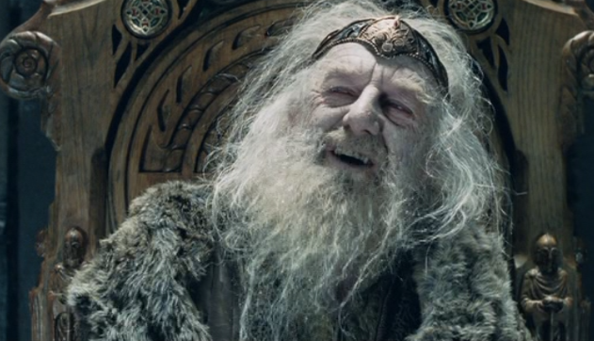
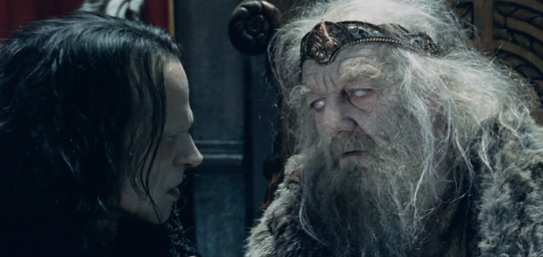
The power of influence
King Theoden of Golden Hall (from the Lord of the Rings)
A good king, corrupted by listening to the subtle lies and deception of Wormtongue.

Slide 17
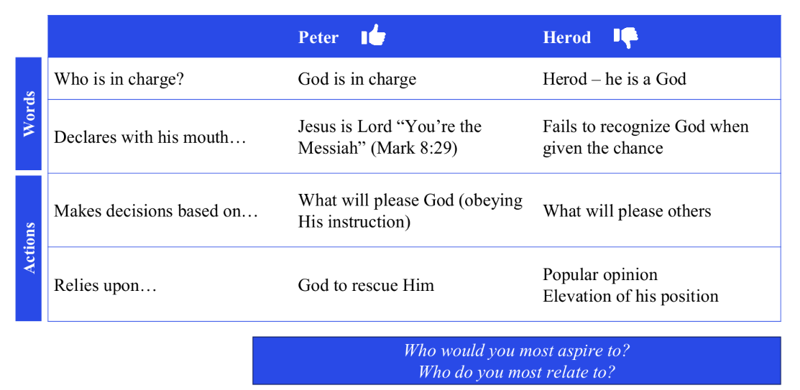
Who have I been listening to?
As a result of listening to Wormtongue, the king is
Aged
Weak
Unsure
Insecure
Miserable
Unable to function, unable to love

Slide 18
Take every thought captive
We need to be those who take every thought captive to make it obedient to Christ (2 Cor 10:5)
There are conversations and thought patterns that are never going to help us
Deuteronomy 28:13 The LORD will make you the head, not the tail. If you pay attention to the commands of the LORD your God that I give you this day and carefully follow them, you will always be at the top, never at the bottom.
Notes:
When faced with a fearful situation that we can't actually do anything about, we give ourselves the illusion of control (and relief from helplessness) by engaging worry. We may not be able to actually do anything about a problem, but worrying about it makes us feel like we're doing something.

Slide 19
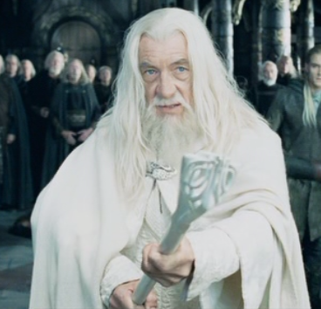
So, what brings about the change for us?
Well, it isn’t Gandalf the Grey...
We can bring release by the power of the Holy Spirit
Then Saul, who was also called Paul, filled with the Holy Spirit, looked straight at Elymas and said, ¹⁰ “You are a child of the devil and an enemy of everything that is right! You are full of all kinds of deceit and trickery. Will you never stop perverting the right ways of the Lord? ¹¹ Now the hand of the Lord is against you. You are going to be blind for a time, not even able to see the light of the sun.”
Immediately mist and darkness came over him, and he groped about, seeking someone to lead him by the hand. ¹² When the proconsul saw what had happened, he believed, for he was amazed at the teaching about the Lord.
Notes:
Sometimes we do this by declaring what we know to be true, sometimes by active rejection of the lies

Slide 20
He delights in you
Matthew 3:17 - And a voice from heaven said, “This is my Son, whom I love; with him I am well pleased.”
Zephaniah 3:17 - The Lord your God is with you,
the Mighty Warrior who saves.
He will take great delight in you;
in his love he will no longer rebuke you,
but will rejoice over you with singing.”
“You’re better than you think you are”

Slide 21
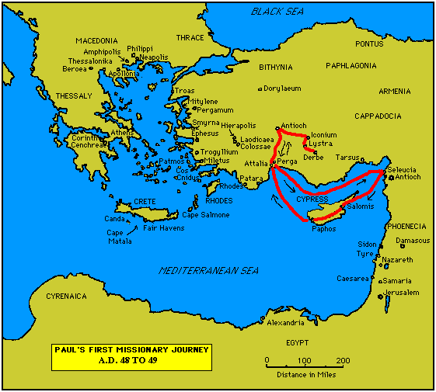
Notes:
¹³ From Paphos, Paul and his companions sailed to Perga in Pamphylia, where John left them to return to Jerusalem. ¹⁴ From Perga they went on to Pisidian Antioch. On the Sabbath they entered the synagogue and sat down. ¹⁵ After the reading from the Law and the Prophets, the leaders of the synagogue sent word to them, saying, “Brothers, if you have a word of exhortation for the people, please speak.”

Slide 22
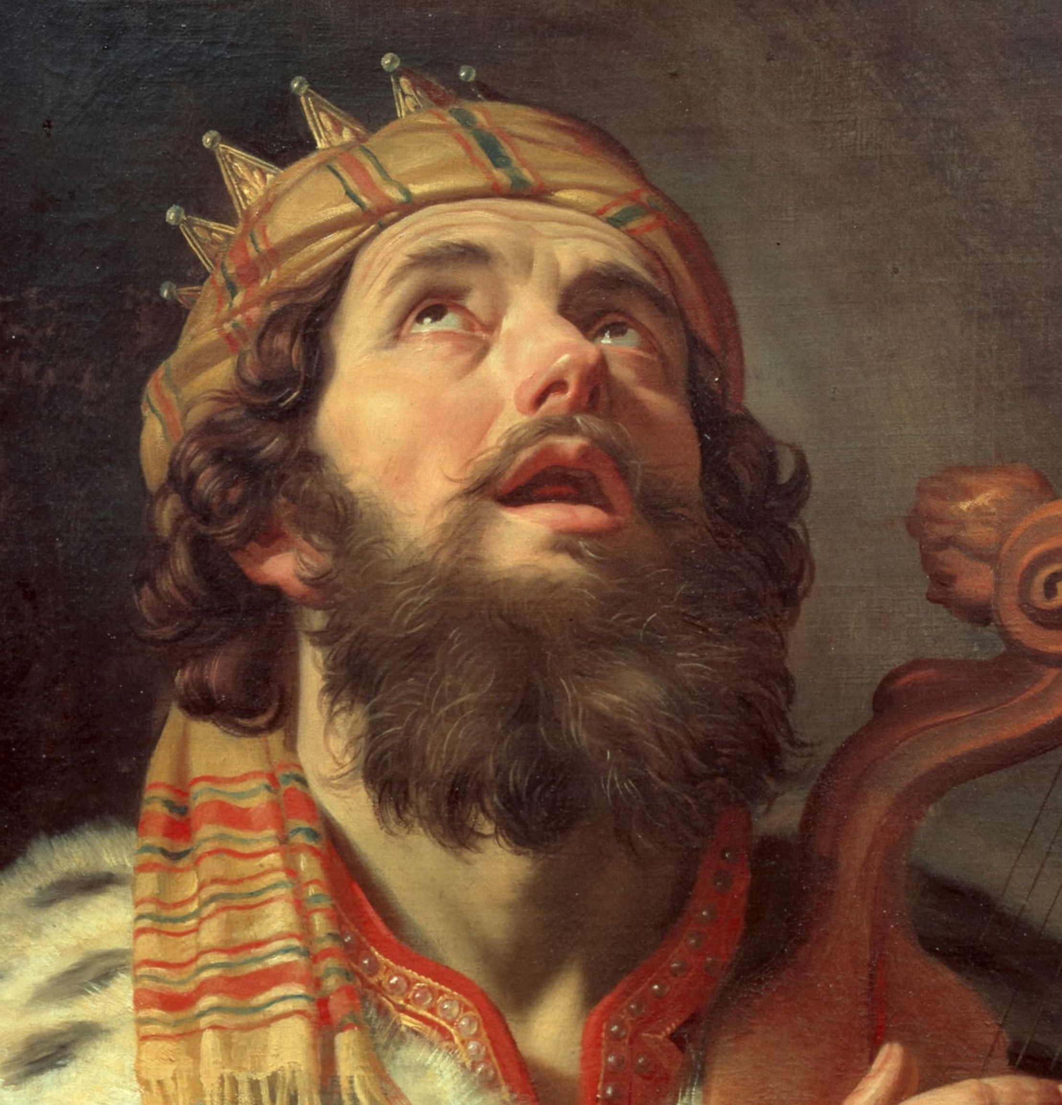
Acts 13: 13-52 – Jesus the fulfilment of promise
The God of the people of Israel chose our ancestors; he made the people prosper during their stay in Egypt; with mighty power he led them out of that country
He overthrew seven nations in Canaan, giving their land to his people as their inheritance
…He made David their king. … “a man after my own heart; he will do everything I want him to do”.
From this man’s descendants God has brought to Israel the Savior Jesus, as he promised
Notes:
¹³ From Paphos, Paul and his companions sailed to Perga in Pamphylia, where John left them to return to Jerusalem. ¹⁴ From Perga they went on to Pisidian Antioch. On the Sabbath they entered the synagogue and sat down. ¹⁵ After the reading from the Law and the Prophets, the leaders of the synagogue sent word to them, saying, “Brothers, if you have a word of exhortation for the people, please speak.”
¹⁶ Standing up, Paul motioned with his hand and said: “Fellow Israelites and you Gentiles who worship God, listen to me! ¹⁷ The God of the people of Israel chose our ancestors; he made the people prosper during their stay in Egypt; with mighty power he led them out of that country; ¹⁸ for about forty years he endured their conduct^{[a]} in the wilderness; ¹⁹ and he overthrew seven nations in Canaan, giving their land to his people as their inheritance. ²⁰ All this took about 450 years.
“After this, God gave them judges until the time of Samuel the prophet. ²¹ Then the people asked for a king, and he gave them Saul son of Kish, of the tribe of Benjamin, who ruled forty years. ²² After removing Saul, he made David their king. God testified concerning him: ‘I have found David son of Jesse, a man after my own heart; he will do everything I want him to do.’
²³ “From this man’s descendants God has brought to Israel the Savior Jesus, as he promised.

Slide 23
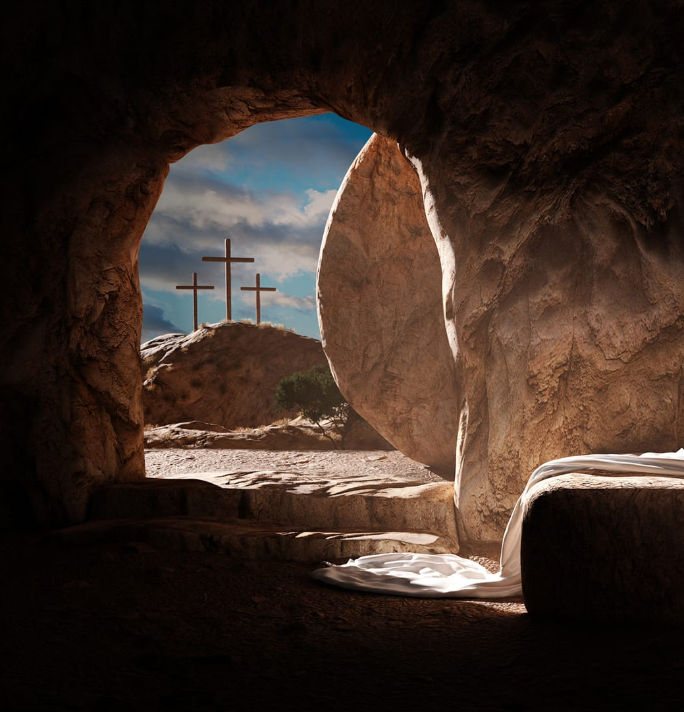
Jesus the fulfilment of promise
²⁷ The people of Jerusalem and their rulers did not recognize Jesus, yet in condemning him they fulfilled the words of the prophets that are read every Sabbath. ²⁸ Though they found no proper ground for a death sentence, they asked Pilate to have him executed. ²⁹ When they had carried out all that was written about him, they took him down from the cross and laid him in a tomb. ³⁰ But God raised him from the dead, ³¹ and for many days he was seen by those who had traveled with him from Galilee to Jerusalem. They are now his witnesses to our people.
³² “We tell you the good news: What God promised our ancestors ³³ he has fulfilled for us
Notes:
²⁴ Before the coming of Jesus, John preached repentance and baptism to all the people of Israel. ²⁵ As John was completing his work, he said: ‘Who do you suppose I am? I am not the one you are looking for. But there is one coming after me whose sandals I am not worthy to untie.’
²⁶ “Fellow children of Abraham and you God-fearing Gentiles, it is to us that this message of salvation has been sent. ²⁷ The people of Jerusalem and their rulers did not recognize Jesus, yet in condemning him they fulfilled the words of the prophets that are read every Sabbath. ²⁸ Though they found no proper ground for a death sentence, they asked Pilate to have him executed. ²⁹ When they had carried out all that was written about him, they took him down from the cross and laid him in a tomb. ³⁰ But God raised him from the dead, ³¹ and for many days he was seen by those who had traveled with him from Galilee to Jerusalem. They are now his witnesses to our people.
³² “We tell you the good news: What God promised our ancestors ³³ he has fulfilled for us, their children, by raising up Jesus. As it is written in the second Psalm:
“‘You are my son;
today I have become your father.’^{[b]}

Slide 24

Jesus the fulfilment of promise
³⁶ “Now when David had served God’s purpose in his own generation, he fell asleep; he was buried with his ancestors and his body decayed. ³⁷ But the one whom God raised from the dead did not see decay.
³⁸ “Therefore, my friends, I want you to know that through Jesus the forgiveness of sins is proclaimed to you. ³⁹ Through him everyone who believes is set free from every sin, a justification you were not able to obtain under the law of Moses.
…⁴⁴ On the next Sabbath almost the whole city gathered to hear the word of the Lord.
Notes:
³⁴ God raised him from the dead so that he will never be subject to decay. As God has said,
“‘I will give you the holy and sure blessings promised to David.’^{[c]}
³⁵ So it is also stated elsewhere:
“‘You will not let your holy one see decay.’^{[d]}
³⁶ “Now when David had served God’s purpose in his own generation, he fell asleep; he was buried with his ancestors and his body decayed. ³⁷ But the one whom God raised from the dead did not see decay.
³⁸ “Therefore, my friends, I want you to know that through Jesus the forgiveness of sins is proclaimed to you. ³⁹ Through him everyone who believes is set free from every sin, a justification you were not able to obtain under the law of Moses. ⁴⁰ Take care that what the prophets have said does not happen to you:
⁴¹ “‘Look, you scoffers,
wonder and perish,
for I am going to do something in your days
that you would never believe,
even if someone told you.’^{[e]}”
⁴² As Paul and Barnabas were leaving the synagogue, the people invited them to speak further about these things on the next Sabbath. ⁴³ When the congregation was dismissed, many of the Jews and devout converts to Judaism followed Paul and Barnabas, who talked with them and urged them to continue in the grace of God.
⁴⁴ On the next Sabbath almost the whole city gathered to hear the word of the Lord. ⁴⁵ When the Jews saw the crowds, they were filled with jealousy. They began to contradict what Paul was saying and heaped abuse on him.
⁴⁶ Then Paul and Barnabas answered them boldly: “We had to speak the word of God to you first. Since you reject it and do not consider yourselves worthy of eternal life, we now turn to the Gentiles. ⁴⁷ For this is what the Lord has commanded us:
“‘I have made you^{[f]} a light for the Gentiles,
that you^{[g]} may bring salvation to the ends of the earth.’^{[h]}”
⁴⁸ When the Gentiles heard this, they were glad and honored the word of the Lord; and all who were appointed for eternal life believed.
⁴⁹ The word of the Lord spread through the whole region. ⁵⁰ But the Jewish leaders incited the God-fearing women of high standing and the leading men of the city. They stirred up persecution against Paul and Barnabas, and expelled them from their region. ⁵¹ So they shook the dust off their feet as a warning to them and went to Iconium. ⁵² And the disciples were filled with joy and with the Holy Spirit.

Slide 25
Response
Do you know that you’re on a mission? What does that look like for you?
  ‘I have made you a light for the Gentiles,
  that you may bring salvation to the ends of the earth.’
Is God calling you to be an “under rower” ?
What are the enemy’s lies that you need God to deal with?
God keeps his promises – every word of his proves true. Is there a promise God wants you to remember today?
  Every word of God proves true;
  he is a shield to those who take refuge in him. Prov 30.5

