Slide 1
Possess your Right
John Singleton
19/05/24

Slide 2
His Provision vs My Effort

Slide 3
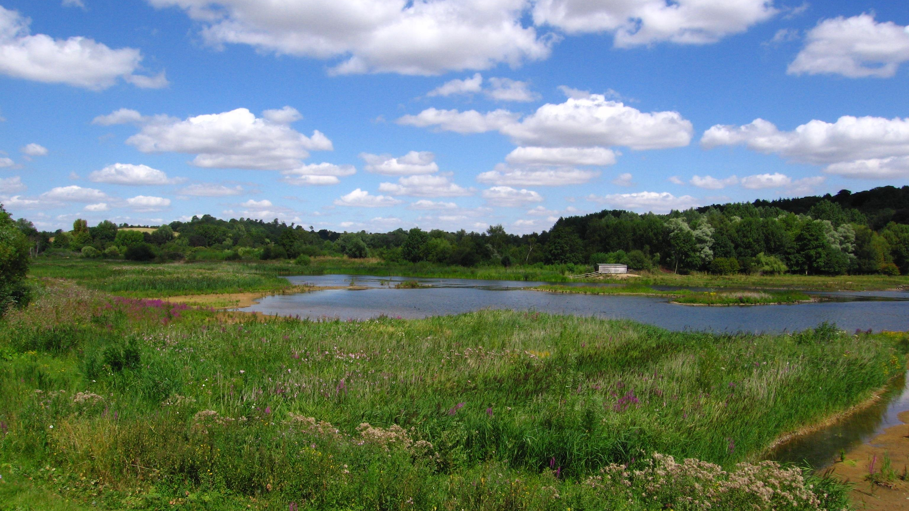
Great Amwell Springs, Hertfordshire

Slide 4
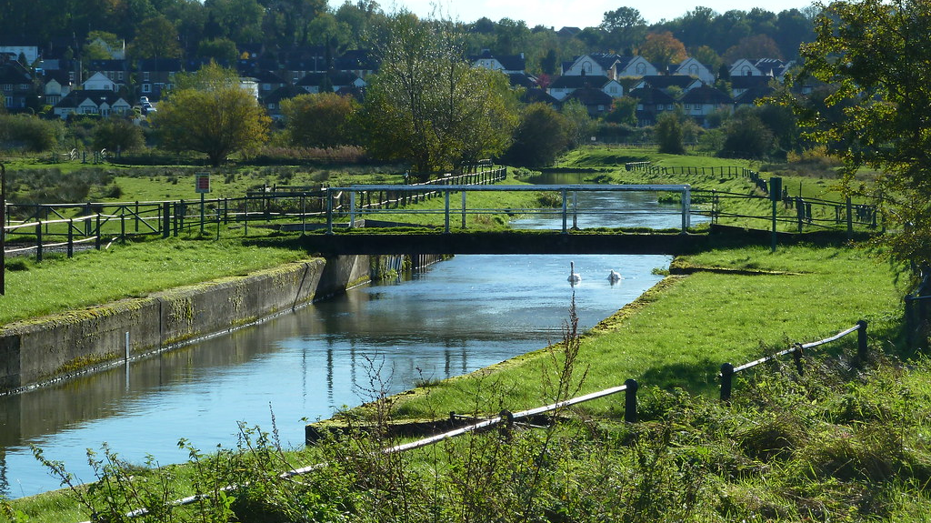
New River, Hertfordshire

Slide 5
What rights (promises) have we been given?

Slide 6
1) Heart transplant
  I will give you a new heart and put a new spirit in you; I will remove from you your heart of stone and give you a heart of flesh. (Ezekiel 36:26)
2) Invitation to “come up here”
…And the voice I had first heard speaking to me like a trumpet said, “Come up here, and I will show you what must take place after this.” (Rev 4:1)

Slide 7
3) Times of refreshing
Repent, then, and turn to God, so that your sins may be wiped out, that times of refreshing may come from the Lord, (Acts 3:19)
4) Renewing of strength
but those who hope in the Lord will renew their strength.
They will soar on wings like eagles; they will run and not grow weary, they will walk and not be faint. (Isa 40:31)

Slide 8
5) Thirst replaced with rivers of living water
…Jesus stood and said in a loud voice, “Let anyone who is thirsty come to me and drink. Whoever believes in me, as Scripture has said, rivers of living water will flow from within them.” By this he meant the Spirit, whom those who believed in him were later to receive. Up to that time the Spirit had not been given, since Jesus had not yet been glorified.
(John 7:37-39)

Slide 9
How to claim rights

Slide 10
With joy you will draw water from the wells of salvation.
(Isa 12:3)

Slide 11
When he saw the crowds, he had compassion on them, because they were harassed and helpless, like sheep without a shepherd.
(Matt 9:36)

